Slide 1


Automated Latte
Art Scoring System
Quantitatively scoring latte art
Cecelia Hein
Jaeku Kang
Junkyu Kim
Ranju Kim

Slide 2
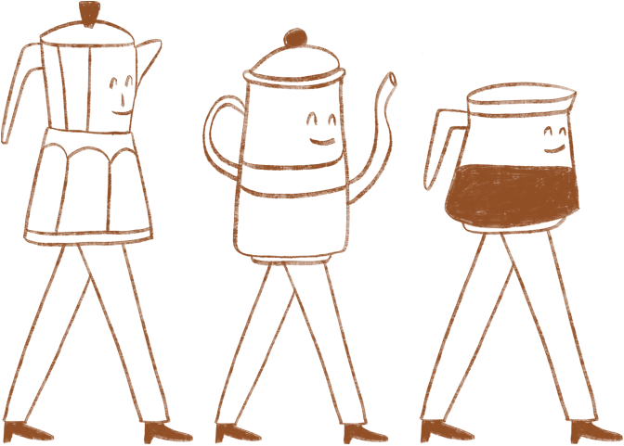

BACKGROUND
Latte art has been an evaluation factor in barista training for a long time. Evaluations were always subjective to the judge, meaning a baristas talent was subjective to the judge. With the rise in demand for trained baristas, there needs to be an objective grading system for latte art.

Slide 3
THE PROBLEM
Subjective Evaluation
Limited Feedback Access
Appearances > Structure
Details are valued differently, leading to judges giving different scores to the same cup.This makes it hard for the barista to identify a specific flaw to improve.
Objective evaluations need a human judge present.Baristas practicing at home have a harder time finding a judge than those at a training institution.
Judges tend to look at aesthetics more than the specific structure of the art. Leading to a higher scores given to cups with the wrong design.

Slide 4

OBJECTIVES
Integrate and combine digital image processing techniques to solve a real world problem
Create a reproducible scoring system not dependent on camera technique
Produce a scoring method that priotizes structure over aesthetics
Potential expand into a constructive feedback service for basitas in training

Slide 5
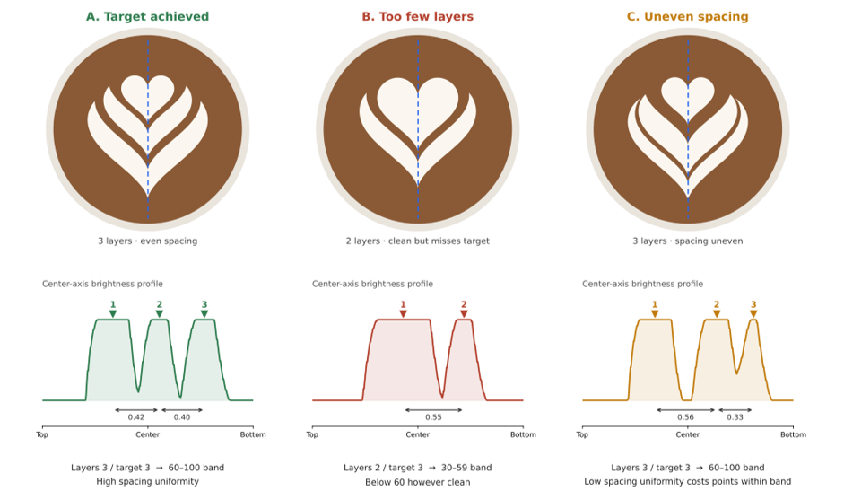
EVALUATION

Slide 6

EVALUATION - STRUCTURE
Layer Count
Layer Spacing
Layer Thickness
  How many layers are there?
  How many layers should there be?
  How far apart are the layers?
  Is the spacing between the layers even?
  How thick are the layers?
  Are they all the same thickness?

Slide 7
EVALUATION - QUALITY
Layer Contrast
Shape
Foam Texture
  How sharp is the boundary between the foam and crema?
  Is it clearly defined?
  Does it have the same symmetry as the target pattern?
  Does the form match the target pattern?
  Does the foam look silky?
  Does the foam look glossy?
  Are there bubbles?
Postition
Size
  Is the pattern centered in the cup?
  Does the pattern have a straight axis?
  Does the pattern fill up enough of the cup?

Slide 8

PIPELINE OVERVIEW
Normalize Cup Appearance
Check Layer Spacing
Count Layers
Quality Check
  Find circumference of cup
  Correct tilt
  Adjust cup size
  Match orientation
  Check how many layers there are
  Compare number of layers to target pattern
  Calculate distances between layers
  Determine if the gaps between layers vary in size
  Compare to correct gap size in target pattern
  Check if foam edges are sharp
  Check the overall shape of the design
  Check foam texture for bubbles or rough patches
  Evaluate postition and size of pattern

Slide 9
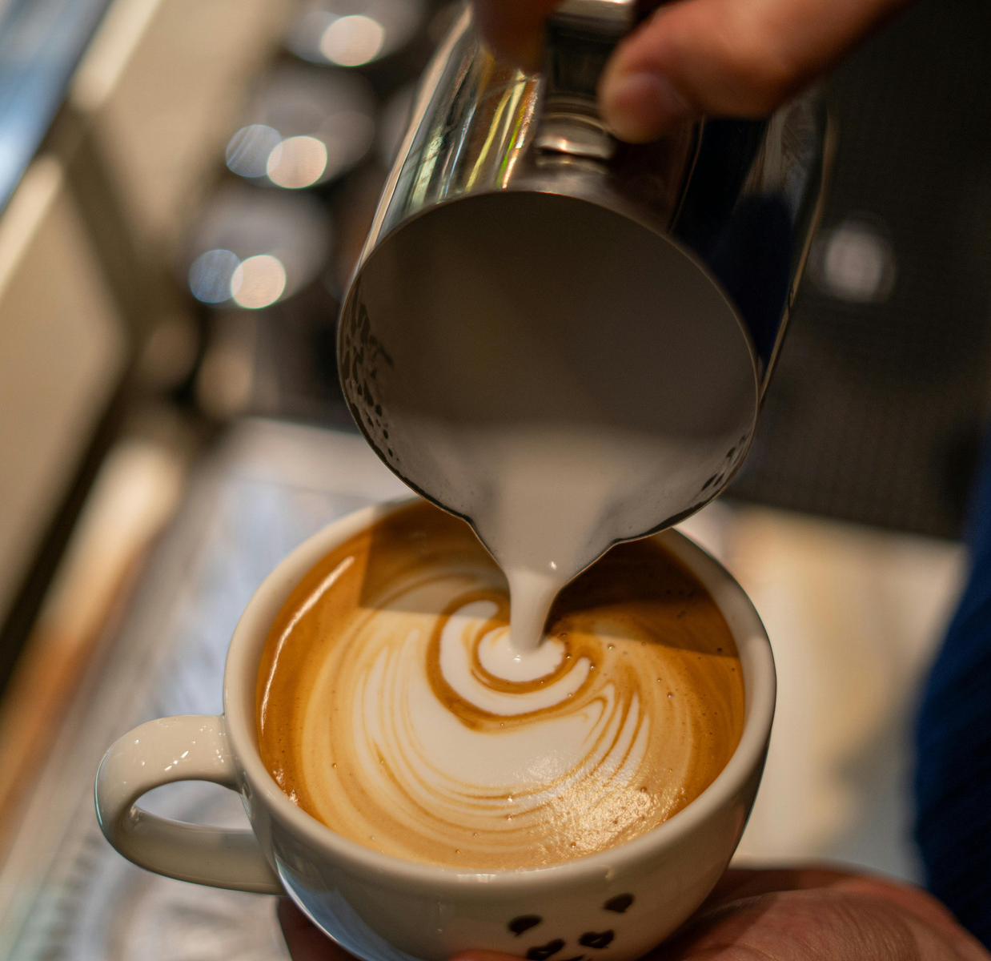

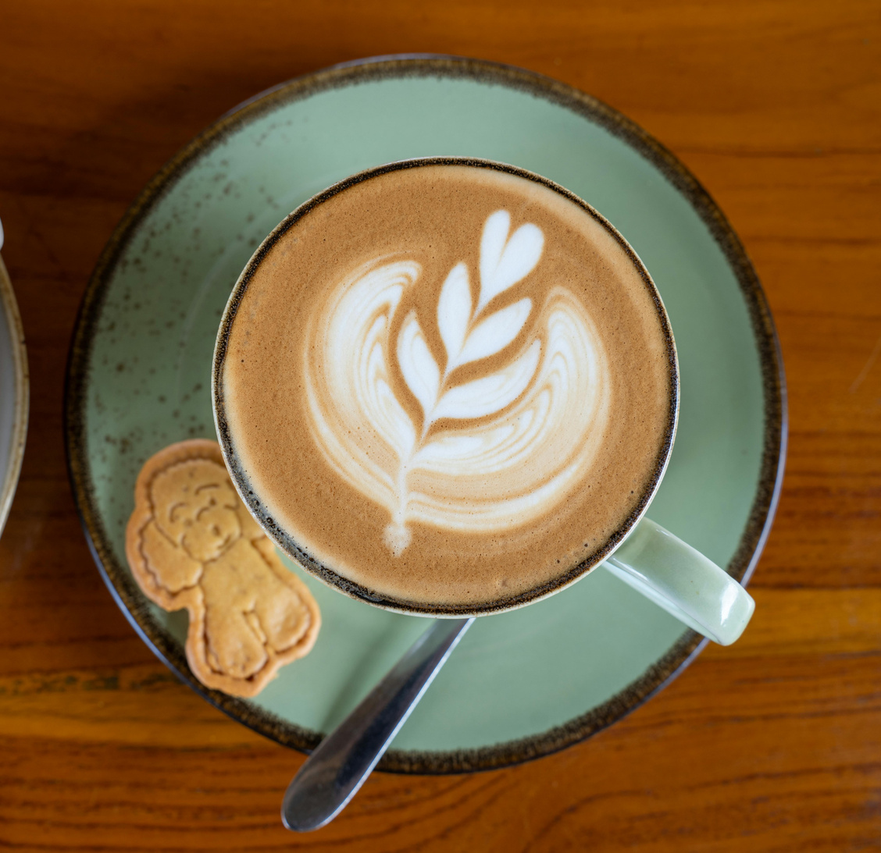
THE BUSINESS
The Market
Cost
Target Customers
  95,337 coffee and beverages shops in Korea during Q1 2025
  Starting to decline
  Cafe operating costs are rising
  Cutting cost by cutting training time
  Home cafes are growing in popularity
  Primary Customers: Barista beginners and home cafe owners
  Secondary Customers: Barista training schools
  Long-Term Customers: Franchise training teams

Slide 10


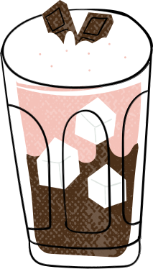
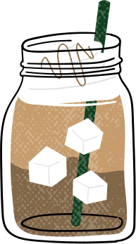
COMPARING COMPETITION
Most latte art scoring apps are based off AI models
  Lower Operating Cost
    Uses only image processing operations
    No GPU servers or AI APIs needed
  Scalability vs Growth
    Server costs don’t rise in proportion to usage
    Works well even with unstable internet connection
  Adding New Features
    Adding a new pattern does not require much
    No need to collect mass amounts of reference photos
  Structure-Based Judging
    Prioritizes structure of art isntead of aesthetics

Slide 11

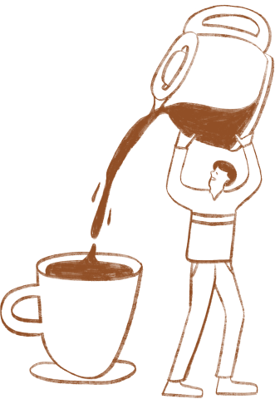
PHASES
Phase | Scope | Metrics | Timing
Prototype | Finish scoring program for two patterns; run 10-20 trials | Agreement with human rankings | Nov-Dec 2026
Web Service Launch | Launch a simple web service; promote to home cafes and local baristas | Gather sign-ups | Jan-Feb 2027
Small Pilot | Free pilot trials; gather feeback | Gather weekly usage data and payment survey | H1 2027
Commercialization and Review | Apply startup support program | Selection for startup program | H2 2027

Slide 12

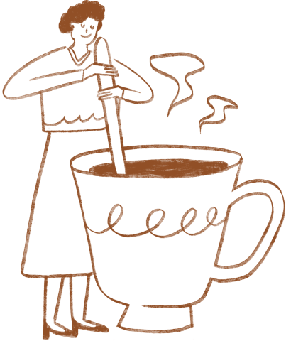
Thank You

