Slide 1
OUTFITR
Rank 1 Hackathon Team

Slide 2
How did you think of your outfit today?

Slide 3
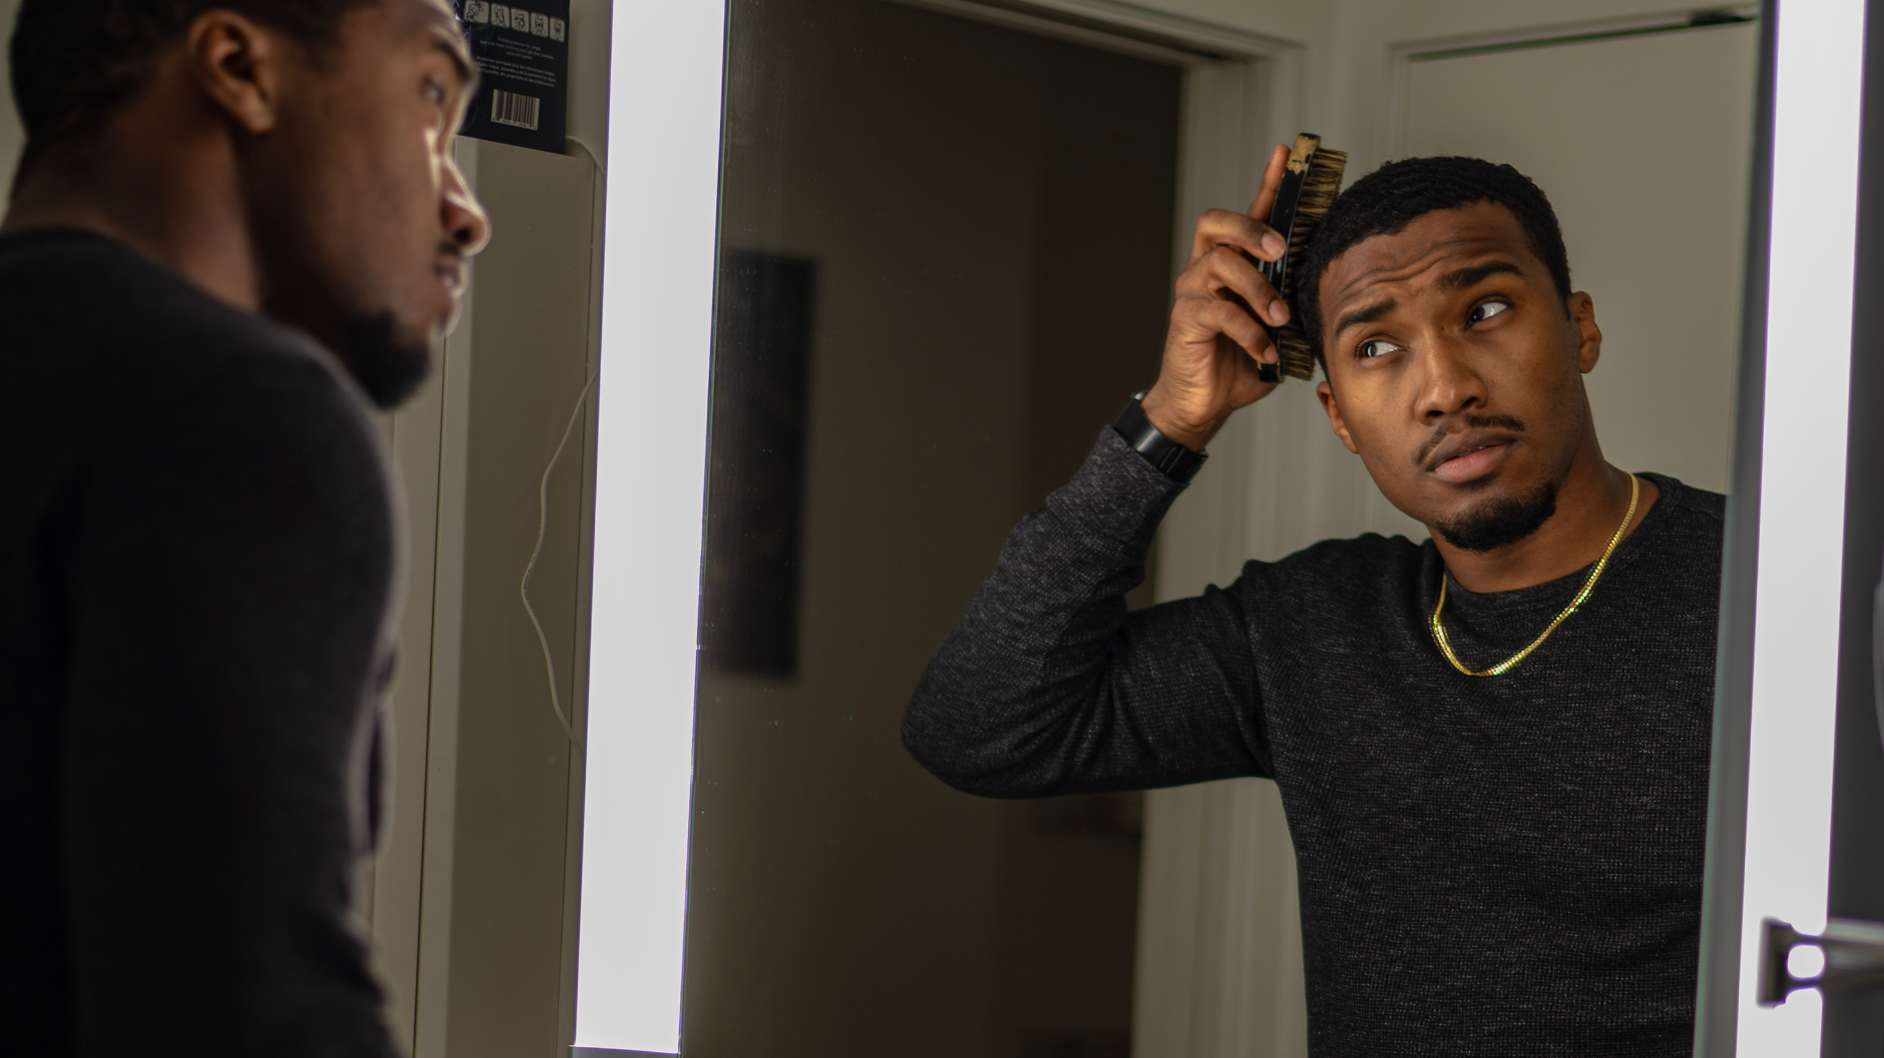
What we offer
No more outfit anxiety
Know what you have
Plan what you wear
Rely less on fast fashion

Slide 4
What we do
Upload your own clothes
Use the app to see how the clothes fit
Save the outfits YOU see and like
Plan when to wear those outfits.

Slide 5
Tech demo

Slide 6
Where outfitr can go

Slide 7
Thank you

