Slide 1

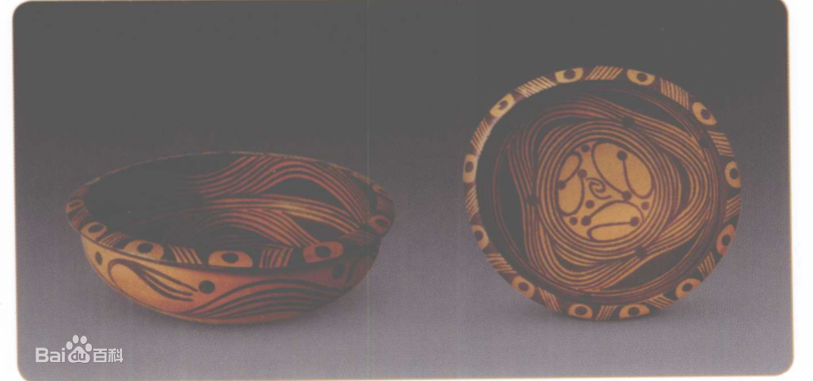
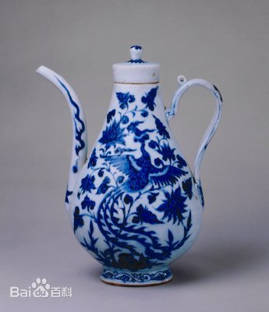
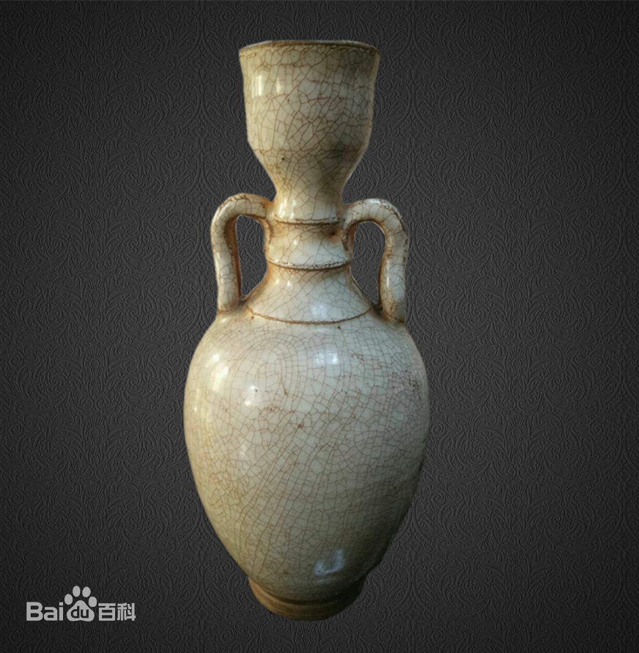
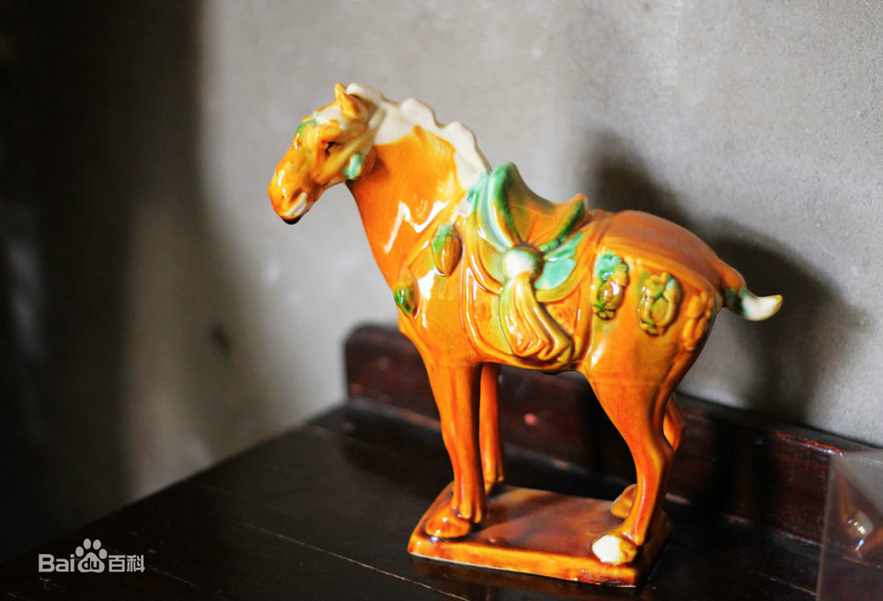
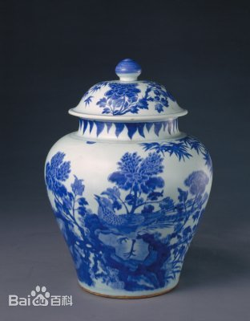
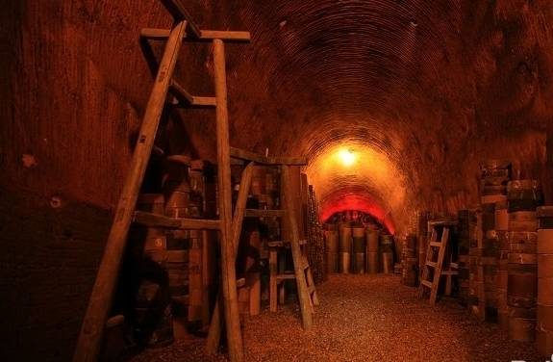
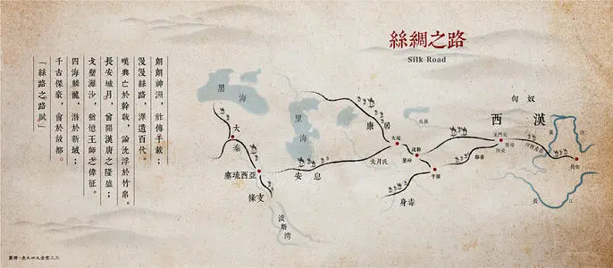
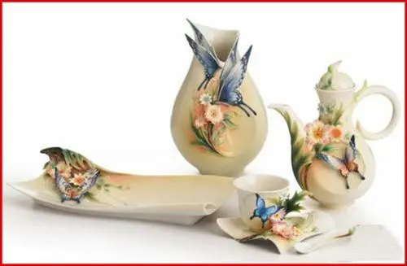
China’s china
Dates back to 4th century BC
First found in the area of the Yellow River
The growth in diversity could be seen during the historical process.
In the Qing Dynasty ↓
←In the Song Dynasty
In the Tang Dynasty →
↑ In the Yuan Daynasty
Made of clay
Is based on a complicated procedure
Baked in the kiln at the temperature high up to 1300 °C
Combines graceful outline with delicate painting
Earns its stature in the trades along the Silk Route
Serves as cultural bond between China and the globe
Nowadays ceramics perfectly reconcile Eastern aesthetic with Western art.
Is bound to be more fascinating and gains more popularity

