Slide 1
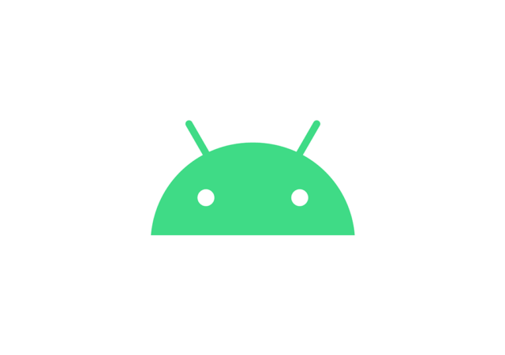
Android
Developer
Challenge
Developing a wearable-app
To cure
Deafness and Dumbness
Jay Rank

Slide 2
About Me
An individual looking for a chance to strive against Removing Human Error of hearing as well as speaking.

Slide 3

An initiative to
Strive
against
Human Error

Slide 4
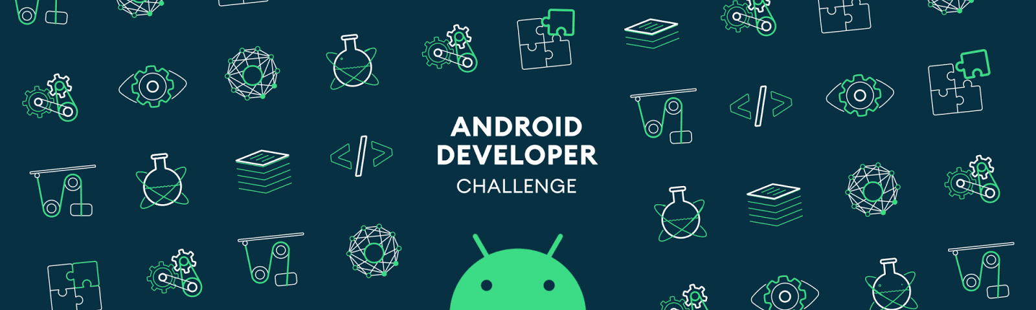
Vision
01
Connecting a wearable that can be put on the ear that sends the electric impulses directly to the middle ear via bones and hence, allows their mind to interpret and hear the voice of surroundings.
02
Developing a wearable that fits on the neck and can sense neuromuscular pulses below the vocal cord and hence, interprets them in the sound and emits them as a voice.

Slide 5
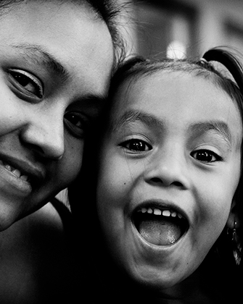
Mission
MISSION
Wearables developed for Deaf and Dumb people not only interprets data in real-time but analyses and rather come up with some of regularly and frequently used words and hence serve the respective person with better user experience by constantly popping those phrases to rather provide an option to carry it forward. Also, this more often daily used words are then stored in temporary memory and it automatically kicks in, whenever it feels it needs to be. This idea may be still out of phase for a person like me, but surely it has the potential to work and of course, many technical oriented people like you may be able to bring it to life one day.

Slide 6
B
I
Builds
As already, we know that market is already providing products related to hearing impairment, another point to look for is google translate is already providing language translation.
Innovations
What I am proposing is to provide users a platform where not only live language translation is provided but also hearing as well as speaking impairment is provided. One platform to access all three features at a time.

Slide 7

An
Interactive UI
Because, Simplicity catches Audience
Google Fonts Developer API, People API, Service Consumer Management API are the UI prospects that will help us with providing better user experience as well as developing simplified-ambient UI to interact with and hence, provide an impact in sales and marketing services.

Slide 8
Global Need Distribution
Based on Customer Feedback from various
Other third-party users.
+70%
+90%
+80%
Asia
Australia
+65%
Europe
+40%
America
Africa

Slide 9
Briefing down further, taking logs and manipulating the data in real-time across the world to better understand the need of the same wearable technology and also accordingly distribute the marketing sales as well as production and provide with low-cost upgrades immediately in those areas, and hence uplift the scale of our global community.
Early Launch
For Training AI
35M
PRODUCTIVE POPULATION
10M
Physically Challenged people without cure

Slide 10
Growth
Production
Research
For
Need
Revenue
collection
Customer
Review
Surveys for
Updating

Slide 11
Incorporated APIs
Ad Experience Report API
Admin Directory API 1
Admin Reports API 1
AI Platform Training & Prediction API
Analytics Core Reporting API v3
Analytics Metadata API v3
Analytics Reporting API
App Engine Admin API
Apps Script API
Big Query API
People API
Service Consumer Management API
Stackdriver Error Reporting API
Web Security Scanner API
Cloud Asset API
Cloud Build API
Cloud Composer API
Cloud Data Fusion API
Cloud Datastore API v1
Google Cloud Deployment Manager API
Google Cloud DNS API
Cloud Filestore API
Cloud Key Management Service API
Cloud Speech-to-Text API v1 and v2 beta 1
Cloud SQL Admin API
Cloud Testing API
Drive Activity API
Google Fonts Developer API

Slide 12
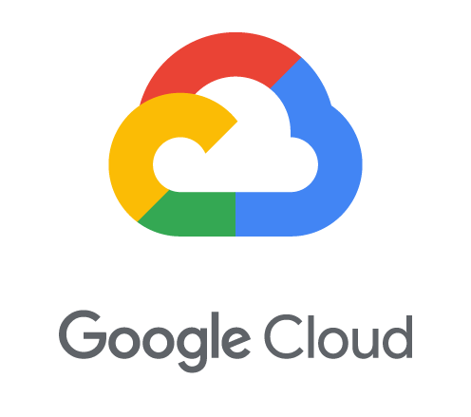
Contributions of APIs
Specific Service Distribution
For supporting the above big data analysis, incorporation of Analytics Core Reporting API v3, Analytics Metadata API v3, and Analytics Reporting API is provided, to get the most efficient and best of results, for handling this big of query responses integration of Big Query API is implemented. App Engine Admin API and Apps Script API are used for not much but administrating the entire procedures and logs that are to be parsed in the backend system of the app. Furthermore, cloud services provided by Google like Cloud Asset API, Cloud Build API, Cloud Composer API, Cloud Data Fusion API, Cloud Datastore API v1, Google Cloud Deployment Manager API, Google Cloud DNS API, Cloud Filestore API, Cloud Key Management Service API, Cloud Speech-to-Text API v1 and v2 beta 1, Cloud SQL Admin API, Cloud Testing API are used for providing, managing and storing data for the entire human resource market to better understand the market as well as for the means of external reviews such as customer surveys, focus groups, beta-testers, subject-matter experts and potential investors. For beta testing and provisions for security APIs like Stackdriver Error Reporting API, Web Security Scanner API is to be incorporated for further acknowledging the security and privacy of data of users connected. Google Fonts Developer API, People API, Service Consumer Management API are the UI prospects that will help us with providing better user experience as well as developing simplified-ambient UI to interact with and hence, provide an impact in sales and marketing services.

Slide 13
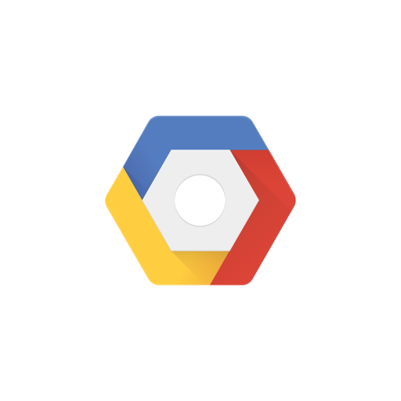
Training
Google AI Model
For marketing purpose
GCP Services
Briefing down further, APIs, SDKs and frameworks that are to be incorporated in the processing of the app that not only includes converting speech and text and other features mentioned earlier but also taking logs and manipulating the data in real-time across the world to better understand the need of the same wearable technology and also accordingly distribute the marketing sales as well as production and provide with low-cost upgrades immediately in those areas, and hence uplift the scale of our global community.

Slide 14
Marketing Product
Using GCP services
01
Selective Updates in required areas of dormant investment leads to more and more fund raising for future investment in any other innovation.
Need-based Update
02
Deploying and taking consideration of almost every other UI prospects in collaboration with best simplified user experience.
Productivity
Distribution based on above mentioned factors would consume time constraint but rather provide us with overtime better economical as well as community services.
03
Distribution

Slide 15
Architecture
Key-Points / Milestones
Cloud services provided by Google like Cloud Asset API, Cloud Build API, Cloud Composer API, Cloud Data Fusion API, Cloud Datastore API v1, Google Cloud Deployment Manager API, Google Cloud DNS API, Cloud Filestore API, Cloud Key Management Service API, Cloud Speech-to-Text API v1 and v2 beta 1, Cloud SQL Admin API, Cloud Testing API are used for providing, managing and storing data for the entire human resource market to better understand the market as well as for the means of external reviews such as customer surveys, focus groups, beta-testers, subject-matter experts and potential investors.
DETAILS
1. Research
2. Communication
3. Project Brief Prep.
4. UI design / App Creation
Deploy and Updates as per feedbacks

Slide 16
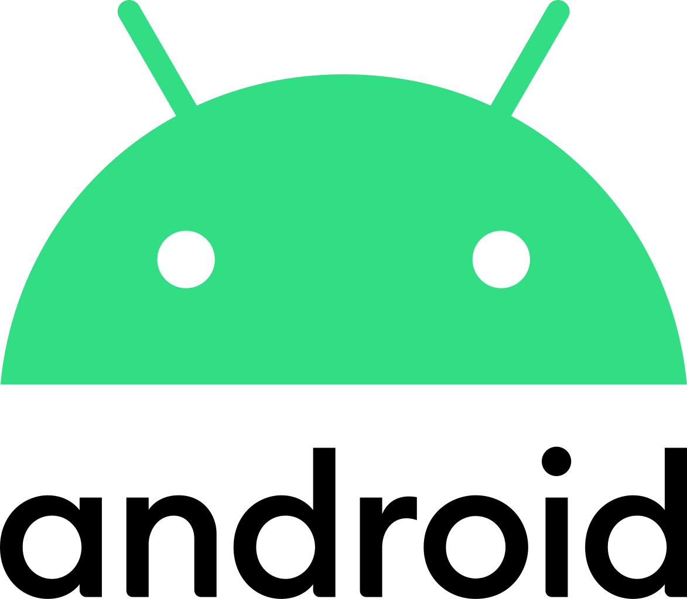
HOPE
Timeline:
By mid-January: I tend to complete the development of the app for the above-mentioned purposes and also finish the integration of a live language translator.
By March-end: I tend to complete the developing and processing of wearable for a deaf person and hence integrate it in my app and be ready for use.
By May-end: I finish the most important and toughest part of my idea i.e. finishing the developing of wearable for a dumb person to help them provide a voice

Slide 17

MIRACLES AROUND
Uplifting Globalization Community Scale
8 FROM 10 CHALLENGED
Cured
Though this idea is still in its infant stage, it can still be brought to life, if only right nurture is provided which from my perspective can only be provided by Google. More than I need this opportunity, I really hope, countries like mine are god blessed with this miracle.

Slide 18
THANK YOU

