Slide 1
JavaScript for Web Warriors, 7e Chapter 1: Introduction to JavaScript

Slide 2
Icebreaker
The class will be broken up into pairs of students.
Each student will create three questions to ask their partner:
one True/False question;
one question that can be answered with a number;
one question that requires a short answer
Partners will take turns asking the questions they’ve prepared.
Each student will then introduce their partner to the class using the information they’ve learned.
Notes:
Instructions:
Task: This is an introductory exercise for the beginning of a course.
Objectives: To provide an informal way for participants to learn about each other and begin working together. This exercise also gives students practice speaking in front of a group, introduces them to interviewing, and gives the instructor insight into who the students are and what is important to them.
Steps: Break the class into pairs of students. Have them interview each other to discover interesting facts and then introduce each other to the class.
Average Time In Class: 30-45 min
Note: to adapt this activity for an online learning environment, conduct the interviews using a web conferencing tool (e.g., Zoom or Microsoft Teams). When you break the class into pairs, send the pairs into breakout rooms for 10 minutes to interview each other. When the class comes back together, give each pair 2-4 minutes to introduce each other to the rest of the class.

Slide 3
Chapter Objectives
By the end of this chapter, you should be able to:
Explain the history of JavaScript and scripting languages and how each has been developed for its current use.
Write content into a web page using JavaScript.
Add JavaScript code to a web page.
Create and apply JavaScript variables.
Work with event handlers within a web page.
Connect to an external JavaScript file.
Notes:
Instructions: Briefly review with students the major concepts you will be covering during this class. There is one objective for every major A-head section of the chapter.

Slide 4
Exploring the JavaScript Language (1 of 11)
JavaScript: a programming language that adds complex interactive features to a website
Developed to handle customer data validation for online commerce
World Wide Web (web) allows data sharing across a network of linked documents
Introducing scripting languages
JavaScript is a type of programming language, specifically a scripting language
Programming language: a set of instructions directing the actions of the computer
Typically must be compiled into machine code by a program called a compiler
Scripting languages: subcategory of programming languages that run directly from a program or script (are not compiled)
Must be interpreted (read and scanned line-by-line) by an interpreter

Slide 5
Exploring the JavaScript Language (2 of 11)
Introducing scripting languages (continued)
Markup languages: languages that define the content, structure, and appearance of a document
HTML (Hypertext Markup Language) defines the content and structure of a web page
CSS (Cascading Style Sheets) defines how a web page will appear on a specified device

Slide 6
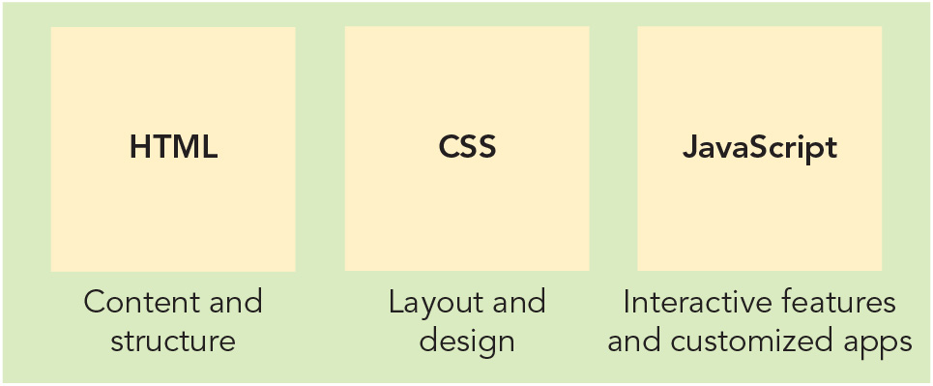
Exploring the JavaScript Language (3 of 11)
Figure 1-1 The roles of HTML, CSS, and JavaScript in web development

Slide 7
Exploring the JavaScript Language (4 of 11)
JavaScript and ECMAScript
Developers struggled to reconcile JavaScript and JScript in the late 1990s
JavaScript was submitted as a proposal for a standardized scripting language to the European Computer Manufacturers Association (ECMA) in 1997
An ECMA committee developed a set of scripting language standards
The specification for this scripting language, called ECMAScript (ECMA-262), is updated to a new edition annually

Slide 8
Exploring the JavaScript Language (5 of 11)
The DOM and the BOM
Three foundations of the full implementation of JavaScript:
ECMAScript (core of the language: syntax, keywords, properties, methods, etc.)
Document Object Model (DOM): describes how to access the contents of a web page and user actions within that page
Browser Object Model (BOM): describes how to access the features and behaviors of the browser itself
DOM and BOM are Application Programming Interfaces (APIs)
DOM specifications are managed by the World Wide Web Consortium (W3C)
Current version is DOM Level 4, described as an ongoing “living standard”
BOM is implemented by each browser application (largely the same among them)

Slide 9
Exploring the JavaScript Language (6 of 11)
Understanding client/server architecture
Traditionally, a two-tier system consisting of:
Server (back end): a device or application from which a client requests information; responsible for data storage, management, communication with external services, and heavy processing
Client (front end): a device or application that presents an interface to the user and requests information from a server; responsible for gathering information from the user, submitting it to a server, then receiving, formatting, and presenting the results, and sometimes some related data processing
Web’s two-tier client/server system consists of a web browser and web server that communicate via Hypertext Transfer Protocol (HTTP)
Adding databases and other applications to a web server yields a three-tier client/server system (a.k.a. multitier client/server system, n-tier client/server system): client tier, processing tier (a.k.a. middle tier), and data storage tier

Slide 10

Exploring the JavaScript Language (7 of 11)
Figure 1-4 A two-tier client/ server system

Slide 11
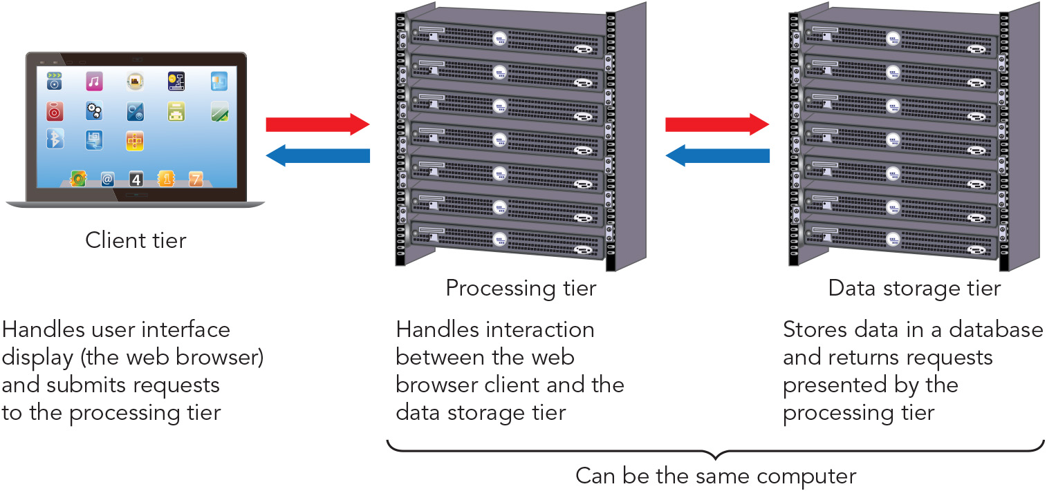
Exploring the JavaScript Language (8 of 11)
Figure 1-5 A three-tier client/ server system

Slide 12
Exploring the JavaScript Language (9 of 11)
JavaScript and client-side scripting
HTML produces static documents, whereas client-side scripting provided by JavaScript can respond dynamically to user actions because it runs on a local browser (client)
Security concerns limit where JavaScript can be used, what files it can access/ commands it can run on the client’s system, and its direct interactions with web servers operating at the processing tier
Understanding server-side scripting
Server-side scripting: programming using a scripting language (e.g., PHP, ASP.NET, Python, Ruby) that is executed from a web server
These languages work in the processing tier and can handle communication between the client and data storage tiers, often preparing and processing data
JavaScript and server-side scripts operate in separate environments but must work together to deliver interactive websites to users

Slide 13
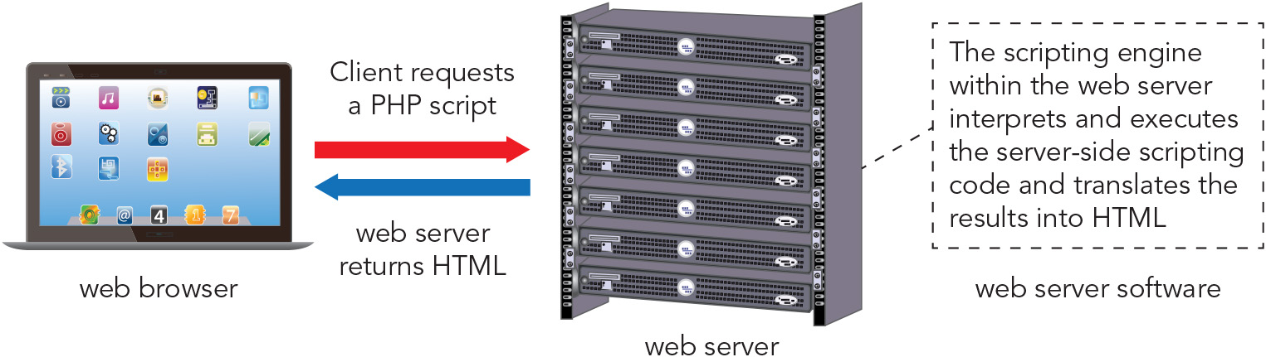
Exploring the JavaScript Language (10 of 11)
Figure 1-6 How a web server processes a server-side script

Slide 14
Exploring the JavaScript Language (11 of 11)
Should you use client-side or server-side scripting?
Allow the client to handle the user interface processing and other light processing such as data validation
Allow the web server to perform intensive calculations and data storage
Performing some processing on the client is beneficial because:
Processing power is not limited to the capabilities of the server when processing is distributed among multiple client devices using a web application
Transfer times across the Internet are minimized, increasing speed
Server resource requirements (infrastructure, power use) are decreased, reducing costs

Slide 15
Writing a JavaScript Program (1 of 10)
IDEs and code editors
Use an Integrated Development Environment (IDE) to manage all of the facets of website development
Use a code editor to manage coding in HTML, CSS, and JavaScript within a graphical interface

Slide 16
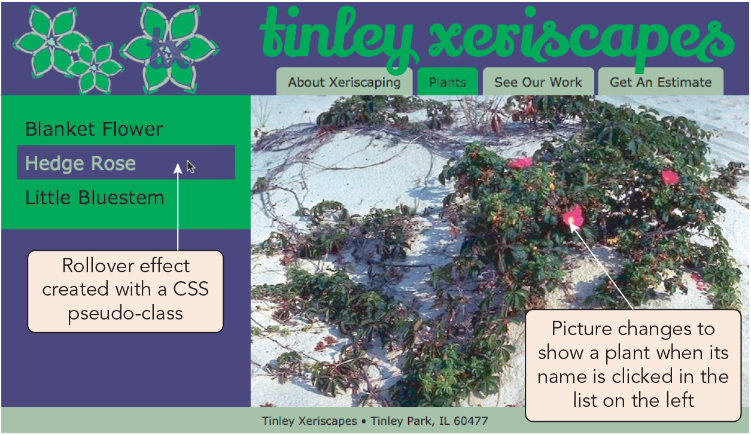
Writing a JavaScript Program (2 of 10)
Figure 1-7 Completed Tinley Xeriscapes Plants page using JavaScript
U.S. Department of Agriculture

Slide 17
Writing a JavaScript Program (3 of 10)
The script element
Syntax for embedding JavaScript code in a web page’s HTML file: <script> statements </script>
Browser stops loading the page and processes the statements when it encounters an embedded script
JavaScript statements
A JavaScript program is composed of statements (lines of code)
Sample statement showing optional (but desirable per convention) ending semicolon: document.write("<p>Plant choices</>");

Slide 18
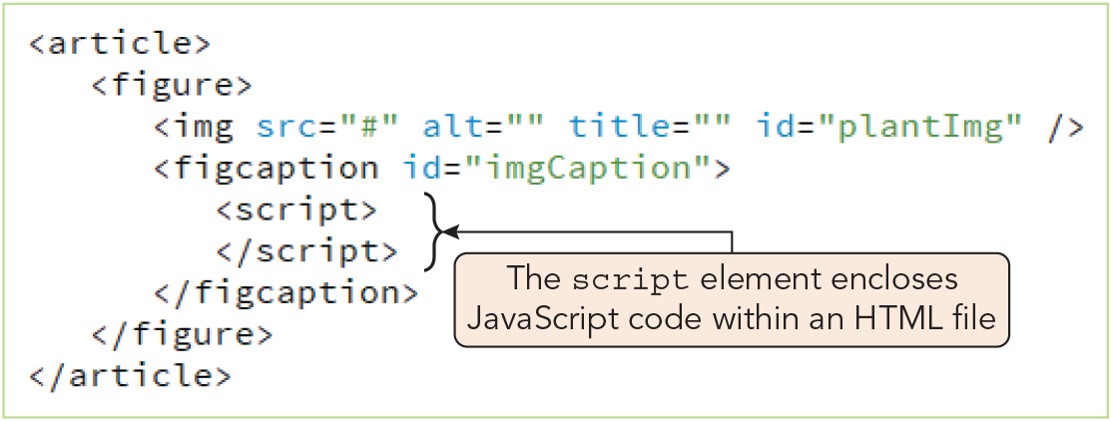
Writing a JavaScript Program (4 of 10)
Figure 1-8 Adding a script element

Slide 19
Writing a JavaScript Program (5 of 10)
Understanding JavaScript objects
JavaScript is considered an object-based programming language
Object: programming code (including methods) and data (properties) that can be treated as an individual unit or component
Procedure: logical unit of a computer program consisting of a group of statements that perform a specific task
Method: a procedure associated with an object
Sample method call on carLoan object: carLoan.calcPayments(60)
Methods often require that you provide data (argument[s]) within the parentheses, which is known as passing arguments
Property: a piece of data associated with an object
Sample statement assigning a value for the interest property of the carLoan object: carLoan.interest = .0349;

Slide 20
Writing a JavaScript Program (6 of 10)
Using the write() method
DOM's Document object represents the entire content of the web page
The Document object's write() method writes new content to a web page while it is being loaded
Performs essentially the same function that you perform when you manually add text to the body of a standard web document
Useful for incorporating constantly-changing data at load time
Requires a text string (a.k.a. literal string), which is text contained in double or single quotation marks, as an argument
Will overwrite the entire web page if used after the browser finishes loading the page

Slide 21
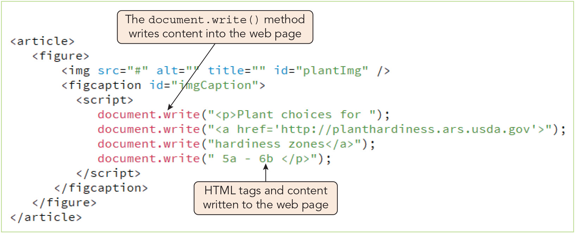
Writing a JavaScript Program (7 of 10)
Figure 1-9 Applying the document.write() method

Slide 22
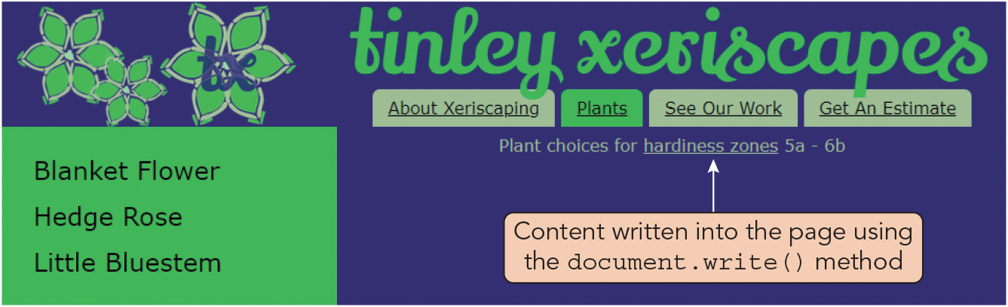
Writing a JavaScript Program (8 of 10)
Figure 1-10 Content generated using the document.write() method

Slide 23
Writing a JavaScript Program (9 of 10)
Case sensitivity in JavaScript
Object names must always be all lowercase
Incorrect capitalization, e.g. Document.write("Plant choices"); or document.WRITE("Plant choices");, will cause errors
Adding comments to a JavaScript program
Comments: lines of code that are not processed by browsers, which you can use to add notes about your code
Line comment syntax: let apple = "Fuji"; // Variable assignment
Block comment syntax: /* Here comes a function! */

Slide 24
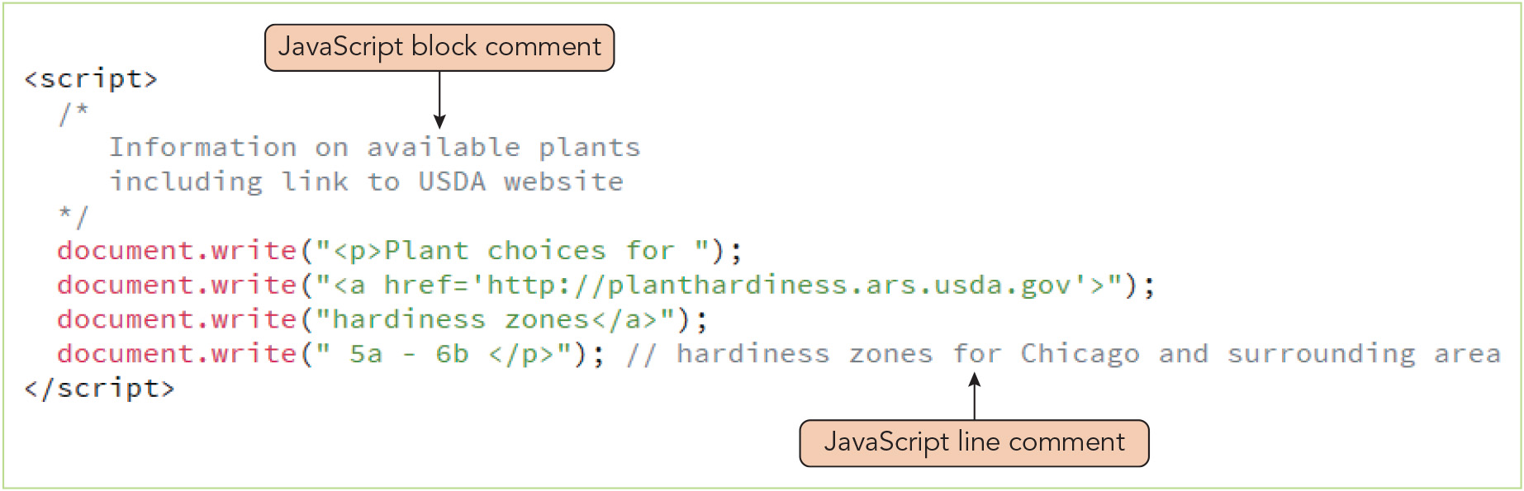
Writing a JavaScript Program (10 of 10)
Figure 1-11 Adding JavaScript comments

Slide 25
Writing Basic JavaScript Code (1 of 3)
Using variables
Variable: specific location in the computer's memory where a program stores a value
First created and assigned a name, then used to store a value
Assigning variable names
Rules and conventions for variable names, known as identifiers:
Must begin with an uppercase or lowercase ASCII letter, dollar sign, or underscore
Can include numbers but not as the first character
Cannot include spaces
Cannot be a reserved word (a.k.a. keyword)—a special word that is part of JavaScript syntax
Best practice is to use camel case, e.g., myVariableName

Slide 26
Writing Basic JavaScript Code (2 of 3)
Declaring and initializing variables
Declaring a variable creates it and thus is mandatory prior to using the variable
Initializing a variable assigns it an initial value and is optional
Syntax for declaring and initializing a variable using the assignment operator: let variable = value; var variable = value;
Syntax for declaring a variable with a constant (unchangeable) value: const variable = value;
Sample statements that declare and/or initialize variables: let salesTotal; // Declares only let curOrder = 47.58; // Declares and initializes salesTotal = curOrder; let orderNumber = "R0218", salesTotal = 47.58, curOrder;

Slide 27
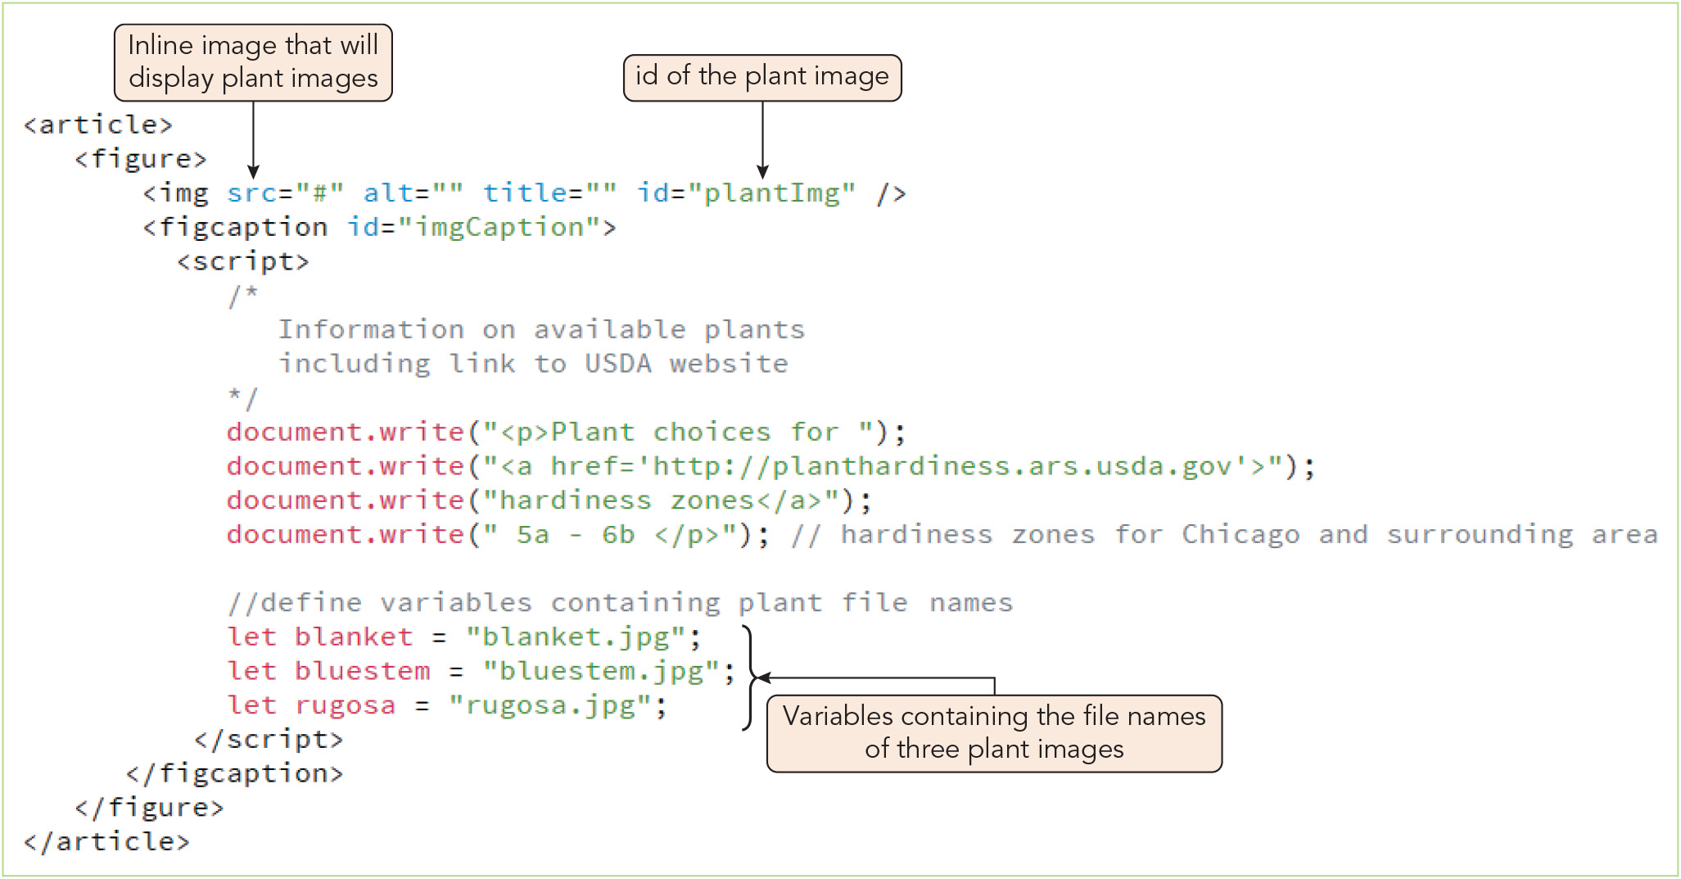
Writing Basic JavaScript Code (3 of 3)
Figure 1-13 Declaring JavaScript variables

Slide 28
Building Expressions with Variables (1 of 2)
Building an expression
Expression: a literal value or variable, or a combination of literal values, variables, operators, and other expressions, that can be evaluated by a JavaScript interpreter to produce a result
Expressions are written using:
Operands: variables and literals (values such as text strings or numbers)
Operators: symbols used to manipulate operands
Example uses of the addition (+) and assignment (=) operators: let salesTotal = 47.58, shippingCost = 10; let totalCost = salesTotal + shippingCost; document.write("<p> Your total costs is $" + totalCost + "</p>"); Generates the HTML code <p>Your total cost is $57.58</p> 5 + "2" returns the text string "52"

Slide 29
Building Expressions with Variables (2 of 2)
Modifying variables
Expressions can be used to assign new values to variables at any point in a script
Applies to variables declared with let or var; variables declared with const cannot be modified
Variables need be declared only once, then can be assigned repeatedly
Example: let totalSales = 0; let item1Sales = 50, item2Sales = 75, item3Sales = 40; totalSales = item1Sales + item2Sales + item3Sales; document.write("<p>Total sales = $" + totalSales + "</p>"); Writes the HTML <p>Total sales = $165</p> to the web page

Slide 30
Activity 1.1: Knowledge Check
Imagine a colleague writes some JavaScript code containing a companionAnimal object. What is an object? What do the following statements from this program do? companionAnimal.fillFoodBowl("treats"); companionAnimal.name = "Marco"
Describe what each of the following JavaScript statements is and what it does. const accelerationDueToGravity = 9.81; let ballMass = 3, dropHeight; dropHeight = landElevation + structureHeight; document.write("<p>A " + ballMass " kg ball fell " dropHeight " m.</p>");
Notes:
Instructions:
Use the Knowledge Check questions to periodically pose a question to students during class to gauge how well they can recall the material that was presented.

Slide 31
Activity 1.1: Knowledge Check Answers (1 of 2)
Imagine a colleague writes some JavaScript code containing a companionAnimal object. What is an object? What do the following statements from this program do? companionAnimal.fillFoodBowl("treats"); companionAnimal.name = "Marco" An object is programming code and data that can be treated as an individual unit or component. The first statement calls the fillFoodBowl() method on the companionAnimal object, passing in the string "treats" as the argument. The second statement assigns the value "Marco" to the name property of the companionAnimal object.
Notes:
Instructions:
Use the Knowledge Check questions to periodically pose a question to students during class to gauge how well they can recall the material that was presented.

Slide 32
Activity 1.1: Knowledge Check Answers (2 of 2)
Describe what each of the following JavaScript statements is and what it does. const accelerationDueToGravity = 9.81; Declaration and assignment statement using the const keyword to assign the unchangeable value 9.81 to the accelerationDueToGravity variable let ballMass = 3, dropHeight; Declares two variables, ballMass and dropHeight, and initializes ballMass with the value of 3, using the let keyword dropHeight = landElevation + structureHeight; Expression assigning the sum of landElevation and structureHeight as the value of dropHeight; will cause an error if landElevation and structureHeight were not declared and initialized earlier in the program document.write("<p>A " + ballMass " kg ball fell " dropHeight " m.</p>"); Calls the write() method of the Document object; assuming dropHeight's value is 10, it will generate the HTML code: <p>A 3 kg ball fell 10 m.</p>
Notes:
Instructions:
Use the Knowledge Check questions to periodically pose a question to students during class to gauge how well they can recall the material that was presented.

Slide 33
Understanding Events (1 of 5)
Event: a specific circumstance (such as an action performed by a user or an action performed by the browser) that is monitored by JavaScript and that your script can respond to in some way
E.g., a user action generates a click event, but a browser triggers a load event
Not all events happen with all devices; here are a few examples (part of Figure 1-14)
Event | Keyboard Trigger | Mouse Trigger | Touchscreen Trigger
change | The value of an element, such as a text box, changes
click | A user presses a key when an element is selected | A user clicks an element once | A user touches an element and then stops touching it
mouseover |  | A user moves the mouse pointer over an element | A user touches an element
touchend |  |  | A user removes finger or stylus from the screen

Slide 34
Understanding Events (2 of 5)
Working with elements and events
Events are associated with HTML elements, with each element having its own set of available events
The click event is available for many elements, including the a element and form controls created with the input element
The load and unload events are available for the body element
Event handler: code that is executed in response to a specific event occurring on a specific element
Syntax for an event handler included as an attribute of the initiating element: <element onevent="JavaScript code">
Example using the window.alert() method, which displays the string passed to it in a dialog box with an OK button: <input type="submit" onclick="window.alert('Thanks for your order! We appreciate your business.')" />

Slide 35
Understanding Events (3 of 5)
Referencing web page elements
You can reference an element by its id assigned using the HTML id attribute
In JavaScript, you look up an element by its id value using the getElementById() method of the Document object
Sample HTML creating an input element with the id value firstName: <input type="text" id="firstName" />
Sample JavaScript creating a variable that references that element: let fName = document.getElementById("firstName");
Syntax for changing the value assigned to an attribute thus retrieved: document.getElementById("firstName").value = value; or fName.value = value;

Slide 36
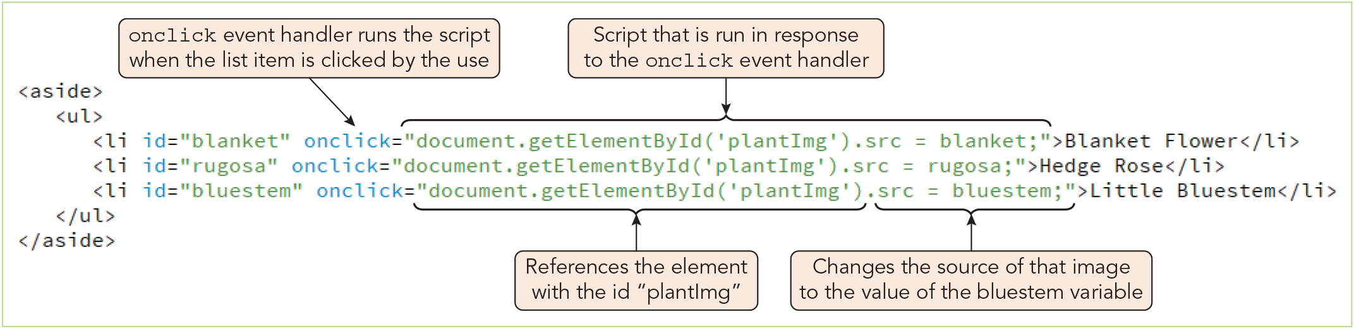
Understanding Events (4 of 5)
Figure 1-17 Changing the source of an inline image using JavaScript

Slide 37

Understanding Events (5 of 5)
Figure 1-18 Web page after clicking Hedge Rose
U.S. Department of Agriculture

Slide 38
Structuring JavaScript Code
Including a script element for each code section
Several script elements can be included in a single HTML file
Statements in one script section are accessible to subsequent script sections
E.g., variables declared in a script section can be used in subsequent script sections
Placing the script element
Place script sections containing the document.write() method where the content is to be written
The DOM is created during page load, and a script that references a part of the page that has not been loaded will cause an error
Many developers place scripts at the end of the document to avoid this type of error
The document.getElementById() method can reference page objects only after they are loaded into the DOM

Slide 39
Creating a JavaScript Source File (1 of 6)
A JavaScript source file contains only JavaScript code and has a .js extension
Referencing an external file
Syntax for attaching a web page to a JavaScript source file from within the HTML file: <script src="url"></script> where url is the JavaScript source file's name and location
The script element can be used for embedding JavaScript code or referencing a file—not both at once
Using the async and defer keywords (script element attributes)
Default behavior is for commands in an external .js file to be loaded when the browser initially encounters the script element in the HTML file
With the async attribute, the browser parses the HTML and JavaScript code together, only pausing to process the script
With the defer attribute, the browser parses and loads the HTML, then processes the script

Slide 40
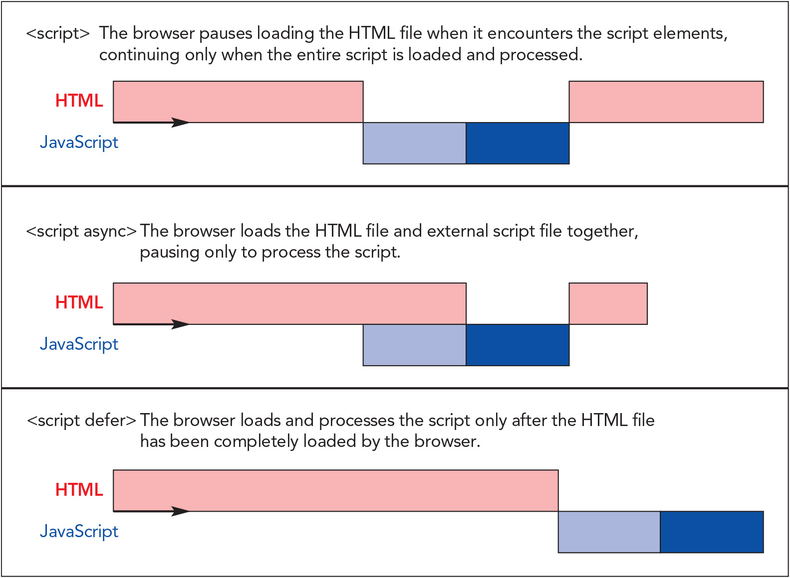
Creating a JavaScript Source File (2 of 6)
Figure 1-20 Loading HTML and JavaScript code

Slide 41
Creating a JavaScript Source File (3 of 6)
Using the async and defer keywords (continued)
Placing JavaScript code in an external file is preferable because:
Code can be shared among pages or among team members
When shared among pages, code need only be downloaded once
The HTML file is kept neater and cleaner
Websites are easier to manage when the HTML, CSS, and JavaScript files each focus on one task

Slide 42
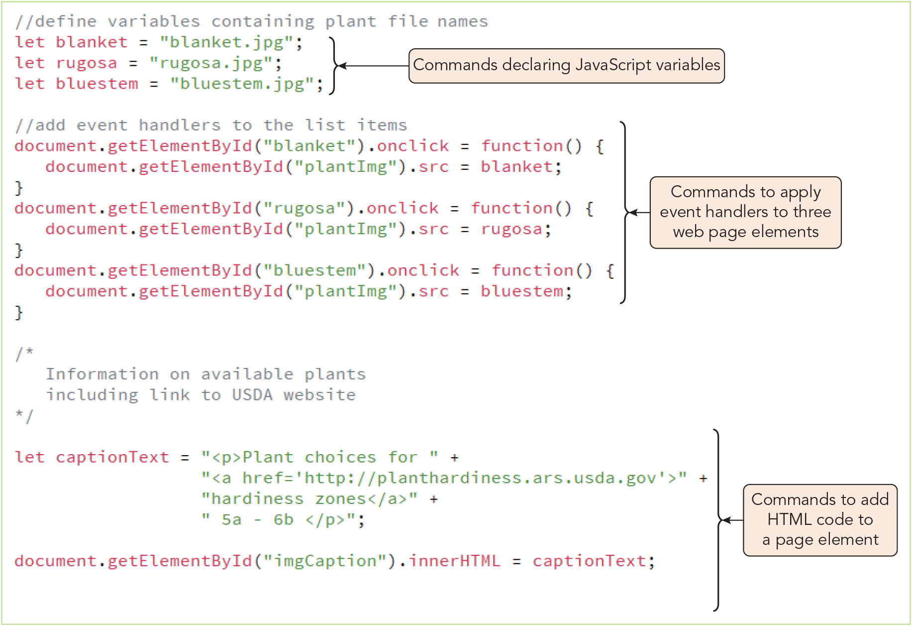
Creating a JavaScript Source File (4 of 6)
Figure 1-21 An external JavaScript file

Slide 43
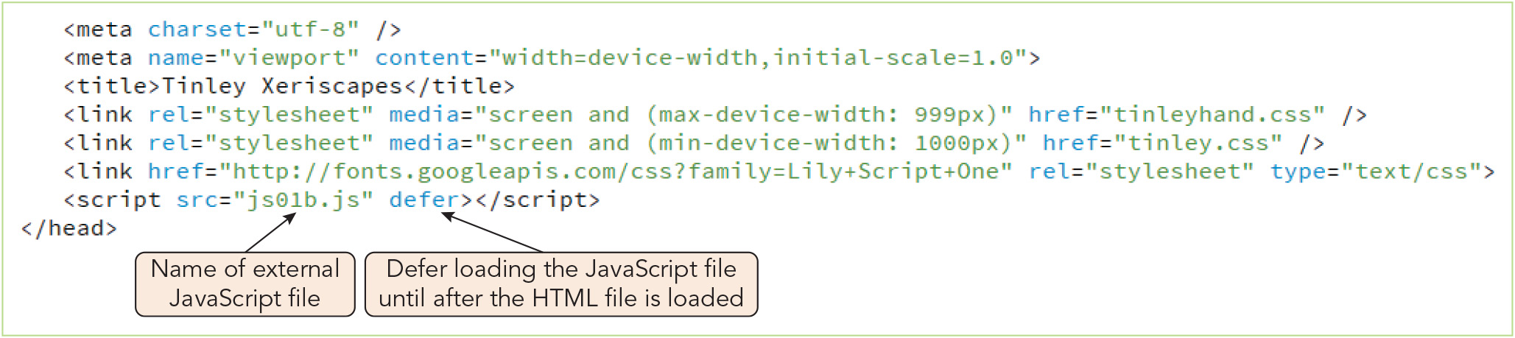
Creating a JavaScript Source File (5 of 6)
Figure 1-22 Connecting to an external JavaScript file

Slide 44
Creating a JavaScript Source File (6 of 6)
Working with libraries
Libraries: JavaScript source files that store especially useful generic scripts used on many different websites
You can incorporate a library into HTML code by creating a script element in the head section and using the src attribute to specify the file name
Popular libraries include Node.js, jQuery, and Modernizr
Developers usually create customized versions of large libraries containing only the code they need to limit download time

Slide 45
Validating Web Pages
Well formed web page documents conform to the rules and requirements of HTML
Validating parser: a program that checks whether a web page is well formed and whether the document conforms to a specific language definition known as DTD
E.g., W3C Markup Validation Service at http://validator.w3.org/
Validation: the process of verifying that your document is well formed and checking that the elements in your document are correctly written according to the element definitions in a specific DTD
Embedding JavaScript in an XHTML document
Enclose the script element within a CDATA section
Character data (CDATA): a document section that is not interpreted as markup
Parsed character data (PCDATA): a document section that is interpreted as markup

Slide 46
Activity 1.2: Think, Pair, and Share
Form pairs/groups of two to four class members.
Your group will attempt to modify the Tinley Xeriscapes "Plants" web page from Chapter 1 so that an additional plant is added to the left-side menu. Open the completed HTML and JavaScript files for this project in a code editor. Together, examine the code and make a list of the changes you will need to make to add another plant option that users can click on to see an additional photo image.
Choose a plant to add to the menu. Make the necessary modifications that you identified to the HTML and JavaScript code.
Optionally, locate a JPEG file of your chosen plant and add it to the appropriate folder so that you can see the new image when you click on the plant in the menu. Be sure to incorporate the file name in the code where it belongs.
Notes:
Instructions:
Use the Think, Pair, Share activity to encourage students to solve problems collaboratively and to apply the real-world skill of evaluating, modifying, and debugging code created by another programmer.

Slide 47
Activity 1.3: Discussion Questions
How does the Internet affect your daily life? Try to imagine and describe how it would be different if the Internet ceased to be available to you.
What JavaScript characteristics do you consider most and least helpful to you as a programmer based on what you have learned so far? Explain why.
Notes:
Instructions:
Use the Discussion activity to encourage group conversation about a related topic of interest

Slide 48
Self-Assessment
Are you interested in professional server-side web development? Why or why not? If so, how do you expect the experience you are gaining with JavaScript to be helpful to you as a server-side developer?
Which IDEs and/or code editors have you used or considered using? What do you like and dislike about the tools you are currently using for website development?
How would you describe the value of using JavaScript to develop web applications used by business organizations to attract and serve customers? What value would you say it offers for web applications with other purposes?
Notes:
Instructions:
Use the Self-Assessment question to encourage students to evaluate their progress or goals in the course, as well as determine how they might apply their learning or grow as an individual.

Slide 49
Summary
Now that the lesson has ended, you should have learned to:
Explain the history of JavaScript and scripting languages and how each has been developed for its current use
Write content into a web page using JavaScript
Add JavaScript code to a web page
Create and apply JavaScript variables
Work with event handlers within a web page
Connect to an external JavaScript file
Notes:
Instructions: Reiterate the learning objectives for the lesson. Students should use this information to guide their studies and reinforcement of new concepts.

