Slide 1
JavaScript for Web Warriors, 7e Chapter 3: Building Arrays and Controlling Flow

Slide 2
Chapter Objectives (1 of 2)
By the end of this chapter, you should be able to:
Create an array containing a list of data values.
Access a collection of HTML elements by type.
View arrays and HTML collections using the browser console.
Create program loops using while, do while, and for loops.
Notes:
Instructions: Briefly review with students the major concepts you will be covering during this class. There is one objective for every major A-head section of the chapter.

Slide 3
Chapter Objectives (2 of 2)
By the end of this chapter, you should be able to:
Explore array methods to replace program loops.
Make decisions with if statements and switch statements.
Manage program loops and conditional statements with the break, continue, and label commands.
Notes:
Instructions: Briefly review with students the major concepts you will be covering during this class. There is one objective for every major A-head section of the chapter.

Slide 4
Storing Data in Arrays (1 of 6)
Changing the order in which JavaScript code is executed is known as controlling flow
Array: a set of data represented by a single variable name
Declaring and initializing arrays
Syntax for creating an array with an array literal (values as a comma-separated list, or no values to initialize an empty array): let array = [values];
Syntax for creating an array with the new Array() object constructor: let array = new Array(values) let array = new Array(length)

Slide 5
Storing Data in Arrays (2 of 6)
Elements and indexes
Element: a value stored in an array
Index: position of an element within an array; indexes begin with 0
Syntax to set a specific array value by its index: array[index] = value;
JavaScript arrays are dynamic
They automatically expand to allow for new elements
Can create sparse arrays in which some values are left undefined so the length is greater than the number of defined values
Syntax for the property used to query an array's current size: array.length

Slide 6
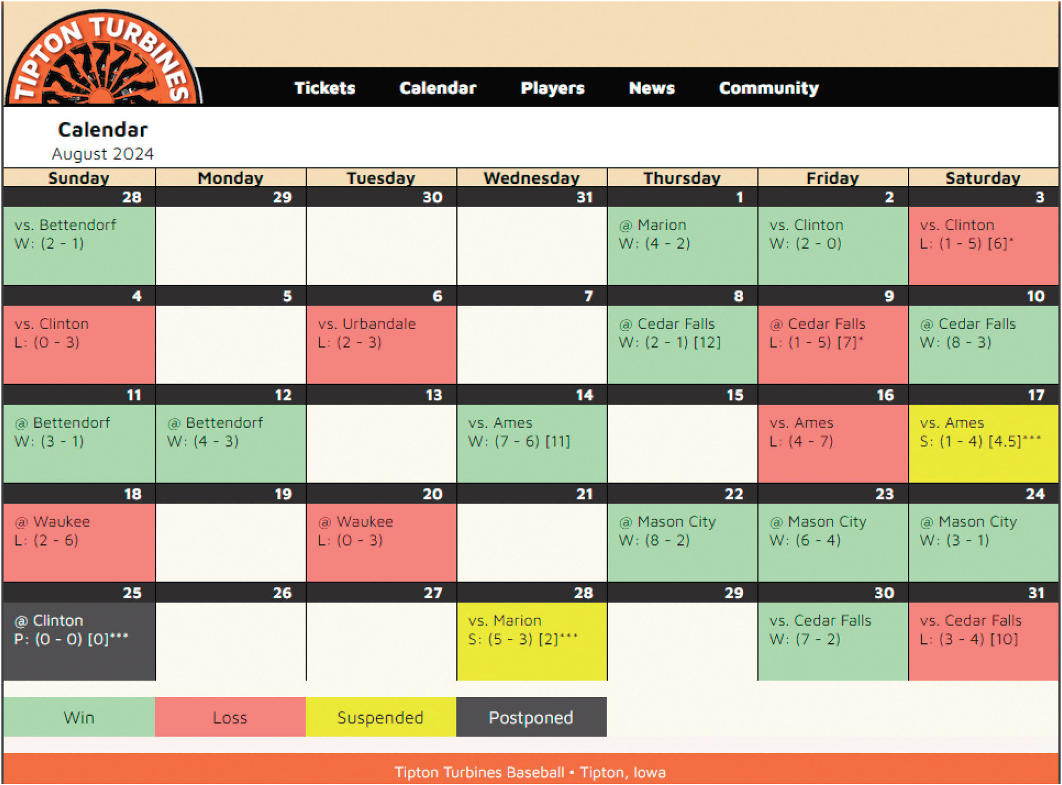
Storing Data in Arrays (3 of 6)
Figure 3-1 Tipton Turbines game calendar

Slide 7
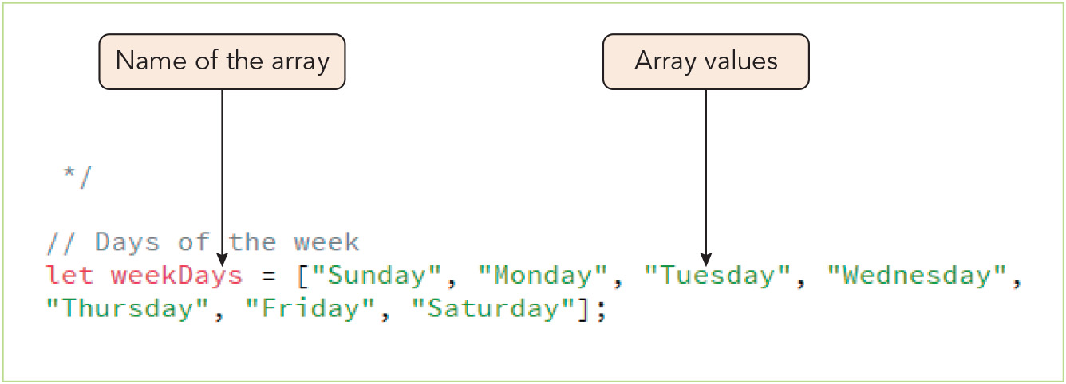
Storing Data in Arrays (4 of 6)
Figure 3-2 Creating the weekDays array

Slide 8
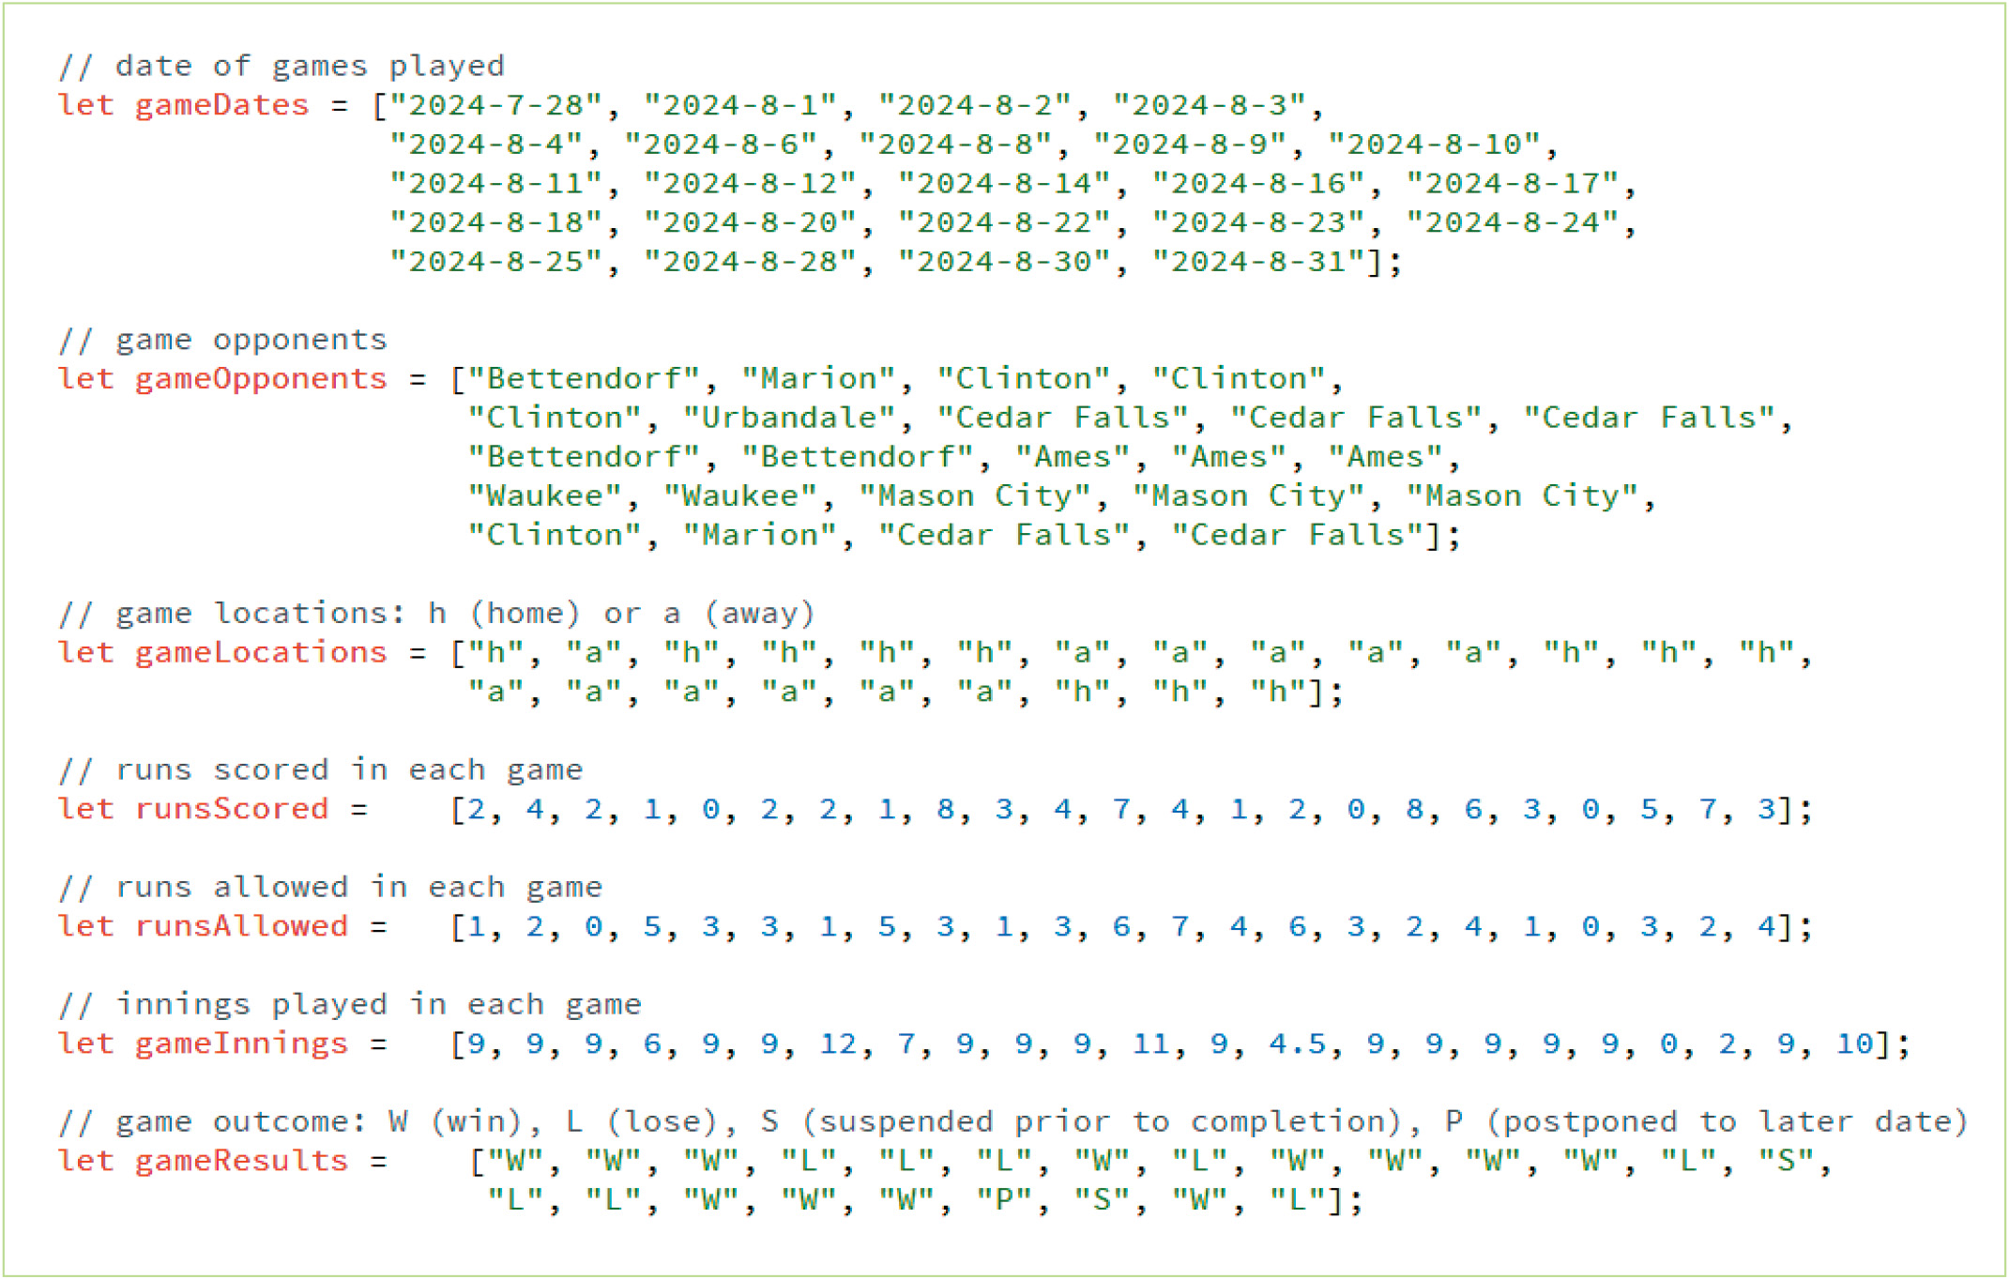
Storing Data in Arrays (5 of 6)
Figure 3-3 Arrays describing the results of 23 games

Slide 9
Storing Data in Arrays (6 of 6)
Multidimensional arrays
Matrix: a data storage format in which values are arranged in a rectangular grid
JavaScript does not support matrices
Multidimensional array: a structure that nests one array within another to mimic the behavior of a matrix
Sample multidimensional array: var mArray = [ [4, 2, 1, 2], [1, 3, 18, 6], [3, 7, 3, 4] ];
The expression array[x][y] is used to reference values (x is the index of the outer array, or row; y is the index of the inner array, or column)
length property returns the number of rows; applied to first row to return number of columns

Slide 10
Exploring HTML Collections (1 of 2)
The DOM organizes HTML elements into collections where each element is an HTML Collection Object
HTML Collection | Collection of
embeds | <embed> elements in the document
forms | <form> elements in the document
form.elements | Elements within a web form
getElementsByClassName(class) | Elements in the document with belonging to the class class
getElementsByName(name) | Elements in the document with a name attribute equal to name
getElementsByTagName(tag) | Elements in the document with a tag name equal to tag
images | <img> elements in the document
links | <a> elements and <area> elements with a href attribute
scripts | <script> elements in the document
styleSheets | Stylesheet objects associated with the document

Slide 11
Exploring HTML Collections (2 of 2)
Referencing an element within a collection
Syntax: objects[idref] or objects.idref
objects is the HTML collection
idref is either an index number for the element's position or the value of the id attribute assigned to the element
Searching through the DOM
Syntax for methods that form an HTML collection by searching through DOM elements: document.getElementsByClassName(class) document.getElementsByTagName(tag) document.getElementsByName(name)
Add the index in brackets to reference a particular element in the collection
Nest the object reference to search within a specified part of the document, e.g.: document.getElementsByTagName("td")[0].getElementsByTagName("p")

Slide 12
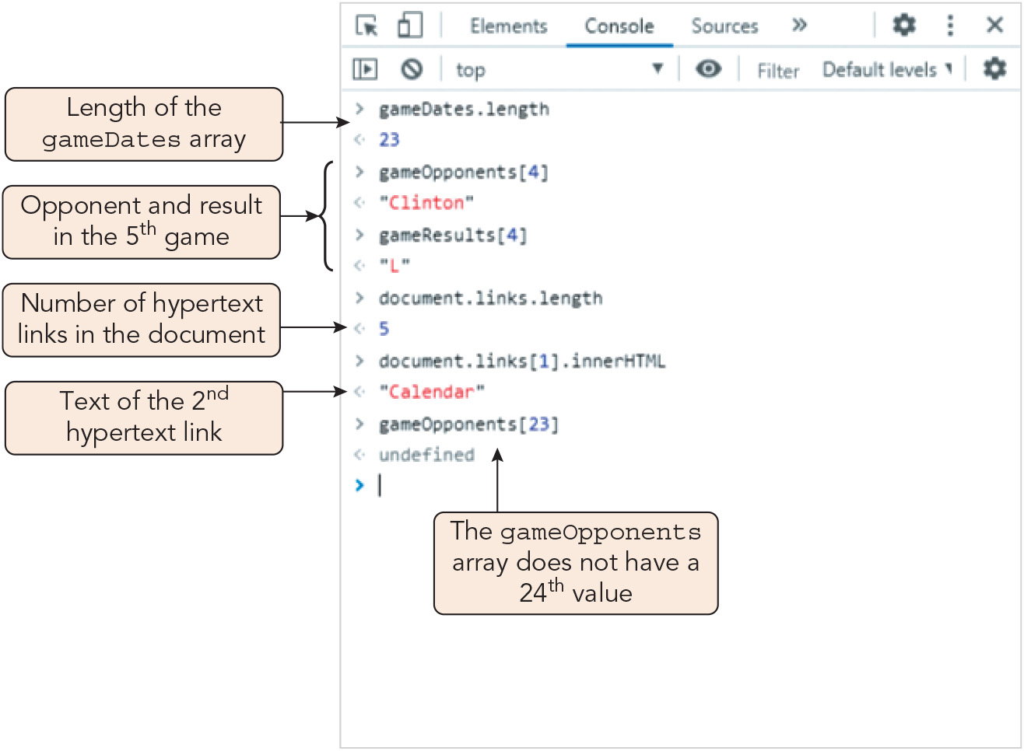
Viewing Arrays and HTML Collections with the Console
Figure 3-5 Information on arrays and collections viewed in the console

Slide 13
Working with Program Loops (1 of 11)
Program loop: a command block that executes repeatedly until a stopping condition is met
The while loop
Command block executes while a given condition is true and stops when it is not true
Syntax: while (condition) { statements; }
Iteration: one repetition of the command block for a loop
Include at least one statement that eventually results in a falsy value for the stopping condition to avoid an infinite loop
To abort an infinite loop, force-close/force-quit the browser

Slide 14
Working with Program Loops (2 of 11)
The while loop (continued)
Counter: a variable whose value changes with each iteration
Sample while loop: let i = 1; while (i <= 5) { document.write(i + "<br>"); i++; // increase the value of i by 1 } document.write("<p>The value of i is equal to " + i + "</p>");
This sample while loop writes the following to the web page: 1<br>2<br>3<br>4<br>5<br> <p>The value of i is equal to 6</p>

Slide 15
Working with Program Loops (3 of 11)
Initial Value | Iteration | While Condition | Iterated Values
let i = 5 | i++ | i <= 10 | i = 5, 6, 7, 8, 9, 10
let i = 5 | i-- | i > 0 | i = 5, 4, 3, 2, 1
let i = 0 | i += 60 | i <= 180 | i = 0, 60, 120, 180
let i = 1 | i *= 2 | i <= 50 | i = 1, 2, 4, 8, 16, 32
let i = 90 | i /= 3 | i > 5 | i = 90, 30, 10

Slide 16
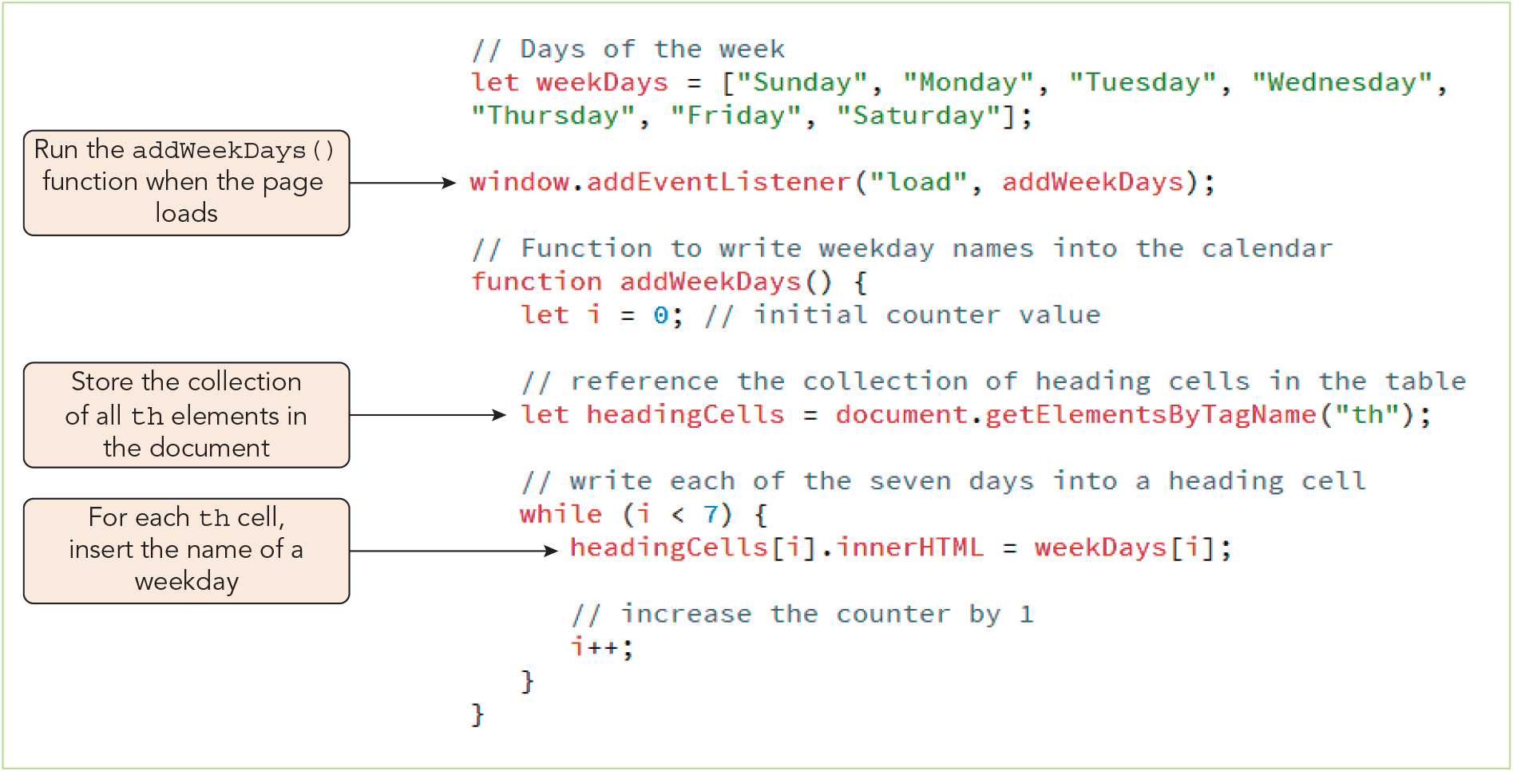
Working with Program Loops (4 of 11)
Figure 3-7 Creating a while loop

Slide 17
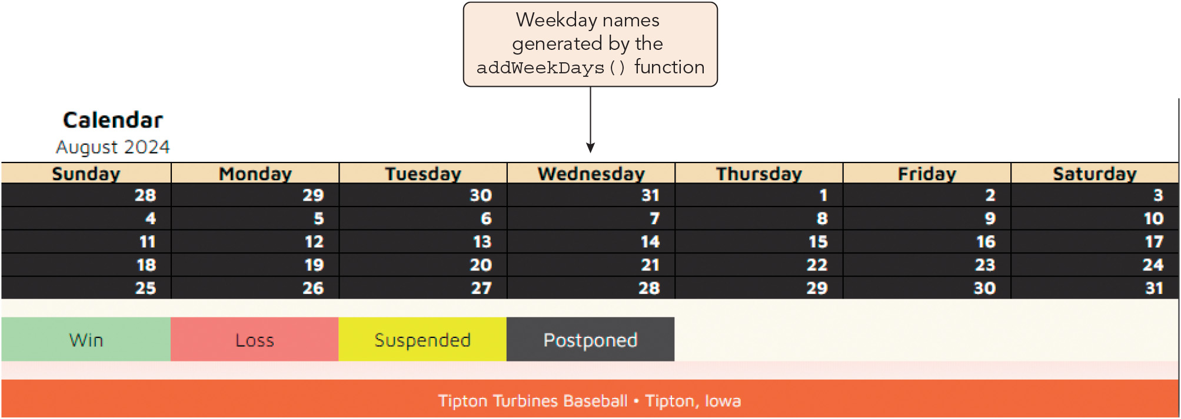
Working with Program Loops (5 of 11)
Figure 3-8 Adding the weekday names to the table

Slide 18
Working with Program Loops (6 of 11)
The do while loop
The while loop is a pretest loop, where the condition is evaluated before each iteration
The do while loop is a posttest loop, where the condition is evaluated after the command block has been executed at least once
Syntax for the do while loop: do { statements; } while (condition);
Aside from the location of the stopping condition, while and do while loops are the same

Slide 19
Working with Program Loops (7 of 11)
The for loop
A pretest loop that places the initial condition, stopping condition, and iterative expression within a single line
Syntax of the for loop: for (initial; condition; iteration) { statements; }
Sample for loop: for (let i = 1; i <= 5; i++) { document.write(i + "<br>"); }
Preferred method for writing loops

Slide 20
Working with Program Loops (8 of 11)
The for loop (continued)
Sample nested for loops (outer loop iterates through a set of table rows, inner loop iterates through a set of table cells within each row): document.write("<table>"); for (let i = 1; i <= 2; i++) { document.write("<tr>"); for (let j = 1; j <= 3; j++) { document.write("<td>" + i + "," + j + "</td>"); } document.write("</tr>"); } document.write("</table>");

Slide 21
Working with Program Loops (9 of 11)
Writing a for loop
Syntax for creating a for loop that iterates through the contents of an array or HTML collection: for (let i = 0; i < objects.length; i++) { statements; }
Sample loop to apply an event handler to every input element in a document: let allInputs = document.getElementsByTagName("input"); for (let i = 0; i < allInputs.length; i++) { allInputs[i].addEventListener("click", checkOrder); }
Method for inserting additional content into an element (not overwriting it): element.insertAdjacentHTML(position, text)
Position is "beforeBegin", "afterBegin", "beforeEnd", or "afterEnd"

Slide 22
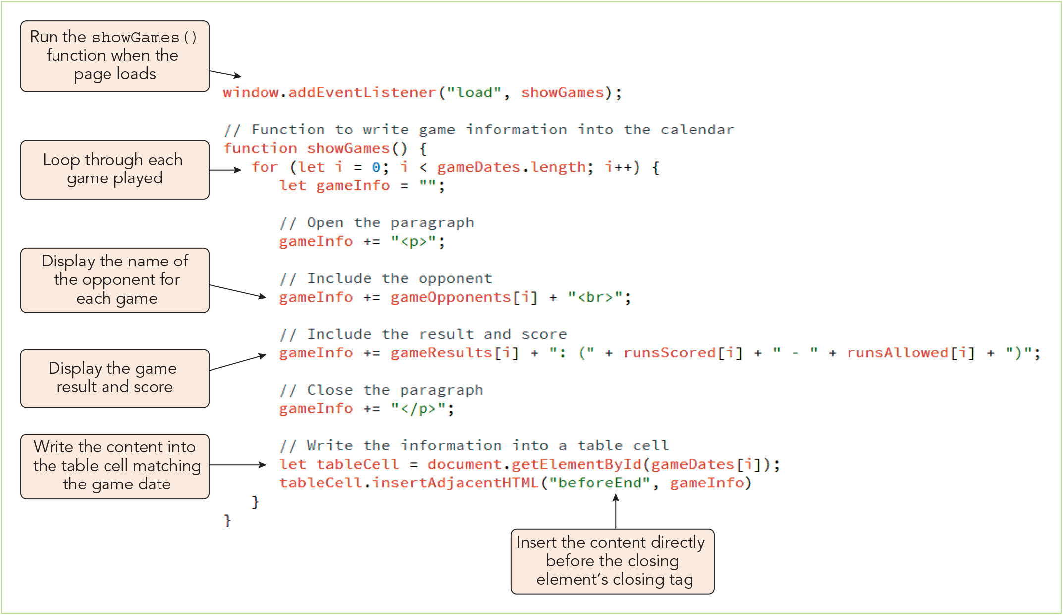
Working with Program Loops (10 of 11)
Figure 3-9 Add information on each game to the calendar

Slide 23
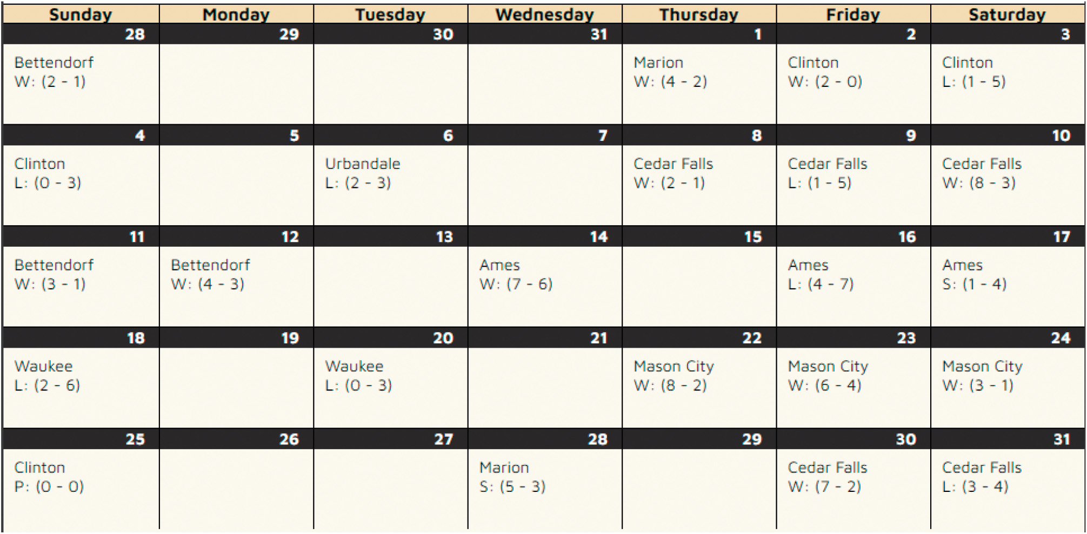
Working with Program Loops (11 of 11)
Figure 3-10 Game data for July and August

Slide 24
Exploring Array Methods for Generating Loops (1 of 4)
Built-in JavaScript array methods can replace program loops, are usually faster, and make code simpler and more compact
Each employs a callback function, a function passed as a parameter to another function or method
For example, the forEach() method calls a function for each array element: array.forEach(callback, thisArg)
Callback function syntax: function callback(arrValue, index, array) { statements; }
To create an efficient loop, place all calculations that will not change during the loop outside of the loop

Slide 25
Exploring Array Methods for Generating Loops (2 of 4)
Example using the forEach() method to change array values from [1, 3, 5, 10] to [6, 8, 10, 15]: let x = [1, 3, 5, 10]; x.forEach(stepUp5); function stepUp5(arrValue, i, arr) { arr[i] = arrValue + 5; }
Parameters in this example:
arrValue: value of the array element at each iteration
i: index number at each iteration
arr: name of the array

Slide 26
Exploring Array Methods for Generating Loops (3 of 4)
Array Method | Description
every(callback, thisArg) | Tests whether the value of the callback function is true for all array elements
filter(callback, thisArg) | Creates a new array populated with the elements of the array that return a value of true from the callback function
forEach(callback, thisArg) | Applies the callback function to each array element
map(callback, thisArg) | Creates a new array by passing the original array elements to the callback function, which returns the mapped value of those elements

Slide 27
Exploring Array Methods for Generating Loops (4 of 4)
Array Method | Description
reduce(callback, thisArg) | Reduces the array by keeping only those elements returning a true value from the callback function
reduceRight(callback, thisArg) | Reduces the array starting from the last element by keeping only those elements returning a true value from the callback function
some(callback, thisArg) | Tests whether the value of callback function is true for at least one array element
find(callback, thisArg) | Returns the value of the first array element returning a true value from the callback function
findIndex(callback, thisArg) | Returns the index of the first array element returning a true value from the callback function

Slide 28
Adding Decision Making to Your Code (1 of 13)
Decision making is the process of choosing which code to execute in response to a circumstance
JavaScript decision-making statements (a.k.a. decision-making structures or conditional statements) are special types of statements used for making decisions
The if statement
Runs a set of statements only if the given condition is true
Syntax, where condition is a Boolean expression that returns true or false: if (condition) { statements }
Sample if statement : if (day === "Friday") { window.alert("Get ready for the Weekend!"); }

Slide 29
Adding Decision Making to Your Code (2 of 13)
The if else statement
Runs one command if the given condition is true or a different command if it is false or falsy
Syntax: if (condition) { statements if condition is true } else { statements if condition is not true }
Sample if else statement: if (day === "Friday") { window.alert("Get ready for the Weekend!"); } else { window.alert("Have a great day!"); }

Slide 30
Adding Decision Making to Your Code (3 of 13)
The else if statements
Include multiple if statements
Only the first if statement whose condition is true is executed
Or if all the if statements' conditions are false, the else statement (default option) is executed
Syntax: if (condition1) { statements if condition1 is true } else if (condition2) { statements if condition2 is true } else { statements if neither condition1 nor condition2 is true }

Slide 31
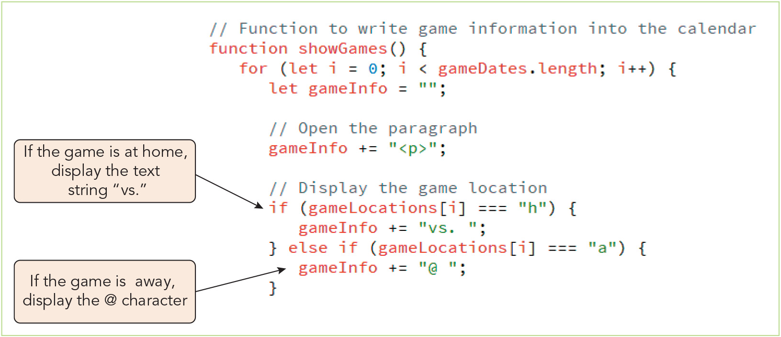
Adding Decision Making to Your Code (4 of 13)
Figure 3-12 Inserting an else if statement

Slide 32
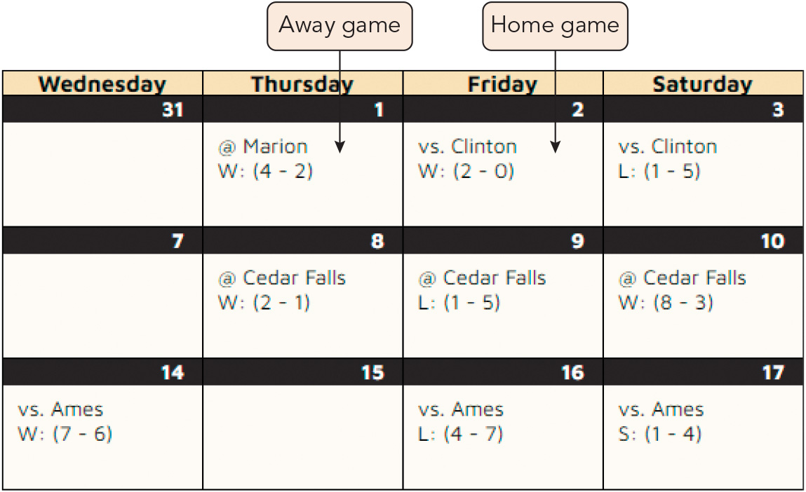
Adding Decision Making to Your Code (5 of 13)
Figure 3-13 Home and away games

Slide 33
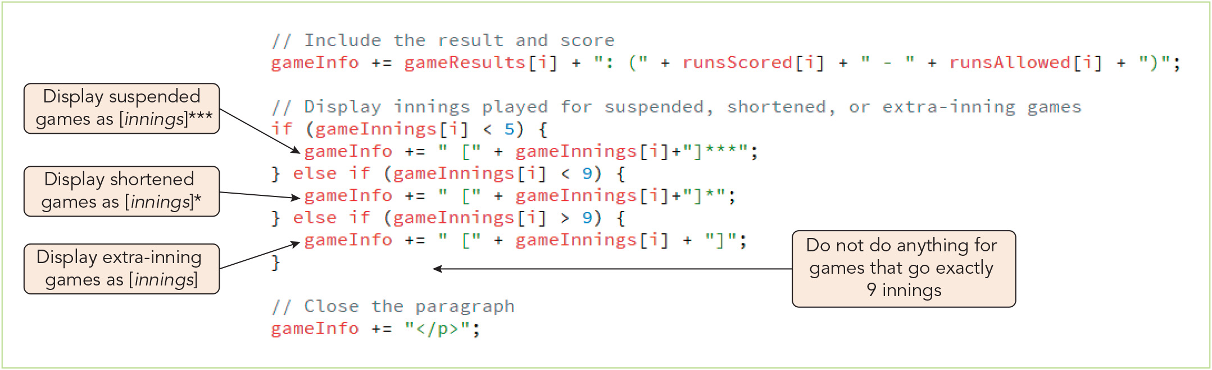
Adding Decision Making to Your Code (6 of 13)
Figure 3-14 Conditional statements based on innings played

Slide 34
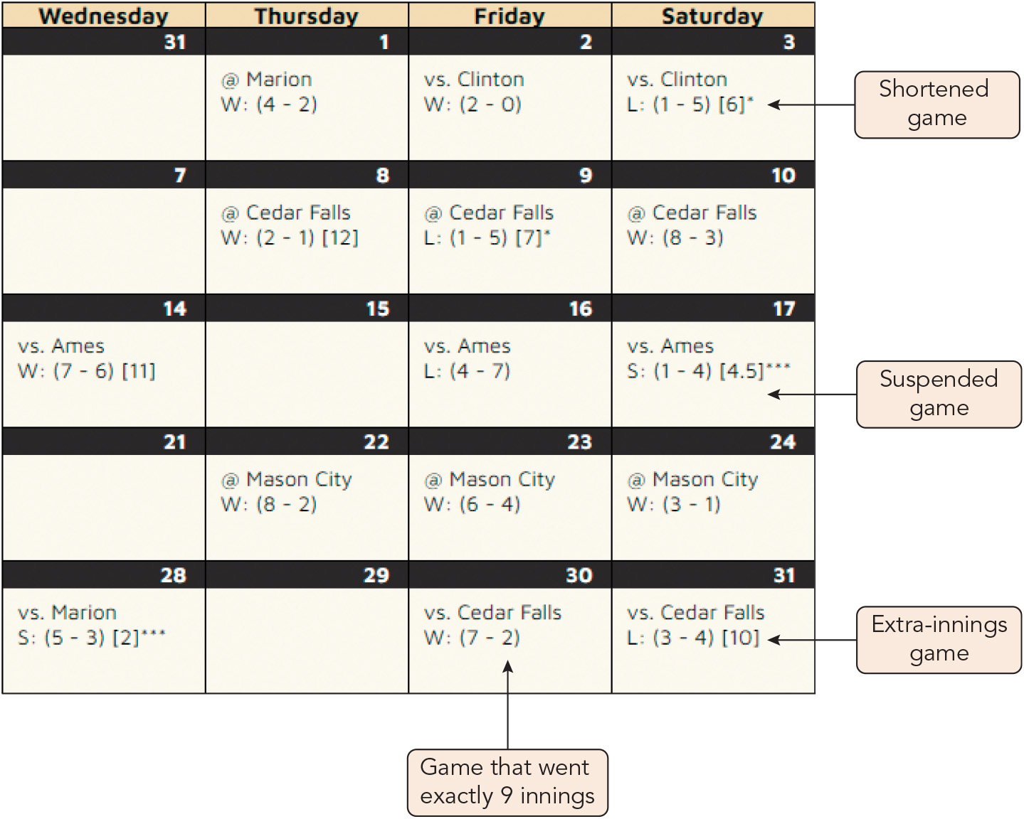
Adding Decision Making to Your Code (7 of 13)
Figure 3-15 Displaying innings played

Slide 35
Adding Decision Making to Your Code (8 of 13)
Nested if and if else statements
Nested decision-making structure: a program structure that creates a series of conditions that all must be true before an action is taken by nesting decision-making statements within one another
Sample nested if statements: if (day === "Friday") { if (time === "8am") { window.alert("Start of the last day of the week."); } else if (time === "5pm") { window.alert("Time to start the weekend!"); } else { window.alert("A few more hours until the weekend."); } } else if (day === "Monday") { window.alert("Start of another work week."); } else { window.alert("Have a great day!"); }

Slide 36
Activity 3.1: Knowledge Check
Characterize the following code snippet and describe what will happen when it runs. for (let i = 1; i < 100; i++) { document.write(i + "<br>"); } document.write("<p>The value of i is equal to " + i + "</p>");
Suppose you want your program to execute command block A if the integer value of the numberOfGuests variable is 15 or fewer, block B if its value is between 16 and 50, block C if its value is between 51 and 150, and block D if its value is 151 or more. Which decision-making structure discussed in Chapter 3 would likely be the best fit?
Notes:
Instructions:
Use the Knowledge Check questions to periodically pose a question to students during class to gauge how well they can recall the material that was presented.

Slide 37
Activity 3.1: Knowledge Check Answers (1 of 3)
Characterize the following code snippet and describe what will happen when it runs. for (let i = 1; i < 100; i++) { document.write(i + "<br>"); } document.write("<p>The value of i is equal to " + i + "</p>"); This begins with a for loop, a type of pretest loop that places the initial condition, stopping condition, and iterative expression within a single line. As a pretest loop, a for loop tests for the stopping condition prior to executing the loop statements with each iteration, and exits once that condition is met. This for loop will count from 1 to 99 and output those numbers (one per line). The program will produce a ReferenceError once the loop exits (when i = 100) because i's scope is limited to the loop block. The value of a counter variable for a for loop can't be accessed outside the loop.
Notes:
Instructions:
Use the Knowledge Check questions to periodically pose a question to students during class to gauge how well they can recall the material that was presented.

Slide 38
Activity 3.1: Knowledge Check Answers (2 of 3)
Suppose you want your program to execute command block A if the integer value of the numberOfGuests variable is 15 or fewer, block B if its value is between 16 and 50, block C if its value is between 51 and 150, and block D if its value is 151 or more. Which decision-making structure discussed in Chapter 3 would likely be the best fit? An else if statement would likely be the best fit in this scenario because you could cover all four possibilities using clauses with conditional expressions containing comparison operators in an appropriate sequence. See the following slide for an example. Using nested if or if else statements would be more complicated, and a switch statement could not readily be used because it is based on discrete values (no comparisons).
Notes:
Instructions:
Use the Knowledge Check questions to periodically pose a question to students during class to gauge how well they can recall the material that was presented.

Slide 39
Activity 3.1: Knowledge Check Answers (3 of 3)
if (numberOfGuests > 150) {
// Command block D statements
} else if (numberOfGuests > 50) {
// Command block C statements
} else if (numberOfGuests > 15) {
// Command block B statements
} else {
// Command block A statements
}
Notes:
Instructions:
Use the Knowledge Check questions to periodically pose a question to students during class to gauge how well they can recall the material that was presented.

Slide 40
Adding Decision Making to Your Code (9 of 13)
Conditional statements and browser testing
Program code should be supported by various users' browsers
Browser tests either confirm a feature of ECMAScript is supported or provide alternate statements if it is not
Allow the most current features to be applied where supported and older features to be used when necessary
Syntax, where feature is a JavaScript object, property, or method to test: if (feature) { statements that use the feature } else { statements that use replacement code }

Slide 41
Adding Decision Making to Your Code (10 of 13)
Conditional statements and browser testing
Sample browser test for the find() method: // array of order ids let orders = ["33-104", "21-098", "88-001", "14-791"]; // find the first order that has not shipped if (orders.find) { // the find method is supported by the browser let firstUnshipped = orders.find(unshipped); } else { // alternate code in place of the find method } function unshipped(arrValue) { // callback function to determine whether an order has shipped }

Slide 42
Adding Decision Making to Your Code (11 of 13)
The switch statement
Syntax, where expression is a statement that returns a value and label1, label2, etc. are possible values it returns: switch (expression) { case label1 : statements; break; case label2 : statements; break; case label3 : statements; break; … default: statements; break; }
The optional break statement halts execution of the switch statement once a matching case has been found
Without the break statement, fallthrough occurs—all case statements where a match is found will execute

Slide 43
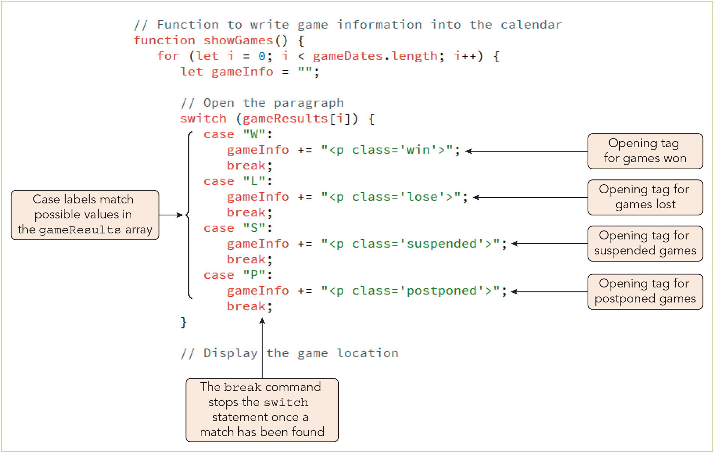
Adding Decision Making to Your Code (12 of 13)
Figure 3-16 Creating a switch statement

Slide 44
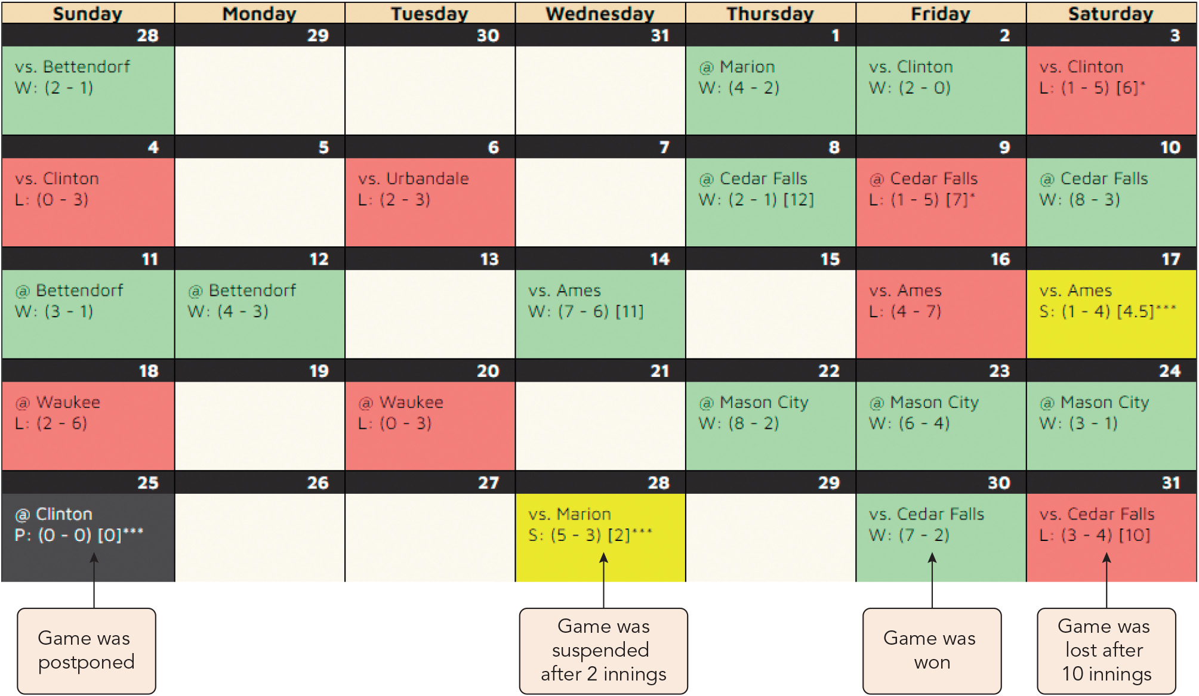
Adding Decision Making to Your Code (13 of 13)
Figure 3-17 Final monthly calendar for the Tipton Turbines

Slide 45
Managing Program Loops and Conditional Statements (1 of 2)
The break statement
Directs code execution to the next set of statements
Useful for exiting a loop when the goal is achieved before the stopping condition is met
The continue statement
Stops the current iteration of a loop and continues to the next iteration
Useful for skipping an iteration of a loop (e.g., to avoid undefined values that would cause program failure)
Example that skips undefined values when iterating over an array: for (let i = 0; i< customerEmail.length; i++) { if (customerEmail[i] === undefined) { continue; } else { // statements to process the e-mail address } }

Slide 46
Managing Program Loops and Conditional Statements (2 of 2)
Statement labels
Identify statements in the code so that they can be referenced elsewhere in the program
Useful when you need to exit a loop/nested loop early and direct the program flow to a specific set of statements rather than the next statement in sequence
Syntax is label: statements
Reference syntax is break: label; or continue: label;
Many developers discourage the use of label statements unless absolutely necessary in order to reduce the risk that the program will become spaghetti code

Slide 47
Activity 3.2: Think, Pair, and Share
Form pairs/groups of two to four class members.
Your group will write a small program to manipulate array elements and display them on a web page. First, choose a theme for your data and write code to declare four arrays and populate them with equal numbers of elements—at least five per array. For instance, your arrays might contain text strings representing the names of flowers of four colors: red, blue, yellow, and purple.
Next, write code to write the arrays to a web page as the four rows of a table using a program loop(s).
Finally, add an alternate block of statements that displays the array data in an appropriate non-tabular format and a decision-making structure to your code. The decision-making structure will determine whether the program displays the array data as a table or in the other format (i.e., which of the alternate command blocks to run).
Notes:
Instructions:
Use the Think, Pair, Share activity to encourage students to solve problems collaboratively and to apply the real-world skill of evaluating, modifying, and debugging code created by another programmer.

Slide 48
Activity 3.3: Discussion Questions
What are the differences between decision-making statements and loop statements?
Is it necessary to use nested decision-making statements? Explain your reasoning. In what programming situations, if any, are nested decision-making statements useful?
Notes:
Instructions:
Use the Discussion activity to encourage group conversation about a related topic of interest.

Slide 49
Self-Assessment
How or in what situations do you expect that you will use JavaScript arrays to store data? If you have used arrays in other programming languages, how will your use of them in JavaScript be similar or different and why?
How have you used HTML collections in web page development previously? Describe how the techniques you learned from Chapter 3 can improve or enhance your code that manipulates HTML elements.
Chapter 3 demonstrated several key program control structures. Which of these were most and least familiar to you, and which do you like best? Which do you expect to rely on most often when involved in professional web development?
Notes:
Instructions:
Use the Self-Assessment question to encourage students to evaluate their progress or goals in the course, as well as determine how they might apply their learning or grow as an individual.

Slide 50
Summary
Now that the lesson has ended, you should have learned to:
Create an array containing a list of data values.
Access a collection of HTML elements by type.
View arrays and HTML collections using the browser console.
Create program loops using while, do while, and for loops.
Explore array methods to replace program loops.
Make decisions with if statements and switch statements.
Manage program loops and conditional statements with the break, continue, and label commands.
Notes:
Instructions: Reiterate the learning objectives for the lesson. Students should use this information to guide their studies and reinforcement of new concepts.

