Slide 1
JavaScript for Web Warriors, 7e Chapter 4: Debugging and Error Handling

Slide 2
Chapter Objectives (1 of 2)
By the end of this chapter, you should be able to:
Understand four different types of errors that programmers must deal with.
Use the debugger console to locate errors in a program.
Use JavaScript in strict mode.
Trace an error to its source.
Notes:
Instructions: Briefly review with students the major concepts you will be covering during this class. There is one objective for every major A-head section of the chapter.

Slide 3
Chapter Objectives (2 of 2)
By the end of this chapter, you should be able to:
Track the flow of your program using debugger tools.
Manage errors in your code using a try catch statement.
Control how a browser handles errors.
Notes:
Instructions: Briefly review with students the major concepts you will be covering during this class. There is one objective for every major A-head section of the chapter.

Slide 4
Introduction to Debugging (1 of 6)
To write a program in JavaScript, you must understand:
JavaScript's syntax (rules)
Computer-programming logic (how to arrange operations to achieve a program's intended goal)
Bug: any error in a program's syntax or logic that causes it to function incorrectly
Debugging: the act of tracing and resolving errors in a program
Load-time errors
Load-time errors (a.k.a. syntax errors) occur when the program is initially loaded by the browser
Sample load-time errors (misspelled keyword and missing closing brace): Function sayHello() { let message = "Hello World"; window.alert(message);

Slide 5
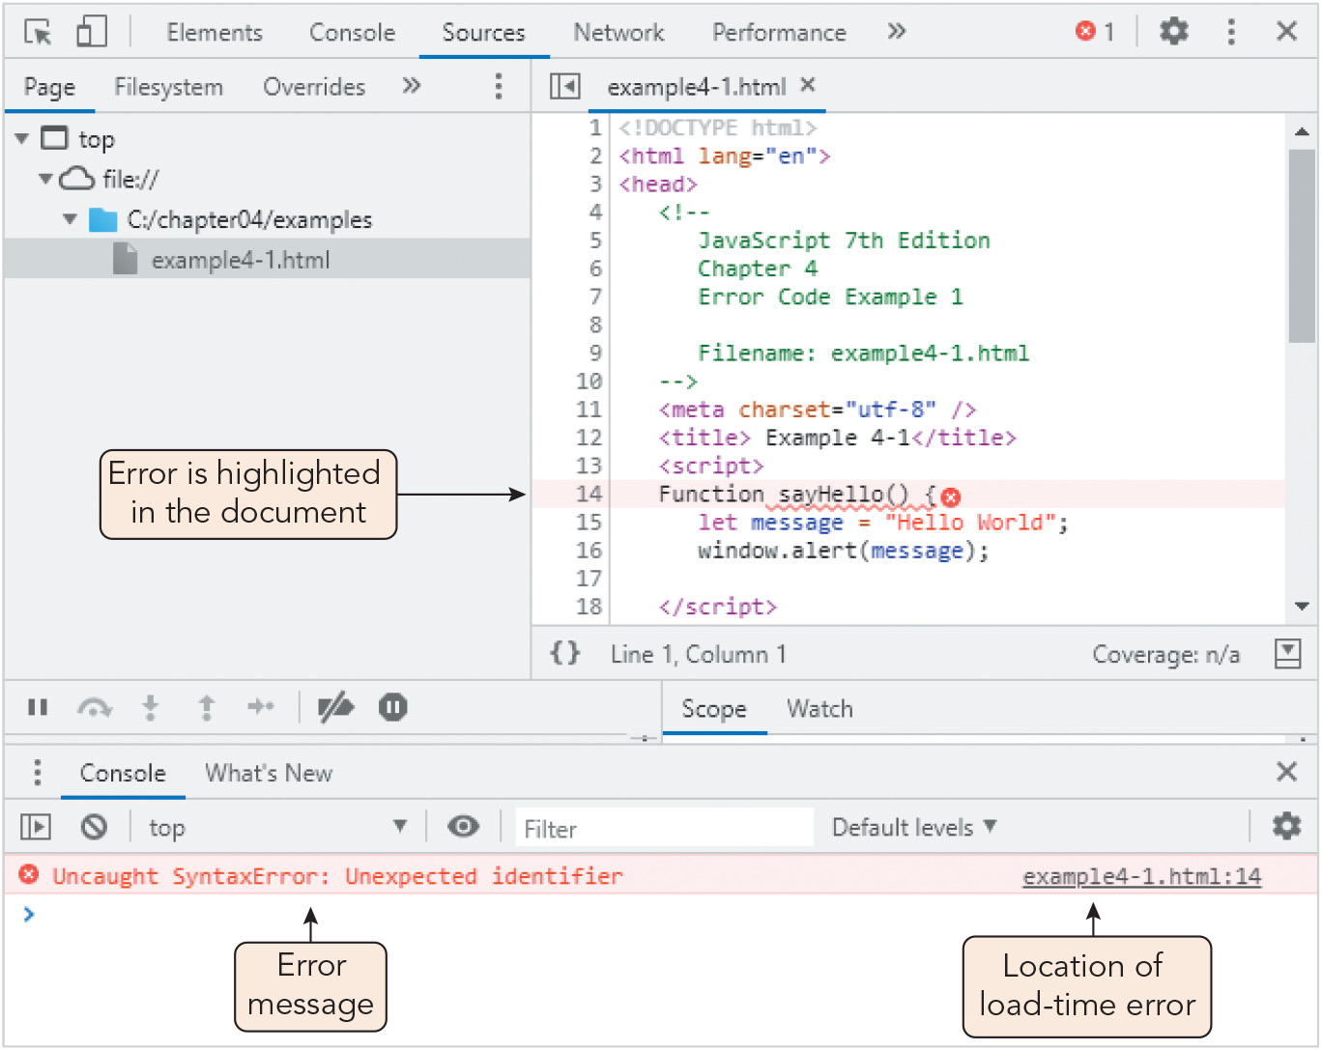
Introduction to Debugging (2 of 6)
Figure 4-1 Load-time error viewed in the Chrome browser console

Slide 6
Introduction to Debugging (3 of 6)
Runtime errors
Runtime errors occur when the interpreter is unable to run the code
Typical causes: attempting to reference an undeclared function or variable, using an undefined value in an expression, illegal mathematical operations
Sample runtime errors (referencing variables outside their scope): function defineVariables() { let pct = 25; // percent value let amt = 1600; // amount value } function calculatePercent() { let result = amt * pct/100; document.write("<p>" + pct + "% of " + amt + " is: "); document.write(result + "</p>"); } defineVariables(); calculatePercent();

Slide 7
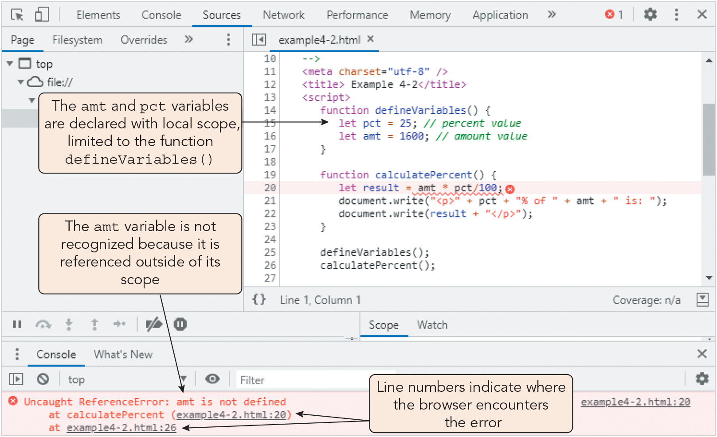
Introduction to Debugging (4 of 6)
Figure 4-2 Runtime error viewed in the Chrome browser console

Slide 8
Introduction to Debugging (5 of 6)
Logic errors
A logic error is a flaw in a program's design that prevents the program from reaching its intended goal
The syntax and statements are correct in themselves but the result is wrong
Sample logic errors (only 2/3 of outcomes are correctly handled): function compareValues(a, b) { if (a > b) { window.alert(a + " is greater than " + b); } else { window.alert(a + " is less than " + b); } }
Linting: sending code through a third-party program that analyzes it and produces a detailed error report

Slide 9
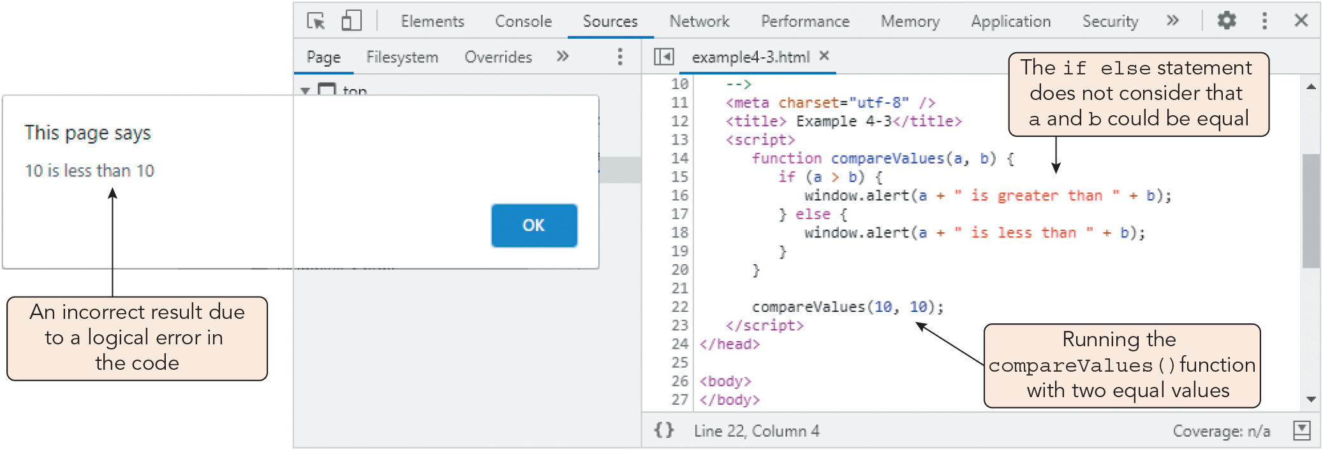
Introduction to Debugging (6 of 6)
Figure 4-3 Logic error viewed in the Chrome browser console

Slide 10
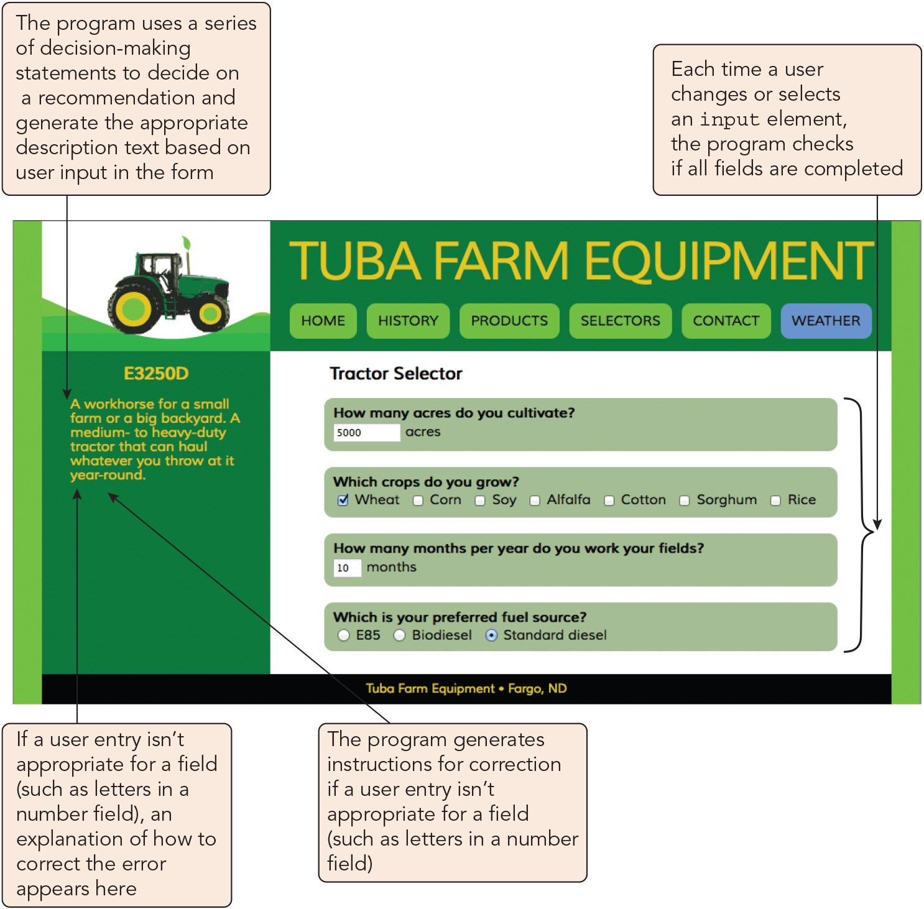
Starting Debugging with the Browser Console (1 of 5)
Figure 4-4 Tuba Farm Equipment page

Slide 11
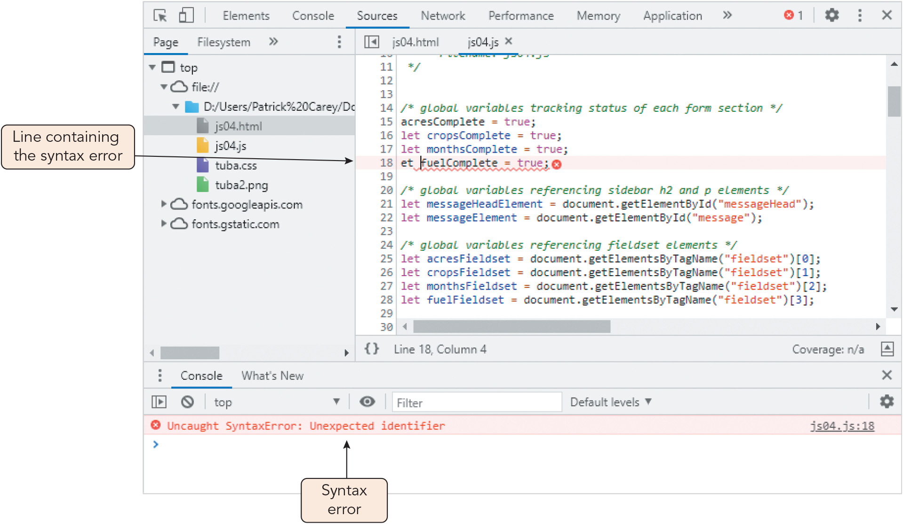
Starting Debugging with the Browser Console (2 of 5)
Figure 4-5 Syntax error in the js04.js file

Slide 12
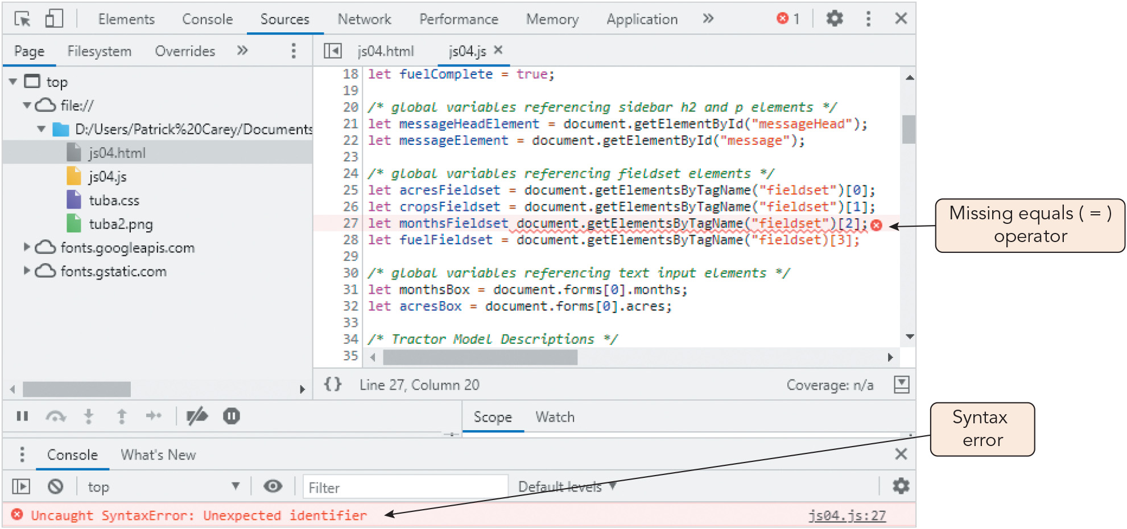
Starting Debugging with the Browser Console (3 of 5)
Figure 4-6 Syntax error declaring a variable

Slide 13
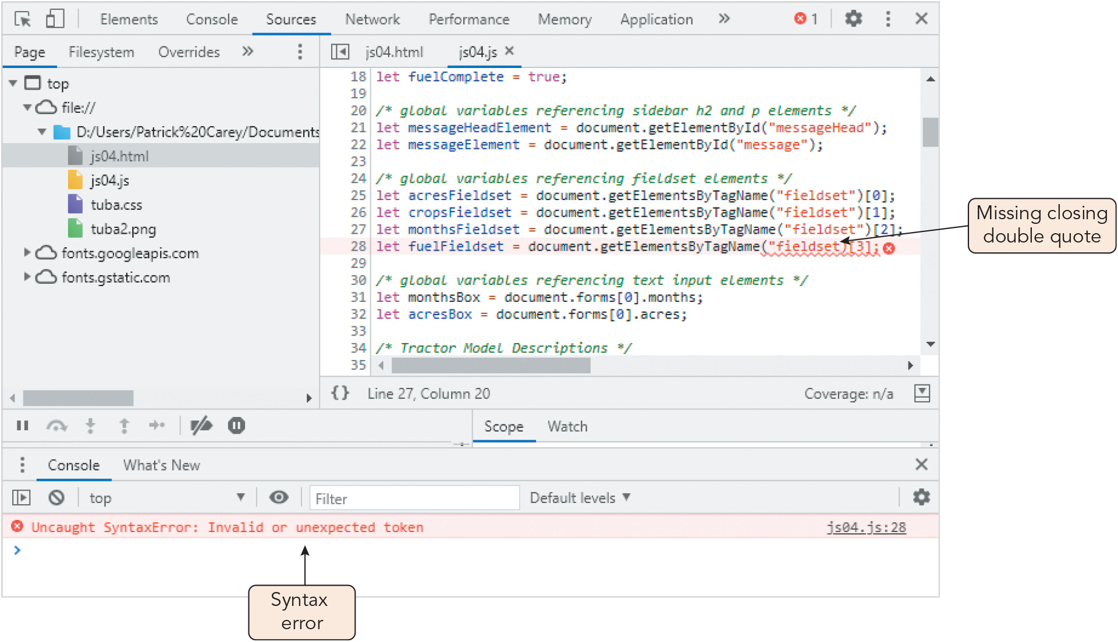
Starting Debugging with the Browser Console (4 of 5)
Figure 4-7 Syntax error with the getElementBy TagName() method

Slide 14
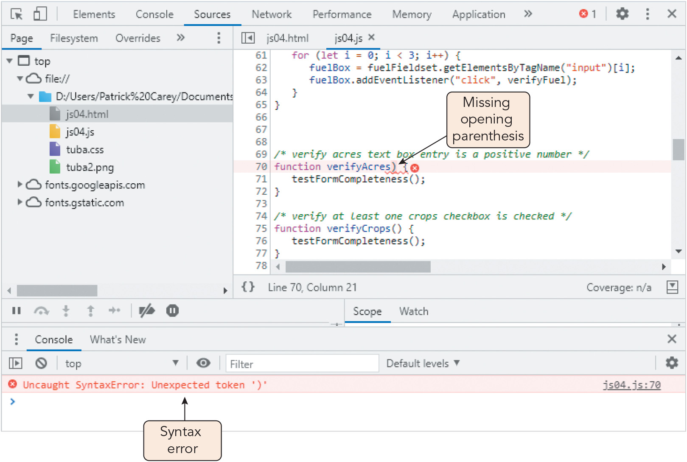
Starting Debugging with the Browser Console (5 of 5)
Figure 4-8 Syntax error declaring a function

Slide 15
Running JavaScript in Strict Mode (1 of 2)
JavaScript interpreters are very forgiving of lapses in syntax and structure
JavaScript's strict mode enforces strict adherence to syntax (marks lapses as errors)
Run a program in strict mode by adding "use strict"; to the beginning of the code
Common error messages:
Uncaught TypeError: cannot read properly
TypeError: 'undefined' is not an object
TypeError: null is not an object
TypeError: object doesn't support property
Uncaught TypeError: cannot set property
ReferenceError: object is not defined

Slide 16
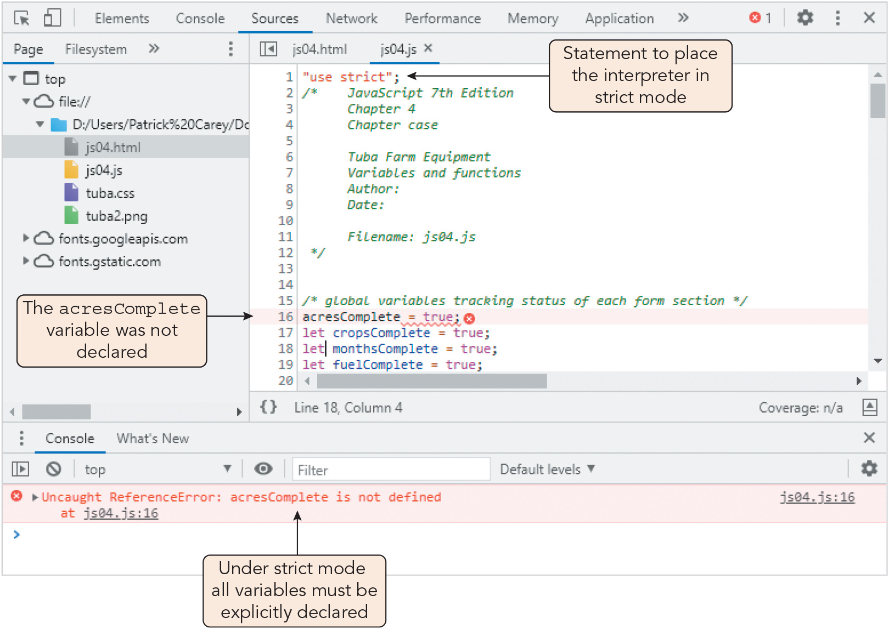
Running JavaScript in Strict Mode (2 of 2)
Figure 4-9 Syntax error under strict mode

Slide 17
Tracing Errors to Their Source (1 of 10)
Tracing errors with the window.alert() method
Tracing: the examination of individual statements in an executing program
Displaying alert boxes at different points in a program to show partial results of a function is one method of tracing logic errors
Statements used to trace code should be placed at a different level of indentation to make them easier to find and remove after debugging
Limitations of this method:
Alert boxes interfere with normal operation and must be deleted after debugging
Alert boxes perform poorly in tracing a long sequence of operations
You cannot compare the contents of alert boxes since only one is visible at a time

Slide 18
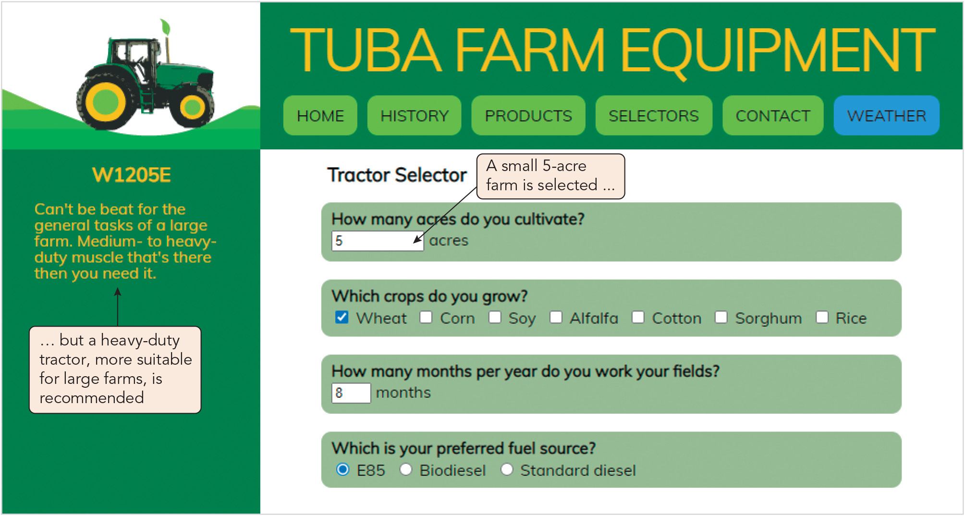
Tracing Errors to Their Source (2 of 10)
Figure 4-11 Logic error in selecting a tractor model

Slide 19
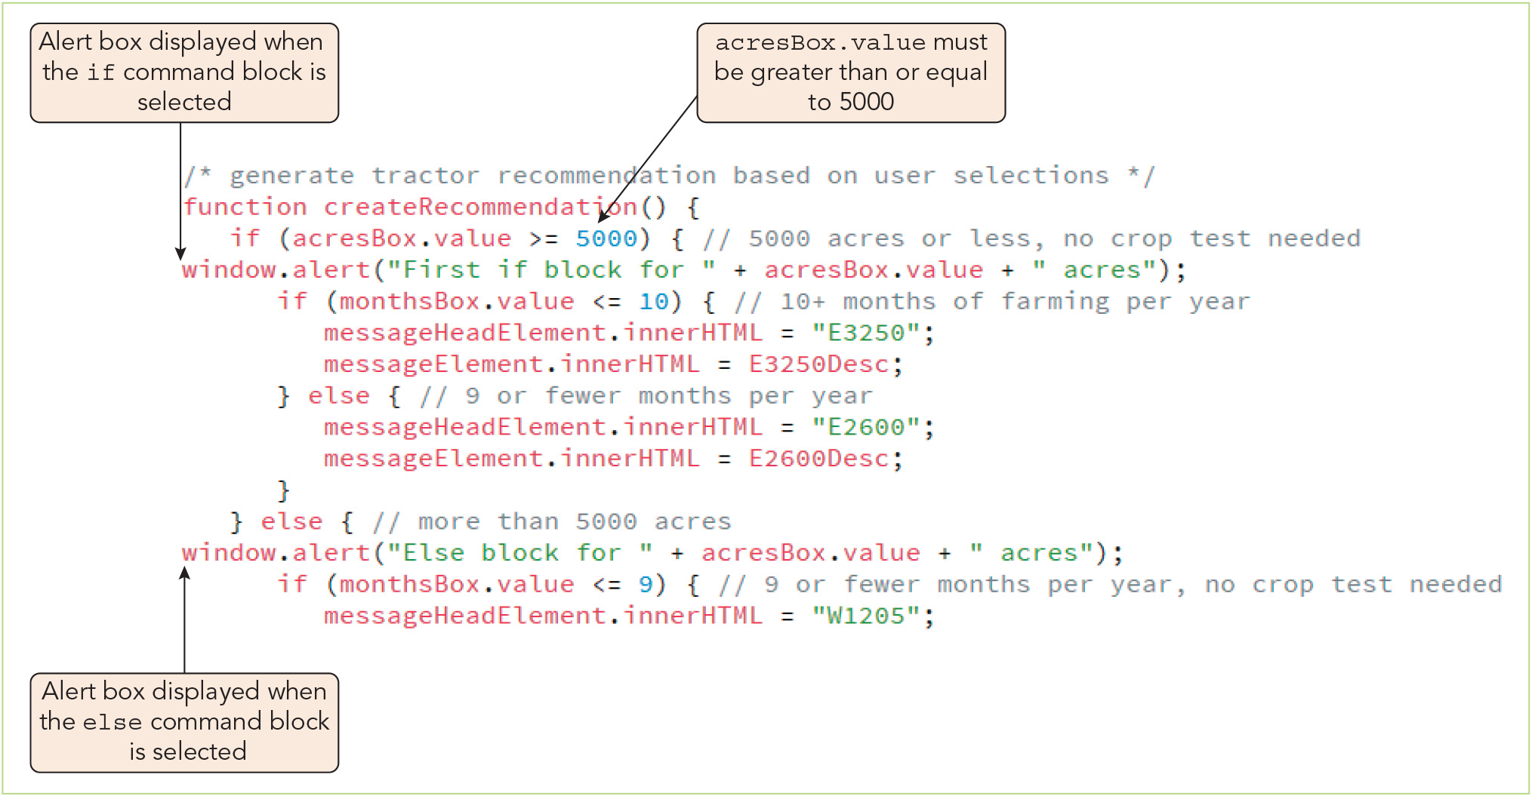
Tracing Errors to Their Source (3 of 10)
Figure 4-12 Tracing a logic error with alert boxes

Slide 20
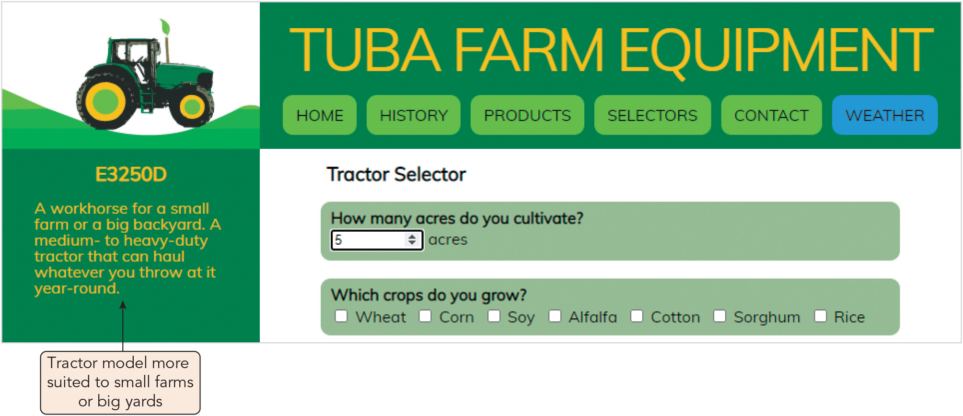
Tracing Errors to Their Source (4 of 10)
Figure 4-13 Selecting a tractor model for a small farm

Slide 21
Tracing Errors to Their Source (5 of 10)
Tracing errors with the console log
Logging (writing) the changing values used in a program in the console log as the program runs is a second tracing strategy
Method, where text is a string that will be written to the console: console.log(text)
Advantages over window.alert() method:
Does not impede program operation (though it might slow it in some cases)
Progression of values is retained in the log for easy viewing/comparison
Console links to the location of each console.log method
Sometimes used in a driver program, a simplified, temporary program used to for testing functions and other code in isolation

Slide 22
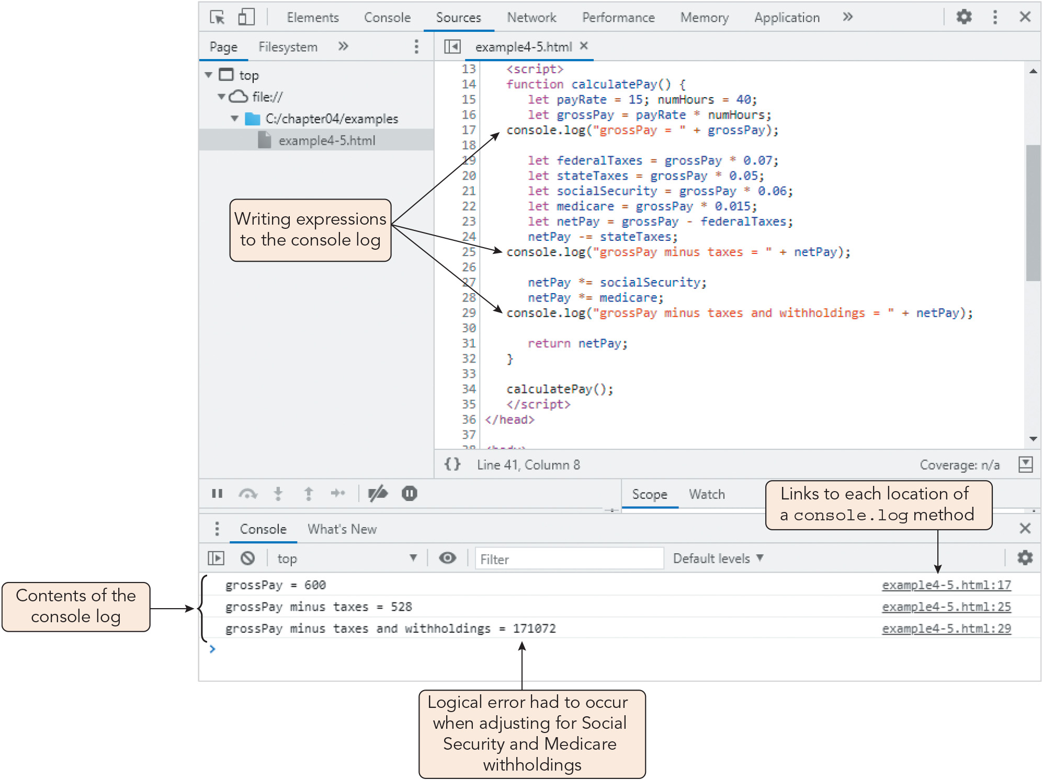
Tracing Errors to Their Source (6 of 10)
Figure 4-14 Using the console log to trace program values

Slide 23
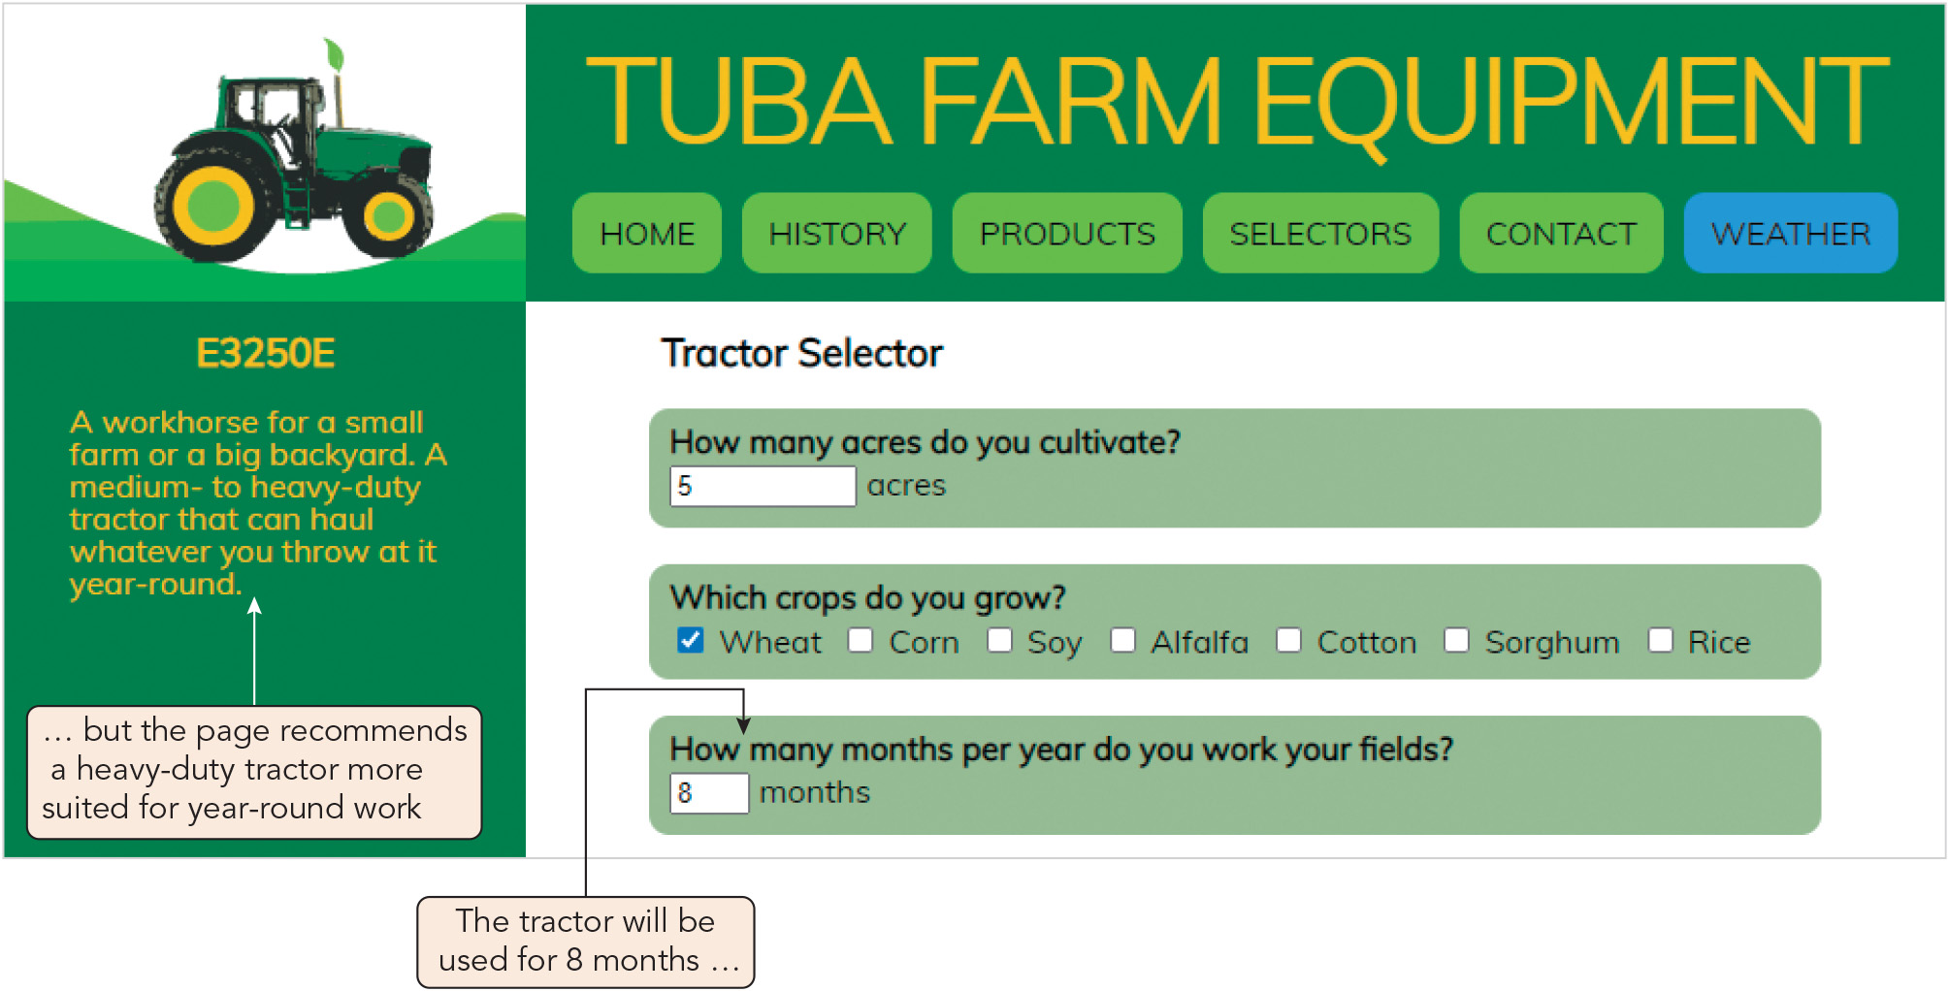
Tracing Errors to Their Source (7 of 10)
Figure 4-15 Logic error in selecting a tractor model for the number of months

Slide 24
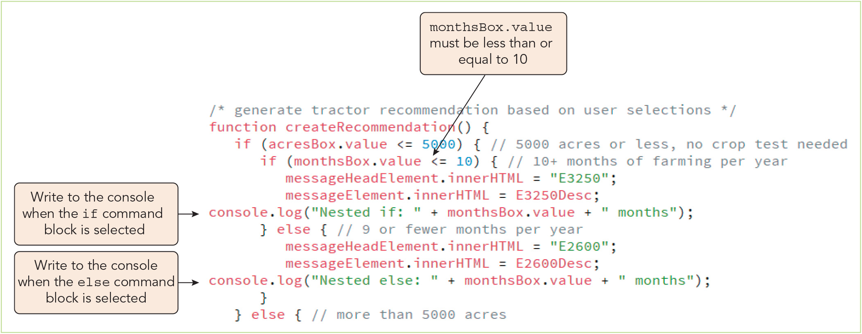
Tracing Errors to Their Source (8 of 10)
Figure 4-16 Tracing a logic error with the console log

Slide 25
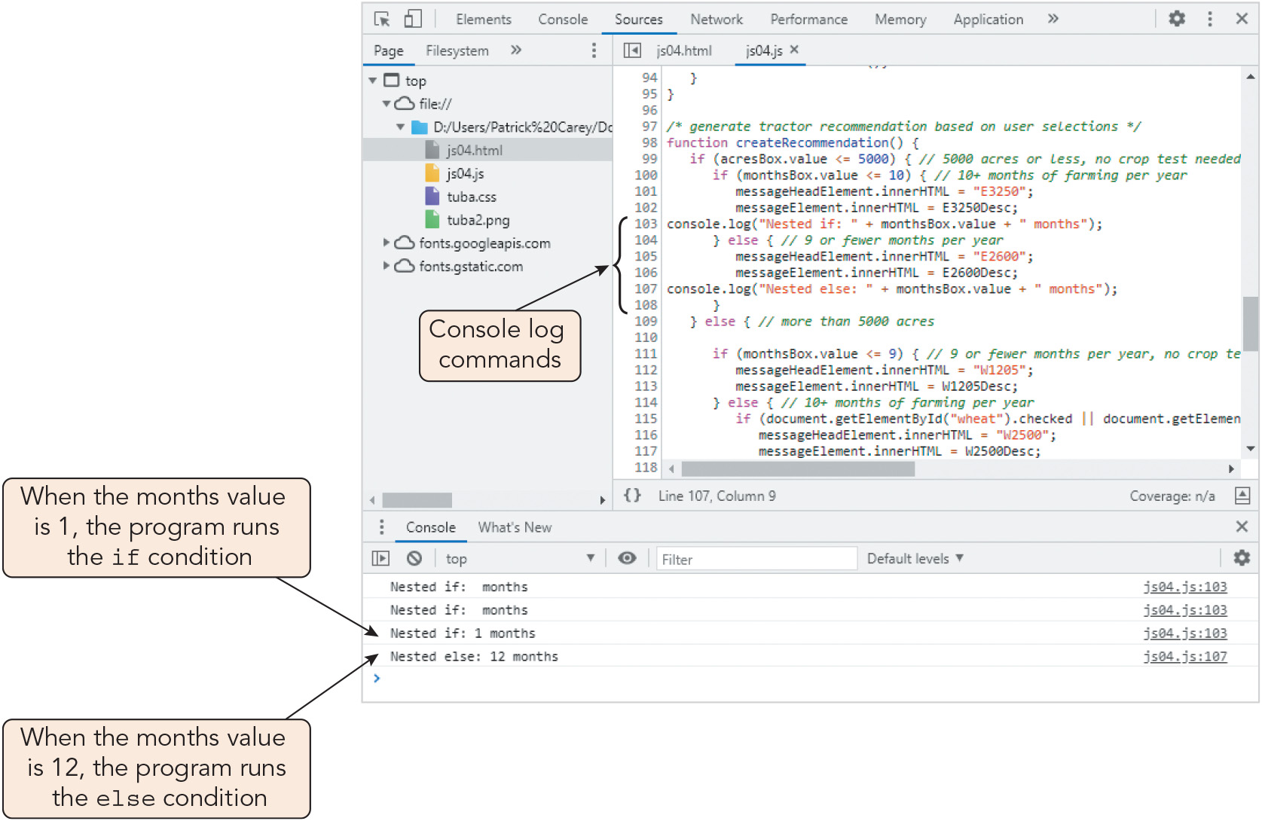
Tracing Errors to Their Source (9 of 10)
Figure 4-17 Console log entries

Slide 26
Tracing Errors to Their Source (10 of 10)
Using comments to locate bugs
Commenting out code: identifying lines that may be causing problems and transforming them into comments by adding // to the start of each line or enclosing a block of statements within the /* and */ characters
If the code runs successfully after the lines are commented out, this indicates the problem lies within that section
Dependencies add an extra layer of complexity to debugging
Dependencies: relationships among statements and the other statements or functions whose successful execution they depend upon
Errors may propagate
Fixing one error may expose or create others, so related functionality must be retested after debugging

Slide 27
Activity 4.1: Knowledge Check
What are the three general types of program errors you must be prepared to debug? Name, describe, and list some common causes in JavaScript for each.
Suppose your program's results are incorrect and you need to modify it so that it functions correctly. How can you trace the problem(s) quickly without making changes to your program that will need to be reverted afterward?
Notes:
Instructions:
Use the Knowledge Check questions to periodically pose a question to students during class to gauge how well they can recall the material that was presented.

Slide 28
Activity 4.1: Knowledge Check Answers (1 of 2)
What are the three general types of program errors you must be prepared to debug? Name, describe, and list some common causes in JavaScript for each.
Load-time errors (syntax errors): These occur when the program is initially loaded by the browser, when the interpreter flags syntax errors in the code. Common causes of JavaScript load-time errors include misspelling keywords, omitting closing curly braces, or omitting quotation marks around strings.
Runtime errors: These occur when the interpreter attempts to run code that has been successfully loaded but cannot. Typical causes include attempting to reference a function or variable that has not been declared, using an undefined value in an expression, or performing an illegal mathematical operation.
Logic errors: These are flaws in a program's design that prevent it from reaching its intended goal; in other words, a program with logic errors runs successfully but does something different from what was intended. Typical causes include incorrectly ordering essential steps, omitting a step, or misinterpreting data.
Notes:
Instructions:
Use the Knowledge Check questions to periodically pose a question to students during class to gauge how well they can recall the material that was presented.

Slide 29
Activity 4.1: Knowledge Check Answers (2 of 2)
Suppose your program's results are incorrect and you need to modify it so that it functions correctly. How can you trace the problem(s) quickly without making changes to your program that will need to be reverted afterward? A program that runs successfully but yields incorrect results likely contains logic errors. An appropriate strategy would be to trace the errors using the console.log() method to write expressions to the console at several points during the program's execution. For example, writing messages noting the values of variables as they change to the console shows the intermediate results so that you can locate where things go wrong and check that part of the program for logic errors. These extra statements can be left in the program if desired without changing how it functions. Alternatively, you could copy the portion of the code you suspect is causing the problem into a separate driver program and comment out different lines or sections to see how this affects the execution or results. Once you locate the problem(s), you can return to the original program file to make corrections.
Notes:
Instructions:
Use the Knowledge Check questions to periodically pose a question to students during class to gauge how well they can recall the material that was presented.

Slide 30
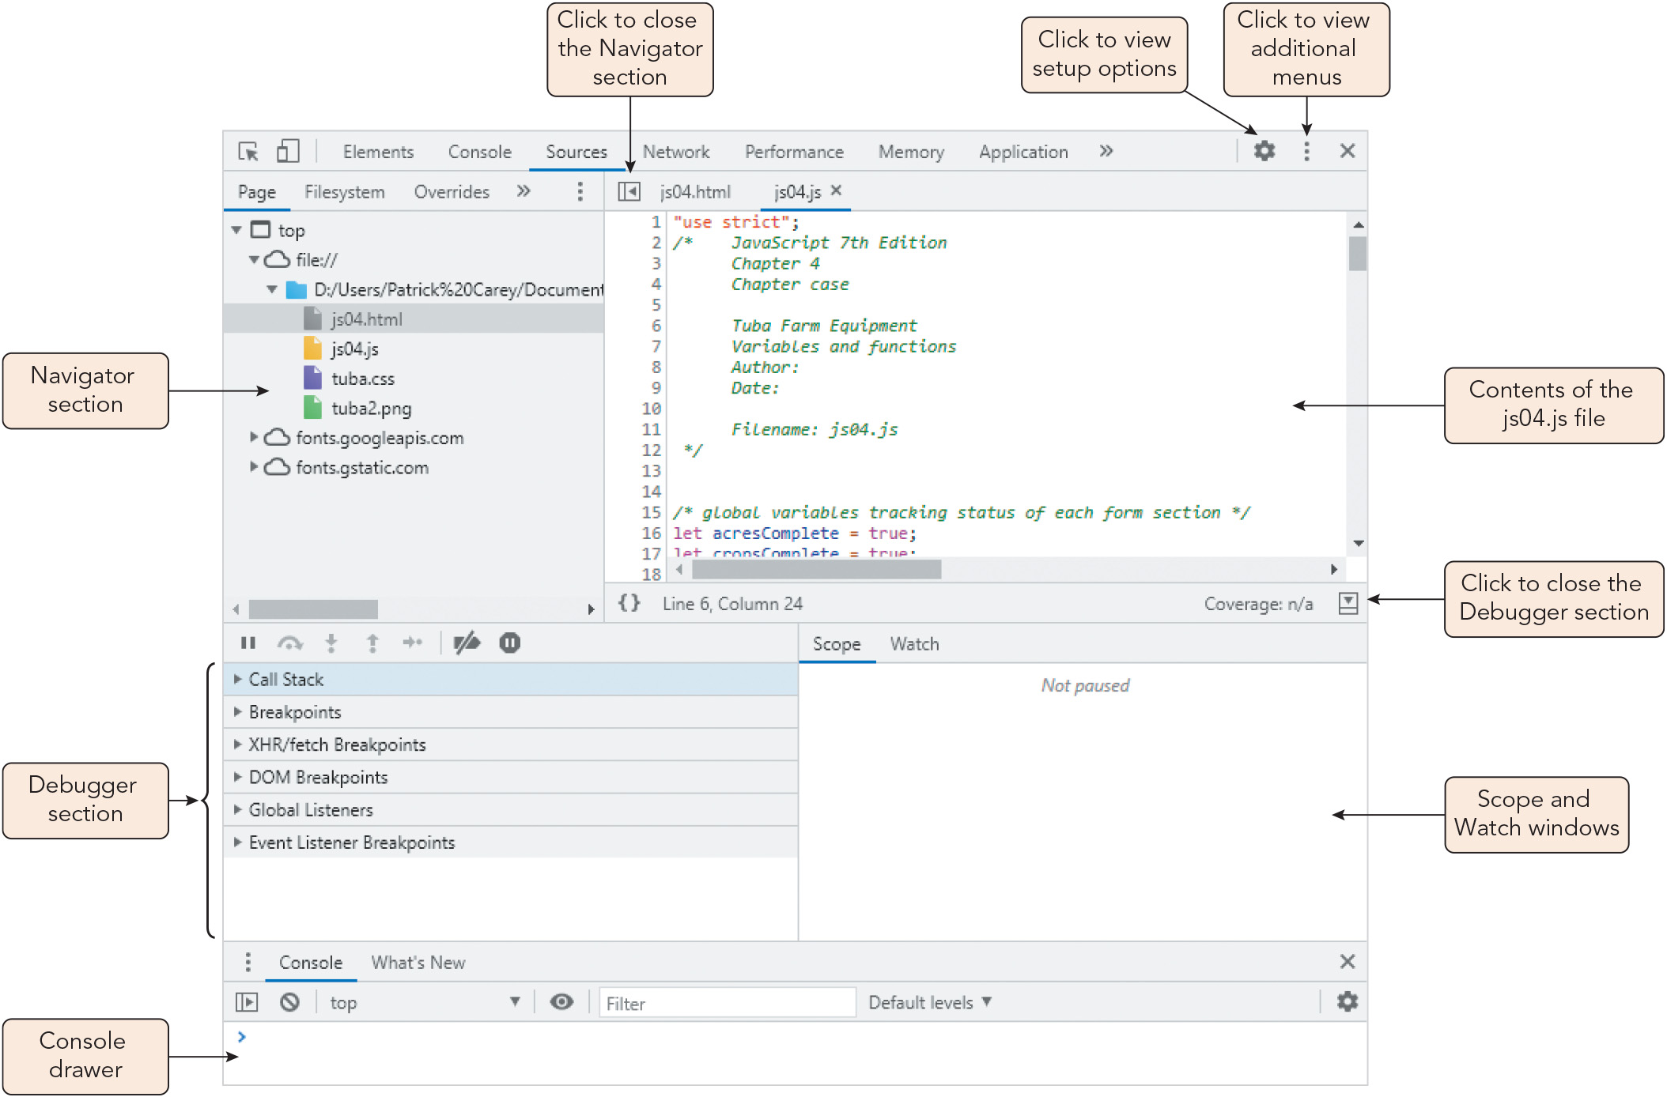
Tracking Program Flow with Debugging Tools (1 of 11)
Figure 4-19 Developer pane in Google Chrome

Slide 31
Tracking Program Flow with Debugging Tools (2 of 11)
Adding and removing break points
Break mode: mode for running a program in which execution is suspended to allow the programmer to review the current state of variables and functions
Breakpoints selected by the programmer mark locations where execution is suspended
Breakpoints are typically added or removed by clicking line numbers
Event listener breakpoints are activated when an event occurs within the web page or browser, and are enabled with a dialog box

Slide 32
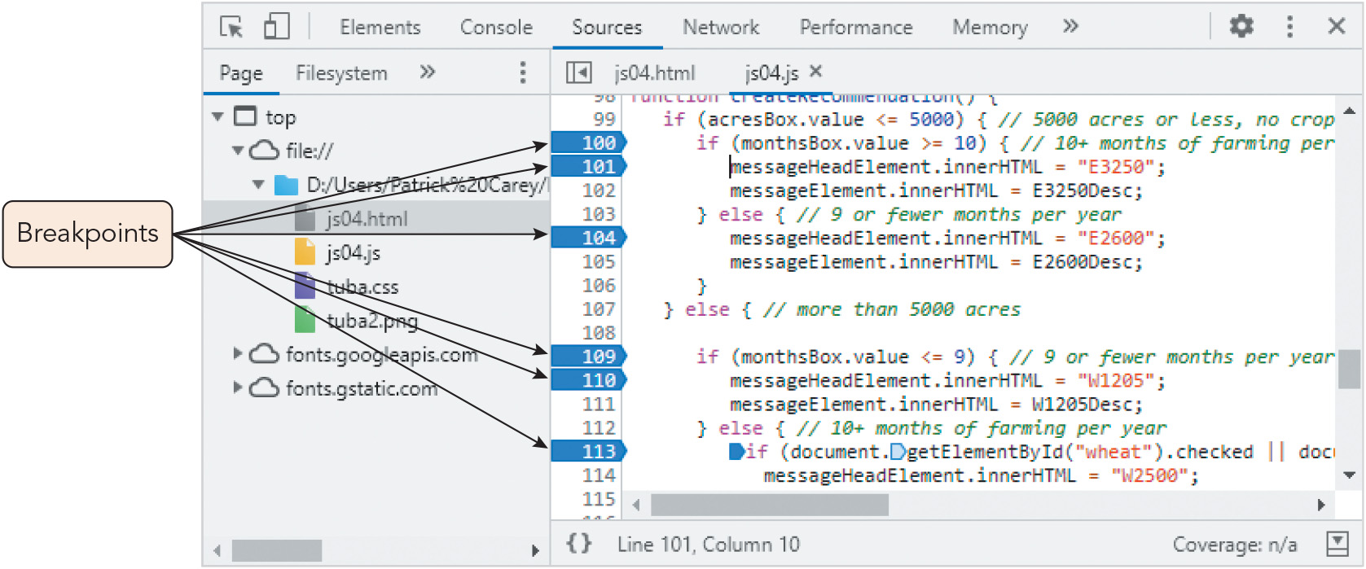
Tracking Program Flow with Debugging Tools (3 of 11)
Figure 4-20 Adding breakpoints to the debugger

Slide 33
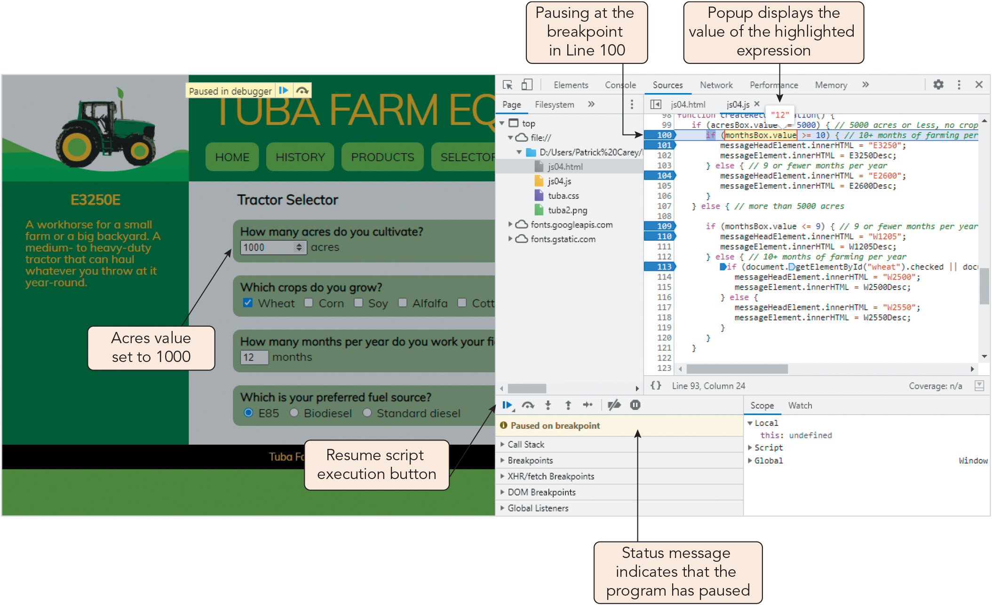
Tracking Program Flow with Debugging Tools (4 of 11)
Figure 4-21 Pausing at a breakpoint

Slide 34
Tracking Program Flow with Debugging Tools (5 of 11)
Stepping through the program execution
Debuggers provide stepping options that control how you step through the code
When you step in (step into) the code, any function called by the program is traced by the debugger one step at a time
You can step over functions you don't need to evaluate in detail
You can step out of the code to execute the remainder without pause
You can insert breakpoints directly into a program by adding the statement debugger;

Slide 35
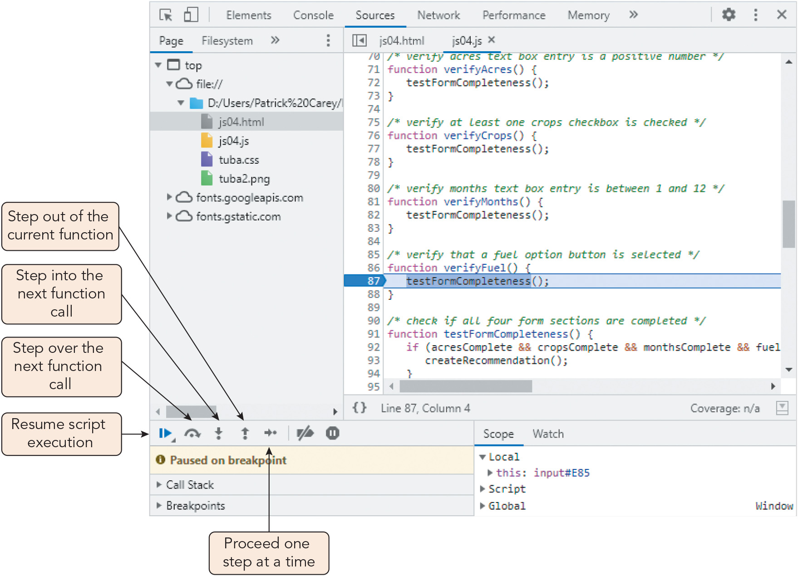
Tracking Program Flow with Debugging Tools (6 of 11)
Figure 4-22 Stepping into a function

Slide 36
Tracking Program Flow with Debugging Tools (7 of 11)
Tracking variables and expressions
The debugger's Scope window lists all the local and global variables and objects available to the program and their current values
List updates as the program executes
Alternatively, you can add a variable or expression you wish to track to the Watch window

Slide 37
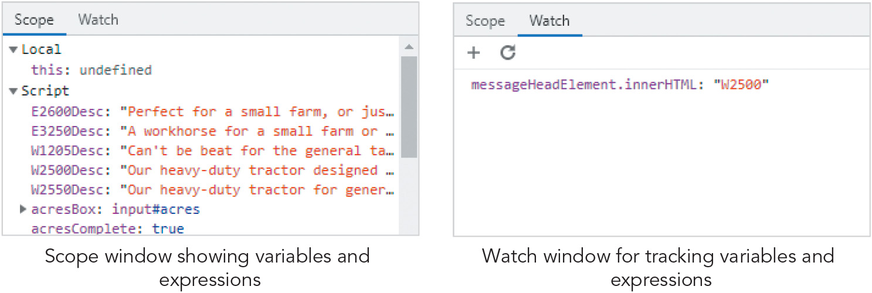
Tracking Program Flow with Debugging Tools (8 of 11)
Figure 4-23 The Scope and Watch windows

Slide 38
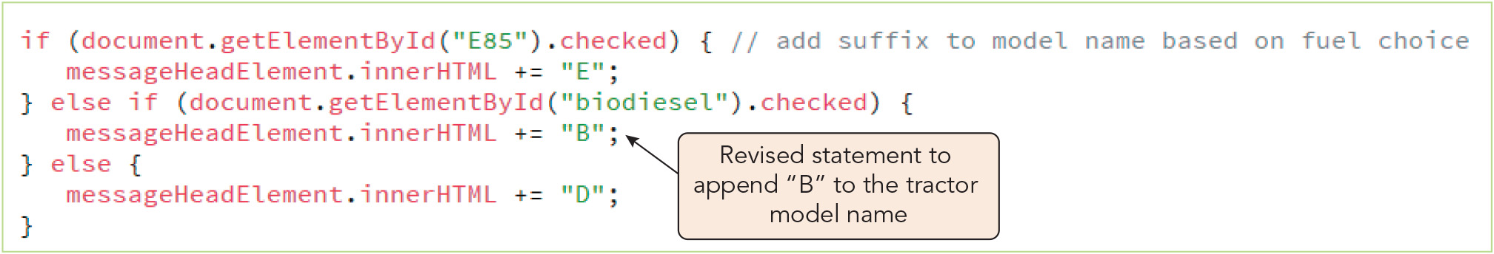
Tracking Program Flow with Debugging Tools (9 of 11)
Figure 4-24 Fixing a logical error

Slide 39
Tracking Program Flow with Debugging Tools (10 of 11)
Examining the call stack
Debugger's call stack lists the functions currently running, displayed in a hierarchical list of function names and properties
Each function or procedure the program calls is added to the top of the call stack
Helpful when tracing code involving multiple functions that call other functions
Can be used to trace the changing values of a variable that is passed as an argument among several functions

Slide 40
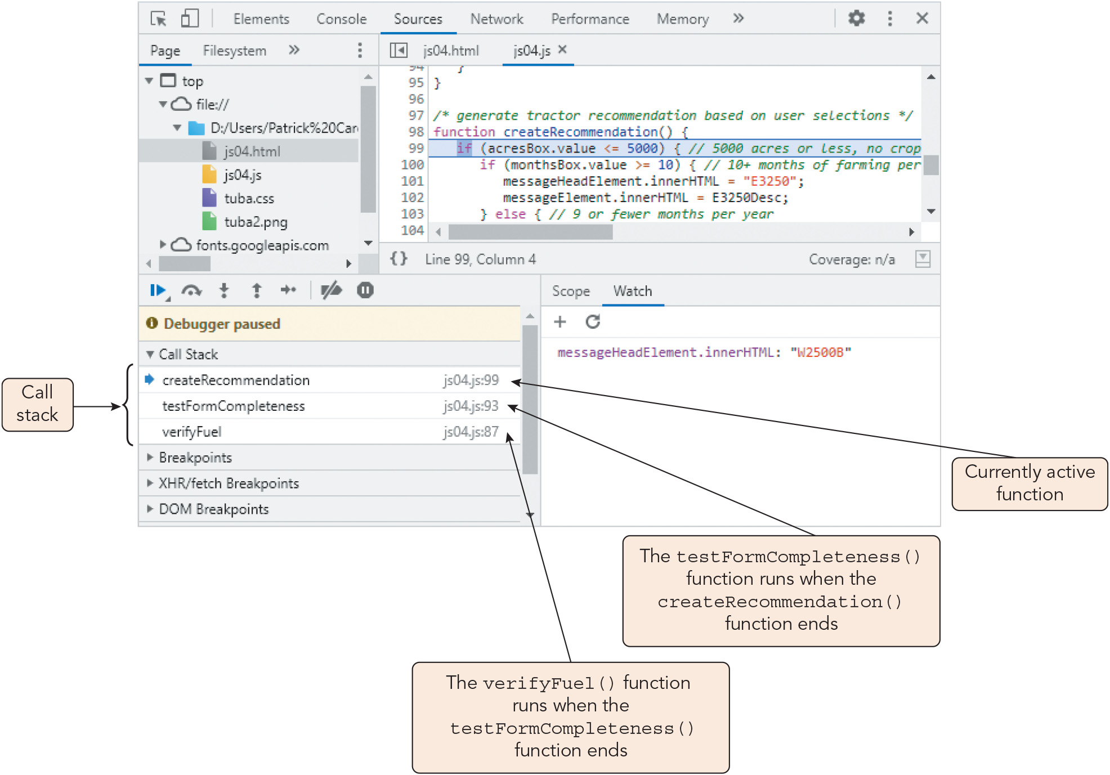
Tracking Program Flow with Debugging Tools (11 of 11)
Figure 4-25 Viewing the call stack

Slide 41
Managing Errors (1 of 10)
User error: an error that occurs when the user mistakenly runs the program in a way not intended by the developer
Bulletproofing: the process of anticipating and handling potential user errors before they cause major problems in the code
Exception handling: a technique whereby the program handles errors rather than leaving that task to the JavaScript interpreter
Handling exceptions with the try catch statement
Statements that might contain an error can be tested within the try command block
If an error is present, the catch command block is run, overriding the browser's default error handling
If no errors are present, the program execution moves to the next statement

Slide 42
Managing Errors (2 of 10)
Handling exceptions with the try catch statement (continued)
Syntax, where error is an error object that contains information about the error: try { statements that might contain an error; } catch (error) { statements that respond to the error }
Sample try catch statement: let userName = "Jenkins"; try { window.alert("The user is " + username); } catch(err) { window.alert("Invalid code"); }

Slide 43
Managing Errors (3 of 10)
Throwing an exception
The code can throw an exception (a programmer-defined error) in response to user errors not recognized by the JavaScript interpreter
Syntax: throw id, where id is a value or text string that identifies the error
Sample exception to prevent calculating the square root of a negative number: if (number < 0) throw "Attempt to calculate the square root of a negative value."; let sqrt = number**0.5; window.alert("The square root of " + number is + " is " + sqrt);
Sample try catch statement that throws an exception for a missing input: try { userID = document.getElementById("IDBox").value; if (userID === "") throw "Missing user ID"; window.alert("Your user ID is " + userID); } catch(err) { window.alert("You must enter a user ID"); }

Slide 44
Managing Errors (4 of 10)
The try catch finally statement
A finally clause, which is always executed (whether or not an error is found), can supplement exception handling
Syntax for a try catch finally statement: try { statements that might contain an error; } catch (error) { statements to respond to the error } finally { statements to run with or without an error }

Slide 45
Managing Errors (5 of 10)
The try catch finally statement (continued)
Sample use of try catch finally statement: try { userID = document.getElementById("IDBox").value; if (userID === "") throw "Missing user ID"; window.alert("Your user ID is " + userID); } catch(err) { window.alert("You must enter a user ID"); } finally { window.alert("Thank You"); }
Multiple catch statements can be included to handle multiple exception types
The nearest catch statement to the thrown exception is executed
Every try statement must be followed by a catch or finally statement or both

Slide 46
Managing Errors (6 of 10)
The error parameter in the catch statement
Contains information about the error that was caught
Object for built-in errors has name a property and message property (description)
For custom errors, the id specified in the throw operator serves as the error message
The error parameter is optional in ES10 (2019)

Slide 47
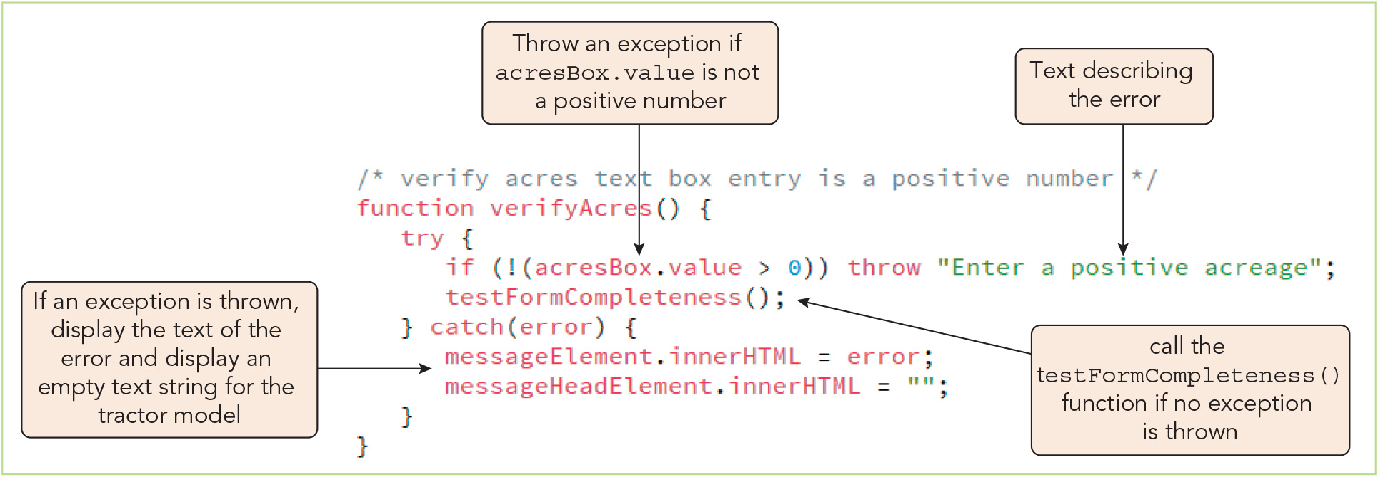
Managing Errors (7 of 10)
Figure 4-26 Creating a try catch statement

Slide 48
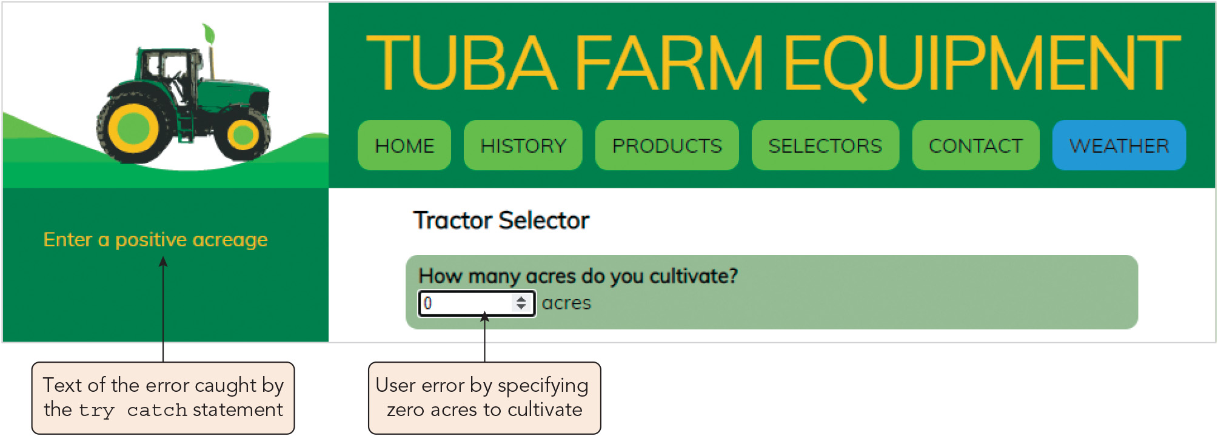
Managing Errors (8 of 10)
Figure 4-27 Catching an invalid acreage

Slide 49
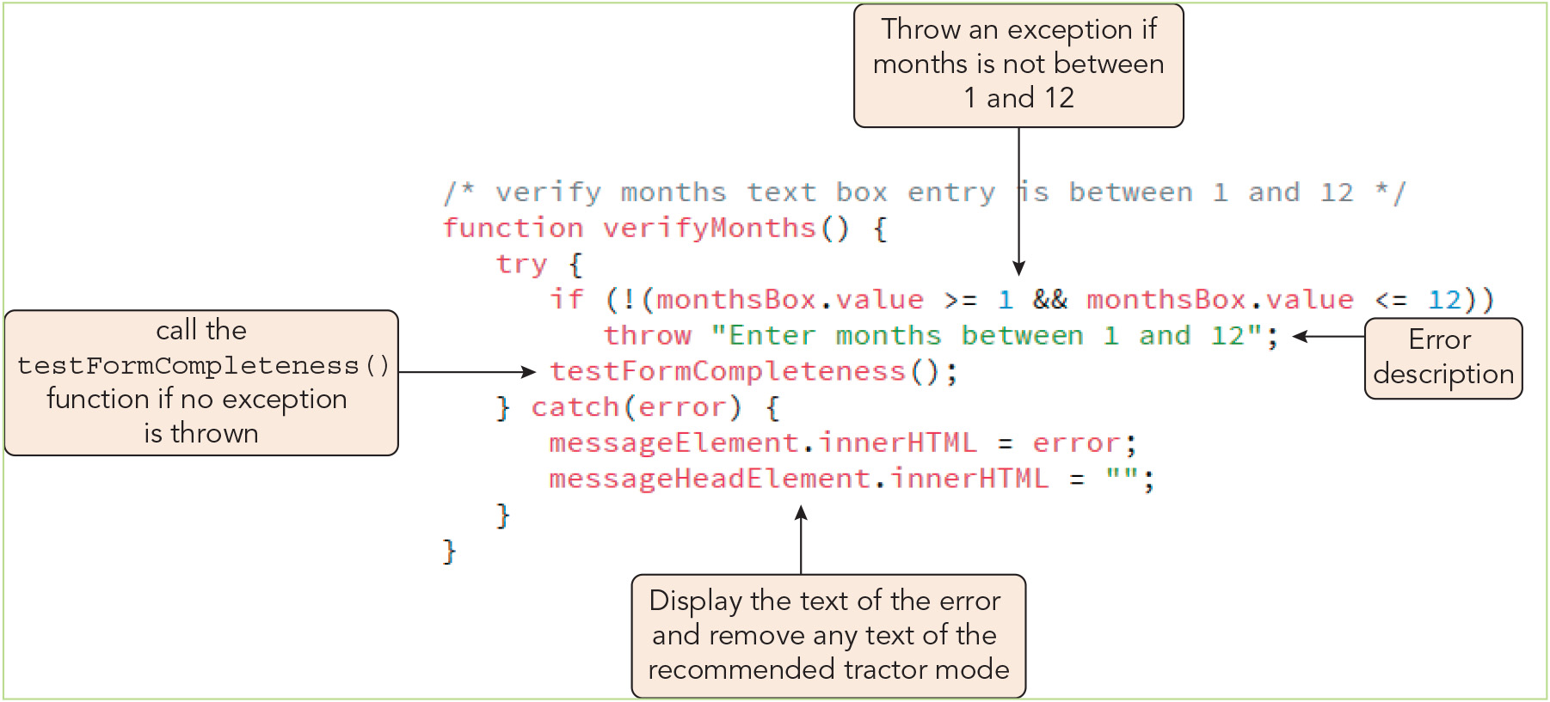
Managing Errors (9 of 10)
Figure 4-28 Testing for invalid months of operation

Slide 50
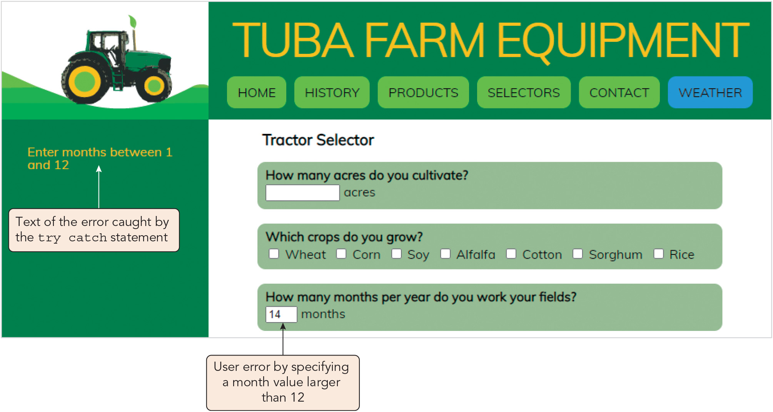
Managing Errors (10 of 10)
Figure 4-29 Catching an invalid duration of operation

Slide 51
Activity 4.2: Think, Pair, and Share
Form pairs/groups of two to four class members.
Your group will be writing a small program to calculate a user's body mass index (BMI) using two numbers submitted through a web form. Write a program to assign the height (in inches) and weight (in pounds) entered in the form's input boxes to height and weight variables, respectively, and calculate the BMI using this formula: BMI = (weight / height²) * 703
Now, modify your program to throw and handle custom exceptions in order to avoid dividing by zero or accepting a negative number for either user-provided value.
Optionally, add additional catch statements that handle custom exceptions for unreasonable height values (e.g., > 96 inches).
Notes:
Instructions:
Use the Think, Pair, Share activity to encourage students to solve problems collaboratively and to apply the real-world skill of evaluating, modifying, and debugging code created by another programmer.

Slide 52
Customizing Your Error Handling (1 of 2)
Catching errors with the error event
Syntax for managing an error event by running a function: window.onerror = function; or window.addEventListener("error", function)
Error handling functions
Syntax, with optional message, file URL, and line location and Boolean return value: function errorFn(message, url, line) { statements; return value; }
The error handling function replaces the browser's default error handling when the return value is true or supplements default error handling if it is false or omitted

Slide 53
Customizing Your Error Handling (2 of 2)
Error handling functions (continued)
Sample error handling function that writes a specialized message to the console log, overriding the default browser behavior: function processErrors(msg, url, line) { console.log("The file " + url + " generated the following error: " + msg + " on line: " + line); return true; }
Minimizing bugs in your code
Always use good syntax
Thoroughly test programs with every browser type and version you anticipate your program will be run on
Run your HTML file and CSS stylesheet through a validator

Slide 54
Activity 4.3: Discussion Questions
What are three types of errors that can occur in a program?
What is debugging? Why is it important to learn a variety of techniques for debugging?
Notes:
Instructions:
Use the Discussion activity to encourage group conversation about a related topic of interest.

Slide 55
Self-Assessment
Reflect on your experiences in debugging your own programs and/or programs written by others. What is your perception of debugging—i.e., is it more of an exciting challenge or a source of frustration for you? If your perception is negative, how can you improve it?
Which error management and handling techniques presented in Chapter 4 have you found, or do you expect to find, most useful to you as a professional developer? Why?
Notes:
Instructions:
Use the Self-Assessment question to encourage students to evaluate their progress or goals in the course, as well as determine how they might apply their learning or grow as an individual.

Slide 56
Summary
Now that the lesson has ended, you should have learned to:
Understand four different types of errors that programmers must deal with.
Use the debugger console to locate errors in a program.
Use JavaScript in strict mode.
Trace an error to its source.
Track the flow of your program using debugger tools.
Manage errors in your code using a try catch statement.
Control how a browser handles errors.
Notes:
Instructions: Reiterate the learning objectives for the lesson. Students should use this information to guide their studies and reinforcement of new concepts.

