Slide 1
JavaScript for Web Warriors, 7e Chapter 5: Creating a Web App Using the Document Object Model

Slide 2
Chapter Objectives (1 of 2)
By the end of this chapter, you should be able to:
Understand the principles of building a web app.
Create nodes and append them to a web document.
Restructure a web document by adding, deleting, copying, and moving element nodes.
Define a timed command that repeats a function or command block at set intervals.
Notes:
Instructions: Briefly review with students the major concepts you will be covering during this class. There is one objective for every major A-head section of the chapter.

Slide 3
Chapter Objectives (2 of 2)
By the end of this chapter, you should be able to:
Create system dialog boxes that receive user input.
Open and configure a browser popup window.
Create an overlay that lies on top of a web document.
Work with the objects within the Browser Object Model.
Notes:
Instructions: Briefly review with students the major concepts you will be covering during this class. The first two objectives listed on this slide are combined into one A-head. Otherwise, there is one objective for every major A-head section of the chapter.

Slide 4
Designing a Web App (1 of 4)
The hands-on project for this chapter is a lightbox (slideshow) web app
A web app is built on four foundations:
HTML code—provides the app's container
CSS code—defines the app's appearance
JavaScript code—manages the operation of and output from the app
Data (usually stored outside the app)
These components may be developed and maintained by different individuals or teams

Slide 5
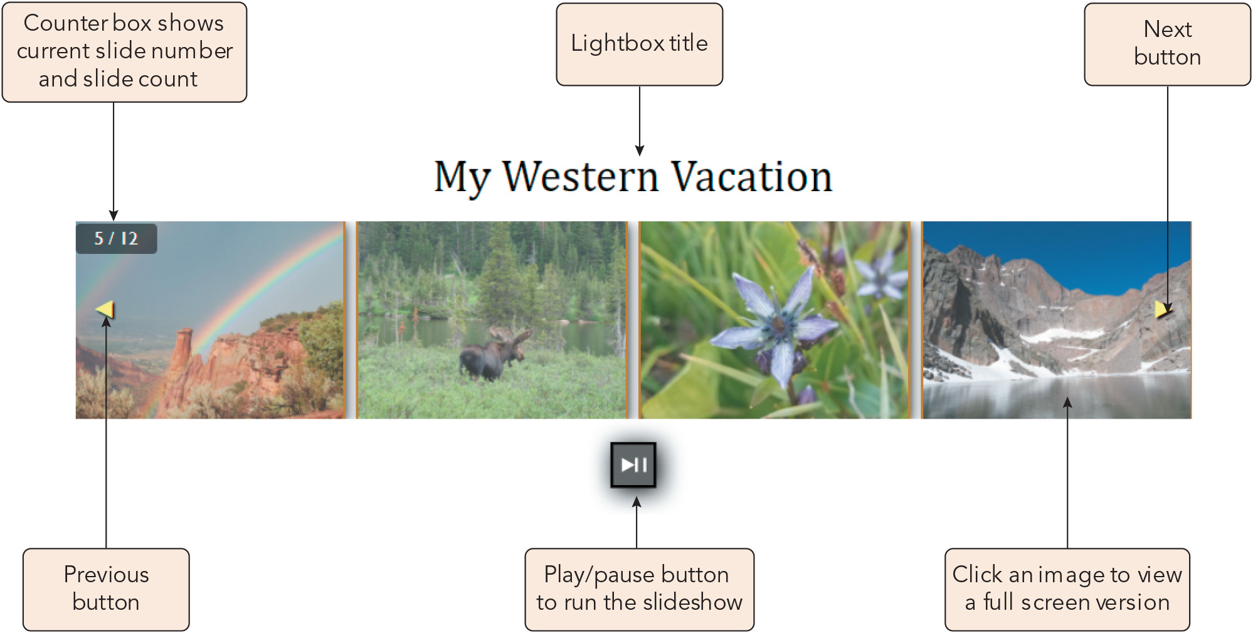
Designing a Web App (2 of 4)
Figure 5-1 Preview of the lightbox app
Joan Carey

Slide 6
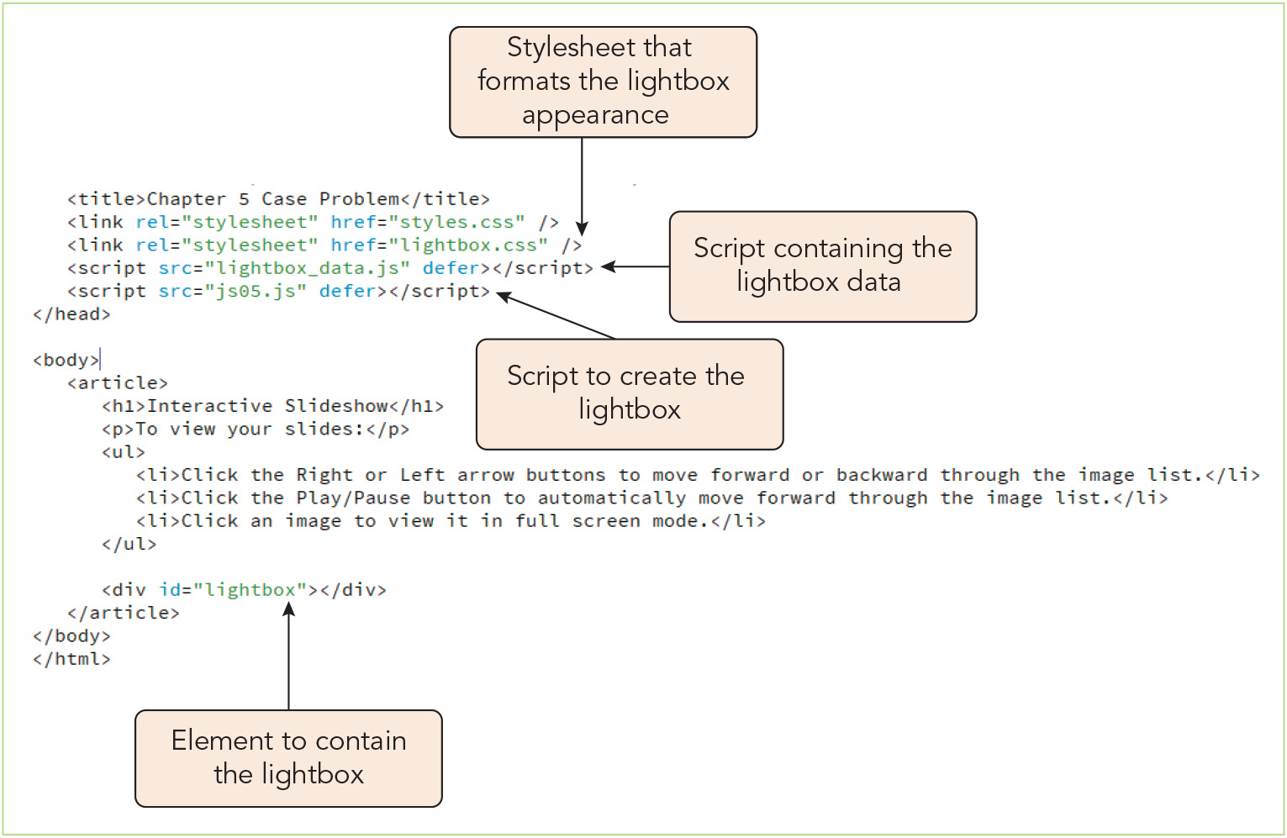
Designing a Web App (3 of 4)
Figure 5-2 Parts of the lightbox app

Slide 7
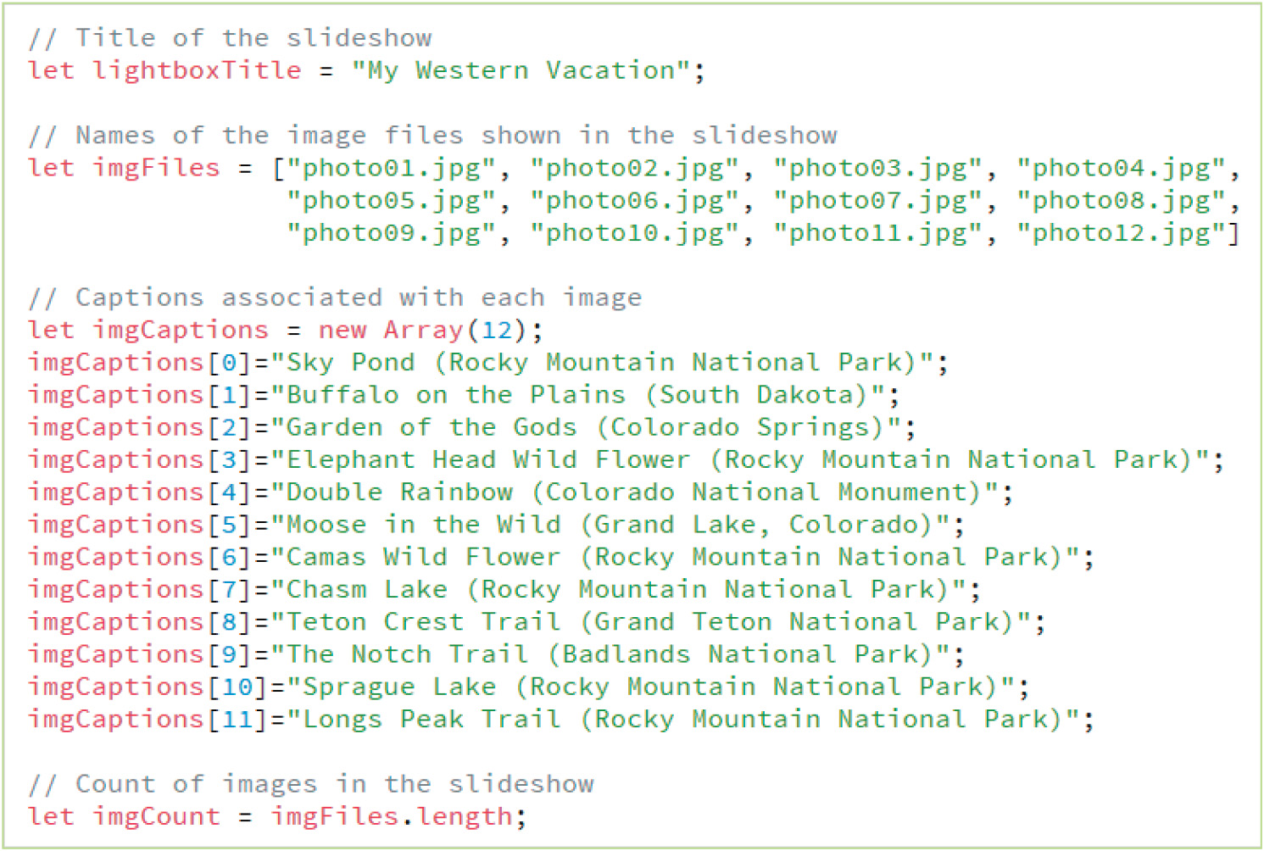
Designing a Web App (4 of 4)
Figure 5-3 Content of the lightbox_data.js file

Slide 8
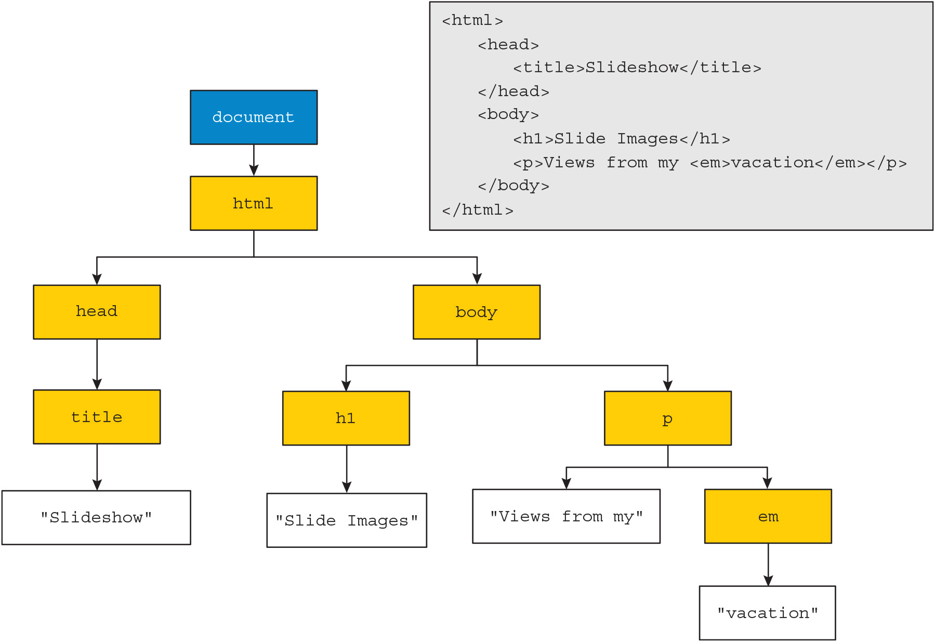
Introducing Nodes (1 of 17)
Figure 5-4 A node tree

Slide 9
Introducing Nodes (2 of 17)
Nodes and the Document Object Model
Node: an entity that represents an element, attribute, comment, processing instruction, or text string within a web document
Node tree: hierarchical structure into which nodes are organized
Nodes have familial relationships, e.g., parent to child, siblings (children of one parent)
Root node: the parent node at the top of the node tree
Nodes can be referenced by familial relationships using JavaScript properties

Slide 10
Introducing Nodes (3 of 17)
Expression | Description
node.firstChild | The first child of node
node.lastChild | The last child of node
node.childNodes | A node list of all nodes which are direct children of node
node.previousSibling | The sibling listed before node on the same level in the node tree
node.nextSibling | The sibling listed after node on the same level in the node tree
node.ownerDocument | The root node of the document
node.parentNode | The parent of node

Slide 11
Introducing Nodes (4 of 17)
Nodes and the Document Object Model (continued)
Sample node references: Parent: node.parentNode Grandparent: node.parentNode.parentNode Aunt/uncle: node.parentNode.previousSibling node.parentNode.nextSibling
Sample reference to the first node in a node list: node.childNodes[0]
JavaScript also provides properties for working directly with element nodes
Note that the children property references only element nodes, whereas the childNodes property references all types of nodes

Slide 12
Introducing Nodes (5 of 17)
Expression | Description
node.children | A node list of all elements which are direct children of node
node.firstElementChild | The first element within node
node.lastElementChild | The last element within node
node.previousElementSibling | The sibling element immediately prior to node in the node tree
node.nextElementSibling | The sibling element immediately following node in the node tree
node.parentElement | The parent element of node

Slide 13
Introducing Nodes (6 of 17)
Selecting nodes with the querySelectorAll() method
Syntax for defining a node list based on a CSS selector: document.querySelectorAll(css)
Node lists are not identical to HTML collections
Items can be referenced only by index
May contain a variety of node types
Static, not dynamic
The querySelector() method returns the first matching element node rather than a list

Slide 14
Introducing Nodes (7 of 17)
Creating and connecting nodes
Sample code for creating the document fragment <h1>My Slideshow</h1>: let mainHeading = document.createElement("h1"); let headingTxt = document.createTextNode("My Slideshow"); mainHeading.appendChild(headingTxt);
To add a document fragment to a web document, attach it to a node already present in the node tree, e.g.: let introDIV = document.getElementById("intro"); introDiv.appendChild(mainHeading);

Slide 15
Introducing Nodes (8 of 17)
Expression | Description
document.createAttribute(att) | Create an attribute node with the name att
document.createComment(text) | Creates a comment node containing the comment text
document.createElement(elem) | Creates an element node with the name elem
document.createTextNode(text) | Creates a text node containing the text string text
node.cloneNode(deep) | Creates a copy of node, where deep is true to copy all the node’s descendants or false to copy only node itself

Slide 16
Introducing Nodes (9 of 17)
Expression | Description
node.appendChild(new) | Appends new node as the last child of node
node.insertBefore(new, child) | Insert new node as a sibling directly before child node (if no child node is specified then new node is added as a sibling after the last child node)
node.removeChild(old) | Remove old node from node
node.replaceChild(new, old) | Replaces old node with new node

Slide 17
Introducing Nodes (10 of 17)
Elements nodes and HTML attributes
Every HTML attribute has a corresponding node property
Most have the same name, e.g., id, src, href
The className property sets a value for the class attribute
The classList property can be used to add, remove, or replace class values from an element with multiple classes
Nodes and inline styles
Sample code defining inline styles using the style property: mainH1.style.fontSize = "1.5em"; mainH1.style.color = "blue";

Slide 18
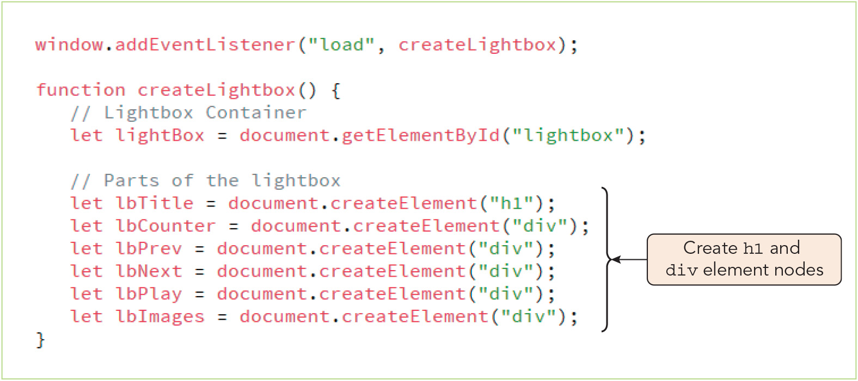
Introducing Nodes (11 of 17)
Figure 5-9 Creating element nodes

Slide 19
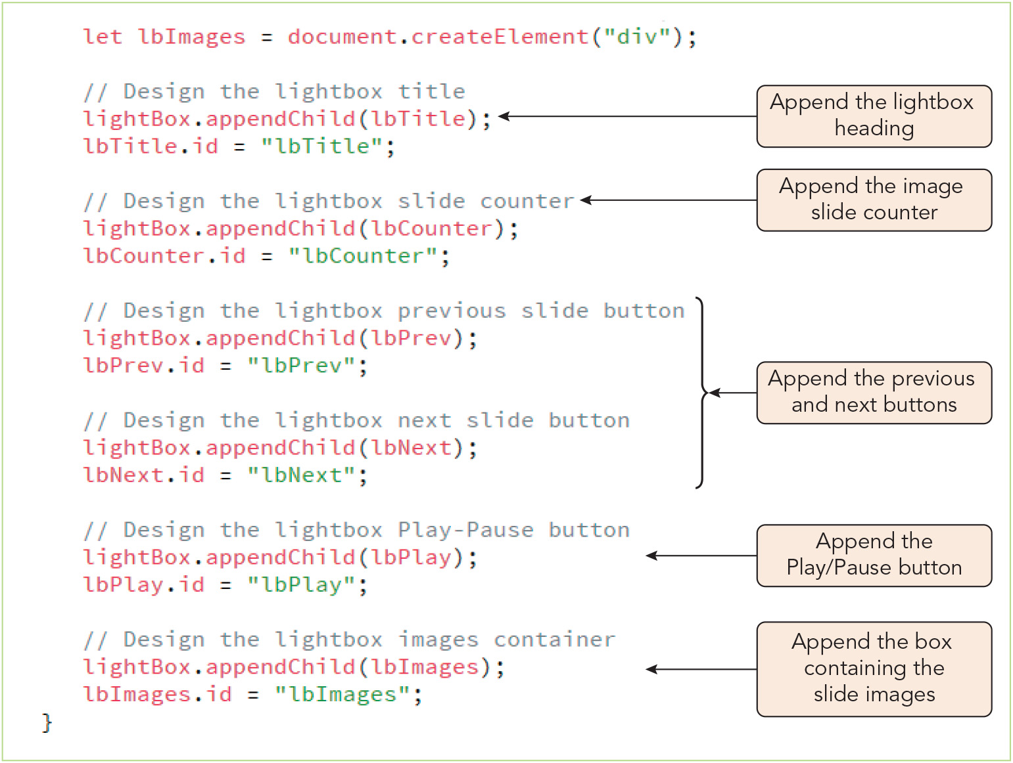
Introducing Nodes (12 of 17)
Figure 5-10 Attaching element nodes to the lightbox container

Slide 20
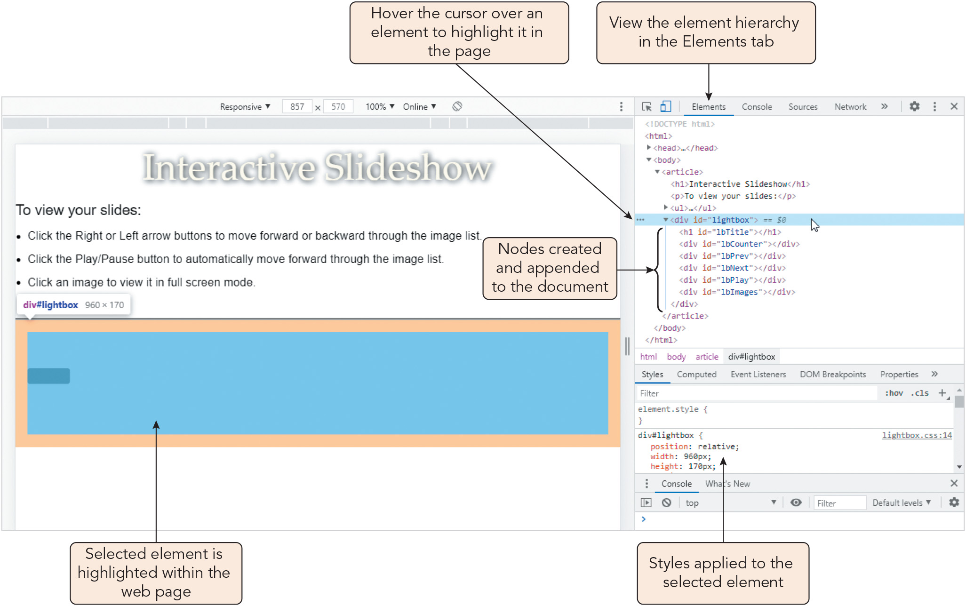
Introducing Nodes (13 of 17)
Figure 5-11 Viewing the element hierarchy in the Elements tab

Slide 21
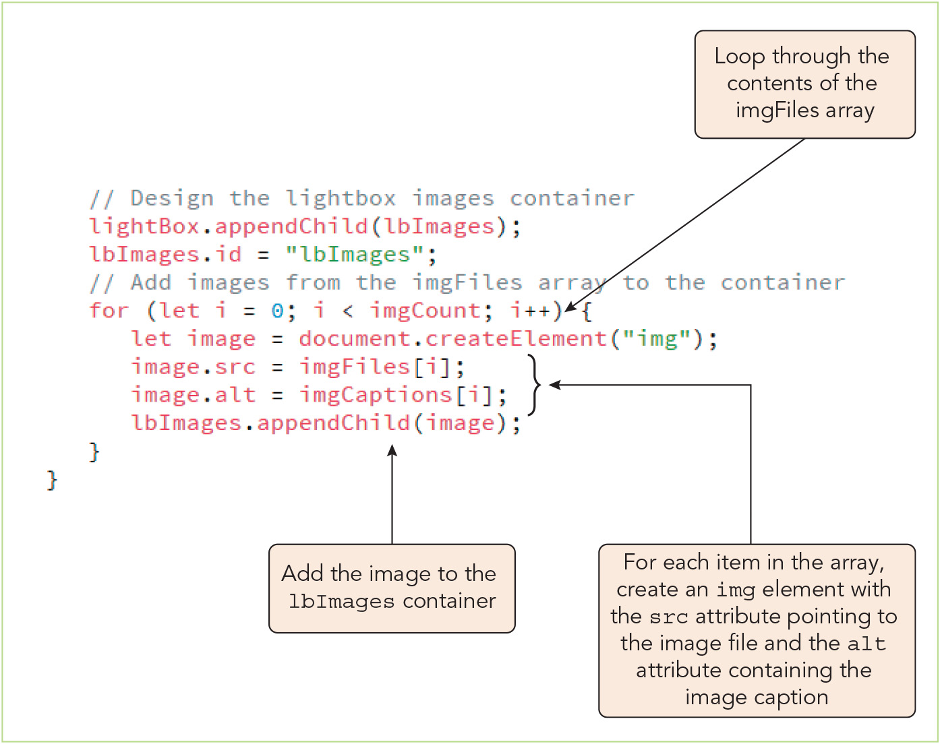
Introducing Nodes (14 of 17)
Figure 5-12 Adding images to the lightbox

Slide 22
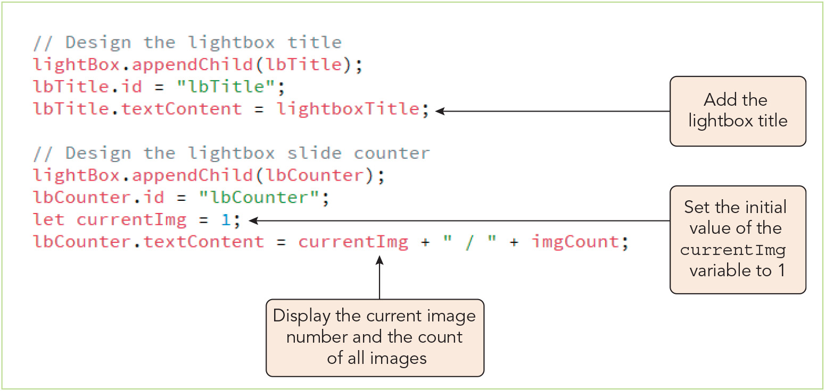
Introducing Nodes (15 of 17)
Figure 5-13 Adding the lightbox title and counter

Slide 23
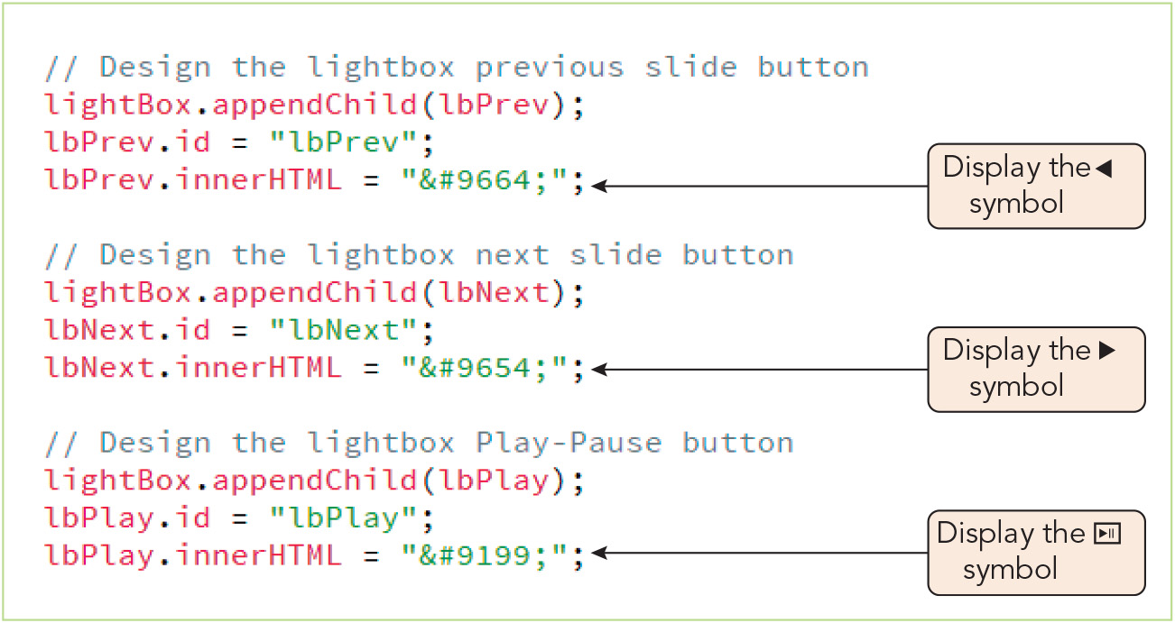
Introducing Nodes (16 of 17)
Figure 5-14 Adding the symbols for the buttons in the lightbox

Slide 24
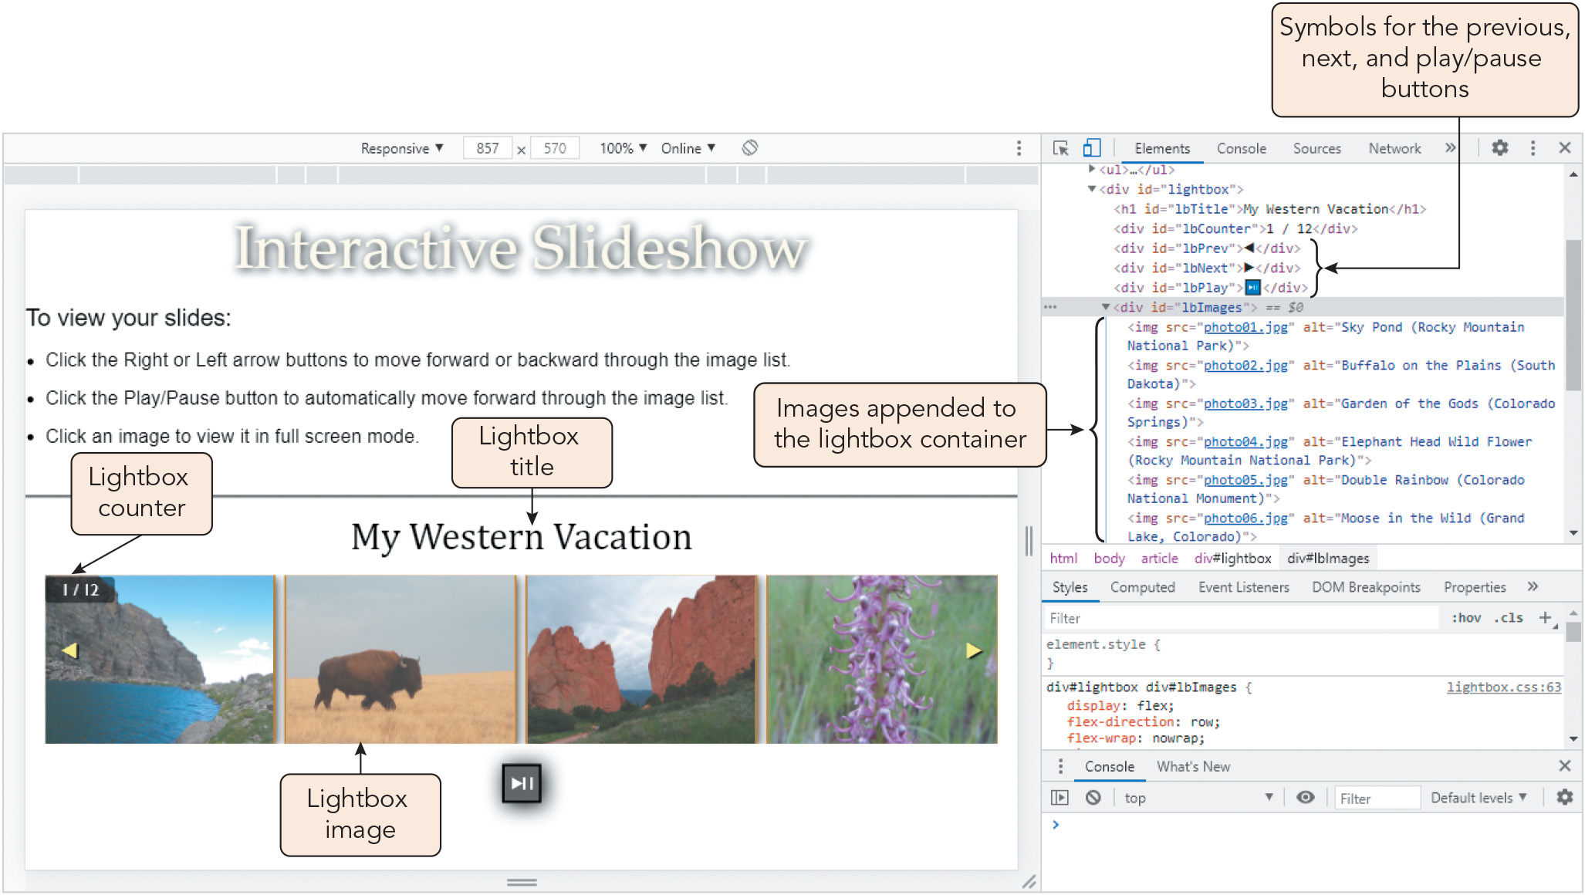
Introducing Nodes (17 of 17)
Figure 5-15 Lightbox images and text
Joan Carey

Slide 25
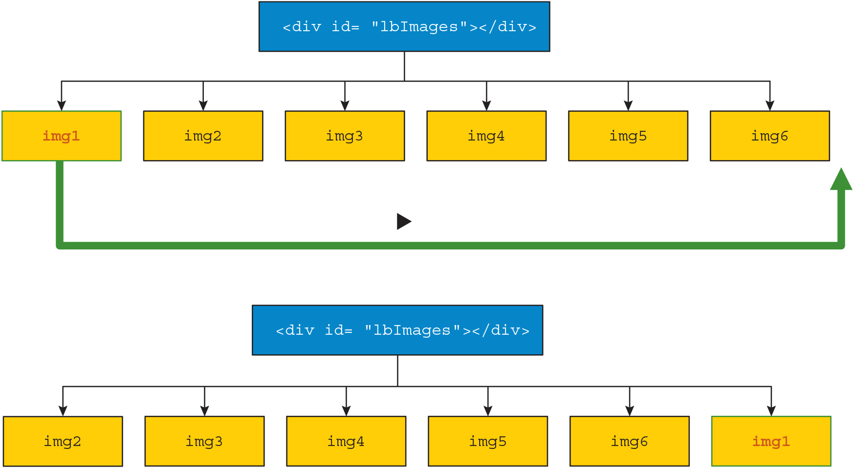
Restructuring a Node Tree (1 of 8)
Figure 5-16 Moving forward through the list of images

Slide 26
Restructuring a Node Tree (2 of 8)
Moving nodes with the appendChild() method
Calling the appendChild() method on a node that is already part of a document tree moves it to the end of the child list
Any nodes with greater index values will have their index reduced by 1 (shift left)
Sample code to move the first child node in a list to the end position: lbImages.appendChild(lbImages.firstElementChild);

Slide 27
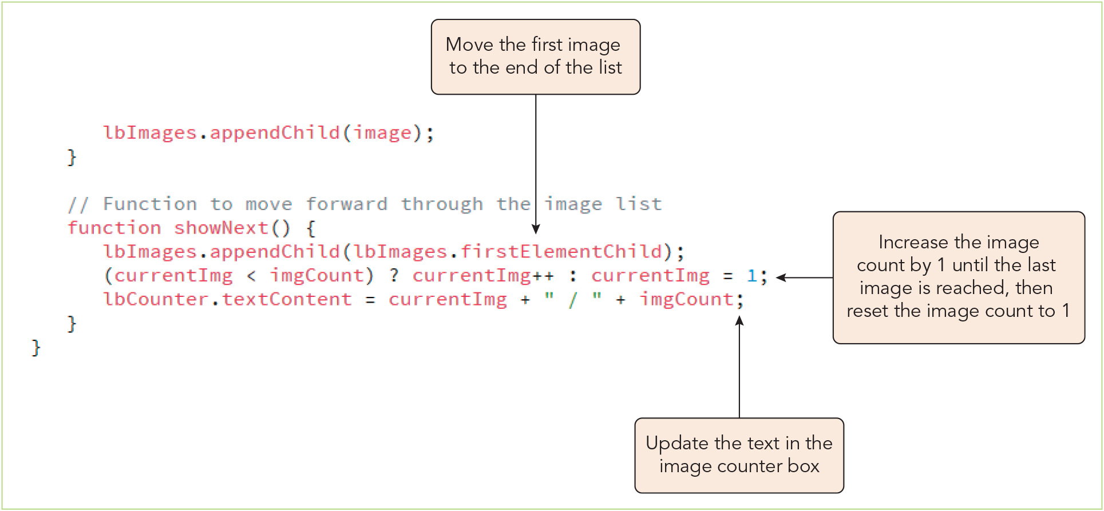
Restructuring a Node Tree (3 of 8)
Figure 5-17 The showNext() function

Slide 28
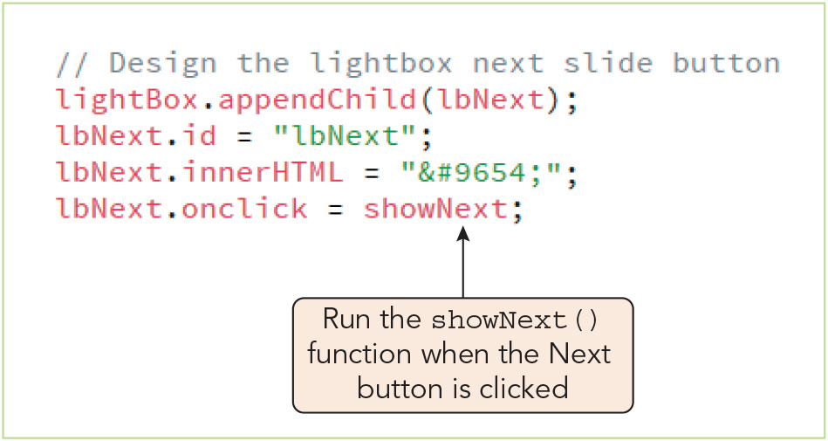
Restructuring a Node Tree (4 of 8)
Figure 5-18 Event handler for the showNext() function

Slide 29
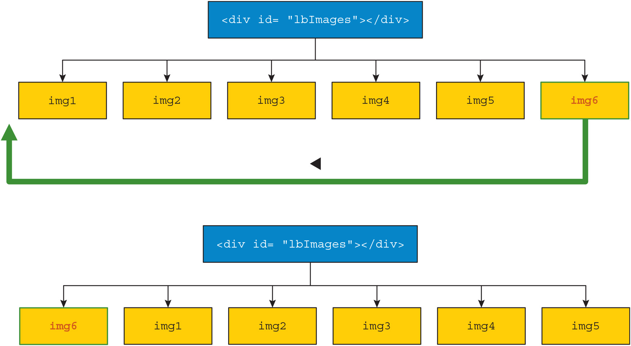
Restructuring a Node Tree (5 of 8)
Figure 5-19 Moving backward through the list of images

Slide 30
Restructuring a Node Tree (6 of 8)
Moving nodes with the insertBefore() method
Syntax of the insertBefore() method, where node is the parent, new is the new child, and child is the existing child before which new will be inserted: node.insertBefore(new, child)
Sample code to move the last element in a node list to the 0 index position: lbImages.insertBefore(lbImages.lastElementChild,lbImages.firstElementChild);
Cloning a node
The node.cloneNode(deep) command creates a node copy
Passing in true for deep creates a deep copy (node plus all descendants)
Passing in false copies only the node itself
This method copies DOM content but not JavaScript properties attached to the node

Slide 31
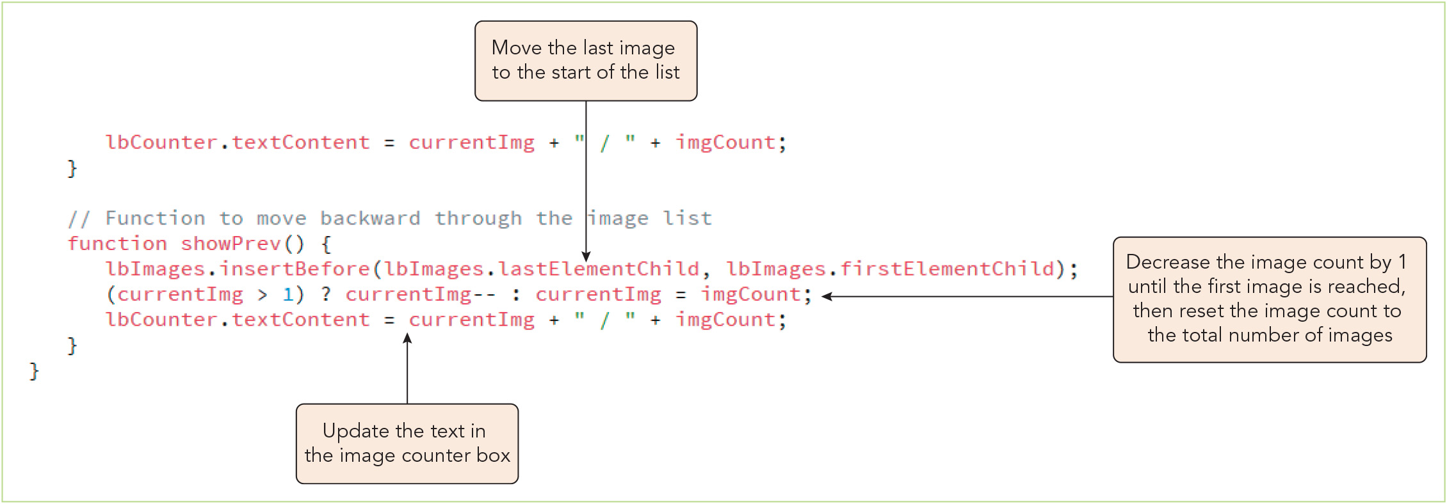
Restructuring a Node Tree (7 of 8)
Figure 5-20 The showPrev() function

Slide 32
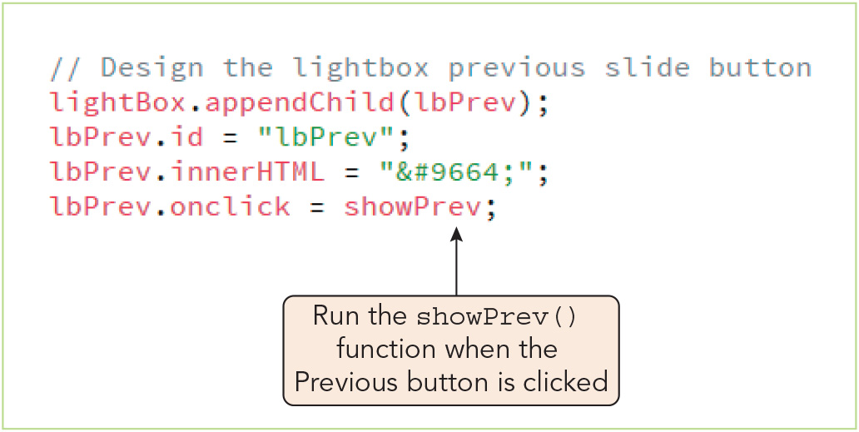
Restructuring a Node Tree (8 of 8)
Figure 5-21 Calling the showPrev() function

Slide 33
Activity 5.1: Knowledge Check
Explain what the following JavaScript statements do. (Assume the web document includes a div element with the id "about.") let aHead = document.createElement("h1"); let aHeadText = document.createTextNode("About Us"); aHead.appendChild(aHeadText); let aboutDiv = document.getElementById("about"); aboutDiv.appendChild(aHead);
What JavaScript methods can you use to rearrange the children of a parent node that is a div element with the id "cutePhotos"? Describe the syntax of each method.
Notes:
Instructions:
Use the Knowledge Check questions to periodically pose a question to students during class to gauge how well they can recall the material that was presented.

Slide 34
Activity 5.1: Knowledge Check Answers (1 of 2)
Explain what the following JavaScript statements do. (Assume the web document includes a div element with the id "about.") let aHead = document.createElement("h1"); let aHeadText = document.createTextNode("About Us"); aHead.appendChild(aHeadText); let aboutDiv = document.getElementById("about"); aboutDiv.appendChild(aHead); These statements create an element node for an h1 heading (aHead) and a text node (aHeadText) containing the string "About Us"; append the aHeadText node as a child of the aHead node to create the document fragment <h1>My Slideshow</h1>; and attach the document fragment to the web page by appending it to the div element with the id "about." In other words, they modify the structure and content of the web page by creating new nodes and appending them to the page's node tree.
Notes:
Instructions:
Use the Knowledge Check questions to periodically pose a question to students during class to gauge how well they can recall the material that was presented.

Slide 35
Activity 5.1: Knowledge Check Answers (2 of 2)
What JavaScript methods can you use to rearrange the children of a parent node that is a div element with the id "cutePhotos"? Describe the syntax of each method. To move a child of a node such as cutePhotos to the end of the child node list, you can use the appendChild() method, where node is the parent and new is a reference to the node you want to move: node.appendChild(new) For example, the statement cutePhotos.appendChild(cutePhotos.firstElementChild); would move the first element child of cutePhotos to the end of the list. To move a child of cutePhotos to any other position in the list, you would use the insertBefore() method, where child is the the child node before which the new node will be placed: node.insertBefore(new, child)
Notes:
Instructions:
Use the Knowledge Check questions to periodically pose a question to students during class to gauge how well they can recall the material that was presented.

Slide 36
Running Timed Commands (1 of 3)
Repeating commands at specified intervals
Timed command: a command or function that is run at a specified time or repeated at set intervals
Syntax to create timeVar, a timed command that repeats a command at set intervals: timeVar = window.setInterval(command, interval)
Stopping a timed command
Timed commands must be stopped after initiation using the clearInterval() method: window.clearInterval(timeVar)
Using time-delayed commands
Syntax to create timeVar, a timed command that runs once after a specified delay: let timeVar = window.setTimeout(command, delay);
To prevent a delayed command from running, use the clearTimeout() method: window.clearTimeout(timeVar)

Slide 37
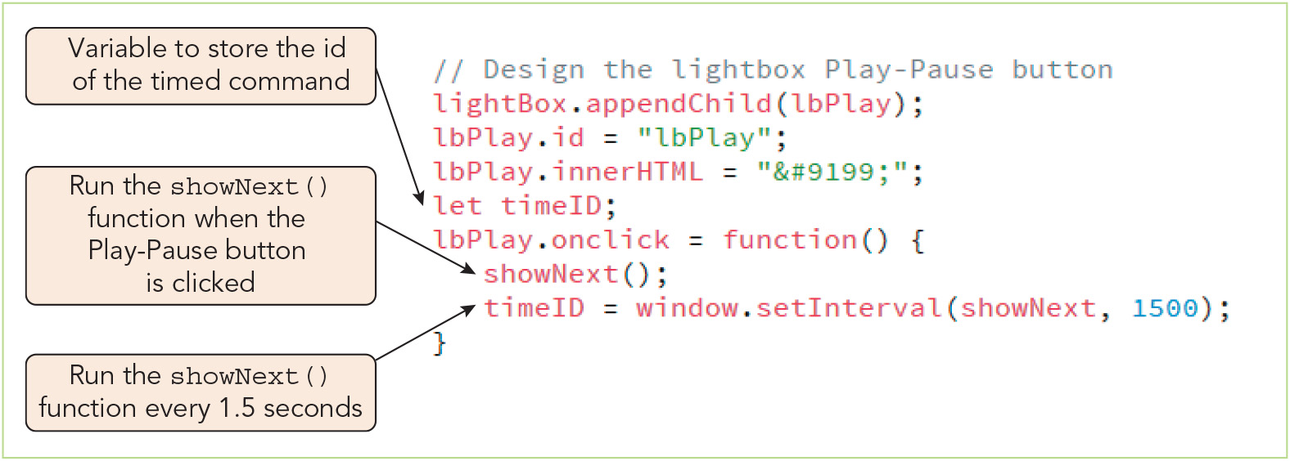
Running Timed Commands (2 of 3)
Figure 5-22 Running a timed command

Slide 38
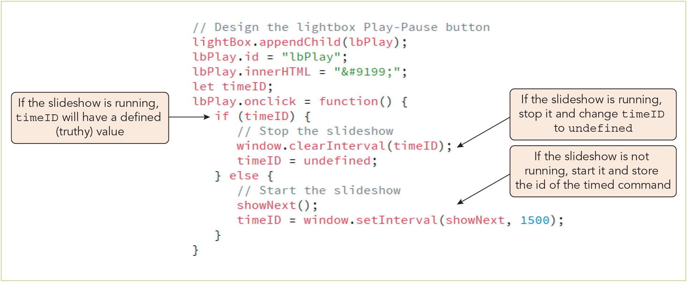
Running Timed Commands (3 of 3)
Figure 5-23 Toggling between starting and stopping the slideshow

Slide 39
Working with Popup Windows (1 of 4)
Popup windows: external windows opened and displayed on top of or adjacent to the application content
System dialog boxes
Alert windows are created with the window.alert() method
Confirmation windows display a message plus OK and Cancel buttons
Created with the method: response = window.confirm(message)
Returns response, a Boolean value (true = OK, false = Cancel)
Prompt windows display a message plus a text input box
Created with the method: response = window.prompt(message, default)
Returns response, a text string

Slide 40
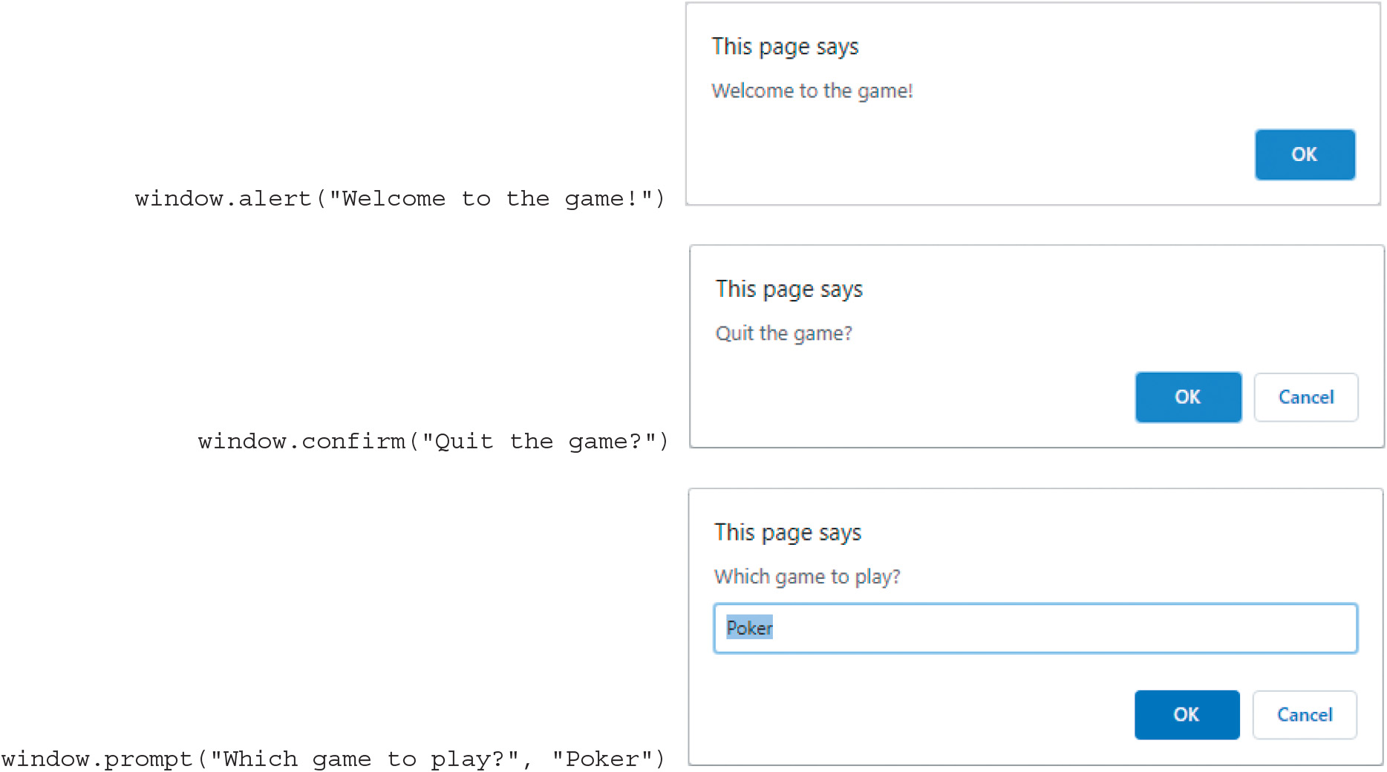
Working with Popup Windows (2 of 4)
Figure 5-24 JavaScript popup windows

Slide 41
Working with Popup Windows (3 of 4)
Working with browser windows
You can open a new window object with its own collection of properties and methods, which can be used to define its appearance and content
Syntax for creating a new browser window: window.open(url, title, options, replace)
url is the location of the file to display
title is the window's title
options is a comma-separated list of features defining the window's appearance
replace is an optional Boolean value to specify whether url should create a new entry in the window's history list (true) or replace the existing entry (false)
url, title, and options are enclosed in double quotation marks
When you assign a new window to a variable, you can apply properties and methods of the window object to it after creation

Slide 42
Working with Popup Windows (4 of 4)
Writing content to a browser window
You can add nodes to the new window's web document by referencing the window.document.body object where window is the variable name for the window
You can add content as a single text string with the document.write() method
Limitations of browser windows
Often blocked by popup blockers
Usually not blocked when a user-initiated event opens the window
Don't scale well to small screens
Cannot display files loaded locally on a user's computer
Handled inconsistently among browsers as regards supported features

Slide 43
Creating an Overlay (1 of 7)
Overlay: an element that lays on top of the rest of the page content, partially obscuring that content
Type of modal (a.k.a. modal window), a window that takes control of an application and must be closed before the user can continue using the app (like popup dialog boxes)
Can be created as a div element sized to cover the browser window using HTML and CSS
Introducing the this object
The this object references the owner of a currently running segment of JavaScript code
For an anonymous function called by an event handler/listener, the owner of the function is the object that initiated the event (e.g., an image that was clicked)
Sample statements using the this object to clone the node that called the function: let overlayImage = this.cloneNode("true"); figureBox.appendChild(overlayImage);

Slide 44
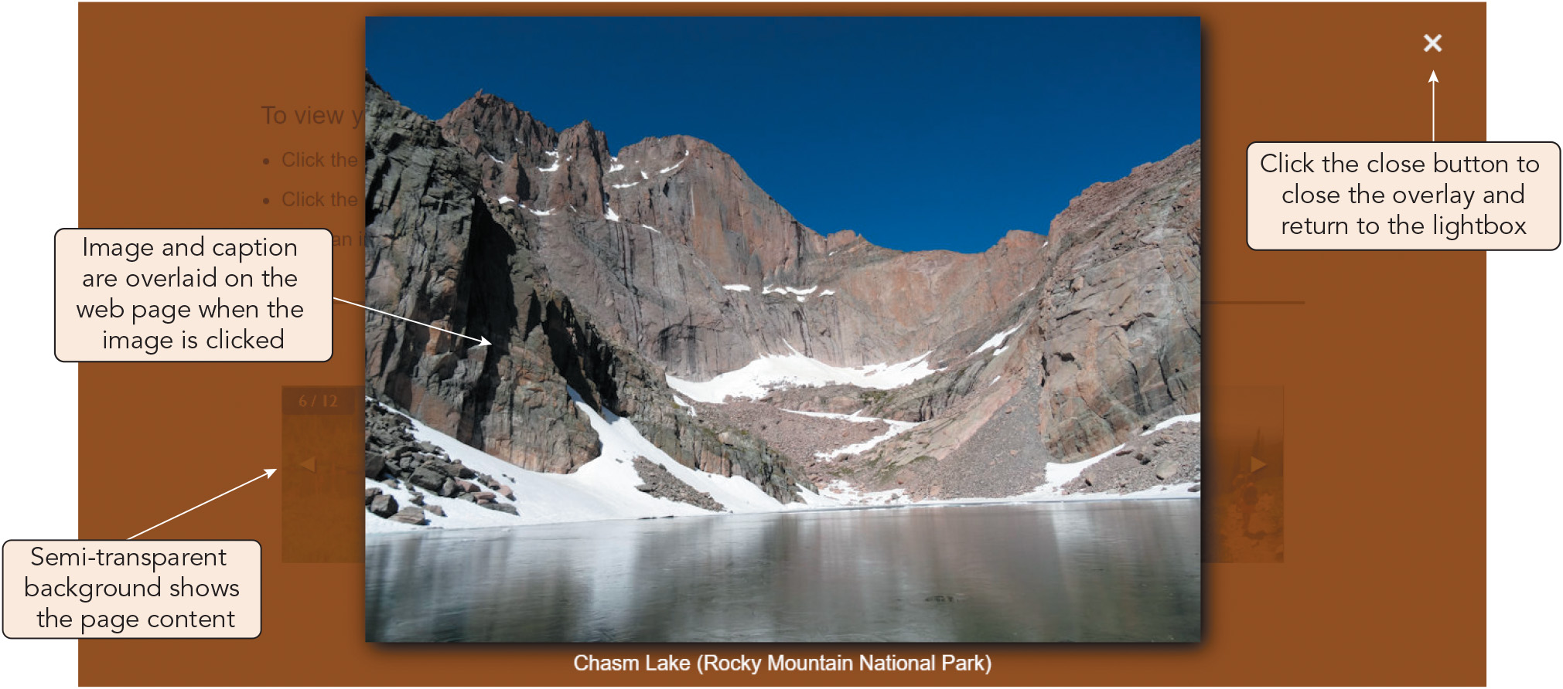
Creating an Overlay (2 of 7)
Figure 5-28 Image overlay for the lightbox app
Joan Carey

Slide 45
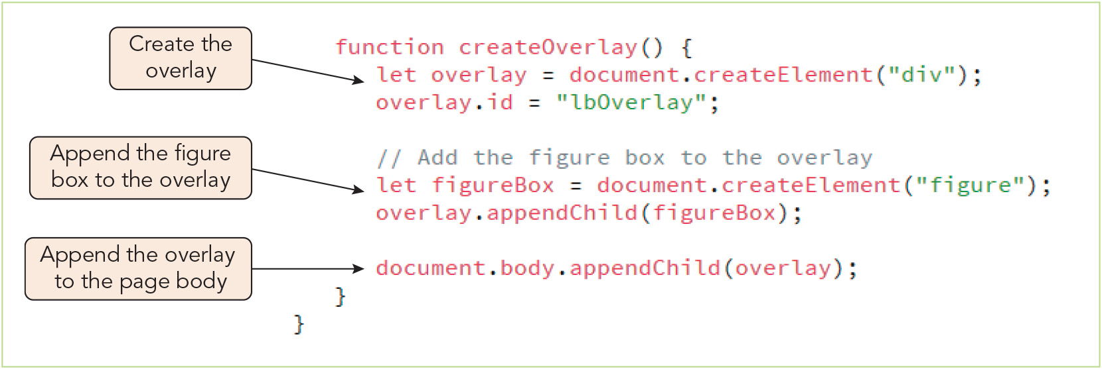
Creating an Overlay (3 of 7)
Figure 5-29 Initial createOverlay() function

Slide 46
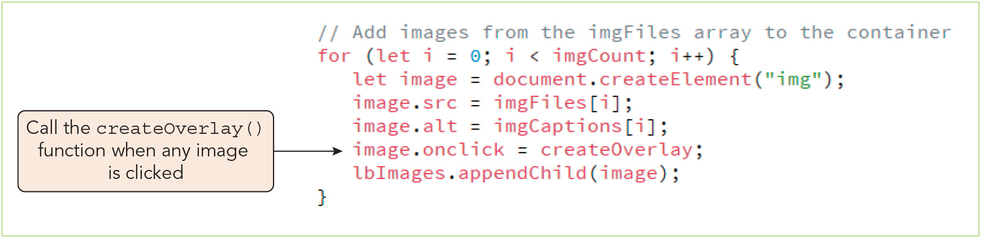
Creating an Overlay (4 of 7)
Figure 5-30 Adding an event handler for the createOverlay() function

Slide 47
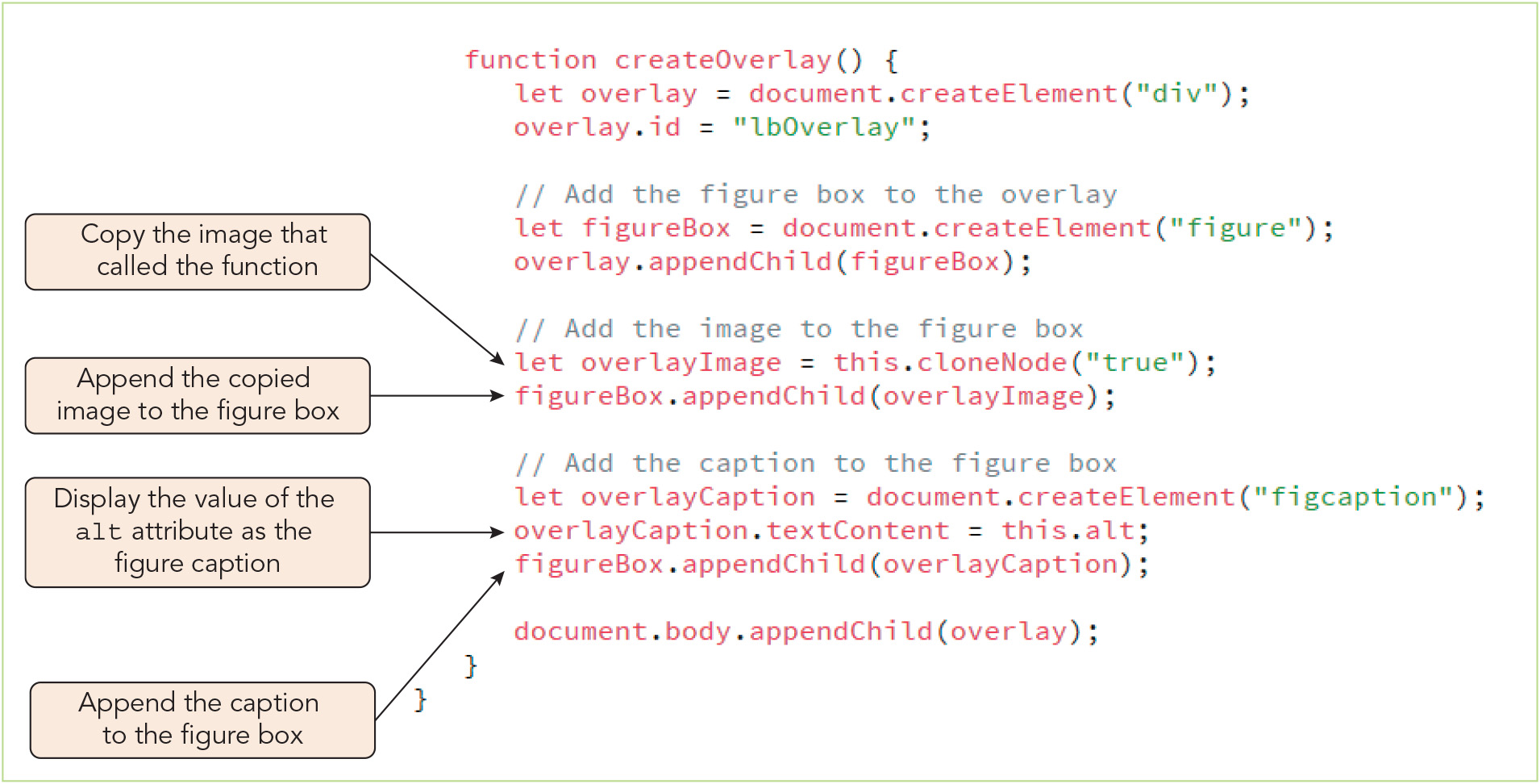
Creating an Overlay (5 of 7)
Figure 5-31 Adding an image and caption to the overlay

Slide 48
Creating an Overlay (6 of 7)
Removing a node
Syntax to remove a node, where node is the parent of the node to be removed and old is the node to be removed itself: node.removeChild(old)
Designing the look of an app
Place design choices in CSS stylesheet to make the app's visual appearance easy to modify
One strategy is to use class names to apply formatting so that the details are stored in the CSS file, not the JavaScript file

Slide 49
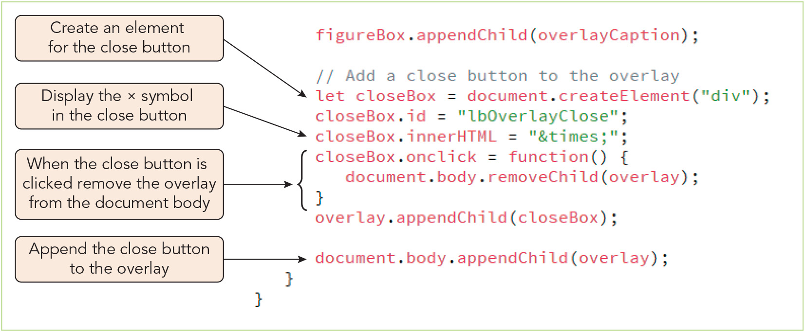
Creating an Overlay (7 of 7)
Figure 5-32 Adding the close box to the overlay

Slide 50
Activity 5.2: Think, Pair, and Share
Form pairs/groups of two to four class members.
Your group will lay out a web page using the new JavaScript skills you learned in Chapter 5. First, sketch out a node tree containing just the elements for a simple web page. Be sure to include at least one parent node with three or more child nodes.
Next, write HTML and JavaScript code to create the basic structure of this page, using JavaScript node object properties and methods as much as possible. Add some content to some of the elements to make them visible. View your web page in a browser.
Add additional JavaScript statements to rearrange the nodes in the page, and view it again to observe the changes.
Notes:
Instructions:
Use the Think, Pair, Share activity to encourage students to solve problems collaboratively and to apply the real-world skill of evaluating, modifying, and debugging code created by another programmer.

Slide 51
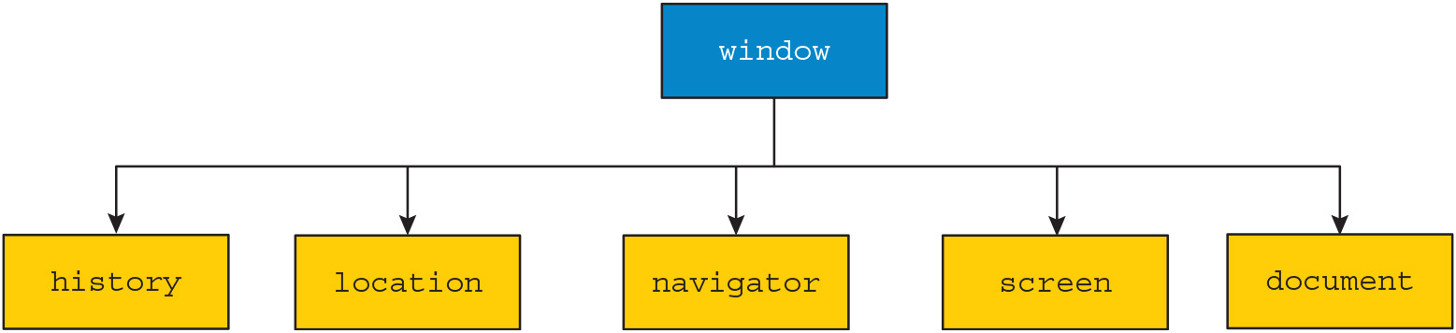
Exploring the Browser Object Model (1 of 3)
Figure 5-33 Browser Object Model

Slide 52
Exploring the Browser Object Model (2 of 3)
The window object (root node) is referred to as the global object because all other objects in the BOM are contained within it
The history object
History list: list of all the pages that have been opened during the current session maintained by a browser window
history object: object that stores history list information (but not the actual contents or addresses of the pages)
The location object
location object: object that stores information about the current page opened in the browser
Can be used to provide a URL to load in a new browser window

Slide 53
Exploring the Browser Object Model (3 of 3)
The navigator object
navigator object: object used to obtain information about the user's browser
Primarily used for debugging or for verifying that the user is running a compatible browser or operating system
Usually more effective to use object detection to determine whether the browser supports a section of code and use a try catch statement to handle exceptions
The screen object
screen object: object that stores information about the user's screen
Designing your web app
Know your users, determine how your app will be used, provide constant feedback to users, anticipate user errors, and keep it simple to use

Slide 54
Activity 5.3: Discussion Questions
Do you agree or disagree with the following statement? Explain your reasoning. The document object is the most important object in the Document Object Model.
Why might a programmer want to use the navigator object to obtain information about the current web browser? Why might a programmer choose to use object detection with a try catch statement? Compare the use cases, benefits, and limitations of these two strategies.
Notes:
Instructions:
Use the Discussion activity to encourage group conversation about a related topic of interest.

Slide 55
Self-Assessment
Which aspect of web app development interests you the most: writing HTML, creating CSS stylesheets, writing JavaScript, managing data, or design of user interfaces or features? Would you like to pursue this interest area professionally?
Can you think of a web page/app you've visited or used that functions similarly to the lightbox app in the chapter? If so, how do they compare? Would you guess that the code is similar in any respects?
How do you feel, personally, about browser popup windows? Do you anticipate that you will employ them in your own projects?
Notes:
Instructions:
Use the Self-Assessment question to encourage students to evaluate their progress or goals in the course, as well as determine how they might apply their learning or grow as an individual.

Slide 56
Summary
Now that the lesson has ended, you should have learned to:
Understand the principles of building a web app.
Create nodes and append them to a web document.
Restructure a web document by adding, deleting, copying, and moving element nodes.
Define a timed command that repeats a function or command block at set intervals.
Create system dialog boxes that receive user input.
Open and configure a browser popup window.
Create an overlay that lies on top of a web document.
Work with the objects within the Browser Object Model.
Notes:
Instructions: Reiterate the learning objectives for the lesson. Students should use this information to guide their studies and reinforcement of new concepts.

