Slide 1
JavaScript for Web Warriors, 7e Chapter 10: Programming with Event Objects and Third-Party APIs

Slide 2
Chapter Objectives (1 of 2)
By the end of this chapter, you should be able to:
Write code for event objects and event properties.
Work with events for mice, touchscreens, and pointer devices.
Program a drag and drop action using pointer events.
Create drag and drop interfaces using the Drag and Drop API.
Write code that responds to keyboard events.
Create interactive maps using the Google Maps API.
Notes:
Instructions: Briefly review with students the major concepts you will be covering during this class. There is one objective for every major A-head section of the chapter.

Slide 3
Chapter Objectives (2 of 2)
By the end of this chapter, you should be able to:
Locate your position using geolocation.
Add routes and directions to a Google Map using the Google Directions and Renderer services.
Use the Device Orientation API to detect changes in client device speed and position.
Create more efficient code for mobile devices by reducing script numbers and sizes.
Notes:
Instructions: Briefly review with students the major concepts you will be covering during this class. There is one objective for every major A-head section of the chapter.

Slide 4
Working with Events as Objects (1 of 6)
The Event object
All user interactions create events, and these events are a type of object that contains information about the event occurring within the web page or browser
The event object is passed as a parameter of the function managing the event, e.g.: myButton.onclick = userClick; function userClick(event) { commands }
Sample code that names the event object e and uses its button property: function userClick(e) { console.log("The " + e.button + " button was clicked."); }

Slide 5
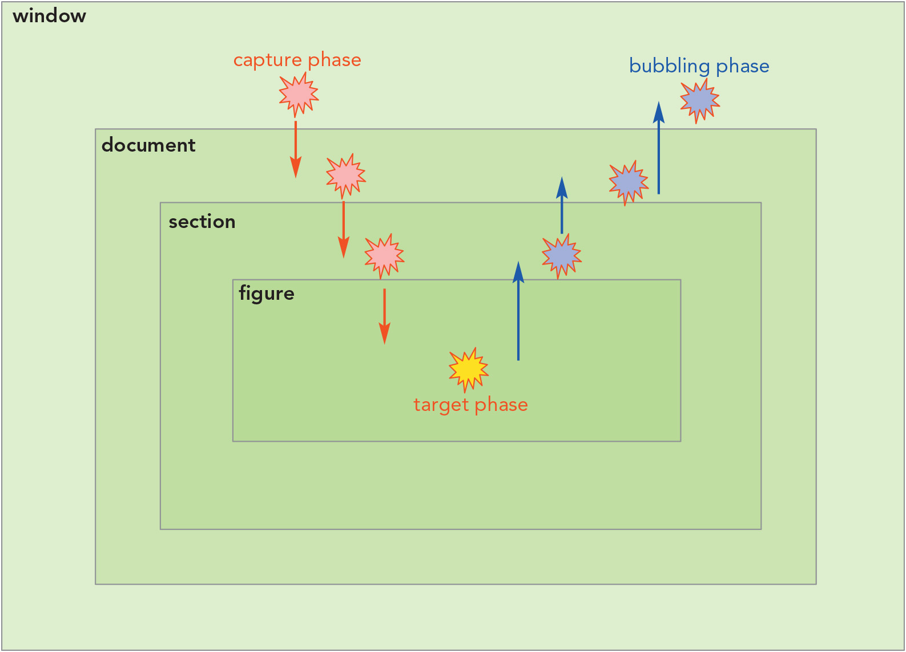
Working with Events as Objects (2 of 6)
Figure 10-3 Capturing and bubbling of events

Slide 6
Working with Events as Objects (3 of 6)
Event capturing and bubbling
All events support the event.target property, which returns a reference to the object that initiated the event based on the way events propagate through the web document
During propagation, events:
Move down the object hierarchy from the window to the innermost object during the capture phase
Reach the innermost object at the target phase
Move back up the hierarchy from the innermost object to the window during the bubbling phase

Slide 7
Working with Events as Objects (4 of 6)
Event capturing and bubbling (continued)
Event listeners listen for events during the bubbling phase by default and offer greater flexibility than event listeners in responding to events
Syntax to listen during the capture phase: addEventListener(event_name, true)
Syntax to prevent an event from propagating to the next object: stopPropagation()
Event handlers respond to the event at the target phase
The currentTarget property returns the object that is currently experiencing the event
An onclick event handler can be used to copy a clicked element and append it as a new child element of an existing element
The CSS zIndex property determines how overlapping page objects are displayed, so giving a new element a higher z-Index value will cause it to appear on top

Slide 8
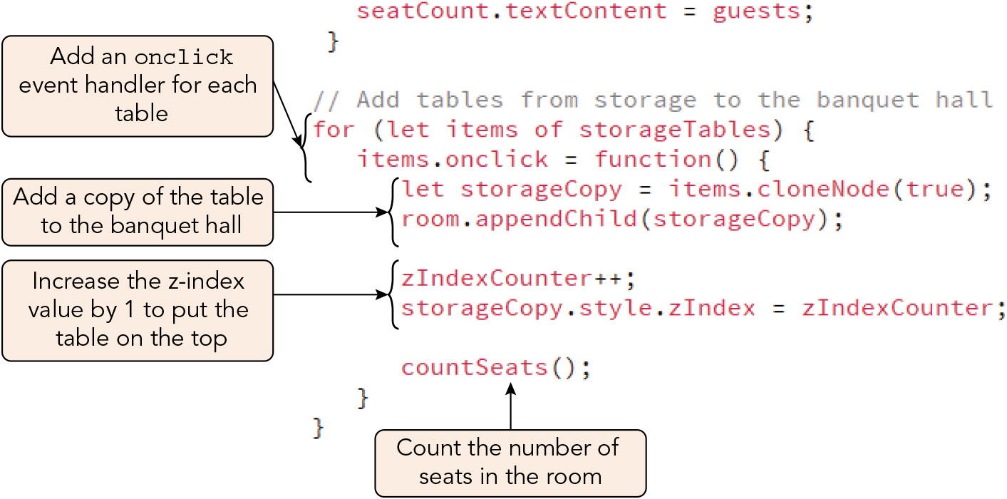
Working with Events as Objects (5 of 6)
Figure 10-4 Creating event handlers for the tables in storage

Slide 9
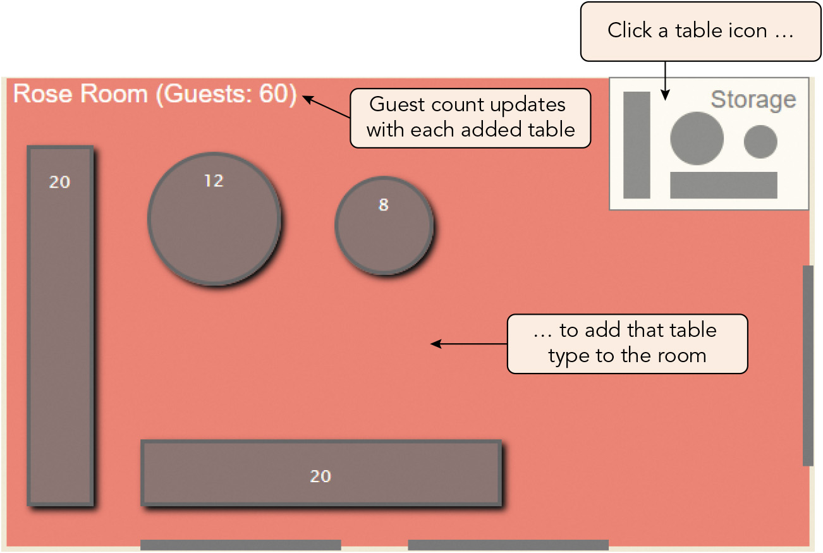
Working with Events as Objects (6 of 6)
Figure 10-5 Adding tables to the Rose Room

Slide 10
Exploring Mouse, Touch, and Pointer Events (1 of 8)
A mouse action can combine several events in quick succession
E.g., clicking a mouse combines three events fired in this order:
mousedown (button is pressed)
mouseup (button is released)
click (button is pressed and released)
Moving a mouse pointer causes the mousemove event to be fired continuously
The mouse event button or buttons property indicates which mouse button was pressed

Slide 11
Exploring Mouse, Touch, and Pointer Events (2 of 8)
Sample code for disabling the browser's context menu for a right-click so that a different action (logging to the console) can be substituted: element.oncontextmenu = function() { return false; } element.onmouseup = function(e) { e.preventDefault(); e.stopPropagation(); if (e.button === 2) { console.log("Right mouse button clicked"); } }

Slide 12
Exploring Mouse, Touch, and Pointer Events (3 of 8)
Exploring touch events
A mouse event consists of a single point of contact and is a single interface
A touch event may involve multiple simultaneous contact points and consists of three interfaces:
Touch interface: user touches the screen at a single point called a touchpoint
TouchList interface: user creates several touchpoints simultaneously
TouchEvent interface: the state of touchpoints on the touch surface changes
Touchscreen browsers emulate mouse events so that a tap on the screen initiates a touch cascade consisting of touch and mouse events

Slide 13
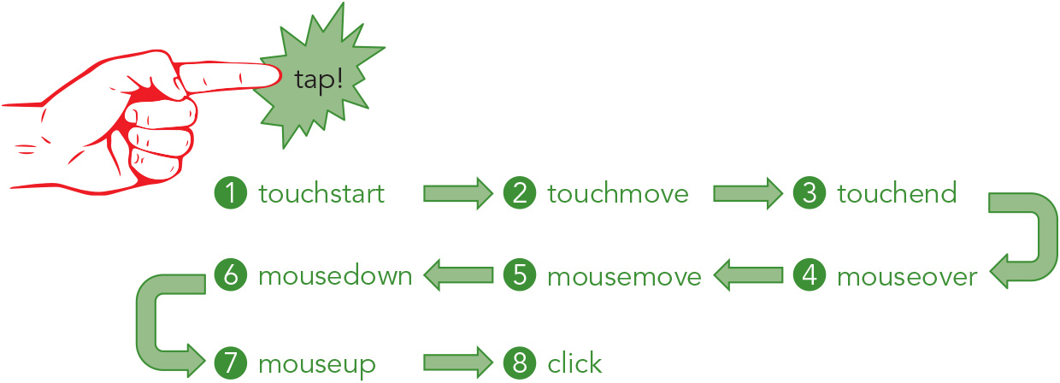
Exploring Mouse, Touch, and Pointer Events (4 of 8)
Figure 10-9 The touch cascade for a tap action

Slide 14
Exploring Mouse, Touch, and Pointer Events (5 of 8)
Exploring touch events (continued)
Syntax for managing the cascade by preventing the browser's default method emulating mouse events from being invoked (this approach can become complicated): element.ontouchstart = function(e) { commands for the touchstart event e.preventDefault(); }
Syntax for disabling the browser's actions associated with touch events by using the CSS touch-action property: element.style.touchAction = "none";

Slide 15
Exploring Mouse, Touch, and Pointer Events (6 of 8)
Managing multiple touchpoints
Multiple touchpoints are stored in a TouchList object
The touches property returns an array of touchpoints related to a single touch action
The changedTouches object returns an array of touchpoints whose properties have changed
The targetTouches object returns an array of touchpoints within a specified element
Using pointer events
Pointer event: any action that involves using a device (mouse, touchscreen, stylus pen, etc.) to point at an object on the screen
Organizes mouse, touch, and other similar events "under one roof"

Slide 16
Exploring Mouse, Touch, and Pointer Events (7 of 8)
Event | Description
pointerdown | The pointer has become active such as when a mouse button is pressed down, or physical contact is made with a touch surface
pointerup | The pointer is no longer active
pointermove | The pointer has changed coordinates
pointerover | The pointer has moved over a specified element
pointerout | The pointer has moved out of a specified element
pointerenter | Similar to pointerover except that it does not bubble
pointerleave | Similar to pointerout except that it does not bubble
pointercancel | The pointer is no longer able to generate events

Slide 17
Exploring Mouse, Touch, and Pointer Events (8 of 8)
Using pointer events (continued)
Some pointer events are associated only with non-mouse devices such as stylus pens
Equivalencies for apps that need to accommodate both mouse and touch events:
pointerdown = mousedown = touchstart
pointerup = mouseup = touchend
pointermove = mousemove = touchmove
Sample event handler that would be interpreted as a mousedown event for a mouse and a touchstart event for a touchscreen: element.onpointerdown = function

Slide 18
Programming a Drag and Drop Action (1 of 9)
A drag and drop action proceeds through three phases:
The grab phase in which an element is selected at the pointerdown event
The move phase in which the element follows the motion of the pointer during the pointermove event
The drop phase in which the element is released at the pointerup event
To initiate the grab phase in response to a pointerdown event, add an event listener for this event that runs a function that stores the positions of the pointer and element it is targeting
This data will be required during the move phase

Slide 19
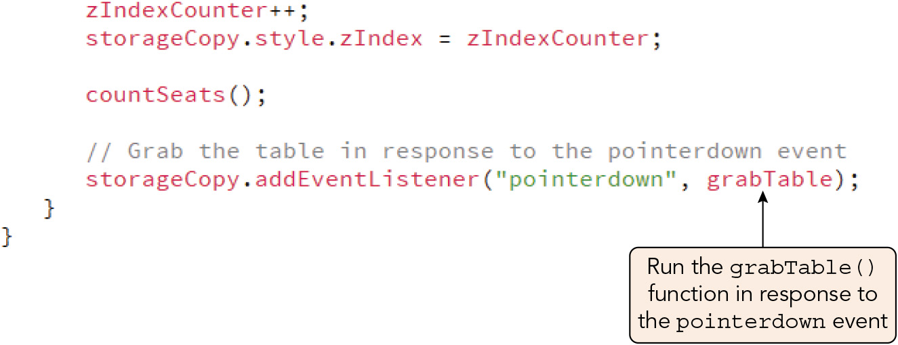
Programming a Drag and Drop Action (2 of 9)
Figure 10-12 Listening for the pointerdown event

Slide 20
Programming a Drag and Drop Action (3 of 9)
Finding event coordinates
Event coordinate properties return the pointer's relative location in pixels
e.offsetX and e.offsetY are relative to the top-left corner of the element
e.clientX and e.clientY are relative to the top-left corner of the browser window or viewport
e.pageX and e.pageY are relative to the top-left corner of the web page
e.screenX and e.screenY are relative to the top-left corner of the screen
The horizontal and vertical coordinates of an element within its parent, measured in pixels, are retrieved with the elem.offsetLeft and elem.offsetTop properties
Element must be placed within its parent with its CSS position property set to absolute and the position property of the parent set to relative or absolute
The function run in response to the pointerdown event during a drag and drop interaction should include event listeners for the pointermove and pointerup events

Slide 21
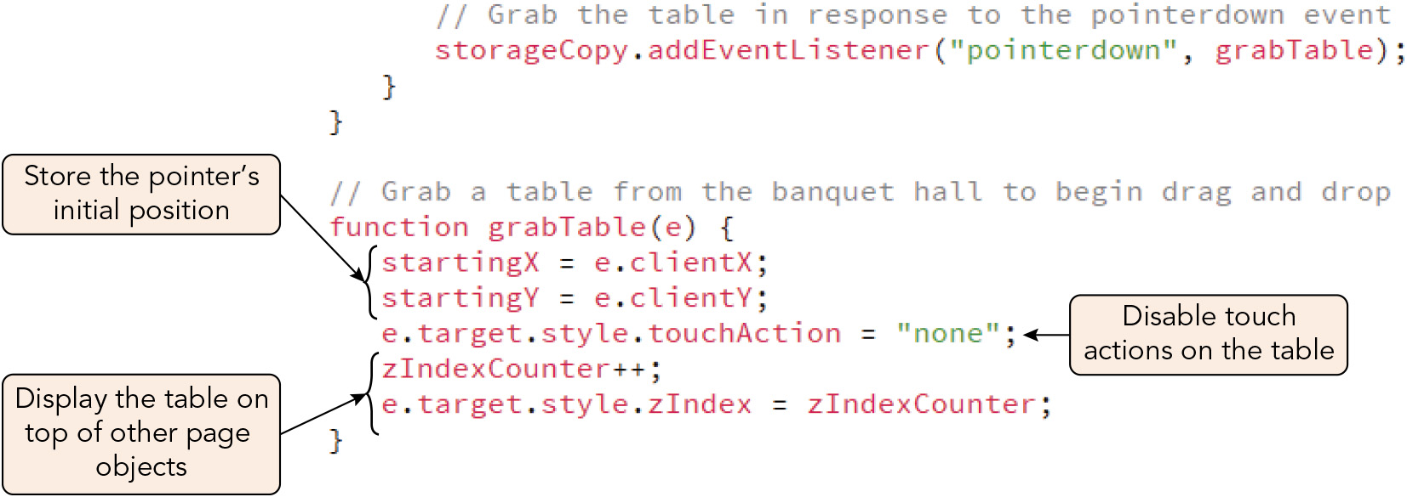
Programming a Drag and Drop Action (4 of 9)
Figure 10-14 The grabTable() function

Slide 22
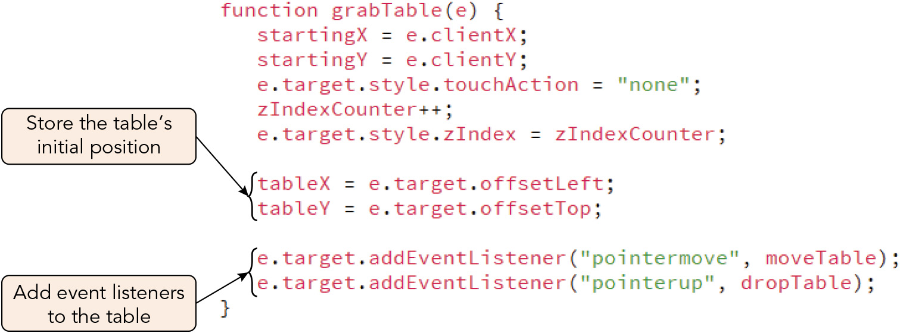
Programming a Drag and Drop Action (5 of 9)
Figure 10-15 Storing the table’s starting position

Slide 23
Programming a Drag and Drop Action (6 of 9)
Dragging and dropping an element
To drag an element, create a function that calculates the change in position of the pointer during the pointermove event and moves the selected object along with it
The dragging function might, for example:
Determine the X and Y coordinates for the pointer's current location and subtract the starting location coordinates (stored by the function run by the pointerdown event listener) to find the distance traveled in horizontal and vertical directions
Replace the dragged object's style.left and style.top properties with new coordinates by adding the distance moved in each direction to the original coordinates (again, stored by the pointerdown event function)
The dropping function should remove the event listeners for the pointermove and pointerup events to leave the dragged object in its new position

Slide 24
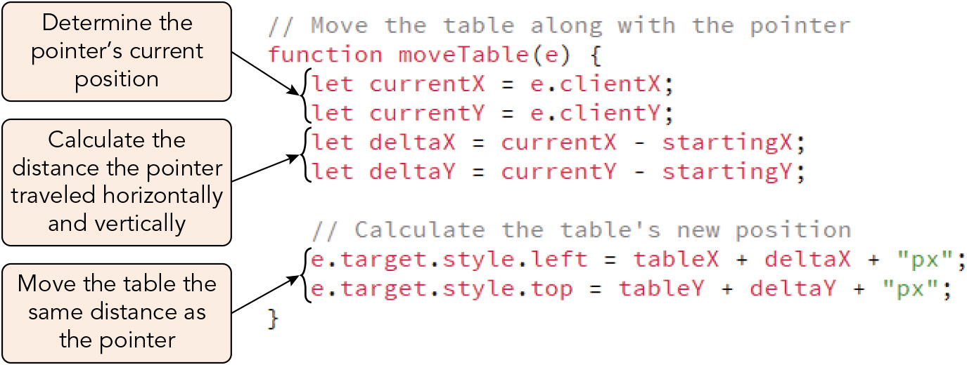
Programming a Drag and Drop Action (7 of 9)
Figure 10-16 The moveTable() function

Slide 25
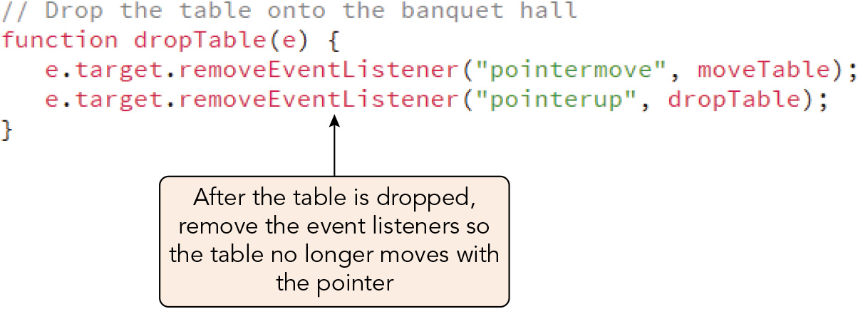
Programming a Drag and Drop Action (8 of 9)
Figure 10-17 The dropTable() function

Slide 26
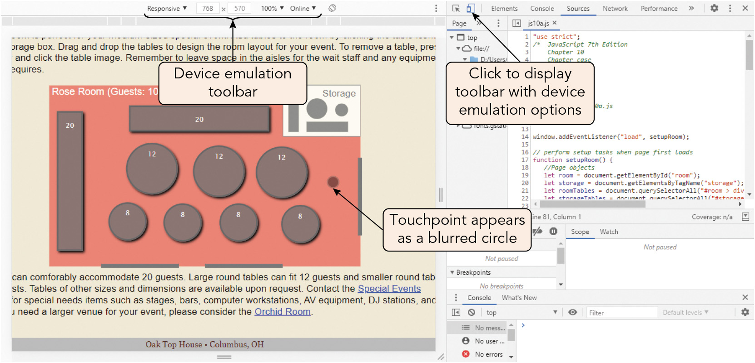
Programming a Drag and Drop Action (9 of 9)
Figure 10-19 Touchscreen emulation within Google Chrome

Slide 27
Activity 10.1: Knowledge Check
What pointer events are typically used to program a drag and drop action? What mouse and touch events do these correspond to?
Imagine you are programming a drag and drop action for a flower image that can be moved around within its parent element, a green box. What should the function run in response to each of the pointer events you named in Question 1 do?
Notes:
Instructions:
Use the Knowledge Check questions to periodically pose a question to students during class to gauge how well they can recall the material that was presented.

Slide 28
Activity 10.1: Knowledge Check Answers (1 of 3)
What pointer events are typically used to program a drag and drop action? What mouse and touch events do these correspond to? (1) pointerdown, equivalent to mousedown or touchstart (2) pointermove, equivalent to mousemove or touchmove (3) pointerup, equivalent to mouseup or touchend
Notes:
Instructions:
Use the Knowledge Check questions to periodically pose a question to students during class to gauge how well they can recall the material that was presented.

Slide 29
Activity 10.1: Knowledge Check Answers (2 of 3)
Imagine you are programming a drag and drop action for a flower image that can be moved around within its parent element, a green box. What should the function run in response to each of the pointer events you named in Question 1 do? (1) Function for pointerdown event: Store the horizontal and vertical event coordinates (i.e., the position of the pointer at the moment the event is fired) and the coordinates of the target element at the moment of the event in variables. Disable the default browser touch actions around the target of the event. Change the appearance of the target element if desired. Add event listeners for the pointermove and pointerup events. (2) Function for pointermove event: Store the horizontal and vertical event coordinates in variables. Assign the difference between each coordinate and the corresponding coordinate stored by the function for the pointerdown event (i.e., calculated distance the pointer was moved) to variables. Change the coordinates of the target of the event by the same distances.
Notes:
Instructions:
Use the Knowledge Check questions to periodically pose a question to students during class to gauge how well they can recall the material that was presented.

Slide 30
Activity 10.1: Knowledge Check Answers (3 of 3)
Imagine you are programming a drag and drop action for a flower image that can be moved around within its parent element, a green box. What should the function run in response to each of the pointer events you named in Question 1 do? (continued) (3) Function for pointerup event: Remove the event listeners for the pointermove and pointerup events. Change the appearance of the target element if desired.
Notes:
Instructions:
Use the Knowledge Check questions to periodically pose a question to students during class to gauge how well they can recall the material that was presented.

Slide 31
Exploring the Drag and Drop API (1 of 4)
Certain elements support drag and drop without JavaScript, e.g., hypertext links
Syntax for adding drag and drop support to other elements:
HTML: <element draggable = "true">
JavaScript: elem.draggable = "true"
The HTML Drag and Drop API
JavaScript manages draggable elements and drop zones, which can receive dragged items, using the Drag and Drop API (DnD API)
Events for draggable elements: dragstart, drag, dragend
Events for drop zones: dragenter, dragover, dragleave, drop
The DnD API leaves the task of recognizing when dragging and dropping have occurred to the browser rather than to pointer events

Slide 32
Exploring the Drag and Drop API (2 of 4)
The HTML Drag and Drop API (continued)
Syntax to manage the start of a dragging event for a draggable element: dragElem.ondragstart = function; or dragElem.addEventListener("dragstart", function);
Syntax to enable an element to act as a drop zone: dropZone.ondragover = function; or dropZone.addEventListener("dragover", function);
Syntax to release a dragged element into a drop zone when the user releases it: dropZone.ondrop = function; or dropZone.addEventListener("drop", function);
Functions for the dragover and drop events should begin with: event.preventDefault();
Remember: With the DnD API, the event target is based on the event, not the element being moved!

Slide 33
Exploring the Drag and Drop API (3 of 4)
Transferring data with drag and drop
Sample results of a drag and drop action using the DnD API:
Dragged element is moved into the drop zone
A copy of the dragged element is added to the drop zone
Data from the dragged element is written into the drop zone
The DnD API transfers information about the draggable element by storing it in a dataTransfer object
Sample code to store the id of the dragged element (referenced by e.target): e.dataTransfer.setData("text", e.target.id)
Sample code to retrieve the stored id during a drop event: e.dataTransfer.getData("text")
Limitation of DnD API: not well supported on touch devices
Set the draggable attribute of naturally draggable elements to "false" to manage them using only pointer events

Slide 34
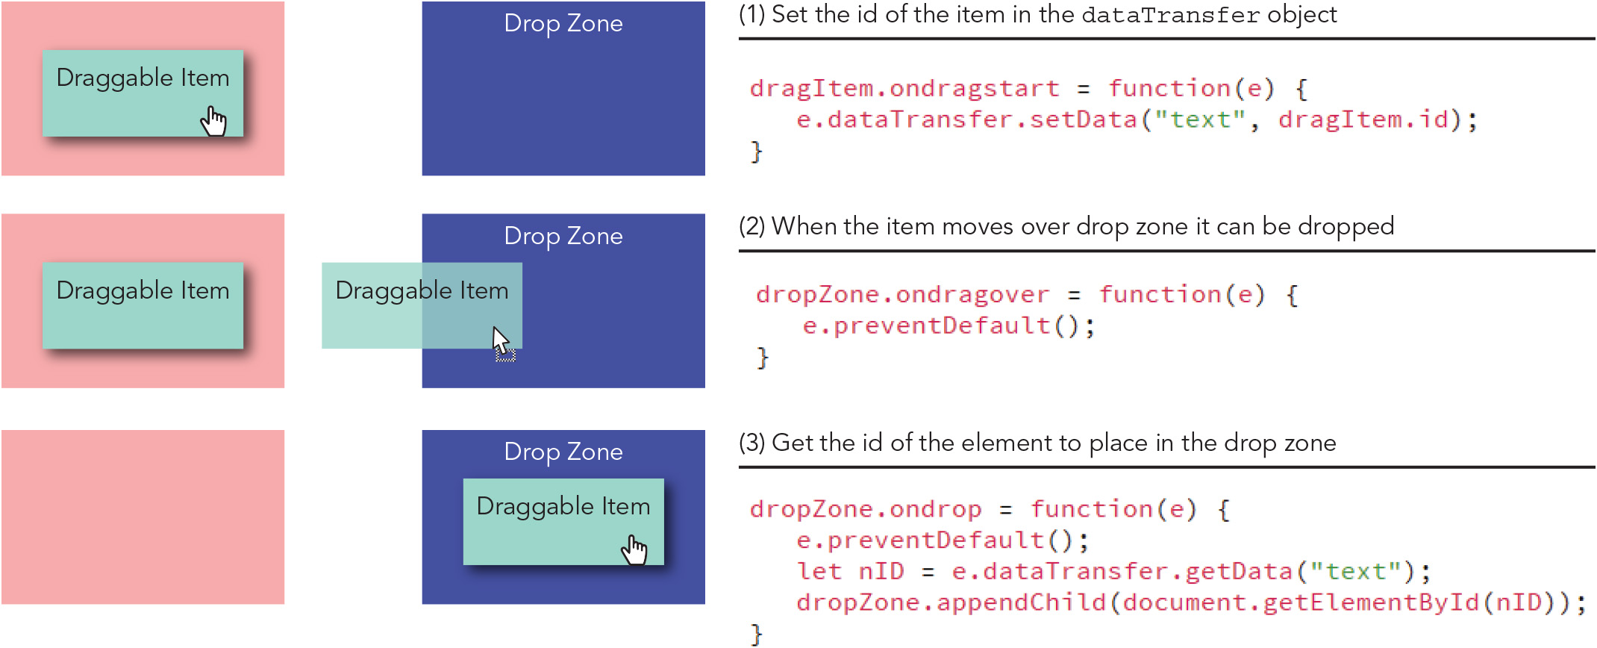
Exploring the Drag and Drop API (4 of 4)
Figure 10-22 Moving an object using the Drag and Drop API

Slide 35
Working with Keyboard Events (1 of 3)
Events fired when a user presses a key on the keyboard, in order:
keydown: the key is pressed down
keypress: a character is created because the key is pressed and released
keyup: the key is released
Properties accessed to determine which key the user pressed:
code: returns the name of the key (e.g., "KeyA")
key: returns the character generated (e.g., "a")
JavaScript supports the modifier keys Alt, Ctrl, Shift, and Command
The altKey, ctrlKey, shiftKey, and metaKey properties return true if the key is depressed during an event
You can combine these properties with pointer events when writing an event handler or listener

Slide 36
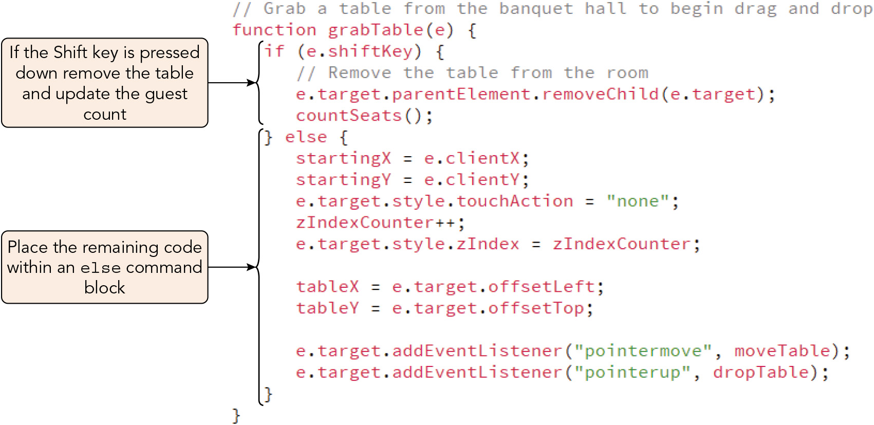
Working with Keyboard Events (2 of 3)
Figure 10-25 Responding to a keyboard event

Slide 37
Working with Keyboard Events (3 of 3)
Making drag and drop user-friendly
Create visual cues for objects that are draggable
During the drag, choose a cursor style that reflects the action
Provide visual clues for the drop zones
Enable dropped items to "snap to" a point when the object is close
Provide touchscreen users with at least one square centimeter of space for grabbing an item
To increase accessibility, enable keyboard events and provide messages to screen readers

Slide 38
Creating an Interactive Map (1 of 9)
Getting started with the Google Maps API
The popular Google Maps API allows developers to add maps augmented with pins or show travel routes between locations
To use this API, you must set up a billing account with Google Cloud (which comes with $200/month free usage), create and enable a project, and obtain an API key through their website
API key: a string of characters passed from your application to an API platform, verifying you are the owner of an account and project that has access to the tools built into the API
HTML script element that makes the Google Maps API accessible to a website: <script src="https://maps.googleapis.com/maps/api/js?key=keyID&callback=function"> </script>
keyID is your API key for this project
function is a callback function called by the API to generate a map

Slide 39
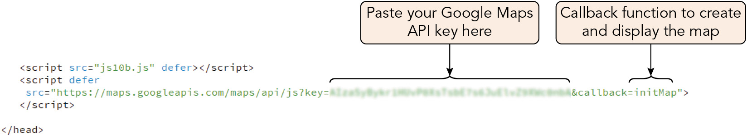
Creating an Interactive Map (2 of 9)
Figure 10-26 Linking to the Google Maps API

Slide 40
Creating an Interactive Map (3 of 9)
The map object
Syntax to create a map object using its new object constructor: let map = new google.maps.Map(element, mapOpt);
map is the variable name for the map and element references a page element in which the map is displayed
Syntax for mapOpt object literal: mapOpt = { zoom: zoomValue, center: LatLng, other map properties }
zoomValue ranges from 0 to 20
Syntax for LatLng object literal: {lat: latitude, lng: longitude}

Slide 41
Creating an Interactive Map (4 of 9)
The map object (continued)
Syntax to change the coordinates using the map object's LatLng() method (both must be replaced): new google.maps.LatLng(latitude, longitude)
Sample call to the constructor to create a Google Map without map controls for street view, map type, and full-screen view: let map = new google.maps.Map(elem, { zoom: 11, center: { lat: 39.96118, lng: -82.99879} streetViewControl: false, mapTypeControl: false, fullscreenControl: false });

Slide 42
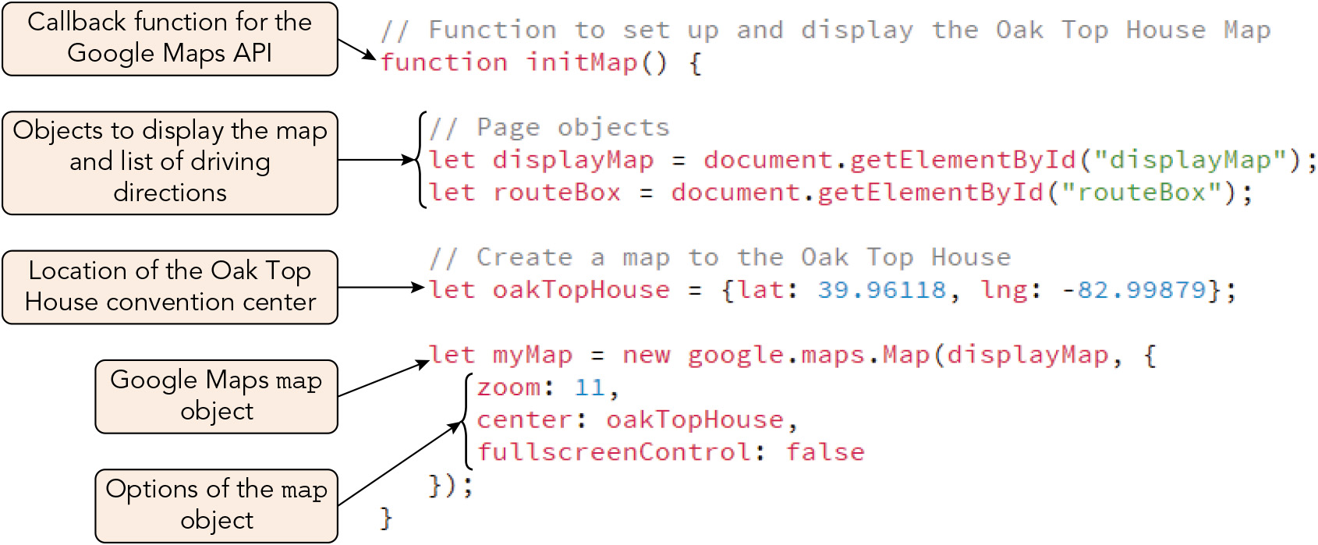
Creating an Interactive Map (5 of 9)
Figure 10-27 Creating a map object

Slide 43
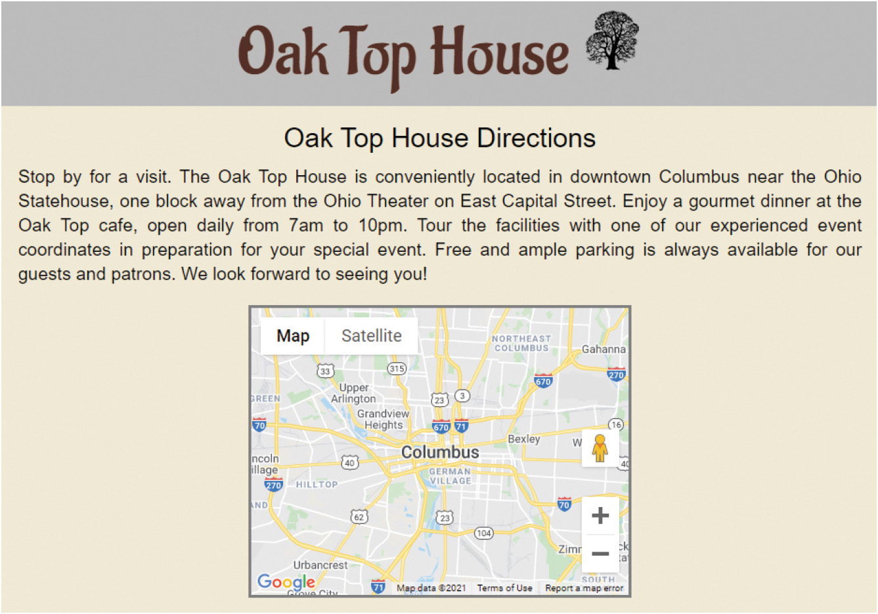
Creating an Interactive Map (6 of 9)
Figure 10-28 Google map of the Oak Top House location

Slide 44
Creating an Interactive Map (7 of 9)
Adding map pins
Syntax for creating a map pin (a.k.a. marker) using the object constructor: markerOpt = { position: LatLng, // latitude/longitude object map: map, // map object title: "title" // hover-over tool tip text icon: image, // marker image file label: text // marker label text }
Alternative syntax for adding a map marker: marker.setMap(map)
Syntax for removing a marker: marker.setMap(null)

Slide 45
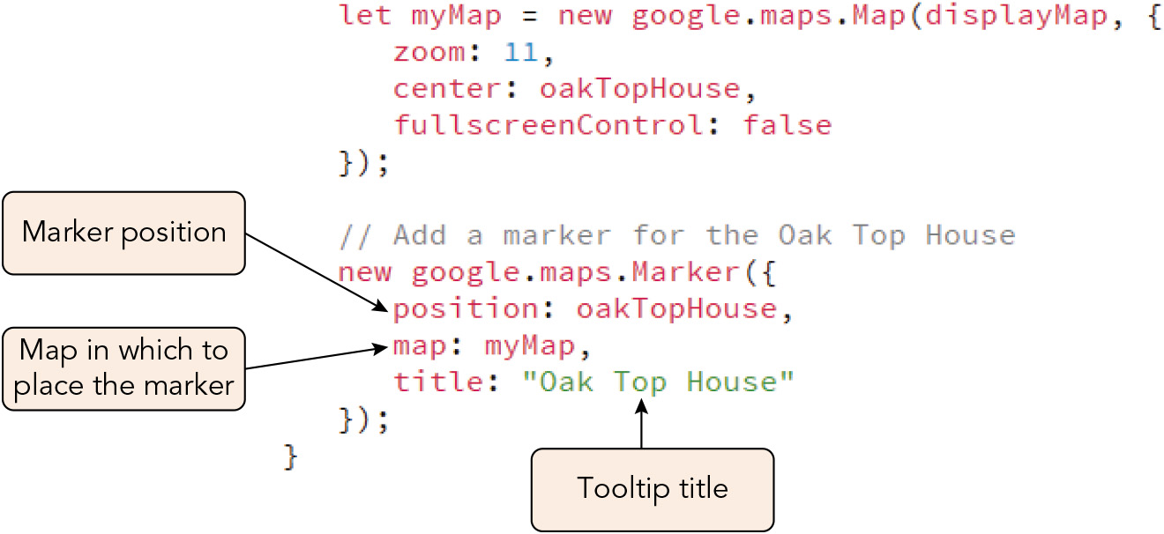
Creating an Interactive Map (8 of 9)
Figure 10-29 Adding a marker to a map

Slide 46
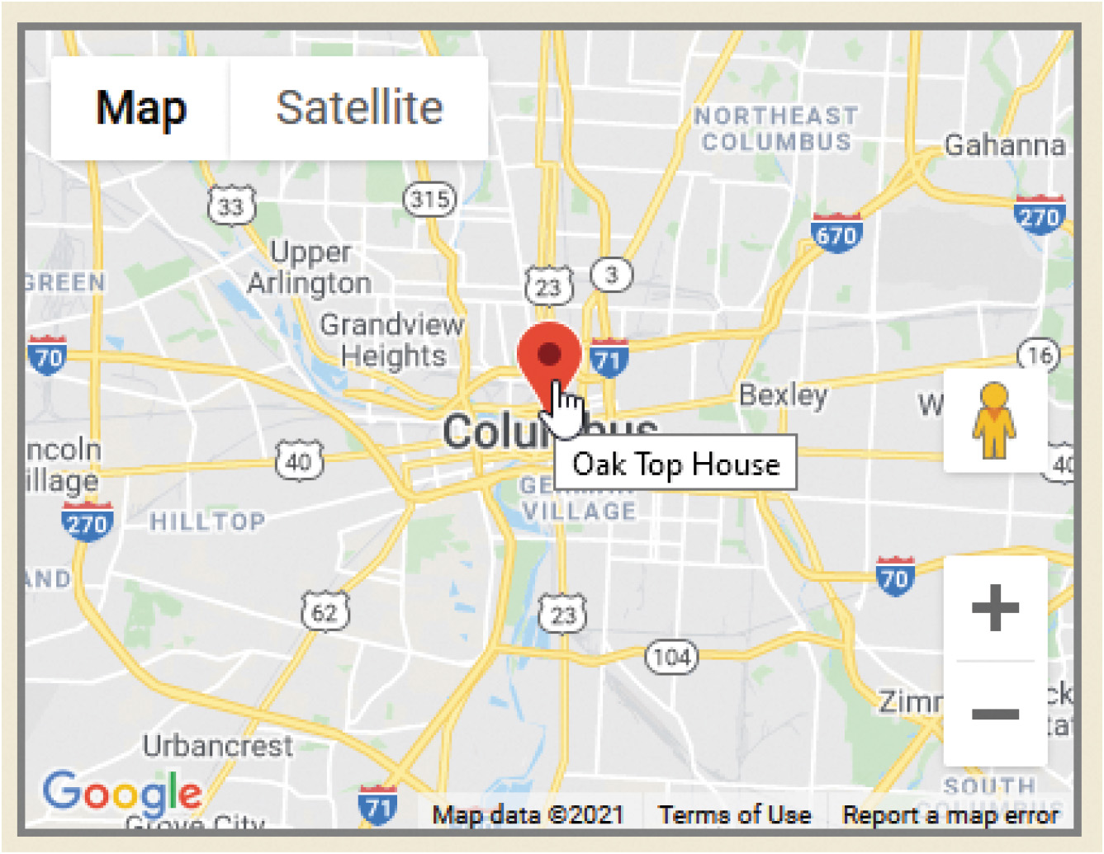
Creating an Interactive Map (9 of 9)
Figure 10-30 Marker with tooltip

Slide 47
Mapping Your Position with Geolocation (1 of 5)
Geolocation: the process that determines the position of a client device using either a built-in GPS receiver or information drawn from the client's network IP address
Geolocation data is accessed using the Geolocation API
Syntax for retrieving the global position of the client device, where success is a callback function to run upon success, fail is an optional callback function to handle failure, and opt is one or more optional geolocation parameters: navigator.geolocation.getCurrentPosition(success, fail, opt)
Syntax for the success-handling function: function success(position) { Commands involving the position object }
The position parameter provides the position object containing data on the device's position

Slide 48
Mapping Your Position with Geolocation (2 of 5)
Syntax for the failure-handling function: function fail(error) { Commands involving the error object }
The error object supports two properties:
code property: contains the error number
message property: contains a description of the error
Properties and values supported by the optional opt parameter of the getCurrentPosition() method: { enableHighAccuracy: Boolean, // retrieve high-accuracy position timeout: value, // milliseconds before timeout maximumAge: value // max age (ms) of cached position }

Slide 49
Mapping Your Position with Geolocation (3 of 5)
Sample call to the getCurrentPosition() method with callback functions to handle success and failure: navigator.geolocation.getCurrentPosition(getPos, handleError); function getPos(pos) { console.log("Latitude = " + pos.coords.latitude); console.log("Longitude = " + pos.coords.longitude); } function handleError(err) { console.log("Unable to get location."); console.log("Error Code: " + err.code); console.log("Reason : " + err.message); }

Slide 50
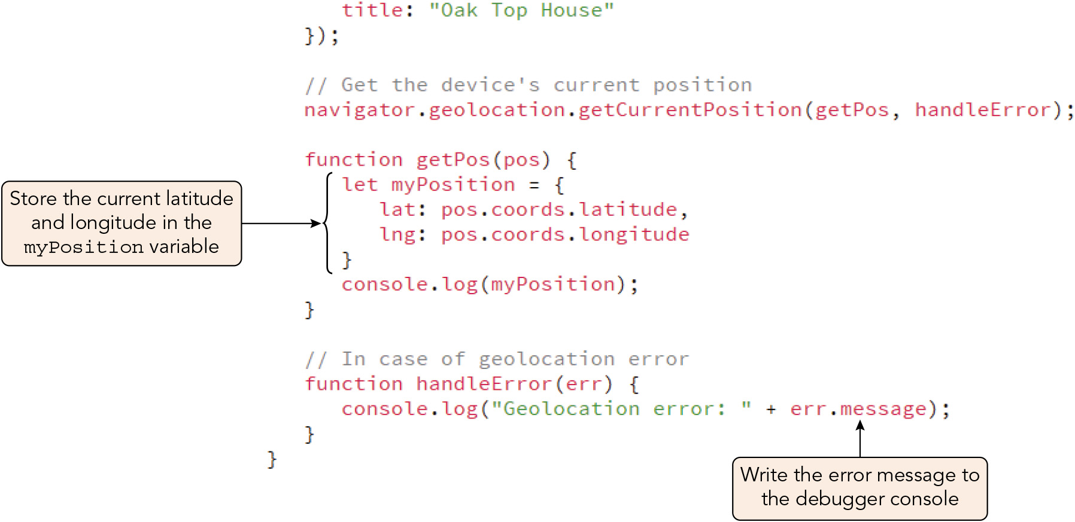
Mapping Your Position with Geolocation (4 of 5)
Figure 10-32 Getting the device’s current position

Slide 51
Mapping Your Position with Geolocation (5 of 5)
Syntax for continually updating position data in response to movement: id = navigator.geolocation.watchPosition(success, fail, opt)
id is a timer ID registering the repeated invocations of the function
Very resource-intensive method
Syntax for clearing the watchPosition() method: navigator.geolocation.clearWatch(id)
Handling errors with geolocation
Use a modern browser version
Enable location services on your browser or device
Ask the network administrator about access restrictions
Reboot the computing device

Slide 52
Adding Directions to a Map (1 of 9)
Google Maps API objects for managing directions:
DirectionsService object, which queries the Google Maps Directions Service to find the most efficient route between two locations for a given mode of travel
DirectionsRenderer object, which draws the route on a map or writes the turn-by-turn directions to the web page
Both must be instantiated before use

Slide 53
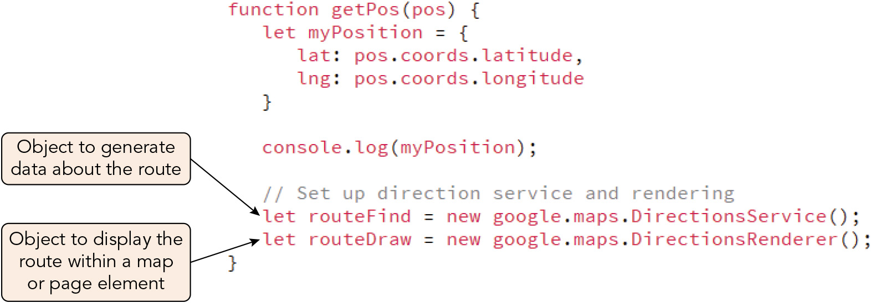
Adding Directions to a Map (2 of 9)
Figure 10-34 The device’s current position

Slide 54
Adding Directions to a Map (3 of 9)
The route object
Syntax for object describing a route that can be passed in to the directions service: route = { origin: location, // LatLng object or location name destination: location, // same travelMode: type // travel conveyance }
Travel modes: DRIVING, BICYCLING, TRANSIT, WALKING
Sample cycling route to Mount Rushmore National Monument: route = { origin: {lat: 43.932652, lng: -103.576607}, destination: "Mount Rushmore, SD", travelMode: "BICYCLING" }

Slide 55
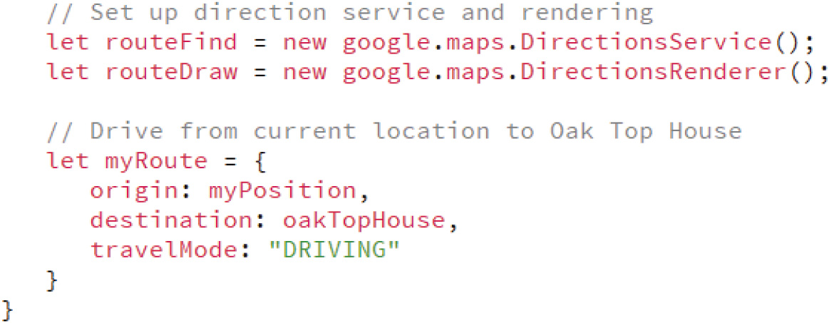
Adding Directions to a Map (4 of 9)
Figure 10-35 Route object from your location to the convention center

Slide 56
Adding Directions to a Map (5 of 9)
Displaying the driving route
Syntax for generating directions using the route() method: directionsService.route(routeObj, callback);
Syntax for the callback function argument for the route() method: function callback(result, status) { if (status === "OK") { display the result } else { report an error } }
Syntax for storing "OK" directions in a DirectionsRenderer object: directionsRenderer.setDirections(result)

Slide 57
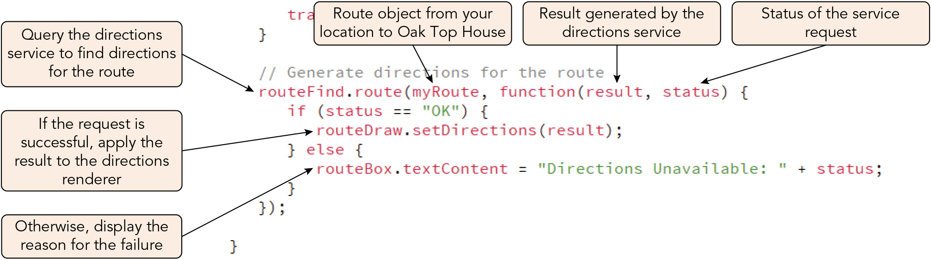
Adding Directions to a Map (6 of 9)
Figure 10-36 Generating directions for the route

Slide 58
Adding Directions to a Map (7 of 9)
Displaying the driving route (continued)
Callback: any executable code that is called to complete a task or return a value
Synchronous callback: a callback that accomplishes its task before returning control to the caller, and can thus cause the script to stall for a long or difficult task
Asynchronous callback: a callback that releases the program execution as it works on its task so that the callback and the rest of the code are working in parallel, and thus requires that the code ensure that a result is provided before the code that needs that result attempts to execute
Syntax for placing a route on the map using the directionsRenderer object's setMap() method: directionsRenderer.setMap(map)
Syntax for displaying turn-by-turn directions within a web page element using the object's setPanel() method: directionsRenderer.setPanel(elem)

Slide 59
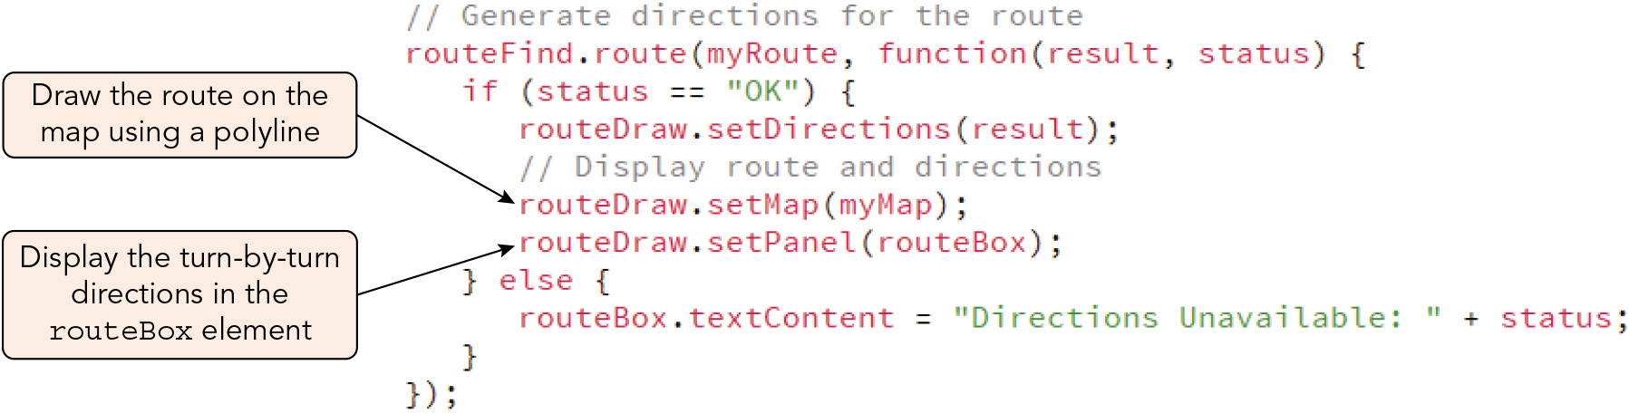
Adding Directions to a Map (8 of 9)
Figure 10-37 Displaying the travel route

Slide 60
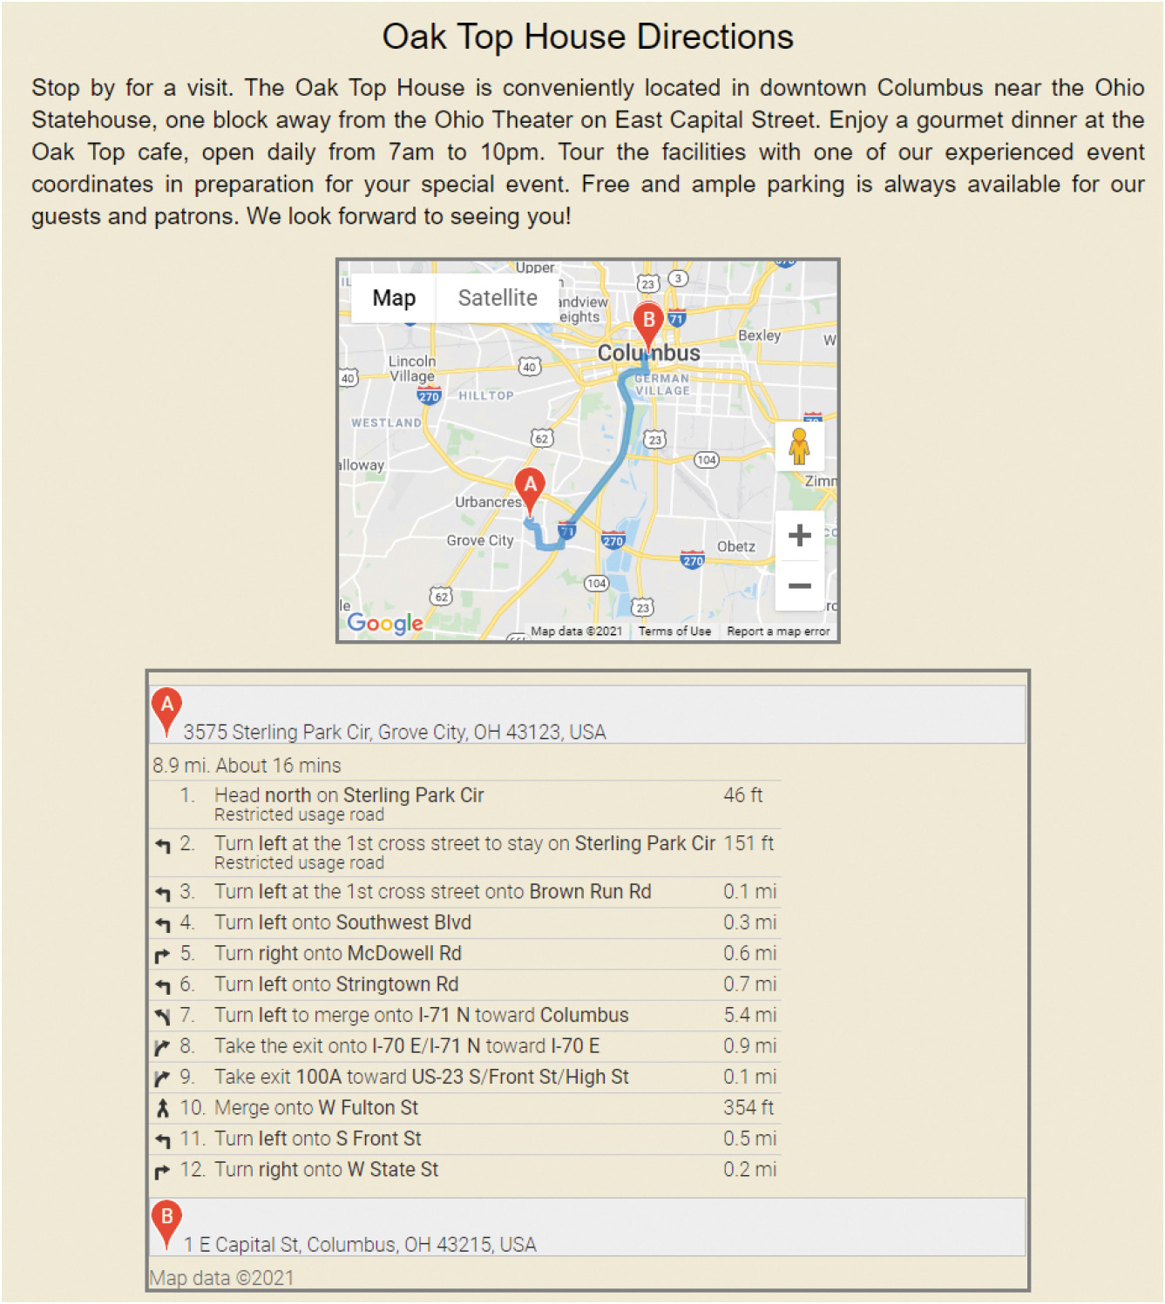
Adding Directions to a Map (9 of 9)
Figure 10-38 Route and directions to the Oak Top House

Slide 61
Activity 10.2: Think, Pair, and Share
Form pairs/groups of two to four class members.
As a group, select two vacation destinations that are accessible from your current location by traveling over land. Choose an overland travel mode that you can realistically and comfortably use to reach each destination.
Make a copy of the source code for the Oak Top House map and directions page from Chapter 10. Modify the page so that users can select either one of the two chosen locations and see a map and directions to it displayed.
Notes:
Instructions:
Use the Think, Pair, Share activity to encourage students to solve problems collaboratively and to apply the real-world skill of evaluating, modifying, and debugging code created by another programmer.

Slide 62
Introducing the Device Orientation API
The Device Orientation API provides access to data from specialized hardware in many mobile devices for detecting changes in position and speed through its deviceorientation and devicemotion events
Common hardware:
Gyroscope: a device that detects its orientation in space
Accelerometer: a device that detects changes in speed
The deviceorientation event reports a set of coordinates with the property names alpha (x axis), beta (y axis), and gamma (z axis)
You can compare changes in orientation mathematically to respond to user actions such as tilting the device
The devicemotion event reports values for acceleration and rotation

Slide 63
Preparing an App for Mobile Use (1 of 3)
Testing tools
Mobile browsers are distinct from desktop versions, so web apps should be tested on both versions
Browsers provide built-in device emulation features, but these don't capture all the subtleties of the actual devices
Mobile device testing services allow developers to interact with multiple devices
Minimizing download size
Mobile network speed limitations and the cost of bandwidth can impair performance of web/mobile apps that must download a lot of data
Strategies for minimizing download size include loading scripts responsibly, minifying files, and dividing up the code for large, complex apps into smaller pieces that can be downloaded as they are needed by the user

Slide 64
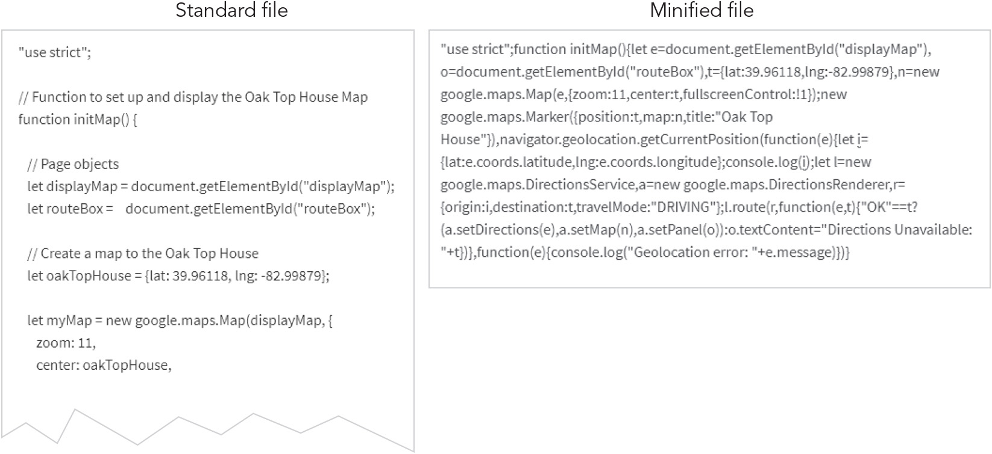
Preparing an App for Mobile Use (2 of 3)
Figure 10-39 Minifying a JavaScript file

Slide 65
Preparing an App for Mobile Use (3 of 3)
Minifying files means removing comments, indents, and line breaks, and tweaking the code in other ways to make the file size smaller
Minify files right before publishing, only after completing debugging
Always keep non-minified versions of files for future revisions
Making your app transparent
When browsers ask users for permission before acquiring geolocation data, this is an example of data transparency
Data transparency: the process of making it clear to users what information your app wants to collect from them and how you intend to use it
Being transparent with data requests and use builds trust with app users and helps colleagues understand what your app does, why, and what it requires from the user

Slide 66
Activity 10.3: Discussion Questions
Brainstorm some examples of how geolocation information is used in modern web apps.
Why would you advise for or against minifying a file for a desktop app? For a mobile app? Explain.
Notes:
Instructions:
Use the Discussion activity to encourage group conversation about a related topic of interest.

Slide 67
Self-Assessment
Imagine that you have been hired to write JavaScript code for a web page that features a complex drag and drop action. Would you prefer to use pointer events or the Drag and Drop API to program this page? What information would you request from your client to determine the most appropriate programming approach?
Would you like to learn more about using the Google Maps API and its more advanced features? Do you expect to use this API frequently as a professional developer?
Which of the APIs you read about in Chapter 10 was the most interesting or exciting to you? Which was the least appealing?
Notes:
Instructions:
Use the Self-Assessment question to encourage students to evaluate their progress or goals in the course, as well as determine how they might apply their learning or grow as an individual.

Slide 68
Summary
Now that the lesson has ended, you should have learned to:
Write code for event objects and event properties.
Work with events for mice, touchscreens, and pointer devices.
Program a drag and drop action using pointer events.
Create drag and drop interfaces using the Drag and Drop API.
Write code that responds to keyboard events.
Create interactive maps using the Google Maps API.
Locate your position using geolocation.
Add routes and directions to a Google Map using the Google Directions and Renderer services.
Use the Device Orientation API to detect changes in client device speed and position.
Create more efficient code for mobile devices by reducing script numbers and sizes.
Notes:
Instructions: Reiterate the learning objectives for the lesson. Students should use this information to guide their studies and reinforcement of new concepts.

