Slide 1
JavaScript for Web Warriors, 7e Chapter 11: Managing Data Requests with AJAX and Fetch

Slide 2
Chapter Objectives (1 of 2)
By the end of this chapter, you should be able to:
Understand the nature of server requests and responses.
Work with the content of HTTP messages.
Create HTTP request objects using AJAX.
View the status of an HTTP request and response.
Understand the limitations of AJAX and nested callbacks.
Write functions in arrow function syntax.
Notes:
Instructions: Briefly review with students the major concepts you will be covering during this class. There is one objective for every major A-head section of the chapter.

Slide 3
Chapter Objectives (2 of 2)
By the end of this chapter, you should be able to:
Create and use promise objects.
Manage requests and responses using the Fetch API.
Retrieve content written in XML.
Create an autocomplete search box.
Work with third-party APIs.
Manage security issues with third-party APIs.
Notes:
Instructions: Briefly review with students the major concepts you will be covering during this class. There is one objective for every major A-head section of the chapter.

Slide 4
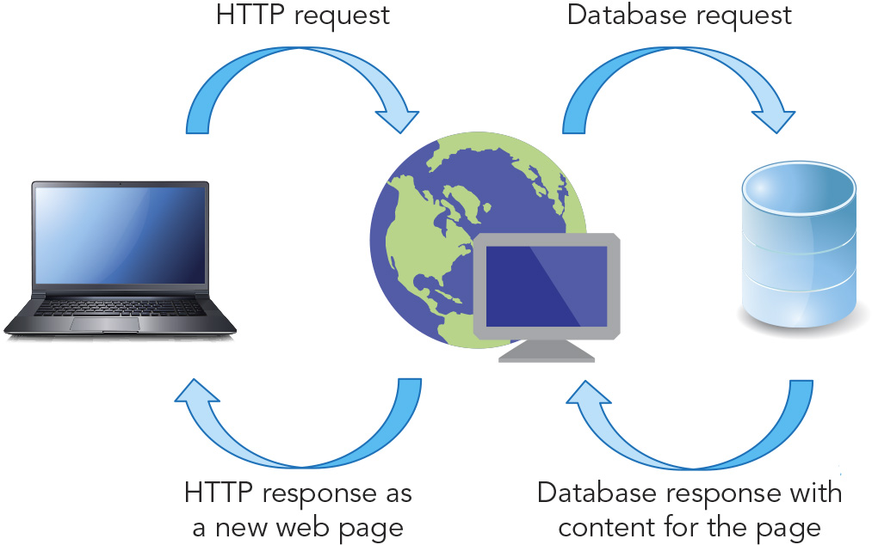
Introducing Server Requests (1 of 4)
Figure 11-1 Processing a web page

Slide 5
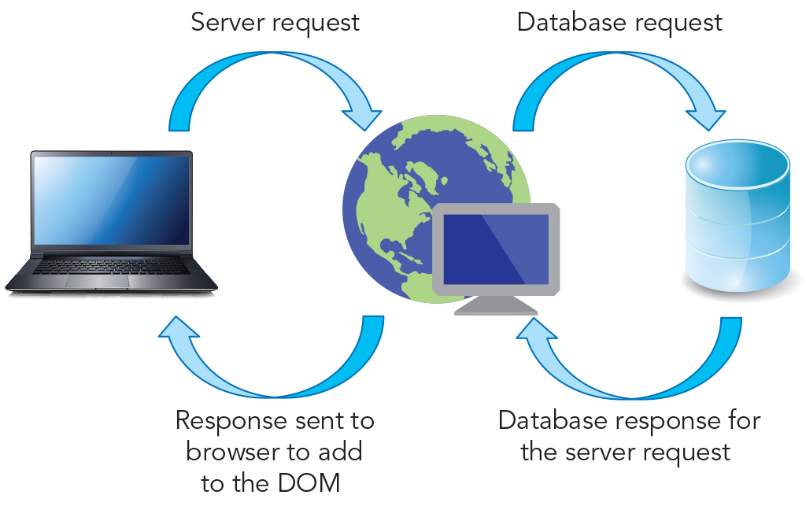
Introducing Server Requests (2 of 4)
Figure 11-3 Processing a server request

Slide 6
Introducing Server Requests (3 of 4)
With synchronous data transfer, once the browser has asked for a web page, nothing can be done on the client until the transfer is complete
Sending a request to the server, which then operates on that request and returns a response to the client, facilitates asynchronous data transfer, where the client can perform other tasks while awaiting a response
Chapter 11's sample project is a sport's blogger's web page
Uses asynchronous requests to retrieve content from a server
Requires a web server (where content files can be stored)

Slide 7
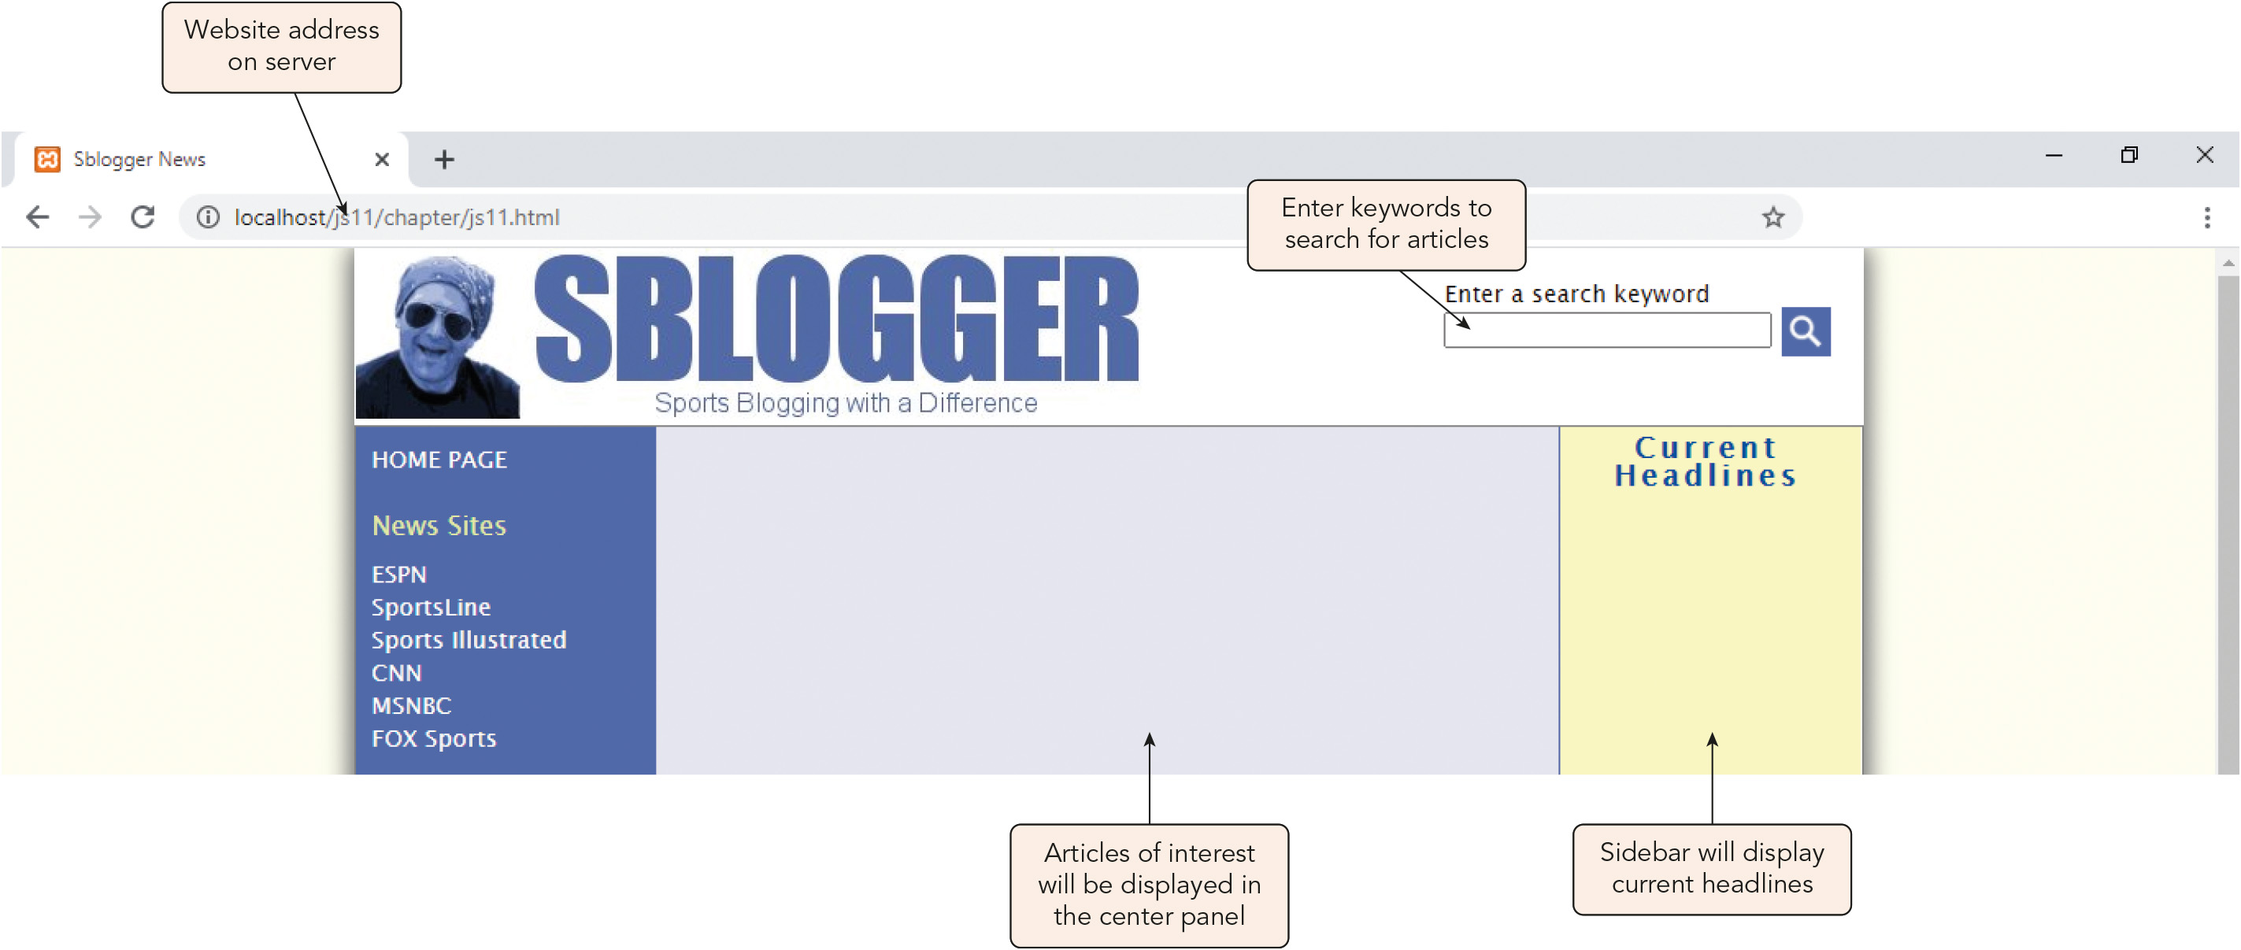
Introducing Server Requests (4 of 4)
Figure 11-4 Initial blogging page

Slide 8
Exploring HTTP Messages (1 of 2)
The Hypertext Transfer Protocol (HTTP) defines how an HTTP client makes a request of an HTTP server, and how the HTTP server returns a response to the HTTP client
Understanding HTTP messages
The HTTP client opens a connection to the server and submits a request encapsulated in an HTTP message
The HTTP server returns an HTTP message
General structure of the request or response message: start line header lines blank line message body

Slide 9
Exploring HTTP Messages (2 of 2)
Understanding HTTP messages (continued)
The start line identifies the request/response type, resource to access, and HTTP version, e.g.: GET submit.cgi?topic=Baseball HTTP/1.1 // Request HTTP/1.1 200 OK // Response
The header includes zero or more lines, each a name: value pair, e.g.: Connection: close Date: Wed, 26 June 2024 18:32:07 GMT Cache-Control: no-cache
Caching: the temporary storage of data on a local device for faster access
The optional message body might contain data needed for the request or returned with the response
GET and POST are among the most common types of HTTP requests
Others include HEAD, DELETE, OPTIONS, PUT, and TRACE

Slide 10
Introducing AJAX (1 of 9)
AJAX (Asynchronous JavaScript and XML): the technology for sending and receiving messages between the client and the server, which is based on the following three foundations:
Asynchronous responses managed in separate data streams
JavaScript as the only client-side programming language
XML as the data storage medium
Changes to AJAX since it was introduced by Jesse James Garrett in 2005:
JSON has replaced XML as the preferred language of data exchange
Better tools to manage server requests are available
The XMLHttpRequest (XHR) object
Object that AJAX is built upon
Used to send asynchronous requests from the client to the server over HTTP

Slide 11
Introducing AJAX (2 of 9)
The XMLHttpRequest (XHR) object (continued)
Syntax for instantiating a request object, where xhr is the variable that stores it: let xhr = new XMLHttpRequest()
Requests are defined using the open() method and sent using the send() method
xhr.open(method, url, async): method that specifies the type of request, where method is either GET or POST, url is the location of requested resource, and async is true to set up an asynchronous request or false to set up a synchronous request
xhr.send(content): method that submits a request using the information specified in the open() method; the optional content argument provides the message body (used only with POST requests)
Sample GET request definition, showing request data appended to the URL as a query string: let xhr = new XMLHttpRequest(); xhr.open("get", "submit.pl&id=41088")

Slide 12
Introducing AJAX (3 of 9)
The XMLHttpRequest (XHR) object (continued)
Sample synchronous GET request definition: xhr.open("get", "submit.pl&id=41088", false)
Sample code to define a POST request and send an id value to a server script: xhr.open("post", "submit.pl"); xhr.send("id=41088");
Sample use of the send() method when message body data is not needed: xhr.send(null)

Slide 13
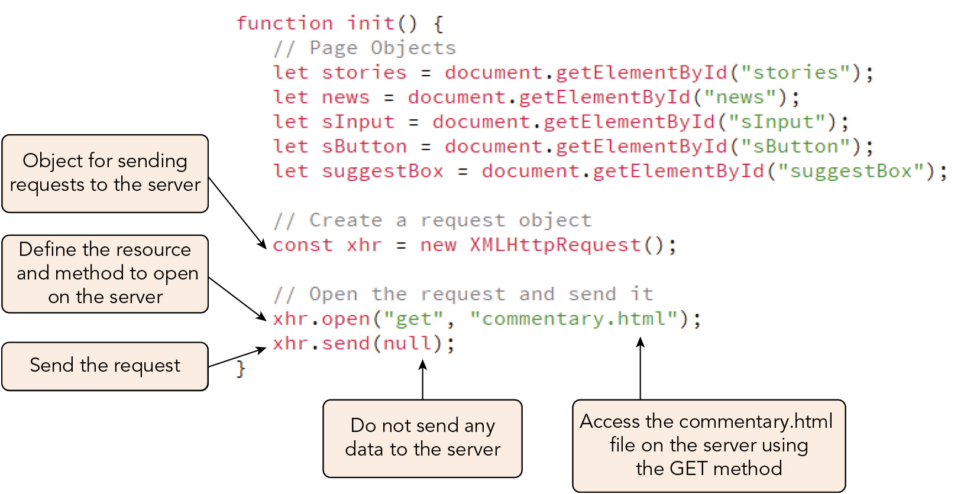
Introducing AJAX (4 of 9)
Figure 11-6 Creating a request object

Slide 14
Introducing AJAX (5 of 9)
Managing a response
The request object passes through five states during a request/response
UNSENT (0): the request object is created but not yet opened
OPENED (1): the open() method has been called
HEADERS_RECEIVED (2): the send() method has been called
LOADING (3): the browser has begun receiving a response from the server
COMPLETE (4): the response from the server is complete
Each change in state triggers a readystatechange event that can be managed using an event handler or listener applied to the request object: xhr.onreadystatechange = function; xhr.addEventListener("readystatechange", function)
Request object properties store information about the current state and contents of the object

Slide 15
Introducing AJAX (6 of 9)
Property | Description
xhr.readyState | Returns an integer indicating the current state of the request (0 = UNSENT, 1 = OPENED, 2 = HEADERS_RECEIVED, 3 = LOADING, 4 = COMPLETE)
xhr.status | Returns an integer indicating the status of the request (200 = “OK”, 404 = “Not Found”, etc.)
xhr.statusText | Returns a text string indicating the status of the request (“OK”, “Not Found”, etc.)
xhr.responseText | Returns the text of the response from the server
xhr.responseXML | Returns the response data as an XML DOM document

Slide 16
Introducing AJAX (7 of 9)
Managing a response (continued)
The readyState and status properties are used together to determine whether the response from the server was complete (readyState value of 4) and a successful connection with the server was made (status value of 200-300)
E.g., by creating an event handler for the readystatechange event
Common status codes include 200 ("OK"), 301 ("Moved Permanently"), 404 ("Not Found"), and 500 ("Internal Server Error")
Once the response is complete and the connection successful, you can evaluate the server response
The text of the response content is stored in the responseText or responseXML property of the request object

Slide 17
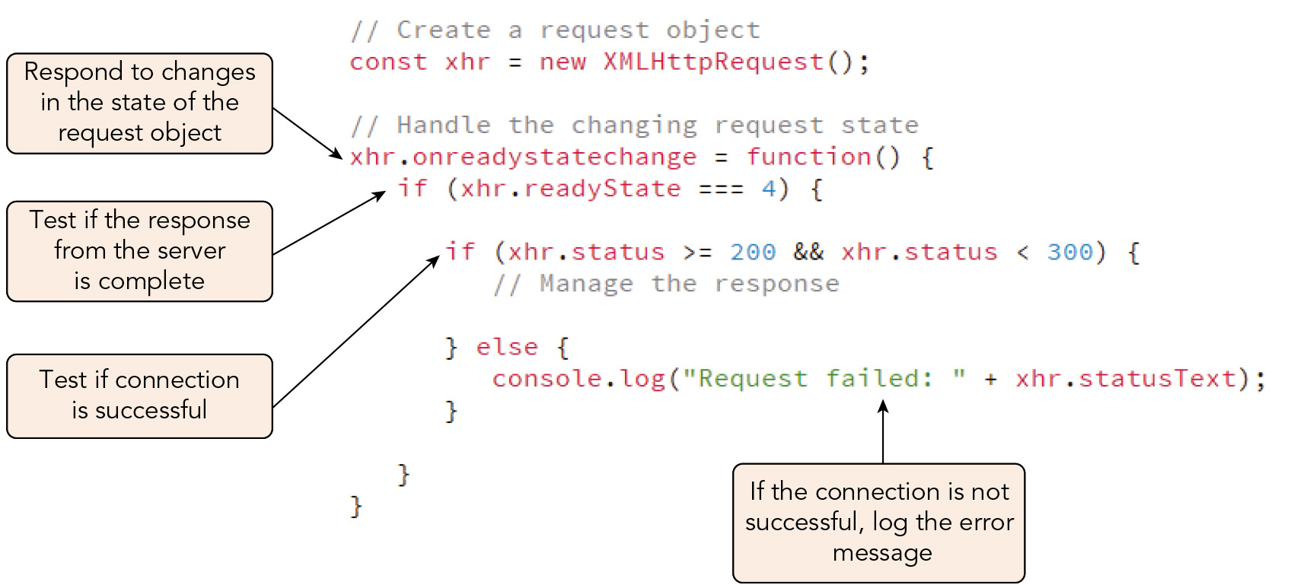
Introducing AJAX (8 of 9)
Figure 11-9 Handling changes in the ready state

Slide 18
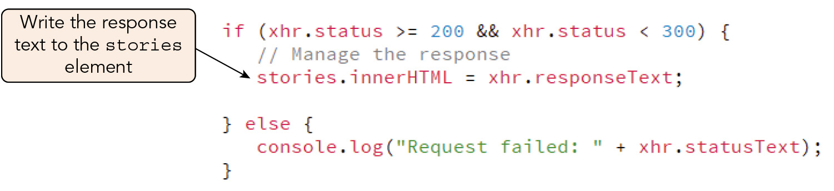
Introducing AJAX (9 of 9)
Figure 11-10 Displaying the request response text

Slide 19
Viewing the State of a Request and Response (1 of 3)
Most browsers provide developer tools to evaluate requests and responses from the server in order to gauge performance or locate and repair network connection errors
Use timing tools to track the performance of requests/responses and identify unacceptable delays for the user
Use network tools to verify that requests and responses are being transferred as expected or to trace files that may be slowing your app

Slide 20
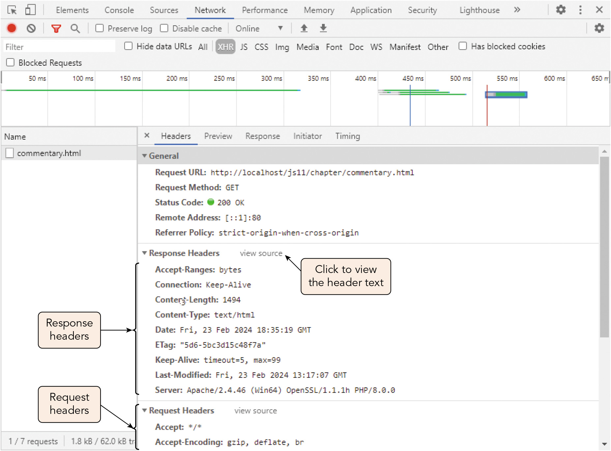
Viewing the State of a Request and Response (2 of 3)
Figure 11-12 HTTP headers for the request and response

Slide 21
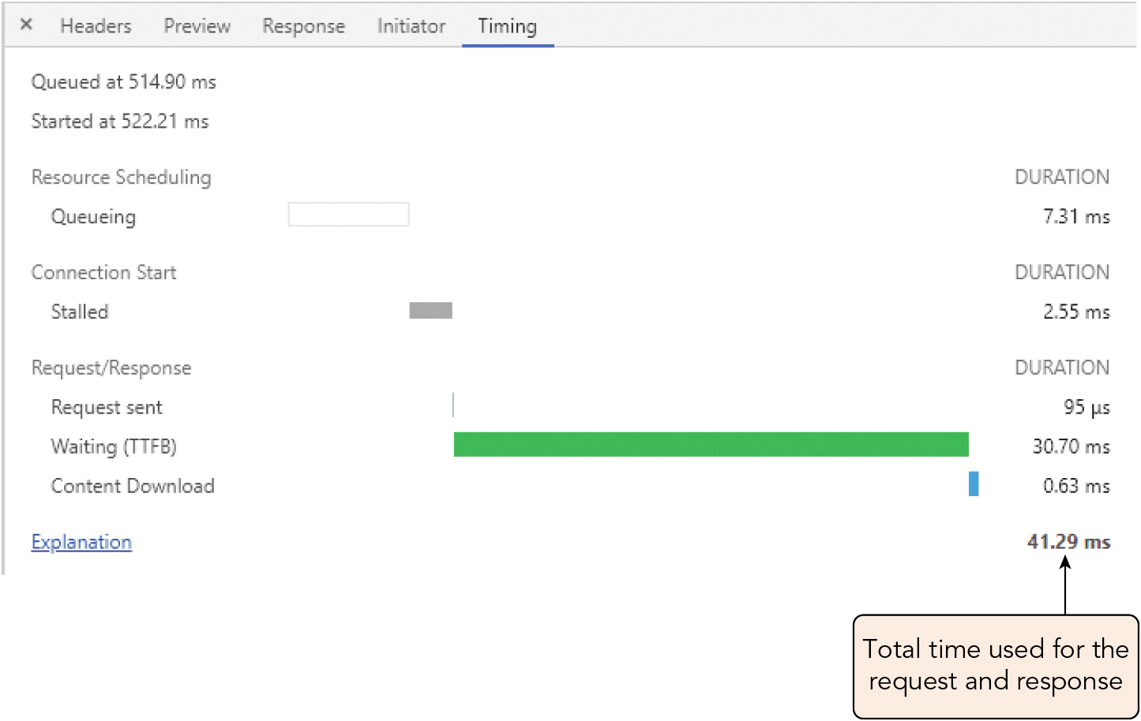
Viewing the State of a Request and Response (3 of 3)
Figure 11-13 Timings of the request and response

Slide 22
AJAX and Callback Hell (1 of 2)
Apps with multiple asynchronous requests can cause the AJAX approach to break down, creating a situation known as callback hell
E.g., imagine an app that has dozens of requests
Each request is associated with a callback function that is run once a complete and successful response is received from the server, which may be slow to respond
Each callback function can initiate one or more new requests
This results in a growing and near-unmanageable pyramid of nested callbacks

Slide 23
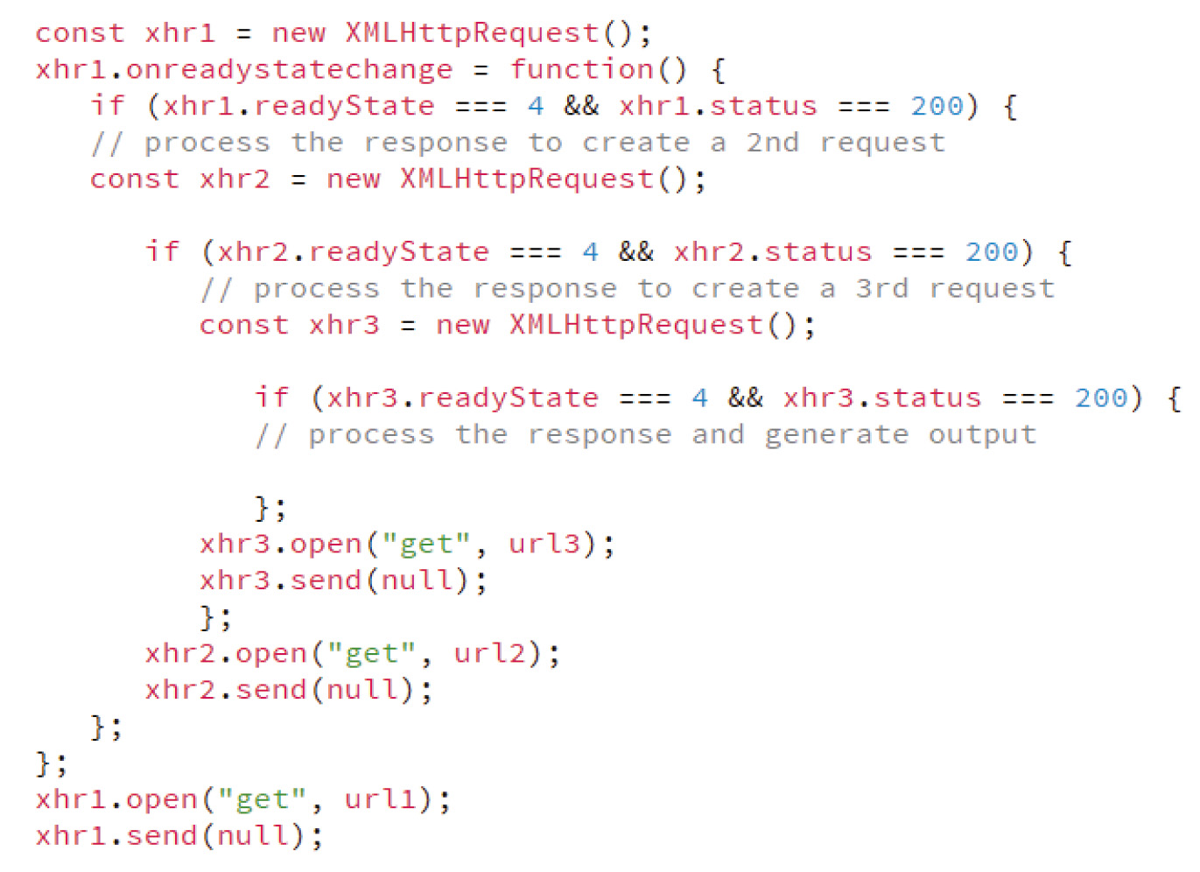
AJAX and Callback Hell (2 of 2)
Figure 11-14 Nested callbacks resulting in callback hell

Slide 24
Introducing Arrow Functions (1 of 5)
Sample code that stores a function using a function expression: let addValues = function(a, b) { let sum = a + b; return sum; } addValues(3, 5); // returns 8
General form for arrow function syntax, which removes extraneous characters: let functionName = (parameters) => { statements }
The fat arrow symbol (=>) replaces the function keyword
The parameters and statements are the same as in a function declaration or function expression

Slide 25
Introducing Arrow Functions (2 of 5)
The addValues() function can be rewritten in arrow function syntax as: let addValues = (a, b) => { let sum = a + b; return sum; }
Arrow functions and parameter values
The parentheses can be removed for a single parameter, but must be used for two or more or included between the assignment operator and fat arrow symbol for zero
The command block and return keyword can be omitted if the function contains a single statement
Anonymous functions can be written in arrow function syntax as well
The this keyword returns the object that called the function with function declarations, but the object that defined or owned the function with arrow functions
Arrow functions take their meaning from outside and do not have their own this

Slide 26
Introducing Arrow Functions (3 of 5)
Function Declaration | Arrow Function
function sumTen(x, y) { let total = x + y + 10; return total; } | let sumTen (x, y) => { let total = x + y + 10; return total; }
function sum(x, y) { return x + y; } | let sum = (x, y) => x + y;
function addTen(x) { return x + 10; } | let addTen = x => x + 10;
function randNum() { return Math.random; } | let randNum = () => Math.random;

Slide 27
Introducing Arrow Functions (4 of 5)
Function Declaration | Arrow Function
function (msg) { console.log(msg); } | msg => console.log(msg);
setTimeout(function() { alert("hello"); }, 2000); | setTimeout(() => alert("hello"), 2000);
numbers.sort(function(a, b) { return b-a; }); | numbers.sort((a,b) => b-a);
form.onclick = function() { alert("Click"); } | form.onclick = () => alert("Click");

Slide 28
Introducing Arrow Functions (5 of 5)
When to use and not use arrow functions
Do not use arrow functions if it makes your code more difficult to interpret and debug
Do not use arrow functions in situations where the function requires its own this value:
Event handlers
Definitions of object methods or methods for object classes
Function declarations support the arguments object that references all arguments used in the function
Arrow function syntax works best with functions containing few statements

Slide 29
Exploring the Promise Object (1 of 7)
Promise: an object that does not have a value currently but might have one in the future
Promises exist in one of three states:
Pending: given but not yet fulfilled or rejected
Resolved: fulfilled
Rejected: never to be fulfilled
Defining a promise object
Syntax for the new Promise() object constructor: let promise = new Promise((resolve, reject) => { // statements defining the promise resolve(resolve value); reject(rejected value); });
resolve and reject are callbacks that are run once the promise is resolved or rejected

Slide 30
Exploring the Promise Object (2 of 7)
Defining a promise object (continued)
Executor: the command block contained within the promise, whose statements are run in the background once the promise is initiated
Once the promise is settled, a value is sent to the resolved and reject functions
Sample promise definition (promise is resolved 80% of the time and rejected 20%): let planDinner = new Promise( (resolve, reject) => { setTimeout( ()=> if (Math.random() < 0.8) resolve("Bought groceries") } else { reject("Ordered takeout"); } }, 2000); });

Slide 31
Exploring the Promise Object (3 of 7)
Defining a promise object (continued)
Syntax for initiating a promise, where promise references the promise object: promise .then(function) .catch(function)
then() and catch() are methods that run functions depending on whether the promise was resolved or rejected
Both functions reference the resolve or reject method stored in the promise's executor
Sample statements to initiate the planDinner promise: planDinner .then(msg => console.log(msg)) .catch(msg => console.log(msg)); console.log("Planning dinner");

Slide 32
Exploring the Promise Object (4 of 7)
Chaining promises
General structure of a promise chain: promise .then(function) .then(function) … .catch(function)
Each then() method returns a promise object with values passed to the next then() method
The chain ends with a catch() statement handling any rejection that breaks the chain

Slide 33
Exploring the Promise Object (5 of 7)
Chaining promises (continued)
Sample promise chain: buyGroceries .then(msg => { console.log(msg); return "Started cooking"; }) .then(newMsg => console.log(newMsg)) .catch(msg => console.log(msg)); console.log("Planning dinner");

Slide 34
Exploring the Promise Object (6 of 7)
Chaining promises (continued)
Sample promise chain with promises nested within the then() method: console.log("Planning dinner"); buyGroceries .then(msg => { console.log(msg); return new Promise( (resolve, reject) => { setTimeout( () => { if (Math.random() < 0.7) { resolve("Made dinner"); } else { reject("Ordered takeout anyway"); } }, 1000); }); }) .then(newMsg => console.log(newMsg)) .catch(msg => console.log(msg));

Slide 35
Exploring the Promise Object (7 of 7)
Running multiple promises
Multiple, independent promises are managed with the Promise.all() method, which receives an array of promise objects as an argument: Promise.all(array).then(function).catch(function)
If all promises successfully complete, the then() method is invoked
If any of the promises fails, the catch() method is immediately invoked
Multiple promises that are racing each other to complete the same task are managed with the Promise.race() method: Promise.race(array).then(function).catch(function)
The then() method handles the resolved function associated with the promise that finishes first
The catch() method handles the rejection if the promise that finishes first fails
All other promises besides the first to finish are ignored

Slide 36
Using the Fetch API (1 of 11)
The Fetch API uses promises to manage server requests
Method for making a request to the server, where url is the location of server resources and options is an optional object defining values for the HTTP message: fetch(url, options)
Sample use of the fetch() method to make an asynchronous GET request: fetch("submit.pl&id=41088")
Sample POST request providing the header and body content of the message: fetch("submit.pl", { method: "POST", headers: {"Content-Type" : "application/json"}, body: "{'id':41088}" })

Slide 37
Using the Fetch API (2 of 11)
Managing fetch responses
Syntax for managing a promise initiated by fetch using a promise chain: fetch(url, options) .then(function) .then(function) … .catch(function)
Sample use of fetch to retrieve an HTML file and write its content to the stories element: fetch("commentary.html") .then(response => response.text()) .then(text => stories.innerHTML = text) .catch((error) => console.log(error));

Slide 38
Using the Fetch API (3 of 11)
Managing fetch responses (continued)
Steps in processing a fetch request:
A promise is made to connect to the resource specified
Once the promise is resolved, it is passed to the first then() method, creating another promise
That promise is passed to the next then() method, and so on
If the promise is rejected at any point, the catch() method is called
The initial promise defined with the fetch() method creates a response object with properties and methods

Slide 39
Using the Fetch API (4 of 11)
Property | Description
response.headers | Returns an object containing the response header
response.ok | Returns a value indicating the nature of the HTTP code, where a status code of 200 to 299 returns true and false if otherwise
response.status | Returns the status code of the response
response.statusText | Returns a text string describing the response status
response.type | Returns the type of response, where type is basic, cors, error, opaque, or opaquedirect
response.url | Returns the URL of the response

Slide 40
Using the Fetch API (5 of 11)
Method | Description
response.error() | Returns a response object associated with a network error
response.arrayBuffer() | Returns a low-level binary data often used with image and multimedia data
response.blob() | Returns a Blob object used file-like objects that contain text or binary data
response.formData() | Returns a promise object that resolves as form data comprised of key-value pairs
response.json() | Returns a promise object that can be parsed as JSON data
response.text() | Returns a promise object that can be parsed as text string data

Slide 41
Using the Fetch API (6 of 11)
Error handling with fetch
An error response from the server is considered a resolved promise, so only network errors are treated as failed promises
The ok property returns false if a non-network failure occurs
Sample fetch promise chain with error handling: fetch("commentary.html") .then(response => { if (response.ok) { return response.text(); } else { return "Commentary not available"; } }) .then(text => stories.innerHTML = text) .catch((error) => console.log(error));

Slide 42
Using the Fetch API (7 of 11)
Using fetch to return a search
The sample sports blog project sends a keyword to a Perl server script that returns articles matching the keyword
Steps to take:
Ensure the file can locate the Perl executable on your server
Create an event handler that runs a fetch request to the script file
Handle errors appropriately

Slide 43
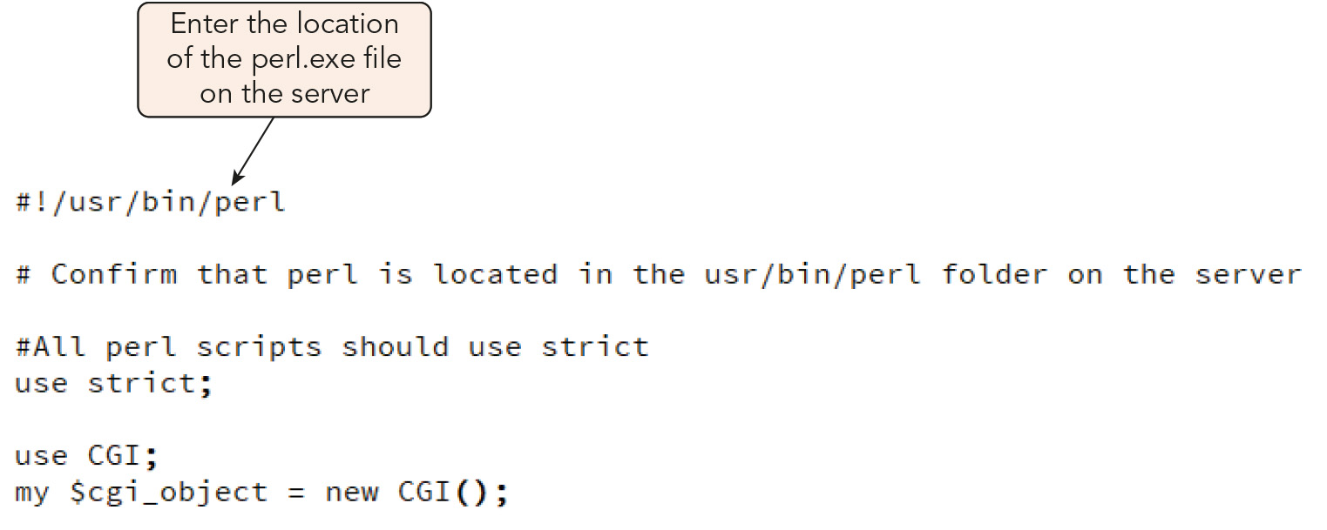
Using the Fetch API (8 of 11)
Figure 11-19 Specifying the location of the perl.exe file

Slide 44
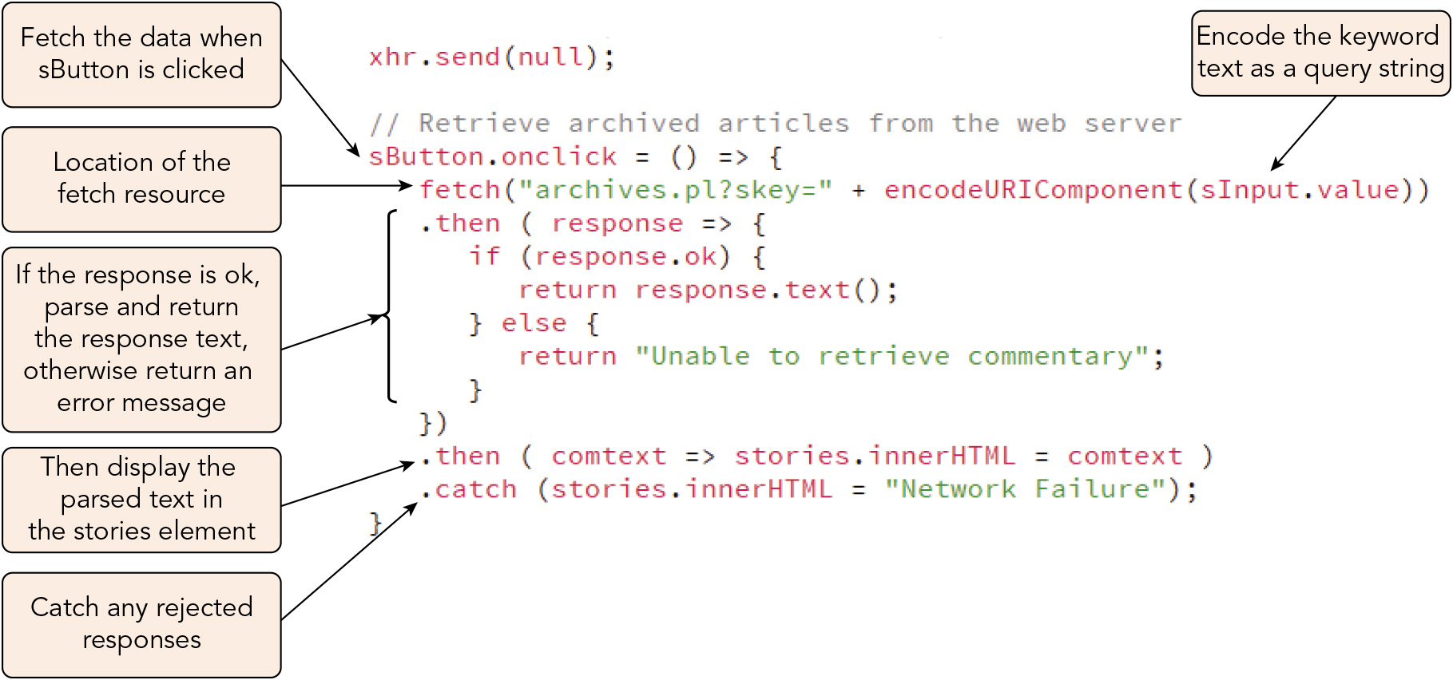
Using the Fetch API (9 of 11)
Figure 11-20 Fetching archived articles by keyword

Slide 45
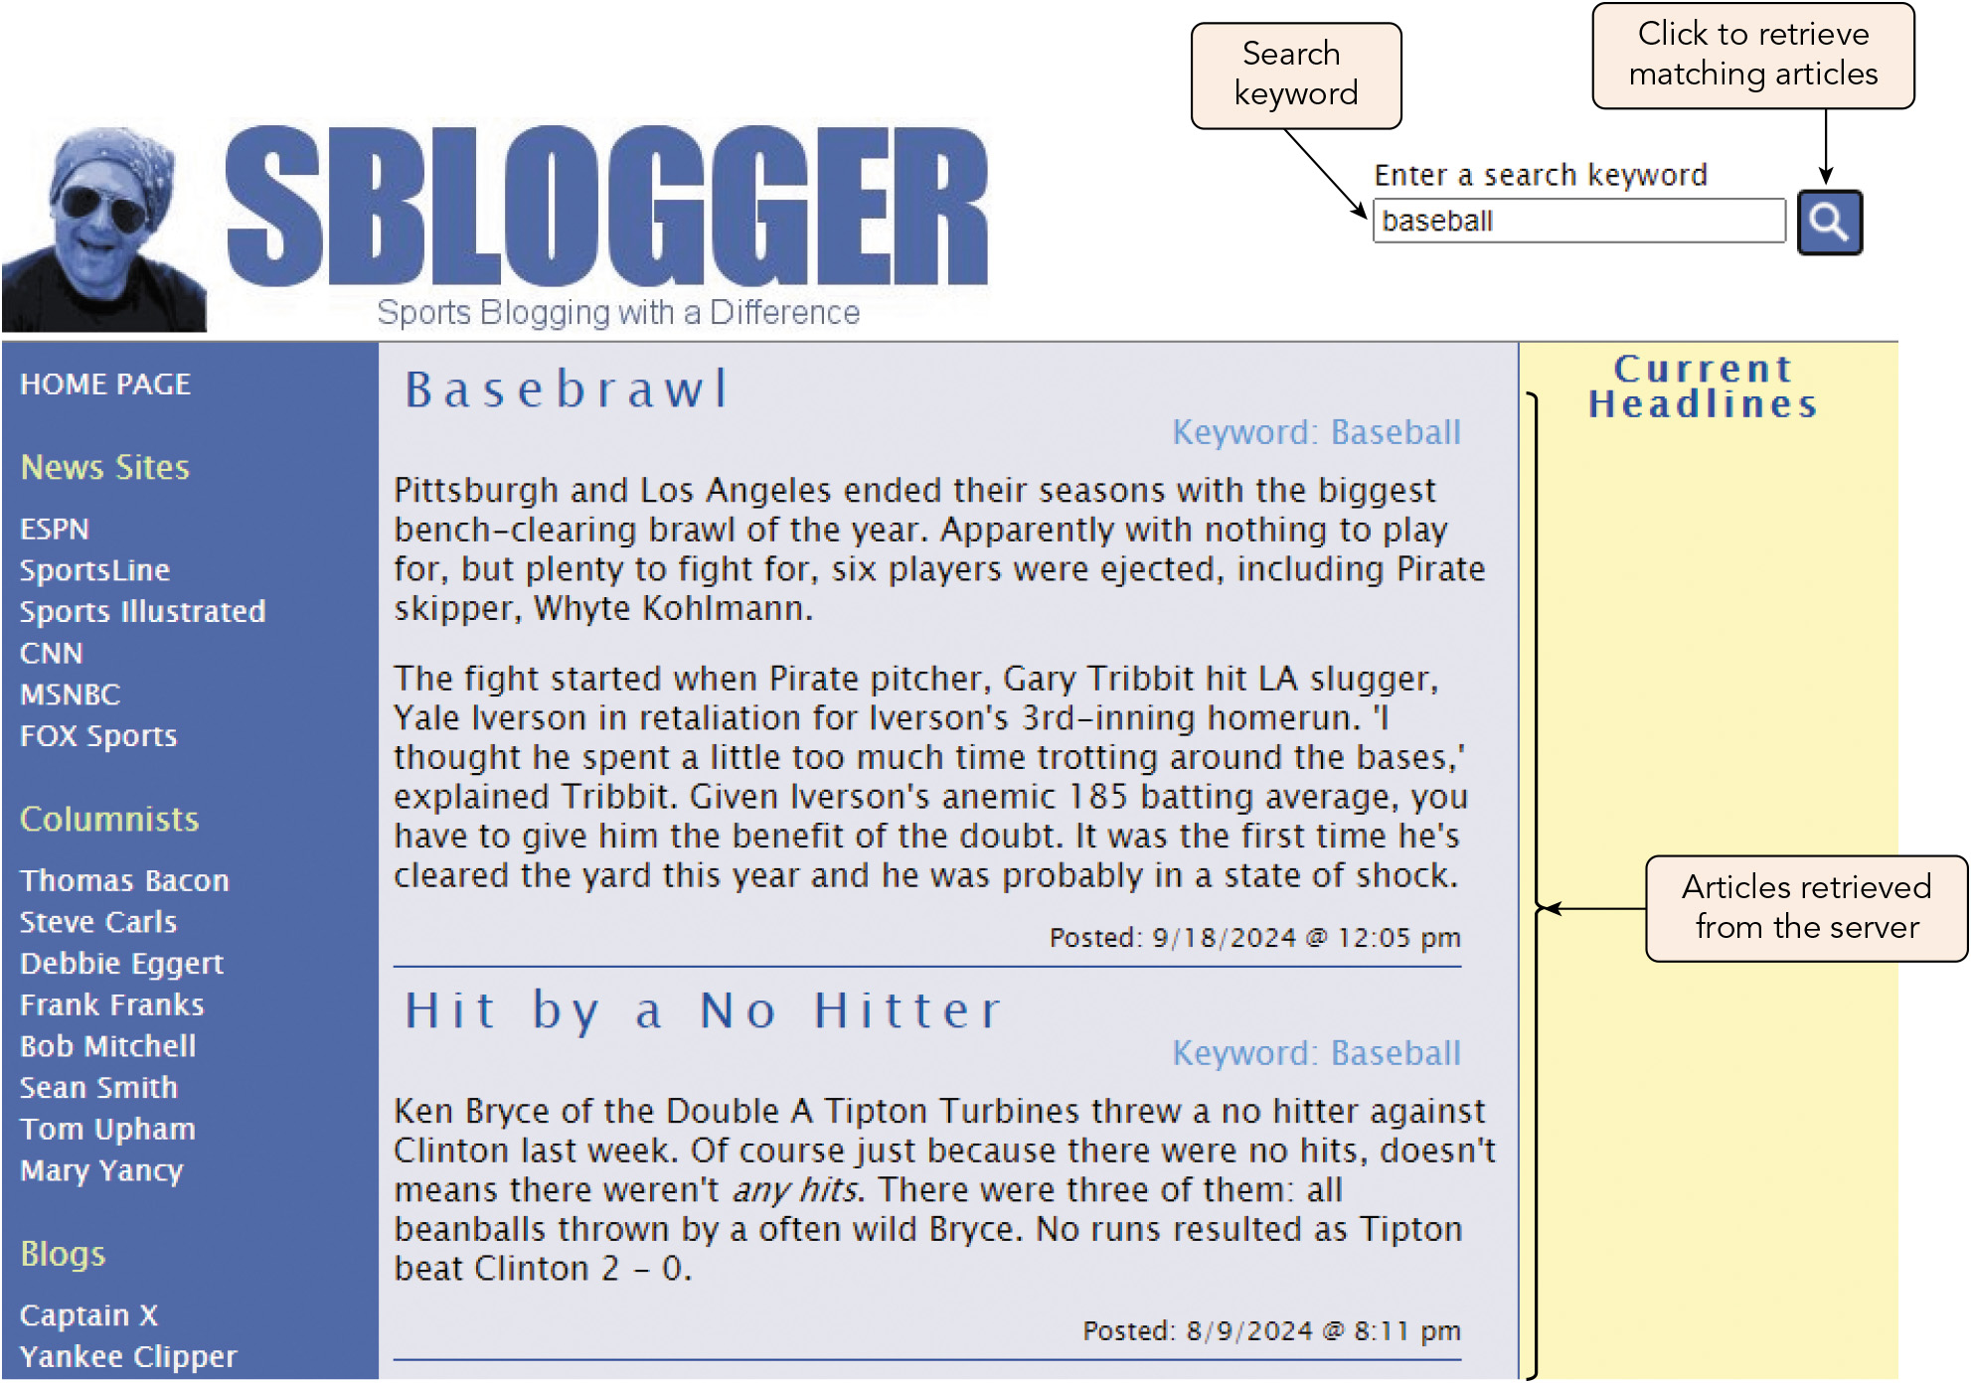
Using the Fetch API (10 of 11)
Figure 11-21 Articles retrieved by keyword

Slide 46
Using the Fetch API (11 of 11)
Working with Fetch
The catch() method will only catch network errors, so you must examine the properties of the response object to catch HTTP errors
Parse the response object returned by the fetch() method using methods such as text() and json()
Apply the correct parser for the data type: response.json() for JSON data or response.text() for basic text strings
The fetch(), then(), and catch() methods are part of one long statement that can be written on a single line

Slide 47
Activity 11.1: Knowledge Check
What object is AJAX built upon? Describe the key methods and properties of this object that you would use to make HTTP requests and handle the server's responses.
Outline the steps for using the Fetch API to make an HTTP request and handle the server's response.
Notes:
Instructions:
Use the Knowledge Check questions to periodically pose a question to students during class to gauge how well they can recall the material that was presented.

Slide 48
Activity 11.1: Knowledge Check Answers (1 of 2)
What object is AJAX built upon? Describe the key methods and properties of this object that you would use to make HTTP requests and handle the server's responses. AJAX is built upon the XMLHttpRequest object (XHR object). To use an instantiated XHR object to send a request, you call its open() method, passing in the method type (GET or POST) and the URL for the resource, with request data appended to the URL as a query string; and then its send() method, passing in null for a GET request or content the resource needs to process the request. To manage the response from the server resource, you use an event handler or listener for the XHR object's readystatechange event and access its readyState property (to determine whether the response from the server is complete) and its status property (to determine whether a successful connection with the server was made). You access its responseText or responseXML property to retrieve and evaluate the server response at that point.
Notes:
Instructions:
Use the Knowledge Check questions to periodically pose a question to students during class to gauge how well they can recall the material that was presented.

Slide 49
Activity 11.1: Knowledge Check Answers (2 of 2)
Outline the steps for using the Fetch API to make an HTTP request and handle the server's response. To make a request, you all the fetch() method, passing in the URL of the server resource and, if desired, an options object that provides content such as a message body, the type of request, and instructions for interacting with the browser. Since the Fetch API uses promises, the fetch() method is chained with one or more then() methods to handle fulfilled promises and a catch() method to handle rejected promises. The properties of the response object created by the initial promise defined with the fetch() method are accessed to determine the status of the response. The methods of the response object are used to return a promise object that can be parsed to retrieve the data from the server's response.
Notes:
Instructions:
Use the Knowledge Check questions to periodically pose a question to students during class to gauge how well they can recall the material that was presented.

Slide 50
Working with XML (1 of 6)
XML (Extensible Markup Language): a language used for structured documents built with markup tags that are more flexible than those found within HTML documents
Widely used in applications such as RSS newsfeeds, which transmit current news stories to media outlets and podcasts
JSON uses nested objects and arrays to accomplish the same thing more concisely
More popular for data exchange owing to its smaller file size and similarity to JavaScript

Slide 51
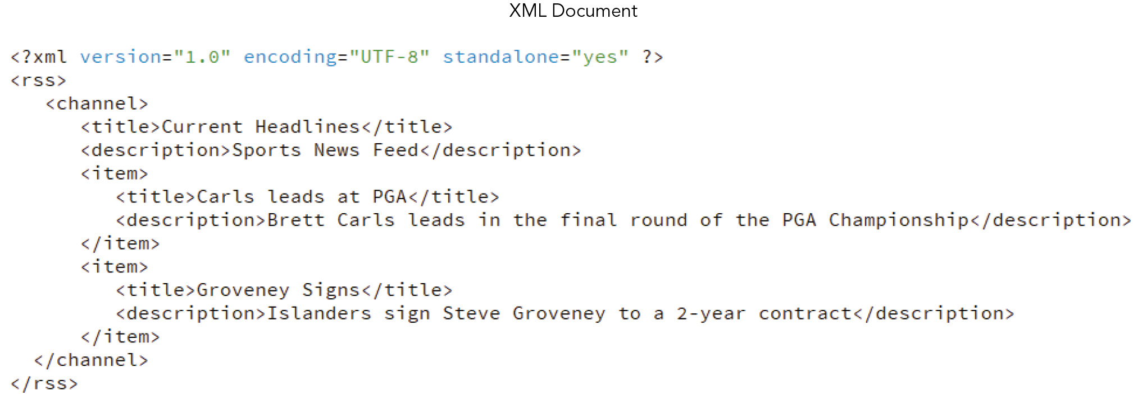
Working with XML (2 of 6)
Figure 11-22 Comparing XML and JSON: XML Document

Slide 52
Working with XML (3 of 6)
Parsing XML content
Syntax for parser object used to convert XML text stored within the body of a server response into an XML DOM object: let parser = new DOMParser();
Syntax to create the XML DOM: parser.parseFromString(text, mimeType)
text is the text string to be parsed
mimeType is the type of structured data, such as text/html, text/xml, or image/svg+xml
Sample expression that creates and uses a parser object: new DOMParser().parseFromString("headlines.xml", "text/xml")

Slide 53
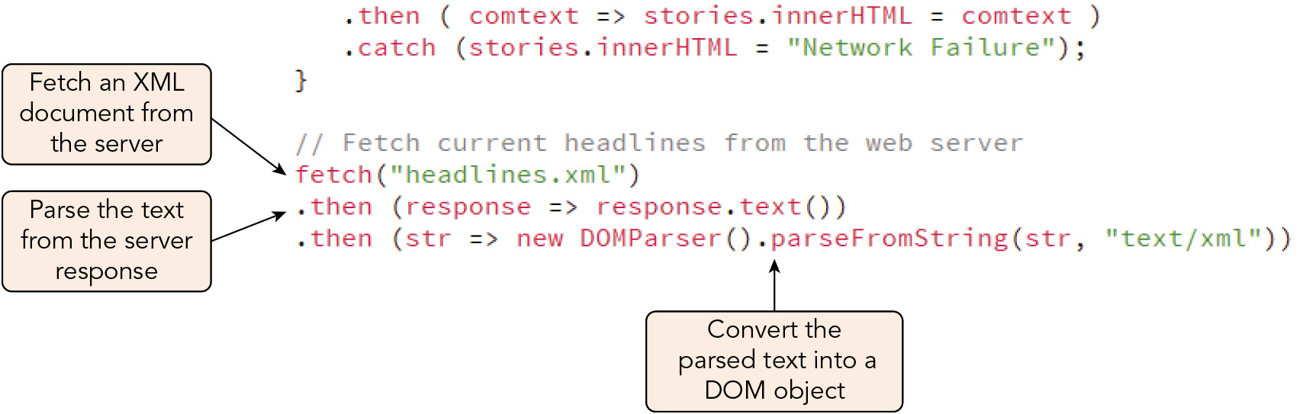
Working with XML (4 of 6)
Figure 11-23 Loading and parsing an XML document

Slide 54
Working with XML (5 of 6)
Working with an XML node tree
XML node trees are DOM objects and thus accessible to the same JavaScript methods used with an HTML DOM, such as querySelectorAll() and appendChild()
For the sports blog project, you can use these methods to convert the XML content from the newsfeed file into an HTML article
To convert an XML DOM into a text string, you create an XML serializer object and apply the serializeToString() method to it: let serializer = new XMLSerializer(); serializer.serializeToString(dom)
Sample expression that converts a DOM into a text string: new XMLSerializer().serializeToString(dom)

Slide 55
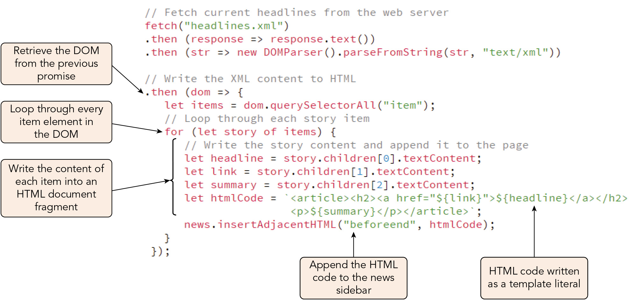
Working with XML (6 of 6)
Figure 11-24 Converting XML content to HTML

Slide 56
Creating an Autocomplete Search Box (1 of 6)
For the sports blog page, a script that generates a list of keyword suggestions is invoked using the URL keywords.pl?suggest=substring, where substring is a substring of characters used by the script to generate suggestions
Working with JSON data
The script returns suggested keywords in JSON format, with individual suggestions stored in the matches array, e.g.: { "matches": ["Seahawks","Senators"] }
You apply the json() method to the Fetch response to parse the JSON text
You can then handle the parsed JSON data as an object literal

Slide 57
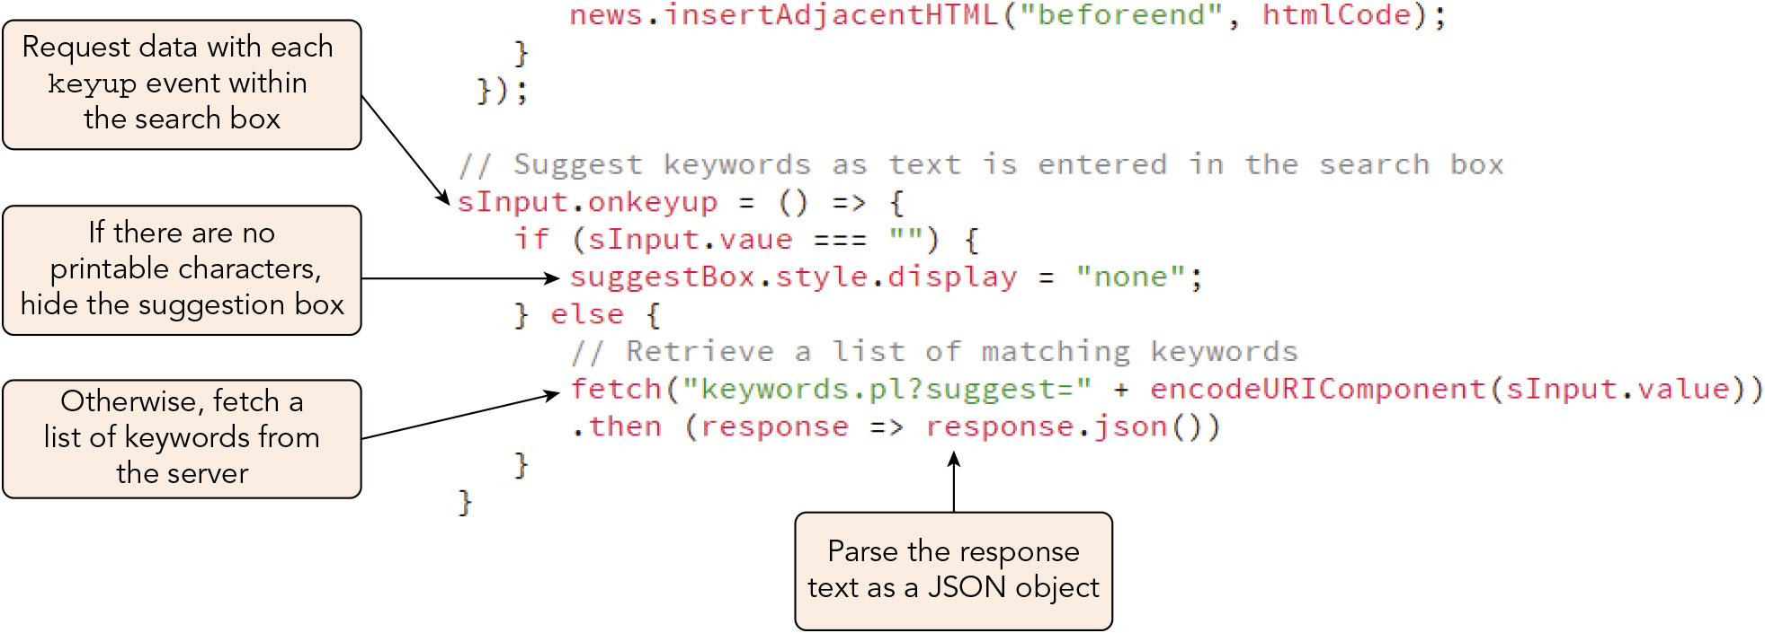
Creating an Autocomplete Search Box (2 of 6)
Figure 11-28 Requesting matching keywords from the server

Slide 58
Creating an Autocomplete Search Box (3 of 6)
Building the suggestion box
You can use the JSON object to write HTML code for a suggestion box, where json.matches[0], json.matches[1], etc. are the suggested keywords from the matches array: <div id="suggestBox"> <div class="suggestion">json.matches[0]</div> <div class="suggestion">json.matches[1]</div> … </div>
Then, you can add an event handler to insert a suggested word clicked by the user in the search box, hide the suggestion list, and run the search function

Slide 59
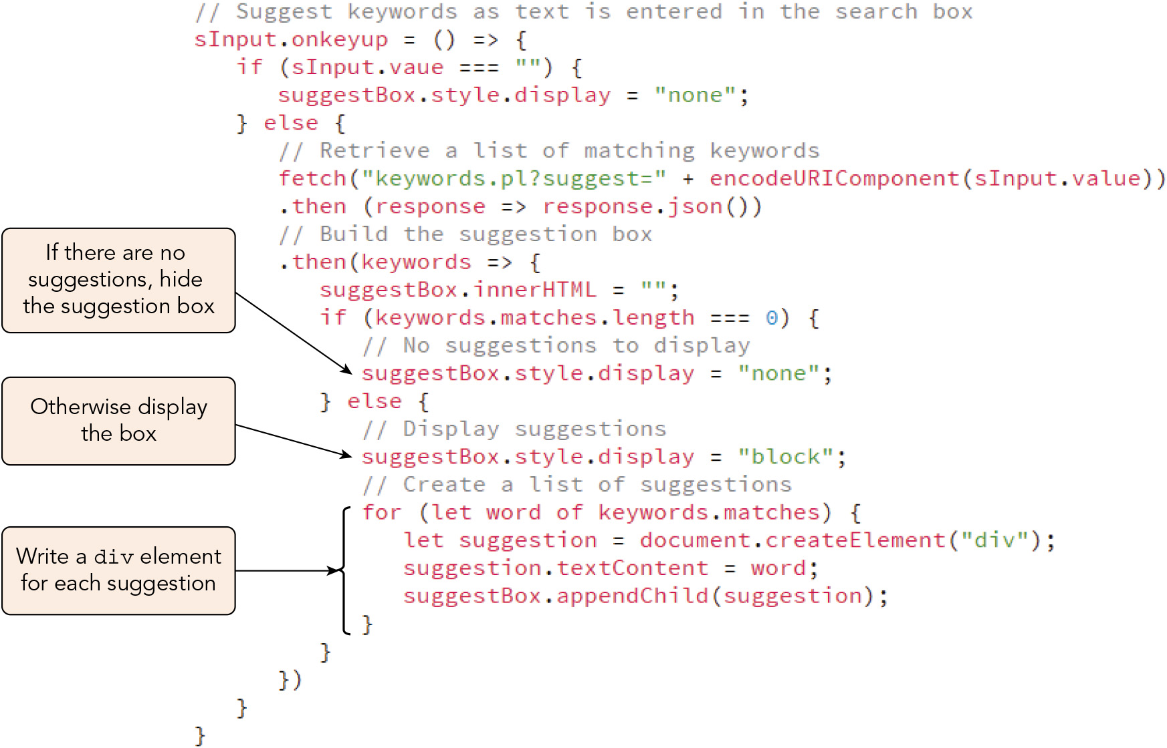
Creating an Autocomplete Search Box (4 of 6)
Figure 11-29 Building the suggestion box

Slide 60
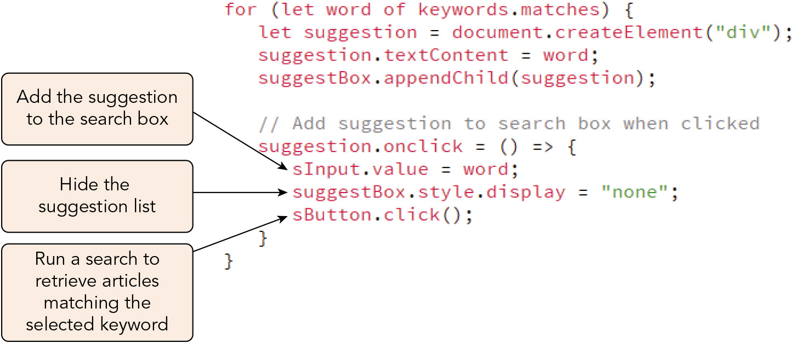
Creating an Autocomplete Search Box (5 of 6)
Figure 11-31 Creating an event handler for each picked suggestion

Slide 61
Creating an Autocomplete Search Box (6 of 6)
GET, POST, PUT, PATCH, and DELETE
These are the most common HTTP methods used with the Fetch API
Each is associated with a specific type of database operation
GET (the default Fetch option) is used to retrieve data from the server
POST sends data to the server
PUT changes existing data in its entirety
PATCH changes a part of existing data
DELETE deletes data on the server
The method name for any HTTP method besides GET must be included in the message body
These methods simply instruct a server script to do something that it knows how to do

Slide 62
Working with Third-Party APIs (1 of 4)
Websites often incorporate content provided by third parties that supply APIs that can be accessed via AJAX or Fetch
Many are freemimum services offered at no cost to the developer if requests are few
Requesting a random GIF
Giphy.com's third-party API provides animated GIFs, but requires an account and its associated API key to access
Third-party endpoints
Third-party services provide several APIs organized by endpoint, a URL representing the point of contact between the client device and a service resource
Requests can be sent to the https://api.giphy.com/v1/gifs/random endpoint with parameter values enclosed in a template literal
Information about a random GIF related to a keyword or phrase specified in the request is returned to the client as a JSON object

Slide 63
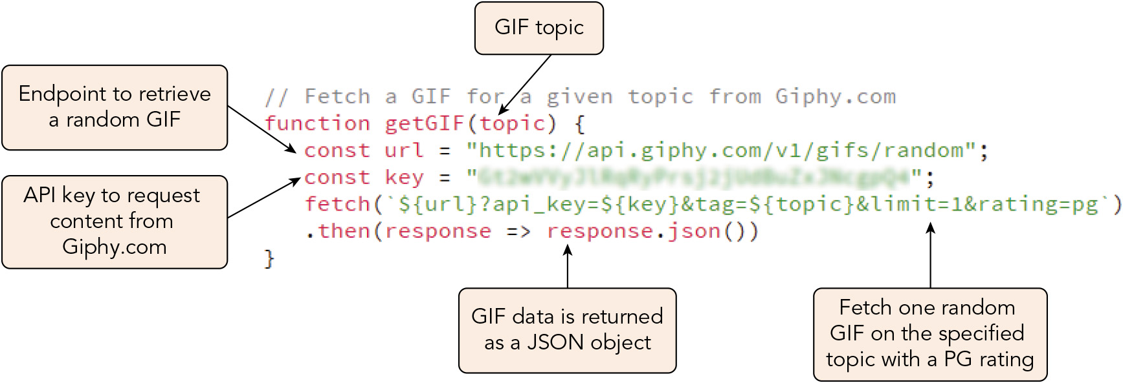
Working with Third-Party APIs (2 of 4)
Figure 11-32 Accessing the Giphy API

Slide 64
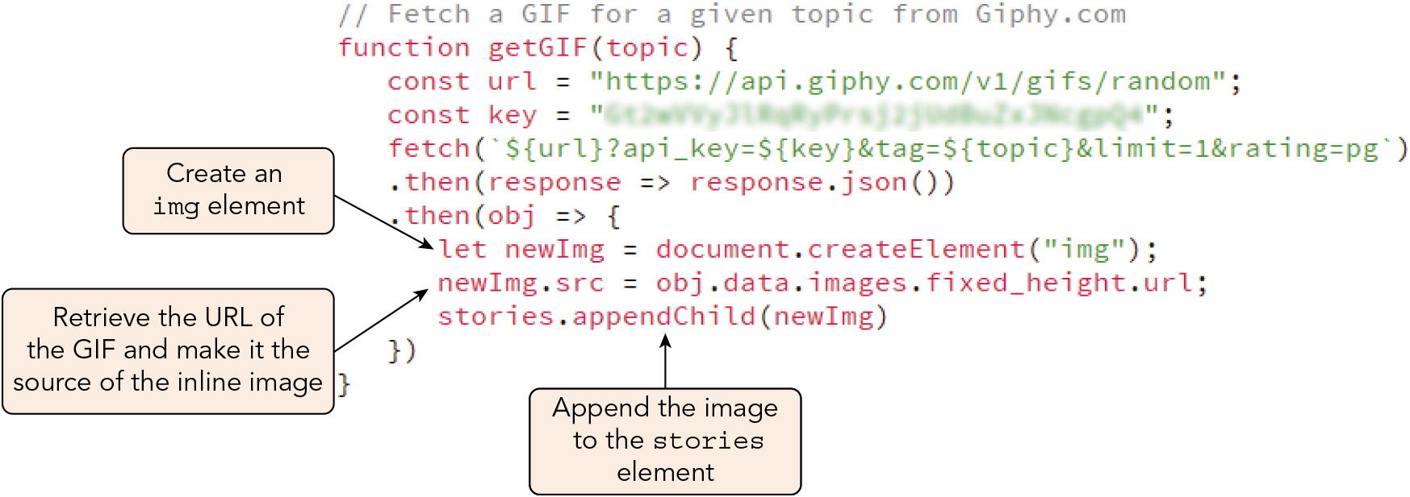
Working with Third-Party APIs (3 of 4)
Figure 11-33 Appending the GIF as a page image

Slide 65
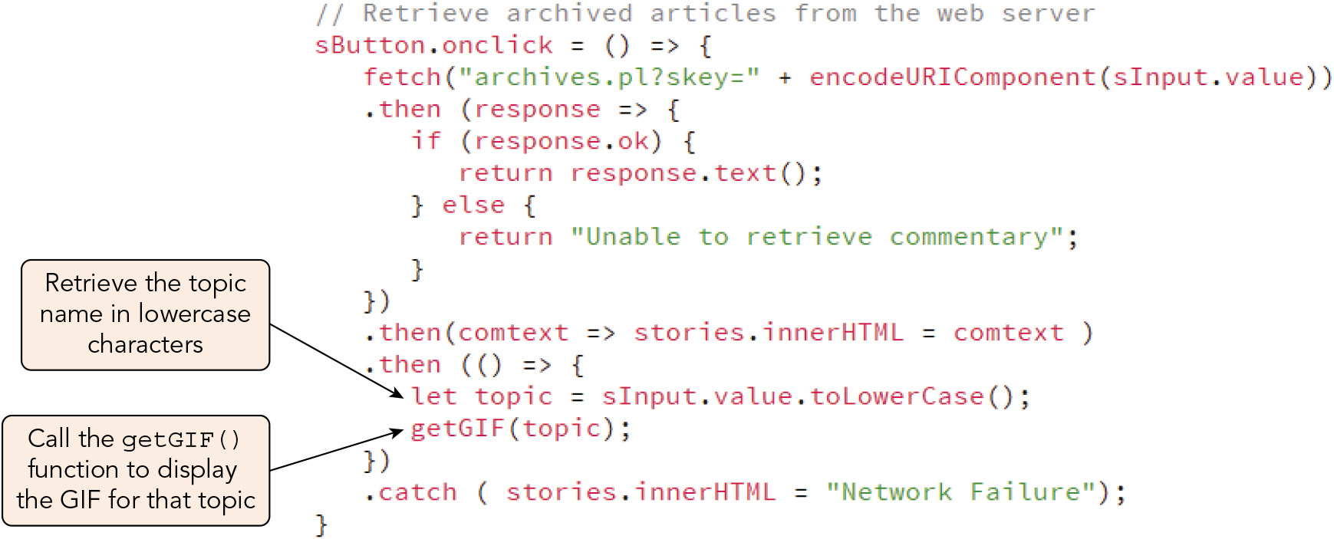
Working with Third-Party APIs (4 of 4)
Figure 11-34 Calling the getGIF() function

Slide 66
Activity 11.2: Think, Pair, and Share
Form pairs/groups of two to four class members.
Use an Internet search engine to research the third-party APIs available for use in commercial web apps. Select one third-party API of universal interest, and locate the developer instructions on its website.
Working as a group, attempt to write a function that would send a request to one of the chosen API's endpoints using the documentation available at the website.
Notes:
Instructions:
Use the Think, Pair, Share activity to encourage students to solve problems collaboratively and to apply the real-world skill of evaluating, modifying, and debugging code created by another programmer.

Slide 67
Exploring Security Issues with APIs (1 of 3)
Three approaches are commonly used to manage the same-origin policy but still allow the transfer of data between websites of differing origins: CORS, JSONP, and XHR proxies
Working with CORS
Cross Origin Resource Sharing (CORS) places information with the HTTP message header indicating that cross-origin requests are allowed
The server hosting the resource must include an Access-Control-Allow-Origin header in the HTTP message it sends to the requesting site, e.g.: Access-Control-Allow-Origin: https://example.com
Requests from any domain can be authorized with a * wildcard character, but if the API client needs to pass authentication headers or cookies, it must connect as a fully qualified domain (as in the example)

Slide 68
Exploring Security Issues with APIs (2 of 3)
Using JSONP
Before CORS, data transfer was managed using JSONP (JSON with Padding)
The script element (which is not subject to the same-origin policy) calls an API running on a server from a different origin, which then returns request content in JSON format
The object is treated as the parameter for a callback function
Syntax for an HTML script element employing the JSONP approach, where resource is the web address of the resource and function is the callback function that handles the JSON data returned: <script src="resource?callback=function"></script>
When using this approach you must ensure that the API is not responding with malicious code
There is no easy way to determine whether a request failed or for what reason

Slide 69
Exploring Security Issues with APIs (3 of 3)
Using XHR with a proxy
With this approach, a proxy server is used to handle the request for your site
You make the request to another (proxy) server that is a trusted domain for the resource and that can then pass the information on to your app
The app then uses an AJAX request object or Fetch to make the request of the proxy server and includes parameters indicating the API that will manage the response
Web developer job titles and roles
A front-end developer works primarily with HTML, CSSS, and client-side JavaScript
A back-end developer works mainly with server-side languages and libraries such as PHP, Perl, SQL, and Node.js
A full stack developer has skills and responsibility for both client-side and server-side code

Slide 70
Activity 11.3: Discussion Questions
What is AJAX? What is the relationship between AJAX and JavaScript?
What are the differences between synchronous and asynchronous requests?
Compare JSONP with CORS.
Notes:
Instructions:
Use the Discussion activity to encourage group conversation about a related topic of interest

Slide 71
Self-Assessment
Which approach to sending HTTP requests do you prefer at this point, AJAX or the Fetch API? Why?
Has reading about how HTTP requests are sent with JavaScript increased your interest in programs written in server-side languages? What do you imagine the general procedure by which they process requests to generate HTTP responses looks like?
Notes:
Instructions:
Use the Self-Assessment question to encourage students to evaluate their progress or goals in the course, as well as determine how they might apply their learning or grow as an individual.

Slide 72
Summary
Now that the lesson has ended, you should have learned to:
Understand the nature of server requests and responses.
Work with the content of HTTP messages.
Create HTTP request objects using AJAX.
View the status of an HTTP request and response.
Understand the limitations of AJAX and nested callbacks.
Write functions in arrow function syntax.
Create and use promise objects.
Manage requests and responses using the Fetch API.
Retrieve content written in XML.
Create an autocomplete search box.
Work with third-party APIs.
Manage security issues with third-party APIs.
Notes:
Instructions: Reiterate the learning objectives for the lesson. Students should use this information to guide their studies and reinforcement of new concepts.

