Slide 1
PockGit

Slide 2
Background information
Wanted to challenge myself with a project slightly beyond the scope of the class
Small in scope compared to the possibilities of the end product
Mobile hub connecting all of your various online repository services.

Slide 3
Benefits / Business need
Versatility of having mobile option for on-the-go needs
Having the ability to access from anywhere the information pertaining to your SDLC is invaluable
PockGit provides a lightweight option to access the information you need, allowing for a constant stream of information
GitHub now, more services later.

Slide 4
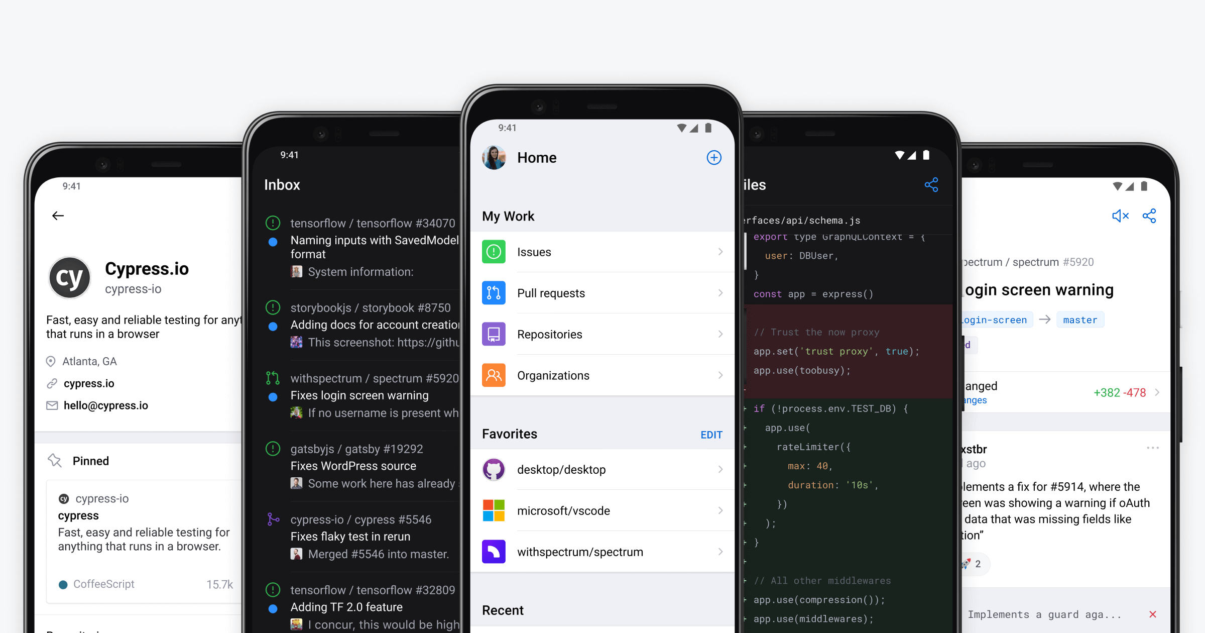
Similar Applications
GitHub Application
Provides similar if not replicated functionality from the website service.
Does not support linking multiple GitHub accounts
Does not support linking services such as BitBucket, GitLab, and other services.

Slide 5
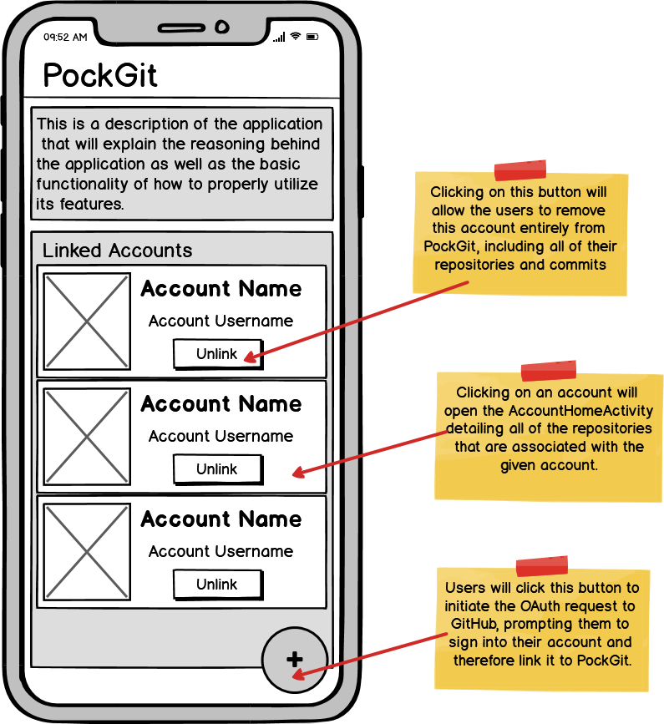
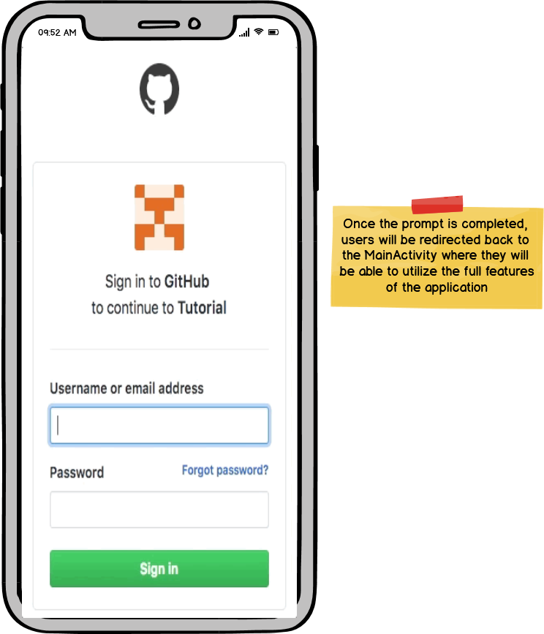
Key Feature #1 – GitHub oauth

Slide 6
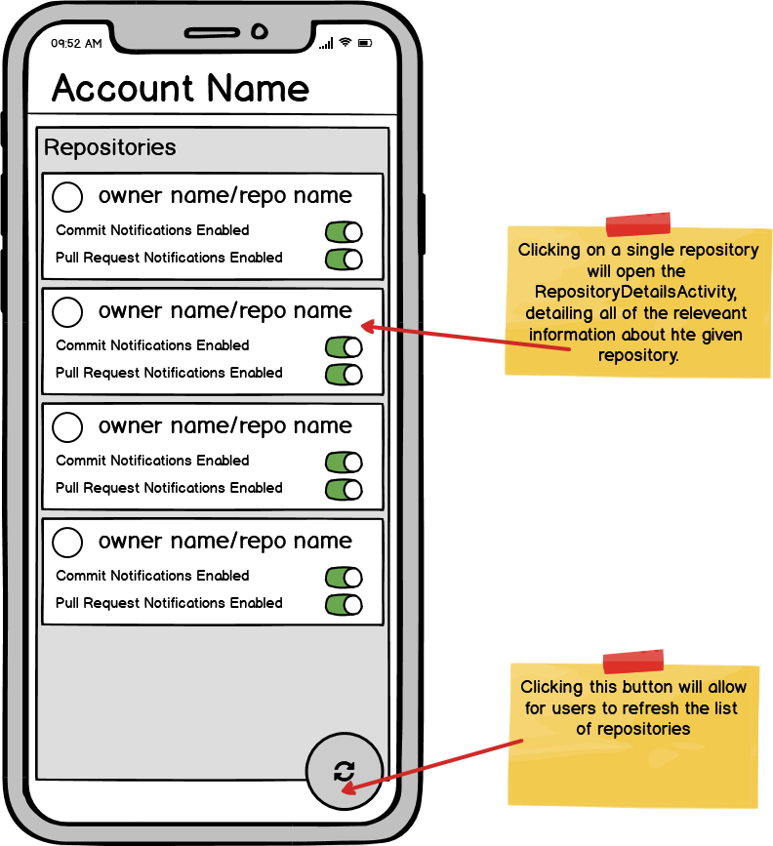
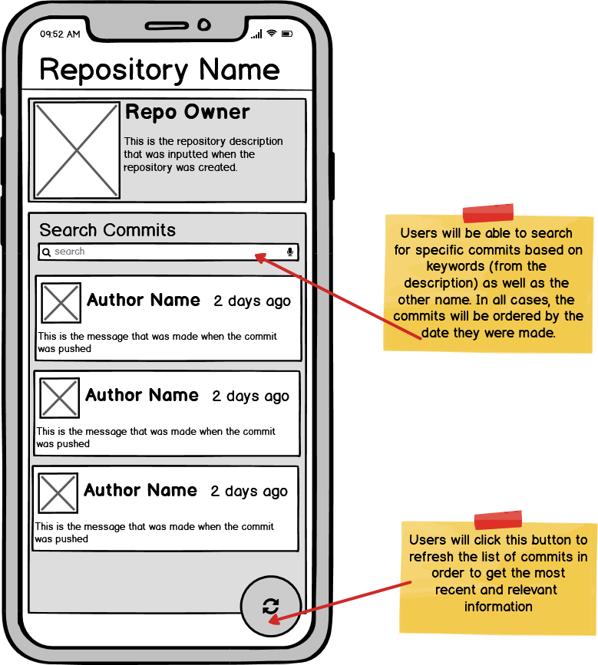
Key Feature #2 – View / Search info

Slide 7
Wrap Up
Project Proposal
https://drive.google.com/open?id=15iSgVFemjzHqD_RG_1Frg-K73RvIF-kU
GitHub Repository
https://github.com/RankenTechnicalCollege/awd-1112-evandmeier/tree/master/projects/FinalProject

