Slide 1
JavaScript for Web Warriors, 7e Chapter 9: Managing State Information and Security

Slide 2
Chapter Objectives (1 of 2)
By the end of this chapter, you should be able to:
Describe the fundamentals of sessions and state information.
Share data between web pages using query strings.
Explain how data is stored using the Web Storage API.
Use browser tools to view and manage web storage contents.
Identify the purpose and structure of a cookie.
Notes:
Instructions: Briefly review with students the major concepts you will be covering during this class. There is one objective for every major A-head section of the chapter. (Note that the A-head section "Storing Data in Web Storage" spans objectives 9.3, 9.4, and 9.7.)

Slide 3
Chapter Objectives (2 of 2)
By the end of this chapter, you should be able to:
Write data into a cookie.
Retrieve data from web storage.
Force the deletion of a persistent cookie.
Describe the fundamental concepts involved in web security.
Notes:
Instructions: Briefly review with students the major concepts you will be covering during this class. There is one objective for every major A-head section of the chapter. (Note that the A-head section "Storing Data in Web Storage" spans objectives 9.3, 9.4, and 9.7.)

Slide 4
Understanding Sessions and State Information (1 of 3)
A session begins each time the user visits a website within a browser window or tab
State information: session data transferred between the client computer and the web server
State information is transferred via Hypertext Transfer Protocol (HTTP): a set of rules defining how data is to be read and interpreted between the client and server
HTTP was originally designed to be stateless (static design) so that data would not be maintained between sessions
Stateless designs are efficient but limiting because information and actions are not preserved for future sessions

Slide 5
Understanding Sessions and State Information (2 of 3)
State information that must be maintained between and during sessions can be stored:
Remotely on the server, making it accessible to any of the user's client devices but straining server resources and slowing the connection
Locally on the client device
Both on the server and on the client device (often the best designs)
Encryption
Secure Sockets Layer (SSL): the main protocol used to encrypt data on websites
Transport Layer Security (TLS): another encryption protocol that is currently replacing SSL
Both protect against a man-in-the-middle attack, in which data being exchanged between two parties is read and potentially changed in transit

Slide 6
Understanding Sessions and State Information (3 of 3)
Common methods for storing client-side data:
Appended as a text string to a website address
Saved to a storage file created and stored on the device
Placed within a cookie created and stored on the device

Slide 7
Sharing Data Between Forms (1 of 7)
An exchange of data between the web server and client generates an HTTP request that consists of:
A header with metadata about the browser and its capabilities
A body with information necessary to process the request
Data from a web form submitted by a user is sent to the server using one of two methods:
The post method, which appends the form data to the body of the HTTP request
The get method, which appends the data as a query string added to a website's URL, allowing it to be read and parsed by a JavaScript program running on the client device
Syntax to append form data within a query string, where url is the website address or file name of the resource that will be opened when the form is submitted: <form method="get" action="url">

Slide 8
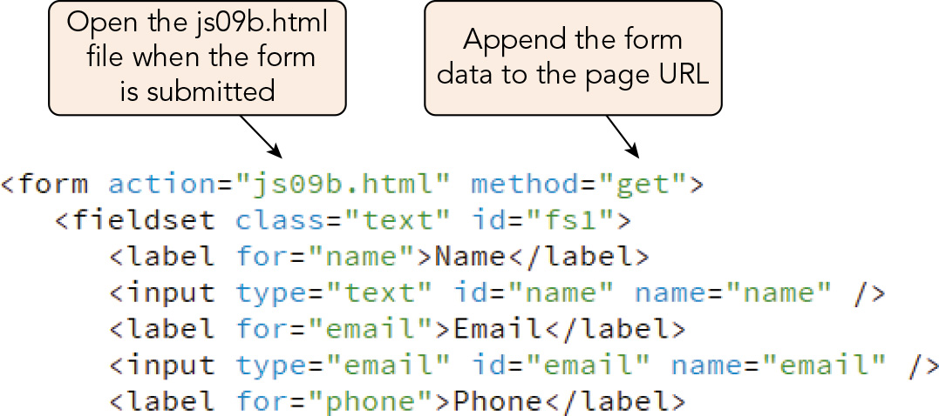
Sharing Data Between Forms (2 of 7)
Figure 9-1 Applying the get method to a form

Slide 9
Sharing Data Between Forms (3 of 7)
General format for a URL containing a query string: http://server/path/file?field1=value1&field2=value2...
server and path are the server and path names for the web page
file is the file name of the web page
Query string starts with the ? character and contains data stored as field=value pairs separated by the & character
Sample query string: ?name=Desmond+Jennings&email=djennings%40example.com&phone=%28802%29+555-4781&address=43+Maple+Hill+Drive&city=Burlington&state=VT&zip=05401
To retrieve the data, split the text string into separate substrings for each name=value pair using JavaScript string methods
Retrieving the query string text using the Location object: text of the query string is referenced with the location.search property

Slide 10
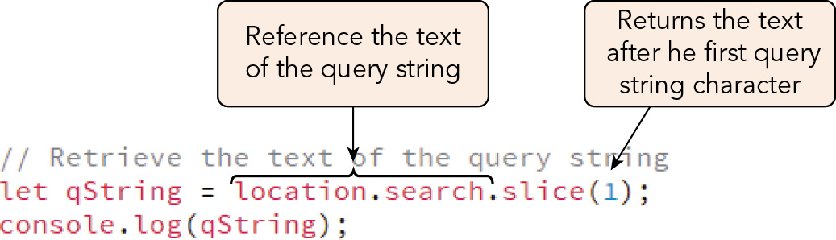
Sharing Data Between Forms (4 of 7)
Figure 9-4 Viewing the query string

Slide 11
Sharing Data Between Forms (5 of 7)
Replacing URI encoding characters
Before it is placed within a query string, data must be encoded to replace characters that are not allowed in website addresses (spaces, /, :, etc.) with URI-encoded characters
Syntax for decoding a URI-encoded text string: decodeURIComponent(string)
Sample code using this method to decode a URI-encoded telephone number: decodeURIComponent("phone=%28802%29%20555-4781") // returns "phone=(802) 555-4781"
To use a query string to transfer form data from one web page to another, you can:
Replace + characters (for spaces) and URI-encoded characters in the query string
Split the query string into an array of name=value pairs
Iterate through the pairs, writing a form label for the field name and an input box for the field value, using a for of loop

Slide 12
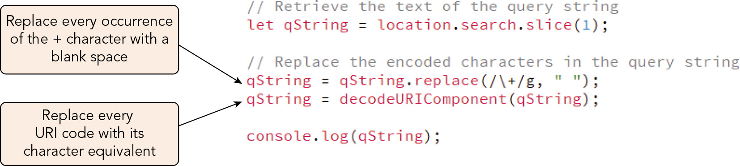
Sharing Data Between Forms (6 of 7)
Figure 9-6 Replacing characters from a query string

Slide 13
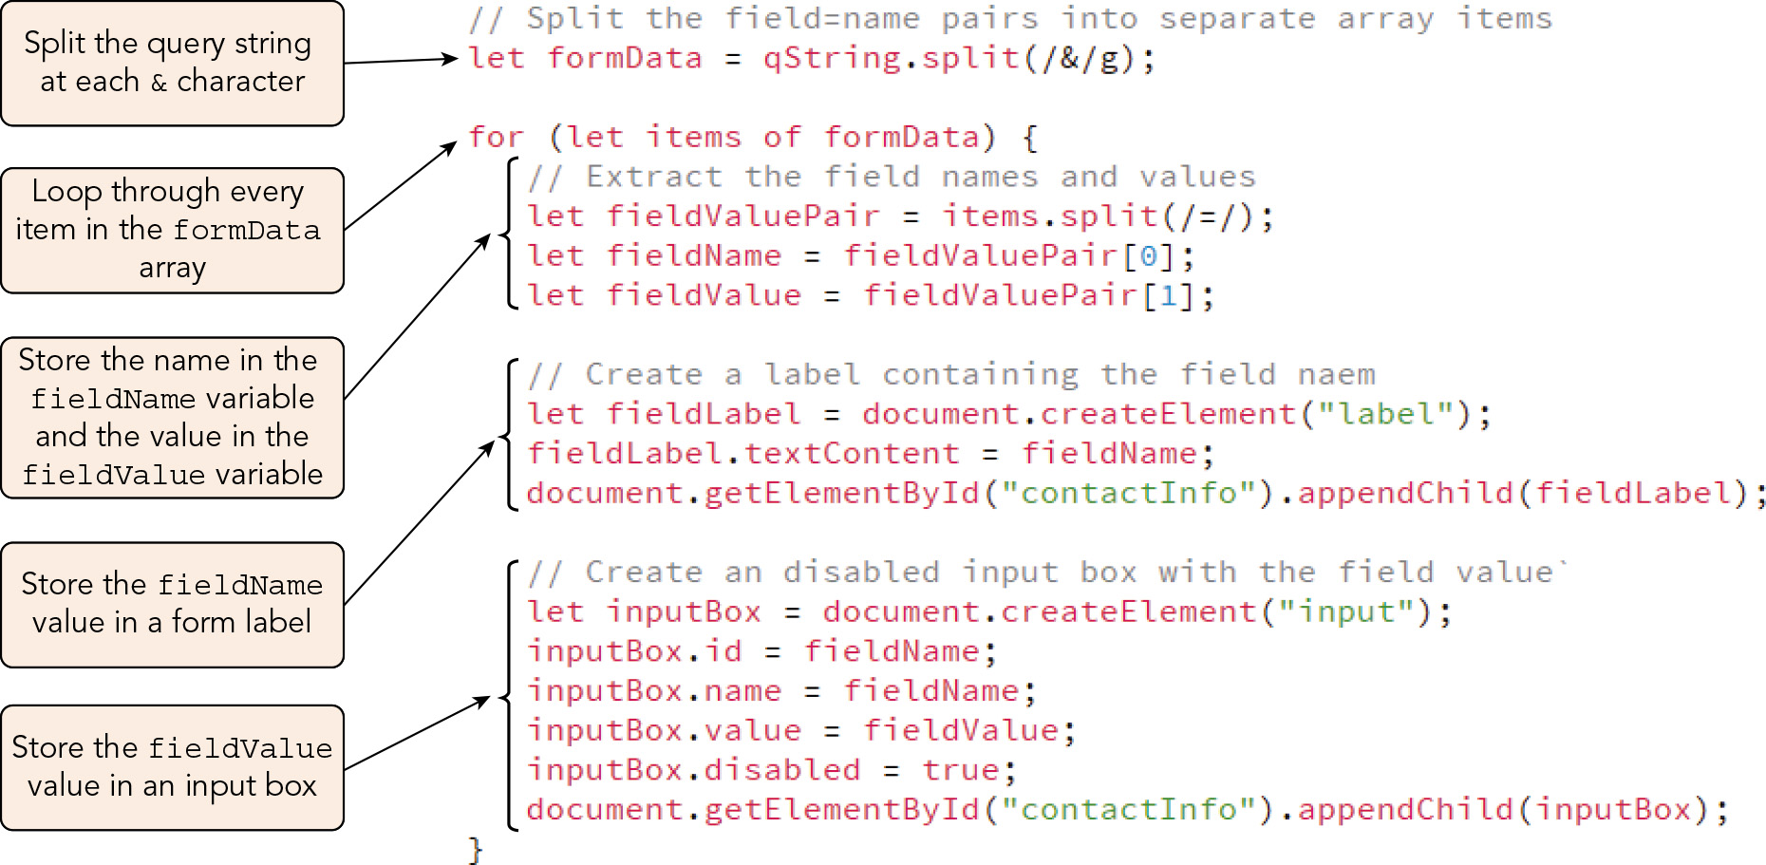
Sharing Data Between Forms (7 of 7)
Figure 9-8 Extracting data from a field name/value pair

Slide 14
Introducing Web Storage
The Web Storage API
A JavaScript specification enabling browsers to store data as an associative array within a file that can be read by the browser
Associative array maps field names and values into key: value pairs
Not supported in older browsers (cookies are an alternative for those browsers)
Supports two types of storage: local storage and session storage
Local storage and session storage objects
Local storage object stores data permanently—it can be accessed at any time
Must be removed explicitly by a web app or the browser's tools
Session storage object makes data accessible only during the current session
Object exists only as long as the browser window or tab in which it was defined is open

Slide 15
Storing Data in Web Storage (1 of 9)
Syntax to store data in web storage: storage.setItem(key, value)
storage is either localStorage or sessionStorage
Sample statement to store a data item in permanent storage: localStorage.setItem("name", "Desmond Jennings");
To write form data displayed on the current page into local storage when the user clicks a submit button, you can set up an event handler to:
Reference input controls using the querySelectorAll() method
Iterate over the node list of fields, writing the field name and value to local storage, using a for of loop

Slide 16
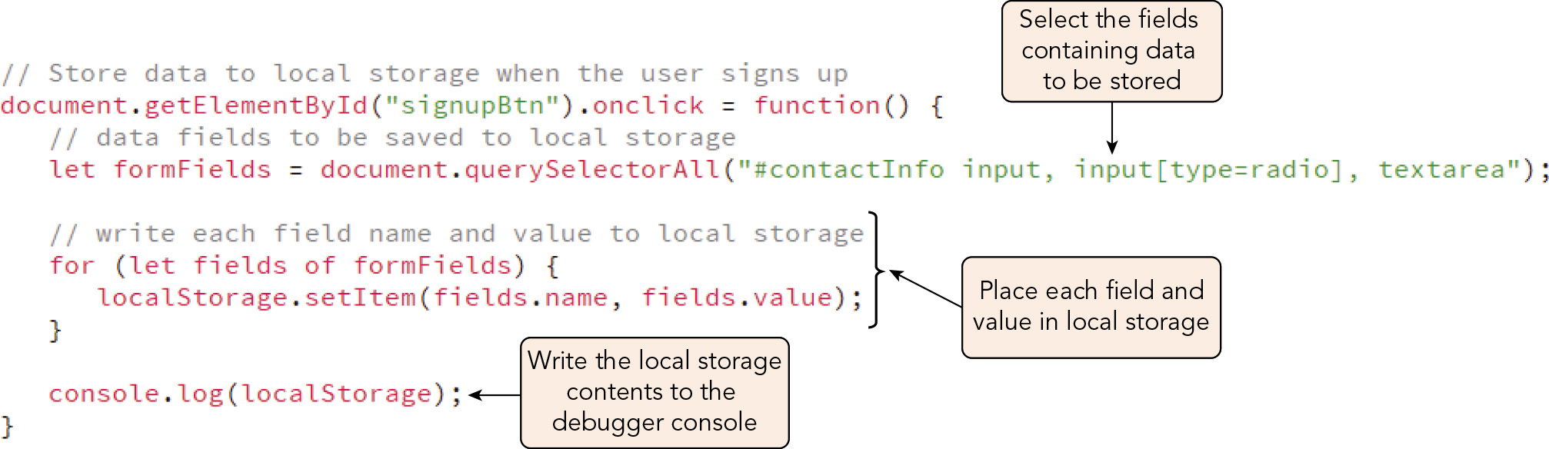
Storing Data in Web Storage (2 of 9)
Figure 9-10 Writing data to local web storage

Slide 17
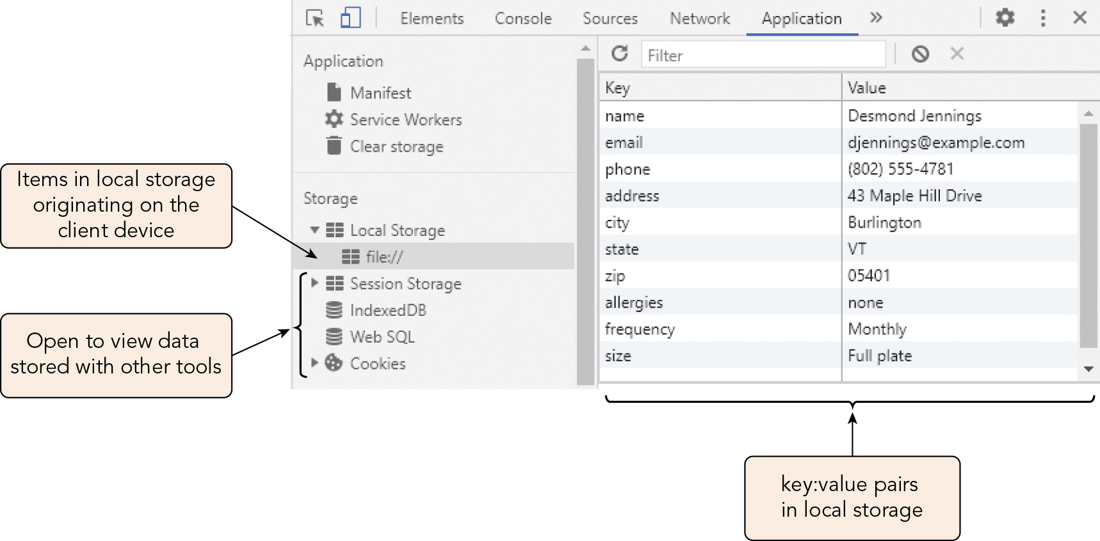
Storing Data in Web Storage (3 of 9)
Figure 9-12 Viewing web storage within the browser

Slide 18
Storing Data in Web Storage (4 of 9)
Retrieving items with the getItem() method
Syntax for retrieving data field values from web storage: storage.getItem(key) or storage.key or storage["key"]
Syntax for retrieving data field keys from web storage with the key() method: storage.key(index)
Sample use of methods and references to retrieve data: localStorage.getItem("name") // returns Desmond Jennings localStorage.name // returns Desmond Jennings localStorage.key(8) // returns "name"
You can use the getItem() method to retrieve data field values from local storage and display them with their associated keys in a table to confirm what the user has entered after form submission

Slide 19
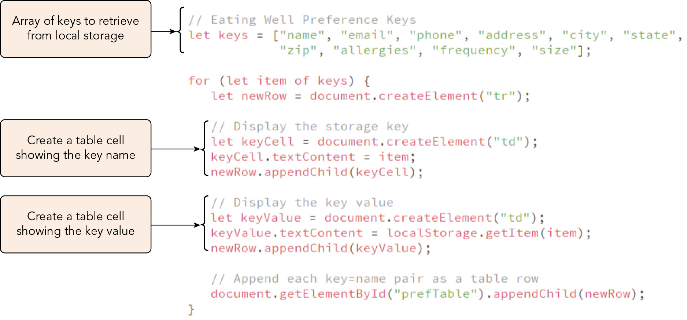
Storing Data in Web Storage (5 of 9)
Figure 9-13 Getting values from web storage

Slide 20
Storing Data in Web Storage (6 of 9)
Removing items from web storage
Syntax for erasing one stored key: value pair using the removeItem() method: storage.removeItem(key)
Syntax for removing all items from local storage using the clear() method: storage.clear()

Slide 21
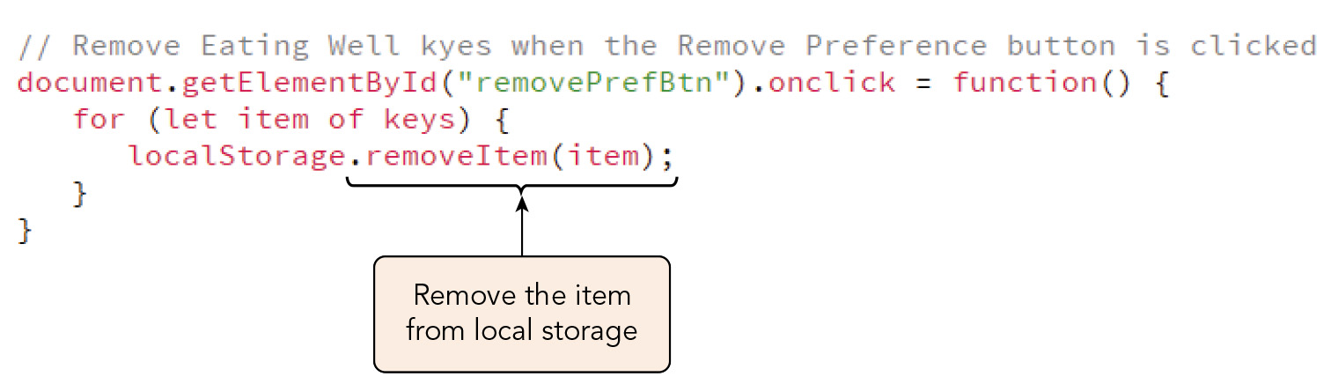
Storing Data in Web Storage (7 of 9)
Figure 9-15 Removing items from local storage

Slide 22
Activity 9.1: Knowledge Check
Suppose you want to use a query string to transfer data from one web form to another web form on a second web page. Describe how you can accomplish this using a query string.
What JavaScript methods can you use to work with web storage, and how are they used?
Notes:
Instructions:
Use the Knowledge Check questions to periodically pose a question to students during class to gauge how well they can recall the material that was presented.

Slide 23
Activity 9.1: Knowledge Check Answers (1 of 2)
Suppose you want to use a query string to transfer data from one web form to another web form on a second web page. Describe how you can accomplish this using a query string. First, to append the first web form's data to the second web form's URL as a query string, you use the get method to send form data to the server by adding method and action attributes to the first web page's form element: <form method="get" action="url/file name of second web form"> Then you must add JavaScript code to retrieve the data stored in the query string to the second web page's script. The query string, which is referenced with the location.search property, requires some processing. First, remove the leading ? character. Next, replace any instances of the + character with spaces and apply the decodeURIComponent() method to replace any URI-encoded characters. Then you can split the text string into name=value pairs on the & character, store the pairs in an array, and iterate over them to split them again by the = character and display or otherwise use them as desired.
Notes:
Instructions:
Use the Knowledge Check questions to periodically pose a question to students during class to gauge how well they can recall the material that was presented.

Slide 24
Activity 9.1: Knowledge Check Answers (2 of 2)
What JavaScript methods can you use to work with web storage, and how are they used? You use the method storage.setItem(key, value) to store data as an associative array in either a localStorage or a sessionStorage object. You can often use a loop to store multiple key: value pairs more efficiently. You can call the storage.getItem(key) method to retrieve the value associated with key. To retrieve the value for a key, you call the storage.key(index) method. Again, you can use a loop to retrieve multiple keys or values from web storage efficiently. To delete key: value pairs from storage, you can either call the storage.removeItem(key) method to remove a single item or call the storage.clear() method to remove all items from the designated storage object at once.
Notes:
Instructions:
Use the Knowledge Check questions to periodically pose a question to students during class to gauge how well they can recall the material that was presented.

Slide 25
Storing Data in Web Storage (8 of 9)
Exploring storage events
A storage event is triggered by saving data to web storage in the active browser window or tab
Notifies any other pages open to the same location
Syntax for the event handler to respond to the storage event, where event is the event object representing the storage event: window.onstorage = function(event) { commands }
Sample code to write information about web storage changes to the debugger console: window.onstorage = function(e) { console.log("The " + e.key + " value was changed from " + e.oldValue + " to " + e.newValue); }

Slide 26
Storing Data in Web Storage (9 of 9)
Web storage and the same-origin policy
Same-origin policy: a set of security standards restricting the transfer of data between web pages of different origins
Having the same origin means having the same protocol, port, and host
Examples of website addresses that point to different origins: http://www.example.com http://store.example.com // different hostname http://www.example.com:8080 // different port number https://www.example.com // different protocol
The same-origin policy does not include the origin's path, which is a storage folder on the web server
Thus, http://www.example.com/members/login.html and http://www.example.com/store/order.html are part of the same origin

Slide 27
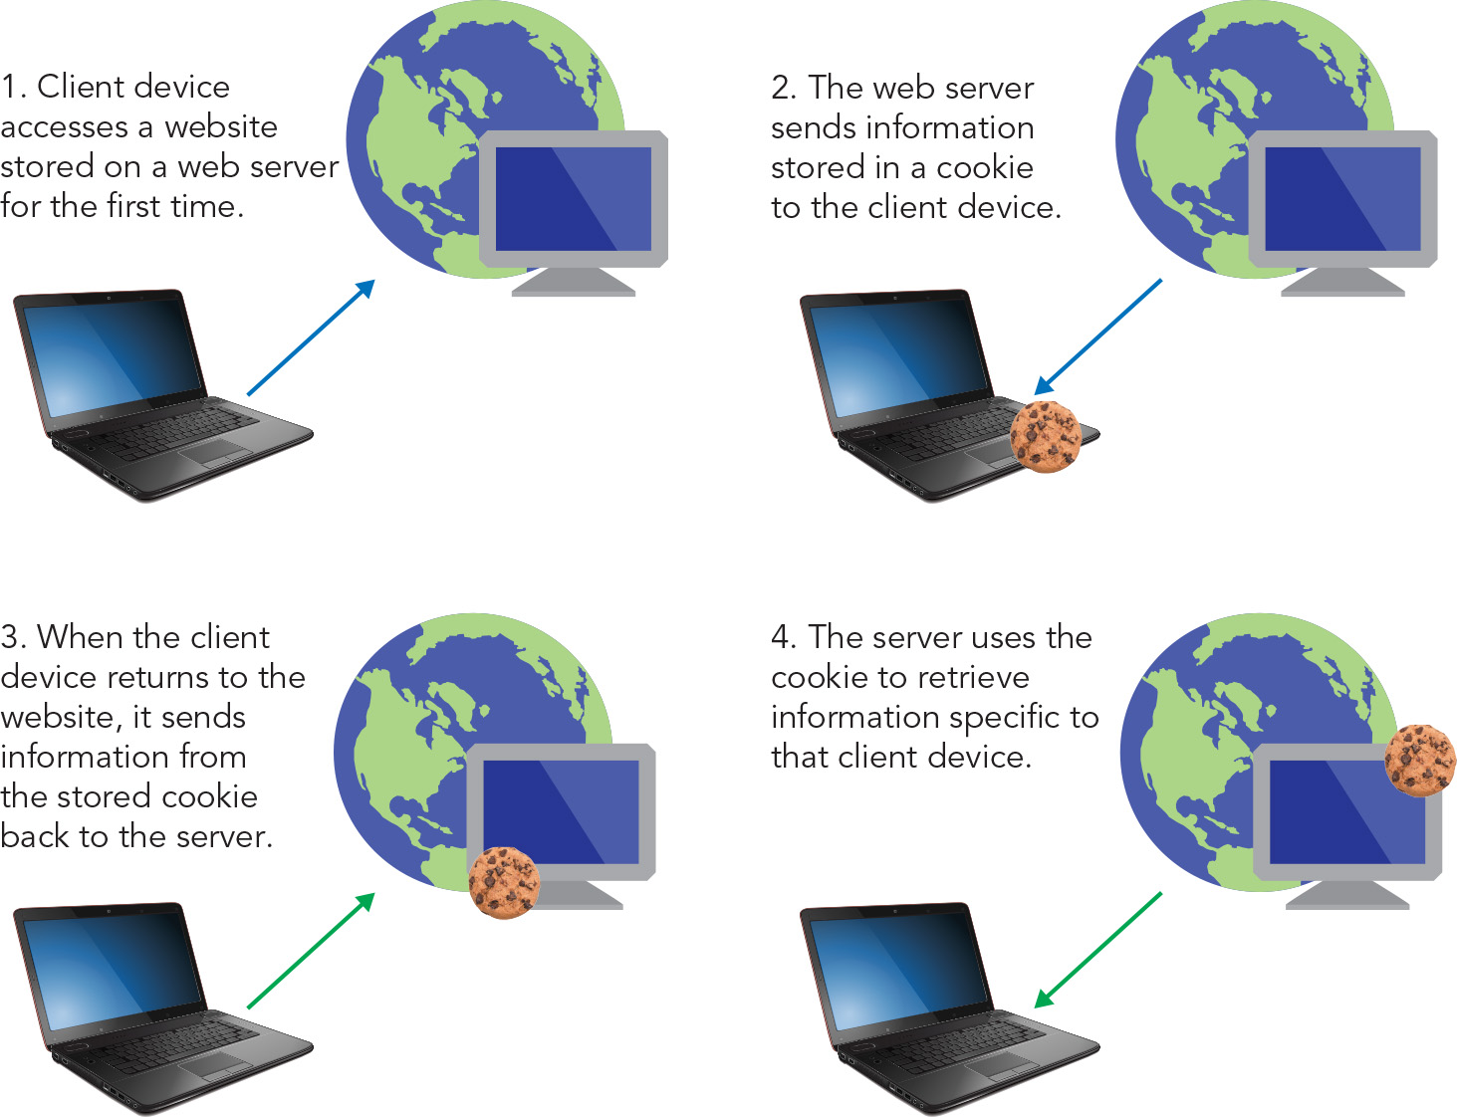
Introducing Cookies (1 of 4)
Figure 9-17 Cookies and web servers

Slide 28
Introducing Cookies (2 of 4)
Cookie: a small piece of information, stored as a text string, exchanged via an HTTP request between the web server and the client device
Cookies vs. web storage
Both are stored on the client device, but cookies and transferred to the web server as part of an HTTP header, whereas web storage is not transferrable to the server
Cookies require access to a web server for testing and development
Cookie storage is much more limited in size and number of storage items
Cookies can be set to automatically expire, whereas local storage requires manual deletion
Cookie data must be parsed from a text string using string methods, whereas web storage data can be read directly using the Web Storage API
Cookie data can be accessed directly on both the server and client sides, whereas web storage can be accessed directly only on the client side

Slide 29
Introducing Cookies (3 of 4)
Cookies vs. web storage (continued)
Session cookies exist only for the current browser session
Persistent cookies are available beyond the current session
The structure of a cookie
Sample simple cookie text string (name=value pair): city=Burlington
Stored in a protected file on the client device
In general, browsers provide storage for:
10 cookies per website domain
300 cookies total
4 kilobytes per cookie
Most browsers will support more cookies than these numbers indicate, but will not save cookies larger than 4 K

Slide 30
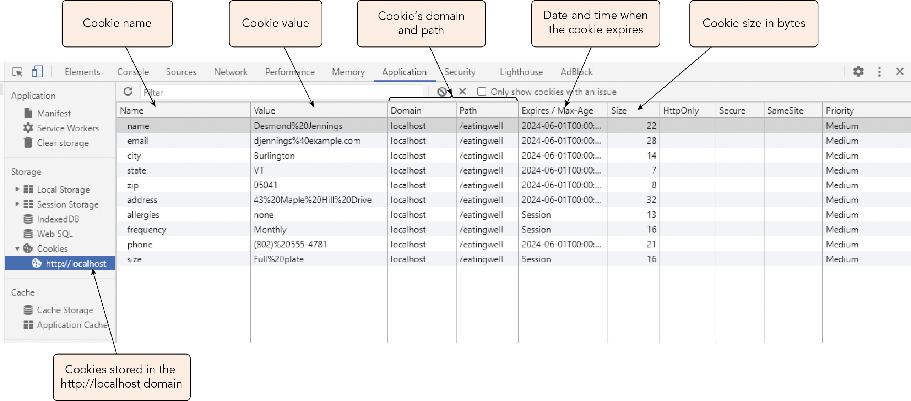
Introducing Cookies (4 of 4)
Figure 9-19 Cookies listed in the Application window of the Chrome Developer pane

Slide 31
Writing Data into a Cookie (1 of 6)
Syntax for creating a cookie, where string defines the cookie for a field: document.cookie = string;
Sample code creating a cookie: document.cookie = "city=Burlington";
Sample code creating a cookie containing values for three fields: document.cookie = "city=Burlington&state=VT&zip=05401";
Means to circumvent the restriction on the number of cookies per website
As with query strings, you must call the encodeURIComponent() method on data containing spaces and non-alphanumeric characters prior to writing it into the cookie, e.g.: let username = "Desmond Jennings"; let nameCode = encodeURIComponent(username); document.cookie = "name=" + nameCode;

Slide 32
Writing Data into a Cookie (2 of 6)
Setting the cookie expiration date
Cookies are created as session cookies; to turn them into persistent cookies you must add an expiration date
Format for an expiration date (in GMT or UTC), which is added to the cookie string: ;expires=wday, dd-mmm-yyyy hh:mm:ss GMT
Example: document.cookie = "city=Burlington;expires=Thu, 18 Apr 2024 00:00:00 GMT";
Sample code to add an expiration date to a cookie using the Date object: let username = "Desmond Jennings"; let nameCode = encodeURIComponent(username); let expire = new Date("June 1, 2024"); let expireCode = expire.toUTCString(); document.cookie = "name=" + nameCode + ";expires=" + expireCode;

Slide 33
Writing Data into a Cookie (3 of 6)
Setting the cookie expiration date (continued)
An expiration date relative to the current date is set using the setMonth() and getMonth() methods, e.g.: let expire = new Date(); let expire = setMonth(expire.getMonth() + 6);
Format for setting an expiration date relative to the cookie's creation using the max-age attribute: ;max-age=seconds;
Sample code creating a cookie that will expire one year from its creation: let username = "Desmond Jennings"; let nameCode = encodeURIComponent(username); let maxAge = 60*60*24*365; document.cookie = "name=" + nameCode + ";max-age=" + maxAge;

Slide 34
Writing Data into a Cookie (4 of 6)
Setting the cookie path
Cookies are associated with and accessible to specific website domains and folders within them
Default: the website and folder of the page in which the cookie was defined, plus its subfolders, if any
Format for specifying a path other than the default, where directory is the directory path on the web server where the cookie is stored and read: ;path=directory
You can set the path to the root folder using ;path=/, but this can cause name collisions if different pages of the website need to create cookies with the same name
Setting the cookie domain
Cookies are accessible only to pages from their domain of creation
Set the ;domain=domain-name attribute to allow domain-name and its subdomains to access the cookie; they must all reside on the same web server for this to work

Slide 35
Writing Data into a Cookie (5 of 6)
Defining cookie security
Adding the secure attribute to the cookie string specifies that the cookie must be exchanged over a secure HTTPS connection (not an HTTP connection)
Providing persistent logins
Sensitive information such as passwords should never be stored in cookies
Each time the user requests access, the web server provides the browser a new token (string of random characters) that is stored in a cookie and used to identify the user the next time the user requests access
A function to write the cookie value
Many apps that employ cookies include a customized function to generate cookie strings and write them to the document.cookie object
To edit a cookie's field values, overwrite it by writing it again with the same name, path, and domain values

Slide 36
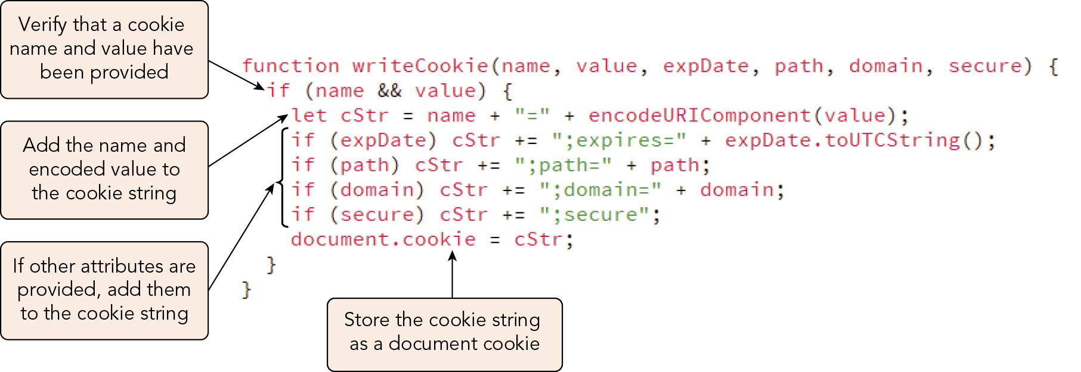
Writing Data into a Cookie (6 of 6)
Figure 9-20 Function to write a cookie

Slide 37
Reading a Cookie (1 of 2)
The document.cookie object contains all the name=value pairs, separated by a semicolon and blank space
The expires, max-age, domain, path, and secure attributes are treated as commands for the browser and web server and are not directly accessible to JavaScript
Steps to extracting field names and values from document.cookie (same approach as used for query strings):
Call the split() method on document.cookie to create an array of name=value pairs
Iterate over the array to save each name=value pair as a separate item
Extract the cookie name and cookie value from each pair
Apply the decodeURIComponent() method to the cookie value from each pair
You can save the return value of the custom function as an object literal in which the name=value pairs are stored as attributes and can be accessed as such

Slide 38
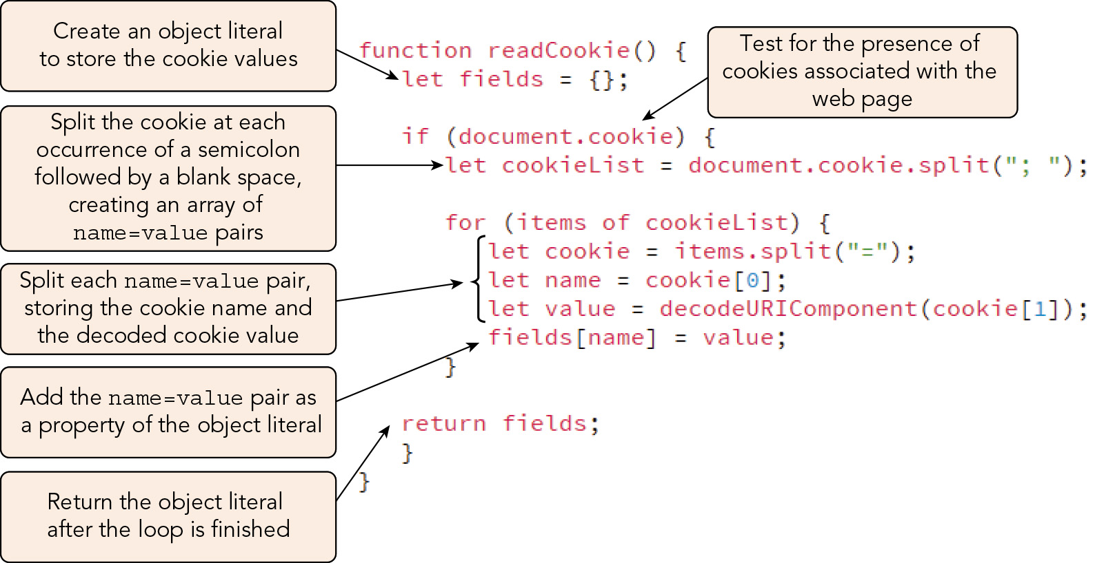
Reading a Cookie (2 of 2)
Figure 9-21 Function to read a cookie

Slide 39
Activity 9.2: Think, Pair, and Share
Form pairs/groups of two to four class members.
As a group, use HTML and JavaScript to create a simple web form that collects several pieces of information related to a theme of your choice.
Add a JavaScript function that stores the information entered by the user into the web form in the document.cookie object.
Add a JavaScript function that retrieves the data from the document.cookie object and saves it in an object literal.
Notes:
Instructions:
Use the Think, Pair, Share activity to encourage students to solve problems collaboratively and to apply the real-world skill of evaluating, modifying, and debugging code created by another programmer.

Slide 40
Deleting a Cookie
Session cookies are deleted when the associated browser window or tab is closed
Sample statement that deletes a cookie by overwriting it with a max-age attribute of 0 s: document.cookie = "city=;max-age=0;path=/members";
The path and domain attributes must be included if the cookie was defined with them
Cookies can also be deleted using the browser's developer tools

Slide 41
Exploring Security Issues (1 of 4)
Web server security involves technologies such as firewalls, which combine software and hardware to prevent access to private networks connected to the Internet
The Secure Sockets Layer (SSL) protocol encrypts data and transfers it across a secure connection
Because it is executed by the browser, a JavaScript program is not governed by firewalls or SSL
Secure coding with JavaScript
Secure coding (a.k.a. defensive coding): writing code in a way that minimizes intentional or accidental security issues
For JavaScript, the first priority is to validate all user input (e.g., validate using regular expressions, handle exceptions, etc.)

Slide 42
Exploring Security Issues (2 of 4)
JavaScript security concerns
Security areas of most concern:
Protection of a web page and program against malicious tampering
Privacy of individual client information
Protection of the local file system of the client or website from theft or tampering
Code injection attack: attack in which a program or user enters code that changes the function of the web page
E.g., entry of code into a form field to retrieve and steal sensitive information
Validating form entries and escaping characters that might be part of malicious code in form field values can protect against code injection attacks

Slide 43
Exploring Security Issues (3 of 4)
JavaScript security concerns (continued)
JavaScript's lack of certain functionalities is a major security feature:
Does not allow file manipulation aside from cookies, web storage, and a few other site-specific standards; this protects individual client information
Because it includes no means of initiating a network connection, it cannot be used to infiltrate a private network or intranet
Cannot run system commands or execute programs on a client
Can only access the client system by reading and writing cookies within the domain that created them
Storing sensitive information in cookies is a security risk; never do this!

Slide 44
Exploring Security Issues (4 of 4)
Using third-party scripts
Websites often run third-party scripts that originate from other domains
E.g., when a large organization uses a content delivery network (CDN) to provide content from a web server optimized for fast delivery
To enable a third-party script in a web document, include a script element with a src value pointing to the third-party content
Using the web securely
Save login information only if you are using a computer whose users you trust
Transmit sensitive data over a public wireless network only when connected to a server using an encrypted connection (HTTPS protocol)

Slide 45
Activity 9.3: Discussion Questions
What are query strings? How can you use query strings to save state information? Is this mechanism better than using hidden form fields? Explain your reasoning.
What are cookies? How can you use cookies to save state information? Are cookies better than query strings or hidden form fields? Explain your reasoning.
Notes:
Instructions:
Use the Discussion activity to encourage group conversation about a related topic of interest.

Slide 46
Self-Assessment
Have you used websites that store information to and retrieve information from your device? How do you perceive this functionality as a website user?
What experience do you have with these sorts of websites as a web developer? Do you anticipate utilizing the functionality provided by the Web Storage API and cookies in future projects?
What security issues or prevention strategies would you like to learn more about, either for personal or professional reasons? Do you feel well-informed enough to protect your personal information and privacy when using the Internet?
Notes:
Instructions:
Use the Self-Assessment question to encourage students to evaluate their progress or goals in the course, as well as determine how they might apply their learning or grow as an individual.

Slide 47
Summary
Now that the lesson has ended, you should have learned to:
Describe the fundamentals of sessions and state information.
Share data between web pages using query strings.
Explain how data is stored using the Web Storage API.
Use browser tools to view and manage web storage contents.
Identify the purpose and structure of a cookie.
Write data into a cookie.
Retrieve data from web storage.
Force the deletion of a persistent cookie.
Describe the fundamental concepts involved in web security.
Notes:
Instructions: Reiterate the learning objectives for the lesson. Students should use this information to guide their studies and reinforcement of new concepts.

