Slide 1
JavaScript for Web Warriors, 7e Chapter 12: Introducing jQuery

Slide 2
Chapter Objectives
By the end of this chapter, you should be able to:
Use the jQuery library to apply jQuery methods to a selection of elements.
Modify the contents and structure of the DOM using jQuery.
Manage browser events using jQuery.
Create effects and animations using jQuery methods.
Apply jQuery Plugins, such as jQuery UI, to create specialized animations.
Notes:
Instructions: Briefly review with students the major concepts you will be covering during this class. There is one objective for every major A-head section of the chapter.

Slide 3
Getting Started with jQuery (1 of 4)
jQuery is a highly successful, free JavaScript library (organized collection of JavaScript code) that was originally developed to facilitate cross-browser compatibility
jQuery's core features:
Easier DOM navigation and manipulation
Tools for event management
Animation effects
Widgets such as photo slideshows, calendars, and web form controls
Easier AJAX request creation and response handling
Collections of third-party jQuery plugins for front-end development are also available
Versions of jQuery
Has gone through several releases since its initial release in August 2006
Current version is 3.6.0

Slide 4
Getting Started with jQuery (2 of 4)
Loading jQuery
Accessible as either a .js file downloaded to your website or a file residing on a Content Delivery Network (CDN)
Using a CDN is the best practice unless your app needs to work offline
jQuery recommends that links to the CDN include subresource integrity checking (SRI)
jQuery library versions:
Uncompressed or minified (for faster performance)
Normal jQuery build (full features of the library) or slim jQuery build (lacks features such as AJAX and some animation tools)
Is jQuery still relevant?
Many features have been supplanted by JavaScript, CSS, or the Fetch API
Important to be familiar with it because it is still widely used in top websites

Slide 5
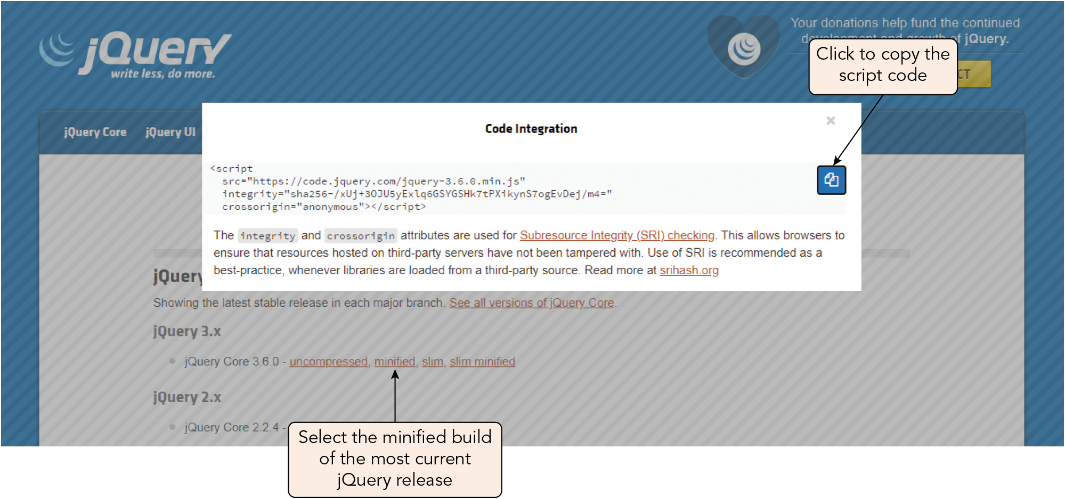
Getting Started with jQuery (3 of 4)
Figure 12-3 Copying the link to the minified jQuery build

Slide 6
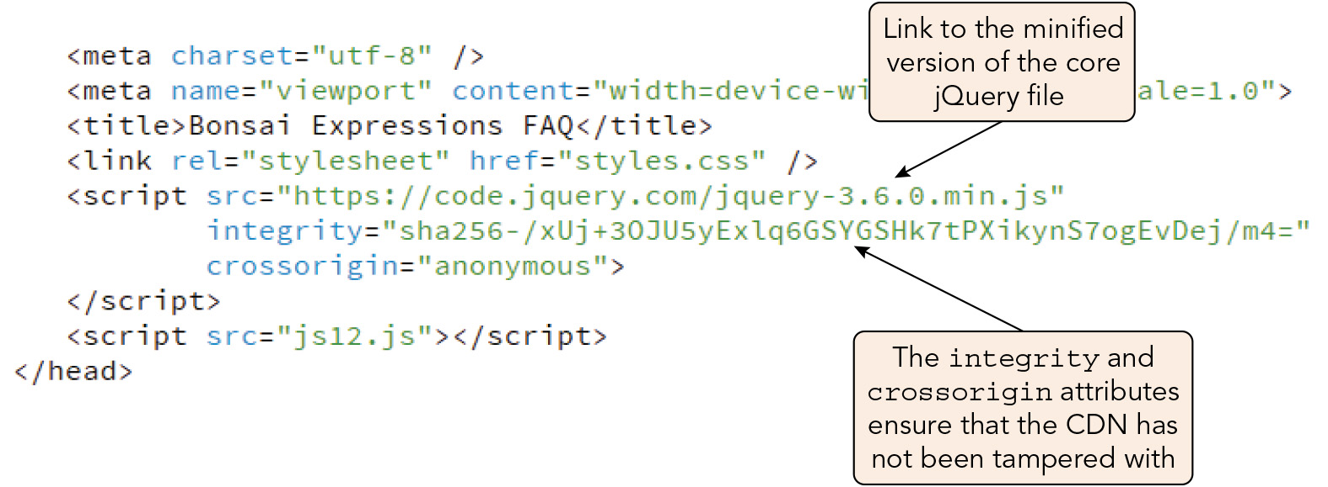
Getting Started with jQuery (4 of 4)
Figure 12-4 Script elements in the document head

Slide 7
Working with jQuery Selectors (1 of 8)
General syntax for jQuery commands: $(selector).action(parameters)
selector references a selection of elements from the web page document
action is an action performed on that selection
parameters are parameter values associated with that action, such as functions
Sample code to apply the ready() action to the web document when it is loaded and read: $(document).ready(function() { jQuery statements }) or (with later versions of jQuery): $(function() { jQuery statements });

Slide 8
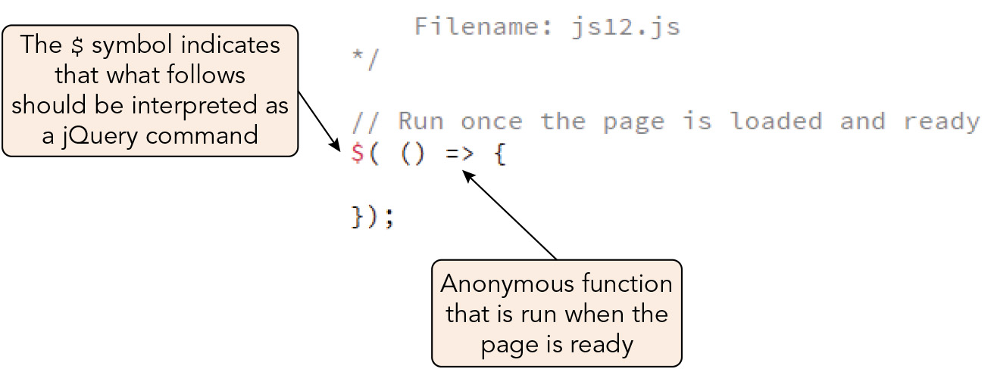
Working with jQuery Selectors (2 of 8)
Figure 12-5 Running a function when the document is ready

Slide 9
Working with jQuery Selectors (3 of 8)
Selecting elements from the DOM
The jQuery $(selector) expression references a selection of elements based on CSS selector patterns
Sample expressions:
$("dd > p") returns an array of all paragraphs nested as direct children of the dd element
$("dd > p, dt > p") returns paragraphs that are direct children of a dt or dd element
$("article.story p") selects all paragraphs nested within article elements belonging to the story class
$("article.story p")[0] selects the first paragraph within an article element because the selected elements can be treated as items within an array

Slide 10
Working with jQuery Selectors (4 of 8)
Selecting elements from the DOM (continued)
jQuery selectors can be saved as variables, e.g.: let mainPara = $("h1#main p"); $(mainPara) // references paragraphs of the main h1 heading
The variable is placed with the $() expression so it's treated as a jQuery selector
Optimizing jQuery selectors
The fastest way to retrieve a specific element is by its id value
Be specific in selectors to limit the search
Include a context for selectors to reduce the size of the node tree to search
Cache selectors by storing them within variables
Avoid pseudo-selectors; use id attributes to reference specific nodes instead

Slide 11
Working with jQuery Selectors (5 of 8)
Traversing the DOM with jQuery
jQuery methods enable navigation of the node tree from parent elements and through sibling and child elements
Sample expression that returns an array of all sibling elements of the main article that are themselves articles: $("article#main").siblings("article")
Sample use of object chaining (appending the selector with jQuery methods that extend or redirect the selected elements) to include only sibling articles with unordered lists: $("article#main").siblings("article").has("ul")
Working with attributes and CSS properties
jQuery methods for working with element attributes and CSS properties allow you to narrow a search based on element or CSS property values or to create new attributes and CSSS properties

Slide 12
Working with jQuery Selectors (6 of 8)
Working with attributes and CSS properties (continued)
Sample expression to retrieve the value of the width attribute for the first inline image of the slides class: $("img.slides").first().attr("width")
Sample expression to set the width to 500 pixels: $("img.slides").first().attr("width", "500px")
Sample expression to set the width and height using attributes in JSON format: $("img.slides").first().({"width": "500px", "height": "300px"})
Sample expression to set the color and font size of the main h1 heading: $("h1#main").css({ fontSize: "2em", color: "blue" })

Slide 13
Working with jQuery Selectors (7 of 8)
Working with attributes and CSS properties (continued)
jQuery returns the computed values of CSS styles, whereas the style sheet may contain values defined in other units
E.g., 2 em and green from CSS become 32 pixels and RGB values 0, 128, and 0 when returned by jQuery
Changing the DOM structure
jQuery methods can be used to edit, replace, or add DOM elements
jQuery methods can act as both getters (methods that get values) and setters (methods that set values)
Sample getter: $("input#username").val()
Sample setter: $("input#username".val("dawson4815")

Slide 14
Working with jQuery Selectors (8 of 8)
Changing the DOM structure (continued)
Sample jQuery statement to change heading styles in an HTML fragment: $("<h2 class='new'>Minor Heading</h2>").replaceAll("h1.old");
The wrap() method encloses elements within a specified HTML structure, creating a new parent for the elements, e.g.: $("h1.story").wrap("<article></article>")
The unwrap() method can be used afterward to restore the original structure, e.g.: $("h1.story").unwrap()

Slide 15
Handling Events with jQuery (1 of 6)
General syntax for managing events with jQuery, where handler is the function that handles the event: $(selector).event(handler)
jQuery responds to events during the bubbling phase only
jQuery supports an event object that is passed as an object of the handler function
Sample code that applies the click() event to every h1 element in the document to display the text of the element that follows the heading: $("h1").click(e => { console.log($(e.target).next().text()); });
The heading clicked is stored in the e.target property, the next() method selects the next sibling element, and the text() method displays the text stored within that sibling
The event object property must be placed within the jQuery selector so that jQuery handles the associated methods

Slide 16
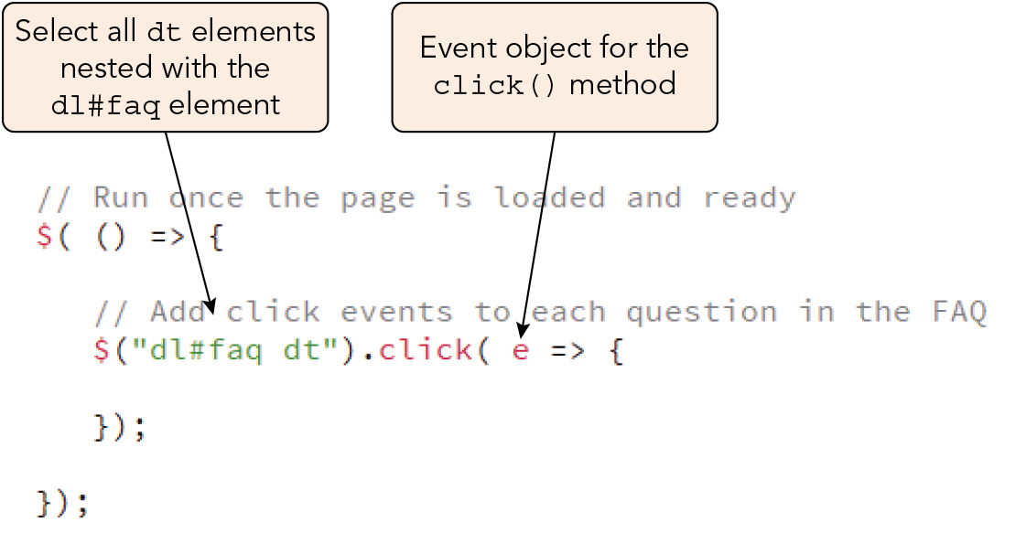
Handling Events with jQuery (2 of 6)
Figure 12-11 Apply the jQuery click() method

Slide 17
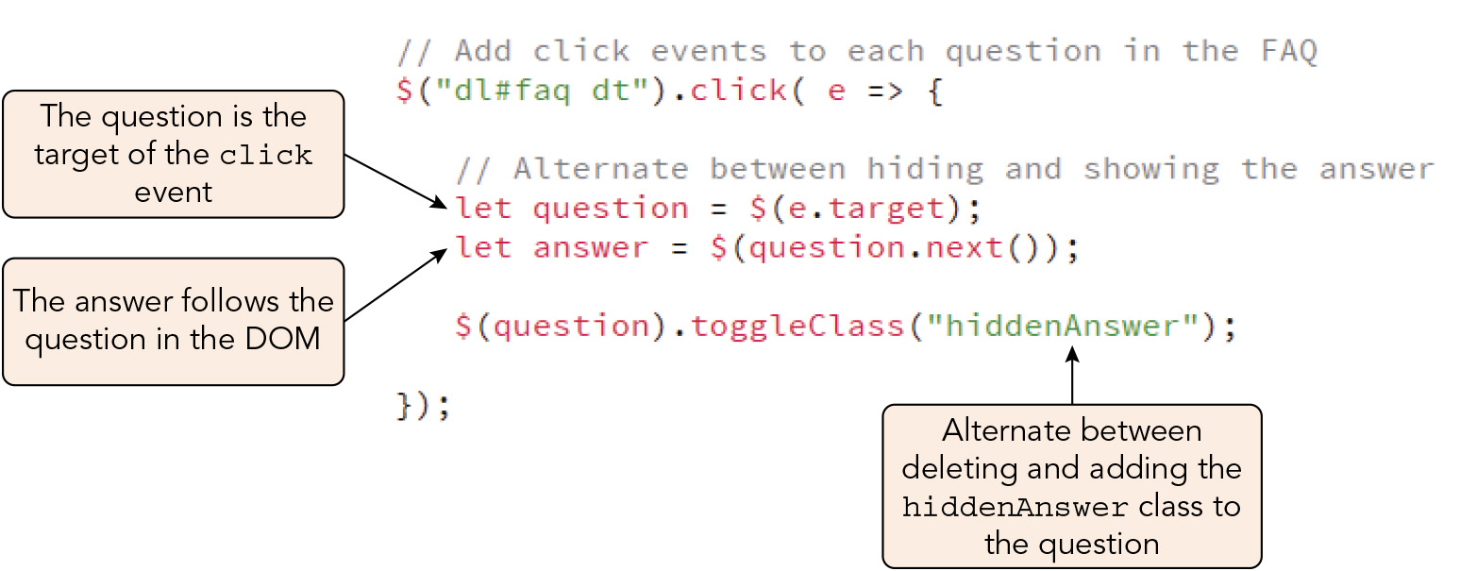
Handling Events with jQuery (3 of 6)
Figure 12-12 Toggling the class attribute on and off

Slide 18
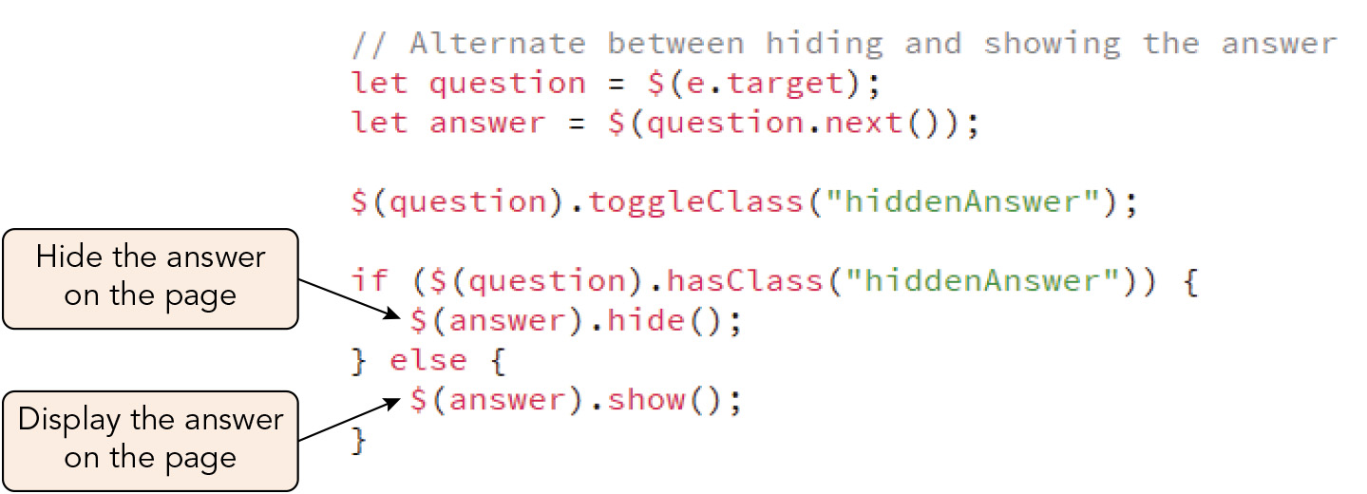
Handling Events with jQuery (4 of 6)
Figure 12-13 Displaying and hiding an FAQ answer

Slide 19
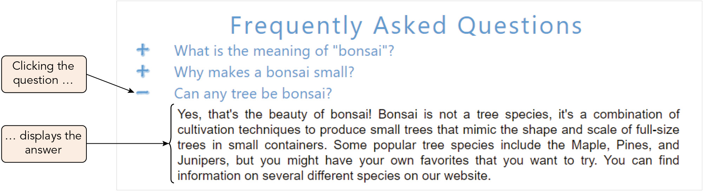
Handling Events with jQuery (5 of 6)
Figure 12-14 Displaying an answer in the FAQ

Slide 20
Handling Events with jQuery (6 of 6)
Managing jQuery efficiently
Use a minified version of jQuery
Use a CDN
Use selectors efficiently by chaining methods together
Ensure that you apply jQuery (not JavaScript) methods to jQuery objects, and vice versa
Use standard HTML, CSS, and JavaScript in preference to the jQuery library

Slide 21
Activity 12.1: Knowledge Check
What elements will be targeted by the following jQuery selectors? $("dd > p, dt > p") $("article.inspirational p")[1] $("article#happy").siblings("article").has("ul")
Compare handling events with jQuery to handling events with standard JavaScript.
Notes:
Instructions:
Use the Knowledge Check questions to periodically pose a question to students during class to gauge how well they can recall the material that was presented.

Slide 22
Activity 12.1: Knowledge Check Answers (1 of 2)
What elements will be targeted by the following jQuery selectors? $("dd > p, dt > p") This selects elements that are nested as direct children of either a dt or a dd element. $("article.inspirational p")[1] This selects the second paragraph within an article element of the "inspirational" class. $("article#happy").siblings("article").has("ul") This selects elements that meet all three of the following conditions: (1) they are siblings of the article with the id "happy," (2) they are articles, and (3) they contain unordered lists.
Notes:
Instructions:
Use the Knowledge Check questions to periodically pose a question to students during class to gauge how well they can recall the material that was presented.

Slide 23
Activity 12.1: Knowledge Check Answers (2 of 2)
Compare handling events with jQuery to handling events with standard JavaScript. Both accomplish the same goal, but there are some important differences. Firstly, the syntax for a jQuery event handler is the same as that for applying a method to selected elements, not the element.onevent = function pattern used in plain JavaScript. Next, jQuery does not support event listeners that respond to events during the capture phase; it only responds during the bubbling phase. jQuery event handling is like that in JavaScript in that an event object is passed as an object of the handler function, and that object has similar properties and methods. However, event object properties must be placed within the jQuery selector, $(), so that jQuery handles the methods associated with the event target.
Notes:
Instructions:
Use the Knowledge Check questions to periodically pose a question to students during class to gauge how well they can recall the material that was presented.

Slide 24
Working with Effects and Animations (1 of 10)
jQuery effects are methods that apply a visual effect to an element selection, e.g.: show(speed, easing, callback) hide(speed, easing, callback)
speed is slow, fast, or the length of the effect in milliseconds
easing is swing (slow at the ends and faster in the middle, the default) or linear (constant rate for the effect)
callback is a function that is run after the effect is completed
The hide() method reduces the size of the selected elements to 0 pixels and the opacity to 0 (transparent); the show() method increases the elements' size to their default and their opacity to 1 (opaque)
Other jQuery effects support the speed, easing, and callback parameters

Slide 25
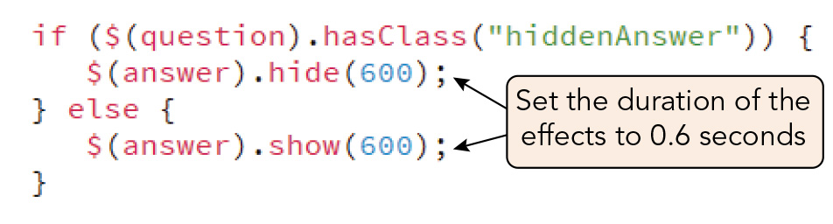
Working with Effects and Animations (2 of 10)
Figure 12-15 Setting the duration of a jQuery effect

Slide 26
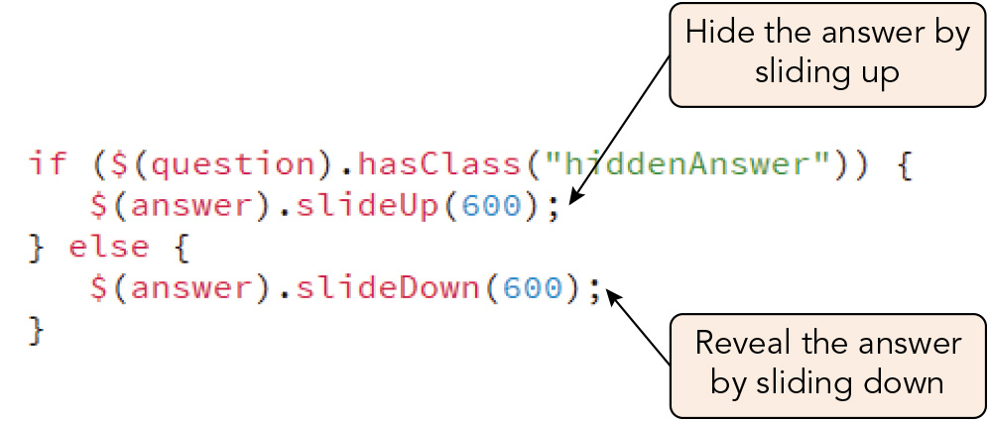
Working with Effects and Animations (3 of 10)
Figure 12-17 Using the slideUp() and slideDown() methods

Slide 27
Working with Effects and Animations (4 of 10)
Chaining effects
Chaining jQuery effects creates a queue in which selected elements exhibit one effect after another in succession
Sample effects chain: $(selector).slideDown(500) .fadeOut(100).fadeIn(100).fadeOut(100).fadeIn(100) .fadeOut(100).fadeIn(100).fadeOut(100).fadeIn(100);
Callback functions can be interspersed within an effects chain so that a function is run as soon as one effect concludes but before the next effect begins
Sample code that causes caption text to fade out and a different caption to fade in: $("div#caption").fadeOut(1000, () => { $("div#caption").text("New caption"); }) .fadeIn(1000);

Slide 28
Working with Effects and Animations (5 of 10)
Creating custom effects with animate
jQuery animation: a visual effect accomplished by gradually changing the values of a collection of CSS properties over a specified time interval
Syntax for creating an animation using the animate() method: $(selector).animate({properties}, duration, callback)
properties is an object literal of CSS properties and their values
duration is slow, fast, or a time interval in milliseconds
callback is a function that is run once the animation is concluded
An animation must have a starting condition to build upon, either from the style sheet or within the jQuery code
Property values that include units must be quoted; property values that are numeric do not

Slide 29
Working with Effects and Animations (6 of 10)
Creating custom effects with animate (continued)
Sample code to animate a heading so it appears to grow larger and darker: $("h1.caption").css({ fontSize: 0, width: 0, opacity: 0 }) .animate({ fontSize: "2em", width: "800px", opacity: 1 }, 500)
A CSS property can be changed relative to its current value using the += and -= operators

Slide 30
Working with Effects and Animations (7 of 10)
Creating custom effects with animate (continued)
Property values can be entered using keywords
hide: changes the CSS property value to zero
show: restores the CSS property value to its original condition
toggle: switches the CSS property value between zero and its initial condition
Sample code that toggles the font size and opacity of the h1.caption elements between zero and their initial condition, alternately hiding and revealing the headings: $("h1").animate({ fontSize: "toggle" opacity: "toggle" }, 500);

Slide 31
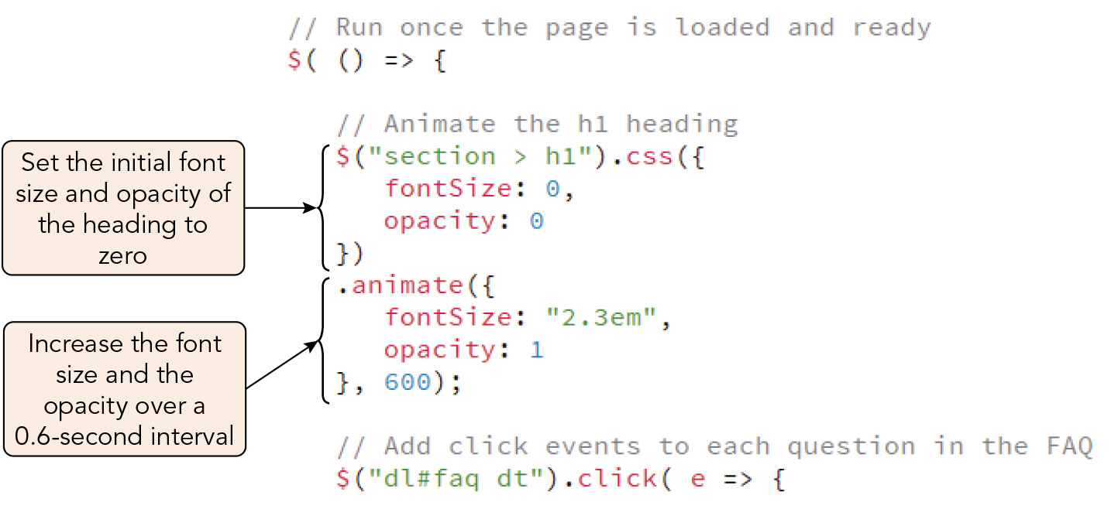
Working with Effects and Animations (8 of 10)
Figure 12-18 Applying an animate() method

Slide 32
Working with Effects and Animations (9 of 10)
Controlling the animation queue
Animation effects placed within a queue are run in order, with each animation starting as soon as the preceding one finishes
jQuery methods can be used to control the queue by delaying, halting, or removing a queued animation
Sample code to shift the div.box element when the mouse pointer moves over it: $("div.box").mouseenter( e => { $(e.target).animate({ left: "+=20px" }, 1000) });
Sample code to stop the animation when the pointer leaves the box: $("div.box").mouseout( e => { $(e.target).stop() }

Slide 33
Working with Effects and Animations (10 of 10)
Controlling the animation queue (continued)
The queue for each animation can be given a unique name that can be referenced in the clearQueue(), delay(), dequeue(), finish(), queue(), and stop() methods
Libraries versus frameworks
A library is a reusable collection of code that is often directed toward one use or purpose
The developer "calls" on the library to perform tasks or get information
A framework (e.g., React.js, Vue.js, Angular.js) encompasses all the tools you need in application development
Might contain several libraries and scripts plus other tools
The framework organizes these tools for the developer and the developer provides the code
The code does not call on the framework; it is a part of the framework

Slide 34
Activity 12.2: Think, Pair, and Share
Form pairs/groups of two to four class members.
As a group, choose a web page element that you'd like to practice animating using jQuery, and then write the HTML and CSS code required to display and style that element.
Using the jQuery library, write JavaScript code that applies some chained effects and at least one custom animation to the element. Optionally, embellish the effects/animations further by adding functions that run during the sequence.
View and enjoy the effects and animations you have created, tweaking the code if necessary to achieve their desired appearance.
Notes:
Instructions:
Use the Think, Pair, Share activity to encourage students to solve problems collaboratively and to apply the real-world skill of evaluating, modifying, and debugging code created by another programmer.

Slide 35
Exploring jQuery Plugins (1 of 6)
jQuery plugins can be downloaded from the web to achieve more advanced effects or perform other tasks
Steps to using a jQuery plugin:
Read the documentation and view demos
Download the plugin files to your site or create a link to a CDN hosting the plugin
Edit the HTML and CSS code to load the required files for the plugin, placing the script element for the plugin after the one for the jQuery library
Edit the JavaScript code to utilize the plugin
jQuery UI: the most popular jQuery plugin, which expands the functionality of jQuery with a large collection of functions and methods for creating specialized user interfaces

Slide 36
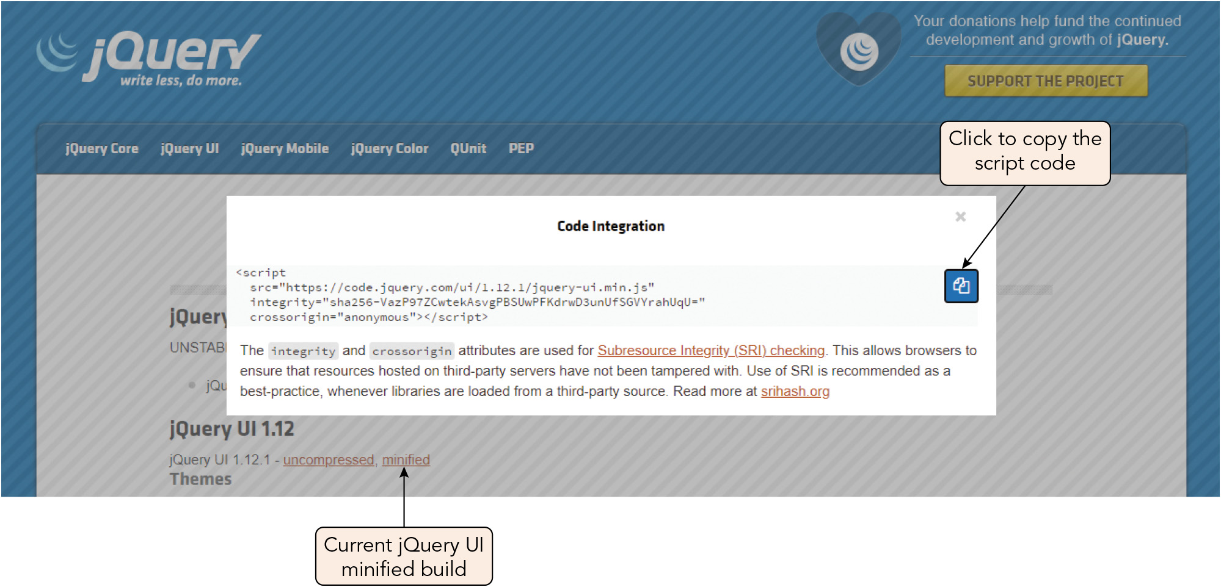
Exploring jQuery Plugins (2 of 6)
Figure 12-20 Copying the link to the minified jQuery UI build

Slide 37
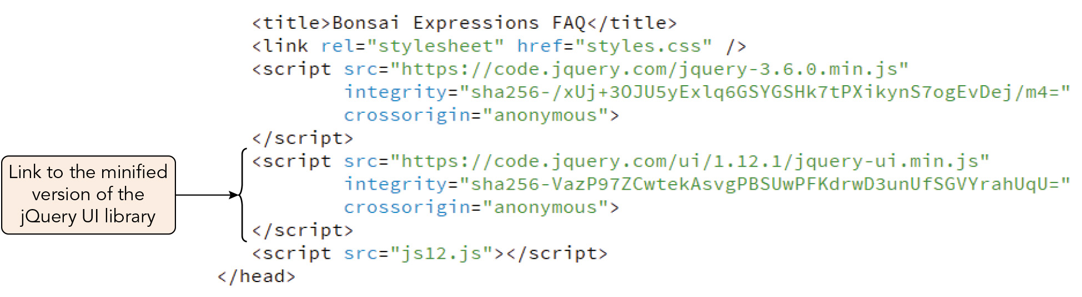
Exploring jQuery Plugins (3 of 6)
Figure 12-21 Linking to the minified jQuery UI build

Slide 38
Exploring jQuery Plugins (4 of 6)
Syntax for the jQuery UI library's effect() method: effect(type, options, speed, callback)
type is the type of effect
options is an object containing parameter values for the effect type
speed is the speed of the effect
callback is a function that will be run once the effect is over
Syntax for a sample effect type, the clip() method: effect("clip", { mode: mode, direction: direction, }, speed, callback)
mode is either hide or show
direction is vertical (the default) or horizontal

Slide 39
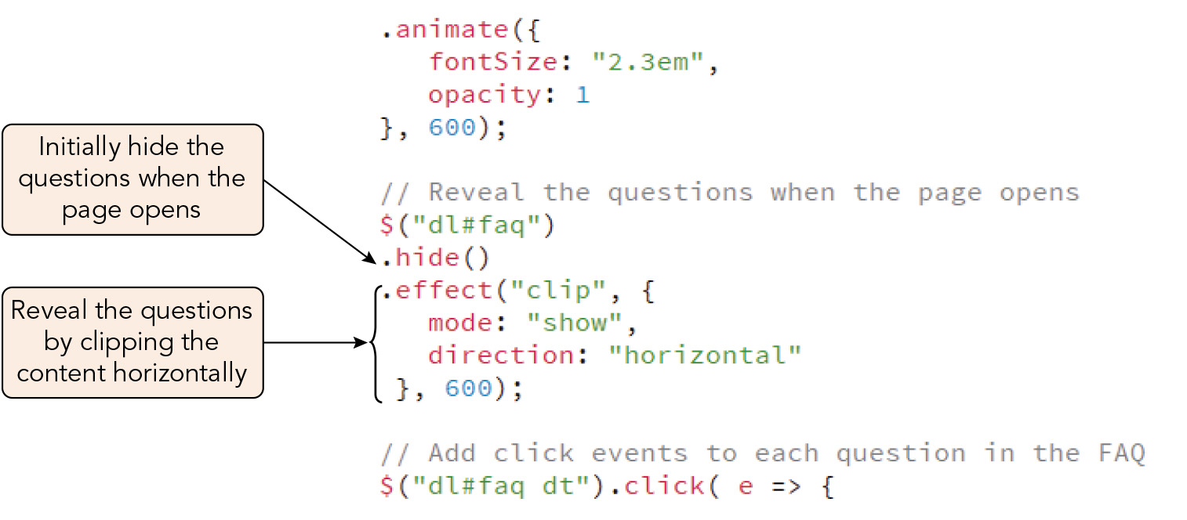
Exploring jQuery Plugins (5 of 6)
Figure 12-23 Adding the clip effect from the jQuery UI

Slide 40
Exploring jQuery Plugins (6 of 6)
Becoming a professional
Choose an area of specialization and master skills in that area
Learn more broad technical skills, especially programming in HTML, CSS, and JavaScript
Knowledge of CSS frameworks and back-end languages (Ruby, PHP, SQL Server) is also important
Practice coding skills and submit code samples to GitHub
Create a portfolio of your coding projects and place it online for prospective employers to view

Slide 41
Activity 12.3: Discussion Questions
Discuss the advantages of using jQuery as compared to using a code library maintained by your organization.
Discuss the advantages and disadvantages of using effects in a mobile app. Is there such a thing as too many (or too few) effects? Why or why not?
Notes:
Instructions:
Use the Discussion activity to encourage group conversation about a related topic of interest.

Slide 42
Self-Assessment
Chapter 12 makes the argument that, although jQuery's functionality now largely overlaps that of standard JavaScript and CSS, it is still useful to be familiar with this library. What do you think about this: is it worthwhile for you to invest time in gaining fluency with using the jQuery library? Why or why not?
Do you enjoy the types of effects and animations available in jQuery as a website user? Which, if any, would you like to use in your own web development?
Notes:
Instructions:
Use the Self-Assessment question to encourage students to evaluate their progress or goals in the course, as well as determine how they might apply their learning or grow as an individual.

Slide 43
Summary
Now that the lesson has ended, you should have learned to:
Use the jQuery library to apply jQuery methods to a selection of elements.
Modify the contents and structure of the DOM using jQuery.
Manage browser events using jQuery.
Create effects and animations using jQuery methods.
Apply jQuery Plugins, such as jQuery UI, to create specialized animations.
Notes:
Instructions: Reiterate the learning objectives for the lesson. Students should use this information to guide their studies and reinforcement of new concepts.

