Slide 1
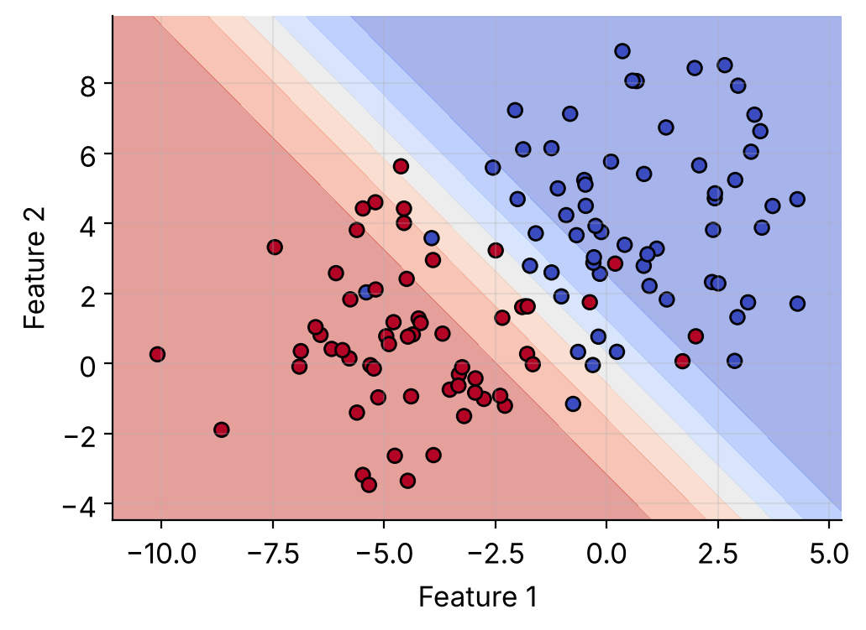
Regression in code
Linear and logistic regression, ready to run
Notes:
A hands-on companion to the regression slides. Three short Python scripts, each with its real output and graph.

Slide 2
Set up in three steps
Install
One command adds the libraries.
1
pip install scikit-learn matplotlib
Save
Paste the code into a file, a Jupyter cell or Colab.
2
linear_regression.py
Run
Run it. The numbers print and a graph opens.
3
python linear_regression.py
The data is built into every script, so there are no files to download.
Notes:
Everything is plain Python. If you do not want to install anything, paste the code into a Google Colab cell instead.

Slide 3
Linear regression: the code
import numpy as np
import matplotlib.pyplot as plt
from sklearn.linear_model import LinearRegression
# 1. Data: hours studied -> exam score
hours = np.array([1, 2, 3, 4, 5]).reshape(-1, 1)
score = np.array([48, 60, 62, 74, 76])
# 2. Fit the model
model = LinearRegression().fit(hours, score)
# 3. Read the results
print("Slope:", round(model.coef_[0], 2))
print("Intercept:", round(model.intercept_, 2))
print("R2:", round(model.score(hours, score), 2))
print("Score for 6 hours:", model.predict([[6]])[0])
# 4. Plot the data and the fitted line
plt.scatter(hours, score, color="red", label="Data")
plt.plot(hours, model.predict(hours), label="Fit")
plt.xlabel("Hours"); plt.ylabel("Score")
plt.legend(); plt.show()
Data
Hours and scores
1
Fit
Finds the best line
2
Results
Slope, intercept, R²
3
Plot
Points plus fitted line
4
Notes:
Full script (copy into linear_regression.py and run it):
import numpy as np
import matplotlib.pyplot as plt
from sklearn.linear_model import LinearRegression
# 1. Data: hours studied -> exam score
hours = np.array([1, 2, 3, 4, 5]).reshape(-1, 1)
score = np.array([48, 60, 62, 74, 76])
# 2. Fit the model
model = LinearRegression().fit(hours, score)
# 3. Read the results
print("Slope:", round(model.coef_[0], 2))
print("Intercept:", round(model.intercept_, 2))
print("R2:", round(model.score(hours, score), 2))
print("Score for 6 hours:", model.predict([[6]])[0])
# 4. Plot the data and the fitted line
plt.scatter(hours, score, color="red", label="Data")
plt.plot(hours, model.predict(hours), label="Fit")
plt.xlabel("Hours"); plt.ylabel("Score")
plt.legend(); plt.show()

Slide 4
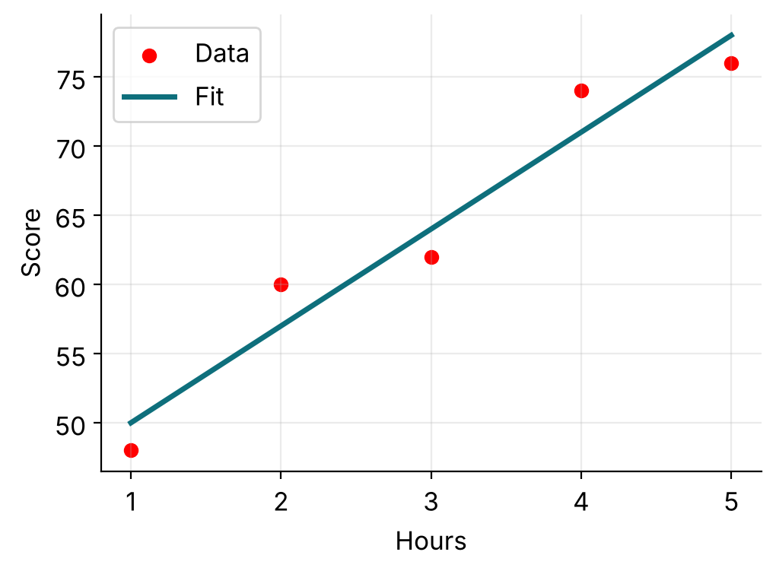
Linear regression: the output
Output
Slope: 7.0
Intercept: 43.0
R2: 0.94
Score for 6 hours: 85.0
How to read it
Slope 7: each hour adds about 7 marks
R² 0.94: the line explains 94% of the variation
Six hours predicts a score of 85
Notes:
The output and graph come from running linear_regression.py exactly as shown on the previous slide.

Slide 5
Logistic regression: the code
import numpy as np
import matplotlib.pyplot as plt
from sklearn.linear_model import LogisticRegression
# 1. Data: hours studied -> passed (1) or failed (0)
hours = np.arange(1, 11).reshape(-1, 1)
passed = np.array([0, 0, 0, 1, 0, 1, 0, 1, 1, 1])
# 2. Fit the model
model = LogisticRegression().fit(hours, passed)
# 3. Predict
p = model.predict_proba([[5]])[0, 1]
print("P(pass) at 5 hours:", round(p, 2))
print("Class for 2 hours:", model.predict([[2]])[0])
# 4. Plot the probability curve
x = np.linspace(0, 11, 100).reshape(-1, 1)
prob = model.predict_proba(x)[:, 1]
plt.scatter(hours, passed, color="red", label="Data")
plt.plot(x, prob, label="P(pass)")
plt.axhline(0.5, linestyle="--", color="gray")
plt.xlabel("Hours"); plt.ylabel("P(pass)")
plt.legend(); plt.show()
Data
Hours, pass or fail
1
Fit
Learns the S-curve
2
Predict
Probability and class
3
Plot
The probability curve
4
Notes:
Full script (copy into logistic_regression.py and run it):
import numpy as np
import matplotlib.pyplot as plt
from sklearn.linear_model import LogisticRegression
# 1. Data: hours studied -> passed (1) or failed (0)
hours = np.arange(1, 11).reshape(-1, 1)
passed = np.array([0, 0, 0, 1, 0, 1, 0, 1, 1, 1])
# 2. Fit the model
model = LogisticRegression().fit(hours, passed)
# 3. Predict
p = model.predict_proba([[5]])[0, 1]
print("P(pass) at 5 hours:", round(p, 2))
print("Class for 2 hours:", model.predict([[2]])[0])
# 4. Plot the probability curve
x = np.linspace(0, 11, 100).reshape(-1, 1)
prob = model.predict_proba(x)[:, 1]
plt.scatter(hours, passed, color="red", label="Data")
plt.plot(x, prob, label="P(pass)")
plt.axhline(0.5, linestyle="--", color="gray")
plt.xlabel("Hours"); plt.ylabel("P(pass)")
plt.legend(); plt.show()

Slide 6
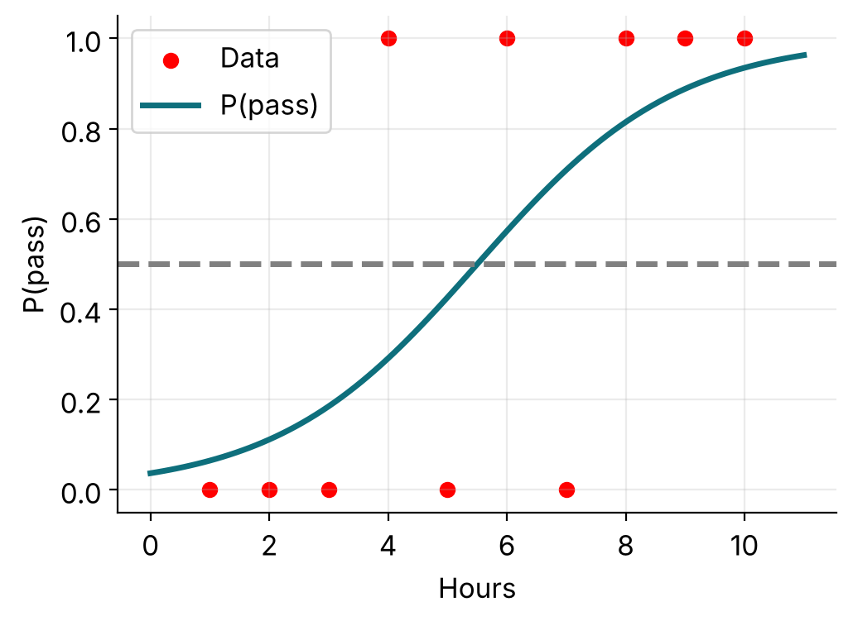
Logistic regression: the output
Output
P(pass) at 5 hours: 0.43
Class for 2 hours: 0
How to read it
The curve is a probability, always from 0 to 1
It crosses 0.5 near 5.5 hours: the pass/fail cutoff
At 5 hours the chance of passing is 43%, so class 0
Notes:
The output and graph come from running logistic_regression.py exactly as shown on the previous slide.

Slide 7
Bonus: see the decision boundary
import matplotlib.pyplot as plt
from sklearn.datasets import make_blobs
from sklearn.linear_model import LogisticRegression
from sklearn.inspection import DecisionBoundaryDisplay
# 1. Data: two features, two classes
X, y = make_blobs(n_samples=120, centers=2,
cluster_std=2.2, random_state=3)
# 2. Fit the model
model = LogisticRegression().fit(X, y)
# 3. Accuracy
print("Accuracy:", round(model.score(X, y), 2))
# 4. Plot the shaded decision regions
DecisionBoundaryDisplay.from_estimator(
model, X, cmap="coolwarm", alpha=0.5,
response_method="predict_proba")
plt.scatter(X[:, 0], X[:, 1], c=y,
cmap="coolwarm", edgecolor="k")
plt.xlabel("Feature 1"); plt.ylabel("Feature 2")
plt.show()
Data
Two features, 2 classes
1
Fit
One straight boundary
2
Accuracy
Share predicted right
3
Plot
Shaded regions
4
Notes:
Full script (copy into decision_boundary.py and run it):
import matplotlib.pyplot as plt
from sklearn.datasets import make_blobs
from sklearn.linear_model import LogisticRegression
from sklearn.inspection import DecisionBoundaryDisplay
# 1. Data: two features, two classes
X, y = make_blobs(n_samples=120, centers=2,
cluster_std=2.2, random_state=3)
# 2. Fit the model
model = LogisticRegression().fit(X, y)
# 3. Accuracy
print("Accuracy:", round(model.score(X, y), 2))
# 4. Plot the shaded decision regions
DecisionBoundaryDisplay.from_estimator(
model, X, cmap="coolwarm", alpha=0.5,
response_method="predict_proba")
plt.scatter(X[:, 0], X[:, 1], c=y,
cmap="coolwarm", edgecolor="k")
plt.xlabel("Feature 1"); plt.ylabel("Feature 2")
plt.show()

Slide 8
Bonus: the output
Output
Accuracy: 0.92
How to read it
Red and blue dots are the two classes
The colour band shows the predicted probability
The pale strip is where the model is 50/50
Notes:
With two features, logistic regression separates the classes with a straight line. Points on the wrong side are the 8% it gets wrong.

Slide 9




Try it yourself
Change the data
Add a feature
Edit the hours or scores and rerun. Watch the slope and the curve move.
Give X two columns, such as hours and sleep, and refit the model.
Move the cutoff
Add regularization
Predict pass when the probability is at least 0.3 instead of 0.5.
Try LogisticRegression(C=0.1) and compare the curve.
Notes:
Small edits that teach a lot. Change one thing, rerun, and compare the graph.

