Slide 1

Institute of Humanities
Advanced Readings
Francis Bacon
Zhen Gong
Assistant Professor of English
gongzhen@shanghaitech.edu.cn
Final Week

Slide 2
Advanced Readings
Final Week
How to reference primary and secondary sources in your essay
Stick to one style (different countries, different journals have their own style requirements. Use one specific style and maintain it throughout your essay.)
The style we are introducing today is MHRA (Modern Humanities Research Association)

Slide 3
Advanced Readings
Final Week
How to reference primary and secondary sources in your essay
Quotations and notes
When you are quoting from an author, always make sure to use quotation marks (‘’) and use footnotes to identify where you quotation comes from.
Paraphrase of a secondary source should also note the reference.
Footnotes should always end with a full stop even it’s not a complete sentence.

Slide 4
Advanced Readings
Final Week
How to reference primary and secondary sources in your essay
(See section 11 ‘references’ in the styleguide on Blackboard, starting from p.58)
a. Journal Articles (most common)
Richard Hillyer, ‘In More than Name Only: Jonson’s “To Sir Horace Vere”’, MLR, 85 (1990), 1–11 (p. 8).
Author’s name (exactly as appeared in the article)
Title of the article, in single quotation marks (‘’)
Title of the journal, italicized
Series number, in Arabic numerals
Volume number, in Arabic numerals
Year of publication, in parenthesis
First and last page numbers of the article (do not use p./pp. here)
Page number (p. for single page, pp. for multiple pages)

Slide 5
Advanced Readings
Final Week
How to reference primary and secondary sources in your essay
b. Books
Tom McArthur, Worlds of Reference: Lexicography, Learning and Language from the Clay Tablet to the Computer (Cambridge: Cambridge University Press, 1986), p. 59.
Author’s name (exactly as appeared in the book; for multiple authors: if there are no more than three, give their name in full; more than three, give the first author’s name followed by and others)
Title of the book, italicized
Publication details put in parenthesis (place of publication: the name of the publisher, year of publication)
Page number (p. for single page, pp. for multiple pages)

Slide 6
Advanced Readings
Final Week
How to reference primary and secondary sources in your essay
b. Books (continued)
(1) Jean Starobinski, Montaigne in Motion, trans. by Arthur Goldhammer (Chicago: University of Chicago Press, 1986), p. 174.
(2) Approaches to Teaching Voltaire’s ‘Candide’, ed. by R. Waldinger (New York: Modern Language Association of America, 1987), pp. 3, 10, 27.
Author’s name (if in the book the editor’s name is given instead of the author, place the title of the book first, followed by the editor’s name)
Title of the book, italicized
Name of the editors (ed. by), translators (trans. by)
Publication details put in parenthesis (place of publication: the name of the publisher, year of publication)
Page number (p. for single page, pp. for multiple pages)

Slide 7
Advanced Readings
Final Week
How to reference primary and secondary sources in your essay
c. Book chapter
Fanni Bogdanow, ‘The Suite du Merlin and the Post-Vulgate Roman du Graal’, in Arthurian Literature in the Middle Ages: A Collaborative History, ed. by Roger Sherman Loomis (Oxford: Clarendon Press, 1959), pp. 325–35 (p. 327).
Author’s name
Title of the chapter/article in single quotation mark
The word ‘in’, title of the book, editor’s name, full publication detail of the book
First and last page numbers of the item, preceded by pp. (this is different from the journal article, where pp. here is omitted)

Slide 8
Advanced Readings
Final Week
How to reference primary and secondary sources in your essay
Later references
If you are quoting from the exact source of the last footnote within four lines, you can use ‘ibid.’
e.g.
Note 12 Francis Bacon, p. 145
Note 13 Ibid., p. 180. (meaning the source used in note 12, in this case, Francis Bacon, p. 180)

Slide 9
Advanced Readings
Final Week
How to reference primary and secondary sources in your essay
Later references
Oftentimes, you could abbreviate the sources you have quoted previously to
author’s last name + page e.g.
Tom McArthur, Worlds of Reference: Lexicography, Learning and Language from the Clay Tablet to the Computer (Cambridge: Cambridge University Press, 1986), p. 59.
Second reference: McArthur, p. 80
If the same author has multiple works you cite, in order not to cause confusion, the name of the author and the shortened title of the work should both be included in later references
Tom McArthur, Worlds of Reference: Lexicography, Learning and Language from the Clay Tablet to the Computer (Cambridge: Cambridge University Press, 1986), p. 59.
Second reference: McArthur, World of Reference, p. 80

Slide 10
Advanced Readings
Final Week
How to reference primary and secondary sources in your essay
A few simple exercises:
Write the citation of the following three sources
You are quoting from pages 190-91 in your version of Bacon’s works
You are quoting from page 173 from Cambridge Companion to Bacon
You are quoting from pages 6-7 from the article ‘Christian Hope and Modern Hope’

Slide 11
Advanced Readings
Final Week
2. Quotations and paraphrases:
It is important that you introduce your quotations, and comment on the quotation. In doing so, you integrate your quotation into the flow of your argument.
Let’s look at a bad example and a good example.

Slide 12
Advanced Readings
Final Week
2. Quotations and paraphrases:
Bad:
Deborah Tannen writes about academia. Academics believe “that intellectual inquiry is a metaphorical battle. Following from that is a second assumption that the best way to demonstrate intellectual prowess is to criticize, find fault, and attack.” I agree with Tannen. Another point Tannen makes is that…
Good:
Deborah Tannen, a prominent linguistics professor, complains that academia is too combative. Rather than really listening to others, Tannen insists, academics habitually try to prove one another wrong. As Tannen herself puts it, “We are all driven by our ideological assumption that intellectual inquiry is a metaphorical battle,” that “the best way to demonstrate intellectual prowess is to criticize, find fault, and attack.” In short, Tannen objects that academic communication tends to be a competition for supremacy in which loftier values like truth and consensus get lost.
Tannen’s observations ring true to me because I have often felt that the academic pieces I read for class are negative and focus on proving another theorist wrong rather than stating a truth

Slide 13
Advanced Readings
Final Week
2. Quotations and paraphrases:
Instead of launching directly into a quotation, what we need to do is to introduce the quotation, and after the quotation, we need to give an explanation of the quotation.
The introduction serves to identify who is speaking (a prominent linguistics professor) and set up what the quotation says (i.e. topic/context).
The explanation follows the quotation and should explain, in your own words, what you think the quotation argues and/or why it is important.

Slide 14
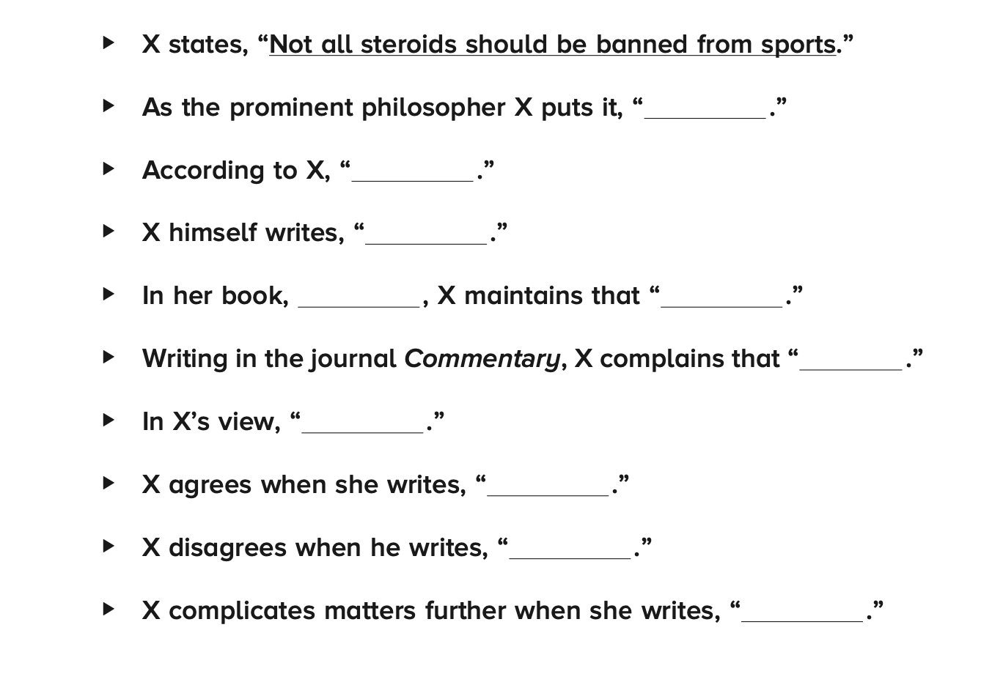
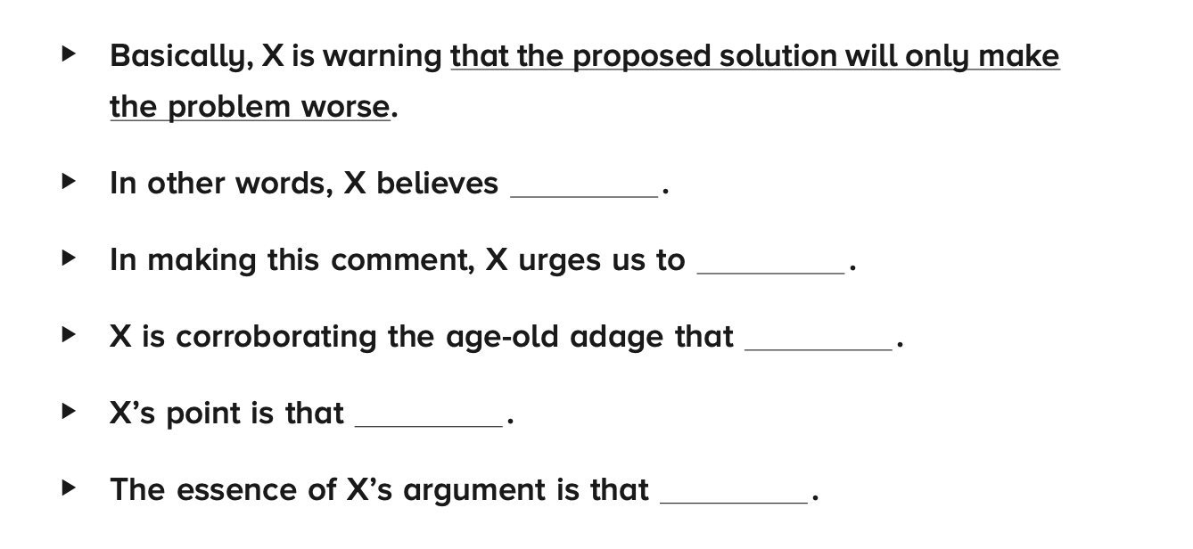
Advanced Readings
Final Week
2. Quotations and paraphrases:
Instead of launching directly into a quotation, what we need to do is to introduce the quotation, and after the quotation, we need to give an explanation of the quotation.
Introduction template Explanation template

Slide 15
Advanced Readings
Final Week
2. Quotations and paraphrases:
What to quote?
Primary sources!
Peer reviewed journals, academic monographs, book chapters from edited volumes…
What not to quote?
Webpages on the internet, even though some might appear professional
Wikipedia, other encyclopedia…

Slide 16
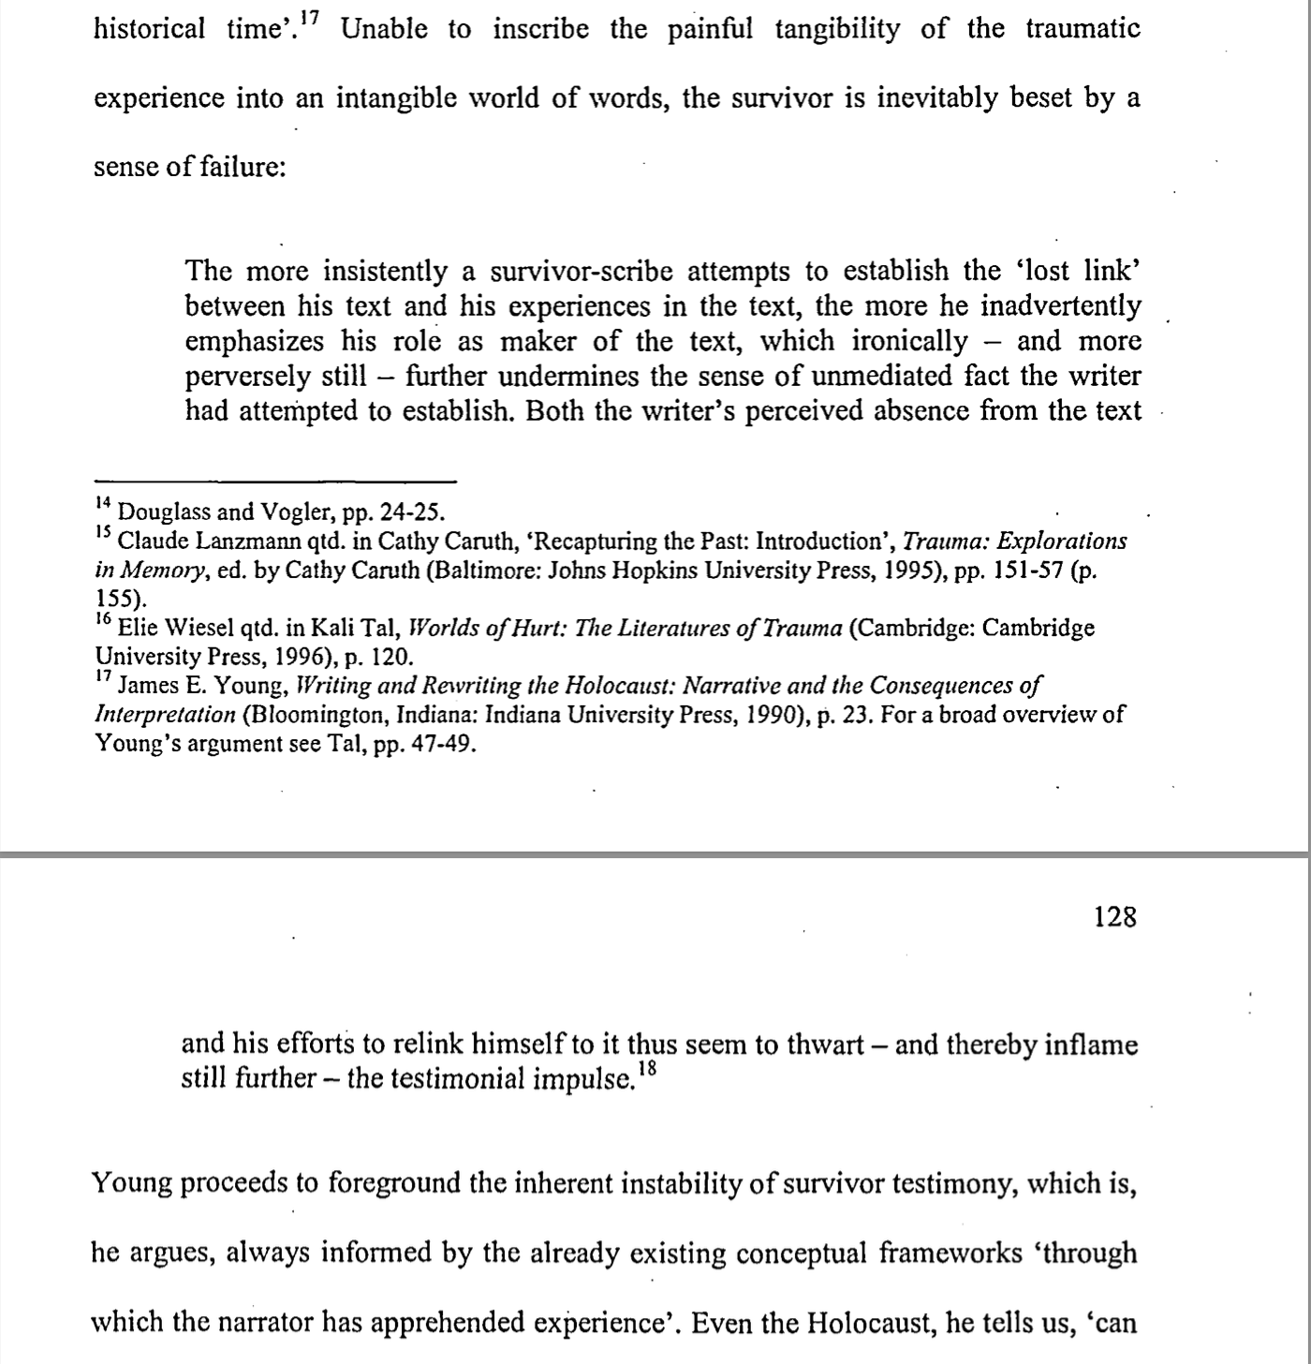
Advanced Readings
Final Week
2. Quotations and paraphrases:
Short quotations (<= 40 words):
Quotation mark (‘’)
Long quotation (>40 words):
No need of quotation mark,
but requires a specific formatting:

Slide 17
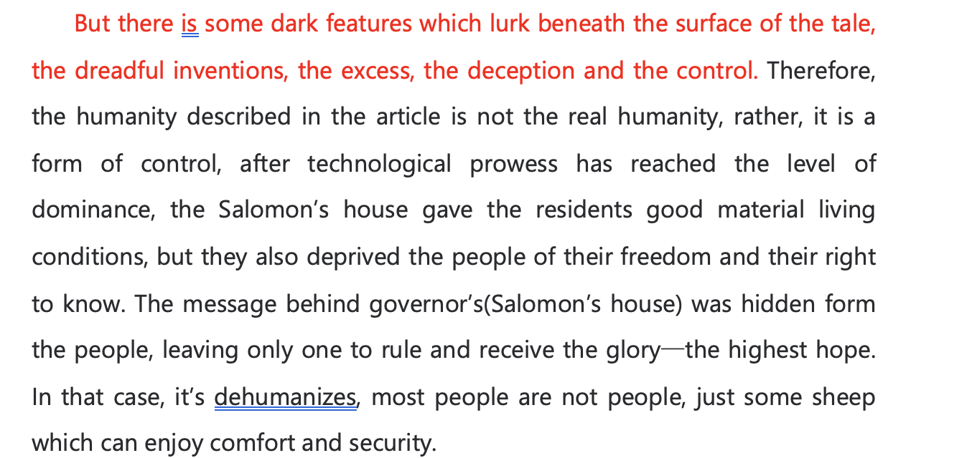
Advanced Readings
Final Week
2. Quotations and paraphrases:
Always, always make sure you specify that you
are quoting from others. Otherwise it will be
considered as plagerism.

Slide 18
Advanced Readings
Final Week
Revision
Aristotle
Form, matter and being.
For Aristotle, material cause alone does not explain the nature of things, e.g. a tree is not mere collection of wood, and an animal is not mere collection of flesh, blood and bones.
Every thing (every being) is a whole, has unity and specific ‘structure’,

Slide 19
Advanced Readings
Final Week
Revision
Aristotle
Problem of Aristotle:
Although Aristotle he himself denies that there is a creator of the world, or that the natural world is of intelligent design, the teleological view allows nature to have an appearance of intelligence.
This creates a backdoor through which theology could enter into philosophy, and integrate philosophy into Christianity.

Slide 20
Advanced Readings
Final Week
Revision
2. Bacon
Bacon turns Aristotle’s form into something that is strictly related to operation. Knowledge of form leads to the knowledge of how to create/introduce a specific quality in the most universal way possible. It is a technical knowhow.
By abandoning Aristotle’s definition of form, Bacon allows form to be something no longer related to teleology, thereby making possible the separation of religion and philosophy, a goal that he always proclaims.

Slide 21
Advanced Readings
Final Week
Revision
2. Bacon
If in philosophy, Bacon is adamant that the study of nature should not be meddled with by theology, the same also applies to morality, on which, however, Bacon argues in a much more subtle way.
Religious extremism and superstition lead to war and destruction of society.
Bacon he himself envisages a future of religious toleration based on a diluted version of Christianity, that aims to fulfill the secular need of humanity.

