Slide 1

Firma convenzione Politecnico di Milano e Veneranda Fabbrica del Duomo di Milano
Minimax regret approach for uncertain parallel machine scheduling problems
Lei Liu
lei.liu@polimi.it
Aula Magna – Rettorato
Mercoledì 27 maggio 2015

Slide 2
Minimax Regret Approach
Deterministic processing time
Find a schedule that minimize the makespan/tardiness
Stochatic processing time (interval data)
Find a schedule that minimize the maximum regret of makespan

Slide 3
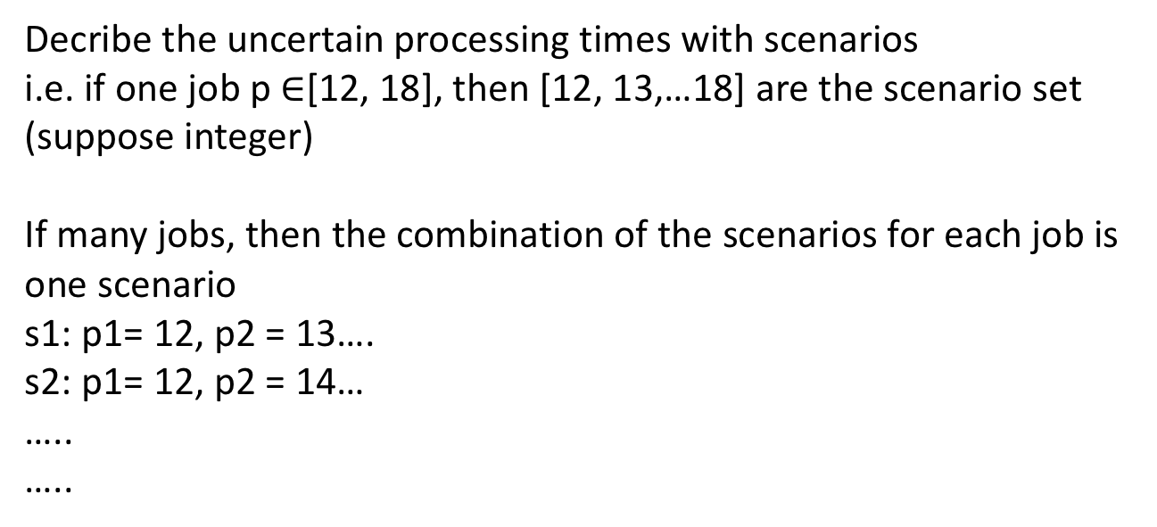
Minimax Regret Approach
Find a schedule that minimize the maximum regret of makespan
Decribe the uncertain processing times with scenarios
i.e. if one job p $∈$[12, 18], then [12, 13,…18] are the scenario set (suppose integer)
If many jobs, then the combination of the scenarios for each job is one scenario
s1: p1= 12, p2 = 13….
s2: p1= 12, p2 = 14…
…..
…..

Slide 4
Minimax Regret Approach
Suppose we know all the scenarios, under each scenario s, there is a minimum makespan (makespan*(s)), use MIP deterministic version can get
Under scenario s, if we have a schedule A, this schedule A has a makespan (makespan(A)), schedule and processing time all known, just calculation can get
Under scenario s, makespan regret of schedule A: R(A,s1) = makespan(A) – makespan*(s1)
For scenario set S, (|S|=n), there are n regrets for each schedule

Slide 5
Minimax Regret Approach
Regret
scenario 1
20
scheduleA
scenario 2
27
worst scenario
27
scenario 3
26
Smallest worst regret
Schedule A
scenario 1
30
worst scenario
30
scheduleB
scenario 2
15
scenario 3
18
With this approach , you can tell the company: If you use this schedule, the largest(worst) makespan can be …
It’s a really conservative approach
Popular in robust scheduling area
H2020 MSCA ITN DIGIMAN4.0 – Mid-Term Review Meeting – WP no. 12 Presentation

Slide 6
Minimax Regret Approach
There are many many scenarios, enumeration is not possible, how to find the worst scenario for one schedule?
Robust Scheduling theory
Definition 1.
A machine f is said to be critical in a schedule X under scenario s,
if f is the machine with maximum completion time in X under s
In the reference paper, Definition 2 and Property 1 are right, but a little too complicate and confusing

Slide 7
Minimax Regret Approach
j1
j4
j5
j0
M1
M2
j2
j3
j6
M3
Robust Scheduling theory
For a know schedule A(then we have the above flow), If a scenario s is the worst scenario for A, then scenario s must be in this form:
All the jobs with either upper interval value or lower interval value
In the longest path(critical machine), all the jobs with upper interval value
Other than jobs in the longest path(critical machine), all the jobs with lower interval value

Slide 8
Minimax Regret Approach
2^n scenarios
A 5-job 2-machine example: 32 scenarios, construct a model to get the minmax regret schedule
Give you a schedule, and processing time interval, generate the worst scenario for this schedule
max{min - min} --> max{calculation-min}

Slide 9
Minimax Regret Approach
Summary:
If the number of job is small, we can enumerate the scenarios with the help of robust scheduling theory no matter how large the interval is.
If the number of job increases, we have a tool to generate the worst scenario for a random schedule, and will develop a iterative algorithm to decrease the scenarios

Slide 10
Minimax Regret Approach
References:
Robust optimization for resource-constrained project scheduling with uncertain activity durations
Robust makespan minimisation in identical parallel machine scheduling problem with interval data

Slide 11
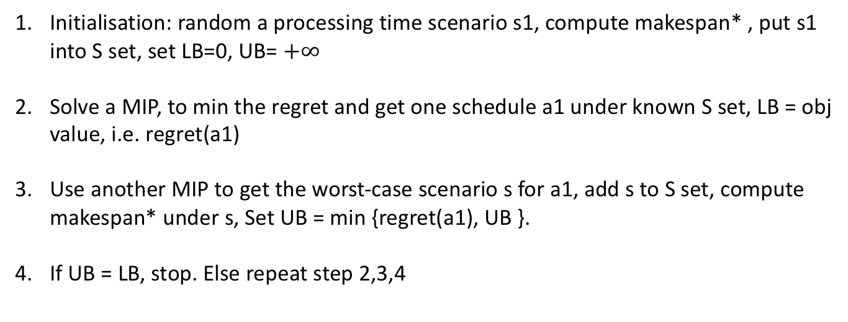
Minimax Regret Approach
Algorithm:
Initialisation: random a processing time scenario s1, compute makespan* , put s1 into S set, set LB=0, UB= $+∞$
Solve a MIP, to min the regret and get one schedule a1 under known S set, LB = obj value, i.e. regret(a1)
Use another MIP to get the worst-case scenario s for a1, add s to S set, compute makespan* under s, Set UB = min {regret(a1), UB }.
If UB = LB, stop. Else repeat step 2,3,4

Slide 12
Minimax Regret Approach

Slide 14
Minimax Regret Approach
M1
M2
M3
How can you know the longest path(critical machine) before we schedule?
In one of my paper, I iterated it, then compare
But in MIP we have other choices

