Slide 1

Building a Basic Calculator with Tkinter

Slide 2
Objective:
To create a simple calculator application in Python using the Tkinter library.

Slide 3
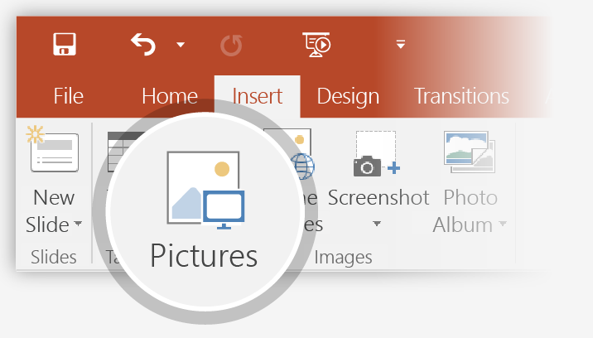
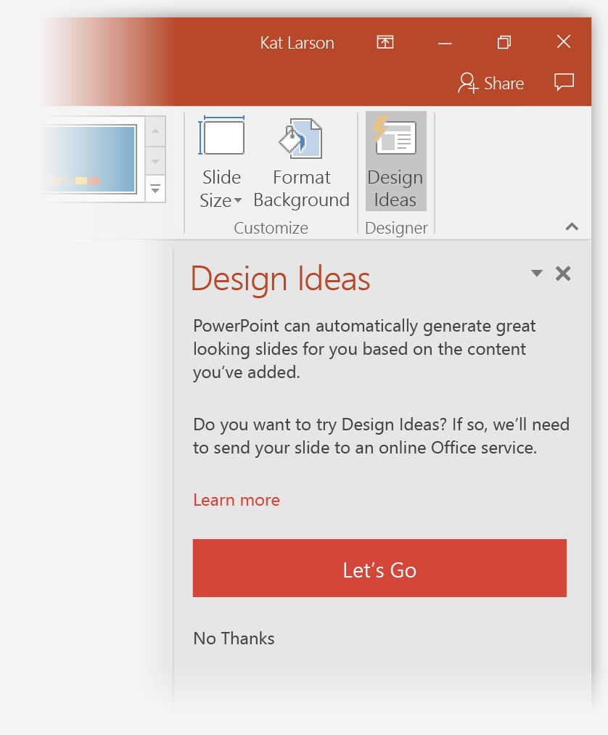
Introduction to Tkinter:
1
Tkinter is the standard GUI (Graphical User Interface) toolkit for Python.
2
It provides various widgets (GUI components) like buttons, labels, entry fields, etc., to build GUI applications.

Slide 4
Key Features of the Calculator:
Equation Display Area:
Shows mathematical expressions and results.
Clickable Buttons:
Represent numerical values or mathematical operations.
Core Mathematical Operations:
Addition, subtraction, multiplication, and division.
Seamless Execution:
Perform calculations yielding results (=).
Clear the equation display (C).

Slide 5

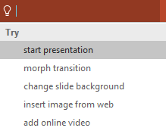

More questions about PowerPoint?
Select the Tell Me button and type what you want to know.
Visit the PowerPoint team blog
Go to free PowerPoint training
SELECT THE ARROW WHEN IN SLIDE SHOW MODE

Slide 6
More questions about PowerPoint?
Select the Tell Me button and type what you want to know.
Visit the PowerPoint team blog
Go to free PowerPoint training
SELECT THE ARROW WHEN IN SLIDE SHOW MODE

