Slide 1
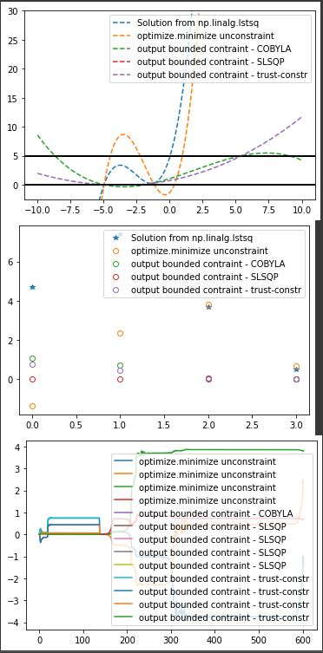
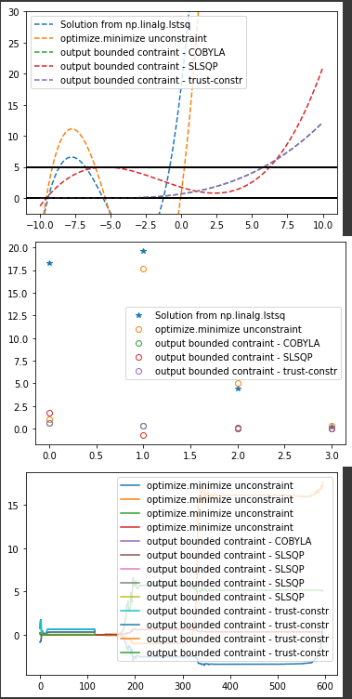
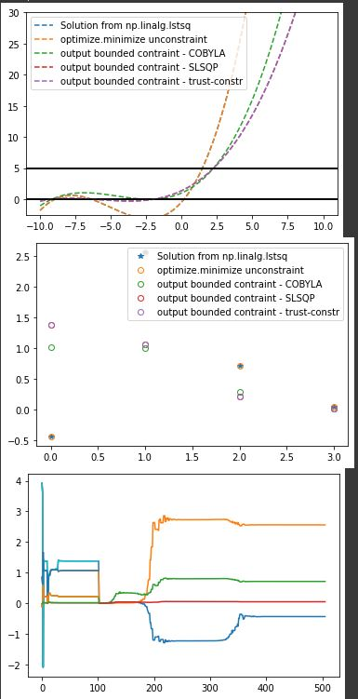
Fig1:
N = 5
Korder = 4,
random data points generated by exp(x)
Fig2:
N = 5
Korder = 4,
random data points by exp(x)
Fig3:
N = 5
Korder = 4,
random data points by exp(x)

Slide 2
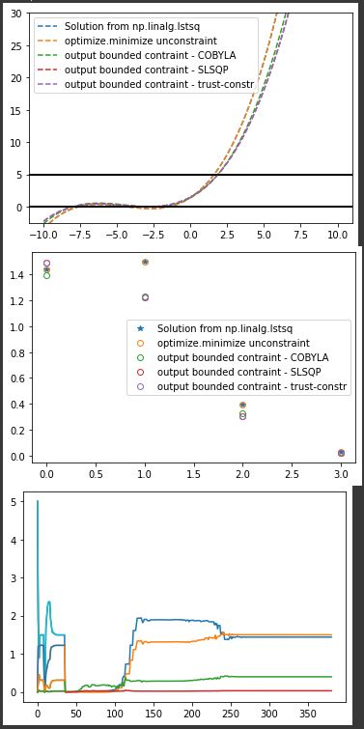
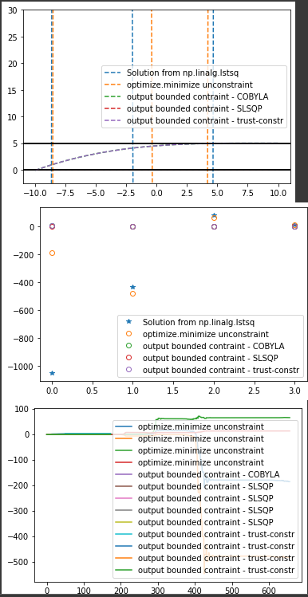
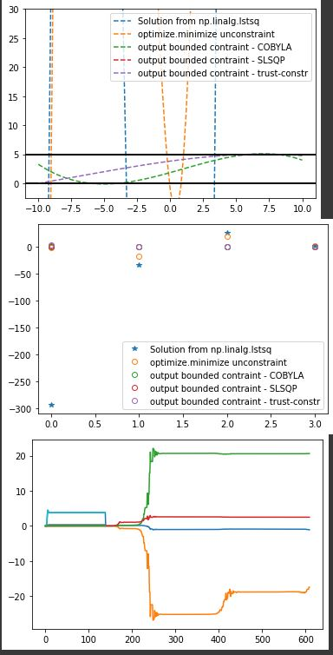
Fig4:
N = 10
Korder = 4,
random data points generated by exp(x)
Fig5:
N = 50
Korder = 4,
random data points generated by exp(x)
Fig6:
N = 10
Korder = 4,
Uniform data generated by exp(x)

Slide 3
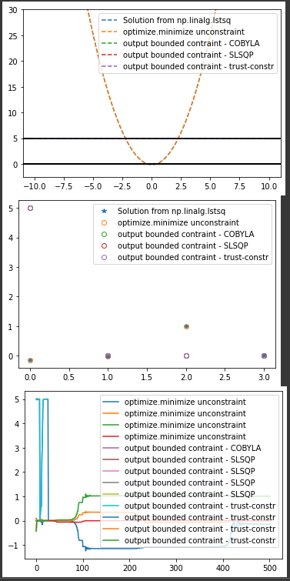
Fig 7:
N = 10
Uniform data points generated by sin(x) + x²

Slide 4
 | Trust-constrain
Compare to Linalg.lstsq | These three methods are close to each other, and it seems they fits better than linalg.lstsq.
Larger numbers of data points | (fig 1,4,5) The larger the number of data points there are, the better the method works
Uniform/smart random data points | (fig 4,6) It doesn’t look like a big difference in a small scale,
# iterations | With more data points, it takes more iterations to converge(fig 4,5) With more uniformed data, it also takes more iteration to converge

Slide 5
 | COBYLA
Compare to Linalg.lstsq | These three methods are close to each other, and it seems they fits better than linalg.lstsq.
Larger numbers of data points
Uniform/smart random data points | (fig 4,6) It doesn’t look like a big difference in a small scale (-10,10)
# iterations

Slide 6
 | SLSQP
Compare to Linalg.lstsq | These three methods are close to each other, and it seems they fits better than linalg.lstsq.
Larger numbers of data points
Uniform/smart random data points | (fig 4,6) It doesn’t look like a big difference in a small scale,
# iterations

