Slide 1
Overall, the iterations that SLSQP needs is much less than trust-constr. However, it has huge fluctuation and initial deviation, and because it needed few steps, so there was a big difference between each step, it was generally of low accuracy. However, the final result was close to trust-contrained, so it was considered reasonable and credible.
It is recommended to use trust-constr when you want a more precise final value, because while it requires more iteration, most of the time the answer is already fairly close to the final value by 3/4 of the cycle time, and the result is more reliable due to steady-state in the second half.
As n (# of data points) increases, SLSQP’s deviation of the initial calculation of will be larger and larger, but it will also jump back to the final value in a shorter number of steps.
When the value of n is small, random numbers and uniform numbers do not have a great impact on the results, but when the value of n increases to a certain value, uniform numbers will make the fluctuation of SLSQP more stable, and the initial value will not become particularly extreme, which is also applicable to trust-constr, in other words, the overall trend of both are more stable

Slide 2
Case 1:
n = 5
random data points generated by sigmoid function
Korder = 4
Numbers of Iterations till stable:
# cf | Trust-Constr | SLSQP | Cobyla
1 | 21 | 10
2 | 22 | 9
3 | 22 | 9
4 | 24 | 9
Final value of coefficient:
#cf | Trust-Constr | SLSQP | Cobyla
1 | 0.6402 | 0.6440
2 | 0.0995 | 0.0995
3 | -0.00240 | -0.00240
4 | -0.000612 | -00000611

Slide 3
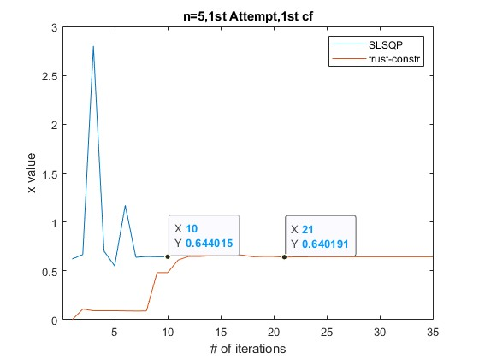
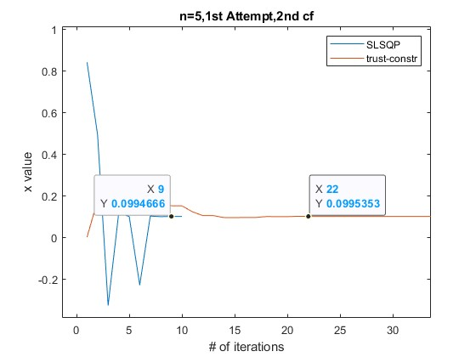
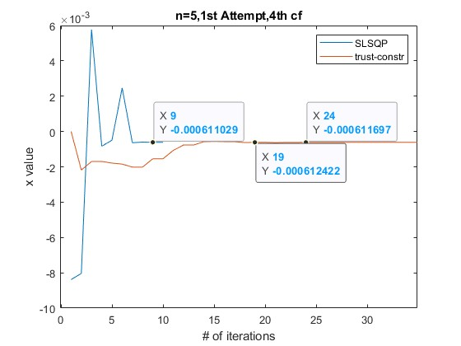
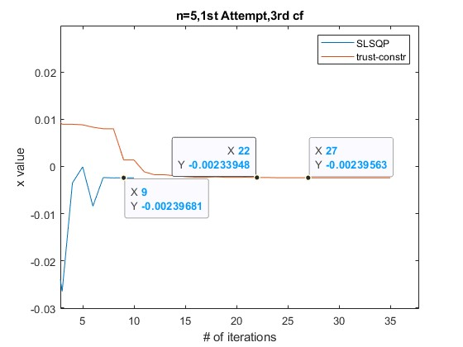

Slide 4
Case 2:
n = 5
random data points generated by sigmoid function
Korder = 4
Numbers of Iterations till stable:
# cf | Trust-Constr | SLSQP | Cobyla
1 | 25 | 11
2 | 27 | 10
3 | 25 | 10
4 | 30 | 10
Final value of coefficient:
#cf | Trust-Constr | SLSQP | Cobyla
1 | 0.4008 | 0.4009
2 | 0.0995 | 0.0995
3 | -0.00240 | -0.00240
4 | -0.000612 | -00000611

Slide 5
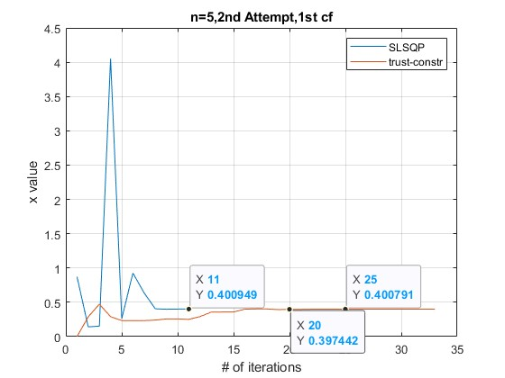
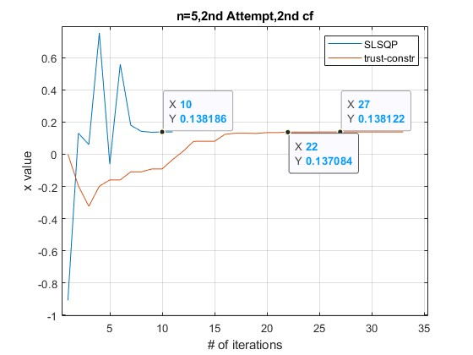
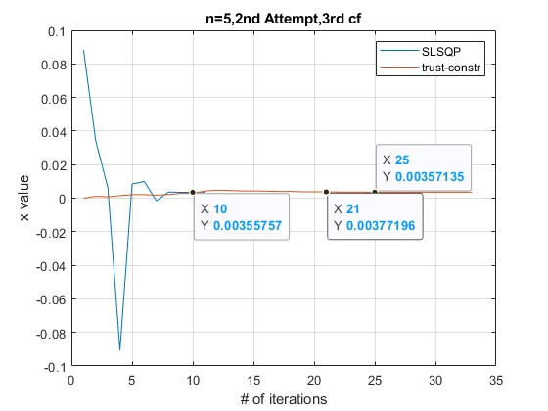
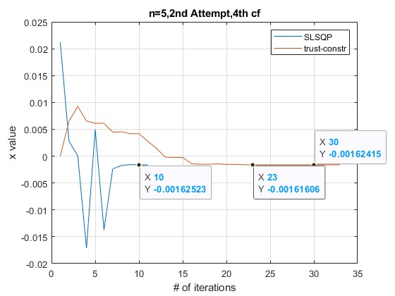

Slide 6
Case 1:
n = 5
random data points generated by sigmoid function
Korder = 4
Numbers of Iterations till stable:
# cf | Trust-Constr | SLSQP | Cobyla
1 | 21 | 10
2 | 22 | 9
3 | 22 | 9
4 | 24 | 9
Final value of coefficient:
#cf | Trust-Constr | SLSQP | Cobyla
1 | 0.6402 | 0.6440
2 | 0.0995 | 0.0995
3 | -0.00240 | -0.00240
4 | -0.000612 | -00000611

Slide 7
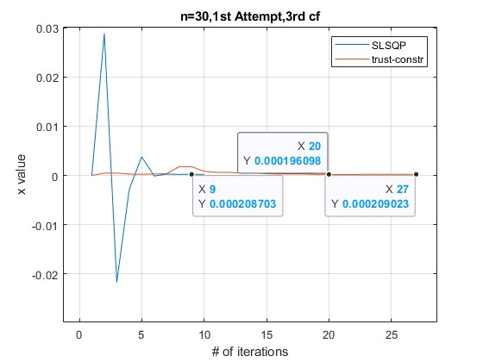
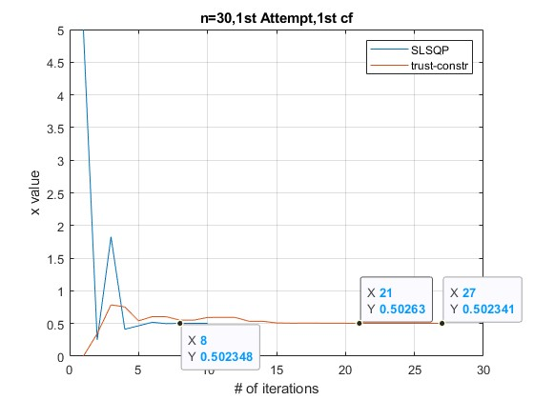
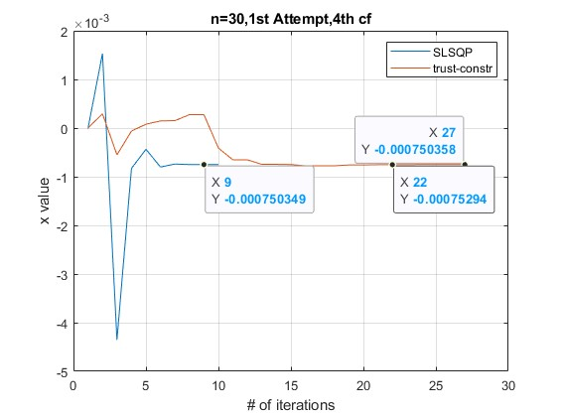
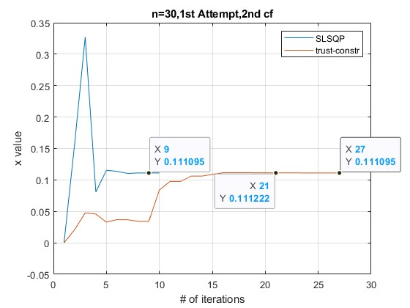

Slide 8
Case 1:
n = 5
random data points generated by sigmoid function
Korder = 4
Numbers of Iterations till stable:
# cf | Trust-Constr | SLSQP | Cobyla
1 | 21 | 10
2 | 22 | 9
3 | 22 | 9
4 | 24 | 9
Final value of coefficient:
#cf | Trust-Constr | SLSQP | Cobyla
1 | 0.6402 | 0.6440
2 | 0.0995 | 0.0995
3 | -0.00240 | -0.00240
4 | -0.000612 | -00000611

Slide 9
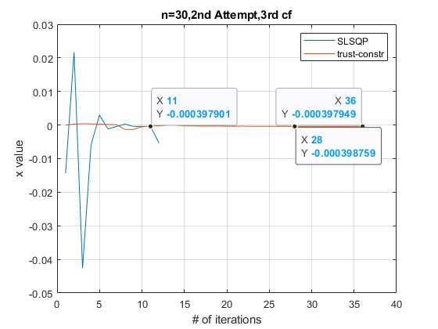
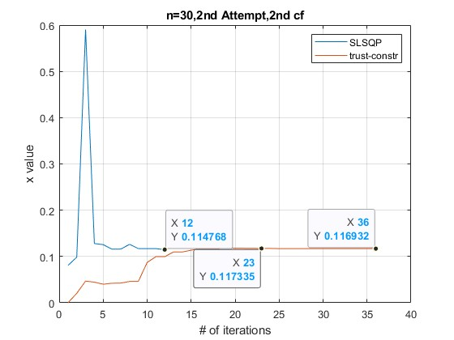
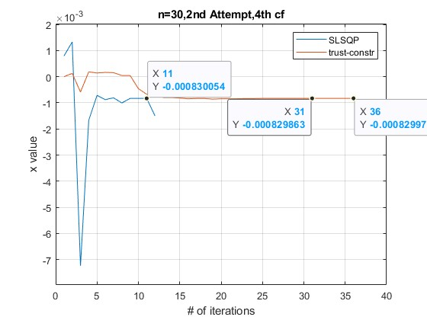
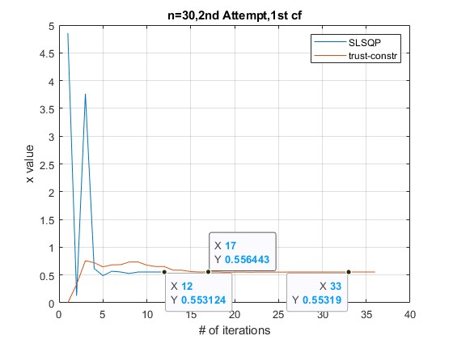

Slide 10
Case 1:
n = 5
random data points generated by sigmoid function
Korder = 4
Numbers of Iterations till stable:
# cf | Trust-Constr | SLSQP | Cobyla
1 | 21 | 10
2 | 22 | 9
3 | 22 | 9
4 | 24 | 9
Final value of coefficient:
#cf | Trust-Constr | SLSQP | Cobyla
1 | 0.6402 | 0.6440
2 | 0.0995 | 0.0995
3 | -0.00240 | -0.00240
4 | -0.000612 | -00000611

Slide 11
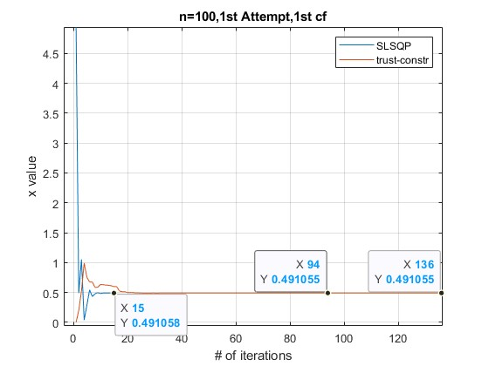
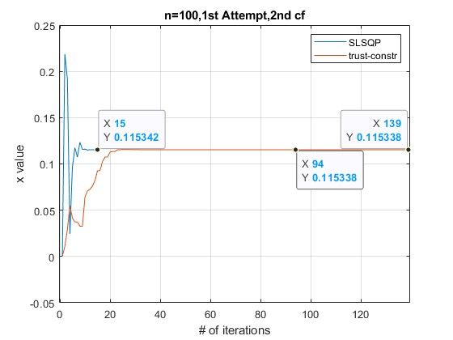
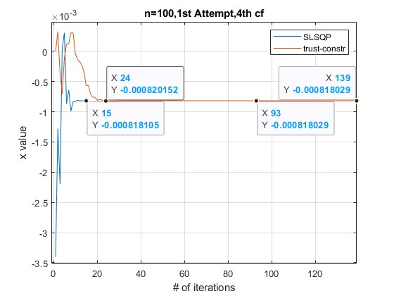
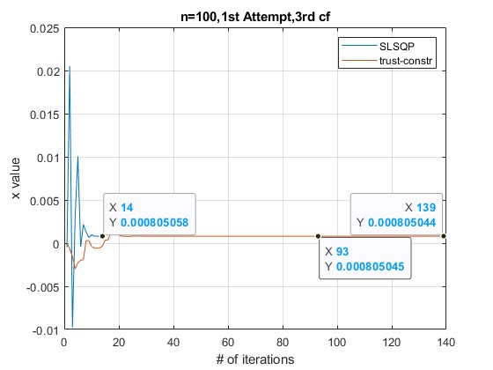

Slide 12
Case 1:
n = 5
random data points generated by sigmoid function
Korder = 4
Numbers of Iterations till stable:
# cf | Trust-Constr | SLSQP | Cobyla
1 | 21 | 10
2 | 22 | 9
3 | 22 | 9
4 | 24 | 9
Final value of coefficient:
#cf | Trust-Constr | SLSQP | Cobyla
1 | 0.6402 | 0.6440
2 | 0.0995 | 0.0995
3 | -0.00240 | -0.00240
4 | -0.000612 | -00000611

Slide 13
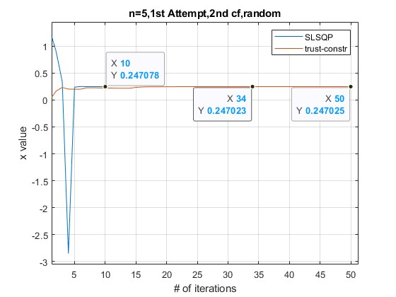
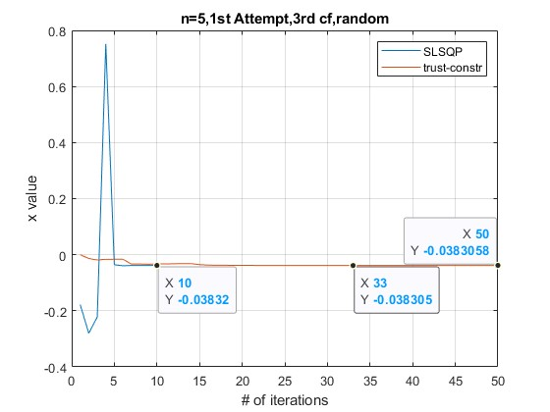
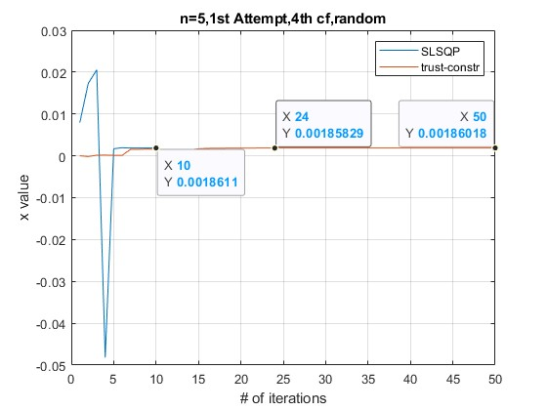
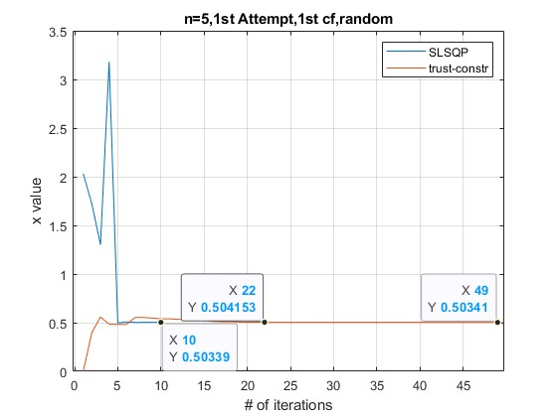

Slide 14
Case 1:
n = 5
random data points generated by sigmoid function
Korder = 4
Numbers of Iterations till stable:
# cf | Trust-Constr | SLSQP | Cobyla
1 | 21 | 10
2 | 22 | 9
3 | 22 | 9
4 | 24 | 9
Final value of coefficient:
#cf | Trust-Constr | SLSQP | Cobyla
1 | 0.6402 | 0.6440
2 | 0.0995 | 0.0995
3 | -0.00240 | -0.00240
4 | -0.000612 | -00000611

Slide 15
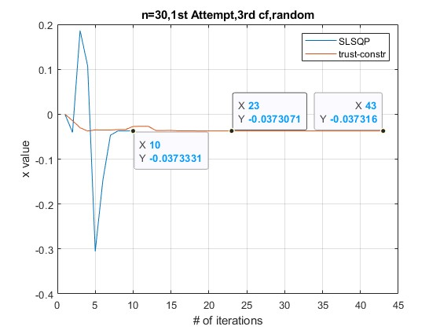
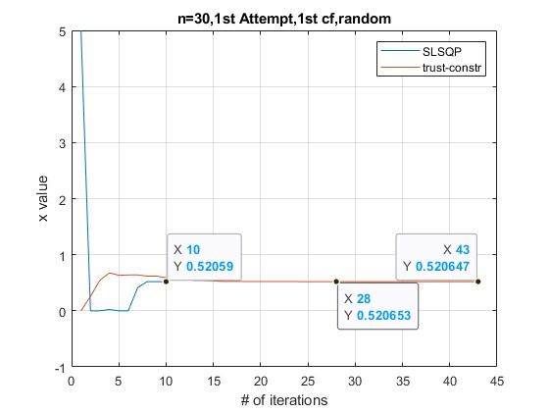
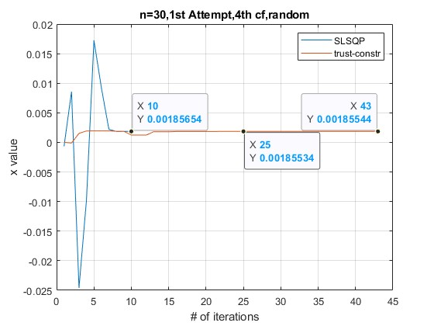
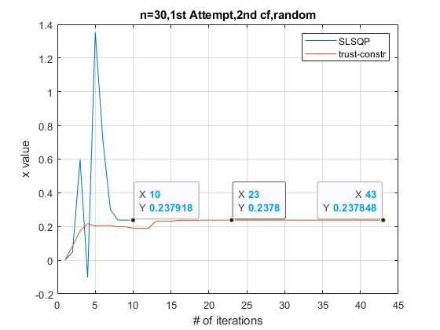

Slide 16
Case 1:
n = 5
random data points generated by sigmoid function
Korder = 4
Numbers of Iterations till stable:
# cf | Trust-Constr | SLSQP | Cobyla
1 | 21 | 10
2 | 22 | 9
3 | 22 | 9
4 | 24 | 9
Final value of coefficient:
#cf | Trust-Constr | SLSQP | Cobyla
1 | 0.6402 | 0.6440
2 | 0.0995 | 0.0995
3 | -0.00240 | -0.00240
4 | -0.000612 | -00000611

Slide 17
