Slide 1
Three methods we are comparing:
‘trust-constr’: Trust-Region Constrained Algorithm
‘SLSQP’: Sequential Least SQuares Programming
‘COBYLA’: Constrained Optimization BY Linear Approximation
We enter a set of data points that are arranged in some way, give the highest order of the polynomial, and let optimizers estimate the coefficients of each order, thus modeling the entire polynomial.
From the level of fitness and the number of iterations taken by each optimizer, we can see the accuracy and efficiency between them because the closer the approximation and less iterations the method uses, the better the optimizer works in this region.

Slide 2
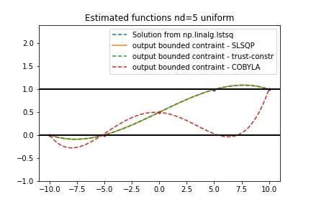
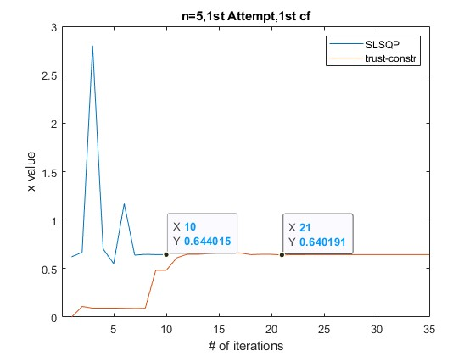
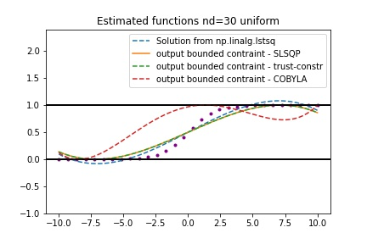
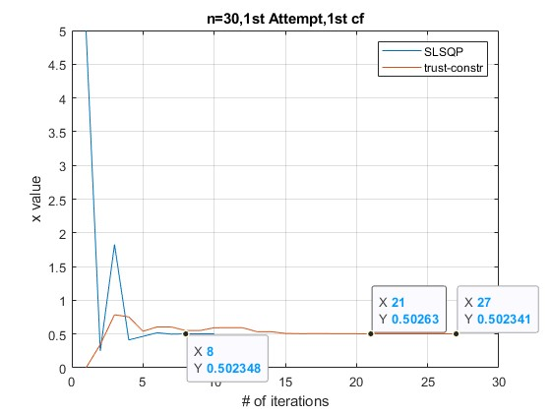
These two graphs are showing the overall process of change when the optimizer predicts one coefficient.
1
2
3
4
More data points gives better estimation
At low order, the final estimate of SLSQP and trust-constr are close.

Slide 3

Case 1:
Comparing using data points
Using random data points generated by sigmoid function
The optimizers are expected to predict the fourth order polynomial (Korder = 5)
Numbers of Iterations till stable:
Sigmoid function
# cf | Trust-Constr | SLSQP | Cobyla
1 | 21 | 10
Final value of coefficient:
#cf | Trust-Constr | SLSQP | Cobyla
1 | 0.6402 | 0.6440 | 0.8544
It is clear that with normal randomization, more data points will have a higher chance be distributed among all regions in space, whereas small amount of data points will cause the data points be set close to edges. So, in case with larger size of data points, all the optimizers works better.
Meanwhile, with the same size of data points, the uniform data points perform better than the random one because the uniform distribution has already reduced the disparity of the distribution, avoiding the extreme samples.
Trust-constr and SLSQP are working well in this case, COBYLA is a bit off the track.

Slide 4
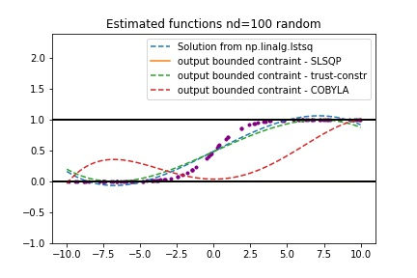
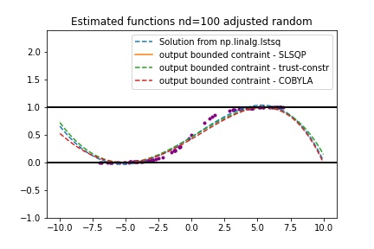
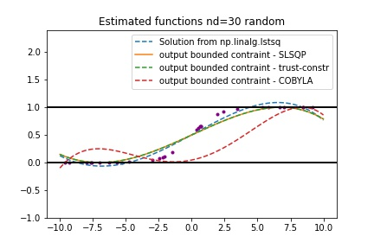
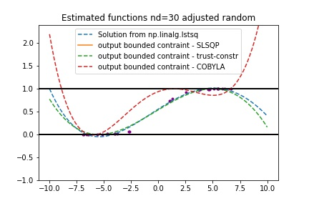
Here we divided the x-range into three different regions : [-7,-3], [-3,3], [3,7] to reduce the extreme cases in random distribution. The adjusted random makes the distribution more reasonably random, which isn’t piled up at a corner.
With enough data points, the methods are not violating the bounds.
1
2
3
4
Whereas with fewer points, the violation happens more and greater.

Slide 5
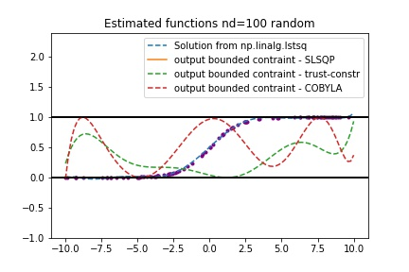
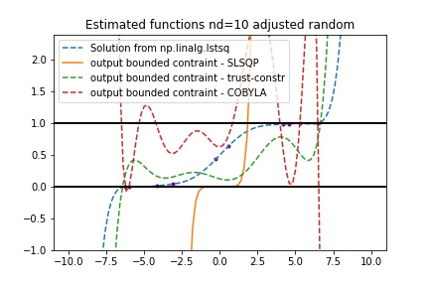
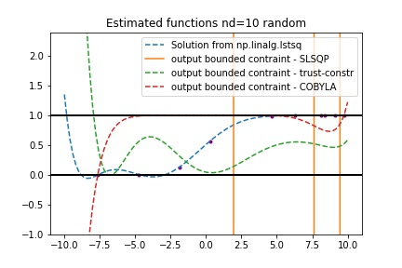
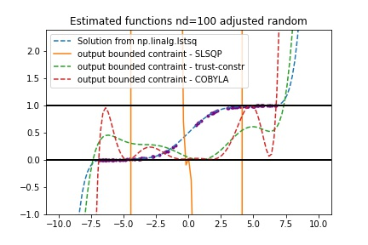
However, in the higher order of polynomial with large data points size, the original adjusted random distribution isn’t working well, especially for the SLSQP method.
My guess is that with fewer data points, the initial random allocation will lead to more extreme distributions, which is less likely to be adjusted random. However, in the case of more data points, the initial randomization has a sufficient degree of randomization, so that extreme cases are not easy to occur.
In this case, adjusted random is used to perform artificial randomization, which will decrease the degree of randomness. In high-level polynomials, slight changes in randomness will result in overfitting, so the adjusted random makes it harder for the optimizer to fit the line.
In this adjusted randomization, the weight of data points in central region(-3,3) is 0.2, and weight on two sides are 0.4 each.

Slide 6
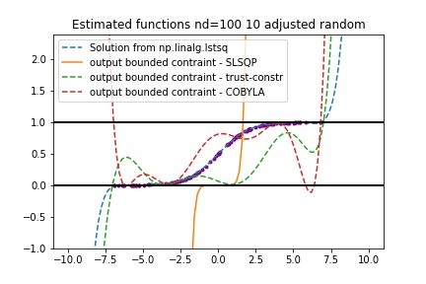
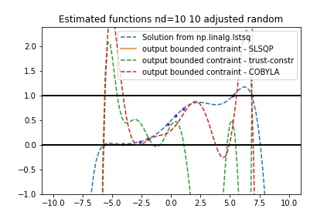
This is centralized random, which means I add more weight into points distribution inside the center region (-3,3). This distribution makes the estimated lines fits better and reduce the overfitting in some way, though the overfitting in general is inevitable under high order.
In this centralized randomization, the weight of data points in central region(-3,3) is 0.4, and weight on two sides are 0.2 each.

Slide 7
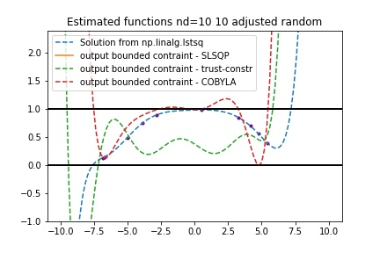
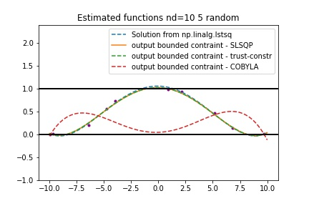
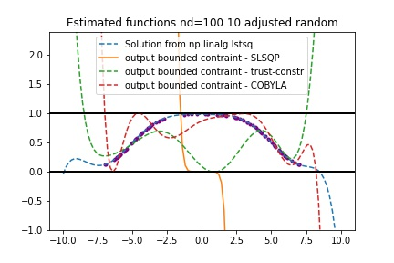
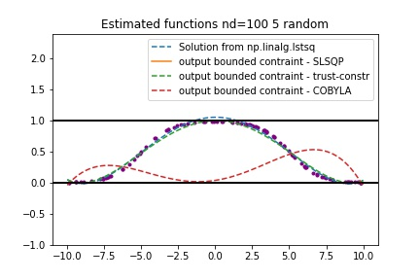
By modifying the sigmoid function, we use another function to generate data points while keeping the range of data points within our desired range. From the image, we can see that compared with the simple sigmoid function, this new function is more conducive to fitting. With only a few data points, the fitting degree of various optimizers is still in a relatively good precision.
However, the problem of overfitting was slightly improved in the advanced number. Except for SLSQP, COBYLA and trust-constr both fitted the preset data points well. In the case of COBYLA, the fitness level increases a lot, even visible to the naked eye.
New function: y = sigmoid(x+5) + sigmoid(-x+5) - 1

Slide 8
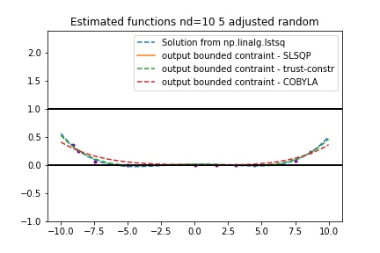
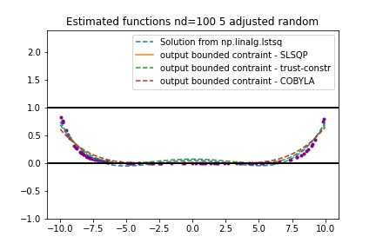

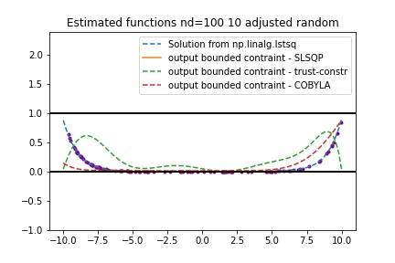
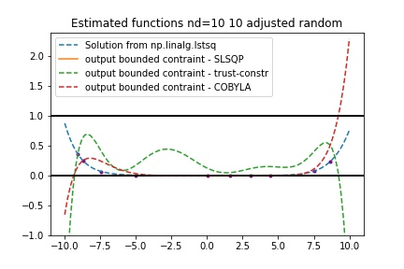
Using new function to generate points:
I also tried to use other functions, such as the function that varies little between x=[0,5] and [-5,0], but greatly between [-10,-5] and [5,10]. We observed the differences in the degree of fitting during the generation of data points by this function, and I concentrated the data points on both sides of the range for convenience of observing the estimation in the wide range of changes. I found a significant increase in the degree of fitness, which was extremely close to the exact value for almost all Optimizers. Overfitting occurs only in extreme cases (high orders with only a few data points).

