Slide 1
Optimization Performance With Output Constraints
---- Estimation of Polynomial Functions
by Feng Zhao

Slide 2
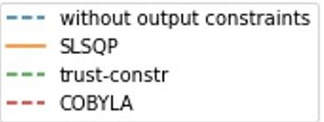
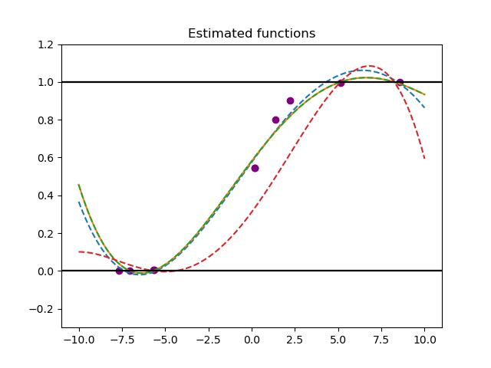
Given data points(N points)
--uniform sampling
--random sampling
--adjusted(weighted) random sampling
(more on the sides, less in the middle)
‘trust-constr’: Trust-Region Constrained Algorithm
‘SLSQP’: Sequential Least SQuares Programming
‘COBYLA’: Constrained Optimization BY Linear Approximation
Polynomial with order K
-- Output is constrained in certain range
Output bound(constraints)
Polynomial with order K

Slide 3
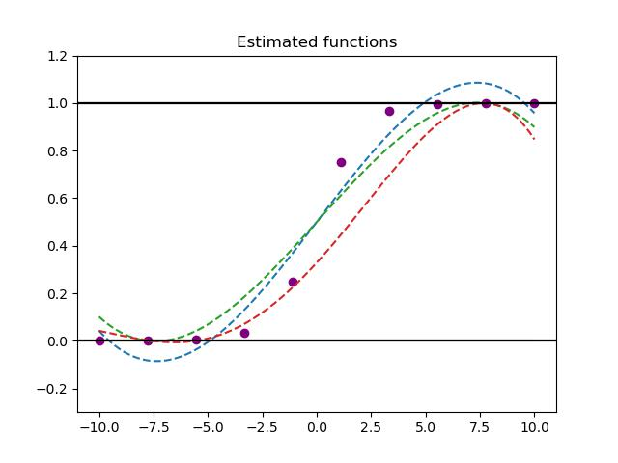
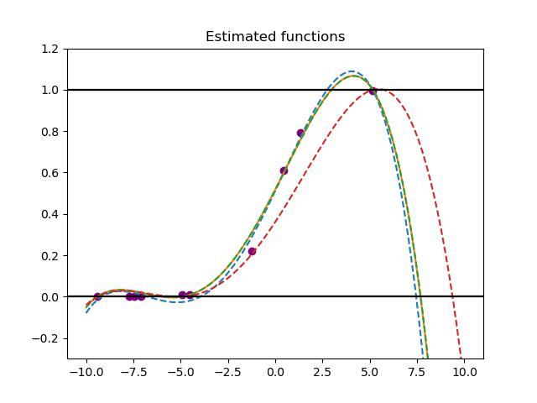
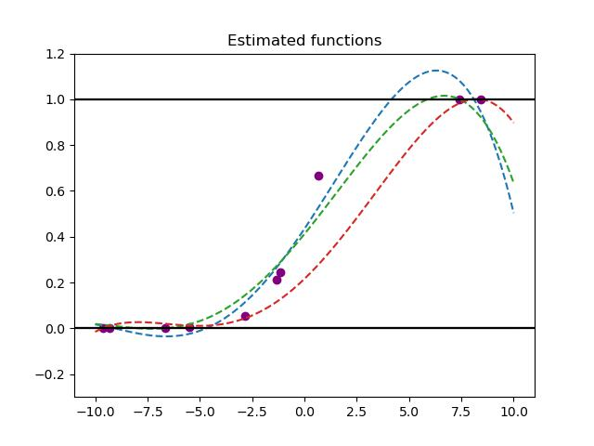

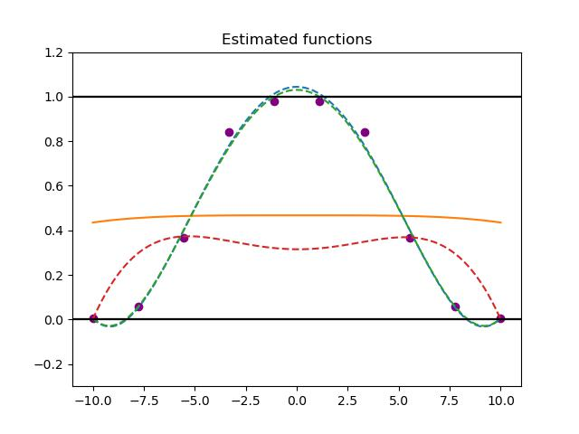
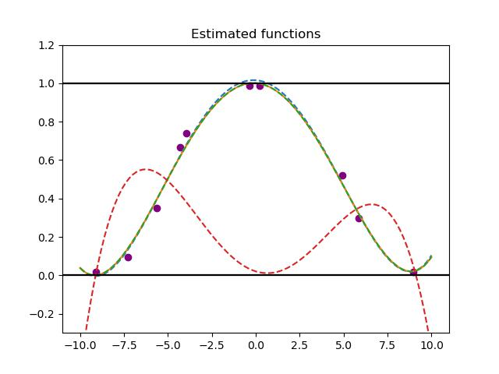
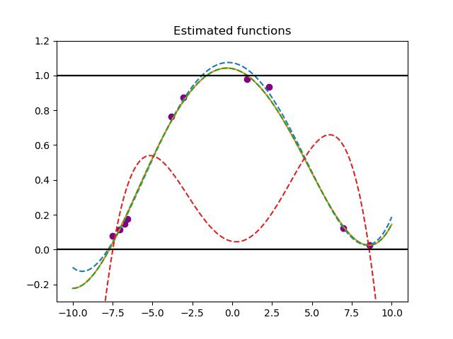
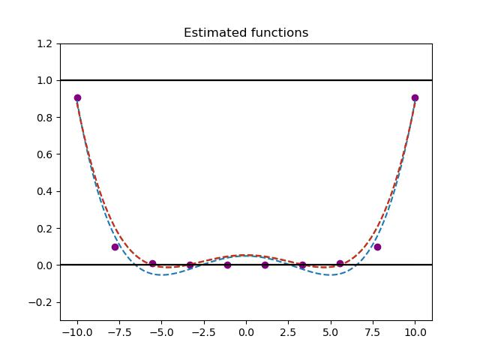
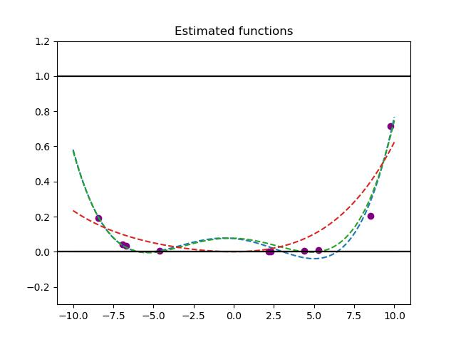
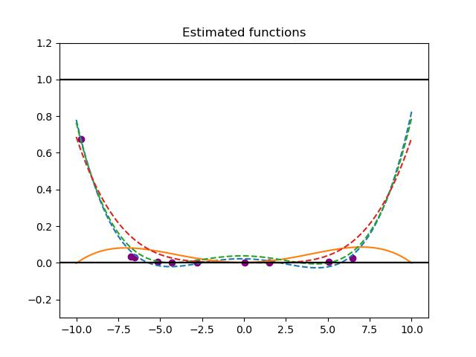

Uniform data points
Random data points
Adjusted(weighted) Random data points
N = 10, K = 5
Green overlaps with yellow
Sigmoid
Combined Sigmoid
Sigmoid(5+x)
+
Sigmoid(5-x) -1
Rate-changing

Slide 4
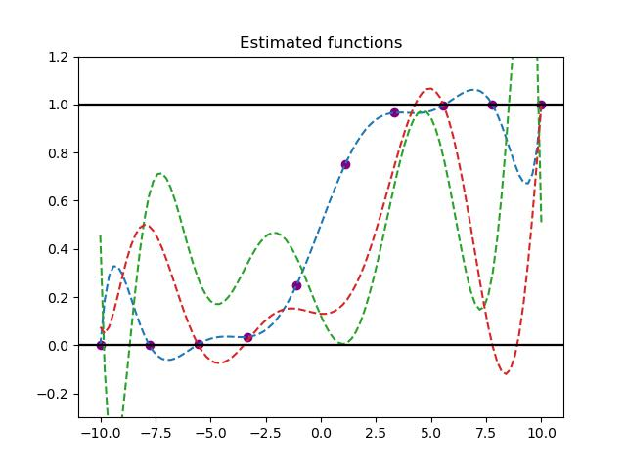
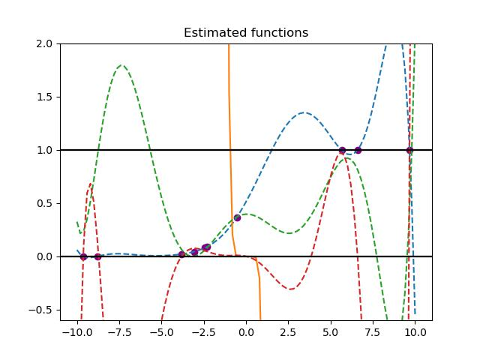
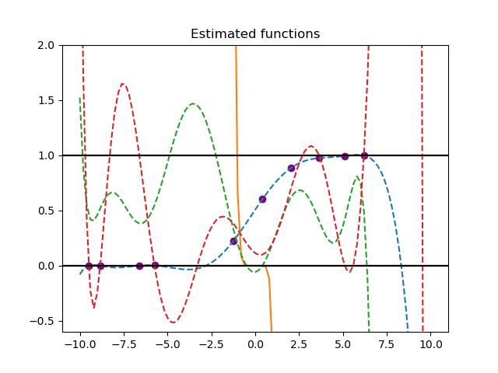
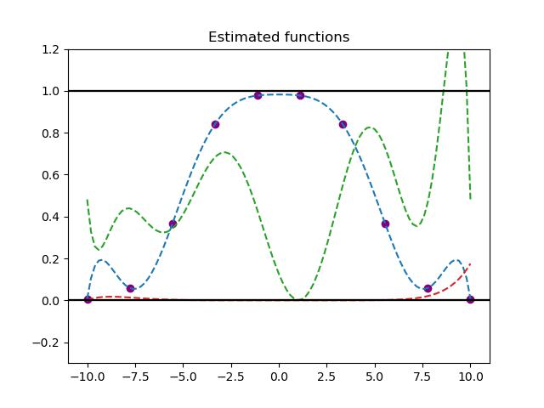
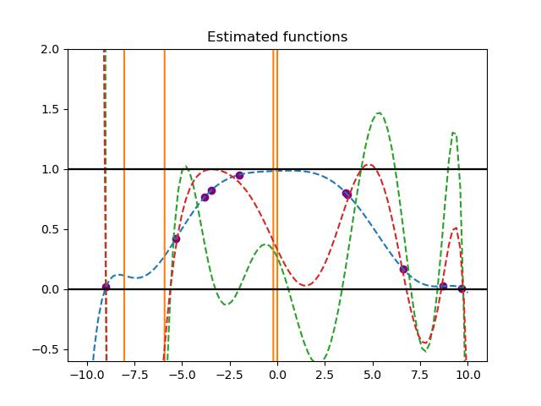
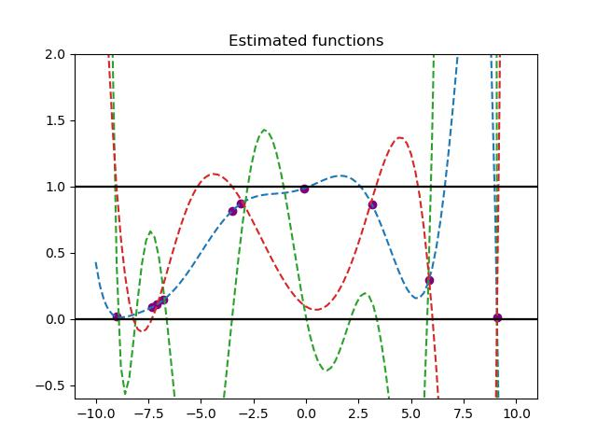
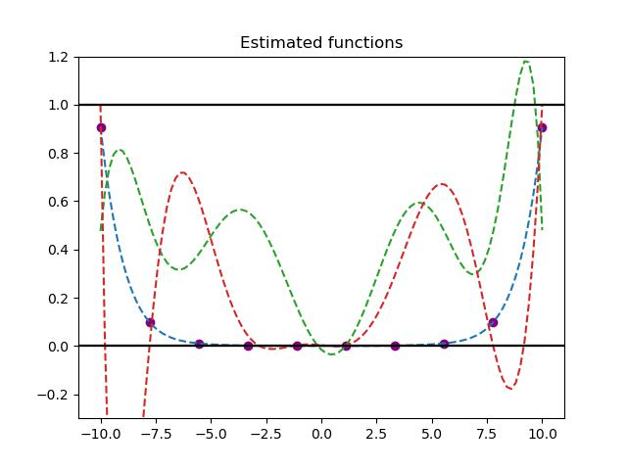
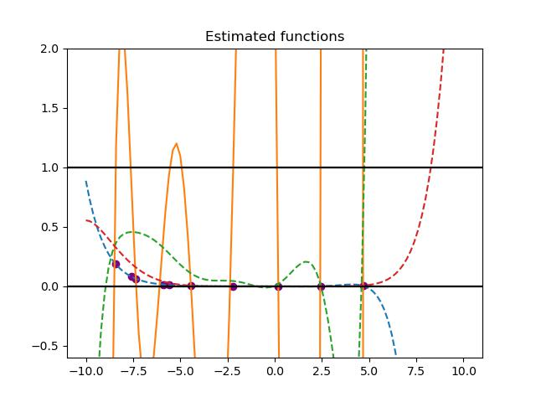
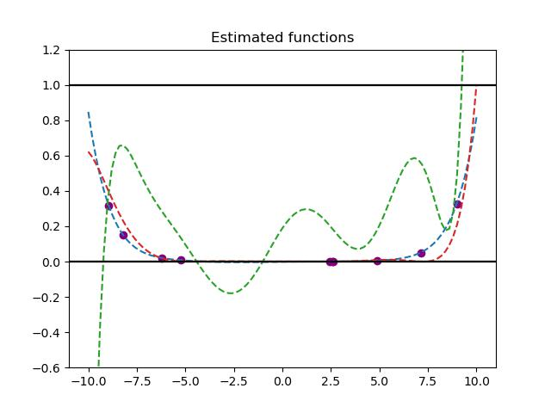
Uniform data points
Random data points
Adjusted(weighted) Random data points
N = 10, K = 10
over-fitting
Sigmoid
Combined Sigmoid
Sigmoid(5+x)
+
Sigmoid(5-x) -1
More wiggling
Rate-changing
off the page

Slide 5
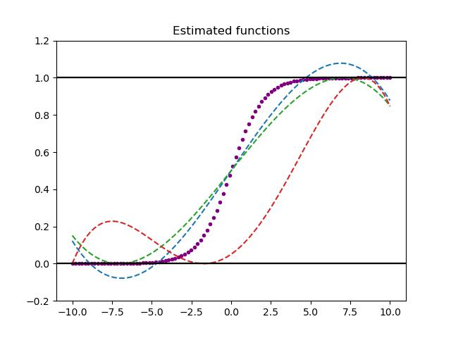
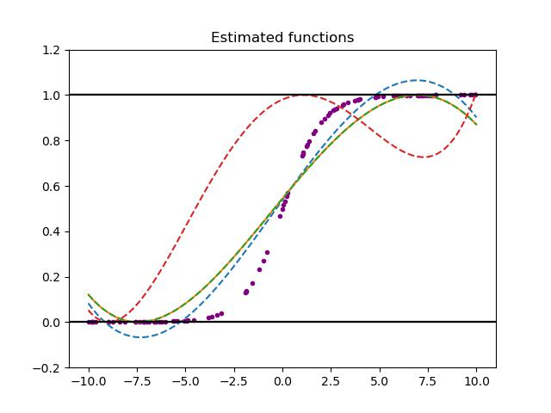
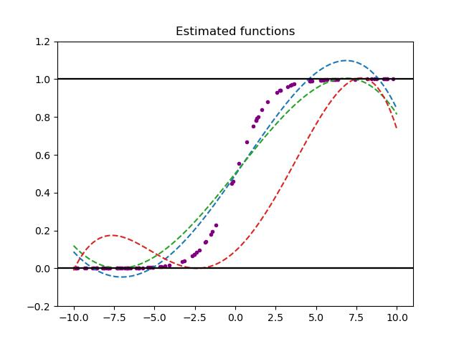
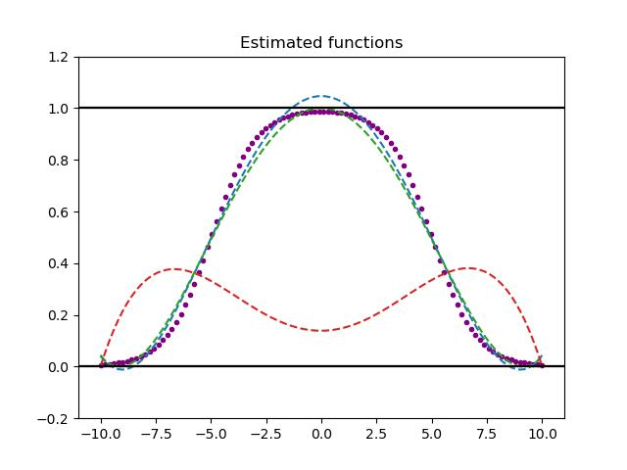
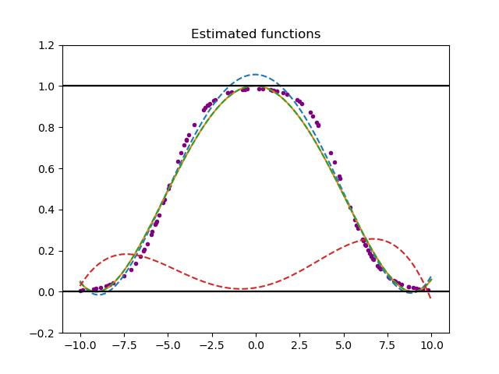
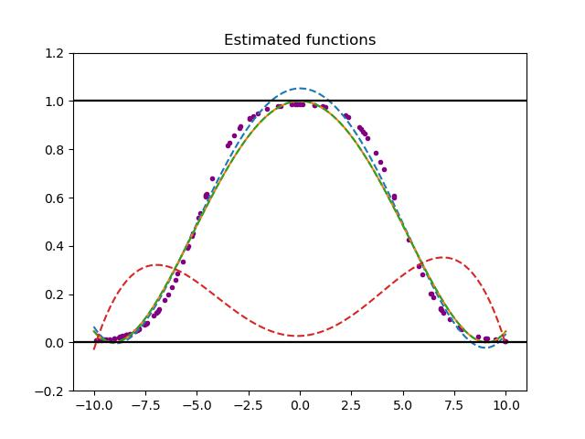
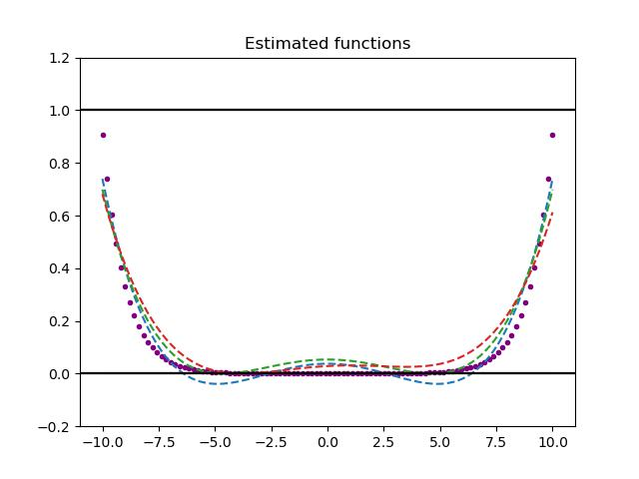
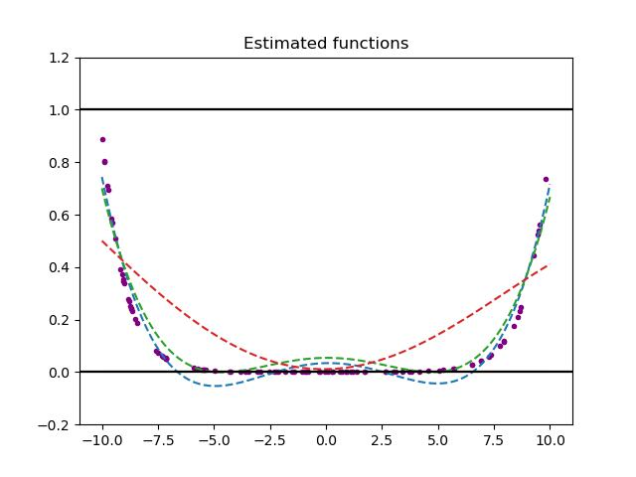
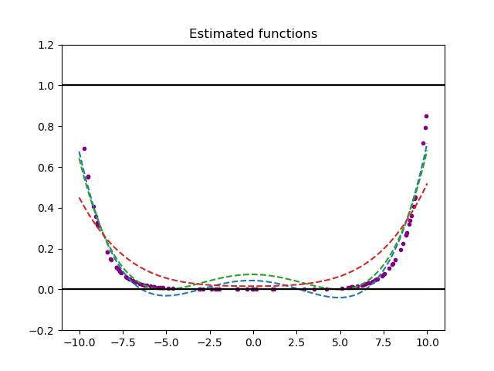
Uniform data points
Random data points
Adjusted(weighted) Random data points
N = 100, K = 5
Green overlaps with yellow
Sigmoid
Less violation
COBYLA doesn’t work well
Combined Sigmoid
Sigmoid(5+x)
+
Sigmoid(5-x) -1
Rate-changing
Less violation

Slide 6
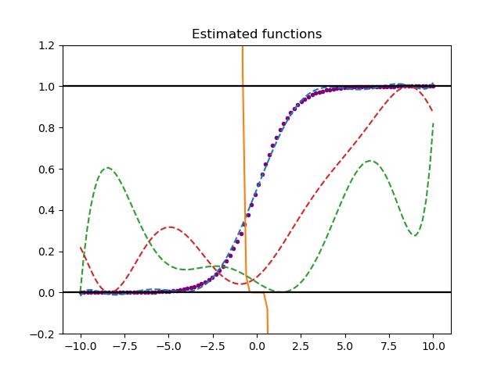
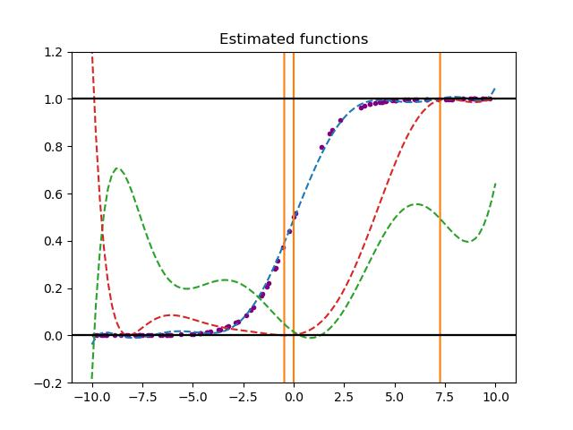
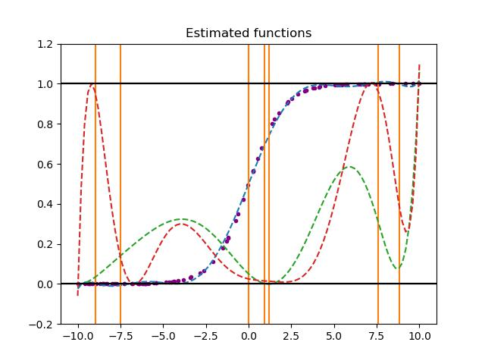
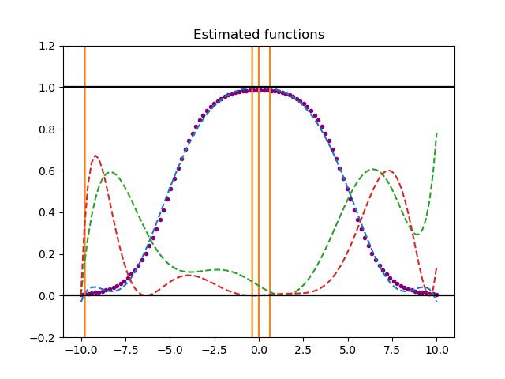
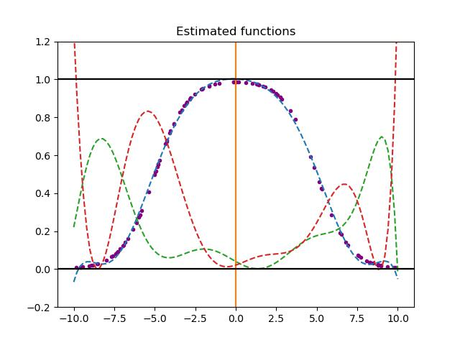
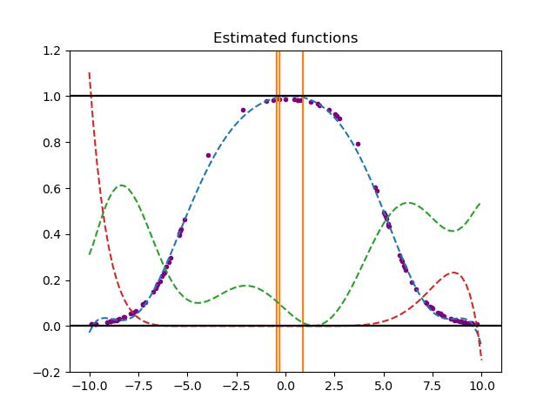
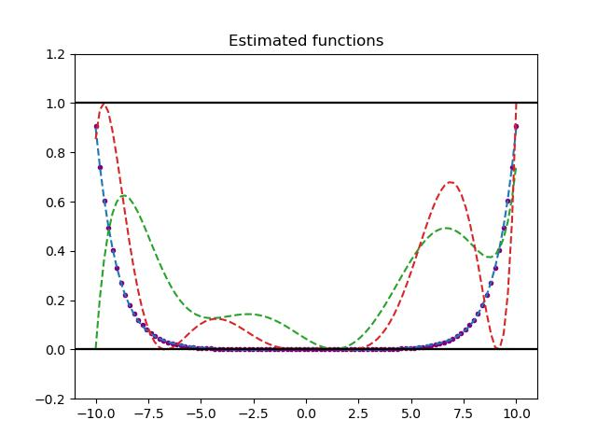
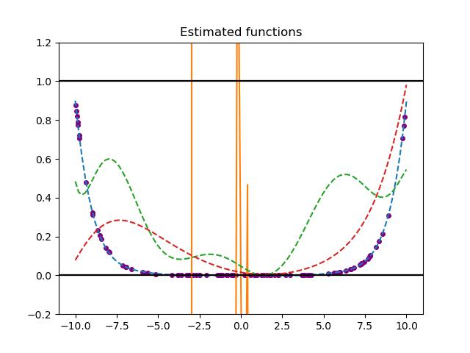
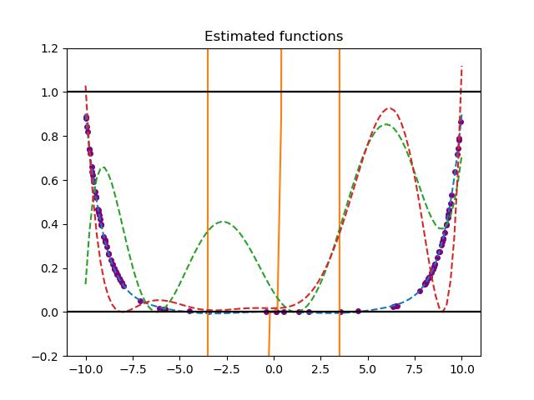
Uniform data points
Random data points
Adjusted(weighted) Random data points
N = 100, K = 10
Sigmoid
Combined Sigmoid
Sigmoid(5+x)
+
Sigmoid(5-x) -1
Rate-changing

Slide 7
Stage Conclusion:
Even if we find that the optimizer that receives the output constraint is not working well as we expected in the range of the given output bound, we can still see the applicable interval and performance differences under certain conditions.
With normal randomization, more data points will have a higher chance be distributed among all regions in space, whereas small amount of data points will cause the data points be set close to edges. So, in case with larger size of data points, all the optimizers works better. Meanwhile, with the same size of data points, the uniform data points perform better than the random one because the uniform distribution has already reduced the disparity of the distribution, avoiding the extreme samples. However, in the higher order of polynomial with large data points size, the original adjusted random distribution isn’t working well, especially for the SLSQP method.
My guess is that with fewer data points, the initial random allocation will lead to more extreme distributions, which is less likely to be adjusted random. However, in the case of more data points, the initial randomization has a sufficient degree of randomization, so that extreme cases are not easy to occur.
In this case, adjusted random is used to perform artificial randomization, which will decrease the degree of randomness. In high-level polynomials, slight changes in randomness will result in overfitting, so the adjusted random makes it harder for the optimizer to fit the line.
By modifying the sigmoid function, we use another function to generate data points while keeping the range of data points within our desired range. From the image, we can see that compared with the simple sigmoid function, this new function is more conducive to fitting. With only a few data points, the fitting degree of various optimizers is still in a relatively good precision.
However, the problem of overfitting was slightly improved in the advanced function. Except for SLSQP, COBYLA and trust-constr both fitted the preset data points better. In the case of COBYLA, with the combined sigmoid and rate-changing functions, it has better performance at a high-order.

