Slide 1
E-Commerce
Dealing in goods and services through the electronic media and internet is called as E-commerce.
E-Commerce or E-business involves carrying on a business with the help of the internet and by using information technology like Electronic Data Interchange (EDI).
With the evolution of technology and increase in consumerism all over India, e-commerce is riding the high tide in online business.
Today, the total number of internet users in the world is close to 3 billion, out of this India has a total of 259.14 million internet and broadband subscribers.

Slide 2
E COMMERCE IN INDIA
According to a research, Indian E-commerce revenues will increase by more than five times by 2016, jumping from U.S. Dollar 1.6 billion in 2012 to U.S. Dollar 8.8 billion in 2016.
A survey by the Associated Chambers of Commerce concluded that, India’s E-commerce market, which stood at $ 2.5 billion in 2009, reached $8.5 billion in 2012 and rose 88% to touch $ 16 billion.
The gradual increase in literate population and the internet penetration driven by some of the cheap and most basic cell phones providing access to internet is helping this substantial growth.
More importantly, e-commerce creates more opportunities for business and also opens up opportunities for education and academics, which seems to have tremendous potential in the future of e-commerce in India.

Slide 3
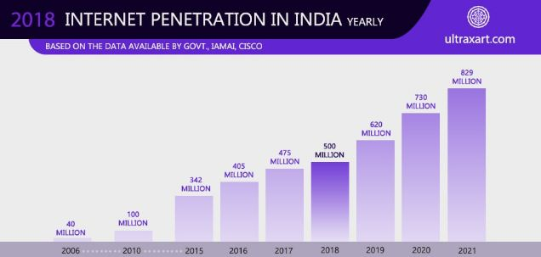
INTERNET USER IN INDIA

Slide 4
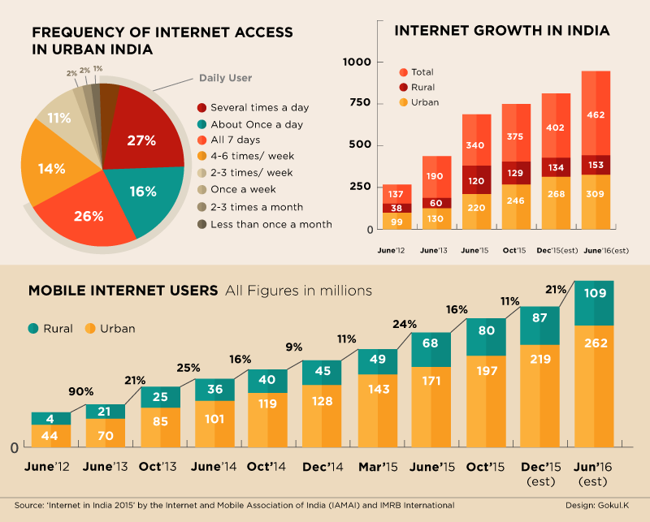
INTERNET USER IN RURAL AND URBAN AREAS

Slide 5
WHY ONLINE SHOPPING
The physical store, through payment gateways and digital catalogs, is moving online.
Mobile technology and the use of apps improve access to online stores and can even build brand loyalty- one reason so many online stores ask consumers to install their apps.
Social media is a game-changer when it comes to advertising. With diverse platforms, you can now use text, visuals, audio, and just great pictures to promote your products.
Online sales patterns vary across age groups. The 18-24 age group prefers to shop more online compared to their older counterparts. This can possibly be attributed to this being the first generation that grew up alongside the internet.

Slide 6
The Advantages Of Online Retail
But as instinct, why do people prefer to shop online? Wouldn’t a physical store experience just be more fulfilling? Moreover, wouldn’t we have the goods in possession immediately after purchase?
The main reasons for increasing online sales are undoubtedly high discounts and greater convenience of buying online.
The wide variety of choices all visible at your convenience, the option to pay through digital wallets and the good logistics services all stand as reasons for the increasing popularity of online shopping.
Developing countries are adding internet users with each passing minute. This means more people have access to online stores with each passing day.

Slide 7
Is Offline Retail Going To Thrive?
In spite of such impressive growth in the online retail sector, about 36% of all shoppers who see a product online prefer to buy it from a physical store. This would be even more relevant for products of high value, such as jewelry.
Beyond this, there is the unorganized offline retail sector that includes everyone from your neighborhood grocer to Walmart. And one look at Walmart will tell you they ain’t shutting shop anytime soon.

Slide 8
The Advantages Of Offline Retail
Consumers, especially those in older demographics, may have trust issues buying online. They may still want to buy products after experiencing them firsthand.
Going to a physical store is an opportunity to interact with society. Moreover, people may prefer to shop in groups and the option to do so is effectively non-existent in online stores.
Establishing a brand exclusively online can be daunting, considering the largest gateway for discovering these products is Google. Even online retail giants such as Amazon have seen the benefit of opening up a few physical bookstores.

Slide 9
THANK YOU

