Slide 1
Problem
Most of the plats needed to be watered and maintained a proper moisture level in the soil to be grown up well.
People can’t spend considerable amount of time to treat their gardens. Because of that, home gardens are looking less attractive day by day and it eliminates another way to relax their minds.
Custom Location!
Node-Red
MQTT Server
Node MCU
(Server + Micro controlling)
Web Application
NTP Server
Motor Controller
DC Valve

Slide 2
Web Server
Webserver
(Node MCU)
HTTP request
Webpage
(User)
HTTP reply
Webserver is implemented in the Node MCU.
According to the HTTP requests sent by the user, operations are carried out.
Location set up data sent by the user is sent to the Node RED and receive the weather details.
Received weather data sent to the webpage.
According to the selected method, watering is done.
Designed using HTML, CSS and JavaScript.
User commands is sent to the Node MCU as HTTP requests.
Location Setup
Mode Selection
Watering
A Clock will be running in order to synchronize the sleeping schedule with the Node MCU. This will be further discussed later.

Slide 3
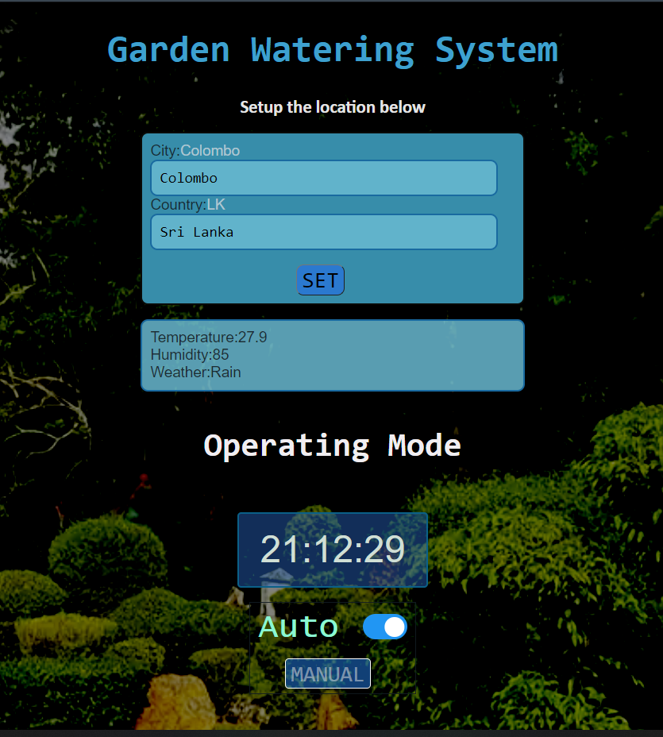
To set up the location
Current Location Weather Details
Toggle between AUTO and MANUAL
When set to MANUAL, this can be used to manually water the plants

Slide 4
Location setup
Location set data
sent via MQTT
Node RED
Location Set data
Node MCU
Location Set data
Webpage
Weather Data
Weather Data
Weather Data is used to adjust the watering.
AUTO
Node MCU
AUTO enable
Webpage
AUTO enable confirm
AUTO watering happens as programmed.
MANUAL
Node MCU
MANUAL enable
Webpage
MANUAL enable confirm
Manual Watering
Manual Watering Confirm
Manual Watering

Slide 5




Node-RED
Get the weather condition of the location
Get the garden location
Send weather data to the NodeMCU
Using MQTT In node, we get the garden location from the MQTT broker.
We use https://test.mosquitto.org/ as our MQTT broker.
To get weather information at the given location, we use the OpenWeatherMap node.
https://openweathermap.org/ Provides real-time weather details to the OpenWeatheMap node.
Using the MQTT Out node, we send the weather details of the given location to the MQTT broker.
NodeMCU then retrieves the weather details from the MQTT broker.

Slide 6
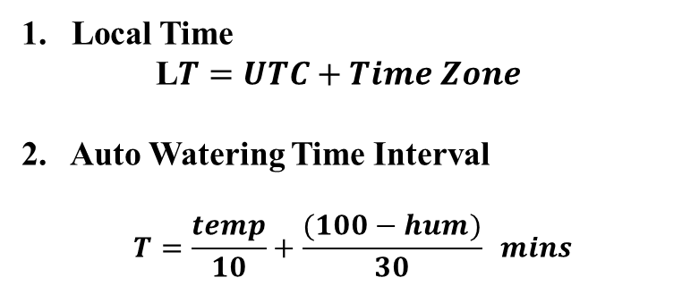
NodeMCU Functionality
Temperature/ Humidity/ Time Zone
Local Time
L$T=UTC+Time Zone$
2. Auto Watering Time Interval
$$T=\frac{temp}{10}+\frac{(100−hum)}{30} mins$$
Node-Red
NodeMCU
NTP Server
UTC time
Watering
Manual Mode
User has the full control
One press −> 5 mins water
No sleeping schedule
Auto Mode
Waters twice a day for a calculated time period (9 – 10 am & 4- 5 pm)
Light Sleeping schedule with a 6 minutes time cycle.
0
3
6
9 mins
User can access the server/web page and do changes
Eg: Switch to Manual mode

Slide 7
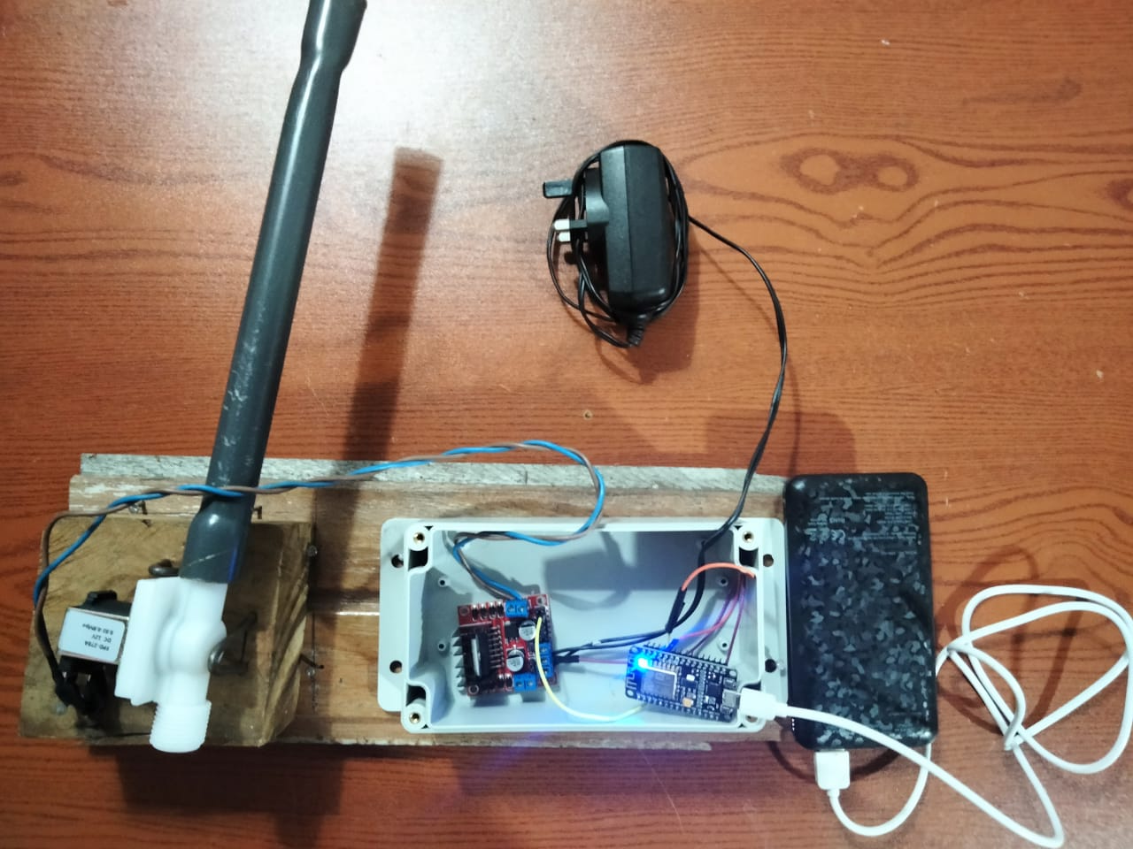
NodeMCU
Motor Controller
DC Valve
LM298n
12V DC water valve
Hardware Setup

Slide 8
Thank you!

