Slide 1
Introduction to Git
Ransingh Satyajit Ray

Slide 2
What is version control?
Keep track of changes to files.
Notice conflicts between changes made by different people.
Synchronize files between different computers.

Slide 3
Where does Git store information?
Each of your Git projects has two parts: the files and directories that you create and edit directly, and the extra information that Git records about the project's history. The combination of these two things is called a repository.
the files + Git records = repository.
Git stores all of its extra information in a directory called .git located in the root directory of the repository.
Suppose your home directory /home/repl contains a repository called dental, which has a sub-directory called data. Where is information about the history of the files in /home/repl/dental/data stored?
/home/repl/dental/.git

Slide 4
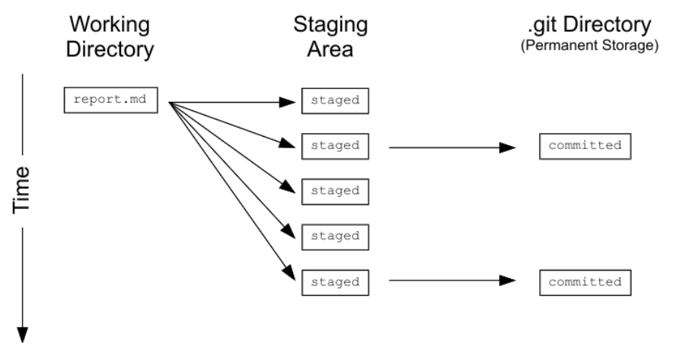
How can I tell what I have changed?
Git has a staging area in which it stores files with changes you want to save that haven't been saved yet. Putting files in the staging area is like putting things in a box, while committing those changes is like putting that box in the mail: you can add more things to the box or take things out as often as you want, but once you put it in the mail, you can't make further changes.

Slide 5
What is in a diff?
Git displays diffs like this:
diff --git a/report.txt b/report.txt
index e713b17..4c0742a 100644
--- a/report.txt wherein lines being removed are prefixed with - and lines being added are prefixed with +
+++ b/report.txt
@@ -1,4 +1,5 @@ A line starting with @@ that tells where the changes are being made. The pairs of numbers are start line and number of lines (in that section of the file where changes occurred).
-# Seasonal Dental Surgeries 2017-18
+# Seasonal Dental Surgeries (2017) 2017-18
+# TODO: write new summary

Slide 6
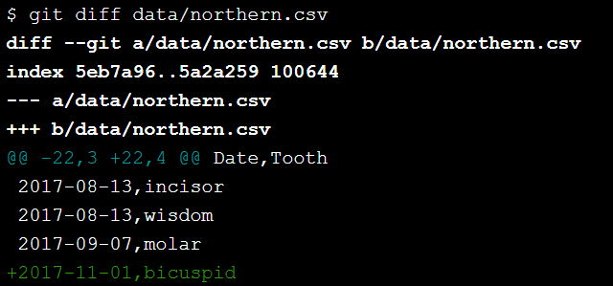
What is in a diff?

Slide 7
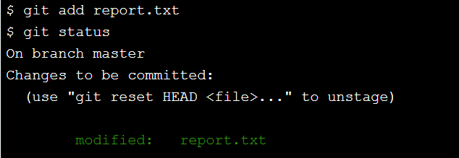
What's the first step in saving changes?
You commit changes to a Git repository in two steps:
Add one or more files to the staging area.
Commit everything in the staging area.
To add a file to the staging area, use git add filename.

Slide 8
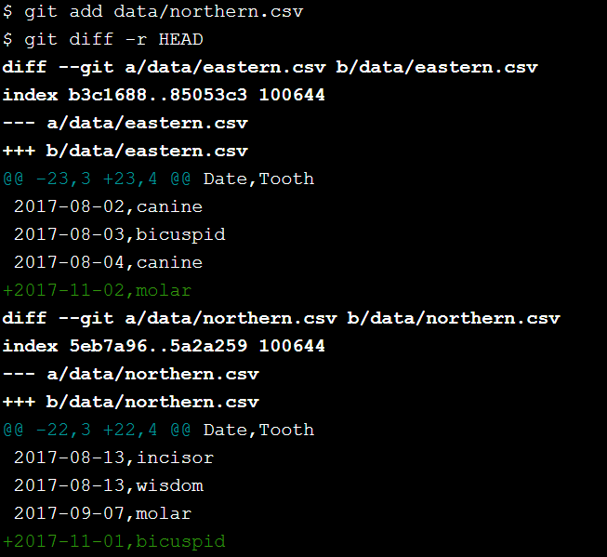
How can I tell what's going to be committed?
To compare the state of your files with those in the staging area, you can use git diff -r HEAD. The -r flag means "compare to a particular revision", and HEAD is a shortcut meaning "the most recent commit".
You can restrict the results to a single file or directory using git diff -r HEAD path/to/file, where the path to the file is relative to where you are (for example, the path from the root directory of the repository).
You have been put in the dental repository, where data/northern.csv has been added to the staging area. Use git diff with -r and an argument to see how files differ from the last saved revision.

Slide 9
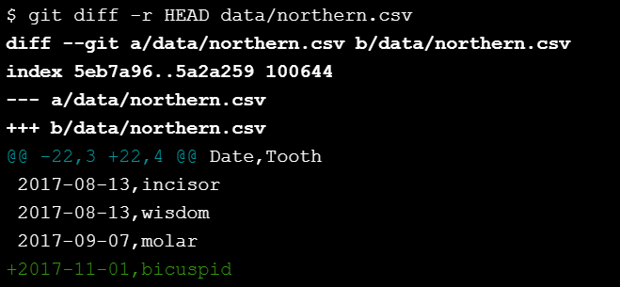
How can I tell what's going to be committed?
Use a single Git command to view the changes in the file that has been staged (and only that file).

Slide 10
Interlude: how can I edit a file?
If you type nano filename, it will open filename for editing (or create it if it doesn't already exist). You can then move around with the arrow keys, delete characters with the backspace key, and so on.
Ctrl-K: delete a line.
Ctrl-U: un-delete a line.
Ctrl-O: save the file ('O' stands for 'output').
Ctrl-X: exit the editor.

Slide 11

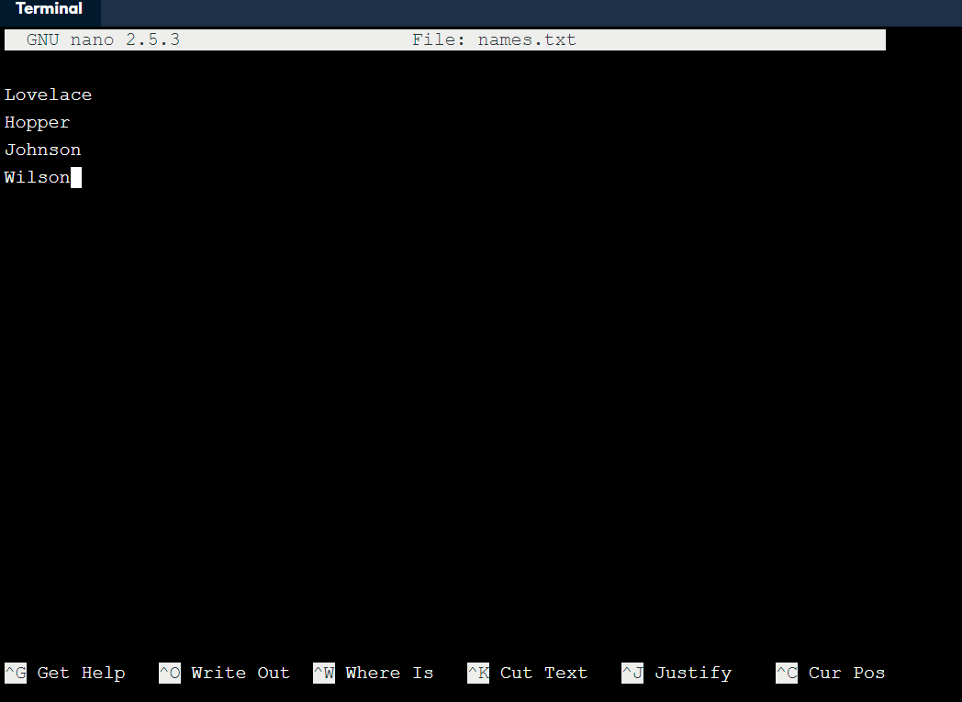
Interlude: how can I edit a file?
type Ctrl-O to write the file out, then Enter to confirm the filename, then Ctrl-X and Enter to exit the editor.

Slide 12
How do I commit changes?
When you commit changes, Git requires you to enter a log message.
By default, Git launches a text editor to let you write this message. To keep things simple, you can use -m "some message in quotes" on the command line to enter a single-line message like this:
git commit -m "Program appears to have become self-aware."

Slide 13
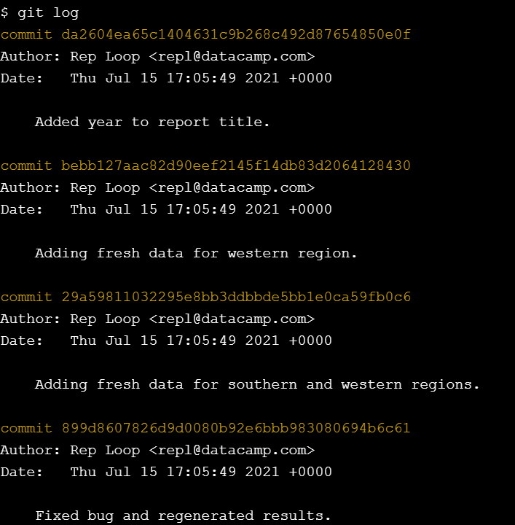
How can I view a repository's history?
The command git log is used to view the log of the project's history

Slide 14
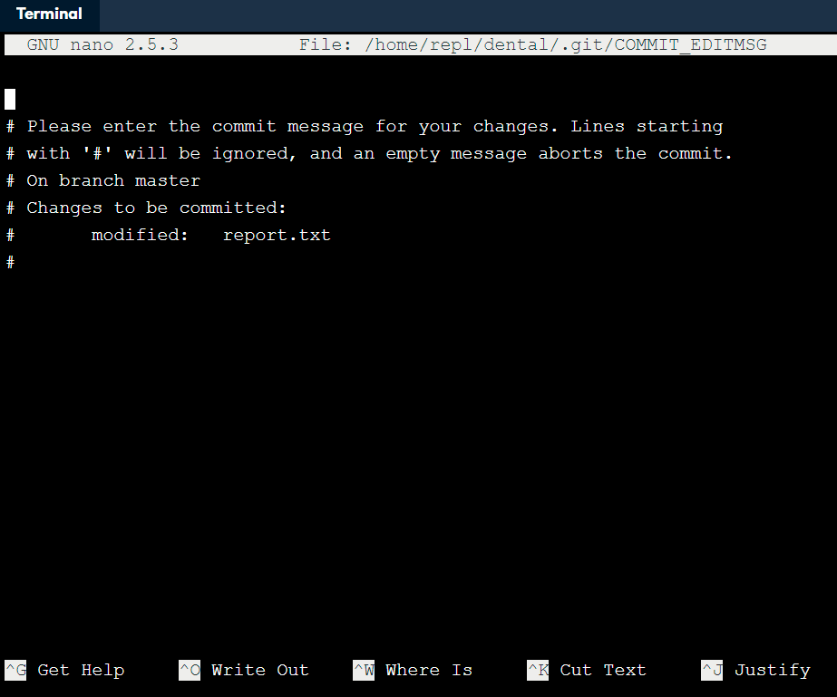

How do I write a better log message
Use git commit without -m to commit the changes. The Nano editor will open up.
type Ctrl-O to write the file out, then Enter to confirm the filename, then Ctrl-X and Enter to exit the editor.

Slide 15
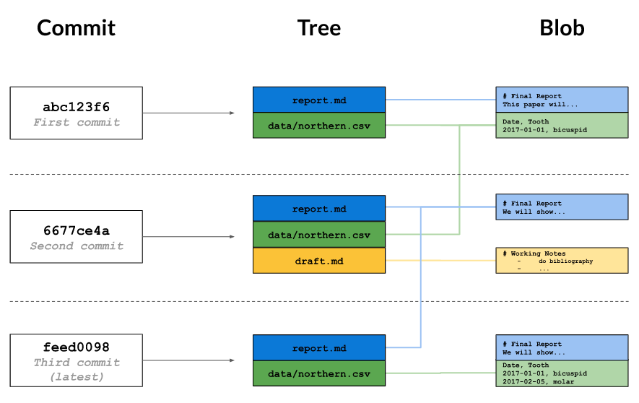
How does Git store information?
You may wonder what information is stored by each commit that you make. Git uses a three-level structure for this.
A commit contains metadata such as the author, the commit message, and the time the commit happened. In the diagram below, the most recent commit is at the bottom (feed0098), underneath its parent commits.
Each commit also has a tree, which tracks the names and locations in the repository when that commit happened. In the oldest (top) commit, there were two files tracked by the repository.
For each of the files listed in the tree, there is a blob. This contains a compressed snapshot of the contents of the file when the commit happened (blob is short for binary large object, which is a SQL database term for "may contain data of any kind"). In the middle commit, report.md and draft.md were changed, so the blobs are shown next to that commit. data/northern.csv didn't change in that commit, so the tree links to the blob from the previous commit. Reusing blobs between commits help make common operations fast and minimizes storage space.

Slide 16
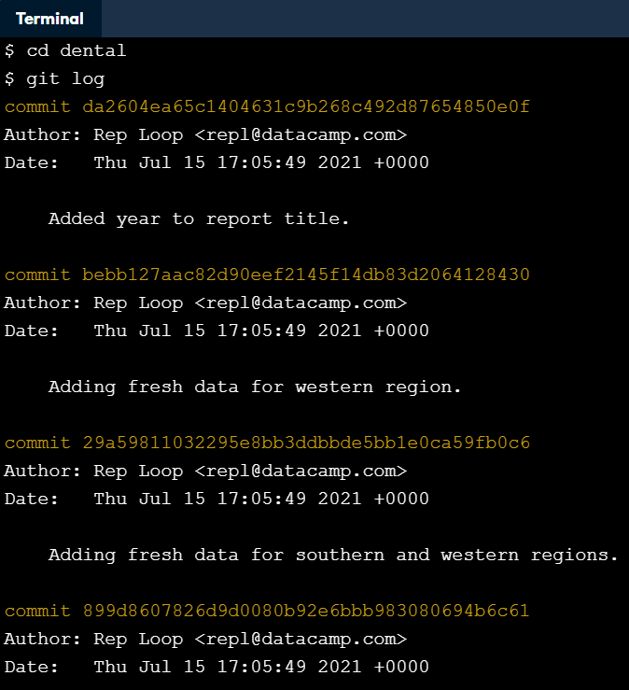
What is a hash?
Every commit to a repository has a unique identifier called a hash (since it is generated by running the changes through a pseudo-random number generator called a hash function). This hash is normally written as a 40-character hexadecimal string like 7c35a3ce607a14953f070f0f83b5d74c2296ef93, but most of the time, you only have to give Git the first 6 or 8 characters in order to identify the commit you mean.
Hashes are what enable Git to share data efficiently between repositories. If two files are the same, their hashes are guaranteed to be the same.

Slide 17
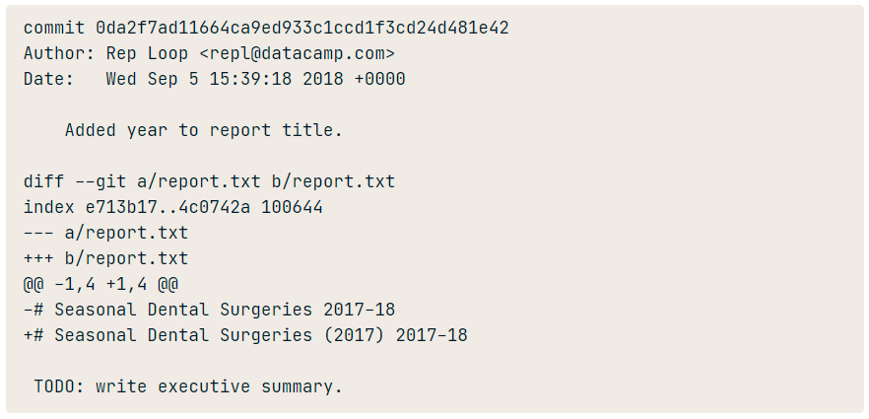
How can I view a specific commit?
To view the details of a specific commit, you use the command git show with the first few characters of the commit's hash. For example, the command git show 0da2f7 produces this:

Slide 18
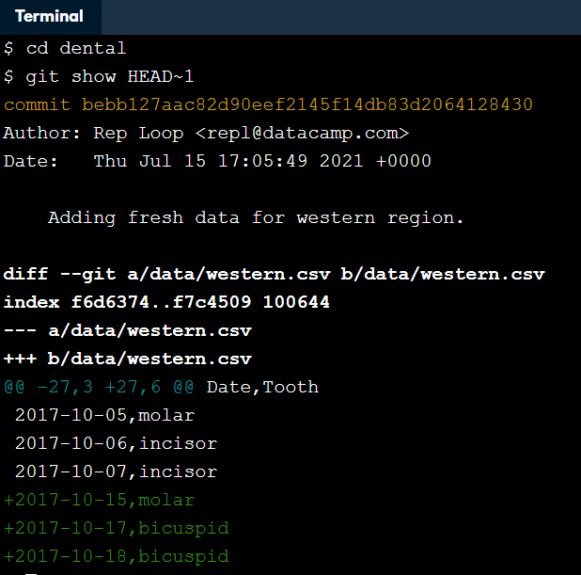
What is Git's equivalent of a relative path?
A hash is like an absolute path: it identifies a specific commit. Another way to identify a commit is to use the equivalent of a relative path. The special label HEAD, which we saw in the previous chapter, always refers to the most recent commit. The label HEAD~1 then refers to the commit before it, while HEAD~2 refers to the commit before that, and so on.
Note that the symbol between HEAD and the number is a tilde ~, not a minus sign -, and that there cannot be spaces before or after the tilde.

Slide 19
How can I see who changed what in a file?
git log displays the overall history of a project or file
The command git annotate file shows who made the last change to each line of a file and when.
For example, the first three lines of output from git annotate report.txt look something like this:
04307054 ( Rep Loop 2017-09-20 13:42:26 +0000 1)# Seasonal Dental Surgeries (2017) 2017-18
5e6f92b6 ( Rep Loop 2017-09-20 13:42:26 +0000 2)
5e6f92b6 ( Rep Loop 2017-09-20 13:42:26 +0000 3)TODO: write executive summary.
Each line contains five elements, with elements two to four enclosed in parentheses. When inspecting the first line, we see:
The first eight digits of the hash, 04307054.
The author, Rep Loop.
The time of the commit, 2017-09-20 13:42:26 +0000.
The line number, 1.
The contents of the line, # Seasonal Dental Surgeries (2017) 2017-18.

Slide 20
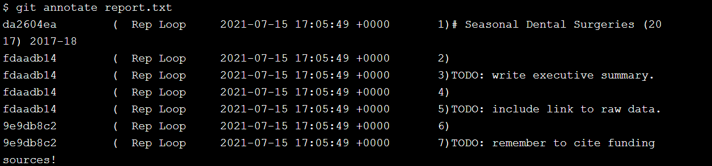
How can I see who changed what in a file?

Slide 21
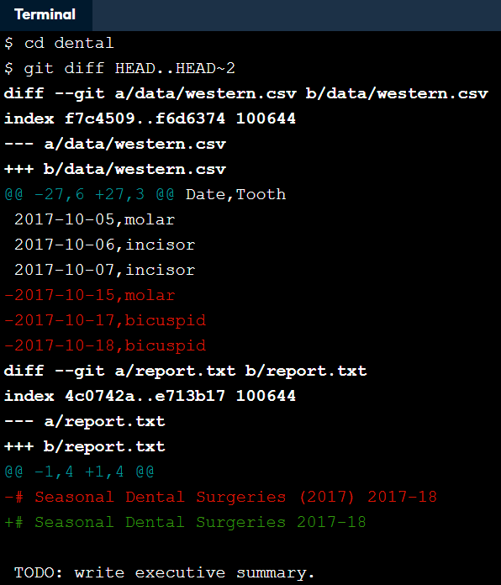
How can I see what changed between two commits?
git show with a commit ID shows the changes made in a particular commit.
To see the changes between two commits, you can use git diff ID1..ID2, where ID1 and ID2 identify the two commits you're interested in, and the connector .. is a pair of dots.
For example, git diff abc123..def456 shows the differences between the commits abc123 and def456, while git diff HEAD~1..HEAD~3 shows the differences between the state of the repository one commit in the past and its state three commits in the past.

Slide 22
How do I tell Git to ignore certain files?
Data analysis often produces temporary or intermediate files that you don't want to save. You can tell it to stop paying attention to files you don't care about by creating a file in the root directory of your repository called .gitignore and storing a list of wildcard patterns that specify the files you don't want Git to pay attention to.
For example, if .gitignore contains:
build
*.mpl
then Git will ignore any file or directory called build (and, if it's a directory, anything in it), as well as any file whose name ends in .mpl.

Slide 23
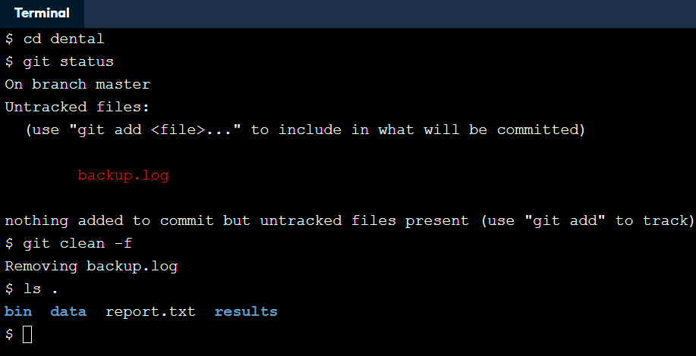
How can I remove unwanted files?
Git can help you clean up files that you have told it you don't want. The command git clean -n will show you a list of files that are in the repository, but whose history Git is not currently tracking. A similar command git clean -f will then delete those files.

Slide 24
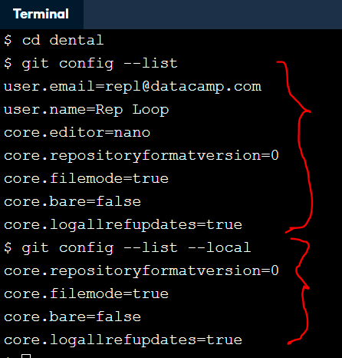
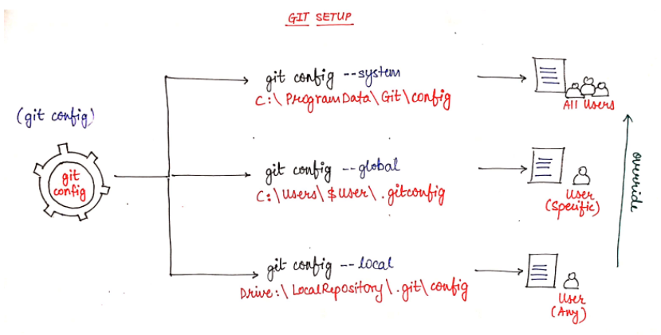
How can I see how Git is configured?
Like most complex pieces of software, Git allows you to change its default settings. To see what the settings are, you can use the command git config --list with one of three additional options:
--system: settings for every user on this computer. You can edit/view the configuration set by git at system level using this command. By default it applies to every user on the system and all their repositories.
--global: settings for every one of your projects. I know that the --global flag could be misleading but remember this that the configuration settings applies specifically to you i.e. the current user with which you're currently logged in.
--local: settings for one specific project. Anyone can view/edit these configuration settings.
Each level overrides the one above it, so local settings (per-project) take precedence over global settings (per-user), which in turn take precedence over system settings (for all users on the computer).
You are in the dental repository. How many local configuration values are set in for this repository?

Slide 25

How can I change my Git configuration?
Most of Git's settings should be left as they are. However, there are two you should set on every computer you use: your name and your email address. These are recorded in the log every time you commit a change, and are often used to identify the authors of a project's content in order to give credit (or assign blame, depending on the circumstances).

Slide 26
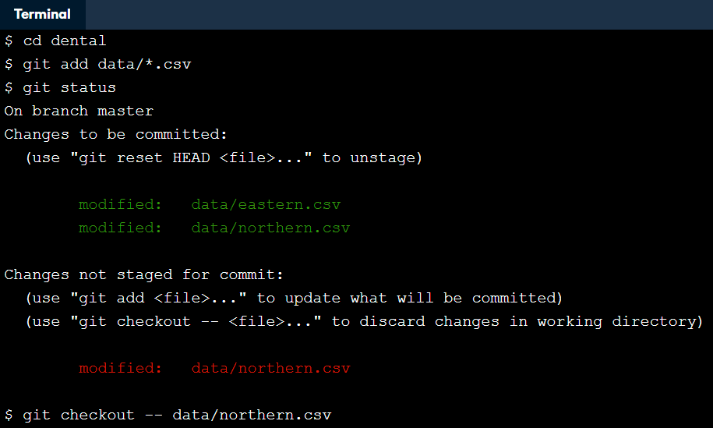
How can I undo changes to unstaged files?
Suppose you have made changes to a file, then decide you want to undo them. Your text editor may be able to do this, but a more reliable way is to let Git do the work. The command:
git checkout -- filename
will discard the changes that have not yet been staged.
Use this command carefully: once you discard changes in this way, they are gone forever.

Slide 27
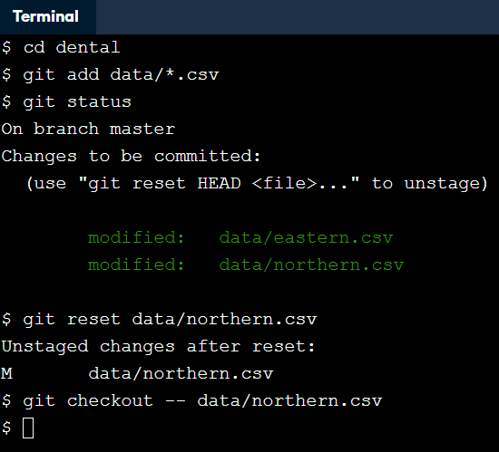
How can I undo changes to staged files?
At the start of this chapter you saw that git reset will unstage files that you previously staged using git add. By combining git reset with git checkout, you can undo changes to a file that you staged changes to. The syntax is as follows.
git reset HEAD path/to/file
git checkout -- path/to/file

Slide 28
How do I restore an old version of a file?
You previously saw how to use git checkout to undo the changes that you made since the last commit. This command can also be used to go back even further into a file's history and restore versions of that file from a commit.
In this way, you can think of committing as saving your work, and checking out as loading that saved version.
For example, if git log shows this:
commit ab8883e8a6bfa873d44616a0f356125dbaccd9ea
Author: Author: Rep Loop <repl@datacamp.com>
Date: Thu Oct 19 09:37:48 2017 -0400
Adding graph to show latest quarterly results.
commit 2242bd761bbeafb9fc82e33aa5dad966adfe5409
Author: Author: Rep Loop <repl@datacamp.com>
Date: Thu Oct 16 09:17:37 2017 -0400
Modifying the bibliography format.

Slide 29
How do I restore an old version of a file?
git checkout 2242bd report.txt would replace the current version of report.txt with the version that was committed on October 16. Notice that this is the same syntax that you used to undo the unstaged changes, except -- has been replaced by a hash.
Restoring a file doesn't erase any of the repository's history. Instead, the act of restoring the file is saved as another commit, because you might later want to undo your undoing.
One more thing: there's another feature of git log that will come in handy here. Passing - followed by a number restricts the output to that many commits. For example, git log -3 report.txt shows you the last three commits involving report.txt.

Slide 30
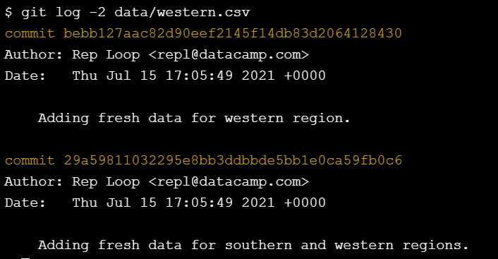
How do I restore an old version of a file?

Slide 31
How can I undo all of the changes I have made?
So far, you have seen how to undo changes to a single file at a time using git reset HEAD path/to/file. You will sometimes want to undo changes to many files.
One way to do this is to give git reset a directory. For example, git reset HEAD data will unstage any files from the data directory. Even better, if you don't provide any files or directories, it will unstage everything. Even even better, HEAD is the default commit to unstage, so you can simply write git reset to unstage everything.
Similarly git checkout -- data will then restore the files in the data directory to their previous state. You can't leave the file argument completely blank, but recall from Introduction to Shell for Data Science that you can refer to the current directory as .. So git checkout -- . will revert all files in the current directory.

Slide 32
What is a branch?
If you don't use version control, a common workflow is to create different subdirectories to hold different versions of your project in different states, for example development and final.
Of course, then you always end up with final-updated and final-updated-revised as well. The problem with this is that it becomes difficult to work out if you have the right version of each file in the right subdirectory, and you risk losing work.
One of the reasons Git is popular is its support for creating branches, which allows you to have multiple versions of your work, and lets you track each version systematically.

Slide 33
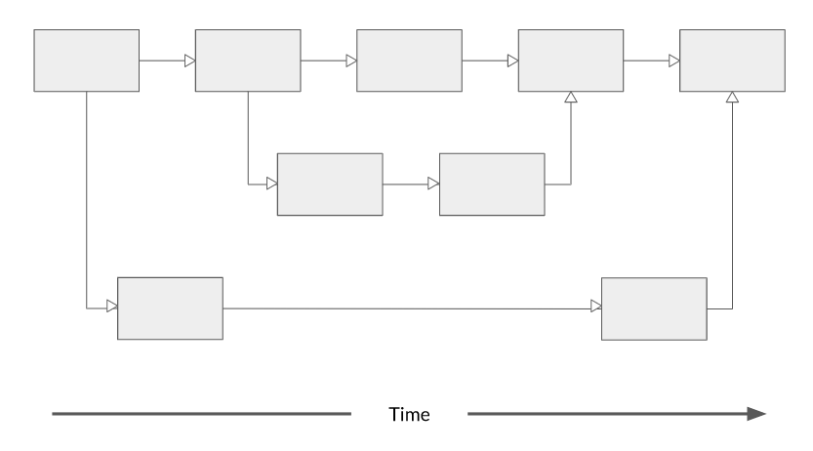
What is a branch?

Slide 34
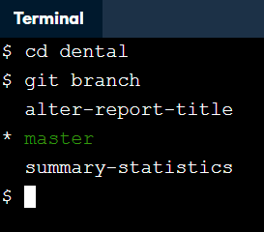
How can I see what branches my repository has?
To list all of the branches in a repository, you can run the command git branch.

Slide 35
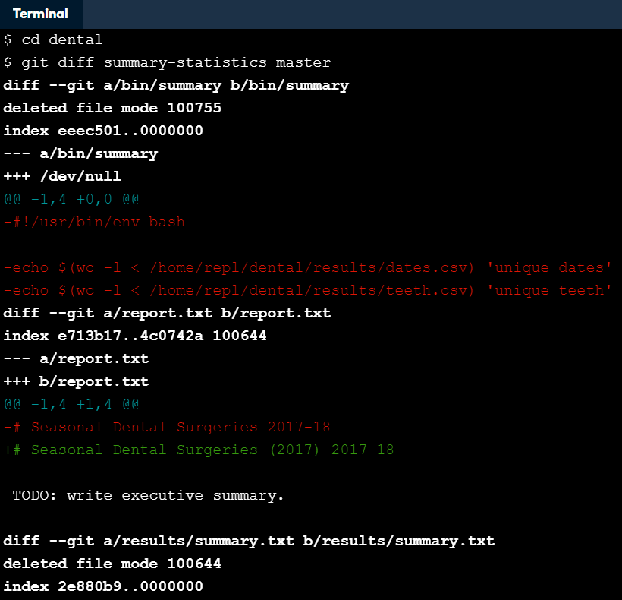
How can I view the differences between branches?
Branches and revisions are closely connected, and commands that work on the latter usually work on the former.
For example, just as git diff revision-1..revision-2 shows the difference between two versions of a repository, git diff branch-1..branch-2 shows the difference between two branches.

Slide 36
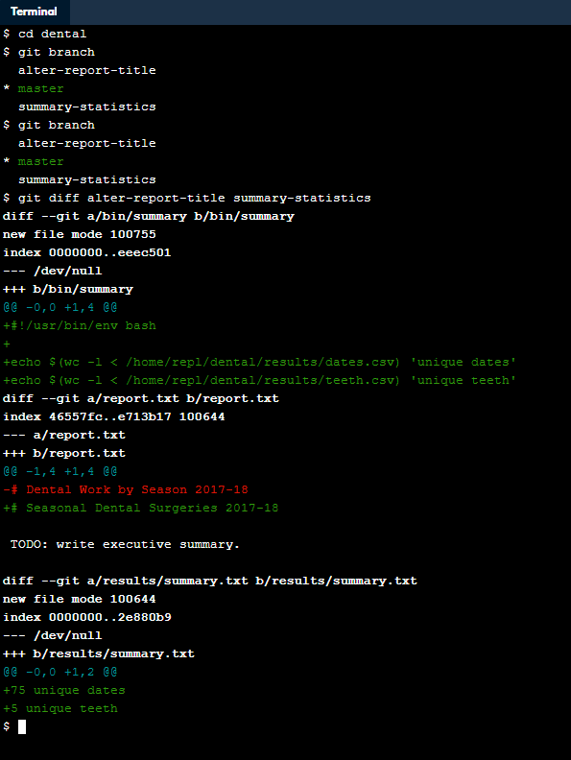
How can I view the differences between branches?
This is the change in summary folder
This is the change in report.txt
This is the change in summary.txt

Slide 37

How can I switch from one branch to another?
You previously used git checkout with a commit hash to switch the repository state to that hash.
You can also use git checkout with the name of a branch to switch to that branch.

Slide 38

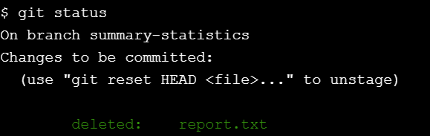
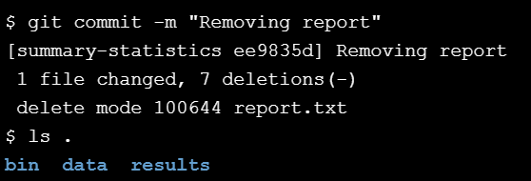
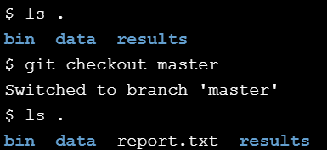
Removing the file/es
git rm file-name

Slide 39
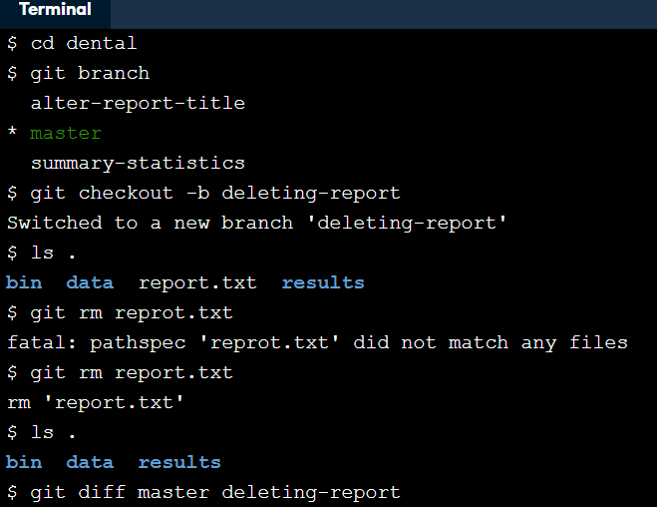
How can I create a branch?
To create a branch then switch to it in one step, you add a -b flag, calling git checkout -b branch-name,
The contents of the new branch are initially identical to the contents of the original. Once you start making changes, they only affect the new branch.

Slide 40

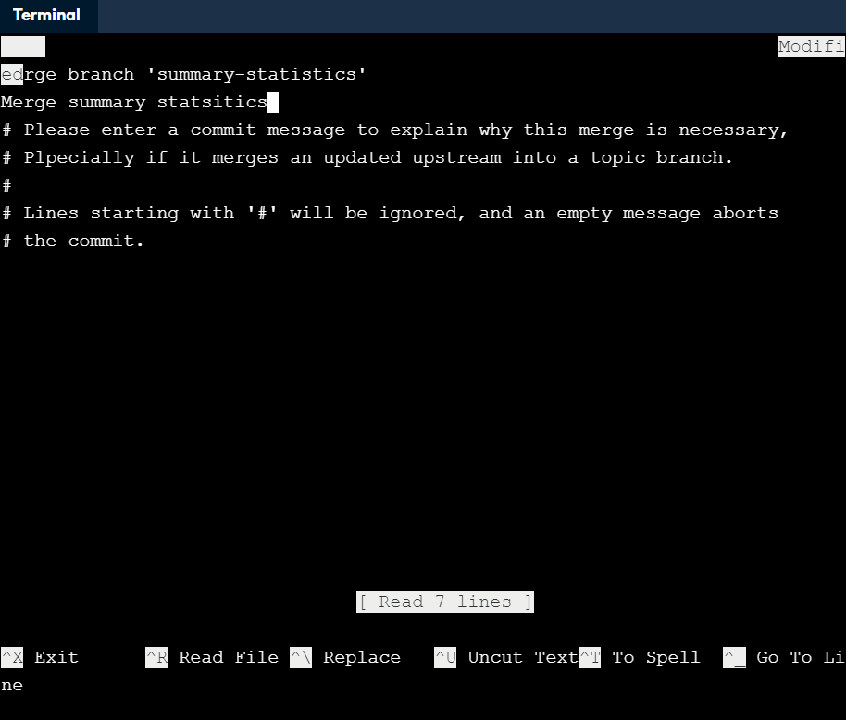
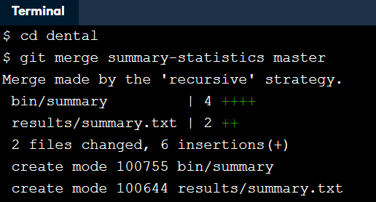
How can I merge two branches?
Branching lets you create parallel universes; merging is how you bring them back together.
Git incorporates the changes made to the source branch into the destination branch.
git merge source destination
Git automatically opens an editor so that you can write a log message for the merge; you can either keep its default message or fill in something more informative.

Slide 41
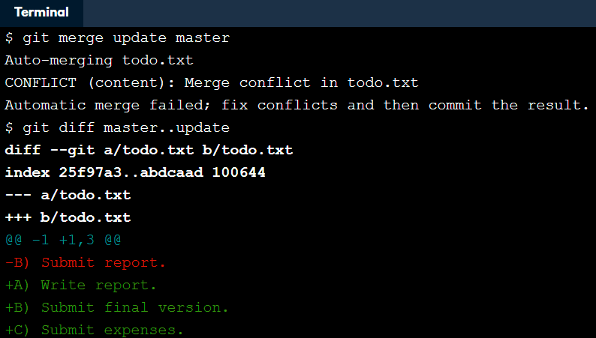
What are conflicts?
Sometimes the changes in two branches will conflict with each other: for example, bug fixes might touch the same lines of code, or analyses in two different branches may both append new (and different) records to a summary data file. In this case, Git relies on you to reconcile the conflicting changes.
Git can merge the deletion of line A and the addition of line C automatically.

Slide 42
How can I merge two branches with conflicts?
When there is a conflict during a merge, Git tells you that there's a problem, and running git status after the merge reminds you which files have conflicts that you need to resolve by printing both modified: beside the files' names.
Inside the file, Git leaves markers that look like this to tell you where the conflicts occurred:
<<<<<<< destination-branch-name
...changes from the destination branch...
=======
...changes from the source branch...
>>>>>>> source-branch-name

Slide 43
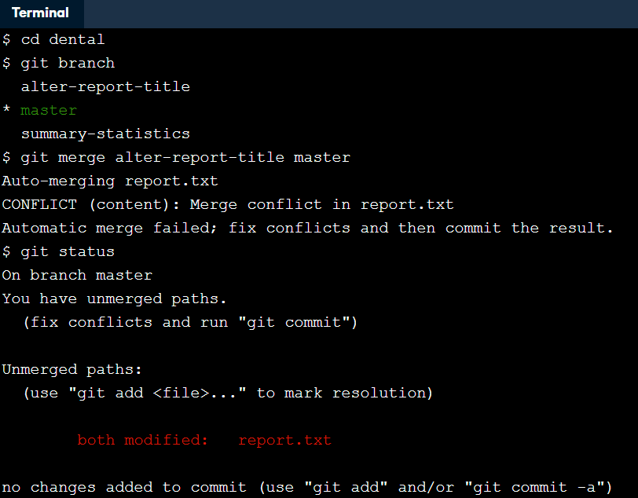
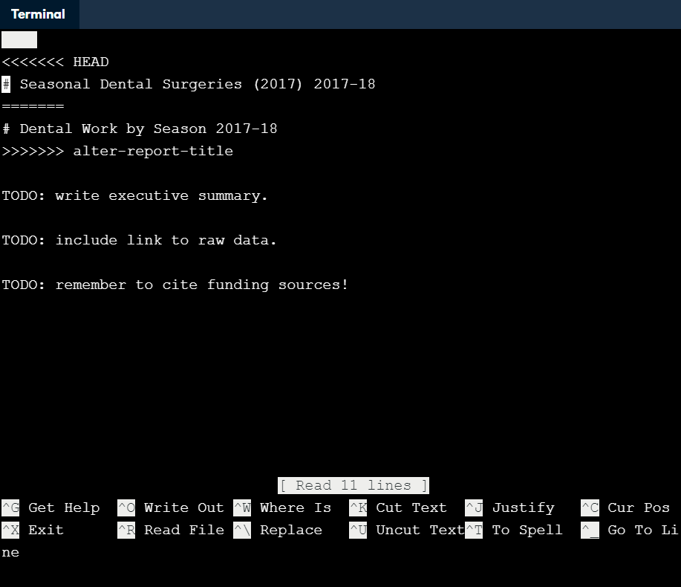

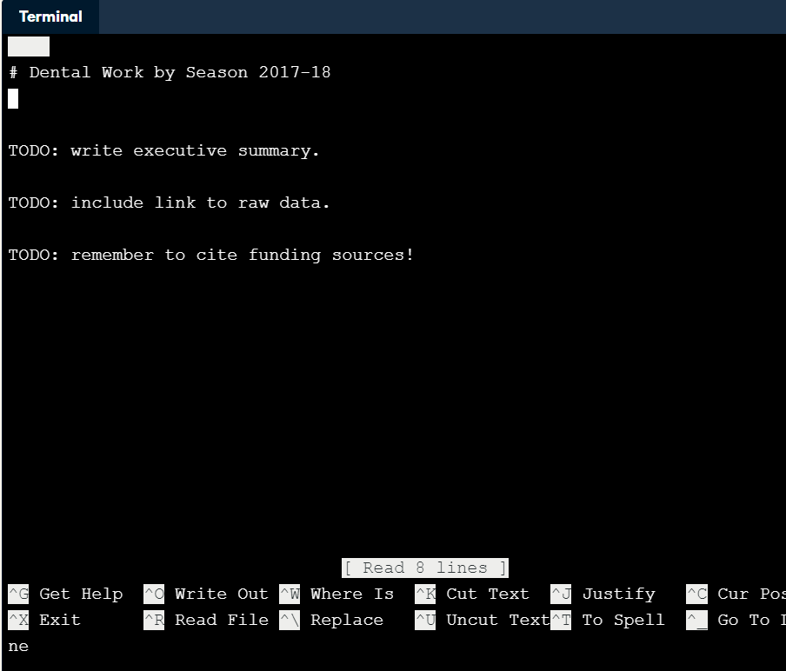

How can I merge two branches with conflicts?

Slide 44

How can I create a brand new repository?
If you want to create a repository for a new project in the current working directory, you can simply say git init project-name, where "project-name" is the name you want the new repository's root directory to have.
One thing you should not do is create one Git repository inside another. While Git does allow this, updating nested repositories becomes very complicated very quickly, since you need to tell Git which of the two .git directories the update is to be stored in.

Slide 45
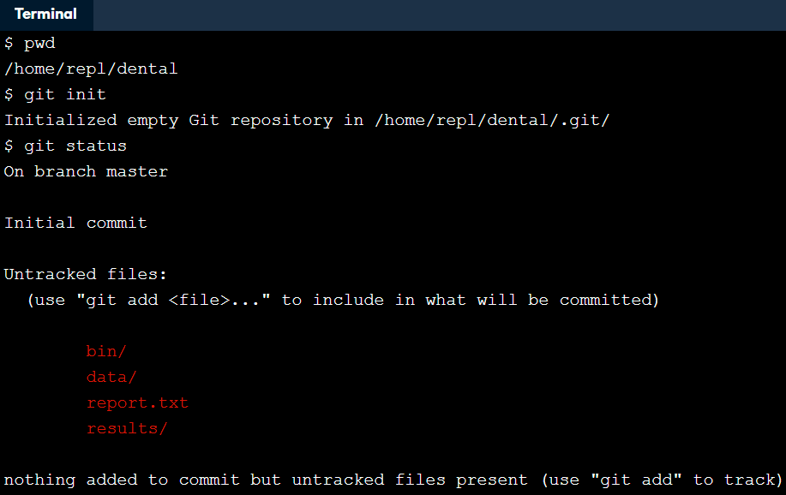
How can I turn an existing project into a Git repository?
Experienced Git users instinctively start new projects by creating repositories. If you are new to Git, though, or working with people who are, you will often want to convert existing projects into repositories.
Doing so is simple, just run:
git init
in the project's root directory, or:
git init /path/to/project
from anywhere else on your computer.

Slide 46
How can I create a copy of an existing repository?
Sometimes you will
join a project that is already running,
inherit a project from someone else, or
continue working on one of your own projects on a new machine.
To clone a repository, use the command
git clone URL
, where URL identifies the repository you want to clone. This will normally be something like
https://github.com/datacamp/project.git
When you clone from a local system we just give the name of the clone’s root directory
git clone /existing/project
Git uses the name of the existing repository as the name of the clone's root directory, will create a new directory called project inside your home directory.

Slide 47
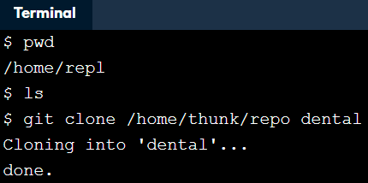
How can I create a copy of an existing repository?
You have just inherited the dental data analysis project from a colleague, who tells you that all of their work is in a repository in /home/thunk/repo. Use a single command to clone this repository to create a new repository called dental inside your home directory.

Slide 48
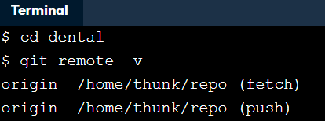
How can I find out where a cloned repository originated?
When you a clone a repository, Git remembers where the original repository was. It does this by storing a remote in the new repository's configuration. A remote is like a browser bookmark with a name and a URL.
If you use an online git repository hosting service like GitHub or Bitbucket, a common task would be that you clone a repository from that site to work locally on your computer. Then the copy on the website is the remote.
If you are in a repository, you can list the names of its remotes using git remote.
If you want more information, you can use git remote -v (for "verbose"), which shows the remote's URLs.
In practice each remote is almost always paired with just one URL.

Slide 49
How can I define remotes?
When you clone a repository, Git automatically creates a remote called origin that points to the original repository. You can add more remotes using:
git remote add remote-name URL
and remove existing ones using:
git remote rm remote-name
You can connect any two Git repositories this way, but in practice, you will almost always connect repositories that share some common ancestry.
As you probably know, Git is a distributed version control system. Most operations are done locally. To communicate with the outside world, Git uses what are called "remotes". These are repositories other than the one on your local disk which you can push your changes into or pull from.
The command
git remote add origin git@github.com:peter/first_app.git creates a new remote called origin located at git@github.com:peter/first_app.git.

Slide 50
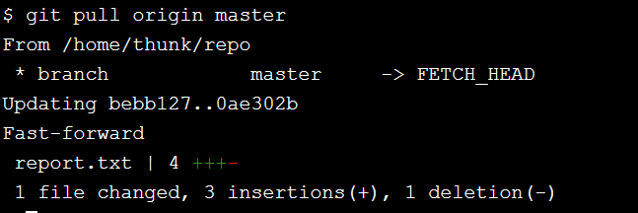
How can I pull in changes from a remote repository?
Pulling changes is straightforward: the command git pull remote branch gets everything in branch in the remote repository identified by remote and merges it into the current branch of your local repository.

Slide 51
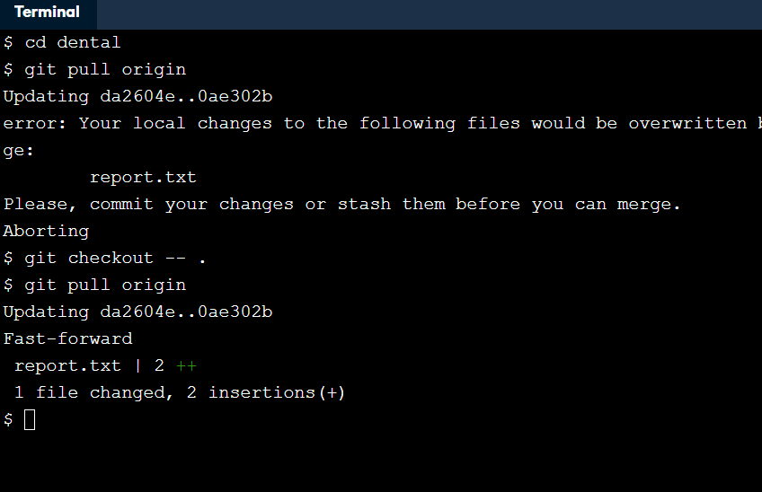
What happens if I try to pull when I have unsaved changes?
Just as Git stops you from switching branches when you have unsaved work, it also stops you from pulling in changes from a remote repository when doing so might overwrite things you have done locally. The fix is simple: either commit your local changes or revert them, and then try to pull again.
You are in the dental repository, which was cloned from a remote called origin. Use git pull to bring in changes from that repository.
Discard the changes in your repository.
Re-try git pull.

Slide 52
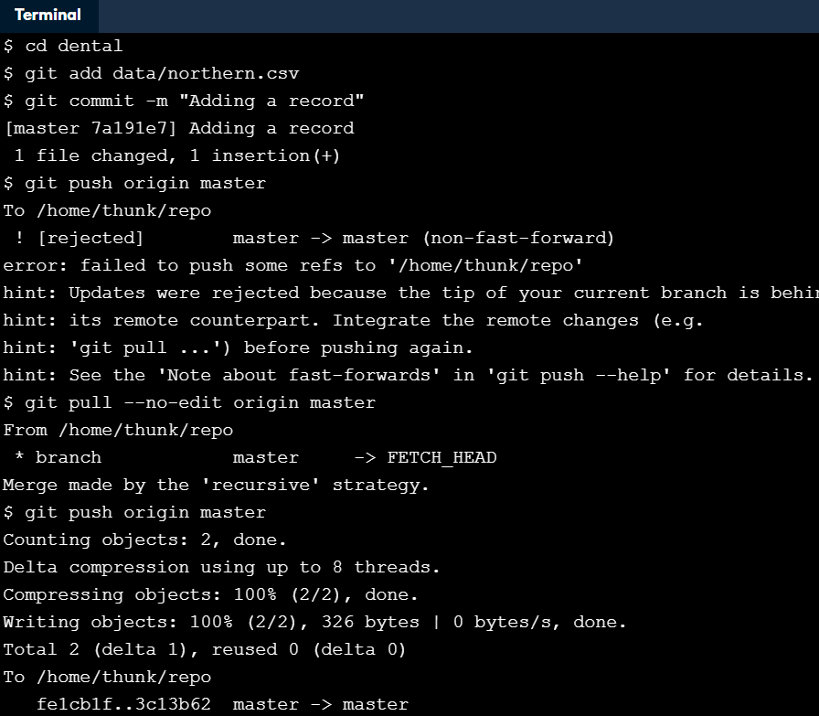
What happens if my push conflicts with someone else's work?
Use git push to push those changes to the remote repository origin, specifying the master branch.
In order to prevent you overwriting remote work, Git has refused to execute your push. Use git pull to bring your repository up to date with origin. It will open up an editor that you can exit with Ctrl+X.
Now that you have merged the remote repository's state into your local repository, try the push again.

