Slide 1


Command Line R
PRESENTATION BY RANSINGH SATYAJIT RAY

Slide 2
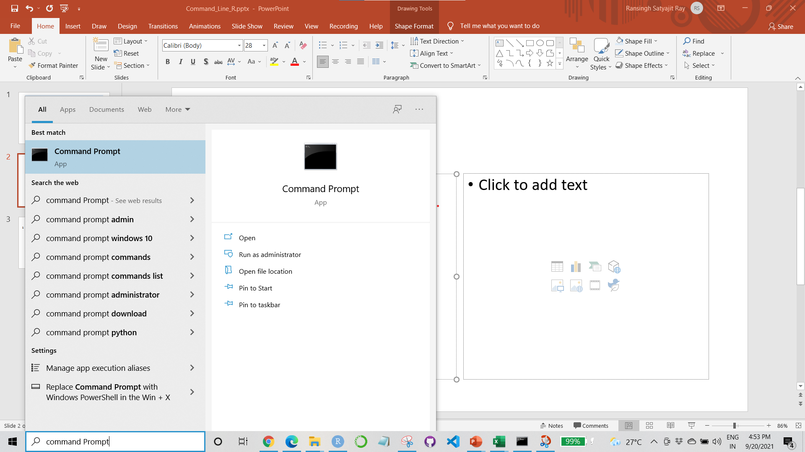
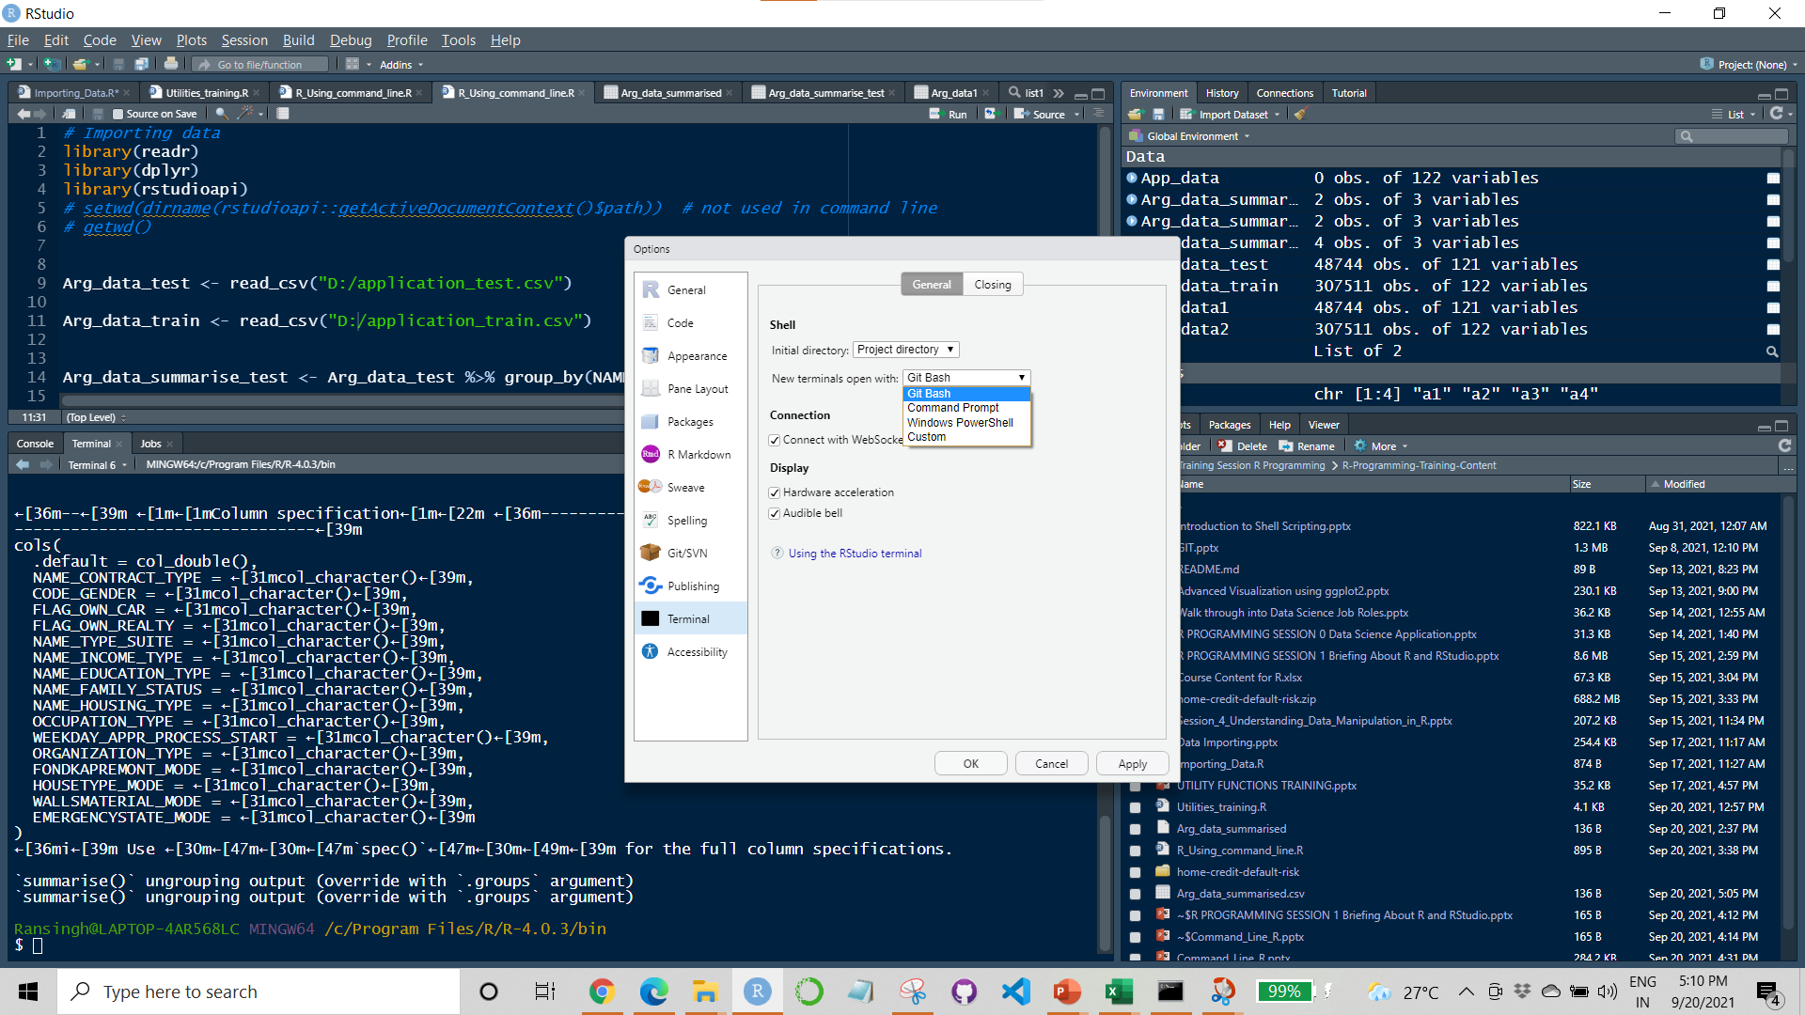
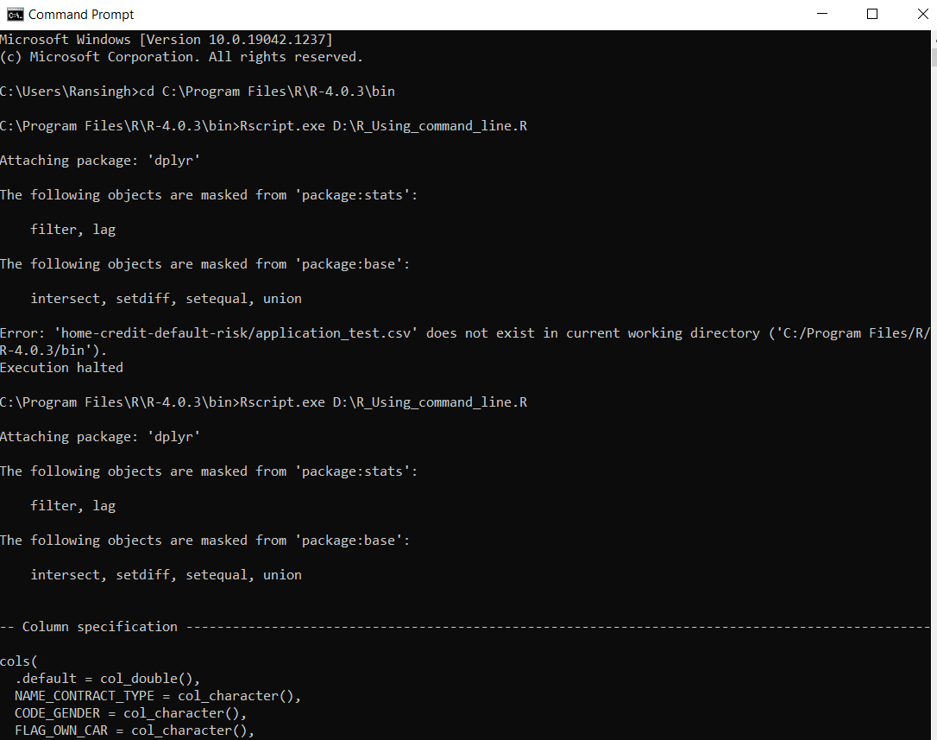
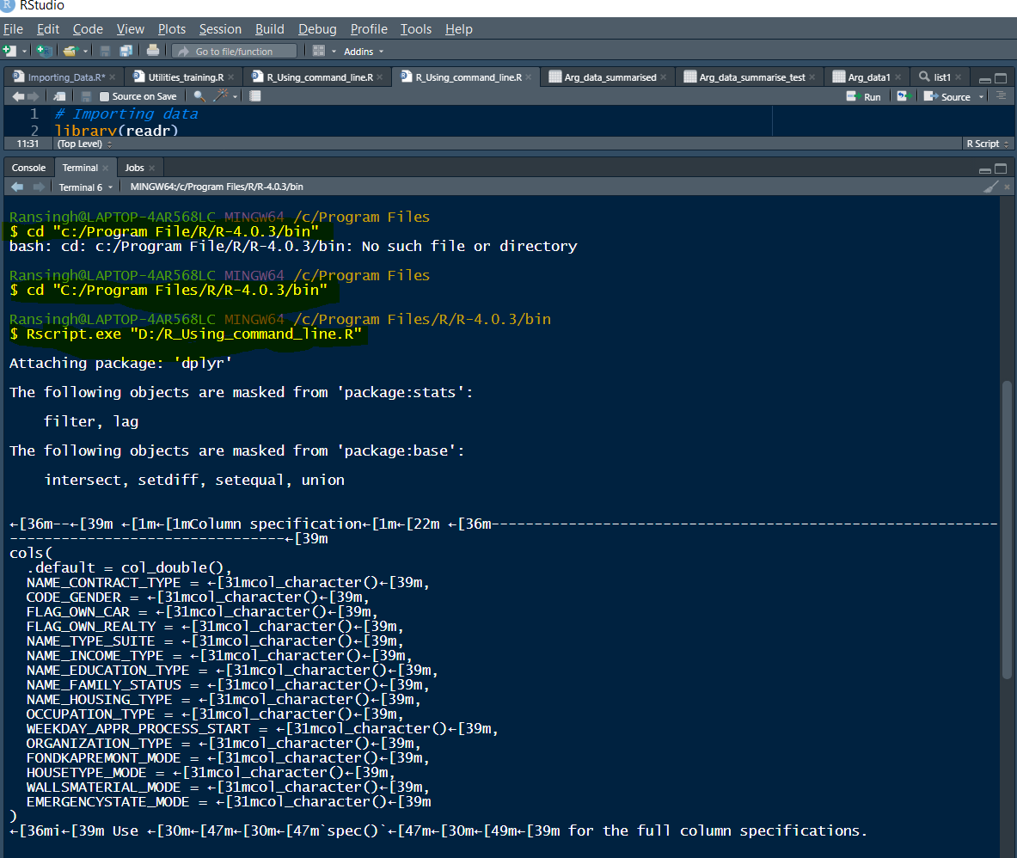
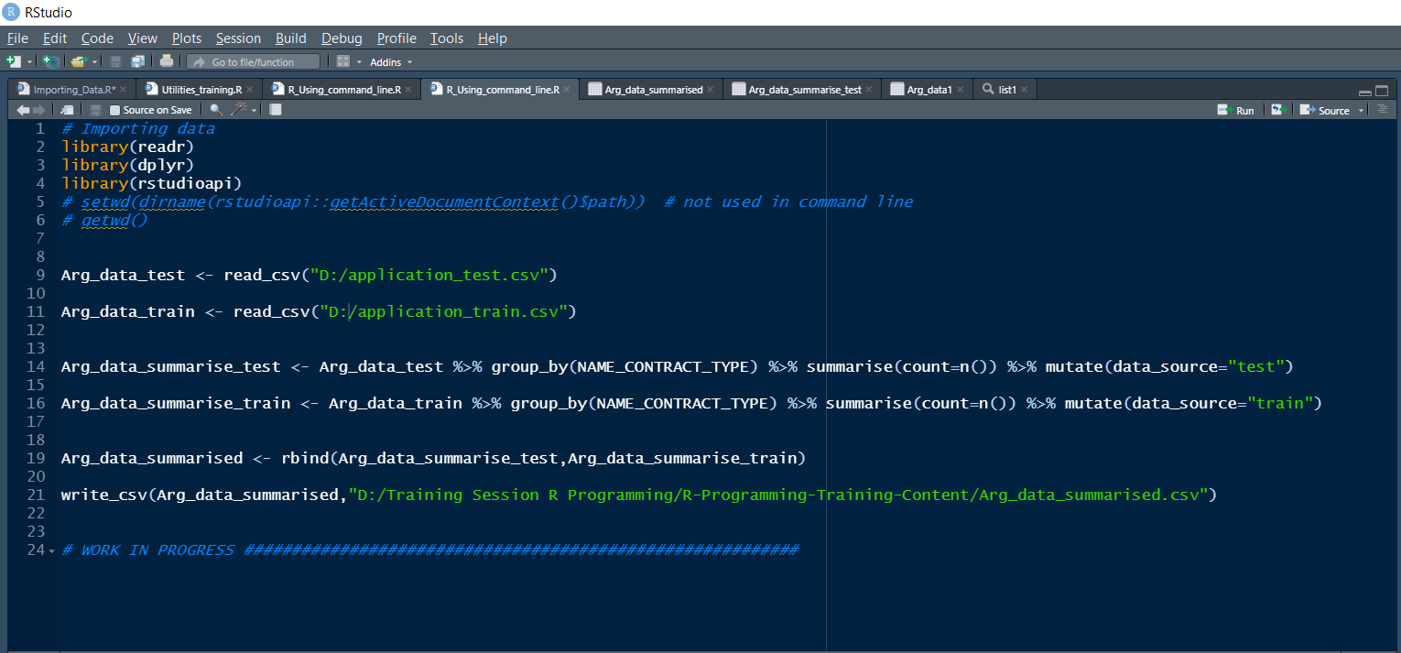
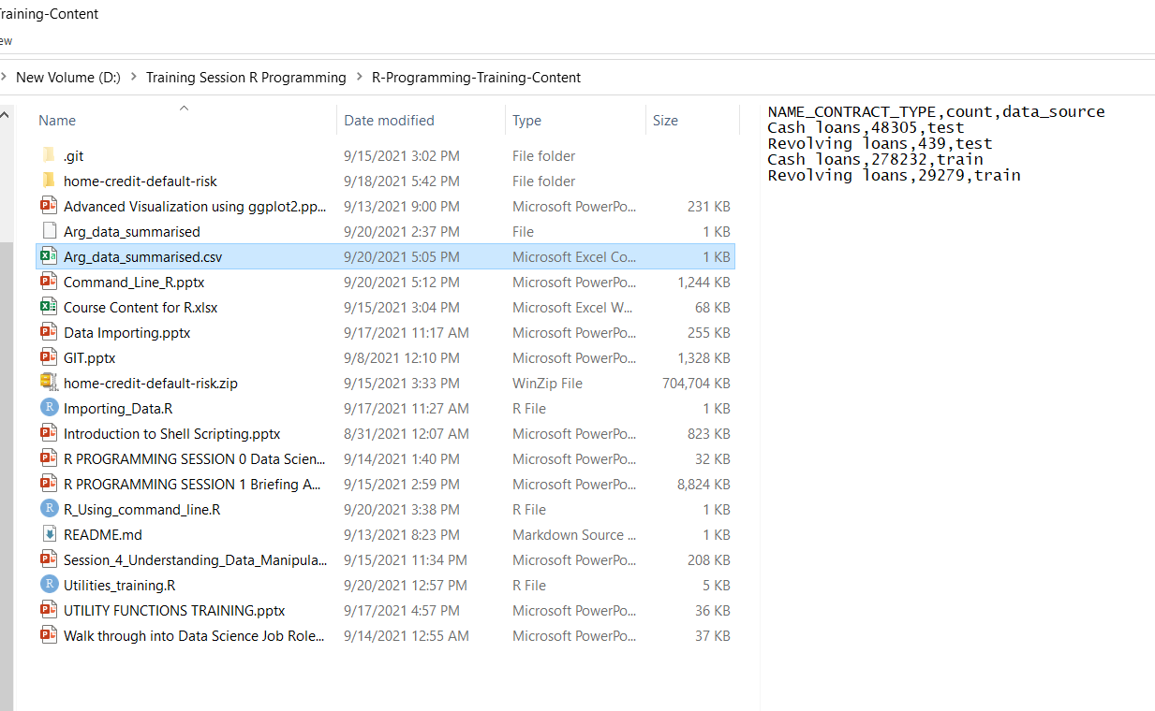
Command Line R
Accessing the command line using the cmd vs accessing using git bash
cmd
Git bash terminal in R Studio

Slide 3



Command line R without command line arguments

Slide 4
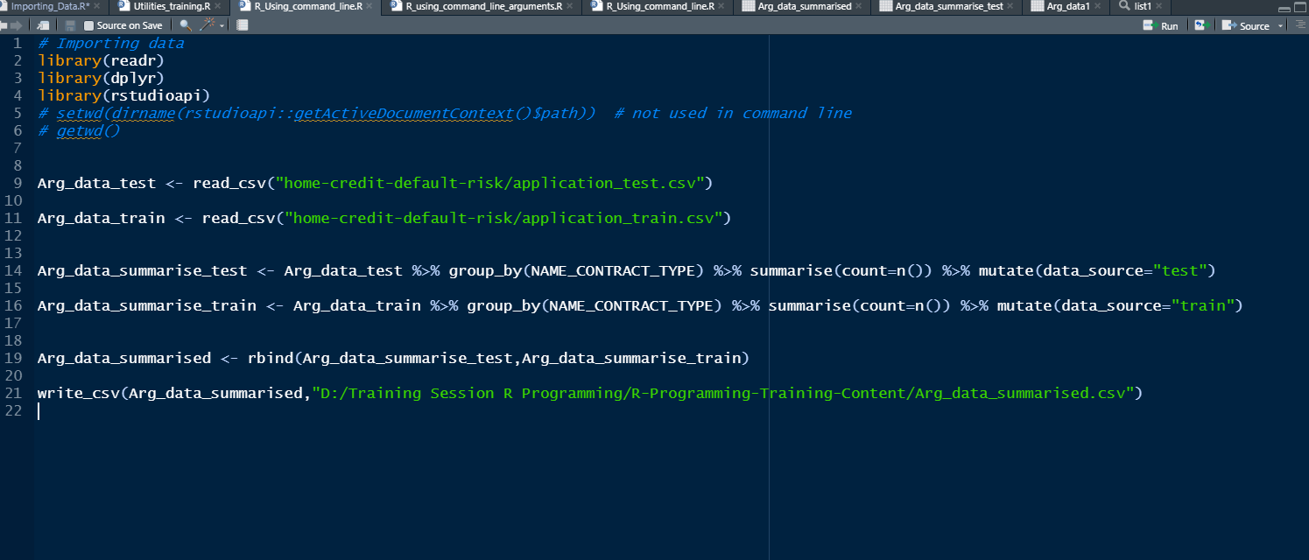

Slide 5


Slide 6
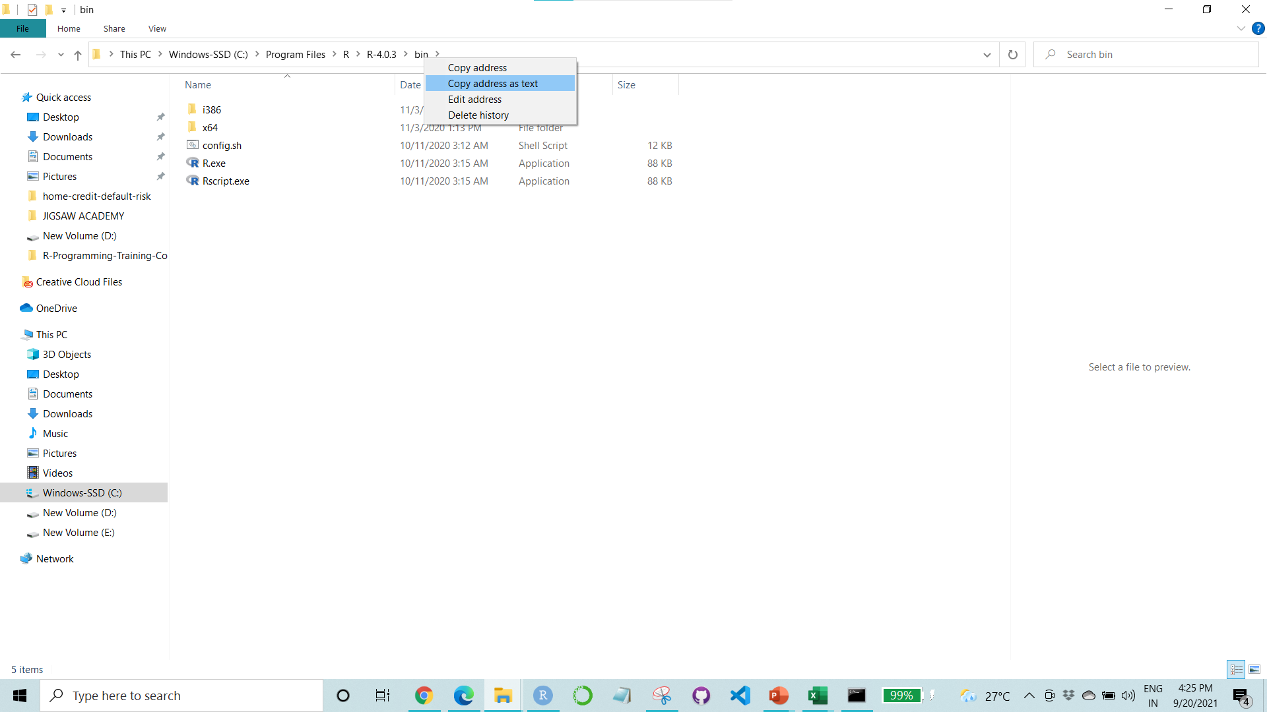
Go to the bin folder in R Folder in Program files and copy the file path
Open the Command Prompt using the search option in windows make and make the copied path as current directory
Write Rscript.exe <path of R script\Rfile.R>
1
2
3
CONTINUED

Slide 7
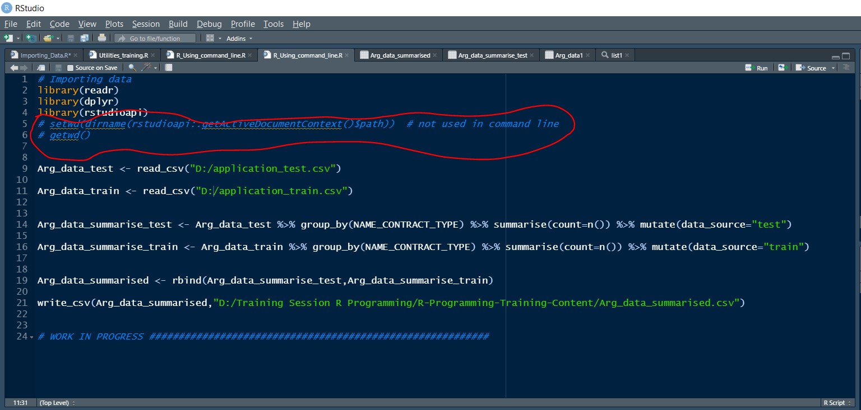
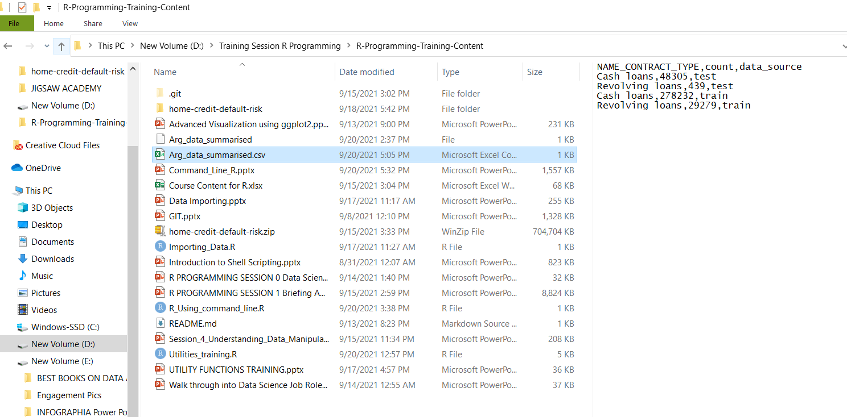
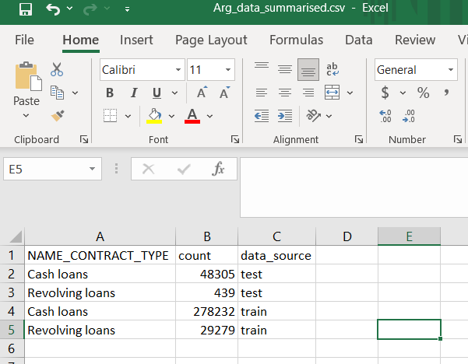
We don’t need to specify the working directory as the specific R file is detected from the path and the script is run
The output file gets reflected in the path provided in r code
We can see the output file in the specific path
4
5
6

Slide 8
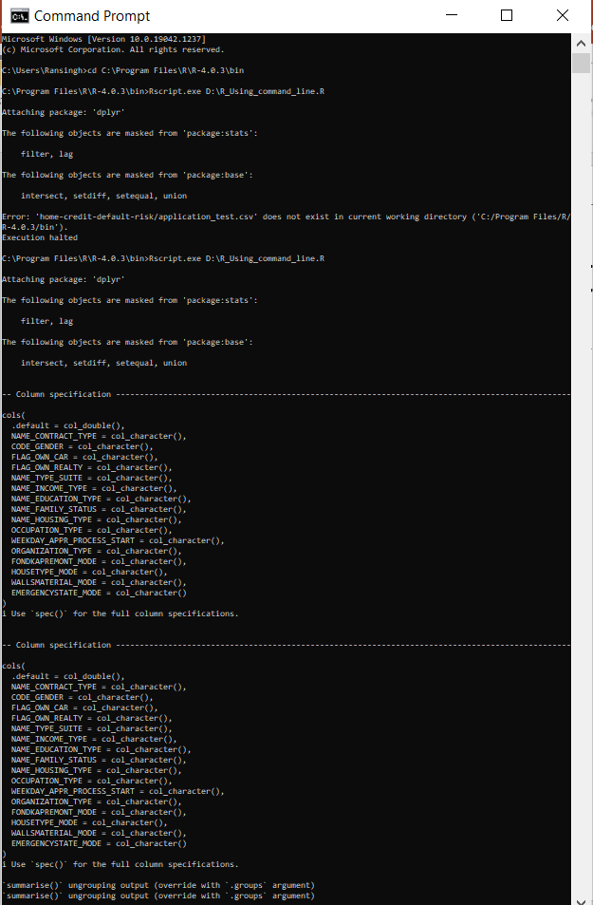
Script including the outputs

Slide 9


Slide 10
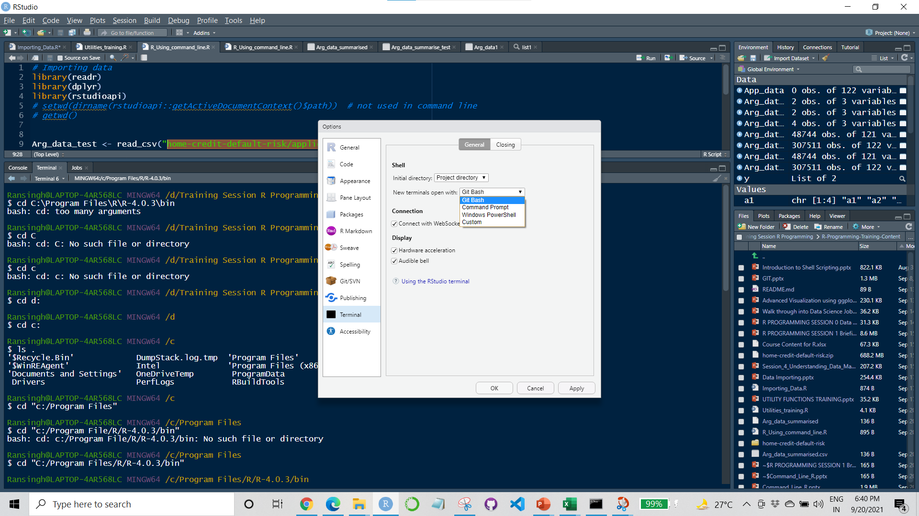
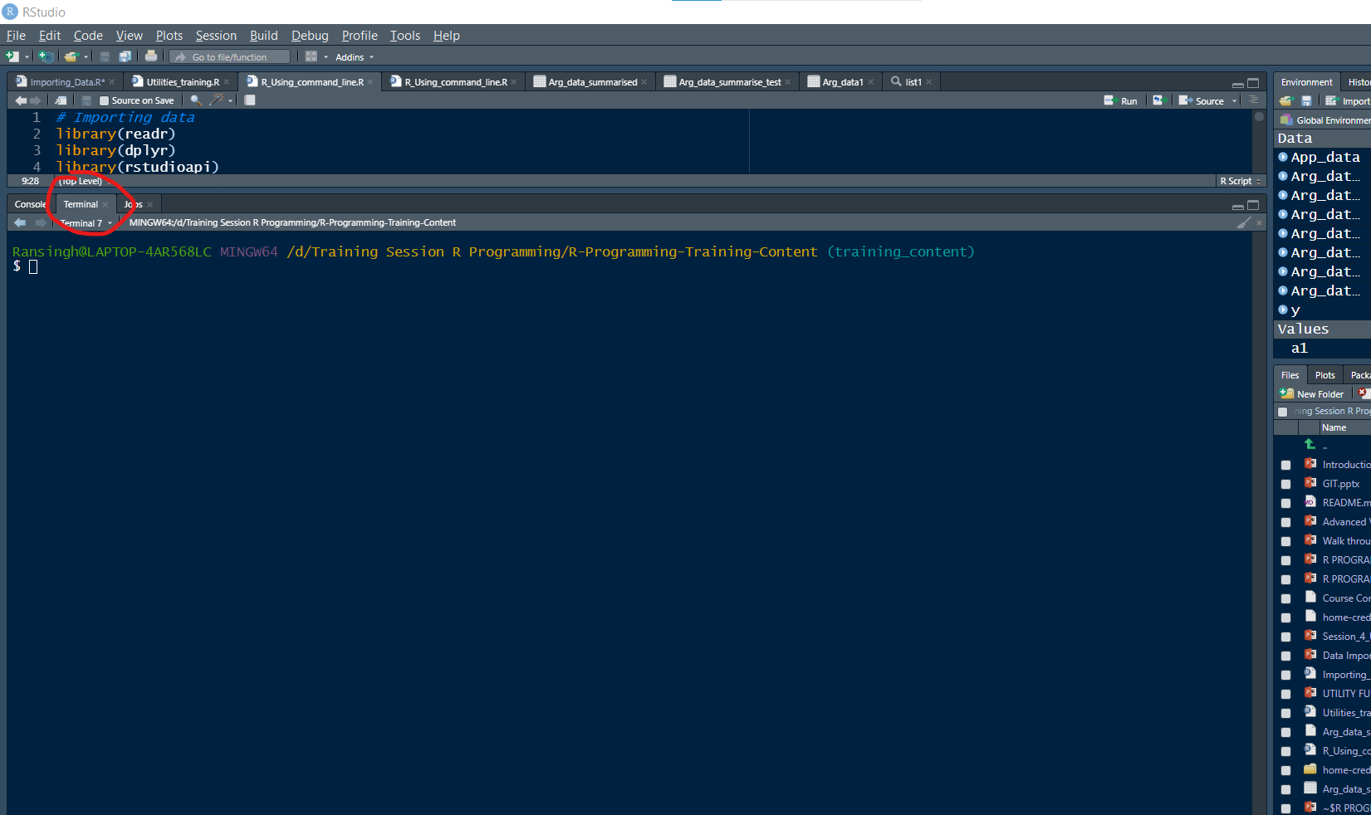

Select git bash as the terminal
Open a git bash terminal in RStudio
Set the current directory as location of the bin folder of R folder in Program Files in C drive
CONTINUED

Slide 11
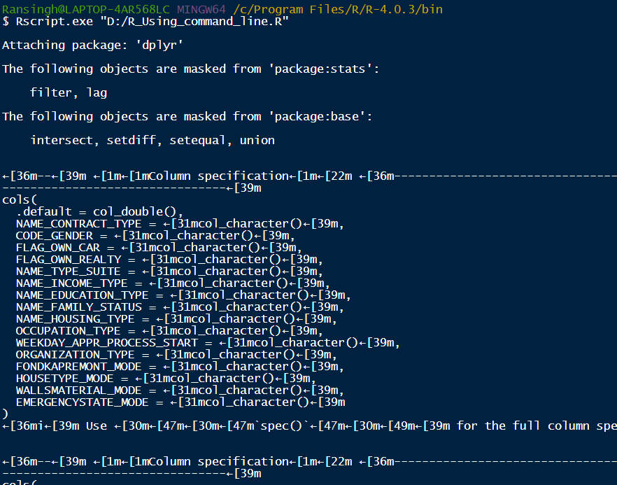
Write Rscript.exe <path of R script/Rfile.R>
The output file gets reflected in the path provided in r code
We can see the output file in the specific path

Slide 12
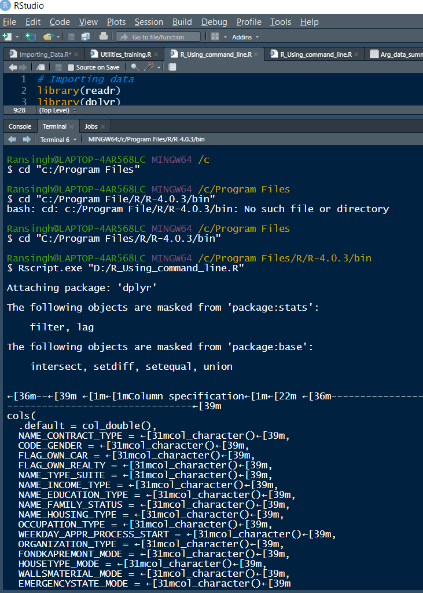
Script including the outputs

Slide 13
Command line R with command line arguments

Slide 14
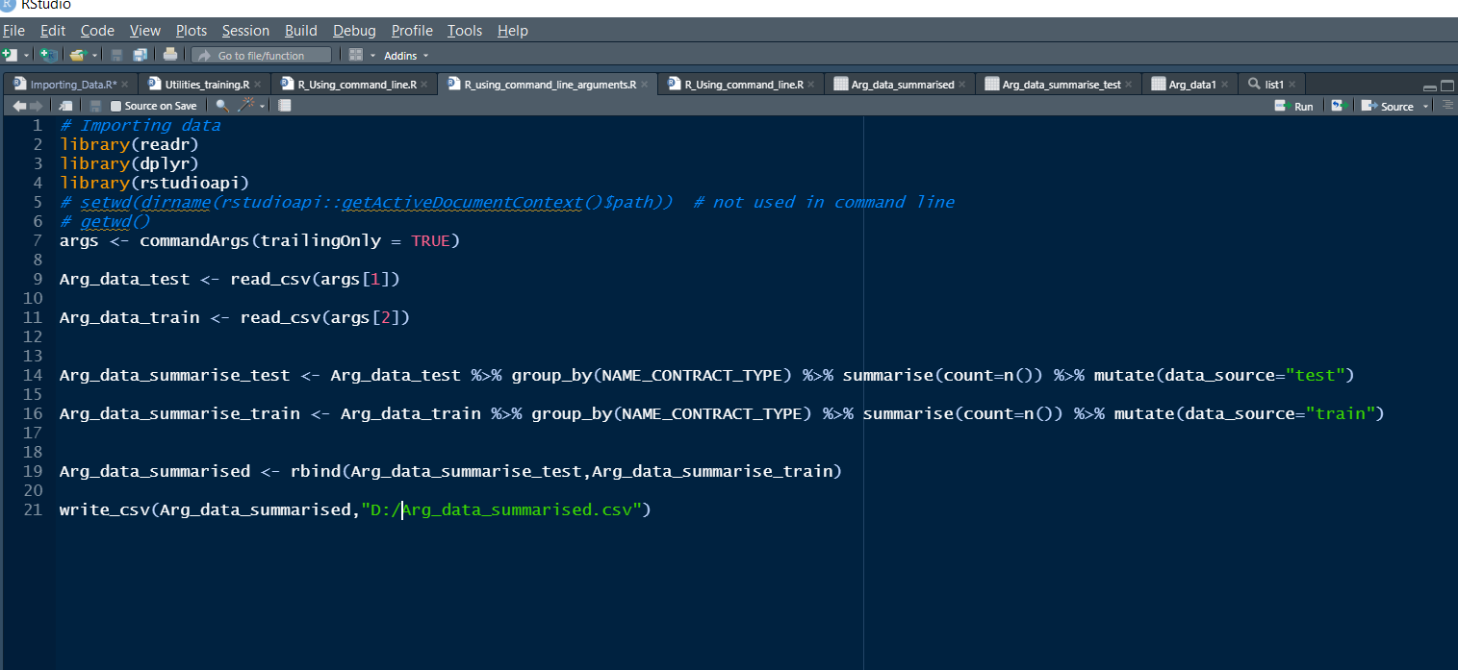

Slide 16
Go to the bin folder in R Folder in Program files and copy the file path
Open the Command Prompt using the search option in windows make and make the copied path as current directory
Write Rscript.exe <path of R script\Rfile.R> path_with_extension_for_file1 path_with_extension_for_file2
1
2
3
CONTINUED

Slide 17
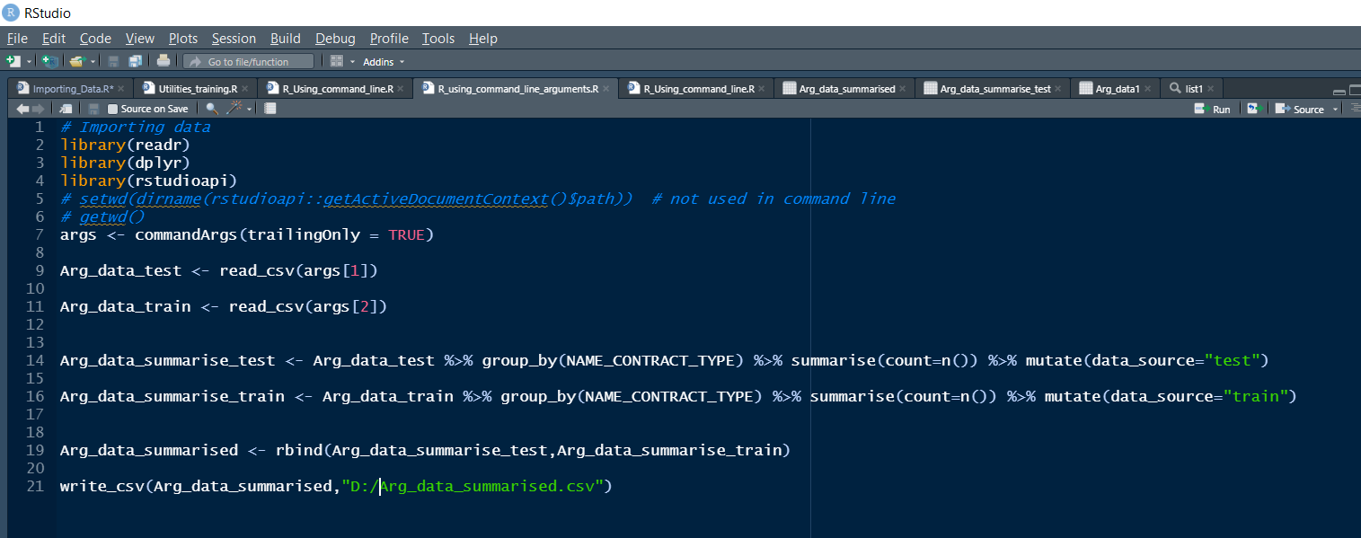
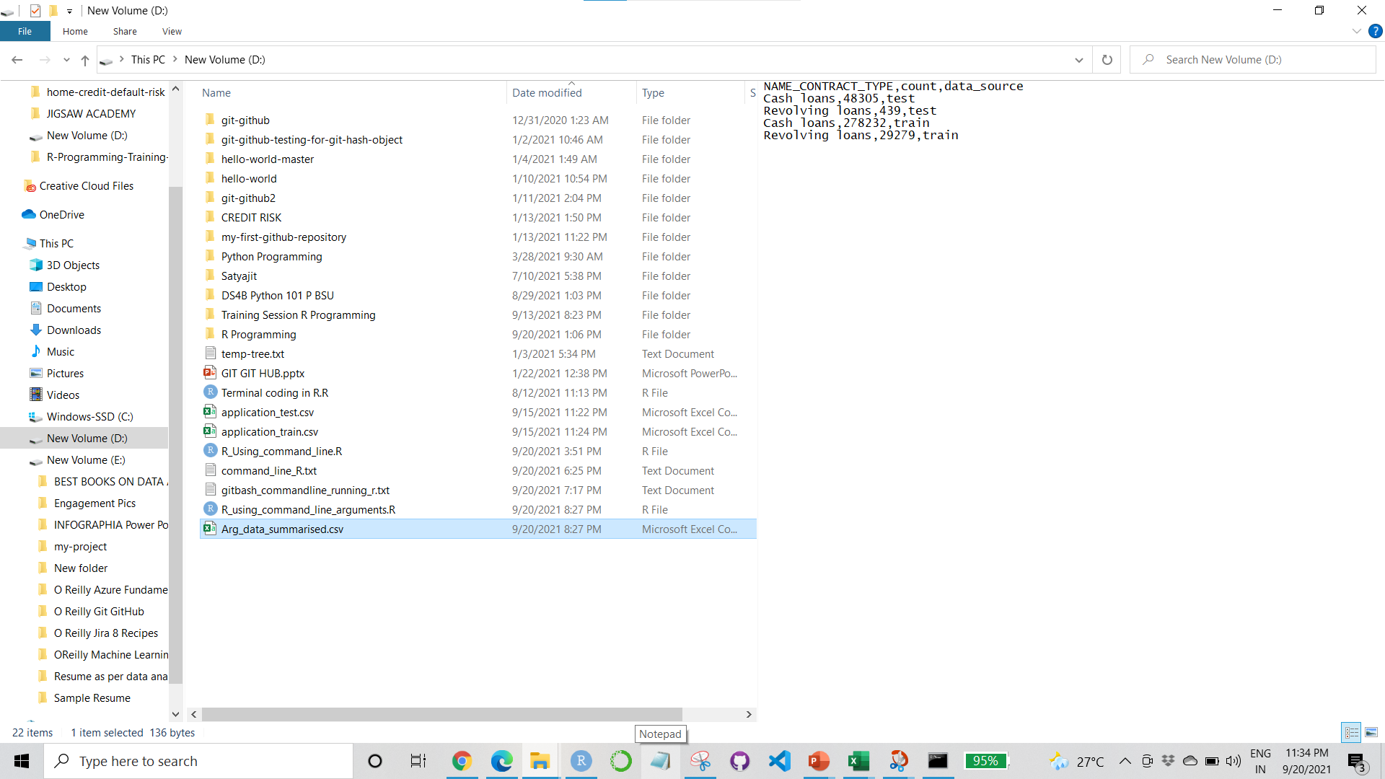
We don’t need to specify the working directory as the specific R file is detected from the path and the script is run
The output file gets reflected in the path provided in r code
We can see the output file in the specific path
4
5
6

Slide 18
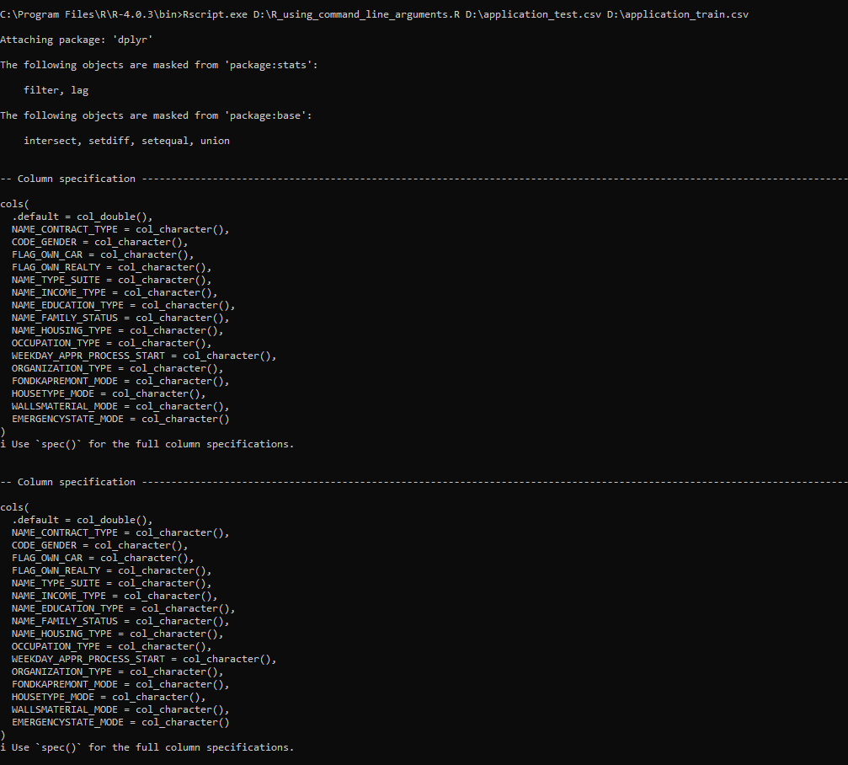

Slide 20
Select git bash as the terminal
Open a git bash terminal in RStudio
Set the current directory as location of the bin folder of R folder in Program Files in C drive
CONTINUED

Slide 21
Write Rscript.exe <path of R script/Rfile.R> path_with_extension_for_file1 path_with_extension_for_file2
The output file gets reflected in the path provided in r code
We can see the output file in the specific path

Slide 22
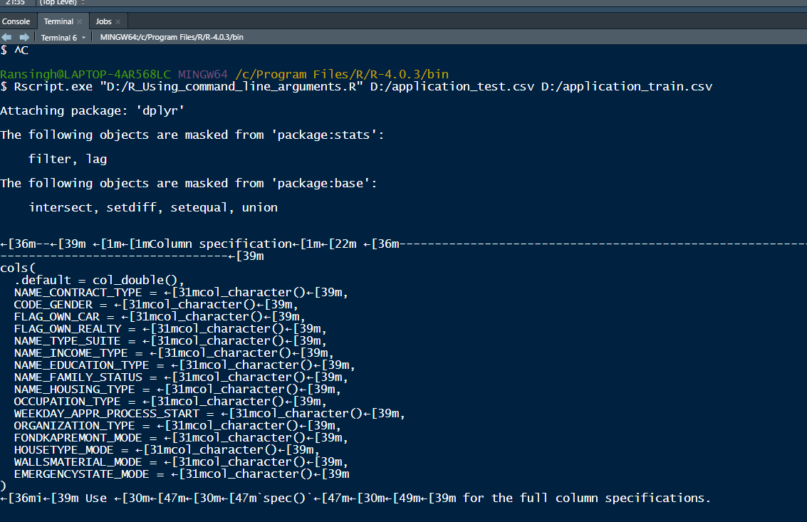

Slide 23
Note
/ in gitbash and \ in cmd
cd location in program files where R folder’s bin folder is present
Rscript.exe path_of_R_file.R path_of_input_file_1 …path_of_input_file_n
Here path_of_input_file_1 is args[1]
path_of_input_file_n is args[n]
args<-commandArgs(trailingOnly =TRUE)

