Slide 1

DATA MINERS · GROUP 1.1 · IT3051 · FINAL PRESENTATION
Call the clients who are
ready to say yes
Term Deposit Predictor · showing a bank's call team who is most likely to open a term deposit
Gunathilaka W.A.D.S.
Edirisinghe E.M.K.L.
Illesinghe E.S.
Kaluarachchi R.G.
IT23859456
IT23857780
IT23557024
IT23544918
Notes:
Speaker: Gunathilaka W.A.D.S. · ~45 s
Good morning everyone. We are Data Miners, Group 1.1. I'm Gunathilaka, and with me are Edirisinghe, Illesinghe and Kaluarachchi.
Our project is the Term Deposit Predictor. In one line: it helps a bank's call team phone the clients who are most likely to say yes first.
Over the next few minutes we'll show you the problem, how we solved it, a live demo of the system, and what the results mean for the bank.

Slide 2
THE PROBLEM
Nearly nine in ten sales calls end in a “no”
45,211
phone calls in the bank's campaigns, 2008–2010
only 11.7%
ended with the client saying yes
Calling everyone in turn wastes agent time and annoys clients who were never going to say yes.
Each dot = 1% of calls · blue = client opened a term deposit (11.7%)
Term Deposit Predictor · Data Miners
02
Notes:
Speaker: Gunathilaka W.A.D.S. · ~1 min
We worked with real data from a Portuguese bank's telemarketing campaigns between 2008 and 2010. That's 45,211 phone calls, each one asking a client to open a term deposit.
[Point to the dot grid.] Each dot here is one percent of those calls. Only the blue ones, about 12 out of 100, or 11.7%, ended with the client saying yes.
So nearly nine in ten calls end in a no. If agents simply work down the list, most of their day goes on clients who were never going to say yes, and those clients get annoyed by calls they didn't want.

Slide 3
OUR SOLUTION
Our predictor scores every client before the call, so the team phones the most promising people first.
Score one client
Rank a whole call list
Understand why
Fill in a short form and instantly get a yes / no and how likely it is.
Upload a CSV and get it back sorted from most to least promising.
Charts show which clients and which timing tend to lead to a yes.
Term Deposit Predictor · Data Miners
03
Notes:
Speaker: Gunathilaka W.A.D.S. · ~45 s
Our answer is to score every client before the call is made, so the team can phone the most promising people first.
The system does three things. You can score one client by filling in a short form and get an instant yes or no with a likelihood. You can upload a whole call list as a CSV file and get it back sorted from most to least promising. And you can see which kinds of clients, and which timing, tend to lead to a yes.

Slide 4
THE VALUE
What scoring clients first gives the bank
Fewer wasted calls
More sales from the same effort
Agents spend their time on the clients most likely to say yes.
Calling the top 20% of the list reaches 63% of all subscribers.
Smarter campaign timing
Kinder to clients
The data shows when and how to call, and when not to bother.
Fewer repeat calls to people who were never interested.
Term Deposit Predictor · Data Miners
04
Notes:
Speaker: Gunathilaka W.A.D.S. · ~45 s
For the bank, this means four things.
Fewer wasted calls, because agents spend their time on likely buyers. More sales from the same effort: calling just the top 20% of the ranked list reaches 63% of everyone who would subscribe. Smarter campaign timing, because the data shows when to call and when not to bother. And it's kinder to clients, with fewer repeat calls to people who aren't interested.
Handover: Edirisinghe will now explain how the system works and what the data told us.

Slide 5
HOW IT WORKS
From past calls to a prediction in four steps
01
02
03
04
Learn from past calls
Clean it and keep it fair
Compare six models
Serve it in an app
45,211 real calls from a Portuguese bank, each with its outcome.
Checked quality and removed call length, which is only known after the call.
Each one tuned and tested the same way. The best one wins.
A web dashboard and API give predictions on demand.
Behind the scenes, Gradient Boosting builds many small decision trees, each one fixing the mistakes of the last.
Term Deposit Predictor · Data Miners
05
Notes:
Speaker: Edirisinghe E.M.K.L. · ~1 min
Thank you. The system works in four steps.
First, it learns from the 45,211 past calls, where we know the outcome of every one.
Second, we cleaned the data and kept it fair. We checked for missing values, duplicates and invalid values. Most importantly, we removed call duration. It's a very strong predictor, but you only know it after the call has ended, so using it would be cheating.
Third, we trained and compared six different models, all tuned and tested in exactly the same way.
Fourth, the best model is served through a web dashboard and an API that gives predictions on demand.
The winning model is Gradient Boosting. It builds many small decision trees, each one correcting the mistakes of the ones before it.

Slide 6
WHAT THE DATA TOLD US
When and how you call matters most
Said yes in the last campaign
64.7%
5.5×
Called in March
52.0%
Called in September
46.5%
more likely to say yes if they said yes last time
Aged over 65
42.6%
Students
28.7%
30%
Called on a mobile
14.9%
of all calls were made in May, when only 6.7% said yes
Called in May
6.7%
Called 10+ times
4.2%
Contact channel unknown
4.1%
average 11.7%
Term Deposit Predictor · Data Miners
06
Notes:
Speaker: Edirisinghe E.M.K.L. · ~1 min 30 s
Before modelling, we explored the data to see who actually says yes. Each bar is the share of a group that subscribed, and the dashed line is the 11.7% average.
[Point to the top bar.] The strongest signal is history. Clients who said yes in the previous campaign subscribe 64.7% of the time, which is 5.5 times the average.
Timing matters a lot as well. Calls in March succeed 52% of the time and in September 46.5%. But look at May: 30% of all calls were made in May, when only 6.7% said yes. The bank was calling most in its worst month.
Some groups are more receptive: clients over 65 at 42.6% and students at 28.7%. Being reached on a mobile also helps.
At the bottom, repeated calling clearly hurts. After ten or more calls in a campaign, only 4.2% say yes.
So the headline is that when and how you call matters most.
Handover: Kaluarachchi will now take you through a live demo of the system.

Slide 7
LIVE DEMO · ABOUT 4 MINUTES
Following one call list through the app
 | Page | What we show | Look for
1 | Home | What the tool does and the model in use | One-line summary of the serving model
2 | Prediction · single client | Score a likely and an unlikely client | Probability bar and priority
3 | Prediction · batch (CSV) | Upload a whole call list | Best leads sorted to the top, export
4 | EDA | Key findings and interactive charts | Which clients say yes most often
5 | Models | Six models side by side | Why Gradient Boosting was chosen
Notes:
[Switch from the slides to the browser with the dashboard already open on the Home page. Each member drives their own part. If the live system fails, use backup slides 16 to 20.]
Part 1 · Home page and single-client prediction
Speaker: Kaluarachchi R.G. · ~1 min 30 s
This is the dashboard. The Home page sums up the tool in one line and shows the model currently serving predictions, Gradient Boosting, with its key numbers.
[Click "Prediction", Single client tab.] Here a call agent fills in what the bank knows about a client before calling: age, job, finances, and contact history. The form is generated from the API, so it always matches what the model expects.
[Click Predict with the default values.] This typical client, a 39-year-old blue-collar worker with a housing loan, called in May and never contacted before, scores about 39%. That's below our 62% cut-off, so the answer is no, with medium priority.
[Change Month to "mar", Days since last contact to 90, Previous contacts to 1, Previous outcome to "success", turn off Housing loan, then click Predict.] Now the same person said yes in the last campaign, is being called in March and has no housing loan. The probability jumps to about 94%, a high-priority yes. That's exactly what the data showed us.
Handover: Gunathilaka will show how a whole call list is scored.
Part 2 · Batch (CSV) scoring
Speaker: Gunathilaka W.A.D.S. · ~1 min
[Click the "Batch (CSV)" tab and upload the prepared CSV file.] In practice the team doesn't score clients one at a time. They upload their call list as a CSV.
Every row is scored at once and the list comes back sorted, with the best leads at the top, each with a probability and a priority. Rows with problems are reported individually instead of breaking the whole upload.
[Click "Download CSV".] The scored list can be downloaded and handed straight to the call team.
Handover: Edirisinghe will show the data exploration page.
Part 3 · EDA page
Speaker: Edirisinghe E.M.K.L. · ~45 s
[Click "EDA".] This page shows the findings from slide 6 live from the data. At the top are the key findings, such as previous success at 64.7% and March at 52%. Below are how the data was cleaned and the interactive charts, where you can see the subscription rate for any group.
Handover: Illesinghe will show how the models compare.
Part 4 · Models page
Speaker: Illesinghe E.S. · ~45 s
[Click "Models".] This page compares all six models we trained, with their ROC curves, confusion matrix and the most important features. Gradient Boosting is marked as the selected model. Let me go back to the slides to explain what these results mean.
[Switch back to the slides, slide 8.]

Slide 8
FINDINGS
Calling by score finds subscribers far faster
Calling in random order
Calling in our model's order (Gradient Boosting)
Top 10% of the list
10%
4.4×
share of subscribers reached
44%
Top 20% of the list
20%
3.1×
share of subscribers reached
63%
Top 30% of the list
30%
2.4×
share of subscribers reached
72%
Measured on 9,043 test clients the model never saw during training
08
Notes:
Speaker: Illesinghe E.S. · ~1 min 15 s
The real question for the bank is whether the scores help the team find buyers faster.
To test this fairly, we kept 9,043 clients completely aside. The model never saw them during training.
[Point to the first row.] If the team calls in random order, after calling 10% of the list they find 10% of the subscribers, the grey bar. If they call in our model's order, those first 10% of calls already reach 44% of all subscribers. That's 4.4 times better.
After 20% of calls the model reaches 63% of subscribers, and after 30% it reaches 72%. Most of the yeses are concentrated at the top of the list.

Slide 9
FINDINGS
Tuning the decision point cut wasted calls by 43%
Default cut-off (50%)
Tuned cut-off (62%)
−43%
Wasted calls
1,212
clients flagged who said no
690
Hit rate
36%
+9 pts
flagged clients who said yes
45%
−17%
Subscribers found
676
out of 1,058
562
Same 9,043 test clients for both · balance score (F1) 0.46 → 0.49
09
Notes:
Speaker: Illesinghe E.S. · ~1 min 15 s
A model gives each client a score, and we have to choose the cut-off above which we say "call this client". By default that's 50%. We tuned it to 62% using only the training data.
The result: wasted calls, meaning clients we flagged who then said no, fell from 1,212 to 690. That's 43% fewer. And the hit rate went up from 36% to 45% of flagged clients actually saying yes.
To be honest about the trade-off: we now find 562 of the 1,058 subscribers instead of 676, about 17% fewer. That's a business decision. If calls are cheap, the bank can lower the cut-off and find more. If calls are expensive, it can raise it.

Slide 10
MODEL CHOICE
Why we chose Gradient Boosting from six models
Model | Ranks clients well (ROC-AUC) | Finds subscribers (recall) | Hit rate (precision) | Accuracy
Gradient Boosting · selected | 0.806 | 64% | 36% | 82%
Random Forest | 0.797 | 58% | 38% | 84%
Logistic Regression | 0.776 | 64% | 27% | 76%
Decision Tree | 0.773 | 58% | 34% | 82%
K-Nearest Neighbours | 0.767 | 12% | 67% | 89%
Naive Bayes | 0.752 | 47% | 35% | 84%
Gradient Boosting ranked clients best both in cross-validation and on unseen data. KNN looks most accurate (89%) but finds only 12% of subscribers.
Test set, default 50% cut-off. The winner was picked on cross-validated ROC-AUC, never on test results.
10
Notes:
Speaker: Illesinghe E.S. · ~1 min 15 s
We compared six models: Gradient Boosting, Random Forest, Logistic Regression, Decision Tree, K-Nearest Neighbours and Naive Bayes. Each was tuned with cross-validation on the training data.
We chose the winner by ROC-AUC, which measures how well a model ranks likely subscribers above unlikely ones. Gradient Boosting was best both in cross-validation and on the unseen test data, at 0.806, with Random Forest close behind.
[Point to the KNN row.] This row shows why accuracy alone is misleading. K-Nearest Neighbours has the highest accuracy at 89%, but it finds only 12% of subscribers. With 88% of answers being no, a model that almost always says no looks accurate but is useless to the bank.
Handover: Edirisinghe will explain what drives the predictions.

Slide 11
WHAT DRIVES A PREDICTION
The model listens to timing, channel and history
Month of the call
How we measured it
Contact channel
Shuffle one input and see how much worse the model gets. The bigger the drop, the more it matters.
Last campaign's outcome
Day of the month
Job, education and marital status barely matter once timing and history are known.
Age
Has a housing loan
Account balance
Term Deposit Predictor · Data Miners
11
Notes:
Speaker: Edirisinghe E.M.K.L. · ~1 min
To see what the model relies on, we shuffled one input at a time and measured how much worse the model got. The bigger the drop, the more that input matters.
The top three are the month of the call, the contact channel and the outcome of the last campaign. Day of the month, age, housing loan and balance follow.
This matches what we found when exploring the data. Timing, channel and history matter most, while job, education and marital status add very little once those are known.
Handover: Kaluarachchi will explain why the results can be trusted.

Slide 12
TRUST
Built to be honest about what it knows
No peeking at the answer
Tested on unseen clients
Honest about limits
Call length is only known after the call, so we removed it. Every cleaning step learns from training data only.
20% of clients were locked away until the end. Training and test scores agree within 0.02.
About 45% of flagged clients say yes. Scores rank clients well but are not exact probabilities.
Verified with 8 passing automated API tests, a frontend routing test and manual end-to-end checks of every page.
Term Deposit Predictor · Data Miners
12
Notes:
Speaker: Kaluarachchi R.G. · ~1 min
We designed the system to be honest about what it knows.
First, no peeking at the answer. Call length was removed because it's only known after the call, and every cleaning step, such as outlier limits, scaling and encoding, learns from the training data only.
Second, it was tested on unseen clients. 20% of the data was locked away until the very end, and the cross-validation and test scores agree within 0.02, so the model isn't over-fitted.
Third, we're open about its limits. About 45% of flagged clients say yes, so it's not perfect. The scores rank clients well but aren't exact probabilities.
We also verified the system with 8 automated API tests, a frontend routing test, and manual end-to-end checks of every page.

Slide 13
NEXT STEPS
From a working prototype to the call centre
01
Retrain on recent data
The calls are from 2008–2010; client behaviour has changed since.
02
Put a price on each call
Set the cut-off from real call costs and deposit profits.
03
Explain every prediction
Show the reasons behind each client's score in the dashboard.
04
Ship it securely
Add login, cloud hosting and monitoring for real use.
Term Deposit Predictor · Data Miners
13
Notes:
Speaker: Kaluarachchi R.G. · ~45 s
To take this from a prototype to a real call centre, there are four next steps.
Retrain on recent data, because these calls are from 2008 to 2010 and client behaviour has changed. Put a price on each call, so the cut-off comes from real call costs and deposit profits. Explain every prediction by showing the reasons behind each client's score in the dashboard. And ship it securely, with login, cloud hosting and monitoring.

Slide 14
THE TEAM
Four members, one pipeline · 25% each
Gunathilaka W.A.D.S.
Edirisinghe E.M.K.L.
Illesinghe E.S.
Kaluarachchi R.G.
IT23859456
IT23857780
IT23557024
IT23544918
Data & batch scoring
EDA & features
Models & evaluation
API, app & testing
• Data download & cleaning
• Data leakage checks
• Batch CSV scoring
• Exploratory analysis
• Feature engineering
• Outlier capping
• EDA page
• Six models compared
• Cut-off tuning
• Feature importance
• Models page & report
• FastAPI backend
• Home & prediction pages
• App shell & routing
• Automated tests
Term Deposit Predictor · Data Miners
14
Notes:
Speaker: each member says their own line · ~1 min
Kaluarachchi R.G.: Each of us owned one stage of the project and contributed 25%. I built the FastAPI backend, the Home and prediction pages, the app shell and the automated tests.
Gunathilaka W.A.D.S.: I handled downloading and cleaning the data, the data leakage checks, and batch CSV scoring.
Edirisinghe E.M.K.L.: I did the exploratory analysis, feature engineering, outlier capping, and the EDA page.
Illesinghe E.S.: I trained and compared the six models, tuned the cut-off, measured feature importance, and built the Models page and training report.

Slide 15
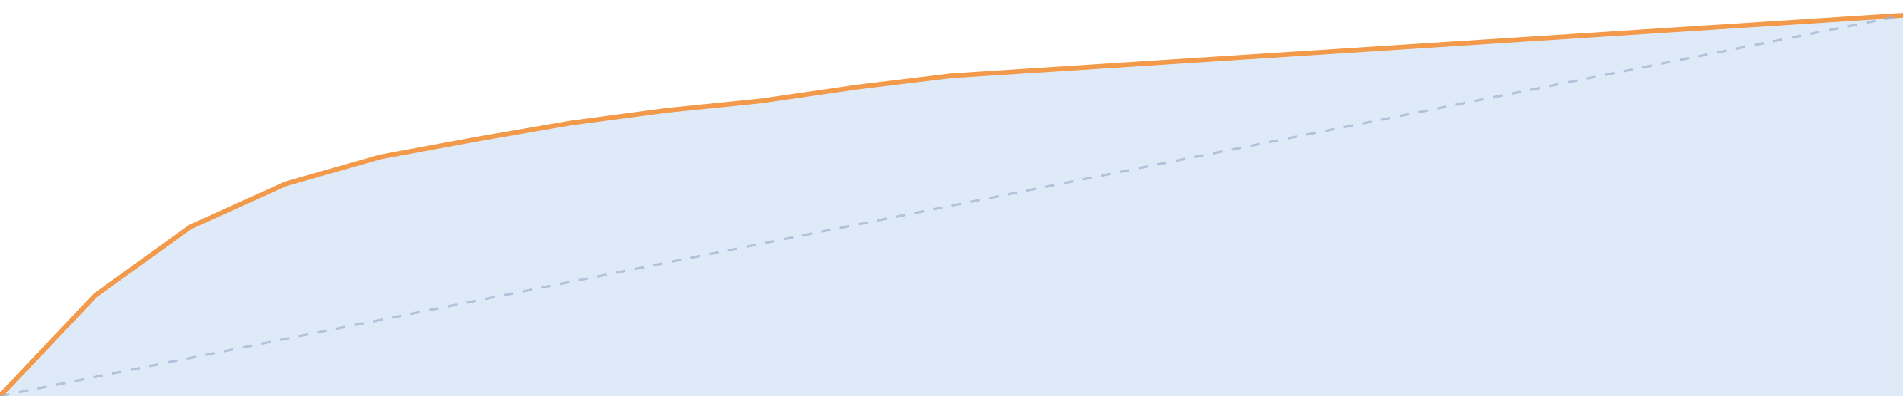
IN ONE SENTENCE
Our predictor tells the call team who to phone first, reaching 44% of subscribers in the first 10% of calls.
Thank you · questions?
Gunathilaka W.A.D.S. (IT23859456) · Edirisinghe E.M.K.L. (IT23857780) · Illesinghe E.S. (IT23557024) · Kaluarachchi R.G. (IT23544918)
Notes:
Speaker: Kaluarachchi R.G. · ~30 s
So, in one sentence: our predictor tells the call team who to phone first, reaching 44% of subscribers in the first 10% of calls.
Thank you for listening. We're happy to take your questions.

Slide 16
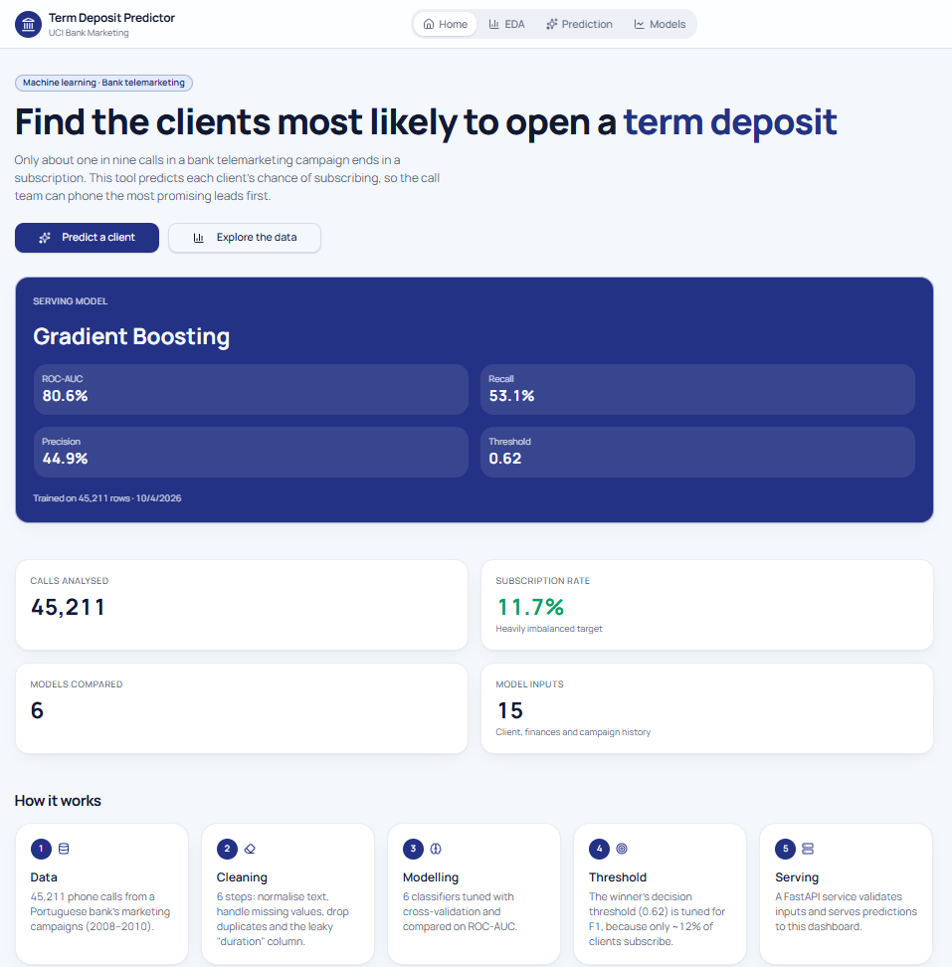
BACKUP · DEMO SCREEN
Home · what the tool does and the model in use

Slide 17
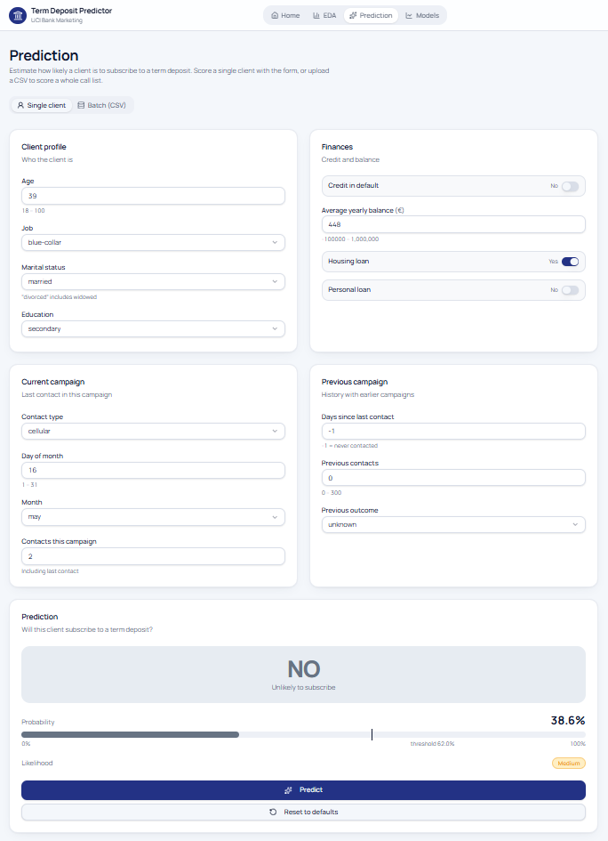
BACKUP · DEMO SCREEN
Prediction · scoring a single client

Slide 18
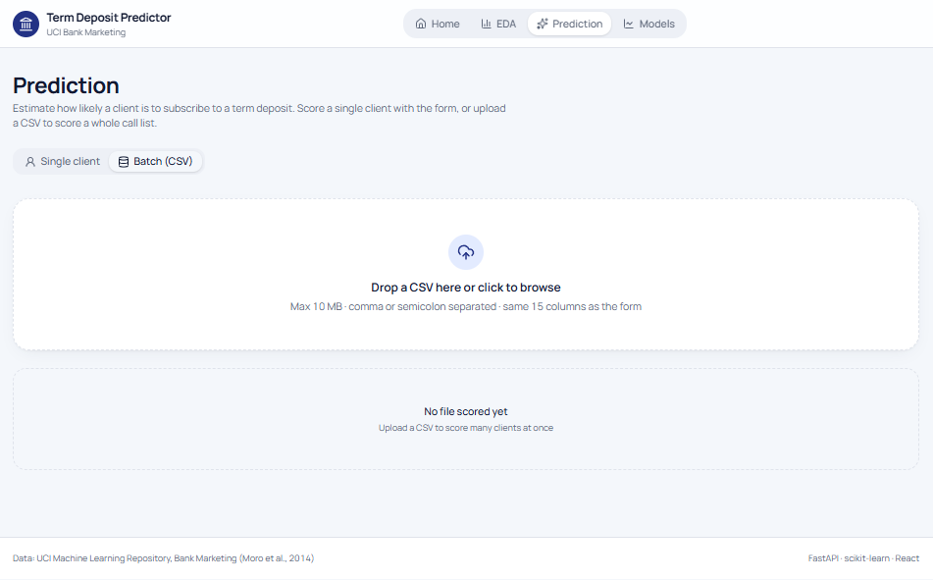
BACKUP · DEMO SCREEN
Prediction · scoring a whole call list from a CSV

Slide 19
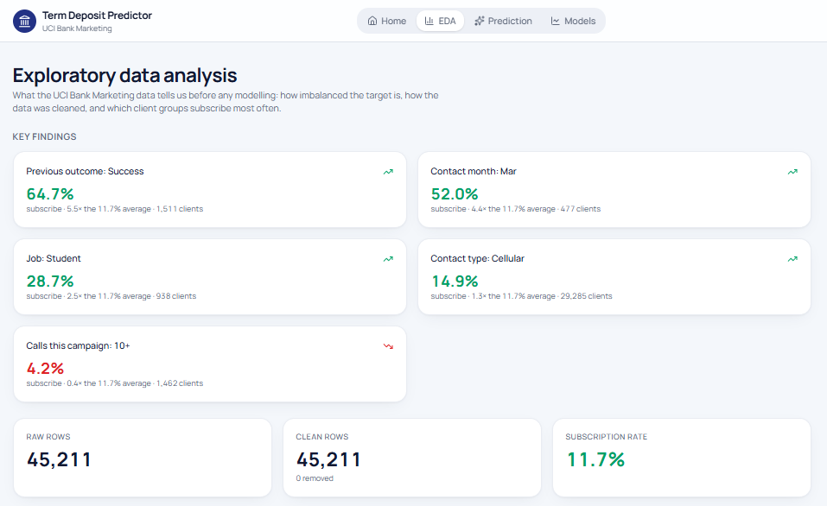
BACKUP · DEMO SCREEN
EDA · key findings at a glance

Slide 20
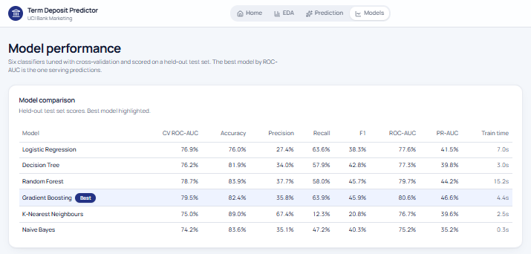
BACKUP · DEMO SCREEN
Models · six models compared

Slide 21
BACKUP · FULL RESULTS
Every model on the test set
Model | CV ROC-AUC | Test ROC-AUC | PR-AUC | F1 | Precision | Recall | Accuracy
Gradient Boosting | 0.795 | 0.806 | 0.466 | 0.459 | 0.358 | 0.639 | 0.824
Random Forest | 0.787 | 0.797 | 0.442 | 0.457 | 0.377 | 0.580 | 0.839
Logistic Regression | 0.769 | 0.776 | 0.415 | 0.383 | 0.274 | 0.636 | 0.760
Decision Tree | 0.762 | 0.773 | 0.398 | 0.428 | 0.340 | 0.579 | 0.819
K-Nearest Neighbours | 0.750 | 0.767 | 0.396 | 0.208 | 0.674 | 0.123 | 0.890
Naive Bayes | 0.742 | 0.752 | 0.352 | 0.403 | 0.351 | 0.472 | 0.836
Gradient Boosting (cut-off 0.62) | – | 0.806 | 0.466 | 0.487 | 0.449 | 0.531 | 0.869
Stratified 80/20 split (36,168 train / 9,043 test), grid search with 3-fold cross-validation, balanced class weights, cut-off tuned for F1 on out-of-fold training predictions.
Term Deposit Predictor · Data Miners
21
Notes:
Test set (9,043 clients), default 50% cut-off; tuned Gradient Boosting shown in the last row.

