Slide 1
Project Presentation of Industry Oriented Hands-on Experience (IOHE) (CS-253)
On
Tech Modernisation for Internal Application
Ranveer Chaudhary
2110993886
Supervised By
Dr. Niharika Thakur
Department of Computer Science and Engineering,
Chitkara University, Punjab

Slide 2
Introduction
Introduction
Problem Statement
Flow Chart
Technical Details
Project Highlights
Future Prospects
Conclusion
References
‹#›

Slide 3
Introduction
This project focuses on the modernisation of an internal application at Morgan Stanley by transitioning from legacy infrastructure to a containerised, cloud-ready architecture.
The existing system is built on traditional servers and uses Kerberos for authentication, which limits scalability and integration with modern platforms.
As part of the upgrade, the application will adopt containerisation for improved portability and resource efficiency, and replace Kerberos with OpenID Connect (OIDC) and OAuth 2.0 for secure, token-based authentication.
Additionally, the implementation of a Zero Trust security model and Role-Based Access Control (RBAC) ensures enhanced security and fine-grained access management across the platform.
‹#›

Slide 4
Problem Statement
The internal application runs on legacy server infrastructure, limiting scalability and flexibility.
It uses Kerberos for authentication, which is outdated and difficult to integrate with modern systems.
Lack of containerisation results in inefficient resource usage and slow deployment cycles.
‹#›

Slide 5
Problem Statement
The system cannot easily adapt to cloud-native environments or DevOps practices.
Current security model lacks fine-grained access control and does not follow modern best practices.
A full modernisation is needed to improve portability, security, and long-term maintainability.
‹#›

Slide 6
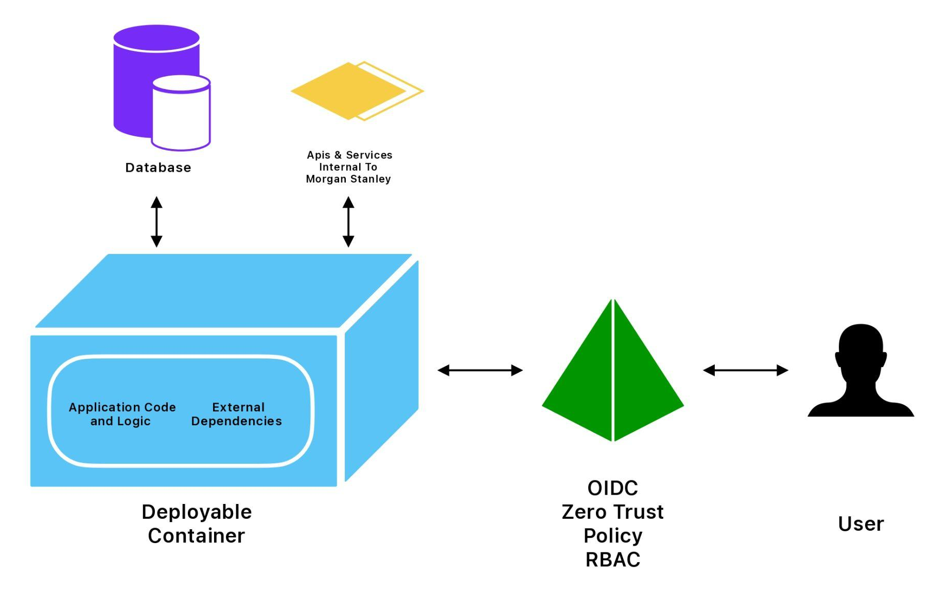
Flowchart
The following flowchart illustrates the transition from the current legacy architecture to the modernised system.
‹#›

Slide 7
Technical Details
Core Application
Core application is built using Python, with some services developed in Java (Spring Boot).
Database
A relational SQL database is used for persistent data storage.
Build Tool
Java services are built using a modern build tool ‘Gradle’.
‹#›

Slide 8
Technical Details
Docker
All components will be containerised for consistent deployment, scalability, and easier maintenance.
Authentication
Kerberos authentication will be replaced with OIDC (OpenID Connect) and OAuth 2.0 for modern, token-based authentication.
A Zero Trust architecture will be implemented to enforce identity-first security across the system.
‹#›

Slide 9
Technical Details
Role-Based Access Control
RBAC (Role-Based Access Control) will be used to manage user permissions and enforce least-privilege access.
‹#›

Slide 10
Project Highlights
Achieved a significant improvement in deployment speed and infrastructure scalability.
Enhanced security posture through token-based authentication and Zero Trust enforcement.
Reduced manual configuration and environment drift via containerised deployments.
‹#›

Slide 11
Project Highlights
Enabled seamless user access control with RBAC, supporting auditability and compliance.
Laid the foundation for cloud-native readiness and smoother future integrations.
Improved developer efficiency through simplified builds and consistent environments.
Strengthened overall system resilience, flexibility, and maintainability.
‹#›

Slide 12
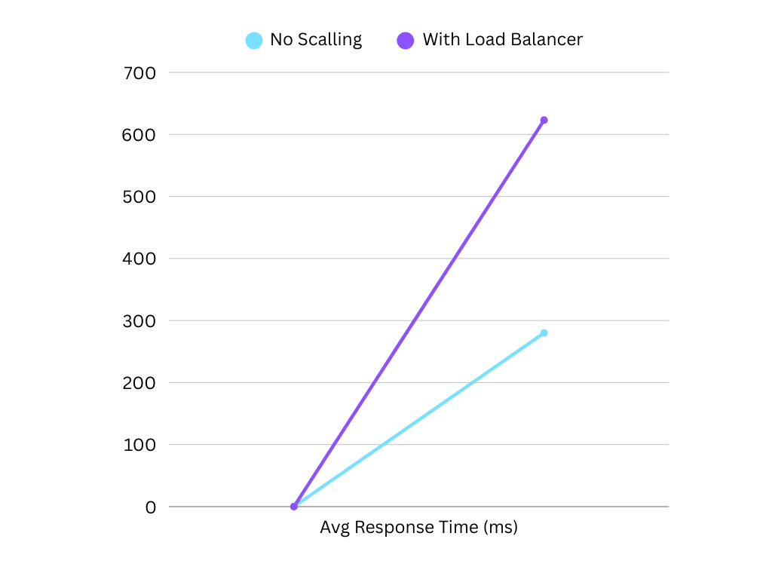
Project Highlights
‹#›
Notes:
Ok this is the response time

Slide 13
Future Scope
Cloud migration: Leverage the containerised setup to transition workloads to cloud platforms for enhanced scalability and cost-efficiency.
API gateway integration: Introduce a central API gateway for managing, securing, and monitoring service traffic.
Automated scaling and orchestration: Implement auto-scaling and advanced orchestration for better performance under varying loads.
Enhanced monitoring and alerting: Integrate comprehensive logging and monitoring tools to improve system visibility and incident response.
‹#›

Slide 14
Future Scope
Policy-driven security: Expand Zero Trust with policy-as-code frameworks for dynamic, adaptive access control.
Secrets management: Introduce secure secrets management systems to handle credentials and sensitive data more safely.
User analytics and behavior tracking: Add insight-driven features to monitor usage patterns and improve user experience.
‹#›

Slide 15
Conclusion
The modernisation of the internal application marks a critical step toward building a more secure, scalable, and future-ready system. By adopting containerisation,
token-based authentication with OIDC, Zero Trust principles, and RBAC, the project not only addressed current limitations but also laid the groundwork for long-term agility and growth.
This transformation enhances operational efficiency, security posture, and integration capability — aligning the application with modern enterprise standards.
With a solid foundation in place, the system is now well-positioned to evolve alongside future technological and business needs.
‹#›

Slide 16
Thank You
‹#›

