Slide 1
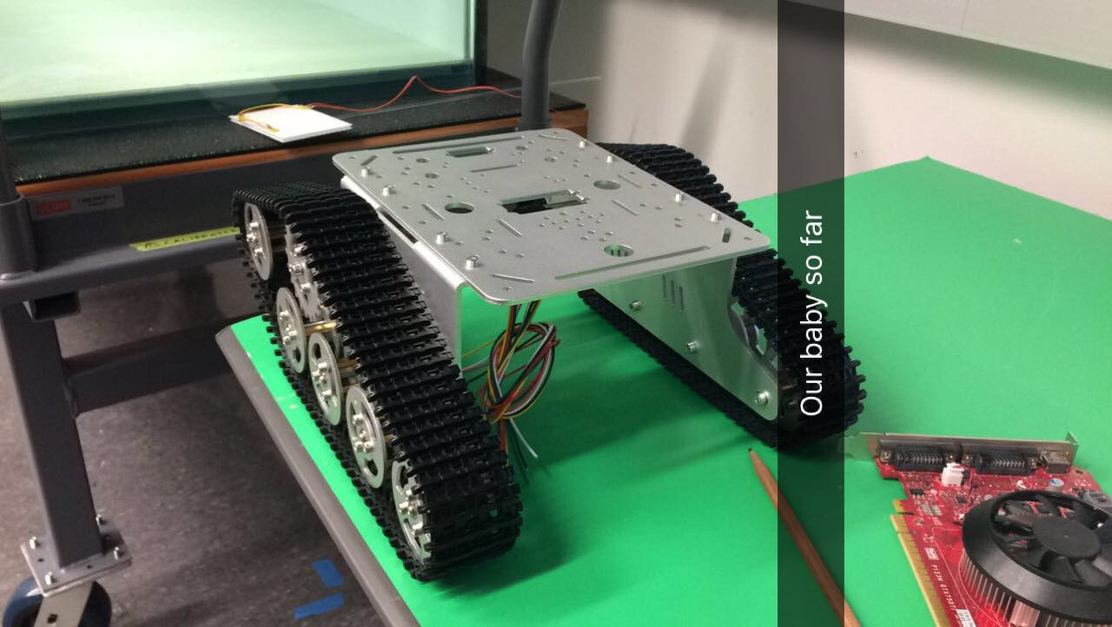
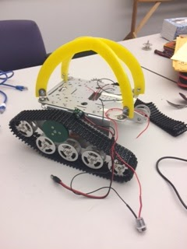
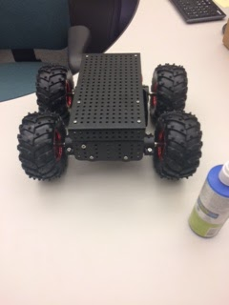
Agile Autonomous Outdoor Robot
Ranye Mclendon, Jeff Dusek, Nicole Carey, Radhika Nagpal
¹University of Maryland Baltimore County ,Harvard University
Harvard SEAS
Professor Radhika Nagpal, who heads the Self-Organizing Systems Research Group at Harvard, organized a summer project with five undergraduates with the help of mentors, Dr. Nicole Carey and Dr. Jeff Dusek. This summer the lab developed a low-cost outdoor autonomous swarm robot. Each robot uses a single UP board computer with an Intel RealSense depth-RGB camera to navigate its surroundings. Our goal for the summer was to develop a combined brain-body design for the swarm robot to autonomously roam the Harvard courtyard while avoiding collision and searching for targets. The robot was primarily programmed in Python and modifications were modeled in Solidworks then lasercut. This project focused on constructing an agile, low-cost, autonomous swarm robot that is capable of functioning together for one enlarge purpose.

