Slide 1

NSU REU/RET Program
Week 1-2 Progress
Ranye Mclendon, Anya Ellis, Jailyn Battle, Alvin Nnabue, Funmi Adediwura, Precious Isidahomen
Notes:
Slides must include:
Twentieth century font (in white only)
Headings - 40 pt
Descriptions- 19-25 pt

Slide 2
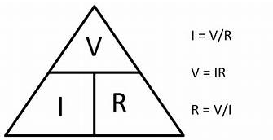

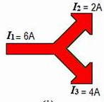
Getting back to the basics (Ohms law, resistors, transistors, diode)
Ohm’s Law - Electric current is proportional to voltage and inversely proportional to resistance
Kirchhoff’s Voltage Law (KVL)
Kirchhoff’s Current Law (KCL)
Resistor - Component reduces the flow of electricity
Transistor - Amplifies the signal in the circuit and acts as a switch for the circuit
Diodes - Allows current to flow in only one direction

Slide 3
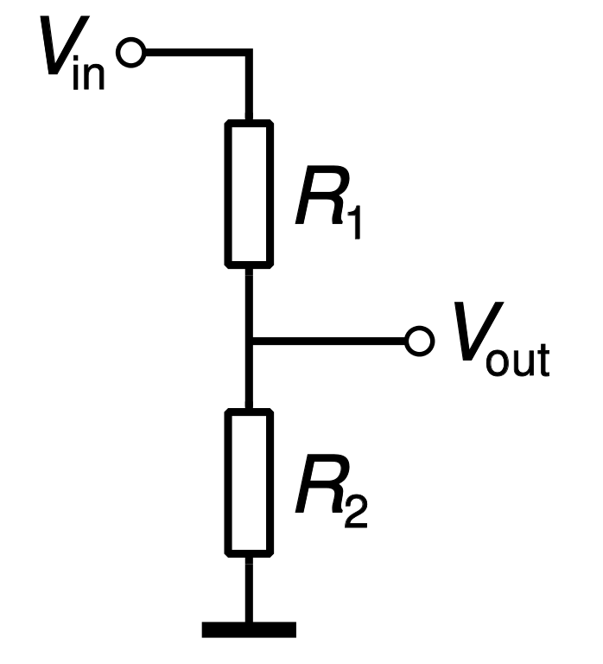
Voltage Divider circuit
A voltage divider is simple circuit used to split voltage in a given ratio using resistors.
Photocell- a resistor sensitive to light in an environment
A voltage divider can be modified to make a switch that is sensitive to ambient light by replacing a resistor with a photocell.

Slide 4
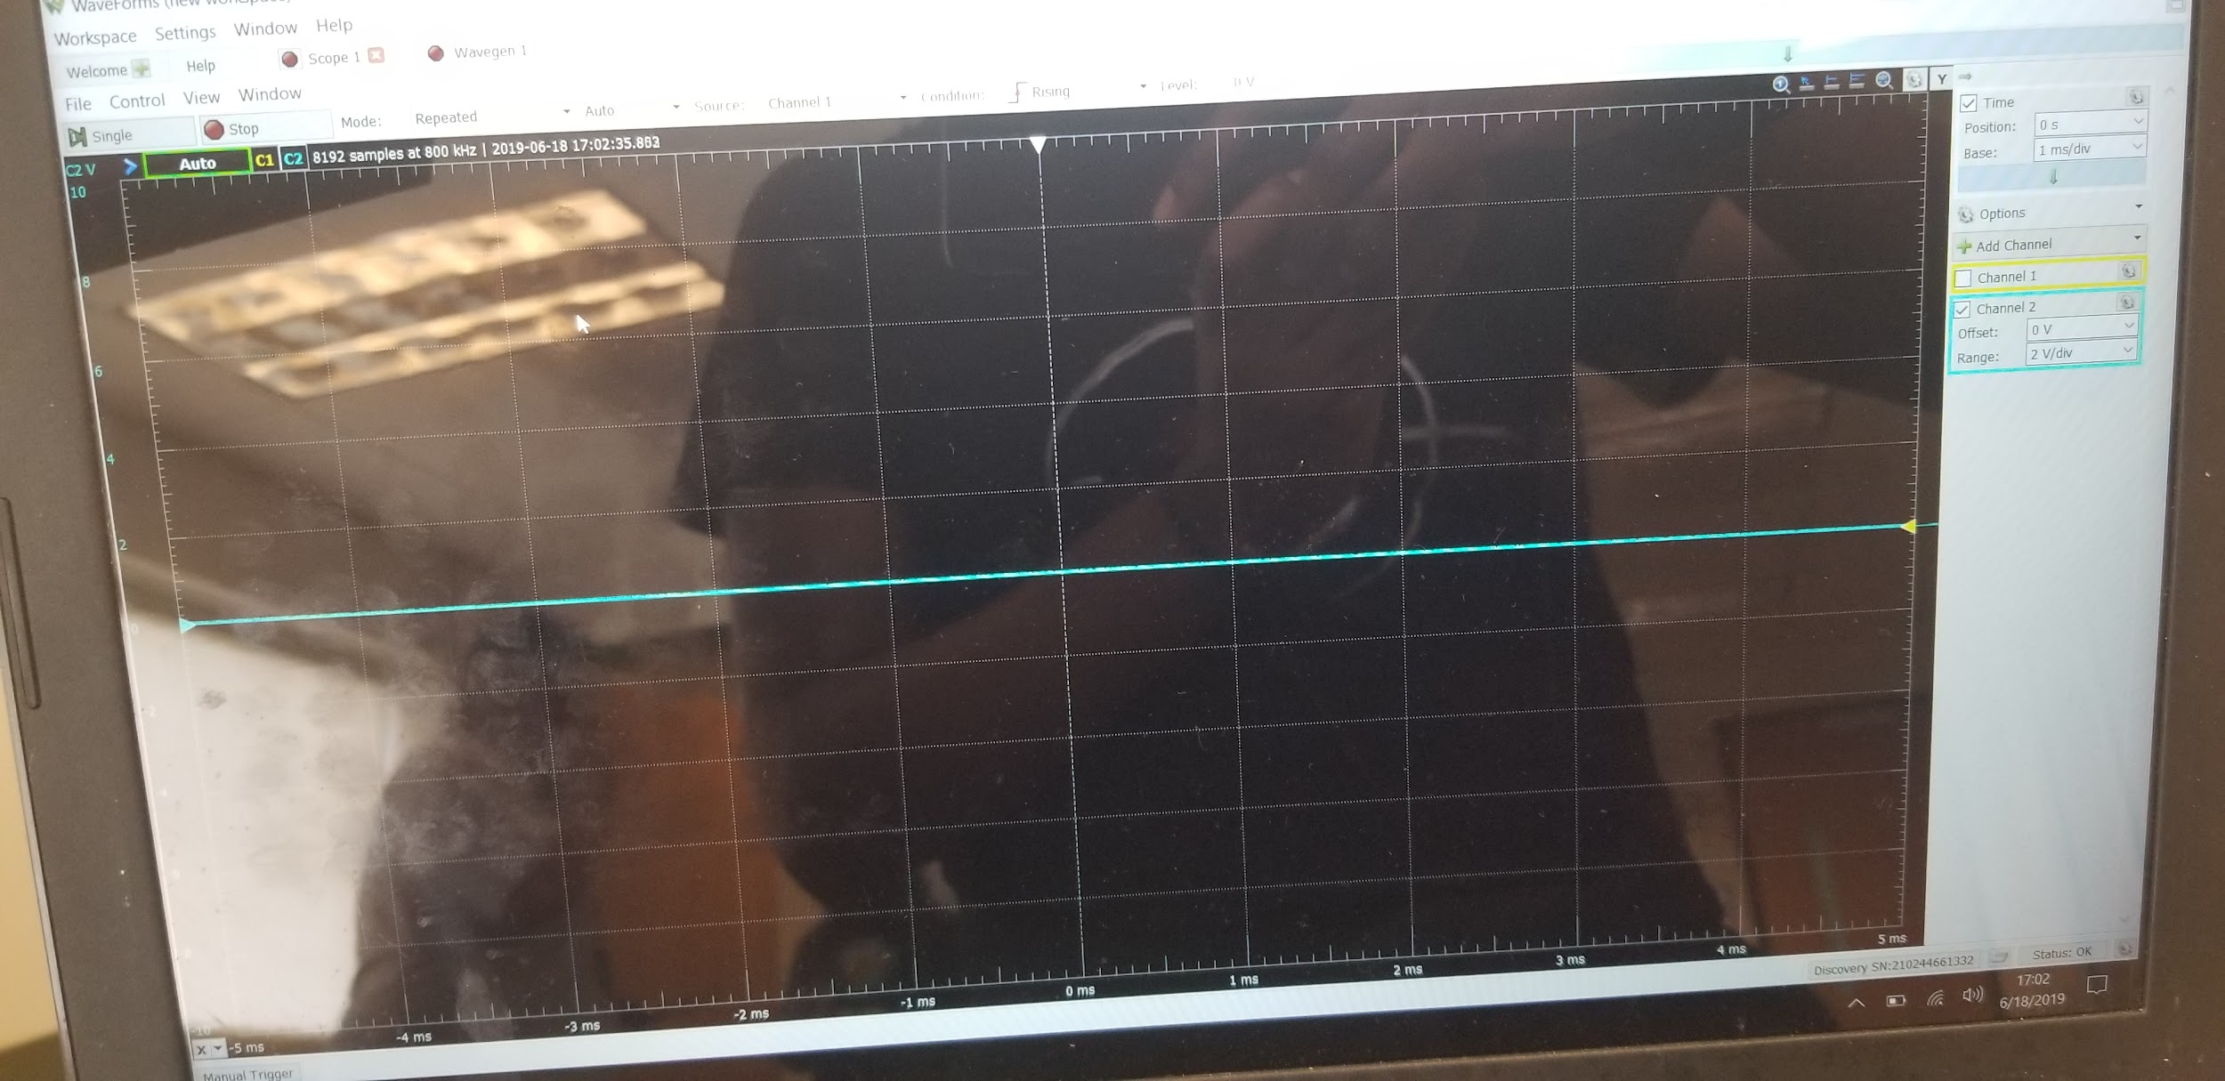
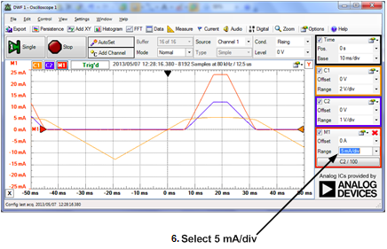
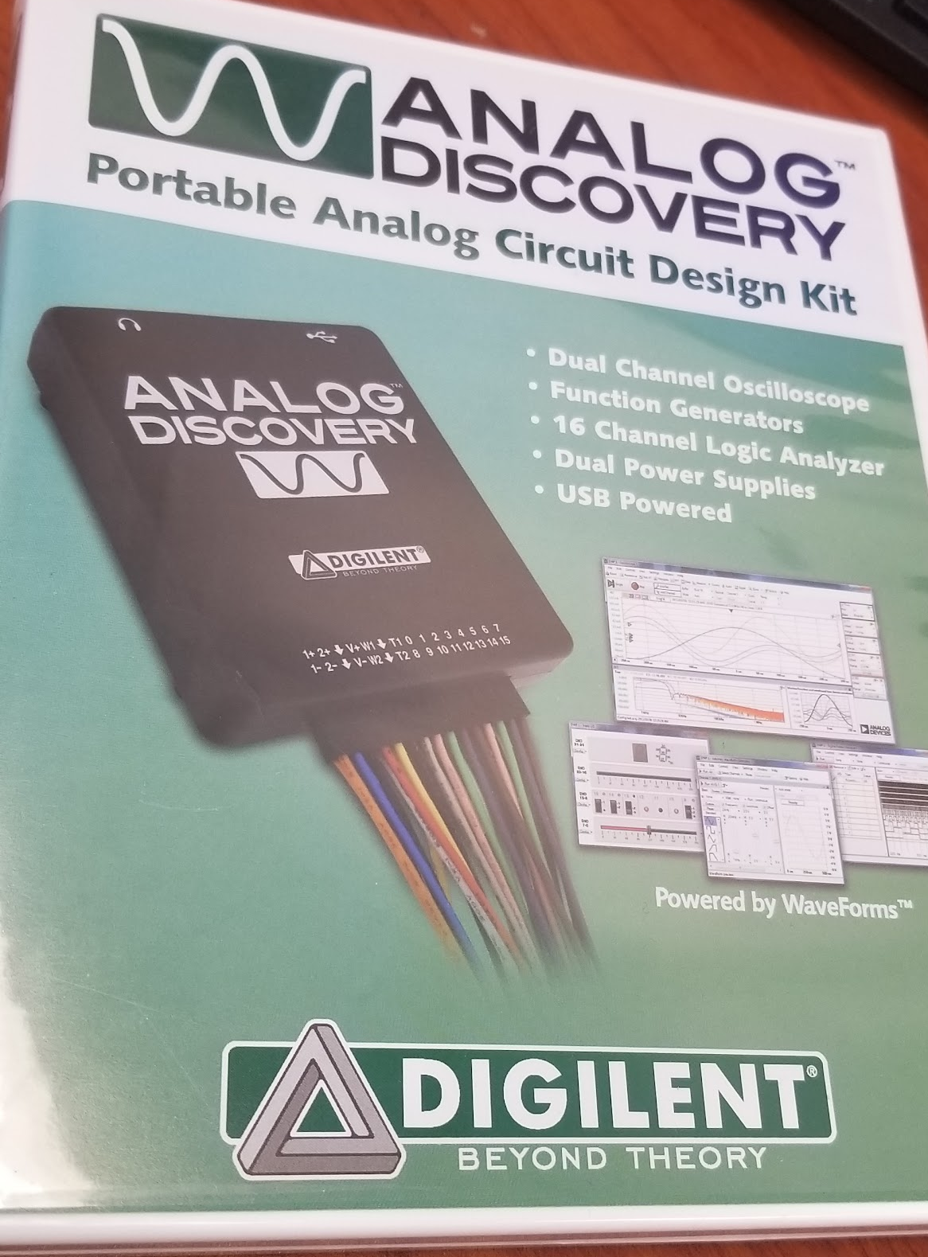
Analog Discovery using Waveforms
We used Analog Discovery + Waveforms to measure, and generate analog and digital signals for our circuit boards.
Analog Discovery is:
an oscilloscope
a function generator
voltmeter
Waveforms is the software component
Notes:
Analog Discovery is all this and more. Its powered by your computer through the usb.

Slide 5
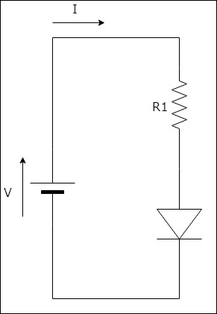
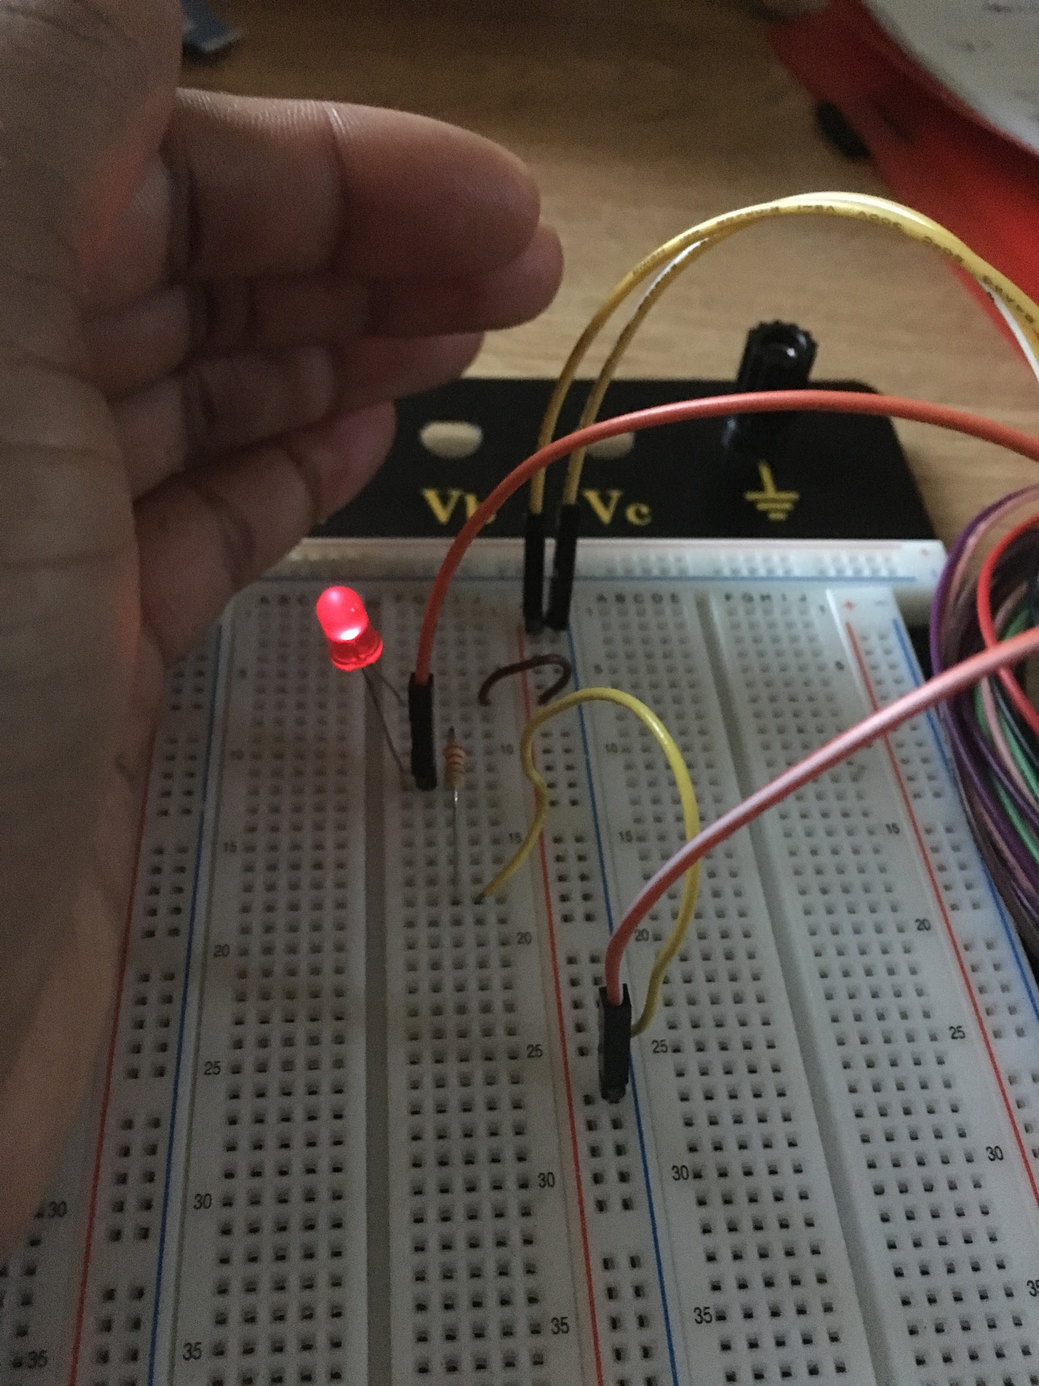
Project 1: IV Characteristics of a Diode
Objective
To find the current-voltage characteristics of a LED diode
Method/Procedure
Connected a circuit using a resistor, wired, LED and analog discovery kit
Increased voltages from 0-5 (in increments of 0.5)
Found the voltage drop across the LED and the resistor
Determined the current through the circuit and plotted the values found in a graph

Slide 6
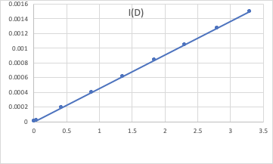
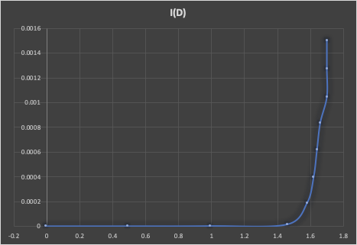
Project 1: IV Characteristics of a Diode
Result:
Based on the result gotten by increasing voltages in 0.5 steps:
IV characteristics of the resistor - the current flowing through the resistor was directly proportional to the voltage across it
IV characteristics of the diode - there was no current flowing through the LED until a voltage of 1.5 was reached
From that point, the current grew exponentially as the voltage increased

Slide 7
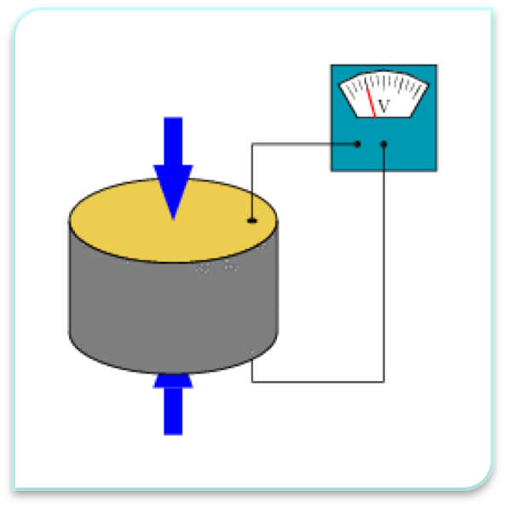
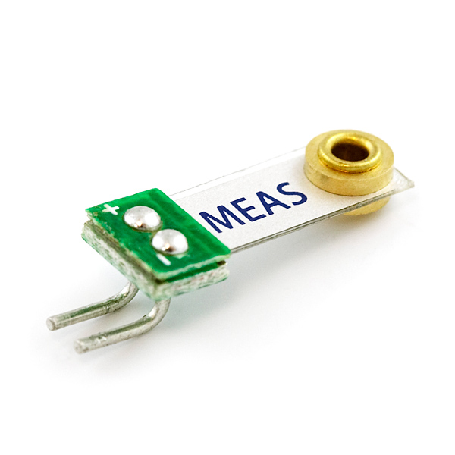
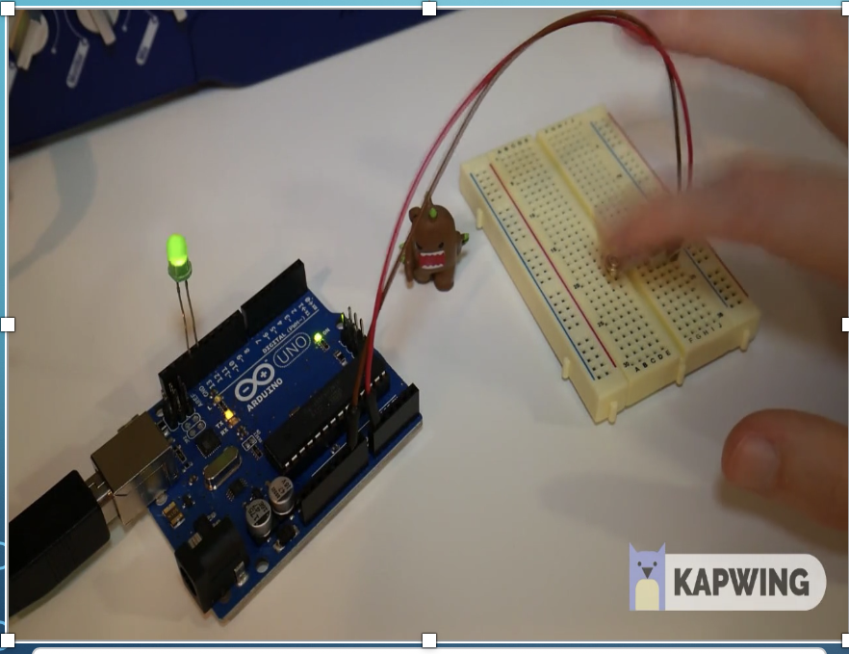
PIEZOELECTRIC SENSOR
Piezoelectric sensor are electromechanical systems that reacts to compression.
Piezo film is very sensitive it has a high dielectric strength, and high mechanical strength.
One of the end goal is to use the piezoelectric sensor to measure heart rate from the mechanical disturbance in a heartbeat.
Notes:
It also produces electric charge in response to mechanical stress or vibration. When its pushed some of the atoms closer together or further apart, upsets the balance of positive and negative charges which causes the electrical current to appear.
The piezo film serves as a very good receiver when it comes to its mechanical input. The film behaves like a dynamic strain that does not require any external power and it can help generate signals.
signals are microcontroller

