Slide 1
PREP PRESENTATION — IE 643 COURSE PROJECT, AUTUMN 2026
Making Large Models Draw Topological Graphs
Teaching a language model to read quantum-circuit code and draw the circuit's DAG — without running the code.
Team Pensieve
Adarsh A Rao · Roll No. 24B2132
Indian Institute of Technology Bombay · September 2026
Notes:
[0:00-0:25] Hello - I'm Adarsh A Rao, roll number 24B2132, Team Pensieve. My allotted topic
is "Making large models draw topological graphs": can a model read code it is not allowed
to run, and output the graph that code builds? The version an ML audience knows is
torch.fx, which traces a network into a computation DAG - but fx node names depend on the
object you traced, so correct answers cannot be compared automatically. Quantum circuit
DAGs give the same structure with an exact, machine-checkable answer, so that is what I
measure on.

Slide 2
Outline
▸ Background: what a quantum circuit is, and why a circuit is a DAG
▸ The task stated precisely, and why it is hard for a language model
▸ Background material read, and the three ways to adapt a model
▸ What we have built: generator, ground truth, validator, metrics
▸ The dataset: four difficulty tiers, with an example of each
▸ Where we stand today, the roadmap of subtasks, and the research questions
ALLOTTED TASK
large models draw
topological graphs
REFERENCE INSTANCE
torch.fx traces a model
into a computation DAG
WHAT WE MEASURE ON
Qiskit circuit DAGs — exact
labels, checkable by machine
IE 643 Course Project · Team Pensieve
2
Notes:
[0:25-0:45] The strip at the bottom is the whole framing: allotted task, the reference
instance, and what I actually measure on. I'll give you just enough quantum background to
read the pictures, then the task, the background reading, what is built, the dataset, and
where I stand.

Slide 3
BACKGROUND · NO PHYSICS REQUIRED
A quantum circuit, in one picture
five lines of Qiskit…
…build this circuit
qc = QuantumCircuit(2)
qc.h(0)
qc.x(1)
qc.cx(0, 1)
qc.rz(0.785, 1)
q0
H
q1
X
+
RZ
0.785
a qubit is a wire
a gate is a box on a wire
cx spans two wires: • control, ⊕ target
straight-line: no branching at run time
IE 643 Course Project · Team Pensieve
3
Notes:
[0:45-1:20] All the quantum you need is on this slide. Five lines of Qiskit on the left
build the circuit on the right. A qubit is a wire and time runs left to right. A gate is a
box sitting on a wire - H, X and RZ each touch one. CX touches two: a control dot and a
target plus. And the structural fact everything depends on: a circuit is a straight-line
program. No branching at run time, just a fixed sequence of operations over fixed wires.

Slide 4
BACKGROUND · THE CORE IDEA
The same circuit, as a graph
the circuit
its DAG
q0
H
0: h
q0
q0
2: cx
q0 q1
q1
3: rz(0.785)
q1
X
RZ
q1
q1
+
1: x
q1
0.785
one node per operation
edge A → B = next operation on that wire
no cycles: time only moves forward
qc.h(0) and qc.x(1) can be written in either order and give the same DAG — so we compare graphs, not gate lists.
IE 643 Course Project · Team Pensieve
4
Notes:
[1:20-2:05] Same circuit, different question: what depends on what? Every operation becomes
a node. I draw an arrow from A to B when B is the next thing that happens on some wire
after A, and I label the arrow with that wire. H is first on qubit zero, then the CX -
blue. X is first on qubit one, then the CX - orange. Then CX to RZ. Every wire is a chain,
and time only moves forwards, so there can never be a cycle. It is a DAG. And look at the
banner: H on qubit zero and X on qubit one are independent, so swapping those two lines in
the code gives an identical DAG. The correct answer is a graph, not a sequence - which is
why I compare graphs.

Slide 5
BACKGROUND · GROUND TRUTH
Where the correct answer comes from
the entire labelling pipeline
from qiskit import QuantumCircuit
from qiskit.converters import circuit_to_dag
qc = QuantumCircuit(2) # two wires
qc.h(0) # append one
qc.x(1) # operation
qc.cx(0, 1) # per call
qc.rz(0.785, 1)
dag = circuit_to_dag(qc) # DAGCircuit
▸ QuantumCircuit(n) → n wires
▸ each qc.<gate>(…) → appends exactly one operation
▸ circuit_to_dag → DAGCircuit, the IR Qiskit’s own compiler uses for optimisation and qubit routing
▸ So: exact labels, zero hand-annotation, unlimited quantity.
▸ The model is given the source text only.
IE 643 Course Project · Team Pensieve
5
Notes:
[2:05-2:40] Where does the correct answer come from? QuantumCircuit of n gives me n wires,
each method call appends one operation, and then the last line - circuit_to_dag - hands me
the answer. I did not write that function. DAGCircuit is the representation Qiskit's own
compiler uses to cancel gates and route qubits onto hardware. So my entire labelling
pipeline is: generate a program, run it, call the converter. Exact labels, no annotation, as
many as I want. The model gets the source text and nothing else.

Slide 6
THE TASK
The task, stated precisely
INPUT — what the model is given
OUTPUT — what it must produce, exactly
from qiskit import QuantumCircuit
qc = QuantumCircuit(2)
qc.h(0)
qc.x(1)
qc.cx(0, 1)
qc.rz(0.785, 1)
QUBITS 2
CLBITS 0
NODES
0 h q0
1 x q1
2 cx q0 q1
3 rz(0.785) q1
EDGES
0 -> 2 : q0
1 -> 2 : q1
2 -> 3 : q1
node: <id> <gate>[(<params>)] <wires…>
edge: <src> -> <dst> : <wires…>
ids are the model’s choice — we compare up to isomorphism
IE 643 Course Project · Team Pensieve
6
Notes:
[2:40-3:10] The task in one picture. Left, the input: plain Python. Right, the output: the
DAG as text in a fixed format - four node lines, then three edge lines, each naming its
wire. The chips at the bottom give the grammar. The one that matters is the last: the ids
are the model's own choice, so numbering the nodes differently but consistently is still
correct, and my metrics compare graphs up to isomorphism.

Slide 7
THE TASK
Why this is hard for a language model
▸ Unroll loops, expand calls, discard dead branches, broadcast qc.h(range(n)).
▸ Track “last operation on each wire” — with no scratch memory except the tokens already written.
▸ One missed gate breaks a chain, and the output stops being a valid DAG.
▸ Our output is almost entirely numbers, and numbers tokenise badly:
rz(0.785) q12 as the model actually reads it
rz
(
0
.
785
)
␣q
12
CRUXEval (2024): models that write code well are substantially worse at predicting what that code does.
IE 643 Course Project · Team Pensieve
7
Notes:
[3:10-3:50] Four difficulties. It has to unroll loops, expand calls and discard dead
branches. It has to track the last operation on every wire, with no scratch memory except
the tokens it has already written - which is a strong hint that chain-of-thought will
matter. It is brittle: one missed gate breaks a chain and the graph stops being valid. And
the tokenisation problem, which is easy to underestimate - "rz open-bracket zero point
seven-eight-five" comes apart into eight tokens, and q12 is never one symbol. My output is
almost entirely numbers. CRUXEval measured exactly this gap between writing code and
predicting what it does.

Slide 8
BACKGROUND MATERIAL READ
Three ways to use a model — our three phases
Phase 1 · Prompting
Phase 2 · LoRA fine-tuning
Phase 3 · From scratch
DATA
0–5 examples in the prompt
COMPUTE
inference only
PYTHON
known, from pretraining
DATA
~1k–10k (code, DAG) pairs
COMPUTE
one free GPU, hours
PYTHON
known, from pretraining
DATA
10k–1M — we generate them
COMPUTE
one GPU, hours to days
PYTHON
none — learnt from our data
LIKELY FAILURE
format errors; loses track of wires
LIKELY FAILURE
overfits our generator’s style
LIKELY FAILURE
poor generalisation to real code
IE 643 Course Project · Team Pensieve
8
Notes:
[3:50-4:30] The TA confirmed any approach is fine as long as the results are good, so I
planned all three, cheapest first, and they became my phases. Prompting touches only the
input. LoRA freezes the pretrained weights and trains small adapters alongside - under one
percent of the parameters, which is what puts a one-billion model on a free Colab GPU.
From scratch starts from random weights, normally hopeless, but my language is tiny and
synthetic. The orange strip on each card is what I expect to go wrong, and those three
failures are different enough that the comparison is informative either way.

Slide 9
BACKGROUND MATERIAL READ
Background material read
FOUNDATIONS — how language models work
DIRECTLY RELATED WORK
▸ 3Blue1Brown, Neural Networks — what attention computes, visually
▸ Karpathy, Intro to LLMs — pretraining → SFT → preference tuning
▸ Alammar, The Illustrated Transformer — the architecture, block by block
– Taken from these: generation is next-token prediction repeated, so an early mistake poisons the rest; attention is the mechanism that finds the last node on a wire; we decode at temperature 0.
▸ Talk like a Graph (2023) — how a graph is written as text changes LLM accuracy: our output format is a variable to test
▸ CRUXEval (2024) — predicting what code does, without running it: the input half of our task
▸ Qiskit HumanEval (2024) — 151 human-written Qiskit tasks: our source of real code for a held-out test set
▸ Qiskit DAGCircuit docs — defines our target structure exactly
– No public dataset of (code → circuit DAG) pairs exists. Building one is part of the contribution.
IE 643 Course Project · Team Pensieve
9
Notes:
[4:30-5:15] On the left, the foundations I worked through, and what I took from them:
generation is next-token prediction repeated, so an early mistake poisons everything after
it; attention is the mechanism that lets the model look back and find the last node on a
wire - which is literally my task; and on the local model I decode greedily; the current hosted models no longer expose
temperature at all, so what I record with every result is the model version and the effort
level. That matters because the answer is
structured. On the right, the directly related work. Talk like a Graph shows the text
encoding of a graph changes accuracy, so my output format is a variable to test rather than
a matter of taste. CRUXEval is the input half of my problem. Qiskit HumanEval is the
reverse direction and my source of real code. And the gap at the bottom: no public dataset
of code-to-DAG pairs exists.

Slide 10
WORK DONE
What has been built so far
generate.py
writes a random Qiskit program
extract.py
runs it → Qiskit gives the true DAG
schema.py
writes that DAG as text = the target
the code, and nothing else
the answer to beat
pipeline/
runner: prompt in, reply out
validate.py / metrics.py
well-formed DAG? how close to the truth?
seven modules under graphart/
runner + scorer written and dry-run
not yet done: call a real model
The model is handed the code and nothing else — never the circuit, never the answer.
IE 643 Course Project · Team Pensieve
10
Notes:
[5:15-6:00] This is the machinery, and it is worth thirty seconds because everything else
rests on it. Top row builds the data. generate.py writes a random Qiskit program.
extract.py actually runs that program and asks Qiskit for the true DAG. schema.py turns
that DAG into the text format you saw earlier - that text is the target. Bottom row is the
experiment. The orange arrow is important: the model receives the code only - never the
circuit, never the answer. Its reply goes back through schema.py to be parsed, validate.py
asks whether it is even a well-formed DAG, and metrics.py asks how close it is to the
truth. Seven modules under graphart/, all working, and the runner and scorer in pipeline/ are
written and dry-run end to end. The one thing left is pointing it at a real model.

Slide 11
THE DATASET
The dataset: four tiers of difficulty
Tier | What the code looks like | Unique samples | Nodes min / avg / max
1 flat | one gate per line — reading it is copying | 500 | 3 / 9.2 / 17
2 loops | for loops over qubits, repeated layers, % n rings, reversed ranges | 500 | 3 / 13.5 / 42
3 control | helper functions, if/else on the loop index, dead branches, nested loops, while, lists of angles | 500 | 3 / 8.6 / 23
4 algorithms | GHZ, QFT, Bernstein–Vazirani, Grover (2q), Deutsch–Jozsa, hardware-efficient ansatz | 93 | 6 / 17.4 / 26
The tiers vary how well the code hides the circuit — not how big the circuit is.
the next four slides: one worked example per tier
tier 4 is 93 samples — test-only until more templates are added
IE 643 Course Project · Team Pensieve
11
Notes:
[6:00-6:35] The dataset is four tiers, and the point is on the line under the table: the
tiers change how well the code hides the circuit, not how big the circuit is. Tier one is
flat, tier two adds loops, tier three adds functions and control flow, tier four is
textbook algorithms. That gives me my first research question almost for free - plot
accuracy against tier and you are measuring how much difficulty comes from the code rather
than from the graph. The next four slides show one real example from each.

Slide 12
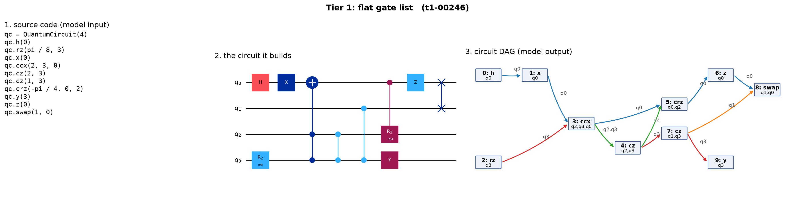
THE DATASET · TIER 1 EXAMPLE
Tier 1 — flat
Every operation is written out. Reading the code is transcription; only the edges have to be worked out.
IE 643 Course Project · Team Pensieve
12
Notes:
[6:35-6:55] Tier one. Every operation is written out on its own line, so reading the code
is transcription. The only real work is the edges - noticing that the swap at the end
follows the z on qubit zero.

Slide 13
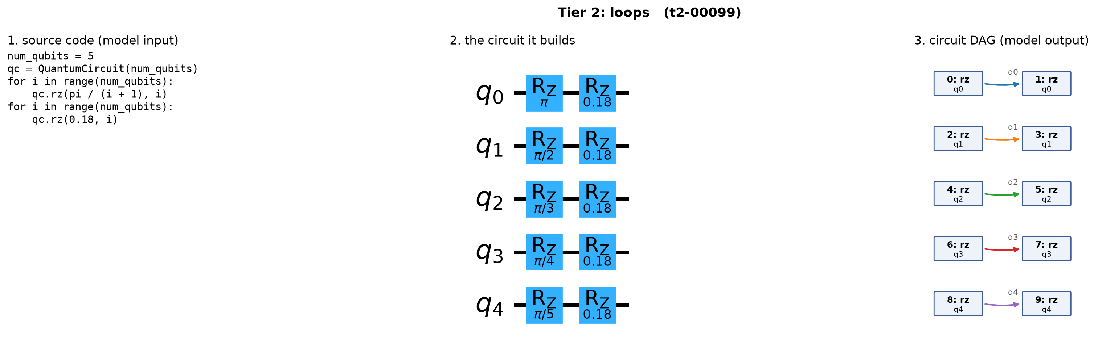
THE DATASET · TIER 2 EXAMPLE
Tier 2 — loops
Two loops over five qubits. Ten operations, five independent chains — and not one of them appears in the code.
IE 643 Course Project · Team Pensieve
13
Notes:
[6:55-7:20] Tier two. Two loops over five qubits. Ten operations, five completely
independent chains - and not one of those ten operations appears literally in the code. The
model has to run the loop in its head, including the angle pi over i plus one changing each
iteration.

Slide 14
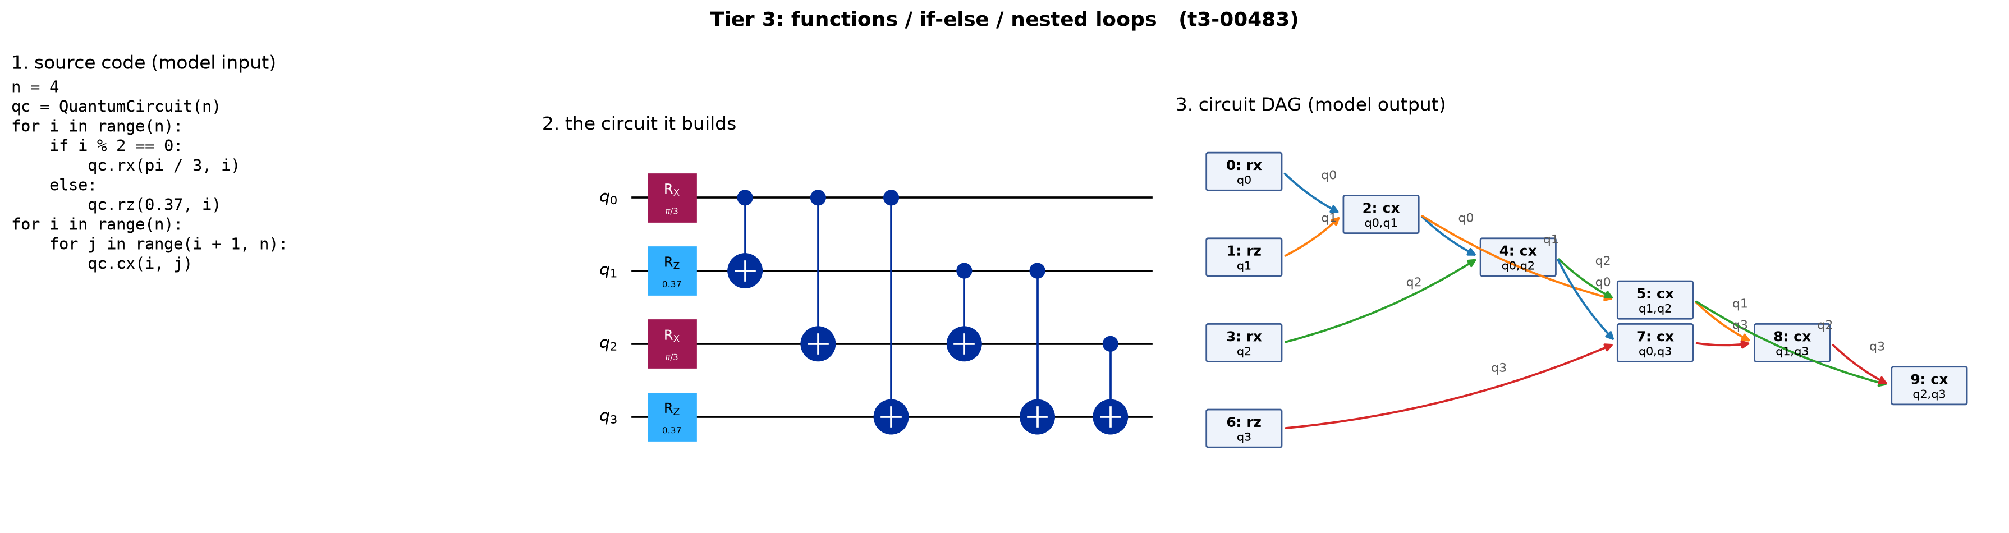
THE DATASET · TIER 3 EXAMPLE
Tier 3 — control flow
if/else on the loop index picks RX or RZ; a nested loop produces six cx gates. Ten operations, none written down.
IE 643 Course Project · Team Pensieve
14
Notes:
[7:20-7:50] Tier three, which is where it gets interesting. The if-else on the loop index
puts RX on the even qubits and RZ on the odd ones. Then a nested loop produces six cx
gates in a specific order. Ten operations again, exactly like tier one - but none of them
are written down, and getting the edges right means tracking four wires at once.

Slide 15
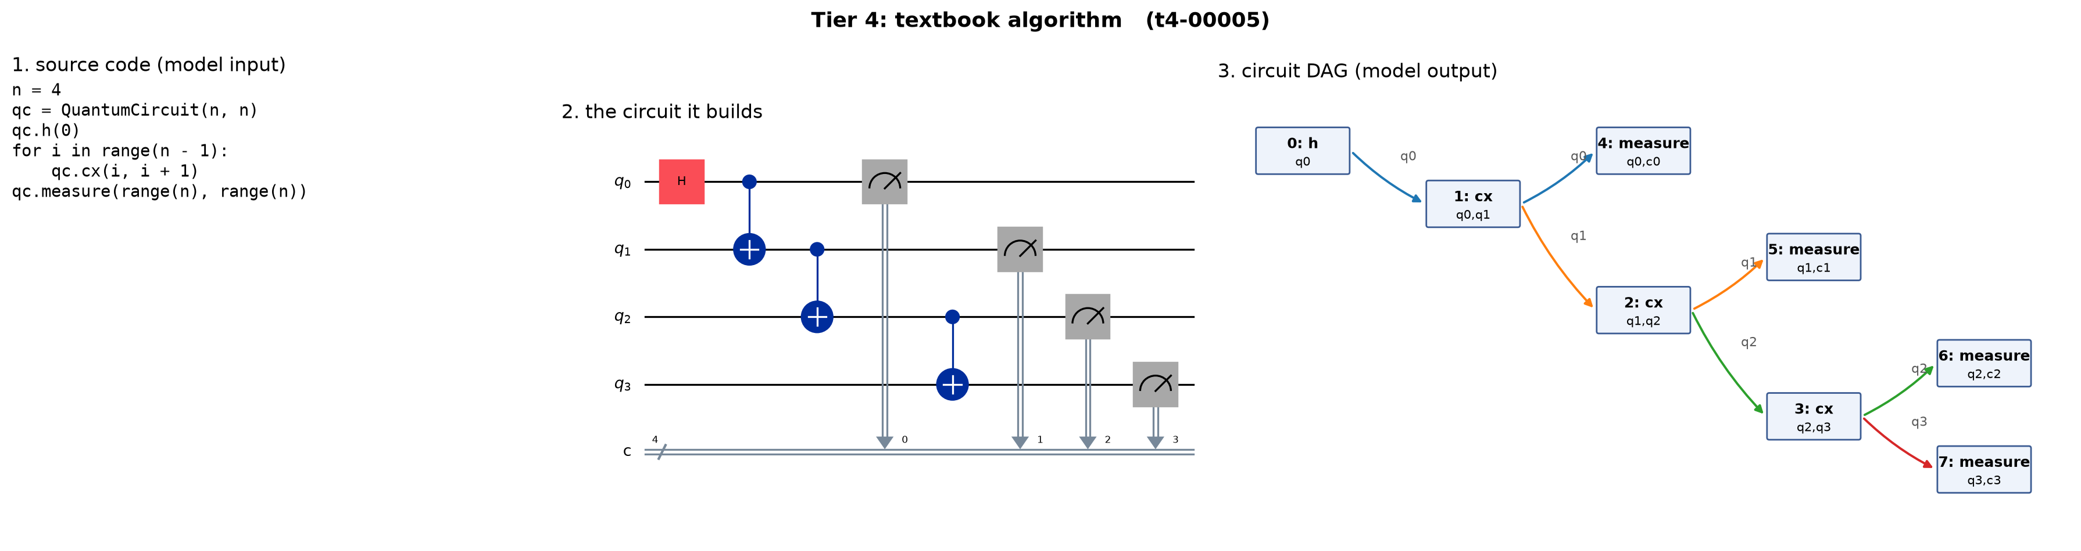
THE DATASET · TIER 4 EXAMPLE
Tier 4 — textbook algorithms
A GHZ state with measurement. Classical bits become wires too, so measure nodes carry both a qubit and a clbit.
IE 643 Course Project · Team Pensieve
15
Notes:
[7:50-8:15] Tier four is textbook algorithms - this one is a GHZ state with measurement.
Two things to notice: the model has to recognise the pattern rather than just read it, and
measurement brings classical bits in, so those nodes carry both a qubit and a clbit and the
graph now has two kinds of wire.

Slide 16
THE DATASET
Data curation: how the splits are kept honest
▸ One command, fixed seed. Nothing is hand-labelled or hand-corrected.
▸ Every ground-truth graph passes our own validator before it is kept. A malformed extraction fails the build instead of poisoning the data.
▸ Deduplicated by the graph itself, across the whole dataset. A sample whose DAG has already been seen is thrown away — so no graph can appear in two splits, and memorising cannot score.
▸ Filtered to 3–60 nodes, which keeps every sample inside a small model’s context window.
▸ Then split 80 / 10 / 10 within each tier: 1274 train · 159 val · 160 test. The generator scales to 4,000 per tier for tiers 1–3 (≈ 9,700 training pairs) when fine-tuning needs more.
IE 643 Course Project · Team Pensieve
16
Notes:
[8:15-8:50] Curation, since the instructions ask for it specifically. One command, fixed
seed, nothing labelled by hand. Two safeguards matter. Every ground-truth graph goes
through my own validator before it is kept, so a malformed extraction fails the build
rather than quietly poisoning the data. And I deduplicate on the graph itself across the
whole dataset, so no DAG can appear in both train and test - memorising cannot score. The
last line matters for phase two: five hundred per tier is deliberate for prompting, and the
generator scales to four thousand per tier when fine-tuning needs more.

Slide 17
THE DATASET
Real code for the generalisation tests
Source | What it is | How we would use it
Qiskit HumanEval | 151 hand-written Qiskit tasks with reference solutions | run each solution that builds a circuit, extract its DAG → a real-code test set
MQT Bench | thousands of benchmark circuits, 2–130 qubits, generated in Python | more tier-4 algorithms, and larger circuits for the size-generalisation test
QASMBench | ~130 OpenQASM circuits from chemistry, arithmetic and ML | load the QASM into a QuantumCircuit, then the same extractor
QCircuitBench | a large dataset for LLM-based quantum algorithm design | algorithm code written in a style quite different from our generator
All four end up as a QuantumCircuit, so the same circuit_to_dag gives the ground truth and the same metrics score it.
our generator has a house style — a fixed vocabulary of gates and code shapes
a model could learn that style instead of the rule; only real code exposes it
IE 643 Course Project · Team Pensieve
17
Notes:
[8:50-9:25] My generated data has one weakness: a house style. A fixed vocabulary of gates,
a fixed set of code shapes. A model could learn my generator's habits instead of the rule,
and my own test split would never tell me. So I bring in real code. The key point is the
line in the middle: every one of these ends up as a Qiskit QuantumCircuit object - either
by running the Python, or by loading OpenQASM - and then the same circuit_to_dag gives me
the ground truth and the same metrics score it. No separate evaluation path, so no way to
flatter the model.

Slide 18
EVALUATION
How an answer is scored
Metric | What it means
valid | the output parses; there are no cycles; every edge’s wires belong to both of its endpoints; and each wire forms one single chain
exact | the same graph as the ground truth, by labelled graph isomorphism — this is the headline number
node F1 | overlap of the (gate, qubits, clbits, params) multisets — partial credit for getting most operations right
edge F1 | overlap of the (source label, target label, wires) multisets — partial credit for the structure
sanity check — scoring a correct graph and two damaged copies
perfect copy valid=True exact=True node_f1=1.00 edge_f1=1.00
one wrong gate valid=True exact=False node_f1=0.93 edge_f1=0.92
one missing edge valid=False exact=False node_f1=1.00 edge_f1=0.96 ['wire q2: 5 nodes should be chained by 4 edges, found 3']
▸ Reported per tier and per circuit size. Node ids are ignored throughout.
IE 643 Course Project · Team Pensieve
18
Notes:
[9:25-10:05] Four metrics. Valid is a structural check that never looks at the correct
answer: does it parse, no cycles, do each edge's wires belong to both endpoints, is each
wire one unbroken chain. That separates nonsense from well-formed-but-wrong, which are very
different failures. Exact is the headline - the same graph, by labelled isomorphism. The two
F1 scores give partial credit so I can see progress before anything is exactly right. The
box at the bottom is the sanity check on the metrics themselves: a correct graph scores one;
change one gate and it is still valid but no longer exact; delete one edge and the validator
names the broken wire.

Slide 19
STATUS AND PLAN
Where we stand today
▸ The harness runs end to end, and is checked. The sanity check on the previous slide is the evidence.
▸ The dataset is built and inspected. 1,593 samples across four tiers, with a rendered example per tier.
▸ The Phase-1 harness is written, and dry-run end to end. Four prompt variants (zero-shot, few-shot, chain-of-thought, and the gate-list ablation), a runner with a hosted and a local backend, and a scorer that reports by tier and by circuit size.
▸ No model has been called yet. We would rather report no numbers than numbers we cannot stand behind. The next command run is the zero-shot baseline over the 160-sample test split.
▸ First measurements: zero-shot and few-shot valid / exact / node F1 / edge F1 on the 160-sample test split, by tier and by circuit size, for one hosted model and one small local model.
▸ Then the ablation that answers the central question: the model outputs only the unrolled gate list, and graphart/connect.py builds the edges. That edge-builder already reproduces the ground truth on all 160 test samples, so whatever it then scores is purely the model’s reading of the code.
IE 643 Course Project · Team Pensieve
19
Notes:
[10:05-10:55] So where am I? Honestly: the infrastructure is done and verified, and the
model experiments have not been run. That sanity check is my evidence the harness works.
The dataset is built - about sixteen hundred samples - and I have inspected an example from
each tier, which you have just seen. The whole Phase-1 harness is written too - four prompt variants, a runner
with a hosted and a local backend, and a scorer - and I have dry-run it end to end. What I
have not done is call a real model, and I would rather stand here with no numbers than with
numbers I cannot defend.
The experiment I most want is the ablation: the model outputs only the gate list, and a
small module builds the edges from it. I checked that edge-builder against all one hundred
and sixty test samples and it reproduces the ground truth exactly - so whatever it scores is
purely the model's reading of the code. If the score jumps, the hard part is the graph. If
it does not, the hard part is executing the code. That splits my problem in half, cheaply.

Slide 20
STATUS AND PLAN
Roadmap: the project as subtasks
▸ Phase 1 — prompting baselines (the next two weeks). Zero-shot, few-shot, chain-of-thought, and the “LLM unrolls, code connects” ablation, on one hosted model and one local model.
▸ Phase 2 — LoRA fine-tuning. A 0.5B–1.5B open code model on a free Colab or Kaggle GPU. Does a fine-tuned 1B model beat a prompted frontier model? How much data is enough?
▸ Phase 3 (stretch) — a tiny transformer from scratch. nanoGPT-scale, 10–50M parameters, possibly with a custom tokenizer in which q12 is one token.
▸ Phase 4 — generalisation. Train on ≤ 5 qubits, test on 6–10; hold out a construct such as while loops; test on real Qiskit HumanEval code; and revisit torch.fx graphs as a second domain.
▸ Phase 5 — interface. Paste code, see the predicted DAG beside the ground truth with the differences highlighted.
▸ Immediate subtasks: (1) run the zero-shot baseline, (2) freeze the test split, (3) the Qiskit HumanEval importer, (4) more tier-4 templates.
IE 643 Course Project · Team Pensieve
20
Notes:
[10:55-11:30] The roadmap, cheapest first, so every phase gives a usable result even if the
next one does not happen. Phase one is prompting - the next two weeks. Phase two is LoRA
fine-tuning a small open code model on a free GPU, and the interesting question is whether a
fine-tuned one-billion model beats a prompted frontier model on a task this narrow. Phase
three, if there is time, is a tiny transformer from scratch. Phase four is the
generalisation tests, including going back to torch.fx as a second domain. Phase five is a
small interface. The four immediate subtasks are at the bottom.

Slide 21
STATUS AND PLAN
The research questions
▸ 1. How does accuracy fall as the code hides more of the structure? Tier 1 → 4 at constant circuit size, and separately as the circuit grows.
▸ 2. Is the hard part executing the code, or building the graph? The Phase-1 ablation answers this, and it decides where the rest of the effort goes.
▸ 3. Prompting, fine-tuning or from scratch — best accuracy for the compute spent? All three are scored by the same harness, so the comparison is fair.
▸ 4. Do the models learn the rule, or memorise the pattern? Tested on larger circuits, held-out language constructs, and real human-written code.
IE 643 Course Project · Team Pensieve
21
Notes:
[11:30-12:05] Which brings me to the four questions I want to answer. How does accuracy fall
as the code hides more of the structure - and is that a different curve from the circuit
simply getting bigger? Is the hard part executing the code, or building the graph?
Prompting, fine-tuning or from scratch - best accuracy for the compute spent? And do the
models learn the rule or memorise the pattern? Bigger circuits, held-out constructs and real
code will tell me. Thank you.

Slide 22
References
Papers
[1] Bahare Fatemi, Jonathan Halcrow and Bryan Perozzi. Talk like a Graph: Encoding Graphs for Large Language Models, arXiv preprint, 2023. https://arxiv.org/abs/2310.04560
[2] Alex Gu, Baptiste Rozière, Hugh Leather, Armando Solar-Lezama, Gabriel Synnaeve and Sida I. Wang. CRUXEval: A Benchmark for Code Reasoning, Understanding and Execution, arXiv preprint, 2024. https://arxiv.org/abs/2401.03065
[3] Sanjay Vishwakarma, Francis Harkins, Siddharth Golecha, Vishal Sharathchandra Bajpe, Nicolas Dupuis, Luca Buratti, David Kremer, Ismael Faro, Ruchir Puri and Juan Cruz-Benito. Qiskit HumanEval: An Evaluation Benchmark For Quantum Code Generative Models, arXiv preprint, 2024. https://arxiv.org/abs/2406.14712
[4] Rui Yang, Ziruo Wang, Yuntian Gu, Tianyi Chen, Yitao Liang and Tongyang Li. QCircuitBench: A Large-Scale Dataset for Benchmarking Quantum Algorithm Design, arXiv preprint, 2024. https://arxiv.org/abs/2410.07961
[5] Edward J. Hu, Yelong Shen, Phillip Wallis, Zeyuan Allen-Zhu, Yuanzhi Li, Shean Wang, Lu Wang and Weizhu Chen. LoRA: Low-Rank Adaptation of Large Language Models, arXiv preprint, 2021. https://arxiv.org/abs/2106.09685
Websites
[6] Grant Sanderson (3Blue1Brown). https://www.youtube.com/playlist?list=PLZHQObOWTQDNU6R1_67000Dx_ZCJB-3pi. Accessed on: 20th September, 2026.
[7] Andrej Karpathy. https://www.youtube.com/watch?v=zjkBMFhNj_g. Accessed on: 20th September, 2026.
[8] Jay Alammar. https://jalammar.github.io/illustrated-transformer/. Accessed on: 20th September, 2026.
[9] IBM Qiskit. https://quantum.cloud.ibm.com/docs/en/api/qiskit/qiskit.dagcircuit.DAGCircuit. Accessed on: 20th September, 2026.
[10] Munich Quantum Toolkit. https://github.com/munich-quantum-toolkit/bench. Accessed on: 20th September, 2026.
[11] Pacific Northwest National Laboratory. https://github.com/pnnl/QASMBench. Accessed on: 20th September, 2026.
IE 643 Course Project · Team Pensieve
22
Notes:
Leave up during questions. Format follows the course instruction: authors, title, venue,
year, URL for papers; authors, URL, access date for websites.

