Slide 1
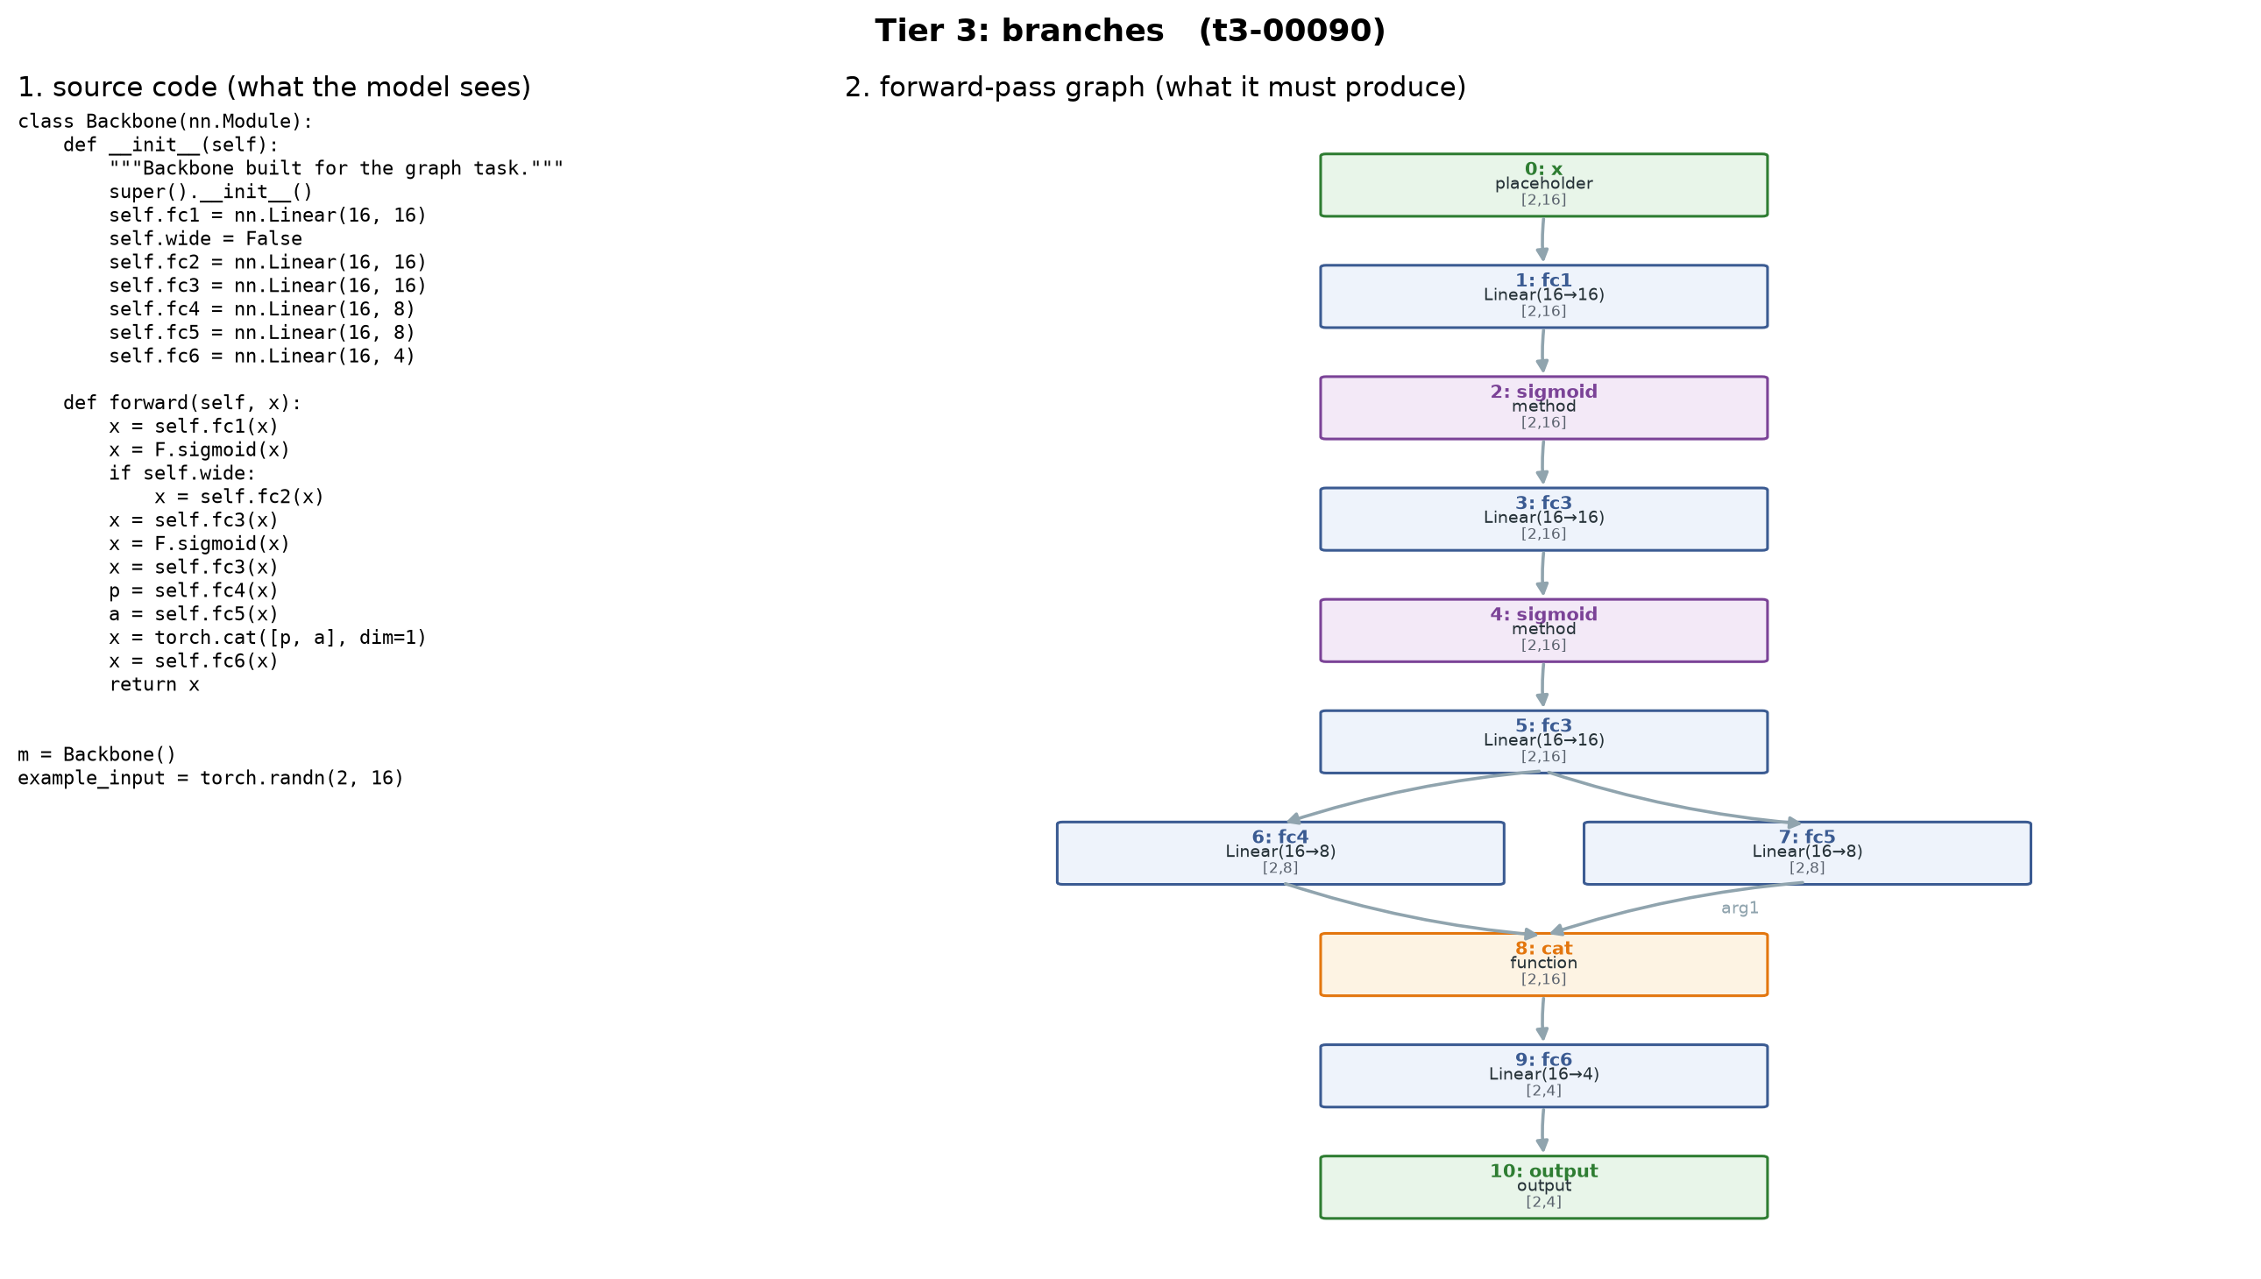
IE 643 COURSE PROJECT · FINAL PRESENTATION
Making Large Models Draw Topological Graphs
Can a language model read a network's code and draw its forward-pass graph — without running it?
Team Pensieve
Adarsh A Rao · Roll No. 24B2132
IIT Bombay · October 2026
Notes:
[0:00-0:20]
• Team Pensieve; Adarsh Rao.
• The question: give a model a network's source code; can it draw the forward-pass graph, without running it?
• The picture on the right is one such graph, traced from code.

Slide 2
Outline
1
The task
2
Workflow
3
Before & after
the review
4
Approach
5
Data
6
Setup
7
Results
8
Conclusions
& next
IE 643 Course Project · Team Pensieve
2
Notes:
[0:20-0:40]
• Eight parts; most of the time goes to results (7).
• Arc: the task -> how it was built -> what the models did -> what it means.

Slide 3
THE TASK
Code in, graph out — no execution
what the model sees
what it must produce
no execution
read the code only
def forward(self, x):
x = self.fc1(x)
x = F.sigmoid(x)
if self.wide: # False
x = self.fc2(x)
x = self.fc3(x)
x = F.sigmoid(x)
x = self.fc3(x)
p = self.fc4(x)
a = self.fc5(x)
x = torch.cat([p, a], dim=1)
x = self.fc6(x)
return x
exact answer
torch.fx traces the truth
order matters
a − b ≠ b − a: edges carry argument slots
code hides it
loops, dead branches, reused layers
IE 643 Course Project · Team Pensieve
3
Notes:
[0:40-1:30]
• Left: the source a model sees. Right: the graph it must write — every operation, and which value feeds which argument.
• No execution allowed: the model reads, like a person reviewing code.
• Ground truth is free and exact: PyTorch's torch.fx traces the real graph.
• Why it is hard (point at the code): 'if self.wide' never runs, so fc2 is NOT in the graph; fc3 is called twice, so it appears twice; the cat merges two branches — argument order matters.

Slide 4
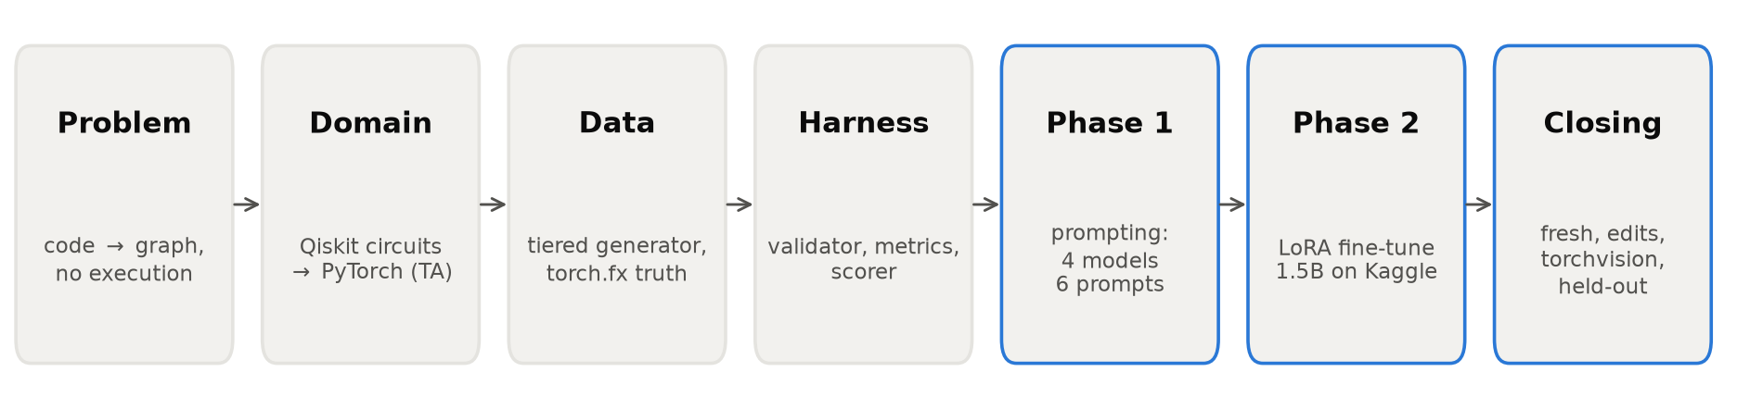
FROM PROBLEM STATEMENT TO RESULTS
Workflow
4 Sep
plan
20 Sep
prep review
16–17 Oct
PyTorch rebuild
17–22 Oct
prompting
23–25 Oct
fine-tuning
25–26 Oct
closing tests
IE 643 Course Project · Team Pensieve
4
Notes:
[1:30-2:10]
• Problem -> domain -> data -> harness -> prompting -> fine-tuning -> closing tests.
• The pivot (second box): the prep review used quantum circuits; corrected to PyTorch, as the task asks.
• Blue boxes = experiments; everything before them is the measuring instrument.
• Dates along the bottom: the experiments themselves took about ten days.

Slide 5
WORK BEFORE THE PREP REVIEW
Before the review: quantum-circuit graphs
a Qiskit circuit…
…and its DAG (exact truth from Qiskit)
q0
H
0: h
q0
q0
2: cx
q0 q1
q1
3: rz(0.785)
q1
q1
q1
X
+
RZ
1: x
q1
0.785
tiered generator
DAG text format
validator + metrics
prompting pipeline
TA correction: the task is a neural network's forward pass → rebuilt on PyTorch + torch.fx
IE 643 Course Project · Team Pensieve
5
Notes:
[2:10-2:50]
• Before the review: the same question on quantum circuits — Qiskit gives the exact DAG for free.
• Built then: the generator, the graph text format, a validator, metrics, a prompting pipeline.
• The review: the TA pointed out the task is a deep network's forward pass.
• What carried over: compare GRAPHS (isomorphism), not lists; the whole harness was domain-agnostic, so the rebuild took two days.

Slide 6
WORK AFTER THE PREP REVIEW
After the review: rebuilt, then measured
GROUND TRUTH
torch.fx
trace
DATA
1,600 programs
4 tiers
PHASE 1
4 models
6 prompts
PHASE 2
LoRA on
a 1.5B model
CLOSING
is it
understanding?
1,600
programs
4
models, 1.5B–31B
6
prompts
97 min
fine-tuning, 1 free GPU
IE 643 Course Project · Team Pensieve
6
Notes:
[2:50-3:25]
• After the review: rebuilt around torch.fx, built a 1,600-program dataset, then three rounds of experiments.
• Phase 1: prompting four models with six prompts. Phase 2: fine-tuning a small model.
• Closing: when fine-tuning scored perfectly, I went back to ask whether that is understanding or memorisation.

Slide 7
APPROACH · FORMULATION
Exact grading, for free
source
reference graph
def forward(self, x):
h = self.fc1(x)
h = torch.relu(h)
h = self.fc2(h) + x
return self.out(h)
0 placeholder x
1 call_module fc1
2 call_function relu
3 call_module fc2
4 call_function add
…
0 -> 4 : arg1
model's reply
↓ parse ↓ validate
labelled graph
isomorphism
fx
valid
well-formed, no answer needed
exact
same graph, strictly
topo
same graph, notation ignored
F1
partial credit
IE 643 Course Project · Team Pensieve
7
Notes:
[3:25-4:15]
• Formulation: source in, graph text out. Edges name the argument slot — 'x feeds the add's second input'.
• torch.fx gives the reference; the reply is parsed, checked for structural sanity without the answer, then compared by labelled graph isomorphism — order of lines does not matter, structure does.
• Four scores: valid; exact (strict); topo — exact but ignoring notation like parameter spelling, added after the first reply failed on notation, not structure; F1 for partial credit.

Slide 8
APPROACH · PROMPTING
Six prompts — one of them ours
zero-shot
rules only
few-shot
+ 3 worked examples
chain-of-simulation (ours): track which node each variable holds
h1 = self.fc_1(x) -> n1 fc_1 <- n0
h2 = func.gelu(h1) -> n2 gelu <- n1
h3 = h1 + h2 -> n3 add <- n1 arg0, n2 arg1
return h3 -> n4 output <- n3
CoT
think step by step
CoS ★
simulate the code
decomposition: is the hard part reading, or wiring?
nodes only
list the operations
edges only
wire given operations
code → operations
operations → edges
IE 643 Course Project · Team Pensieve
8
Notes:
[4:15-5:05]
• Six prompts, each isolating one thing. CoT is the control for ours.
• Ours, chain-of-simulation: act as the interpreter — one line per statement, recording which graph node each variable now refers to. A residual edge then falls out mechanically (n1 still feeds the add).
• Decomposition: 'nodes only' tests reading the code; 'edges only' hands over the correct operations and tests wiring alone.

Slide 9
APPROACH · FINE-TUNING
Fine-tuning a small model with LoRA
every attention + MLP projection
loss only on the answer
W₀
frozen
1.56 B
B
system rules
code…
INPUTS 1
NODES
0 placeholder x
masked
cross-entropy
+
A
BASE
Qwen2.5-Coder 1.5B
DATA
1,280 programs
rank 16, trained
OPTIMISER
AdamW · lr 2e-4 · cosine
BUDGET
2 epochs · 97 min · 1× T4
18.5 M of 1.56 B
parameters trained (1.2%)
IE 643 Course Project · Team Pensieve
9
Notes:
[5:05-5:55]
• Base: Qwen2.5-Coder 1.5B, a decoder-only transformer — the model that scored 5% zero-shot.
• LoRA: the original weights W0 stay frozen; each projection learns a rank-16 update B·A. 18.5 M trainable parameters, 1.2% — fits one free 16 GB T4.
• Training data: 1,280 programs; input = the same zero-shot prompt, target = the reference graph.
• Loss: token cross-entropy on the answer only — prompt tokens masked — so it learns to answer, not to recite.
• AdamW, lr 2e-4 cosine, 2 epochs, 97 minutes; the validation split picks the checkpoint.

Slide 10
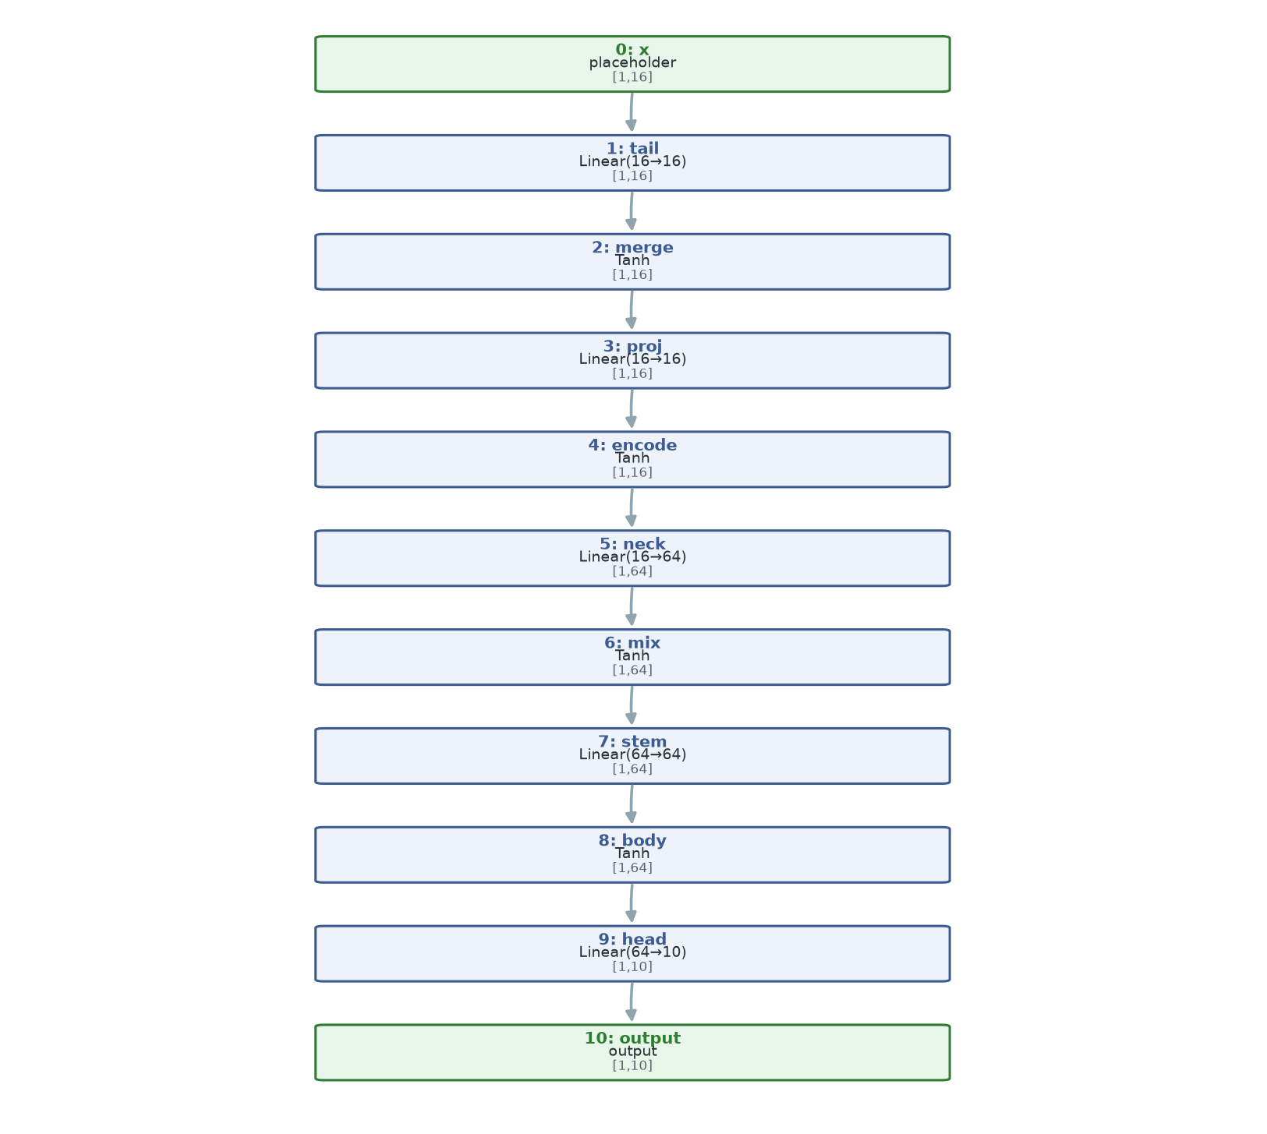
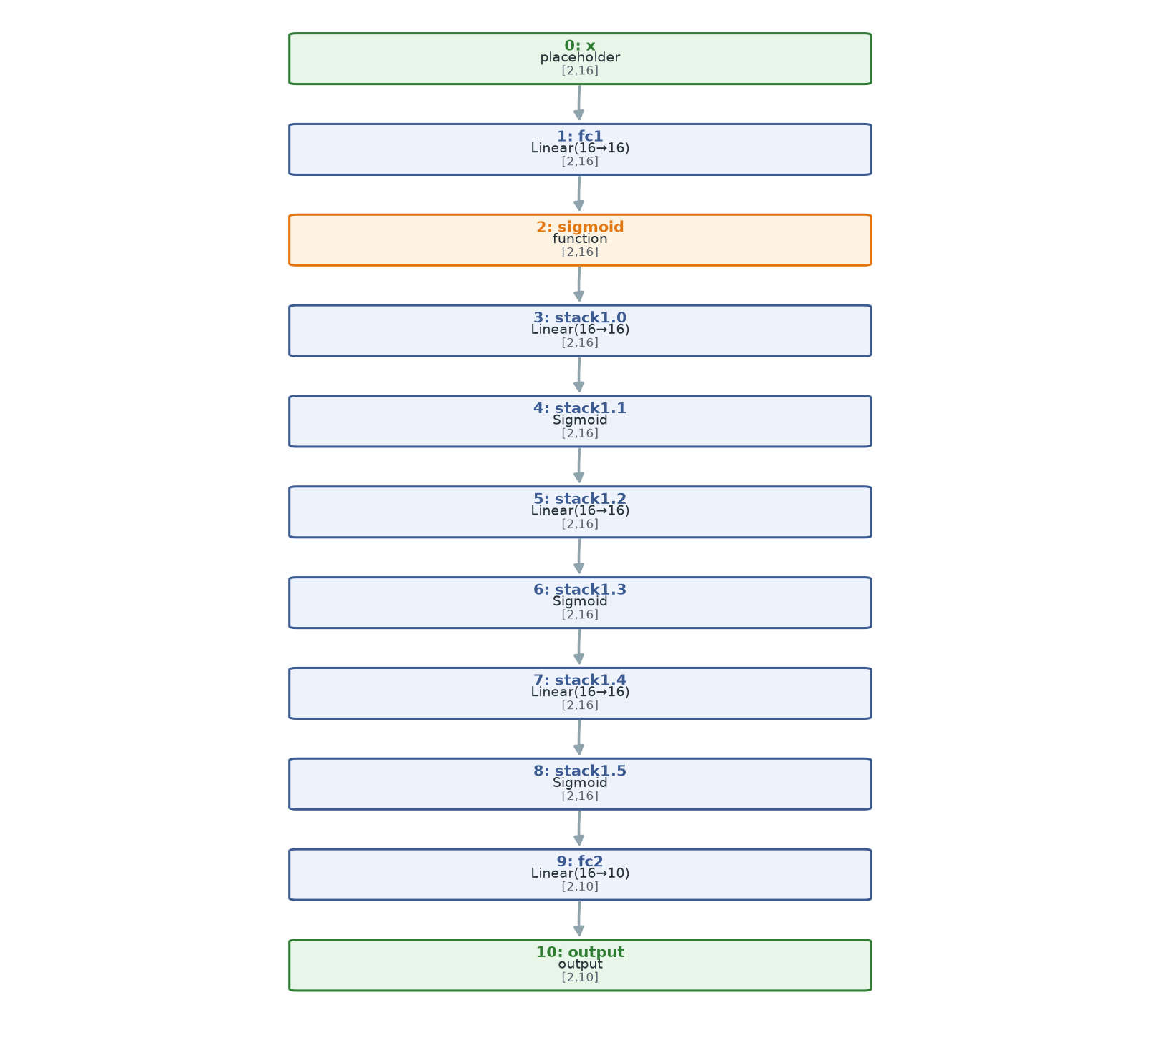
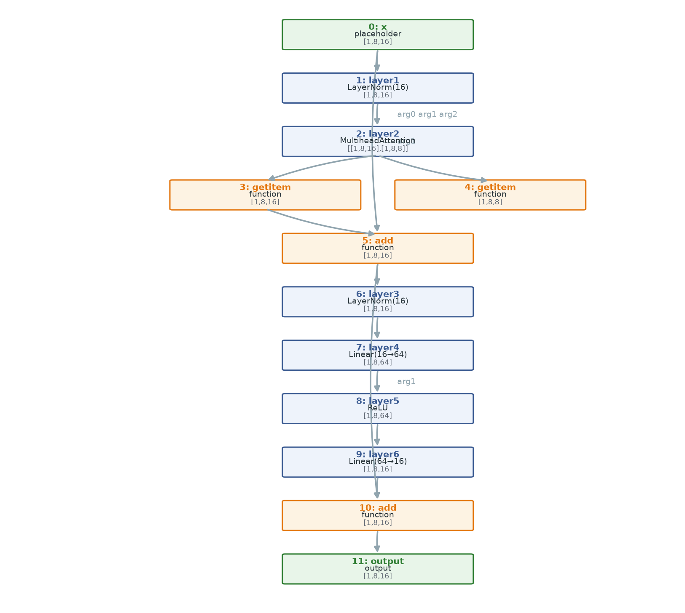
DATA
1,600 programs, four levels of hidden structure
T1 flat
T2 loops
T3 branches
T4 blocks
7–14 nodes
8–13 nodes
8–16 nodes · 2 merges
12–25 nodes · 2 merges
split
style randomised
torch.fx truth
train 1,280
val 160
test 160
IE 643 Course Project · Team Pensieve
10
Notes:
[5:55-6:40]
• Fully synthetic; my generator writes the programs, torch.fx traces each one.
• Tiers vary how much the CODE HIDES the graph, not how big it is: flat lines; loops and Sequential; branches (residuals, concatenation, dead branches, reused layers); whole blocks (ResNet, Inception, transformer, U-net).
• Style is randomised separately — class names, imports, naming — so a model cannot shortcut on house style.
• 80/10/10 per tier; duplicate graphs removed. Every result here uses the same 40 test programs, 10 per tier.

Slide 11
EXPERIMENTAL SETUP
Where it ran
HARDWARE
MODELS
EVALUATION
laptop
CPU only
Qwen2.5-Coder
1.5B · 7B · 14B
40
test programs
Kaggle
2× T4 · 16 GB
Gemma 4
31B
20
fresh programs
OpenRouter
free tier
+ LoRA
on the 1.5B
193 + 21
edits · torchvision
greedy decoding
same prompt, every model
same 40 programs
IE 643 Course Project · Team Pensieve
11
Notes:
[6:40-7:15]
• Three places: the laptop for small local runs, free Kaggle T4 GPUs for the 7B/14B and all fine-tuning, OpenRouter's free tier for Gemma 31B. No money spent.
• Models span 1.5B to 31B; the 1.5B is also fine-tuned.
• Decoding is greedy everywhere, the same prompt and the same 40 programs for every model — so rows compare.
• Plus 20 fresh programs, and two closing sets: 193 edited programs and 21 real torchvision programs.

Slide 12
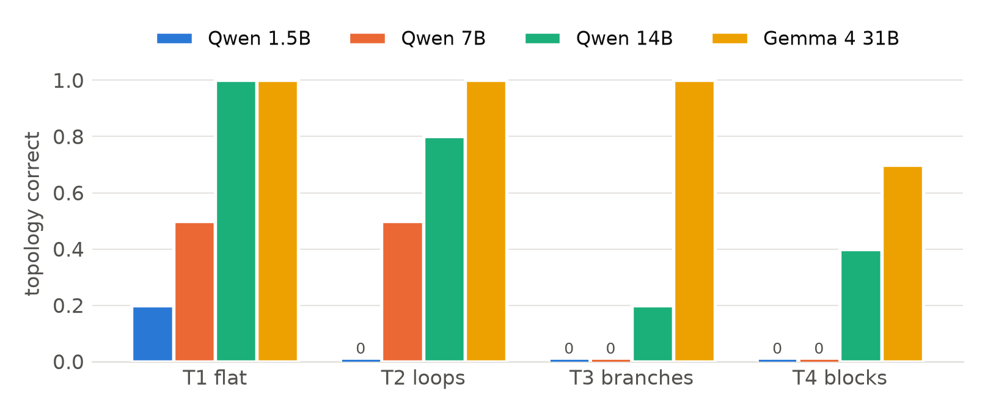
RESULTS · RQ1
Topology appears with scale — chains first
0.05 → 0.93
zero-shot topology
1.5B → 31B
0 / 20
branching programs
solved by the 7B
IE 643 Course Project · Team Pensieve
12
Notes:
[7:15-8:05]
• Share of programs with the right topology, zero-shot, by tier.
• Clear scale curve: 5% at 1.5B, 25% at 7B, 60% at 14B, 93% at Gemma 31B.
• Chains come first: the 7B handles half the flat and loop programs, but none of the branching ones (tiers 3–4). Branching first appears at 14B; the 31B solves tier 3 completely.
• Gemma's few misses: notation (x.tanh written as a function) and tuple unpacking in attention (getitem nodes).

Slide 13
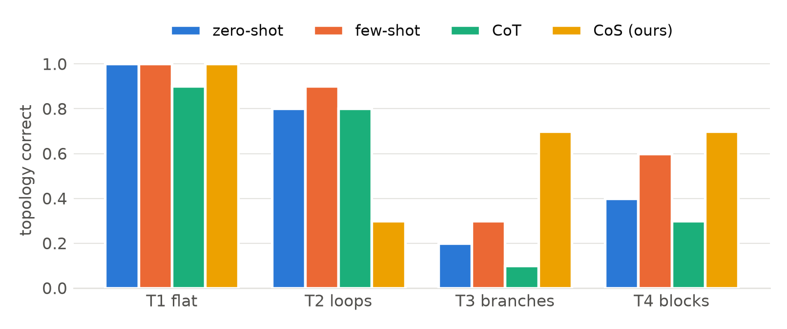
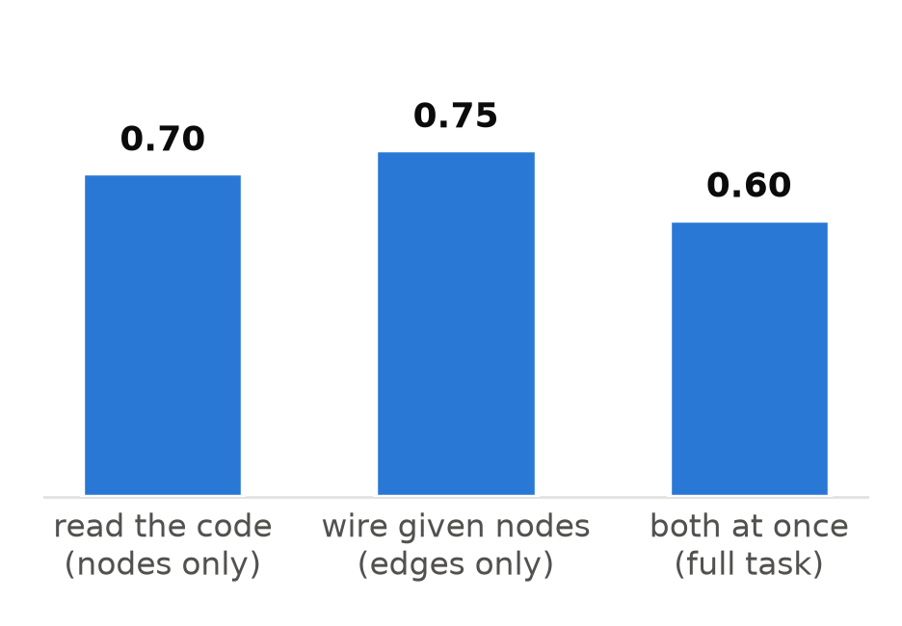
RESULTS · RQ2 · QWEN 14B
Simulation helps on branches; reading and wiring both break there
0.70 × 0.75 ≈ 0.53
no extra cost for doing both
CoT < zero-shot
CoS best on T3–T4
CoS: 3/10 on loops
IE 643 Course Project · Team Pensieve
13
Notes:
[8:05-9:00]
• Left: four prompts on the 14B, by tier. Generic chain-of-thought does WORSE than plain zero-shot: twice the text, no procedure for this task, more format drift.
• Our simulation prompt is the best on the hard tiers (7 of 10 on each), where the code hides the graph. It collapses on loops (3 of 10) — it keeps a node for the Sequential container itself — which is why its total only ties few-shot.
• Few-shot wins overall by fixing FORMAT: worked examples cut unreadable replies from 21 to 4.
• Right: the decomposition. Reading alone 0.70, wiring alone 0.75, both 0.60 — about what two independent skills multiply to. So the hard part is not doing both at once; each skill breaks on branching code.

Slide 14
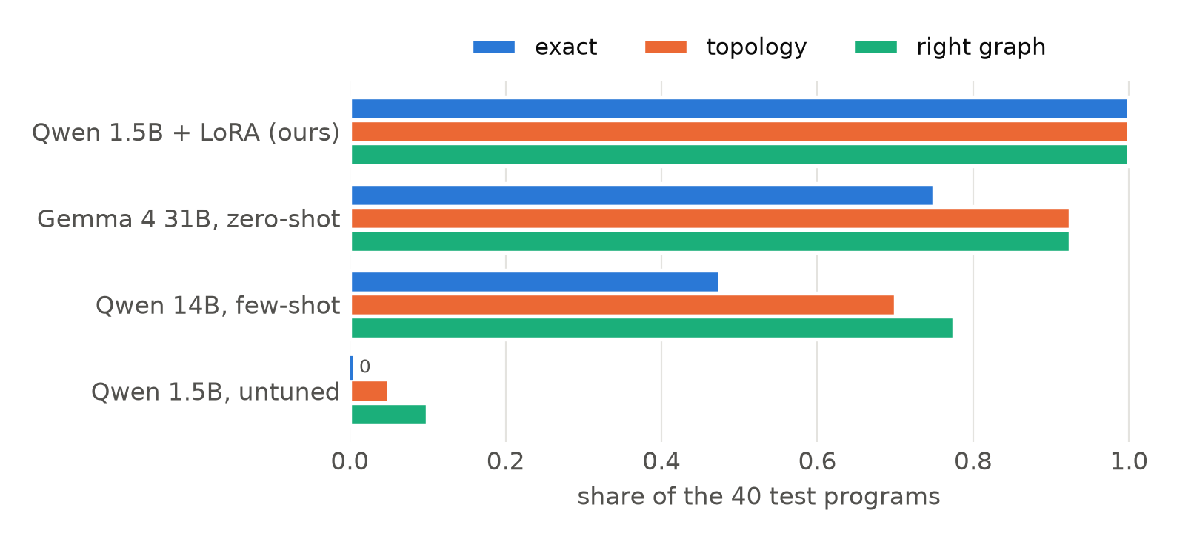
RESULTS · RQ3
On our generator's code, a fine-tuned 1.5B beats a 31B
40 / 40
test programs, exact
20 / 20
fresh programs, unseen graphs
39 / 39
without the one duplicate graph found
leak audit
✓
answer not in prompt
✓
test split never read
✓
no copied answers
✓
untuned: 0 / 40
IE 643 Course Project · Team Pensieve
14
Notes:
[9:00-9:45]
• The fine-tuned 1.5B: every one of the 40 test graphs exactly right — the untuned same model got none; Gemma 31B got 30 exact, 37 with spelling forgiven (the green bars) — so the real gap is 3 programs, not 10.
• Too good, so I audited it: the answer is never in the prompt; training never read the test split; no reply copies a training answer; the same scorer gives the untuned model zero. One test graph duplicated a training graph in a different order — without it, still 39/39.
• Then 20 brand-new programs whose graphs appear nowhere in the data: 20 of 20.
• But every one of these programs came from my generator. The next slide is what happened outside it.

Slide 15
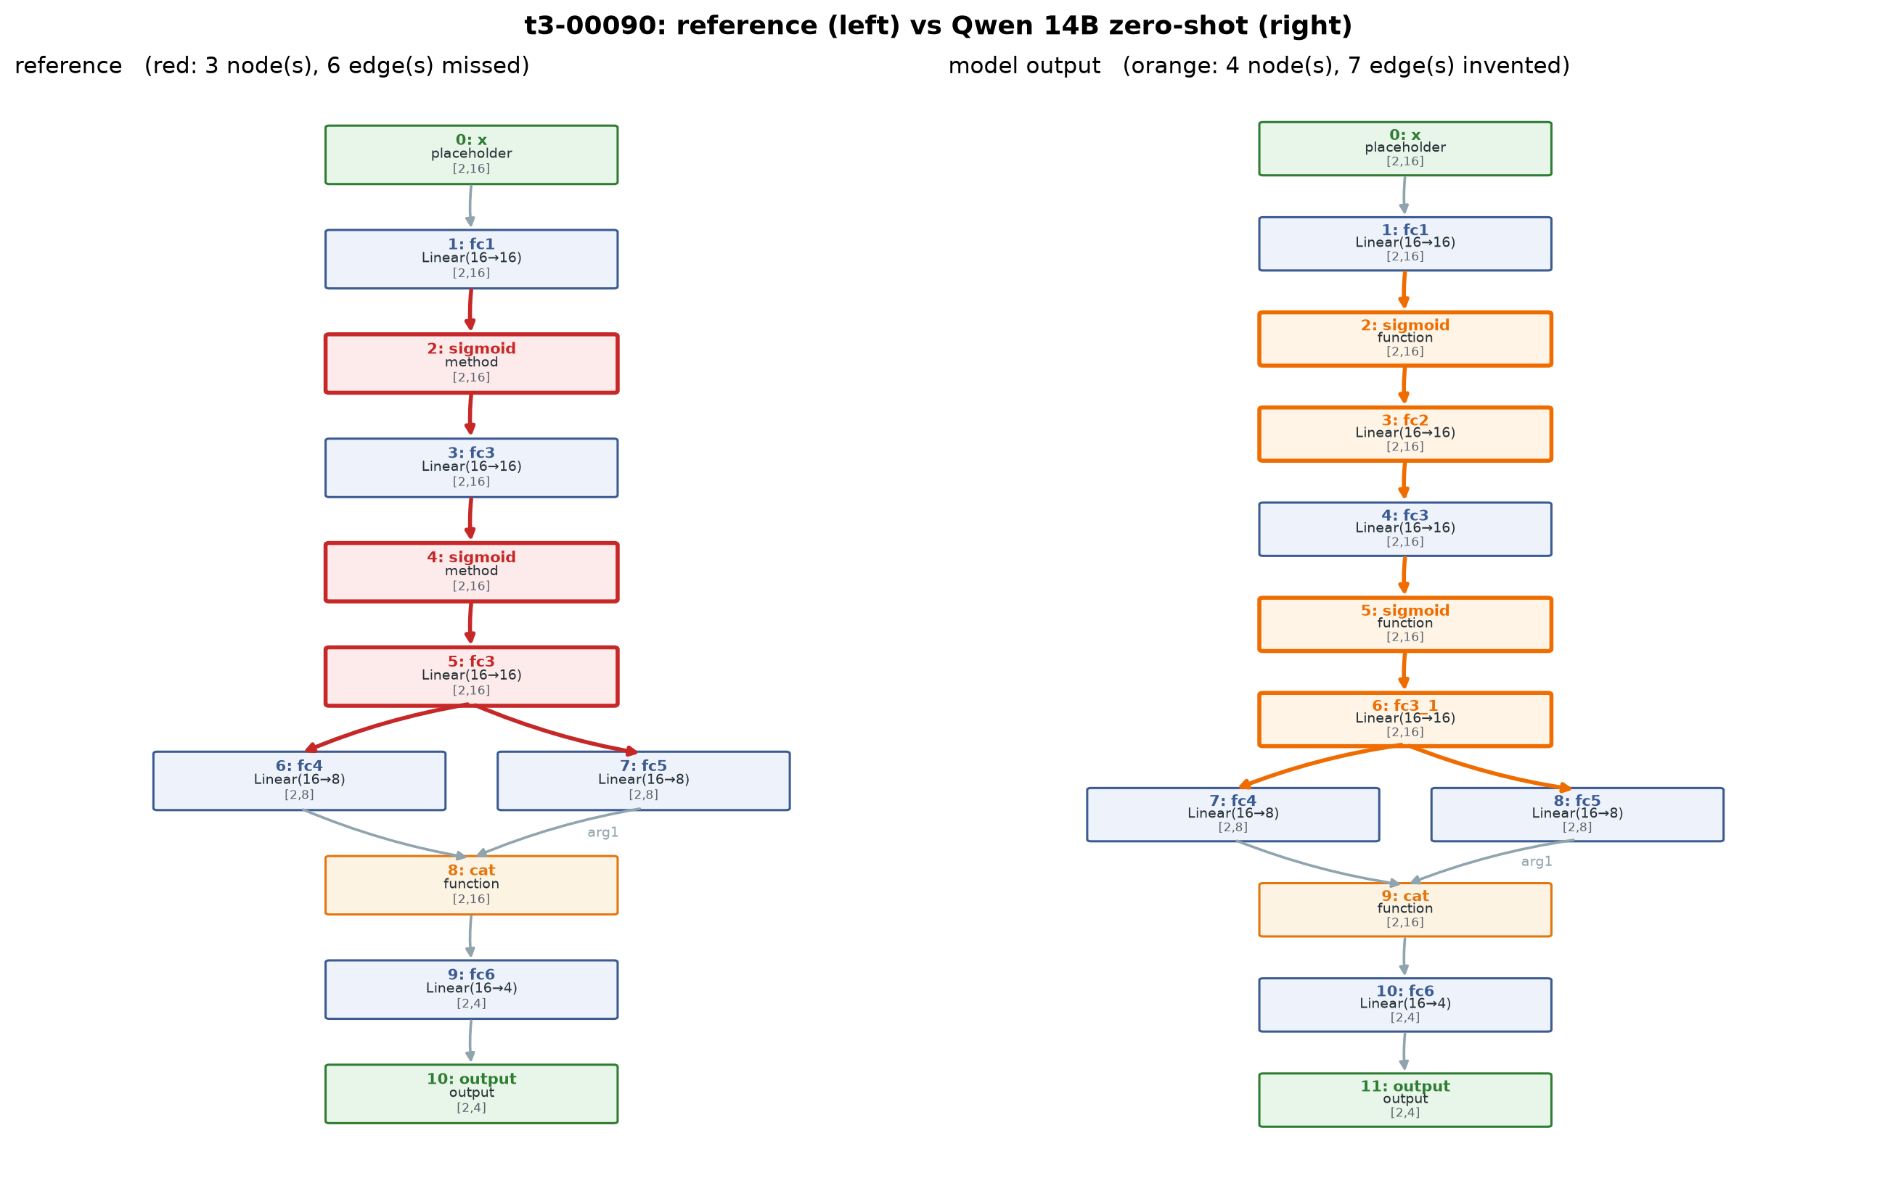
RESULTS · QUALITATIVE · QWEN 14B, ZERO-SHOT
What going wrong looks like
1
dead branch written in
fc2 sits under if self.wide: — never runs
2
reused layer renamed
fc3 called twice → invented fc3_1
3
method vs function
F.sigmoid is traced as a tensor method
left: reference · right: the model · orange/red: mismatches
IE 643 Course Project · Team Pensieve
15
Notes:
[9:45-10:20]
• A real reply — the same program as on the task slide. Left: the truth; right: the 14B's answer; colour marks every mismatch.
• Three different mistakes in one answer:
1. It wrote fc2 into the graph, though it sits under a flag that is False — it never runs.
2. fc3 is called twice; the model invented a new layer, fc3_1.
3. A notation trap: F.sigmoid is recorded by fx as a tensor method.
• Errors 1 and 2 are reasoning about what code DOES — exactly what the closing experiments probe.

Slide 16
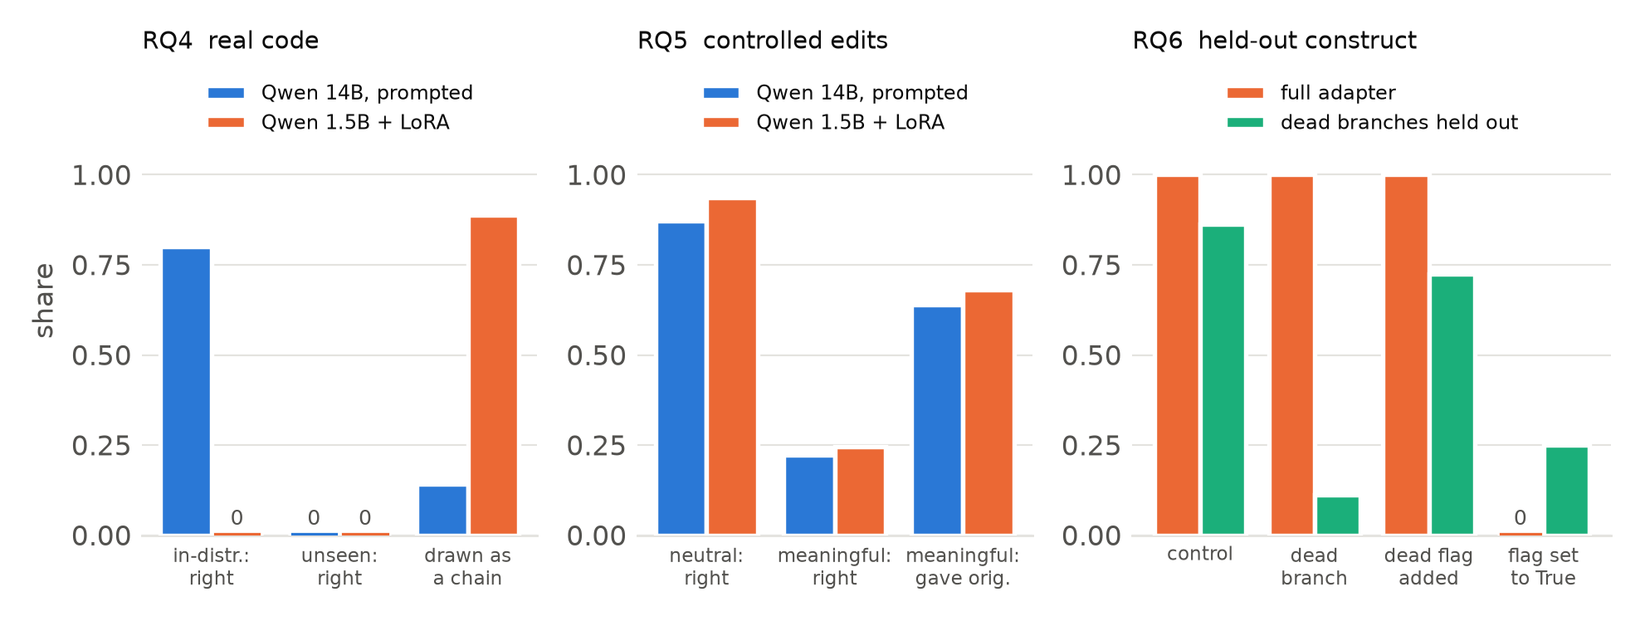
RESULTS · RQ4–RQ6
Fine-tuning learned our generator — not the rule
16 / 18
real-code replies drawn
as one straight chain
0 / 27
rerouted inputs followed
0 / 4
live flags kept
(training: always False)
both models answer changed wiring with the OLD graph: 64% · 68%
small groups (4 live flags, 5 in-distribution samples) · one seed · torchvision split fixed before scoring
IE 643 Course Project · Team Pensieve
16
Notes:
[10:20-11:10]
• Three tests outside the generator. Blue: the prompted 14B. Orange: the fine-tuned 1.5B.
• Real torchvision code: the tuned model gets none right — and draws 16 of 18 replies as a straight chain; branches, concatenations and skip connections vanish. On our own programs it never does that. The 14B still draws branches, 4 of the 5 samples that look like our data.
• Controlled edits: rename a variable and both are fine. Change which value feeds a layer and both answer with the graph the code USED to have — 64% and 68%. The tuned model followed a rerouted input 0 times in 27.
• Held-out construct: trained without dead branches, it writes dead layers in. Trained with them, it deletes the layer even when the flag is True — in training, every flag was False.
• So: it learned to read my generator's code, with shortcuts the data allowed — not the rule.

Slide 17
Conclusions
SCALE
PROMPTING
FINE-TUNING
EDITS
0.05 → 0.93
zero-shot topology,
1.5B → 31B
14 / 20
hard tiers,
chain-of-simulation
40 → 0
our test vs real code
(of 40, of 21)
64% · 68%
changed wiring answered
with the old graph
A perfect score and a clean leak audit did not show understanding — probes did
IE 643 Course Project · Team Pensieve
17
Notes:
[11:10-11:40]
• Scale: the ability grows with size, branching last.
• Prompting: simulating the code beats generic thinking on the hard tiers; examples beat instructions for format.
• Fine-tuning: perfect on our generator's code, nothing on real code — it learned the family, with its shortcuts.
• Both models answer changed wiring with the familiar graph.
• The lesson: 40 out of 40 and a clean leak audit were not evidence of understanding; edits, real code and a held-out construct — each with exact ground truth — were.

Slide 18
PLAN FOR NOVELTY ASSESSMENT
Next: take the shortcuts away
1
live flags
flags that are sometimes
True, not always False
2
varied code
input names, helper classes
& functions, grouped convs
3
edit pairs
training pairs that differ
only in their wiring
retrain → re-run RQ4–RQ6
Gemma 31B on the edits
interface: built — live demo
IE 643 Course Project · Team Pensieve
18
Notes:
[11:40-12:00]
• Each shortcut the closing runs exposed becomes a change to the data: live flags, varied and real-style code, and training pairs that differ only in wiring.
• Then retrain and re-run the same three probes: do the chain and old-graph signatures go away?
• Plus Gemma 31B on the edits. The interface is already built: paste, upload or generate a program and see the model's graph beside the truth, with the metrics — that is the live demo. Thank you.

Slide 19
References
[1] James K. Reed, Zachary DeVito, Horace He, Ansley Ussery, and Jason Ansel. torch.fx: Practical Program Capture and Transformation for Deep Learning in Python, MLSys, 2022. https://arxiv.org/abs/2112.08429
[2] Edward J. Hu, Yelong Shen, Phillip Wallis, Zeyuan Allen-Zhu, Yuanzhi Li, Shean Wang, Lu Wang, and Weizhu Chen. LoRA: Low-Rank Adaptation of Large Language Models, ICLR, 2022. https://arxiv.org/abs/2106.09685
[3] Jason Wei, Xuezhi Wang, Dale Schuurmans, et al. Chain-of-Thought Prompting Elicits Reasoning in Large Language Models, NeurIPS, 2022. https://arxiv.org/abs/2201.11903
[4] Maxwell Nye, Anders Johan Andreassen, Guy Gur-Ari, et al. Show Your Work: Scratchpads for Intermediate Computation with Language Models, arXiv, 2021. https://arxiv.org/abs/2112.00114
[5] Alex Gu, Baptiste Rozière, Hugh Leather, Armando Solar-Lezama, Gabriel Synnaeve, and Sida I. Wang. CRUXEval: A Benchmark for Code Reasoning, Understanding and Execution, ICML, 2024. https://arxiv.org/abs/2401.03065
[6] Bahare Fatemi, Jonathan Halcrow, and Bryan Perozzi. Talk like a Graph: Encoding Graphs for Large Language Models, ICLR, 2024. https://arxiv.org/abs/2310.04560
[7] Heng Wang, Shangbin Feng, Tianxing He, Zhaoxuan Tan, Xiaochuang Han, and Yulia Tsvetkov. Can Language Models Solve Graph Problems in Natural Language?, NeurIPS, 2023. https://arxiv.org/abs/2305.10037
[8] Binyuan Hui, Jian Yang, Zeyu Cui, et al. Qwen2.5-Coder Technical Report, arXiv, 2024. https://arxiv.org/abs/2409.12186
[9] Gemma Team, Aishwarya Kamath, Johan Ferret, et al. Gemma 3 Technical Report, arXiv, 2025. https://arxiv.org/abs/2503.19786
[10] Sourab Mangrulkar, Sylvain Gugger, Lysandre Debut, Younes Belkada, Sayak Paul, and Benjamin Bossan. https://github.com/huggingface/peft, 2022. Accessed on: 26th October, 2026.
[11] TorchVision maintainers and contributors. https://github.com/pytorch/vision, 2016. Accessed on: 26th October, 2026.
[12] Ollama. https://ollama.com · OpenRouter. https://openrouter.ai · Kaggle. https://www.kaggle.com/code. Accessed on: 26th October, 2026.
IE 643 Course Project · Team Pensieve
19
Notes:
Leave up during questions. Format: authors, title, venue, year, URL; websites with access date.

