Slide 1
MiniLang Compiler An Overview of Design and Implementation Presented by : Warda BibI 2020517 Wardah Tariq 2020519 Rao Ehsan Ilahi 2020111
Notes:
<number>

Slide 2
Structure of the Minilang Compiler
Main Components:
Lexer: Converts source code into tokens.
Parser: Builds an Abstract Syntax Tree (AST) from tokens.
Code Generator: Produces assembly code from the AST.
<number>
Notes:
<number>

Slide 3
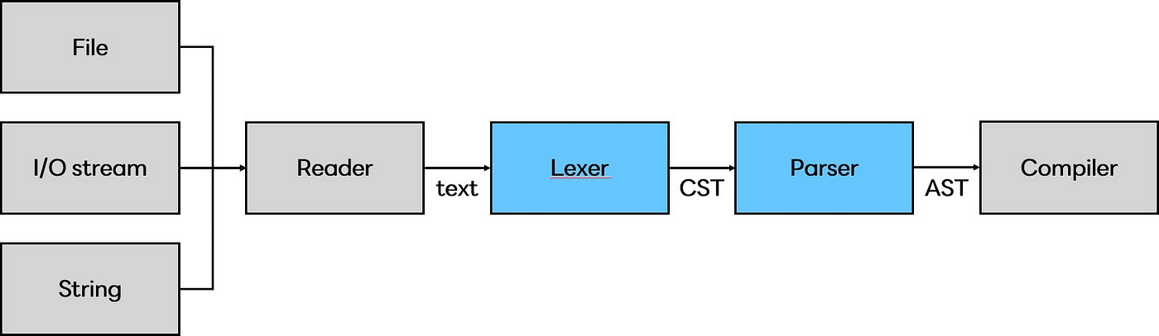
Overview

Slide 4
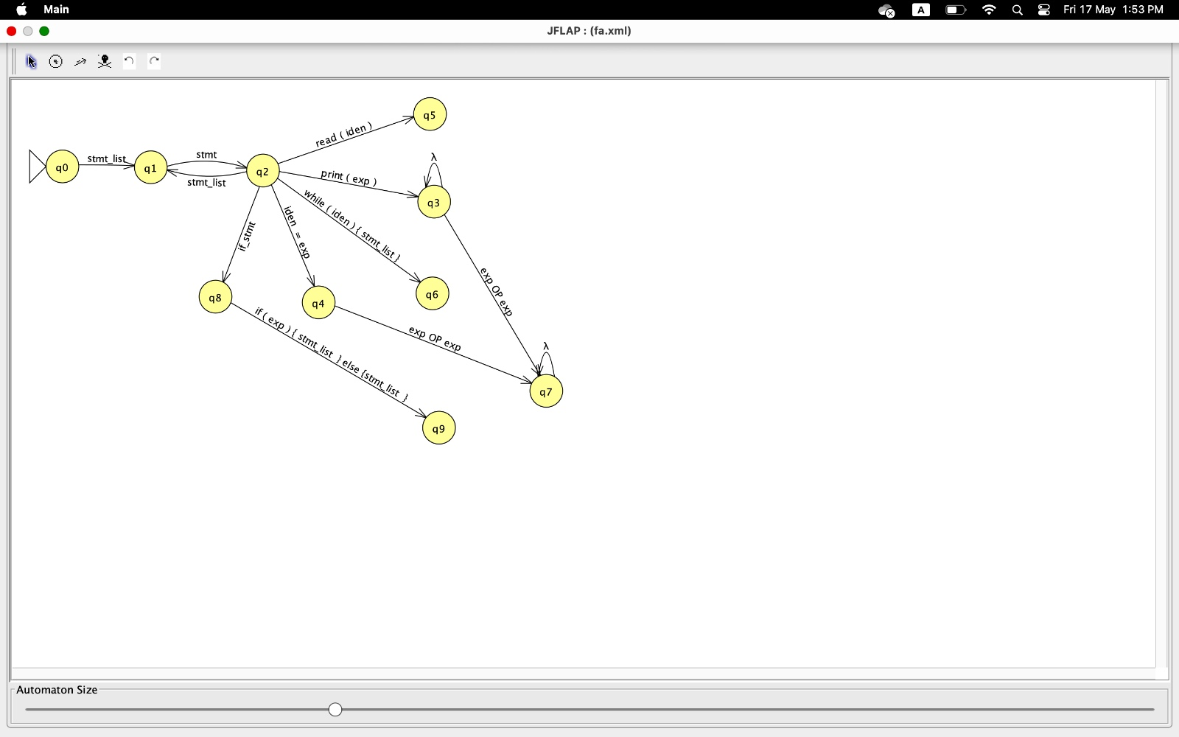
Converting Grammer to FA using JFLAP
vhsdv

Slide 5
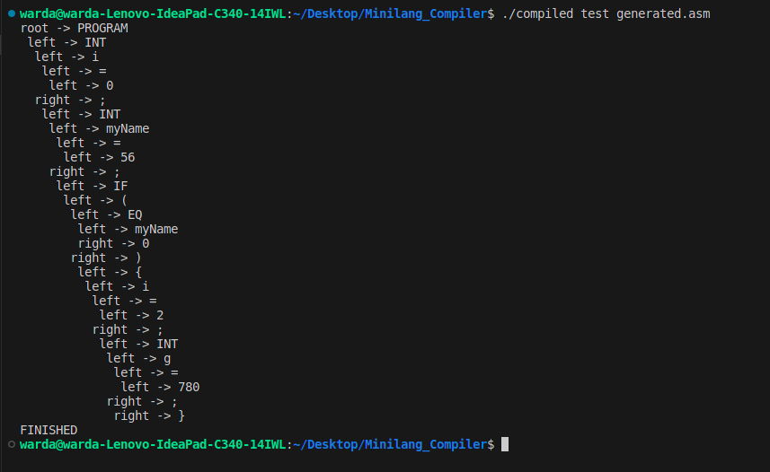
Parse Tree

Slide 6
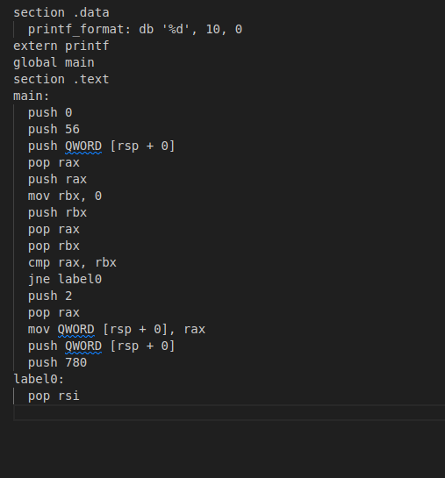
Assembly code

Slide 7
Challenges and Solutions Handling complex language features. Managing memory efficiently. Ensuring error-free parsing and code generation. Solutions implemented: Robust error handling. Efficient data structures for symbol tables. Clear modular design.
Notes:
<number>

Slide 8

Thank you
Notes:
<number>

