Slide 1

oop project

Slide 2
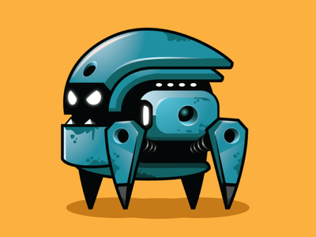
Group Members:
223644 m umair latif
223710 Rao ali ahmed

Slide 3
So we discussed what inheritance and polymorphism concept will we include in this new portal

Slide 5
Now it was time for us to implement our objectives practically, So we started coading…..

Slide 7
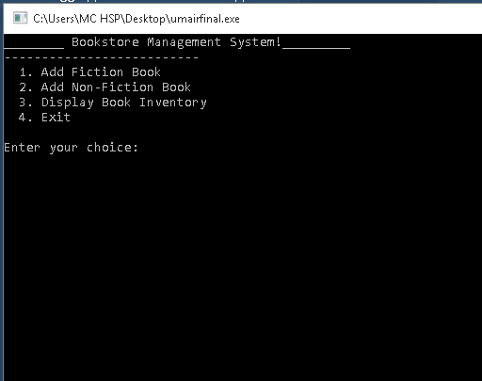
Loading

Slide 8
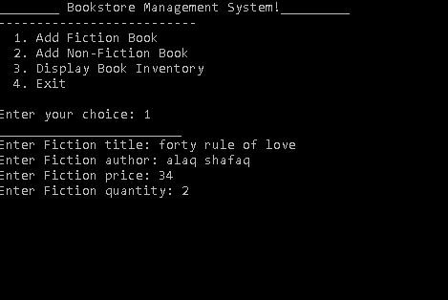
Taking Inputs

Slide 9
Taking Inputs

Slide 10
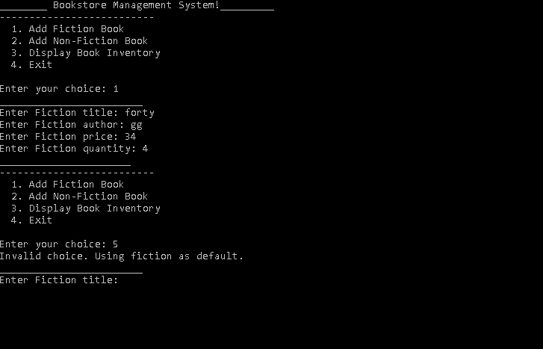

Slide 11



Thanks!
Now lets practically see the portal working……

