Slide 1


CAPASTONE PROJECT
INTERST RATE PREDICTION

Slide 2

InTRODUCTION
The difficulty of increasing earnings and reducing risks for banks and lending organizations which are dealing with significant administrative costs and a fiercely competitive environment is our company's concern. Our objective is to find methods that can assist banks in utilising machine learning and AI to enhance business processes, boost productivity, and keep a profit.

Slide 3

PROBLEM DEFINITION
Banks and lending firms offer various kinds of accounts and provide loans based on the requirements. Apart from it, there are other various activities like investments in market and different funds. Overall, the banking sector has a wide impact on the economy directly and indirectly.
There are many banks across the globe that are leveraging machine learning and AI in their daily routine and getting benefits out of it.
For example, top banks in the US like JPMorgan, Wells Fargo, Bank of America, City Bank and US banks are already using machine learning to provide various facilities to customers as well as for risk prevention and detection.
We know that banks have massive overheads, with thousands of employees to pay and hundreds of branches to maintain. To maintain profitability, banks must take large margins on the money that passes through them. Earning out of the difference in interests (what it pays to depositors and what it charges from borrowers) is the main source of revenue for any bank and has been the key element in the functioning of all traditional financial institutions.
We can use strategies which will permit these clubs maximise profits and minimize the risks involved in the sector.

Slide 4

TECHNOLOGY USED
Financial firms like banks and lending groups are generally free to determine the interest rate they will pay for deposits and charge for loans, but they must take the competition into account, as well as the market levels for numerous interest rates and policies.
There are many types of interest rates and loan products. When it comes to setting rates, certain loans, such as residential home mortgage loans, may not be based on the prime rate fixed by the firm but rather according to the policies set by the government.
These firms use an array of factors to set interest rates mainly to maximize profits for their shareholders. On the flip side, consumers and businesses seek the lowest rate possible. They start from client inputs, such as credit score, collateral provided, down payment and duration for the loan, employment status, assets owned and so on to calculate the optimum interest rates.

Slide 5



Problem
To predict the interest rate category (1 / 2 / 3) that will be assigned to each loan of a customer based on their past data.
Target
Interest_Rate Predictions for different customers.
Technology used.
Supervised Learning - Classification

Slide 6

Our Process
1
2
3
4
Data Cleaning
Missing value imputation
Outlier treatment
Statistical analysis
Balancing Data
Base model - evaluation
EDA
Visualisations

Slide 7
Data-set Information
This dataset was provided by Analytics Vidhya for a banking sector problem. The dataset had 164309 Rows and 14 columns in csv format. The data comprises of different features pertaining to various factors of every customer applying for loan.
Numerical
Loan_Amount_Requested
Length_Employed
Annual_Income
Debt_To_Income
Inquiries_Last_6Mo
Months_Since_Deliquency
Number_Open_Accounts
Total_Accounts
Total 8 Features
Variables
Loan_ID
Loan_Amount_Requested
Length_Employed
Home_Owner
Annual_Income
Income_Verified
Purpose_Of_Loan
Debt_To_Income
Inquiries_Last_6Mo
Months_Since_Deliquency
Number_Open_Accounts
Total_Accounts
Gender
Interest_Rate
Missing Values
Length_Employed | 7371
Home_Owner | 25349
Annual_Income | 25102
Months_Since_Deliquency | 88379
6.36% of total Data values
Categorical
Home_Owner
Income_Verified
Purpose_Of_Loan
Gender
Interest_Rate
Total 5 Features

Slide 8

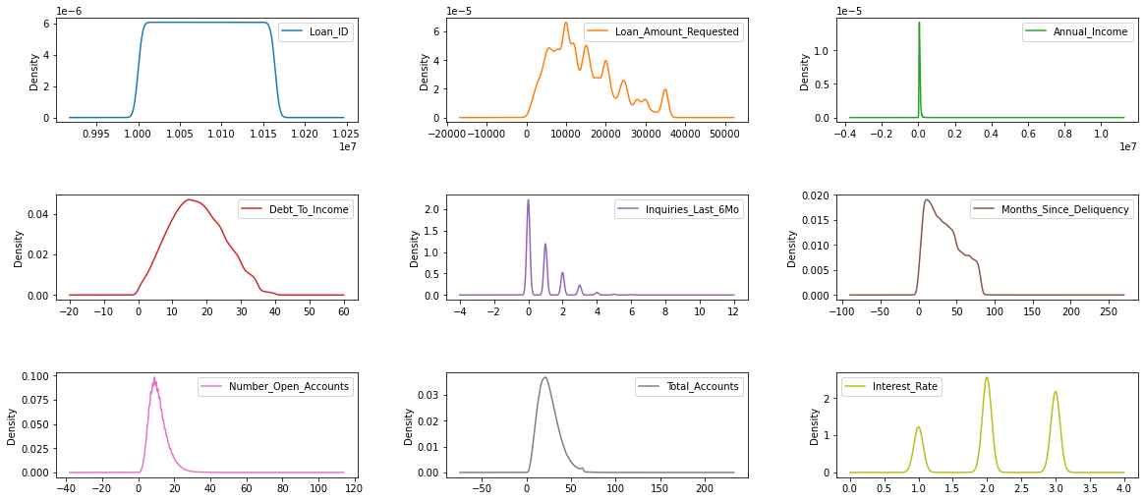
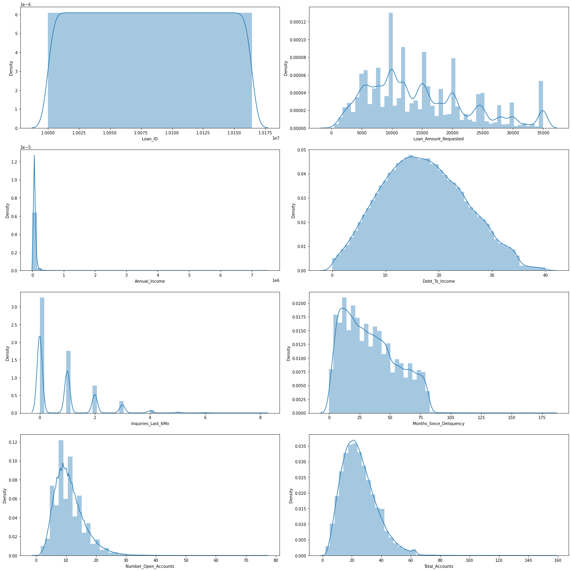
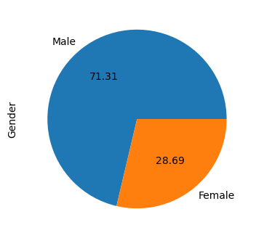
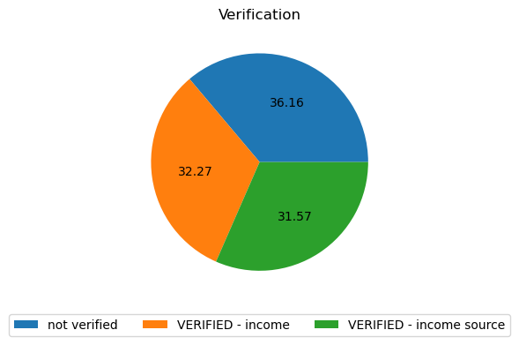
UNIVARIATE ANALYSIS

Slide 9
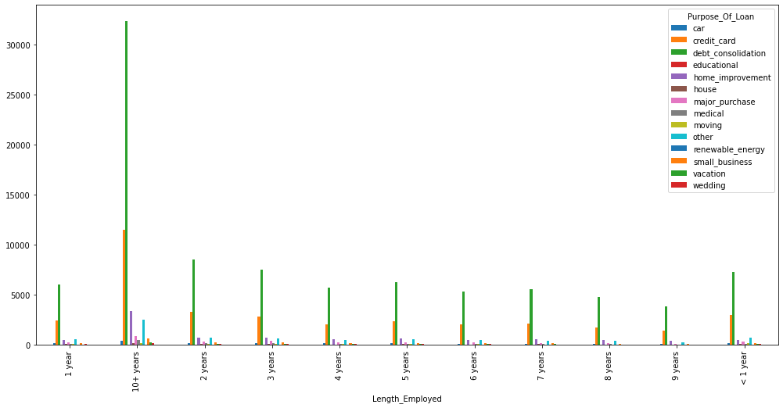
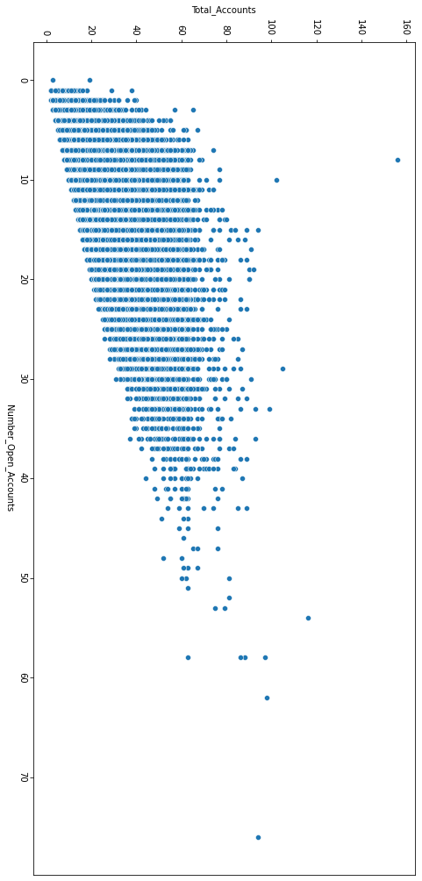
BIVARIATE ANALYSIS
Length_Employed vs Purpose_Of_Loan
Total_Accounts vs Number_open_Accounts

Slide 10
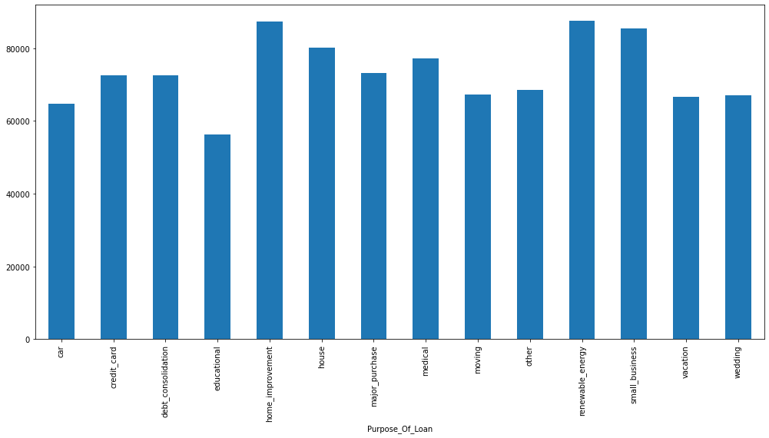
BIVARIATE ANALYSIS
'Purpose_Of_Loan‘ vs 'Annual_Income'

Slide 11
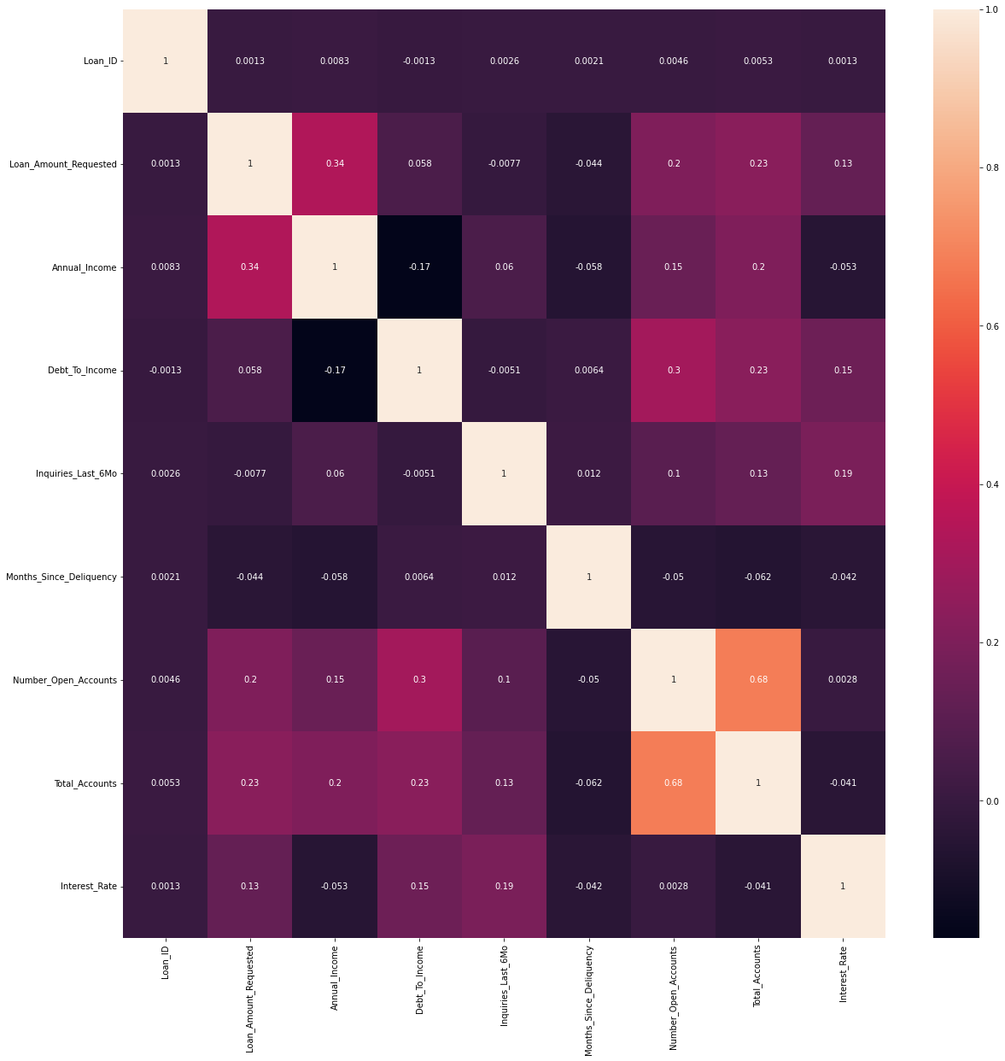
MULTIVARIATE ANALYSIS

Slide 12
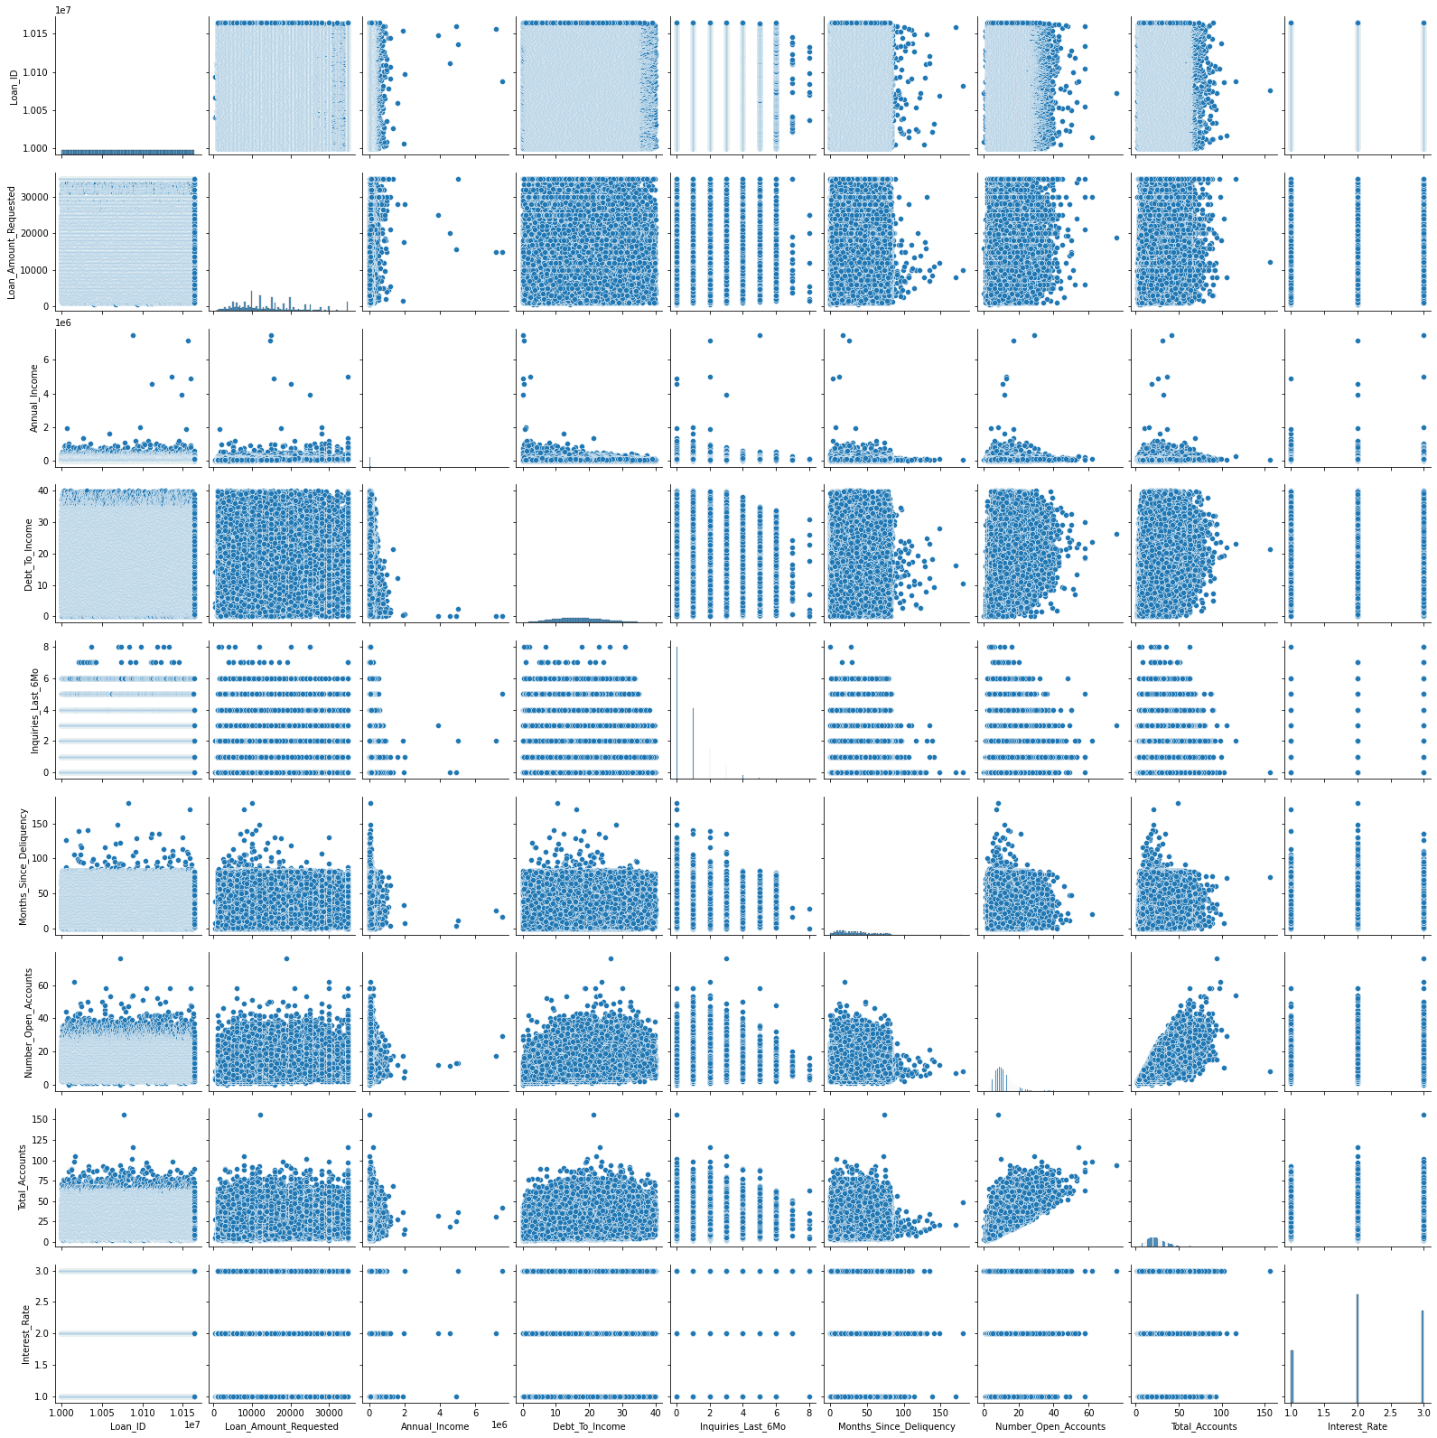
MULTIVARIATE ANALYSIS

Slide 13

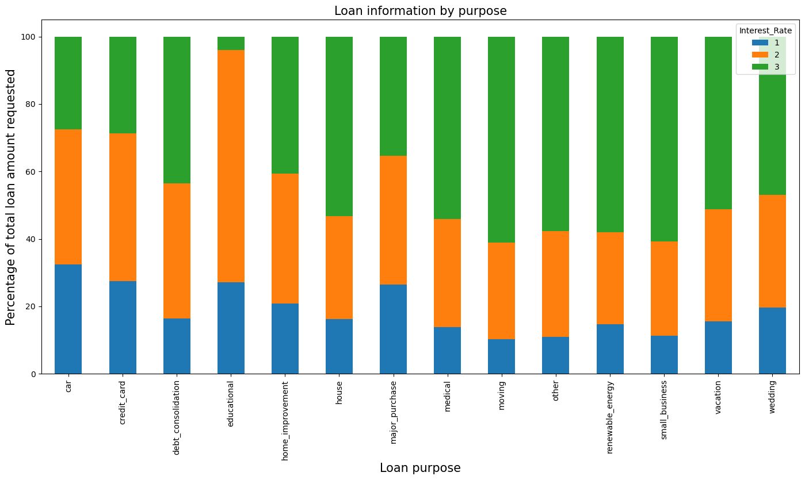
Numerical - categorical

Slide 14
Data Cleaning
Feature Engineering
Loan_ID : Removed as all values were unique.
Length_Employed :Converted into numeric from strings.
Months since Delinquency : Droping its have more than 53+% value
Length_Employed : Converted ‘1 years’ Into 1 using Define function

Slide 15
Missing Values
Encoding
Home ownership : null values replaced with ‘none’.
Employment length :null values imputed with Median
Annual income : null values filled with LinearRegression model
One Hot Encoding :
Using pd.get_dummies

Slide 16

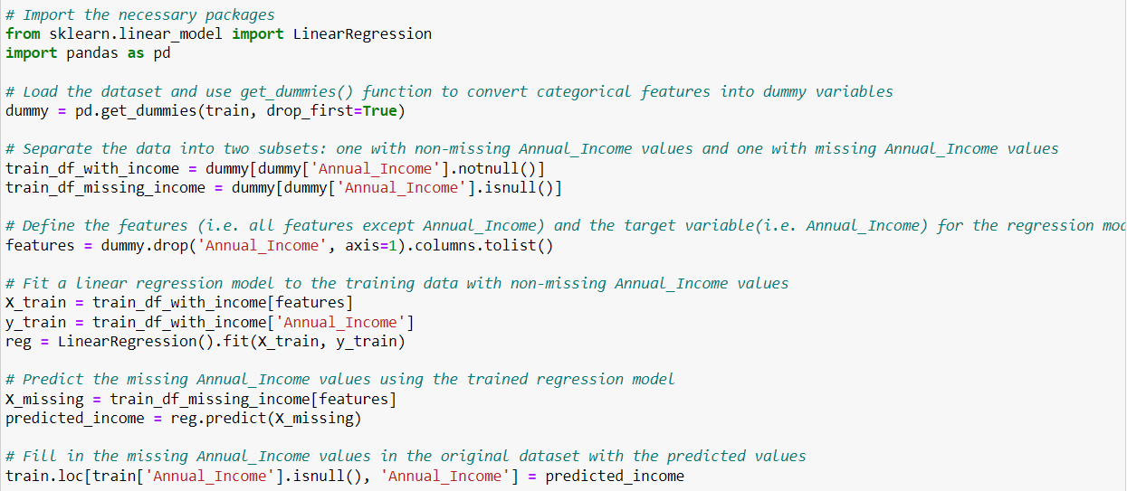


Code of Null Value imputed

Slide 17
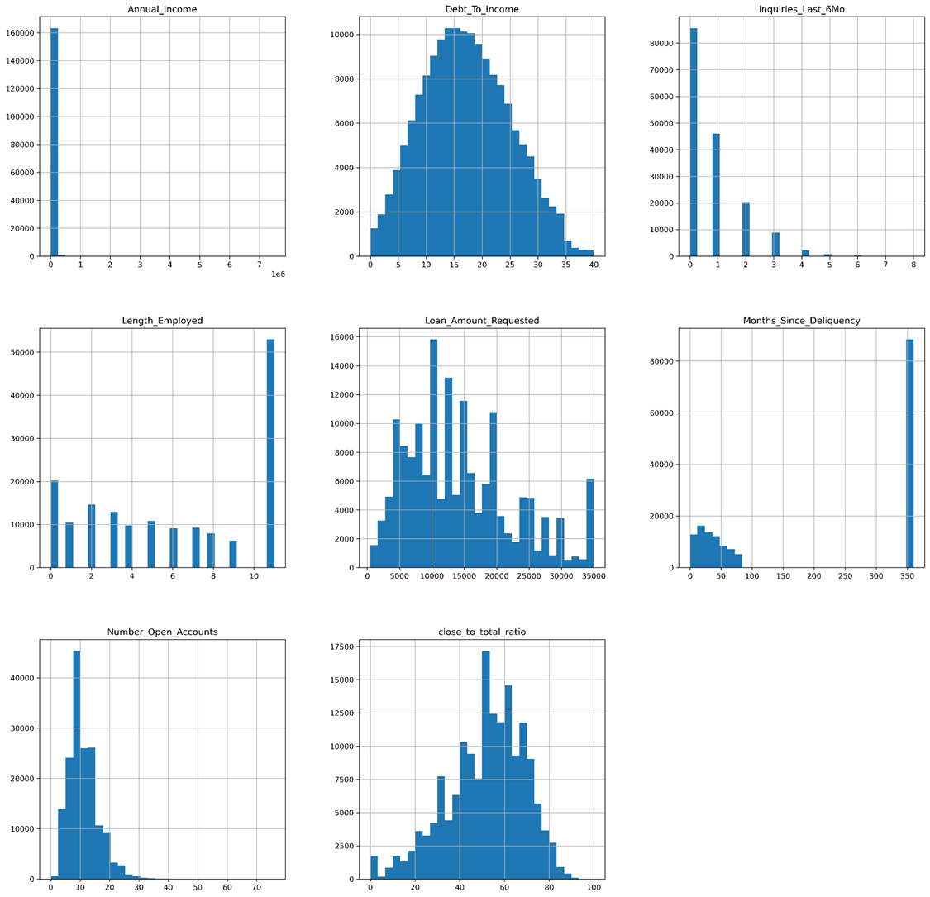
Data Distribution
Using Data.describe() to create a 5 point summary of the data to get a better understanding of the numerical features in the dataset .

Slide 18
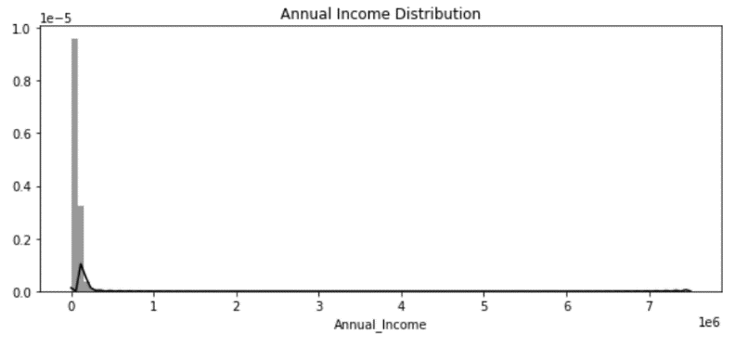
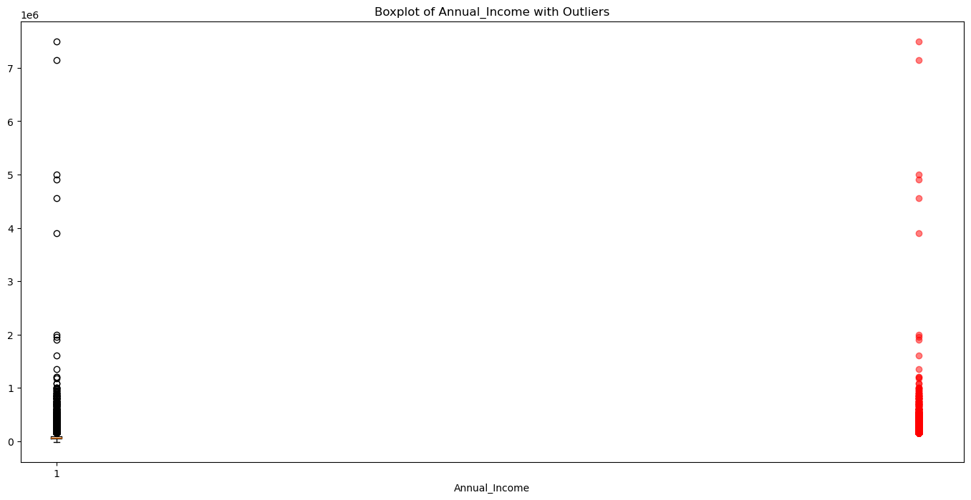
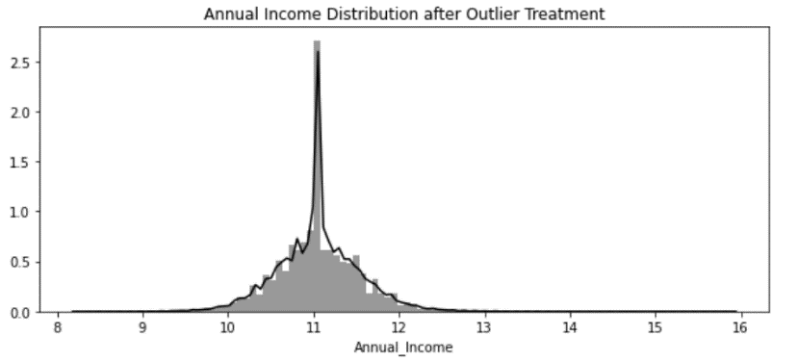
Outliers and Treatment
‘Annual Income’
Before
Skew : 40.22
yeo_johnson_PT.fit_transform('Annual_Income')
Skew : 5.32
After

Slide 19
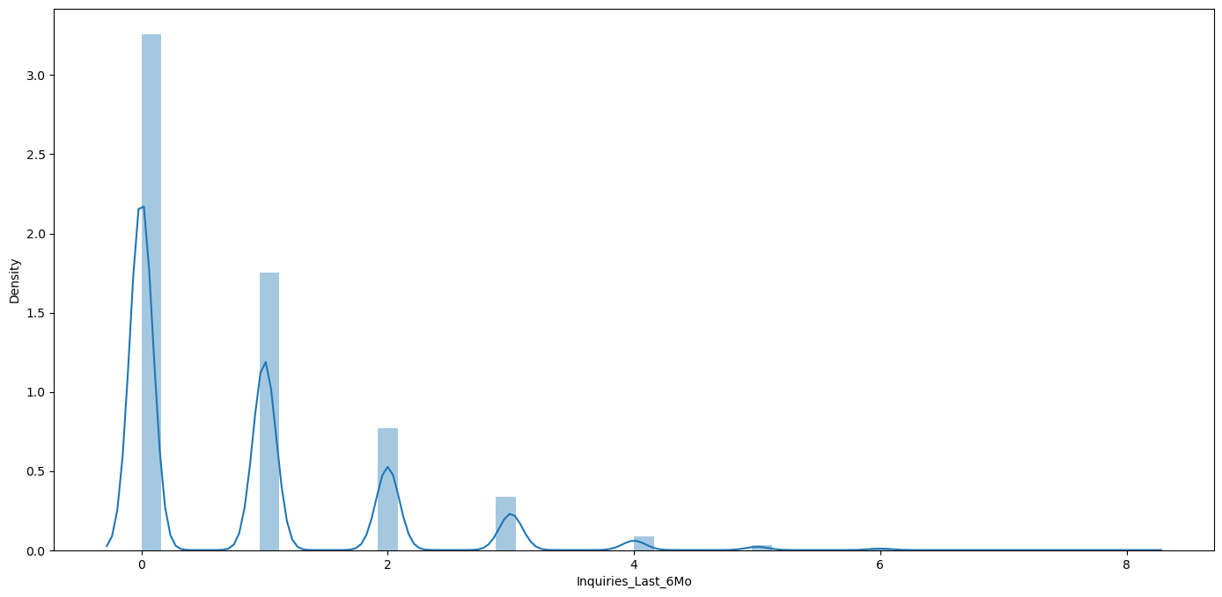
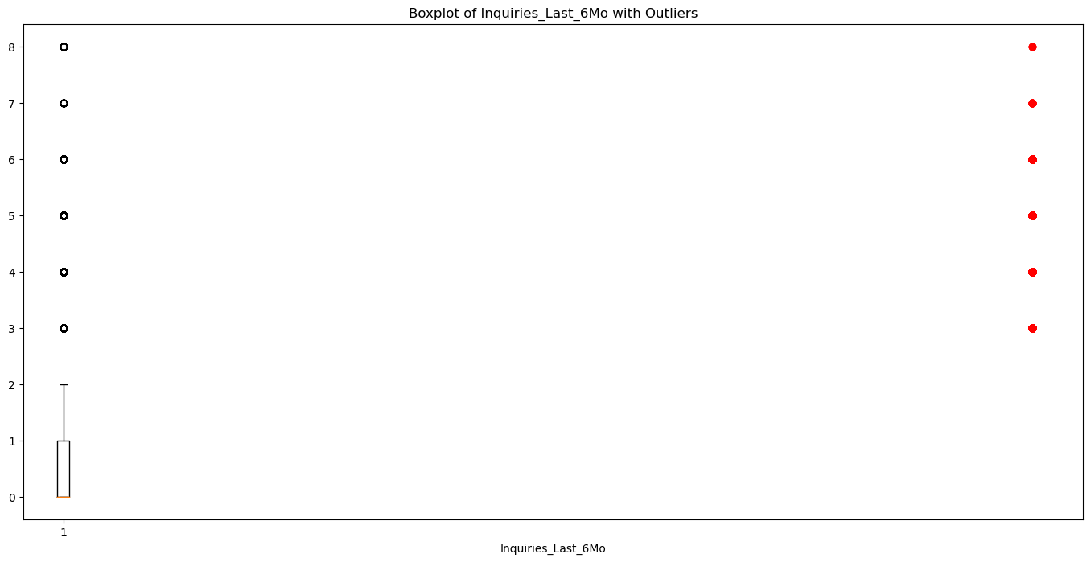
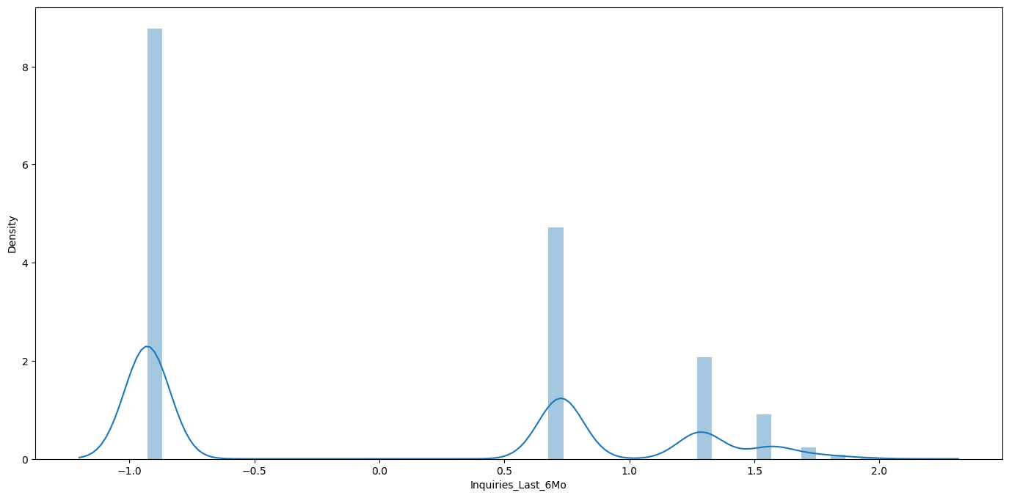
Outliers and Treatment
‘Inquiries_Last_6Mo’
Before
Skew : 1.55
yeo_johnson_PT.fit_transform(‘Inquiries_Last_6Mo ')
Skew : 0.27
After

Slide 20
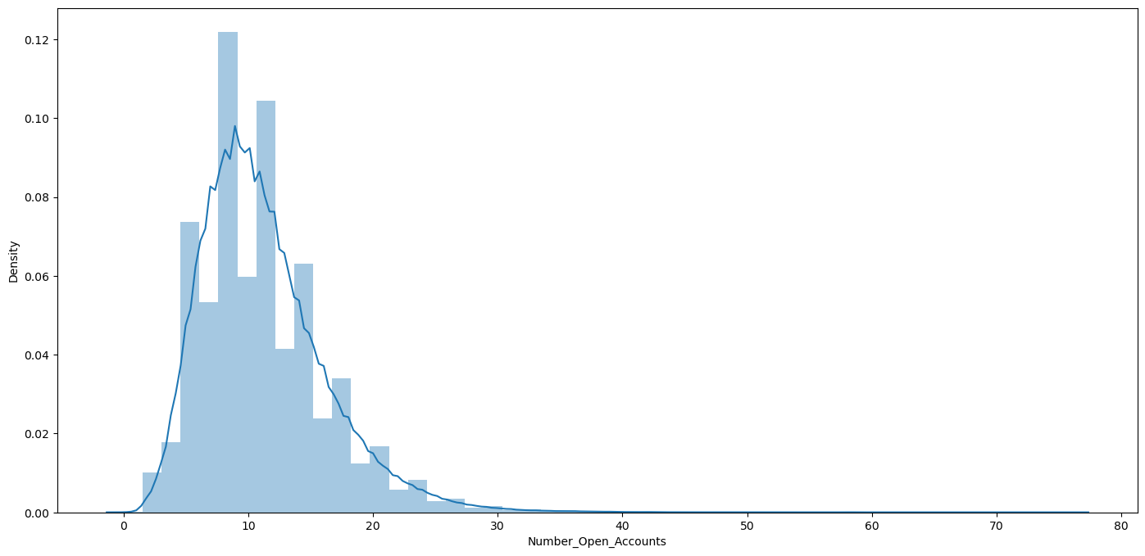
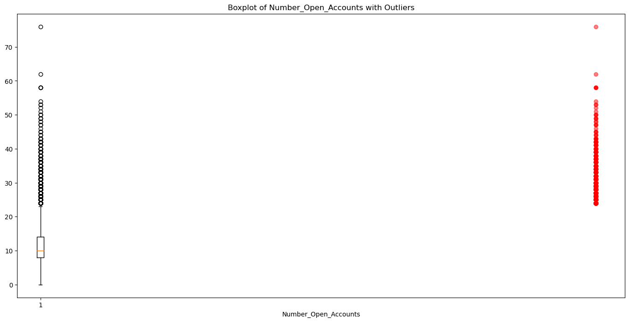
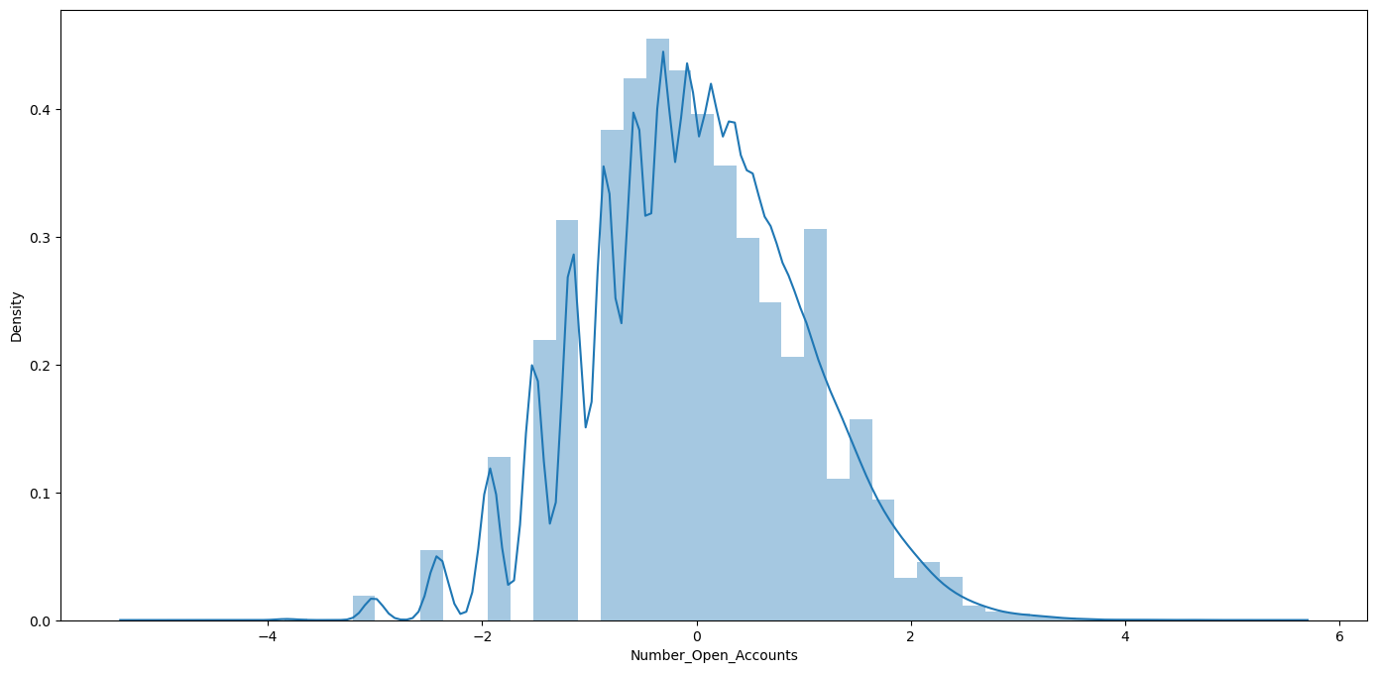
Outliers and Treatment
‘Number_open_Accounts’
Before
Skew : 1.16
yeo_johnson_PT.fit_transform(‘Number_open_Accounts ')
Skew : 0.002
After

Slide 21
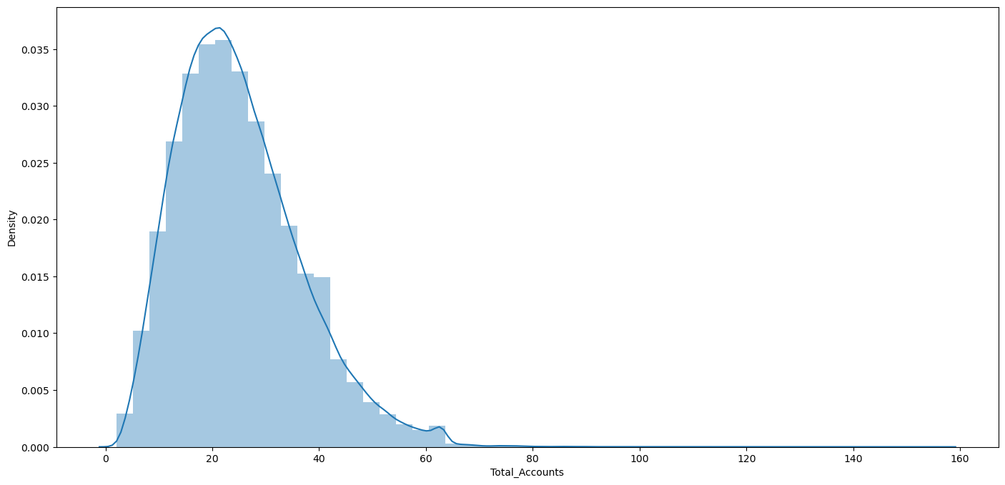
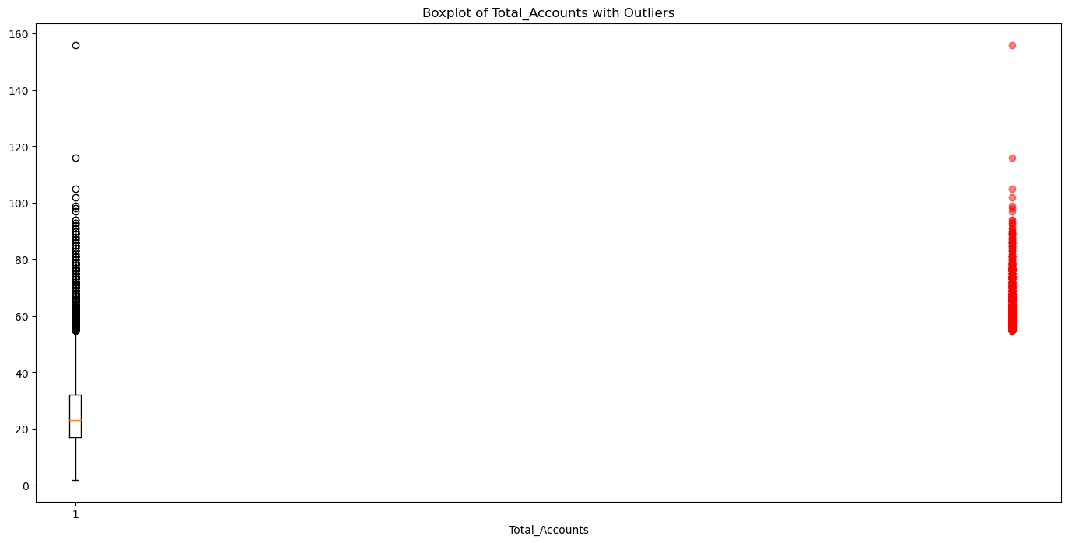
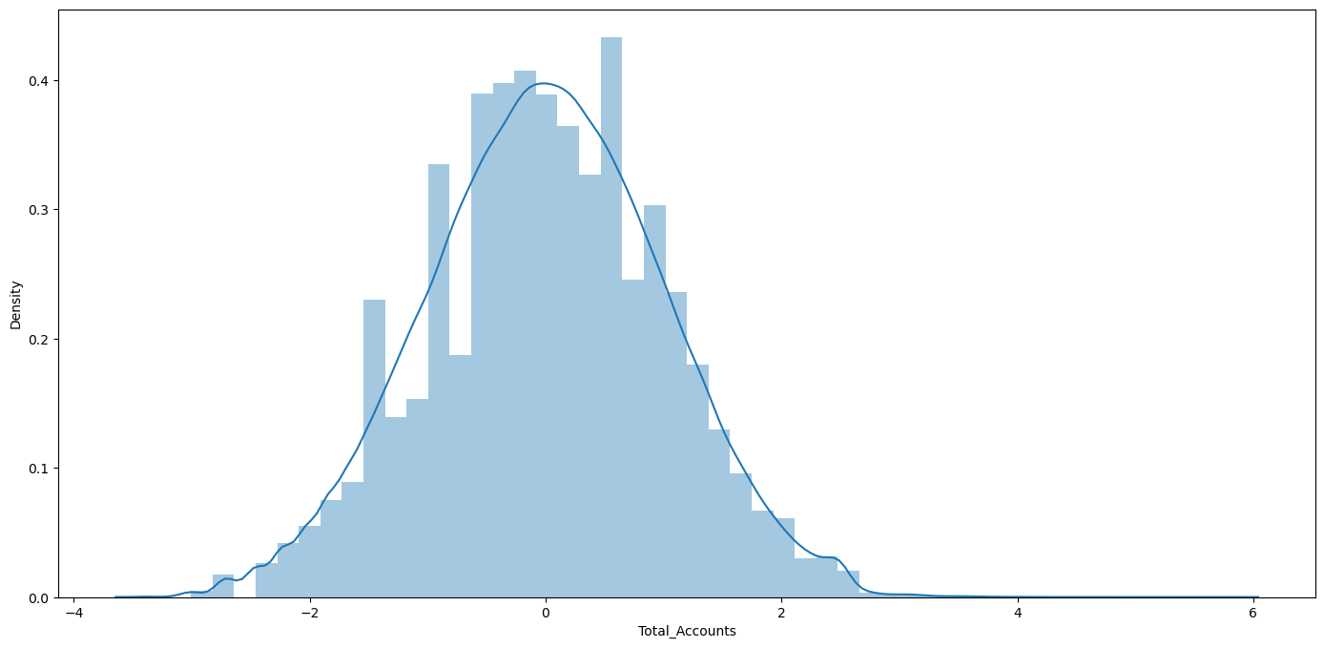
Outliers and Treatment
‘Total_Accounts’
Before
Skew : 0.81
box_cox_PT.fit_transform('Total_Accounts')
Skew : -0.009
After

Slide 22
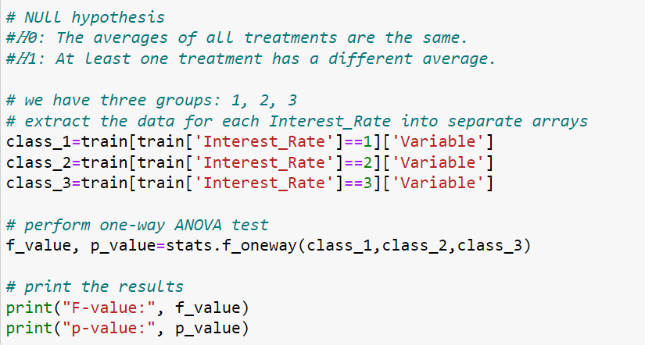
Statistics
Variable:
1) 'Loan_Amount_Requested‘ : F-value - 1936.5
P-value - 0.0
2) ‘Length_Employed’ : F-value - 73.3
P-value - 1.47
3) 'Annual_Income‘ : F-value – 426.03
P-value – 2.85
4) 'Debt_To_Income‘ : F-value – 2001.79
P-value – 0.0
5) 'Inquiries_Last_6Mo‘ : F-value – 3125.99
P-value – 0.0
6) 'Number_Open_Accounts‘ : F-value – 38.89
P-value – 1.29
7) 'Total_Accounts‘ : F-value – 212.11
P-value – 9.9

Slide 23
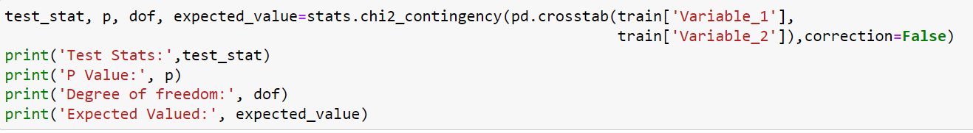
Statistics
Variable_1 and Variable_2:
1) 'Home_Owner‘ and 'Income_Verified' : Test Stats – 1119.4
P-value – 3.34
2) 'Home_Owner‘ and 'Purpose_Of_Loan' : Test Stats – 4747.3
P-value – 0.0
3) 'Home_Owner‘ and 'Gender' : Test Stats – 1.52
P-value – 0.90
4) 'Purpose_Of_Loan‘ and 'Income_Verified' : Test Stats – 1551.4
P-value – 1.29
5) 'Gender‘ and 'Income_Verified' : Test Stats – 4.587
P-value – 0.10
6) 'Gender‘ and 'Purpose_Of_Loan' : Test Stats – 7.67
P-value – 0.86

Slide 24
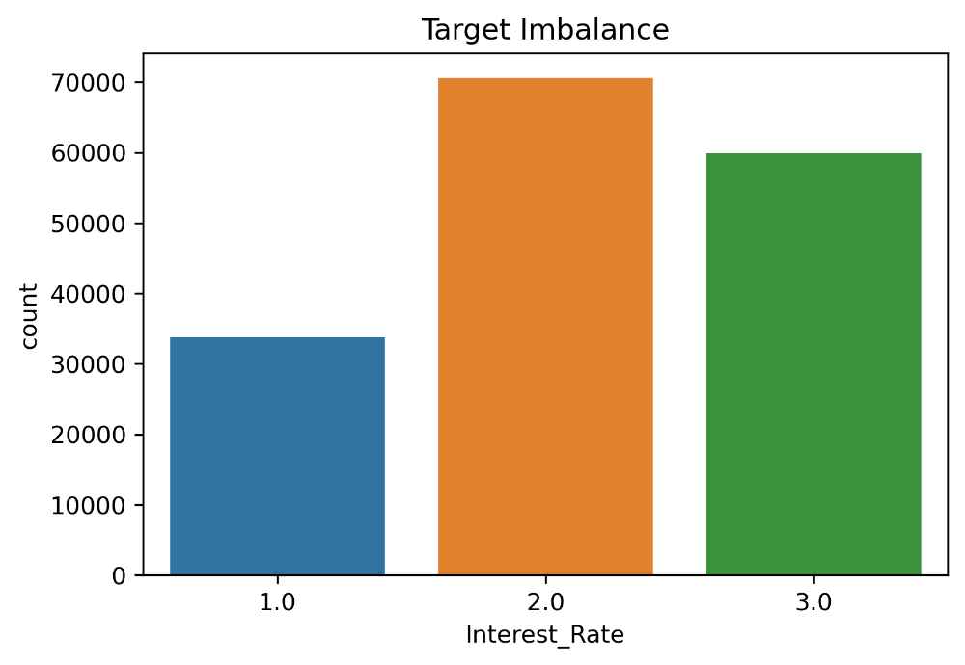
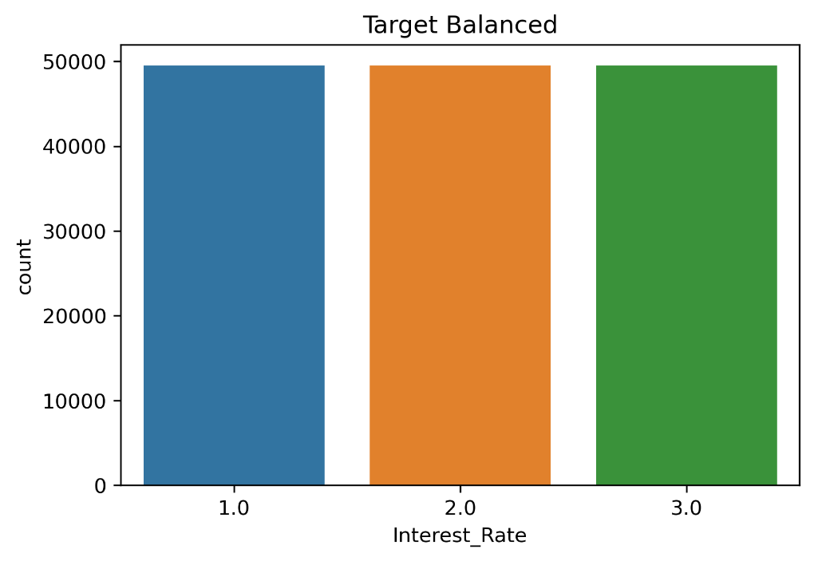
Balance Data
Train Test Split
70 : 30
sm=SMOTE()
x=df.drop('Interest_Rate',axis=1)
y=df['Interest_Rate']
x_res,y_res=sm.fit_resample(x,y)
xtrain,xtest,ytrain,ytest=train_test_split(x_res,y_res,test_size=0.30,random_state=10)
SMOTE

Slide 25
Base model
Here we will use DecisionTreeClassifier algorithm with ‘multinomial’ argument under the multiclass parameter as we have more than two classes in the target.
The report is as follows:
Target Class | precision | recall | f1-score | support
1 | 0.59 | 0.57 | 0.56 | 21102
2 | 0.43 | 0.42 | 0.42 | 21308
3 | 0.48 | 0.48 | 0.48 | 21112
accuracy |  |  | 0.49 | 63522
macro avg | 0.49 | 0.49 | 0.49 | 63522
weighted avg | 0.49 | 0.49 | 0.49 | 63522
Our model gave an overall accuracy of 49%.

Slide 26

Thank you

