Slide 1
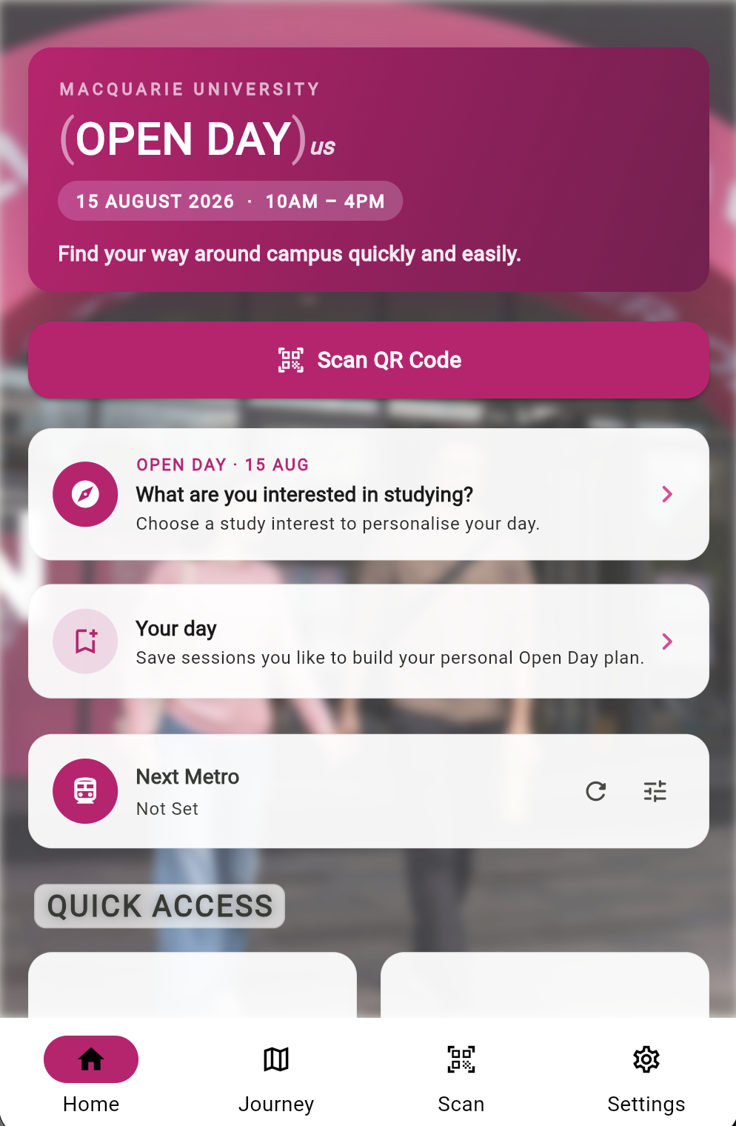
MACQUARIE UNIVERSITY · OPEN DAY 2026
MQ Journey
Scan. Discover. Plan your day at Macquarie.
A privacy-first campus companion for Open Day, 15 August 2026 — one scan turns a printed code into a place, a plan, and a stamp worth collecting.
FLUTTER 3.44 + SUPABASE
35 LANGUAGES
NO LOGIN · NO TRACKING

Slide 2


THE PROBLEM
The first ten minutes decide how campus feels.
Paper maps go quiet
Map apps talk too much
A printed map can't say what's happening right now — 77 sessions across 170 buildings, with wayfinding left to volunteers pointing at intersections.
Commercial map apps arrive with accounts, analytics and location tracking. Visitors shouldn't trade their privacy for directions to a lecture hall.
MQ Journey answers both: live campus guidance, zero tracking.

Slide 3
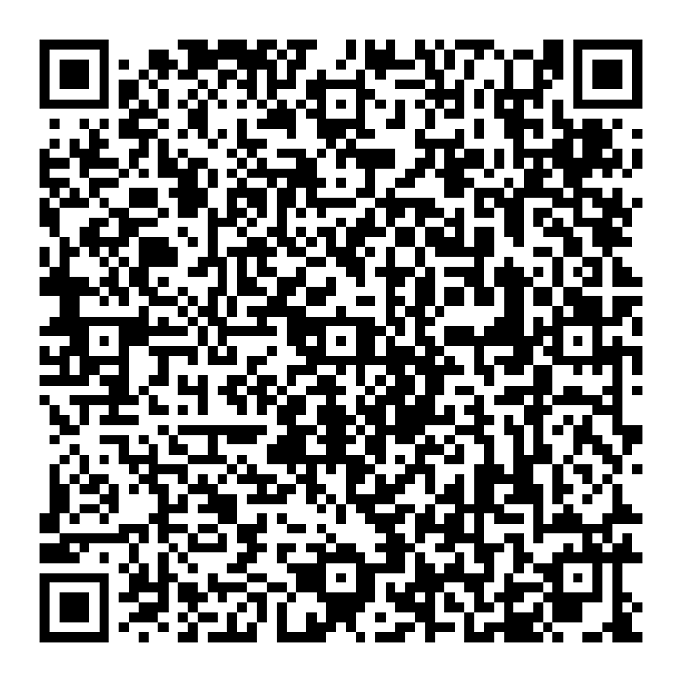
HOW IT WORKS
Scan a code. The campus opens up.
01
Scan
The in-app scanner or the phone's own camera — both routes run identical checks.
02
Verify
Ed25519 signature checked on-device, offline and fail-closed. Forged or reprinted codes go nowhere.
03
Arrive
The location card opens: what's on now, an entrance-accurate pin, and a 360° look inside.
OPEN DAY TRAIL · STOP 10
10 Hadenfeld Avenue
04
Collect
a genuine Ed25519-signed code
A first visit earns one of nine passport stamps, with confetti. Re-scans never duplicate.

Slide 4
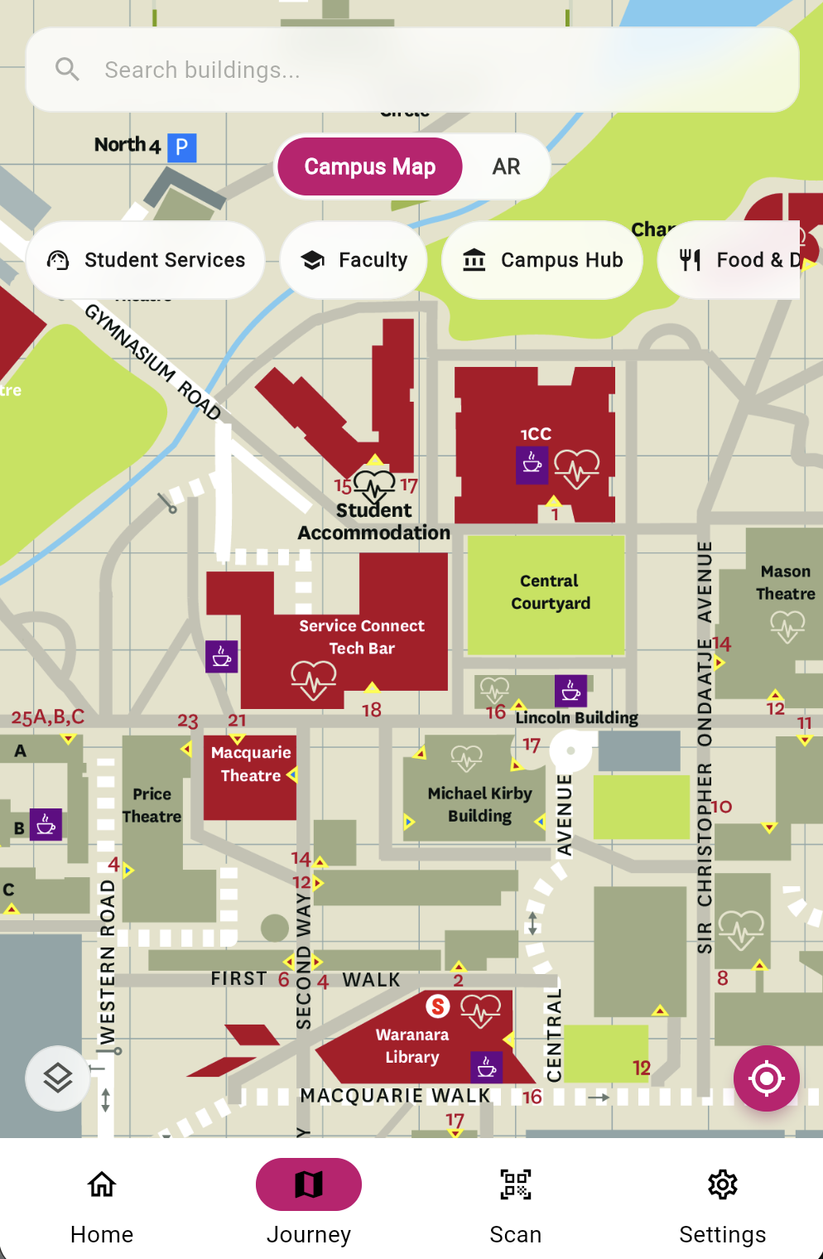
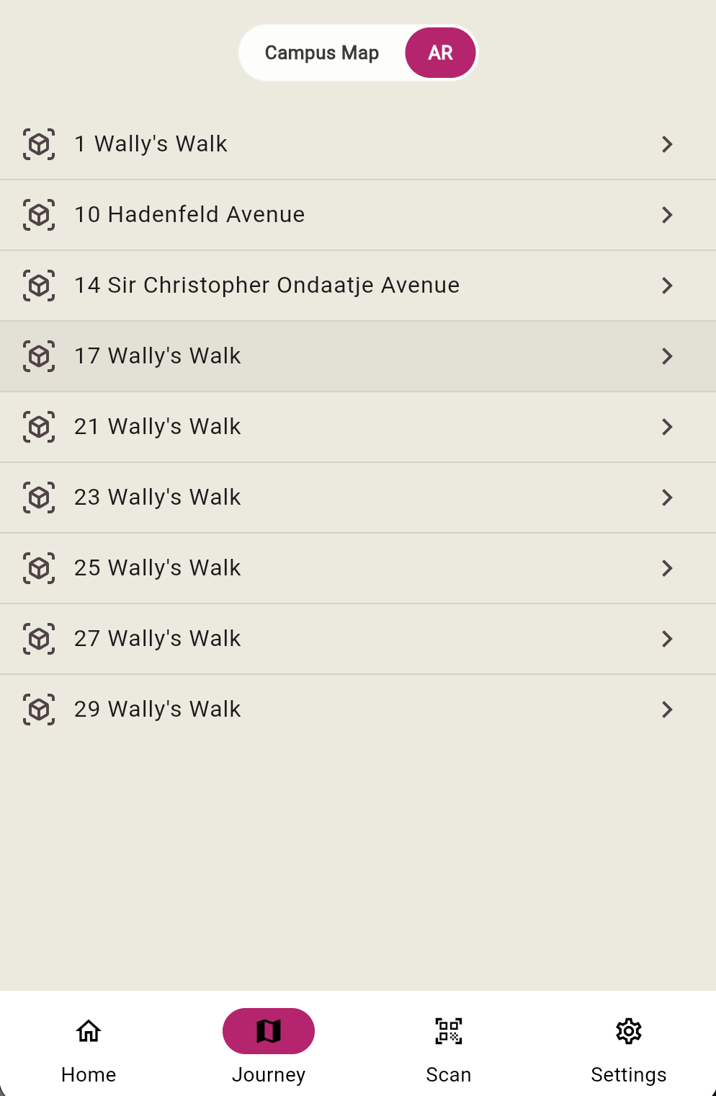
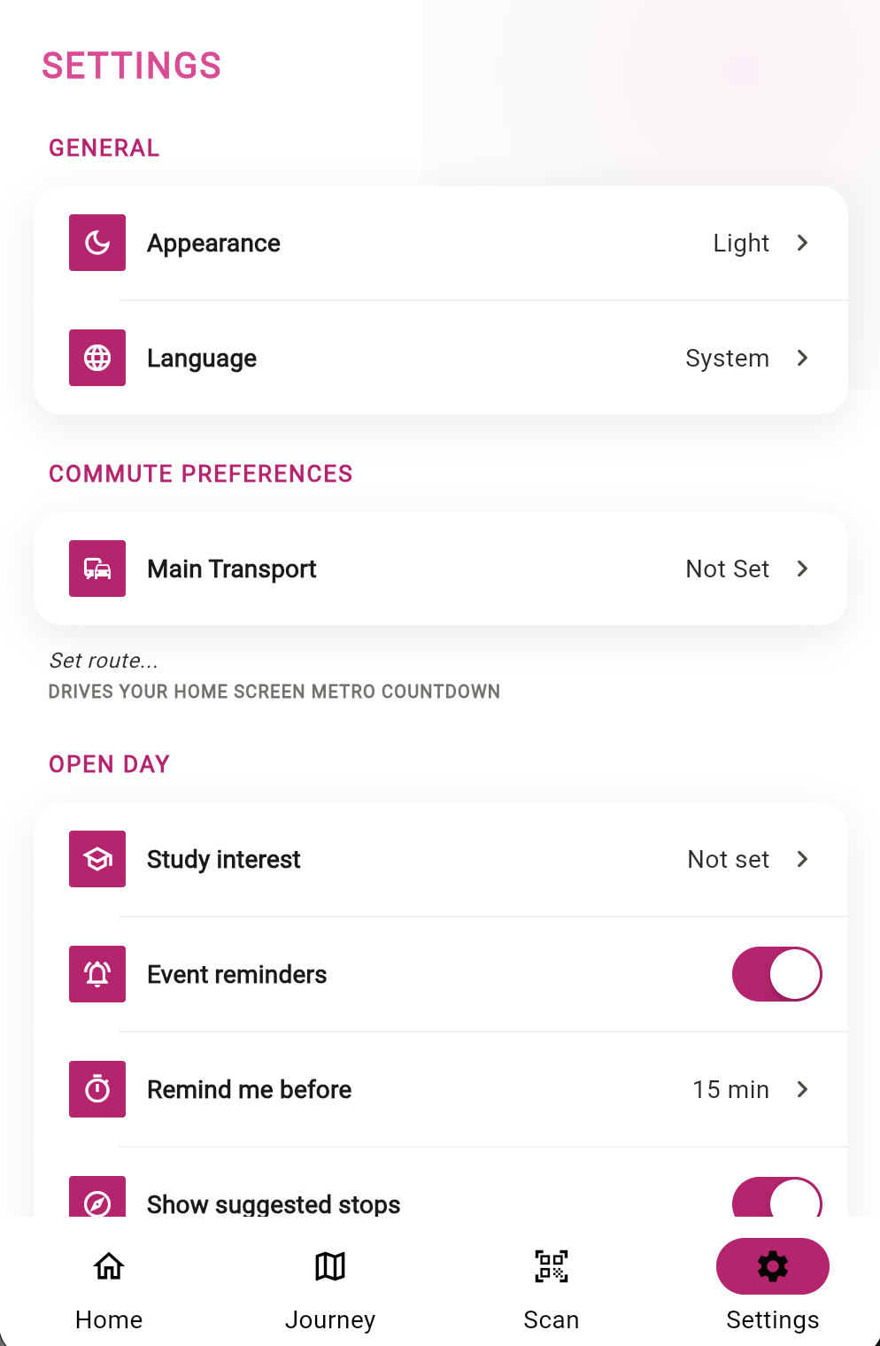
THE APP
A tour of the day, in three screens.
Campus Map
AR & Indoor 360°
Settings
170 buildings, offline-ready
Pick a building, step inside
35 languages, data on-device

Slide 5






WHAT'S INSIDE
Six features, one seamless day.
Signed QR trail
Living campus map
Your Day planner
Nine Ed25519-signed codes across campus feed a collectable stamps passport.
Georeferenced pins, search and routing — tiles cached for offline from first launch.
Pick from 39 degrees; 77 sessions filter into a personal running itinerary.
Indoor 360° previews
Metro countdown
Safety toolkit
26 panoramas across 9 buildings, inside a locked-down local viewer.
Live next departures for Macquarie University station via TfNSW open data.
Emergency contacts, first-aid and help points — one tap from anywhere.

Slide 6
BY THE NUMBERS
Shipped, tested, and repository-verified.
617/617
35
170
automated tests passing
languages, four of them right-to-left
campus buildings georeferenced
77
26
0
Open Day sessions & activities
indoor 360° panoramas
trackers, ads or login screens
Counted from the repository on 23 July 2026 — not estimated.

Slide 7



PRIVACY & TRUST
Private by design — and the CI proves it.
No accounts, ever
Fail-closed cryptography
A firewall against trackers
A silent anonymous Supabase session starts the app. A login screen can't even be merged — the CI gate fails any build that adds one.
QR codes are verified with Ed25519 on-device and offline. Deep links resolve only against a strict signed allowlist.
The pipeline bans eight analytics SDKs by name, scans every commit for secrets, and blocks Google Maps outright.
Adversarial red-team review, July 2026: no exploitable vulnerabilities found.

Slide 8
ENGINEERING DEEP DIVE
Teaching the map where buildings really are.
The university's printed campus artwork hides a survey-grade reference grid. We recovered it — autocorrelating brightness profiles across the 4,678 × 3,307-pixel raster — then re-fitted the GPS-to-pixel mapping with robust least squares.
The refit also exposed nine fabricated coordinate records sitting on a suspicious 45° line through campus. All nine were corrected, guarded by a regression test that fails on the old data.
40 m → 28 m
median pin offset, before → after the refit
38% → 54%
pins landing in the correct printed-grid cell

Slide 9
THE 2026 STACK
Built on this year's platform, not last year's.
Flutter 3.44 · Dart 3.11
Impeller rendering now default on Android; Swift Package Manager is the new iOS standard.
Riverpod 3.3
State layer with auto-retrying providers and paused listeners for off-screen widgets.
Supabase 2.15
Anonymous auth, Postgres with row-level security, and globally distributed Edge Functions.
go_router 17.3
Four-tab stateful shell navigation and a single, verified deep-link entry point.
mobile_scanner 7.2 + Pannellum
Hardware-accelerated QR capture and 360° tours inside a CSP-locked WebView.
Verified against docs.flutter.dev · riverpod.dev · supabase.com — July 2026.

Slide 10
ENGINEERING DISCIPLINE
Every commit walks through twelve gates.
1 · Deps
2 · Format
3 · Analyze
4 · 617 tests
5 · Coverage ≥ 50%
6 · l10n build
7 · Translations
8 · Privacy guard
9 · Secret scan
10 · Name guard
11 · No-login guard
12 · No-Google guard
60.6%
118
100%
line coverage, with a hard floor enforced at 50%
test files that mirror the source tree
of changes logged with verification notes and follow-ups
scripts/check.sh — one command, the whole gate. Green before every claim of done.

Slide 11
AT THE BOOTH
TRY IT NOW
A ninety-second demo.
1
Open the app — no sign-up, no permissions wall, straight to Home.
2
Scan the placard beside the stand; the location card opens instantly.
3
Step inside with the 360° indoor preview.
A real signed code — stop 10, Hadenfeld Avenue. Scan it with the app.
4
Star the building, then drop a session into Your Day.
Ed25519-signed · verifies offline
5
Finish on the metro countdown — the ride home is already planned.

Slide 12
MQ JOURNEY
Scan. Discover. Plan your day at Macquarie.
OPEN DAY · 15 AUGUST 2026 · MACQUARIE UNIVERSITY
Flutter + Supabase · MIT licensed · 617 tests green · zero trackers

