Slide 1

MACQUARIE UNIVERSITY · OPEN DAY 2026
MQ Journey
A privacy-first campus companion that turns a printed QR code into a place, a story, and a stamp worth collecting.
Flutter · Supabase · offline-verified QR

Slide 2
THE PROBLEM
Visitors decide how campus feels in the first ten minutes.
Paper maps cannot say what is on now. Map apps can, by tracking you.

Slide 3
WHY NOW
Two ways to run an Open Day
Today
With MQ Journey
Paper maps and volunteer directions. Any app in the mix brings location tracking and analytics. Nobody learns which buildings visitors actually reached.
Scan a signed code at the door. The location card opens instantly, offline. A first visit earns one of nine passport stamps, with nothing tracked in between.

Slide 4
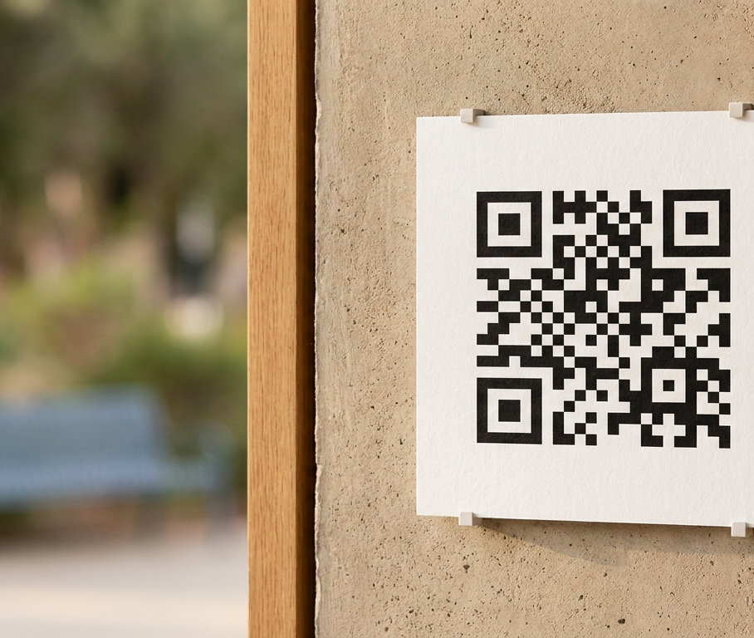
THE PRODUCT
One signed code. One place. One reward.
Nine printed codes map to the nine Open Day locations and their sixteen activity stops. Each carries an Ed25519 signature, so the app proves a code is genuine before it navigates anywhere, with no network call in the loop.
Printed placard at 1 Wally's Walk

Slide 5

HOW IT WORKS
Scan to stamp in four steps
01
Scan
In-app scanner or phone camera. Both run identical checks.
02
Verify
Strict parse, signature, then the nine-location allowlist.
03
Arrive
The location card opens with what is on now and an indoor view.
04
Collect
A first visit awards one stamp. Re-scans never duplicate it.

Slide 6
WHERE THE BUILD STANDS
Shipped, tested, and repository-verified
9
161
Signed codes, one per stamp
Campus buildings in the data
542
0
Automated tests passing
Analytics or stored frames
Physical print scans on Android and iPhone remain the release gate.

Slide 7
TRUST MODEL
A printed code is public, so the app assumes nothing
Trust the signature, not the poster.
CLOSED PAYLOAD
Unknown or duplicate fields fail closed.
CANONICAL BYTES
Signed over rebuilt fields, not raw text.
OFFLINE VERIFY
Public key ships; the signing key never does.
HONEST LIMITS
A valid scan proves a code, not presence.
Protocol mqjourney.open-day.qr.v1, Ed25519 over canonical bytes, key id mqj-open-day-2026-01.

Slide 8
2026 PLATFORM ALIGNMENT
Built on current developer guidance
Every dependency is pinned to a 2026 release with a documented path.
Capability | 2026 pin | Why it matters
UI system | Material 3 Expressive | Expressive layout and adaptive menus from I/O 2026
Client | Flutter 3.44, Dart 3.12 | One codebase across Android and iOS
Scanning | mobile_scanner 7.2 | Camera and torch release on leaving the screen
Crypto | cryptography 2.9 | Ed25519 verification with no network dependency
Deep links | go_router 17.3 | One verified ingress for cold and warm starts

Slide 9
ROADMAP
From verified build to Open Day floor
Jun 2026
Jul 2026
Aug 2026
Sep 2026
Open Day
QR surface and stamps shipped
Signed issuer and print pack
Device matrix on final prints
Staffed pilot, nine locations
Nine-stamp passport live

Slide 10
THE ASK
Three reasons to back MQ Journey
01
Already built: scan, card, and reward pipeline verified in CI.
02
Defensible: offline signatures and a closed location list.
03
Trusted: no tracking, no analytics, no stored camera frames.
Next: sign off the print run and book the device test matrix.

Slide 11
REFERENCES
2026 developer and design sources
DESIGN SYSTEM
m3.material.io
What's new at I/O 2026
PLATFORM
Material Android
Compose-first, May 2026
CLIENT
docs.flutter.dev
Material and deep link docs
LINKING
Android, Apple developer docs
App Links, associated domains
PRINT
DENSO WAVE
QR quiet-zone guidance

