Slide 1
JAVASCRIPT

Slide 2
What is javascript?
Javascript is dynamic computer programming language. It is lightweight and the most commonly used language in the world. It allows the user to interact with the web page by making it dynamic.

Slide 3
Adding javascript to a web page
Javascript can be added into an HTML document by including the script tags (<script></script>)into the HTML file, the script tags can be put anywhere in the HTML file
The script tags tells the browser to start interpreting everything between the tags as javascript

Slide 4
Adding javascript with externally
Javascript can be added externally to the web page using the script tags and adding a source (src) attribute to the opening script and providing the path to the javascript file.
The javascript file is a file with the “.js” extension.
E.g <script src=”script.js”></script>

Slide 5
Javascript Fundamentals
Javascript syntax/rules
Keywords in javascript
Comments in javascript
Data types in javascript
Variables in javascript
Operators in javascript
Decision statements in javascript
Loops in javascript
Functions in javascript

Slide 6
Syntax
It is the set rules that define a javascript.
Javascript is case sensitive language.
E.g “a” is not the same as “A”
Statements in javascript are ended with semicolon(;), but this can be ignored due to automatic semicolon insertion (ASI)

Slide 7
Keywords
Are that are reserved by javascript i.e they cannot be used by the user for naming variables or functions.

Slide 8
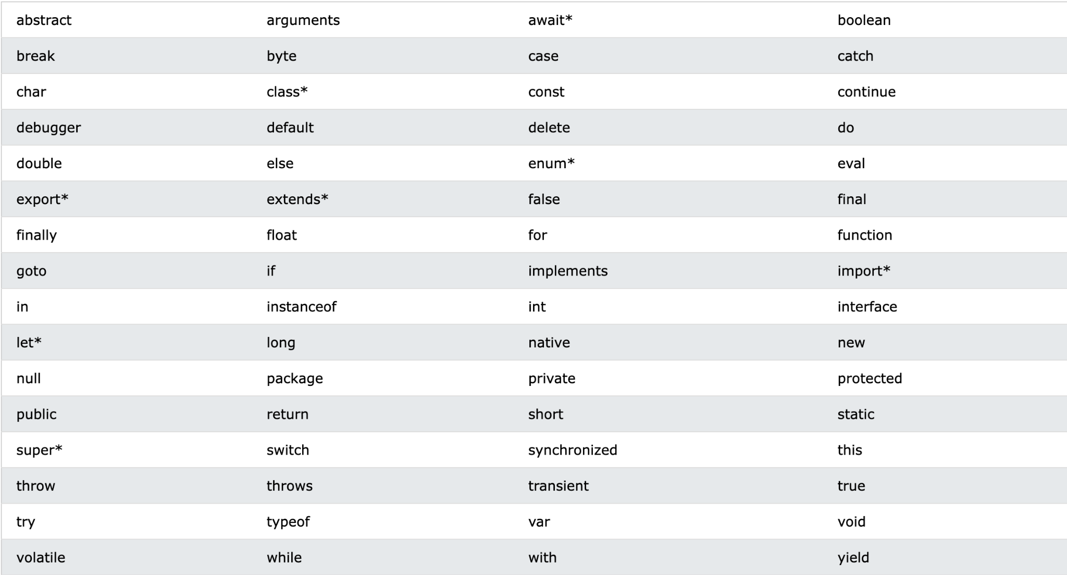
Keywords

Slide 9
Comments
Comments are used to explain javascript code and to make it more readable. Any text with a comment is ignored by the browser.
Single line comments start with “//”
Multiline comments start with “/*” and end with “*/”

Slide 10
Data Types
In javascript there are 6 primitive data types
String
Number
Boolean
Null
Undefined
symbol

Slide 11
Data Types
String: is used for textual data. Eg “ben”,”tim”.
Number: is used for numeric data. Eg 1,2.
Boolean: represents true or false.
Null: represents a nonexistent value.
Undefined: represents an unassigned value.
Symbol: represents a unique and immutable value.

Slide 12
Variables
Variables are containers for storing data.
Variables are declared in 3 keywords:
Var
Let
Const
Followed by the name, an equal to sign (=) then the value
E.g var name = “fred”, var age = 3
Any variable with the const keyword in javascript is a constant value meaning the value it holds cannot be changed

Slide 13
Arrays
An array is a special variable that can hold multiple values

Slide 14
Operators
Operators in javascript perform single or multiple operations on operands(data values)
Javascript has the following categories of operators
Arithmetic operators
Comparison operators
Logical operators
Assignment operator
Ternary operator

Slide 15
Arithmetic Operators
Arithmetic operators are used to perform mathematical operations between numeric operands.
operator | description
+ | Adds operands
- | Subtracts right operand from left operand
* | Multiply operands
/ | Divide left operand by right operand
% | Modulus operator. Returns the remainder of 2 operands
++ | Increment operator. Increases value by 1
- | Decrement operator. Decrease value by 1

Slide 16
Comparison Operators
Compares to operands and returns a true or false
operator | description
== | Compares equality of both operands
=== | Compares equality and type of both operands
!= | Compares inequality of operands
< | Returns true is right is less than left side
> | Returns true if right side is greater than left side
<= | Returns true if right is less than or equal to left side
>= | Returns true is right side is greater or equal to left side

Slide 17
Logical Operators
Logical operators a used to combine two or more conditions
operator | description
&& | And operator checks if 2 operands are true
|| | Or operator checks if 1 out 2 operands is true
! | Not operator reverses a boolean e.g true becomes false

Slide 18
Assignment Operator
Assignment operator ( = ) is used to assign values to variables

Slide 19
Ternary Operator
Ternary operator ( ? : ) assigns a value to a variable based on some condition

Slide 20
Decision statements
Decision statements control behaviour and determine whether some code is executed or not.
Javascript decision statement are :
If
If-else
If-else-if
Switch

Slide 21
If statement
Code is only executed with the condition is true
E.g if (condition){
Code to be executed
}

Slide 22
if -else
Evaluates whether a condition is true, executes the code for when then condition is true and also executes a code when the condition is false.
E.g if(condition){
Code for true condition
} else{
Code for false condition
}

Slide 23
if-else-if
Executes the condition on where a true condition comes out from multiple conditions.
E.g if(condition){
}else if(condition){
}
else if(condition){
}

Slide 24
Switch
Are used to execute one code from multiple conditions.
E.g switch(condition){
Case 1: code
Case 1: code
Default: code
}

Slide 25
Loops
A loop is used to execute code repeatedly
We have the :
For loop.
While loop.

Slide 26
For loop
The for loop requires 3 parts,
The initializer: a counter variable which tells the loop where to start
Condition: a condition which evaluate true for the next iteration
Iteration: an increase or decrease counter
E.g for(initializer;condition;iteration){
Code to be repeated
}

Slide 27
While loop
Executes code repeatedly till a given condition is false
e.g while(condition){
code
}

Slide 28
Functions
A function is a block of code designed to perform a specific task, to execute a function is invoked or called.
A function is defined by the “function” keyword followed by a name, followed by parentheses ( brackets () )and to executed in curly braces {}.
Function parameters are listed in the parentheses, parameter are values to passed into the function.
E.g function name(parameter1, parameter1){
code
}

