Slide 1
css

Slide 2
What is CSS?
CSS stands for Cascading Style Sheet.
It the language used in styling HTML documents

Slide 3
Ways of adding CSS to an HTML document
There are 3 ways of adding css to and HTML document
In-line CSS
Internal CSS
External CSS

Slide 4
In-line CSS
With in-line CSS, the CSS is written within the HTML tag by using the style attribute of the html tag
E.g <p style=””>name</p>

Slide 5
Internal CSS
With internal CSS , the CSS is written within a style tag i.e <style></style> which is required to be added to the the head within the head section of the HTML document.
E.g <head>
<style type=”text/css”>
</style>
</head>

Slide 6
External CSS
With external CSS, CSS is written in external file with the file extension .css and is linked to the HTML document using a link tag <link></link> with the head section of the HTML document
e.g<link rel=’’stylesheet” type=”text/css” href=”style.css”/>

Slide 7
CSS PROPERTIES
A CSS property styles and aspect of an HTML element/tag
E.g color, font-size,font-weight,border

Slide 8
CSS SELECTORS
A CSS selector selects the HTML element to be styled, we have :
Universal selector
Element selector
Class selector
Id selector

Slide 9
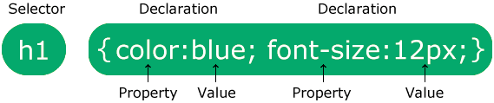
CSS SYNTAX
A CSS syntax or rule consists of a selector and a declaration.

Slide 10
UNIVERSAL SELECTOR
The universal selector(*), It is used to select all the HTML elements in the document,
E.g * {color: white;}

Slide 11
CLASS SELECTOR
The class selector selects all elements bearing a specific class attribute, to select a specific class attribute write a period or dot ( . ) followed by the class name
E.g .heading{ padding: 5px;}

Slide 12
ELEMENT SELECTOR
The element selector selects all the elements bearing the selector name.
E.g p { font-size:10px;}

Slide 13
ID SELECTOR
The ID selector selects the HTML elements bearing a specific id attribute, id attributes are unique within a document, to select an id write a hash ( # ) followed by the id of the element
E.g #name { font-size: 20px; }

Slide 14
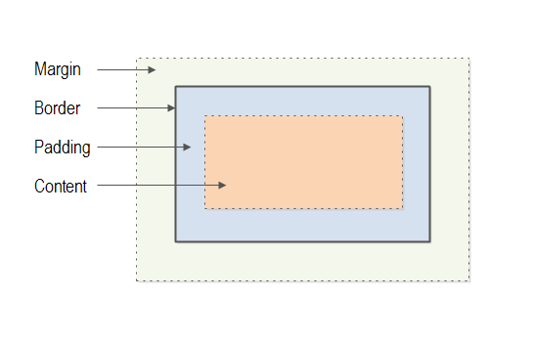
The CSS box model looks like this

Slide 15
CSS BOX MODEL
CSS box model specifies how margins, borders and padding of an HTML element are displayed.
Each HTML element displayed is considered to be a box, the box has 4 parts.
The margin: the area around the HTML element and other HTML elements.
The border: it sits between the and surrounds the content of the HTML element.
The padding: the sits inside the border and surrounds the HTML element.
The content: the content is what is displayed by the inside the element, this is usually a combination of text,images and other HTML elements.

Slide 16
CSS HANDS ON PRACTICE

