Slide 1
BRAND PRESENTATION · 2026
Drop №
A real-world value test, for the pieces the market has not seen yet.
Brand-direct · sealed-bid · one reveal, Thursday 6pm CET

Slide 2
THE REAL PROBLEM
You launch an unseen piece.
At what price do you sell it?
At 4,500 €
At 6,000 €
At 7,500 €
Gone in 3 minutes.
Gone in 6 months.
Nothing sells.
You leave 30 to 50 % on the table.
Diluted cash flow, lost narrative.
The drop exists, with no demand.
No calculation gives you that number. It lives in the heads of collectors.
Drop №
№ 02 / 19

Slide 3
WHAT DROP NO. SOLVES
You no longer set the price.
The market reveals it to you.
01
02
03
04
YOU SET A FLOOR
THE MARKET BIDS BLIND
THE PRICE IS REVEALED
YOU LEARN
The minimum below which you will not sell.
Sealed offers, editable, over five days.
Thursday 6pm. The Nth offer becomes the unit price.
Clearing price, depth of demand, buyer profile.
Drop №
№ 03 / 19

Slide 4
SECTION I
The brand side.
What you gain, step by step — the mechanism, the controlled risk, the data.
Drop №
№ 04 / 19

Slide 5
THE PRODUCT JOURNEY
From first call to payment.
Four weeks to prepare, five days to sell, two weeks to settle.
D - 30
D - 21
D - 14
D - 7
D 0
D + 5
D + 19
Brief
Contract
Selection
Preparation
Opening
Reveal
Payment
First call, exploration.
Onboarding, company KYC.
Piece, floor, editions.
Photos, story, packaging.
Thursday 9am, public drop.
Thursday 6pm, clearing price.
After 14-day withdrawal.
Concierge delivery between D + 5 and D + 10. You ship to Drop No., we coordinate the final handover.
Drop №
№ 05 / 19

Slide 6
THE TEST WITHOUT THE RISK
Three safeguards, to test without breaking.
01
The floor price is yours
Below your threshold, the drop is cancelled. No sale under the floor, no damage to your image.
02
Cancelled drop, zero fees
No fee if nothing sells. Drop No. only wins if you win. Our interest is aligned with yours.
03
You keep control of the calendar
Opening date, duration, communication. One reveal per drop, never alongside your own boutique.
Drop №
№ 06 / 19

Slide 7
WHAT YOU LEARN
Three data points no study will give you.
01
The true market price
What the N most motivated collectors are ready to pay today. Not an average, not a survey. A figure.
02
The depth of demand
The number of offers, their distribution, the gap between the first and the Nth. A direct signal for your next references.
03
The buyer profile
How many collectors are KYC-verified and bid. Countries, segments, loyalty — at no acquisition cost to you.
Drop №
№ 07 / 19

Slide 8
PRIVILEGE № 001
Number 001, reserved for the top bidder.
After the reveal, the highest bidder receives a private offer: to reserve serial number 001 of the edition. A premium, twenty-four hours, an exclusivity that creates desire without a public bidding war.
Private offer
24 hours
The top pays
Made only to the highest bidder, after clearing. Discreet, never announced beforehand.
A short window to decide. No cascade: if declined, 001 follows the ranking.
A premium based on the gap to the Nth offer. One more reason to aim high.
Drop №
№ 08 / 19

Slide 9
LOGISTICS & EDITIONS
Every piece numbered, every delivery insured.
THE PIECE
THE DELIVERY
Numbering 1 / N
Insured DHL Express
Engraved on the rotor and the case back, visible through the sapphire.
For pieces between 3,000 and 10,000 €. 48-72h, full insurance, real-time tracking.
House-signed certificate
Hand-carried concierge
Certificate of authenticity issued and signed by your workshop, delivered with the piece.
Above 10,000 €. Malca-Amit or Brinks, handover against signature.
Original packaging
5 to 10-day window
Your usual box, printed history booklet, reinforced transport case.
From the reveal. You ship to Drop No., we coordinate the delivery.
Drop №
№ 09 / 19

Slide 10
PRICING
12 % + 5 €
per piece sold, up to 10,000 €.
Above 10,000 €, bespoke pricing (concierge logistics included).
INCLUDED · NO ADDITIONAL FEES
Buyer KYC · Stripe Identity
Payment · pre-auth, capture, refunds
Premium logistics · DHL Express or Malca-Amit
Customer support · Crisp chat + email
Communication · newsletter, PR, social
Drop №
№ 10 / 19

Slide 11
SECTION II
The collector side.
The experience that attracts the buyer you are targeting — and keeps them.
Drop №
№ 11 / 19

Slide 12
THE COLLECTOR, BEFORE DROP NO.
I want a beautiful piece.
Where do I even start?
Who do I trust — a forum, a dealer, the grey market?
How do I buy well, without paying for the fear of missing out?
And once I decide: a refusal, a waitlist, an availability I do not get to choose.
Drop No. resets the rules: a price discovered together, one clear window for everyone, a real chance to land the piece.
Drop №
№ 12 / 19

Slide 13
THE FEATURES
An experience built for the collector.
SEALED, EDITABLE OFFER
VERIFIED IDENTITY
PUBLIC COUNTDOWN
A hidden offer, adjustable until one hour before the reveal. No bidding war, no FOMO.
Stripe Identity from the first offer. Real buyers, a verified card, zero fraud.
A dated reveal, Thursday 6pm. The same horizon for everyone, shown on the drop page.
ALERTS & REMINDERS
ACCOUNT & TRACKING
PRIVILEGE № 001
Alert bell and emails: opening, 24h before, last hour. Nobody misses the window.
A dashboard: active offers, status, payment, delivery — all in one place.
The highest bidder can reserve number 001 of the edition. A reason to aim high.
14-day withdrawal · payment pre-authorized, captured only if the offer wins.
Drop №
№ 13 / 19

Slide 14
COLLECTOR JOURNEY
From click to delivered piece.
The collector you reach: KYC-verified, card-verified, watch-collector profile.
Discovery
Sign-up
Follow
D 0
5 days
D + 5
D + 5 → 10
D + 14
Newsletter
Account + KYC
Drop watch
First offer
Editing
Reveal
Delivery
Withdrawal
No bidding war: a decision made calmly, adjustable until the very last hour.
Drop №
№ 14 / 19

Slide 15

THE PRODUCT · ONLINE
The drop page.
What the collector sees, from day one to the last hour before the reveal.
COUNTDOWN
A dated, public reveal, the same for everyone. No extension, no overbidding.
SEALED OFFER
Each offer stays hidden until the reveal, editable until one hour before closing.
YOUR TERMS, SHOWN
Floor, editions, insured delivery, 14-day withdrawal. The frame is set.
Drop №
№ 15 / 19

Slide 16
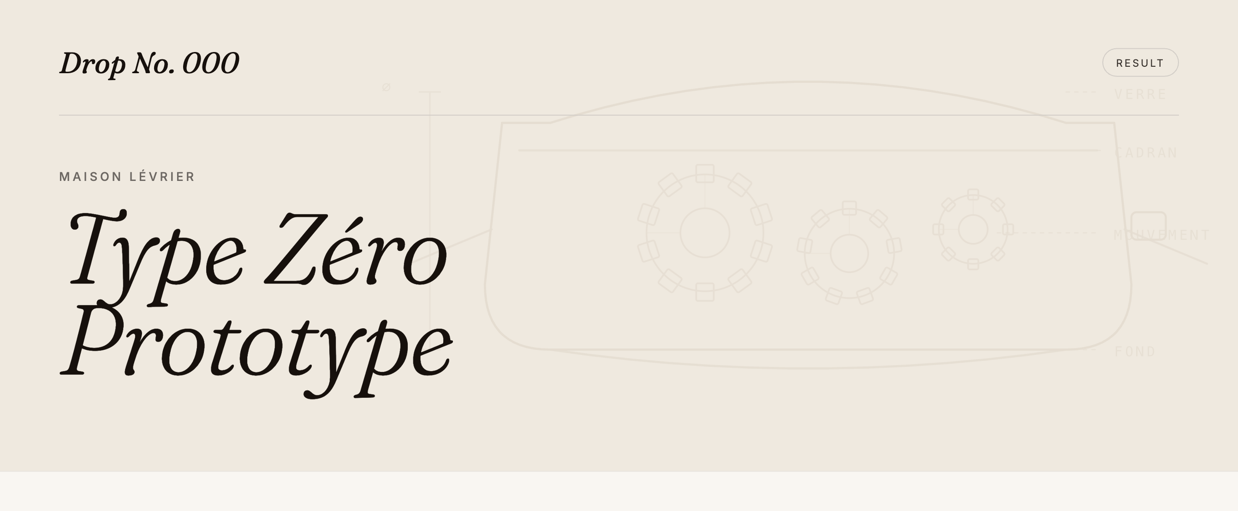
THE PRODUCT · AFTER THE REVEAL
The result, public and dated.
At the reveal, the unit price appears on the drop page. Each archived drop becomes proof for the next.
Drop №
№ 16 / 19

Slide 17
DROP № 001 · MAISON LÉVRIER · REFERENCE TYPE 01
You expected 4,500 €.
6,240 €
What the market said, in five days.
+ 1,740 € per piece · + 13,920 € on the edition · + 38.7 %
Drop №
№ 17 / 19

Slide 18
POSITIONING
For the pieces the market has not seen yet.
Emerging references, limited editions, first releases. When the market does not yet know what to make of them.
IDEAL FOR
OUT OF SCOPE
New independent references, never sold before
Recurring catalogue at an already-set price
Prototypes ready to industrialize, to validate in demand
Pieces under 3,000 € (delivery economics too tight)
Anniversary editions, capsules, collaborations
Secondary resale market (brand-direct only)
Productions under 100 pieces, unit price ≥ 3,000 €
Non-watch categories (jewellery and art in v2)
Drop №
№ 18 / 19

Slide 19
NEXT DROPS
Slots open for Q3 and Q4 2026.
One drop a week. Thirty a year. Selected on application.
TO DISCUSS A DROP
raph@dropno.eu
30-minute demo call. Onboarding in two weeks. First test drop within 30 days.
Drop №
№ 19 / 19

