Slide 1
„Success is not luck, but only the result of blood sweat and tears.“

Slide 2
„Success is not luck, but only the result of blood sweat and tears.“
  KontraK, 2015

Slide 3
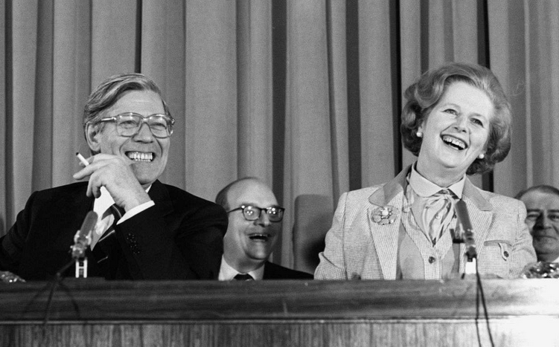
https://www.hdg.de/lemo/biografie/margaret-thatcher.html
https://www.theguardian.com/commentisfree/2013/oct/03/hardworking-people-conservative-mythmaking
Notes:
Dignity and duty of labour evolved out of the protestant work ethik and is a central framing of conservative and neoliberal politicians, addressing the hardworking people in a speeech gives the audience a feeling „we do hard work“ and „they“ do not >>can lead to populism and ignores the fact of social differences in a society, Margaret thatcher is a famous example, she blocked social policy

Slide 4
Talent vs. Luck: Exploring the Role of Randomness in Success
"Talent versus Luck: The Role of Randomness in Success and Failure“
By Alessandro Pluchino, Alessio Emanuele Biondo, Andrea Rapisarda
Raphaela Keßler
Konstanz, 03.07.2024

Slide 5
Outline
The Model
Research Funding Scenarios
Results
Discussion
Modified Simulation

Slide 6
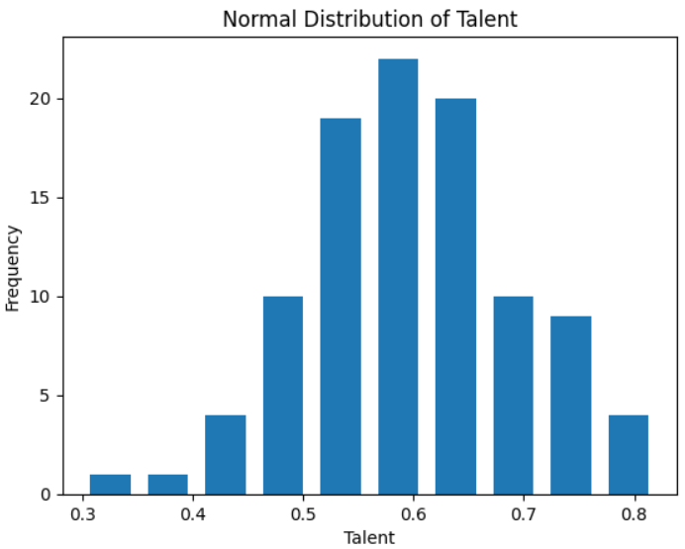
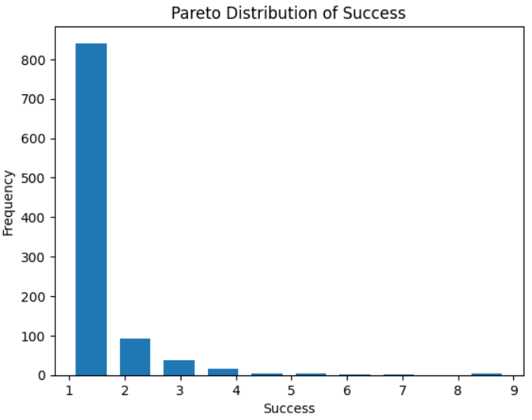
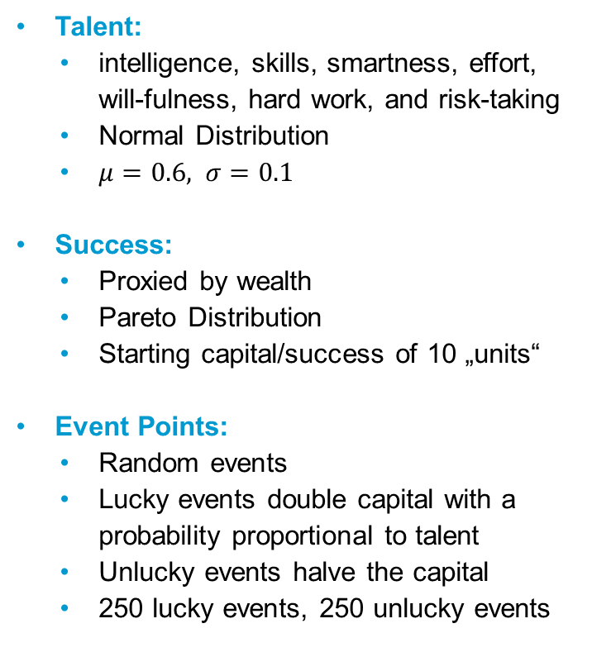
The Model
Talent:
    intelligence, skills, smartness, effort, will-fulness, hard work, and risk-taking
    Normal Distribution
    $μ=0.6,$ $σ=0.1$
  Success:
    Proxied by wealth
    Pareto Distribution
    Starting capital/success of 10 „units“
  Event Points:
    Random events
    Lucky events double capital with a probability proportional to talent
    Unlucky events halve the capital
    250 lucky events, 250 unlucky events

Slide 7
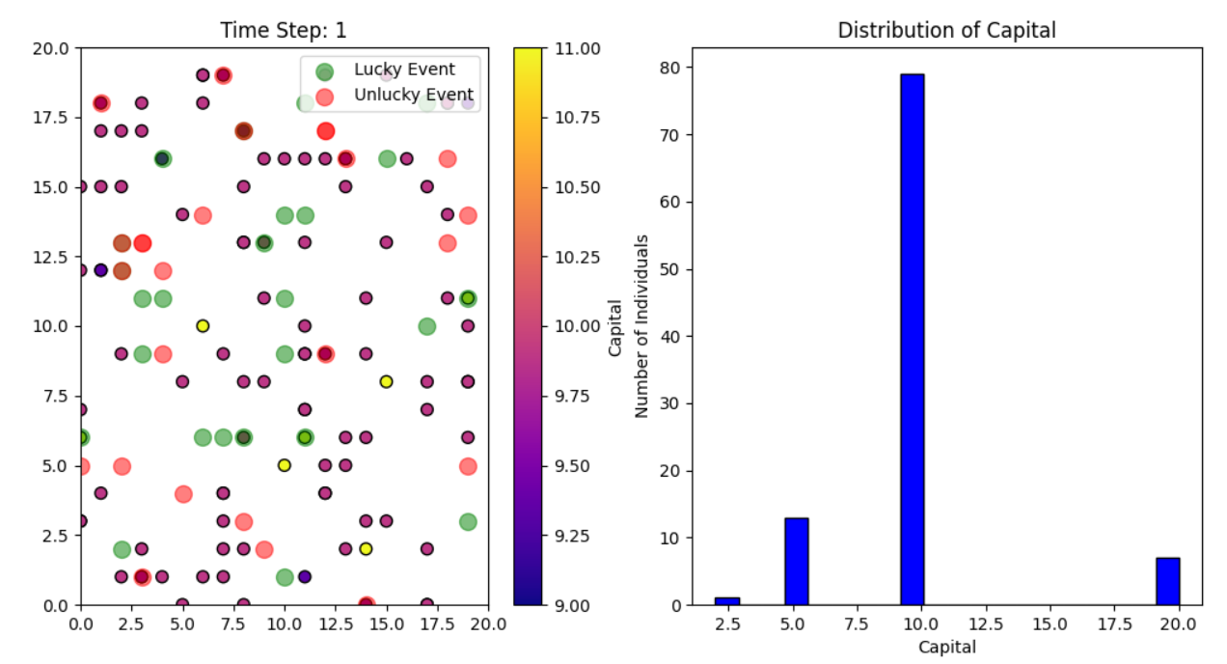
The Model

Slide 8
Research Funding Scenarios
Egalitarian Criterion
    equal distribution of funding
Elitarian Criterion
    funding only the most successful individuals based on past performance
Mixed Criterion
    a combination of elitarian (merit-based) and equal distribution
Selective Random Criterion
    random selection of individuals for funding

Slide 9
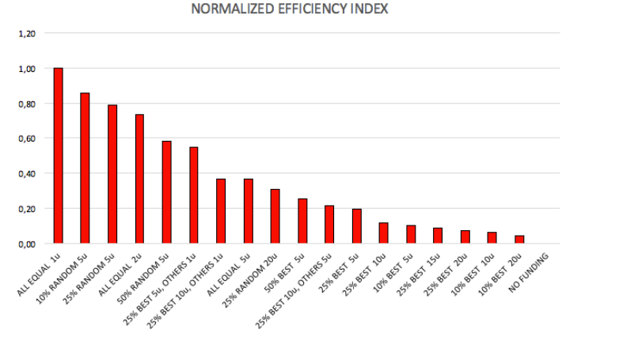
Results
According to the model egalitarian distribution of research
funding is the most efficient strategy

Slide 10
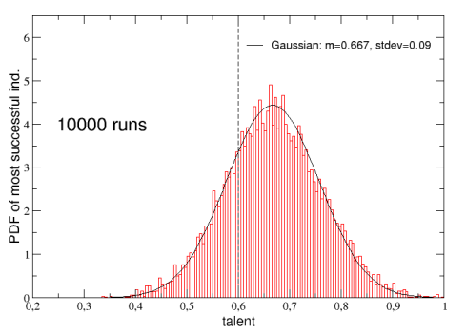
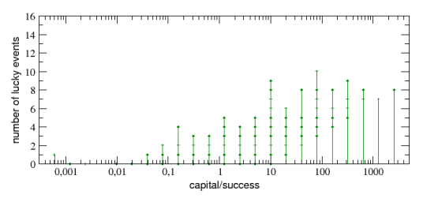
Results
„[…] very strong correlation between success and luck“ (PLUCHINO et al., 2018, p.10)

Slide 11
Discussion
Correlation of luck and success is the result of the construction of the model itself
vague definition of the term ”talent”
all agents start with the same initial capita
talent is time-independent
No feedback loops between success and further lucky opportunities

Slide 12
Modified Simulation
Modified Simulation with survey data out of the European Social Survey
Talent Index:
    atncrse: ”During the last twelve months, have you taken any course or attended any lecture or conference to improve your knowledge or skills for work?”
    ipcrtiva: ”Important to think new ideas and being creative”
    ipshabta: ”Important to show abilities and be admired
  Starting Capital
    Parent’s level of education, measured between 0 and 10
  Socio Economic Status
    index of education and income
  Feedback loop
    probabilistic check to simulate the chance of an agent taking advantage of a lucky even
    (capital + ses index + talent index) / 3

Slide 13
Modified Simulation

Slide 14
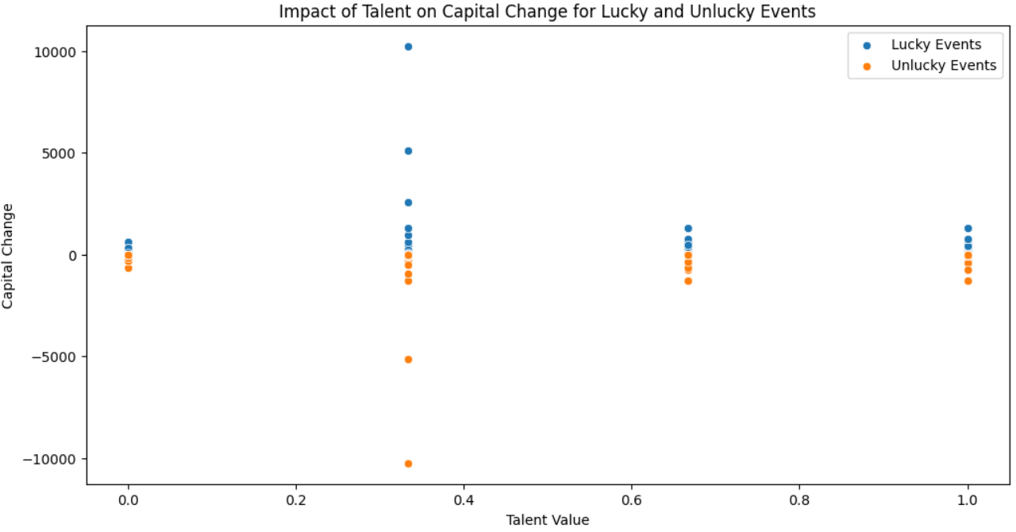
Modified Simulation

Slide 15
Thank
You!
Raphaela Keßler
Social and Economic Data Science
raphaela.kessler@uni-konstanz.de

