Slide 1
Fault Tolerance Approaches for Large-Scale Cloud-Based Systems

Slide 2
Content
Research Question
Fault Tolerance
Approaches
Prototype
References

Slide 3
Research Question
What are different approaches
for fault tolerance in large-scale cloud-based systems,
and how do they compare in terms of
performance,
cost,
and complexity?

Slide 4
Research Question
!
Distributed system is implemented
Best-Practise approaches are investigated
To improve fault tolerance
Matching the constraints of the system
System is deployed in Google Cloud
Metrics measured
Comparison of approaches

Slide 5


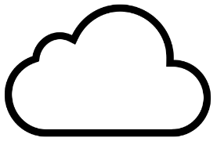
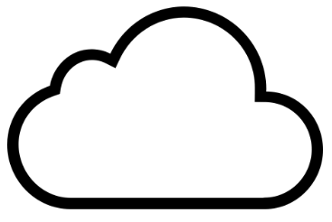
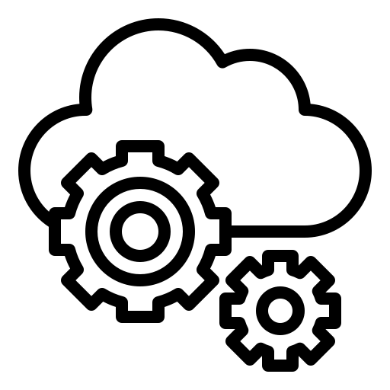


Fault Tolerance
Definition
(High) Availability
Reliability
Redundancy, Auto Scaling, Load Balancing, Distributed Database

Slide 6
Approaches
- Can exclude usage of other approaches
- Can be used together with another approaches
Needs to match constraints
Monolith deployment
Distributed system
Google Cloud
- Best-Practises to improve Fault Tolerance

Slide 7
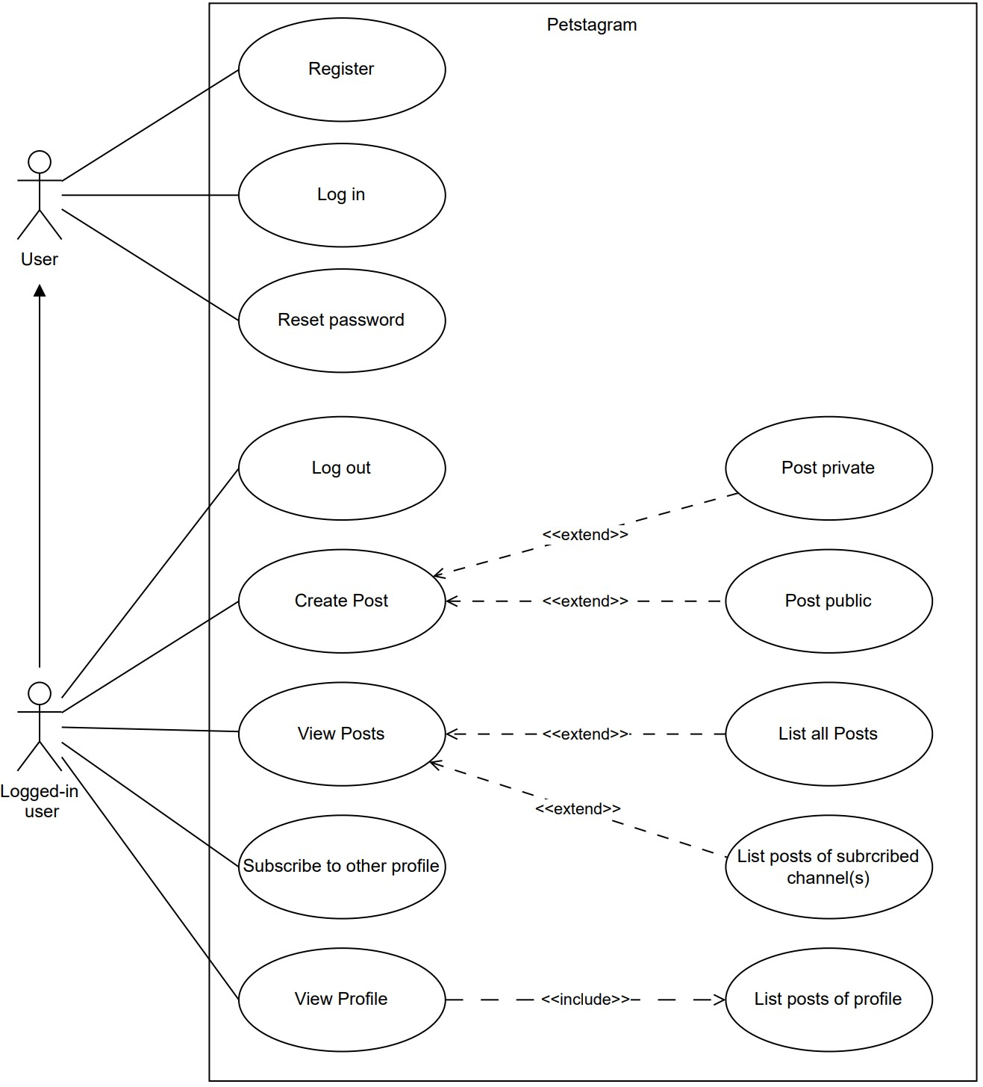
Prototype
Instagram for pets
Users can share pet related content
Client-server webapplication
Browser as client

Slide 8
?
Questions

Slide 9
References
A. U. Rehman, R. L. Aguiar, and J. P. Barraca, “Fault-Tolerance in the Scope of Cloud Computing,” IEEE Access, vol. 10, 2022, doi: https://doi.org/10.1109/ACCESS.2022.3182211.
M. Nazari Cheraghlou, A. Khadem-Zadeh, and M. Haghparast, “A survey of fault tolerance architecture in cloud computing,” Journal of Network and Computer Applications, vol. 61, pp. 81–92, Feb. 2016, doi: https://doi.org/10.1016/j.jnca.2015.10.004.
V. Sivagami and K. Easwarakumar, “Survey on Fault Tolerance Techniques in Cloud Computing Environment,” International Journal of Scientific Engineering and Applied Science (IJSEAS), no. 1, 2015, Accessed: Apr. 25, 2023. [Online]. Available: https://ijseas.com/volume1/v1i9/ijseas20150952.pdf\bibitem{paper_reviewTechniques} Z. Amin, H. Singh, and N. Sethi, “Review on Fault Tolerance Techniques in Cloud Computing,” International Journal of Computer Applications, vol. 116, no. 18, pp. 11–17, Apr. 2015, doi: https://doi.org/10.5120/20435-2768.
“Survey on Fault Tolerance Techniques in Cloud Computing Environment,” Accessed: Apr. 26, 2023. [Online]. Available: https://scaleyourapp.com/monolithic-architecture

