Slide 1
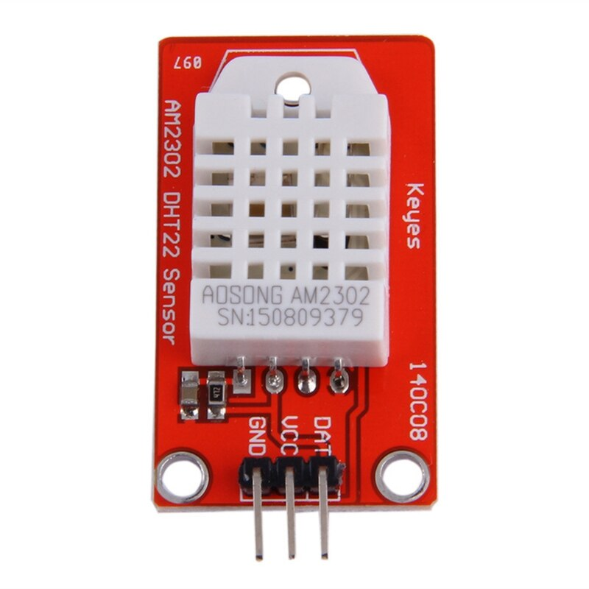



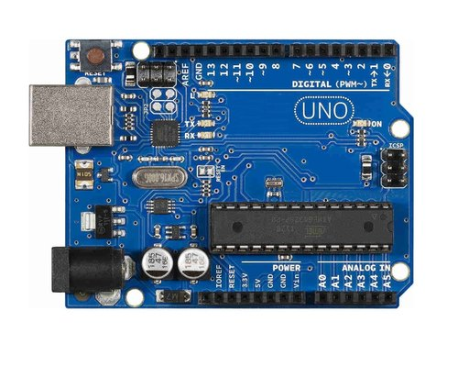
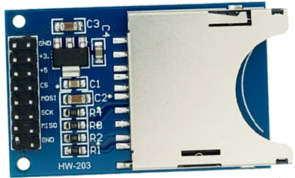
Red to D5
Green to D4
GND to GND
VCC to 5V
DAT to D2
CS to D10
MOSI to D11
MISO to D12
SCK to D13
GND to GND
+5 to 5V

Slide 2
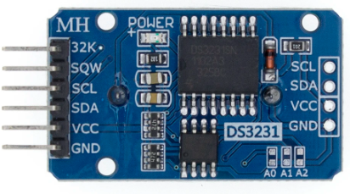
Red to D5
Green to D4
+5 to 5V
CS to D10
MOSI to D11
SCK to D13
MISO to D12
GND to GND
GND to GND
VCC to 5V
DAT to D2
SCL to A5
SDA to A4
VCC to 5V
GND to GND

