Slide 1
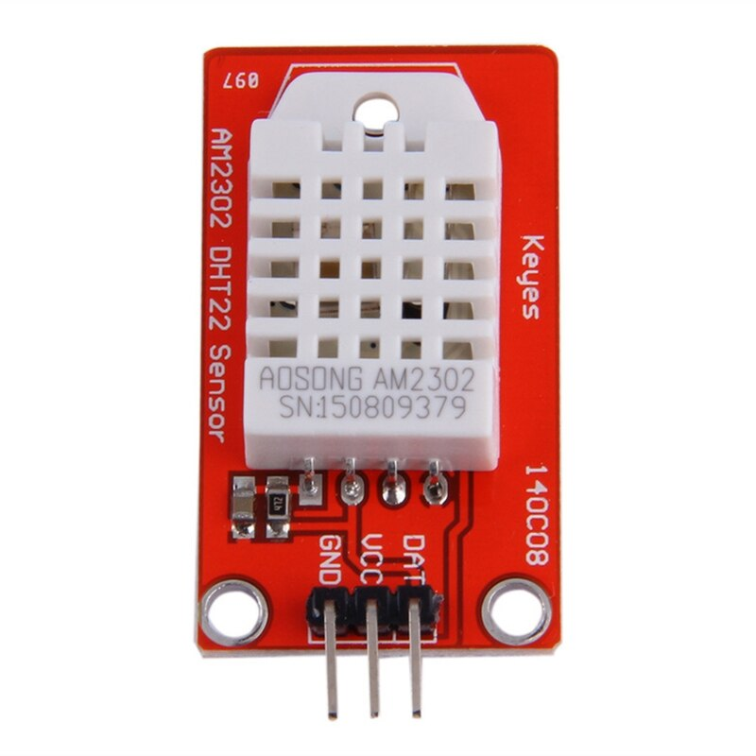



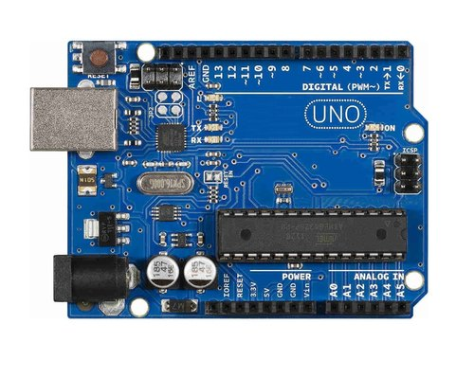
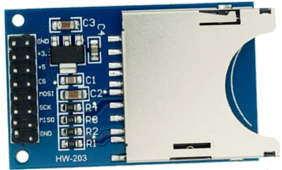
Red to D5
Green to D4
GND to GND
VCC to 5V
DAT to D2
CS to D10
MOSI to D11
MISO to D12
SCK to D13
GND to GND
+5 to 5V

