Slide 1
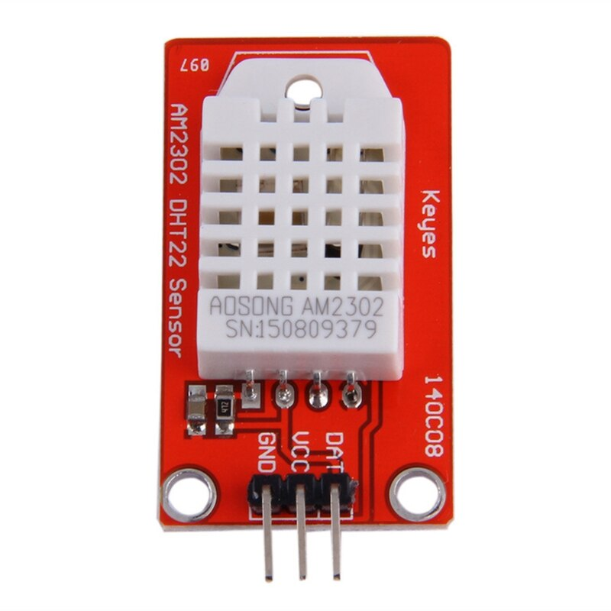



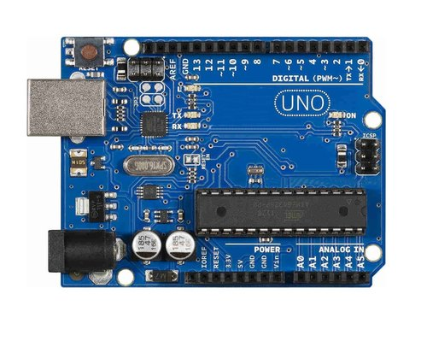
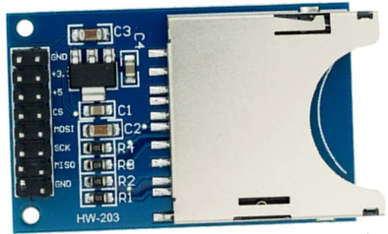
Red to D5
Green to D4
GND to GND
VCC to 5V
DAT to D2
CS to D10
MOSI to D11
MISO to D12
SCK to D13
GND to GND
+5 to 5V

Slide 2
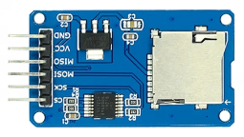
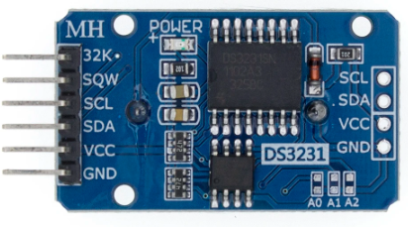
Red to D5
Green to D4
GND to GND
VCC to 5V
MISO to D12
MOSI to D11
SCK to D13
CS to D10
GND to GND
VCC to 5V
DAT to D2
SCL to A5 or SCL
SDA to A4 or SDA
VCC to 5V
GND to GND

