Slide 1
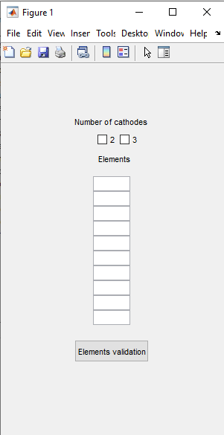
First window
fig1 = figure ;
set( fig1 , 'position' , [ 100 , 300 , 300 , 500 ])
uicontrol ( fig1 , 'style' , ' text' , 'position', [100 400 100 30] , 'string' , 'Number of cathodes ' )
for nc=2:3
nb_cathodes(nc-1) = uicontrol ( fig1,'style', 'checkbox' , 'position',[70+30*nc,390,50,20],
'Max' , 1 ,
'string' ,num2str(nc))
end
uicontrol ( fig1 , 'style' , ' text' , 'position', [125 350 60 30] , 'string' , 'Elements ' )
for i=1:10
elements(i) = uicontrol ( fig1 , 'style' , ' edit' ,
'position', [125,350-i*20,50,20] ,
'Max' , 1 ,
'string' , '' )
end
valid_elements_button=uicontrol ( fig1 , 'style' , 'push' , 'position' , [100 100 100 30 ] ,
'string' , 'Elements validation',
'callback','name_elements=get_elements(elements,fig1)');
uiwait(fig1); % Wait until user click on Elements validation
To be edited by user: enter the name of 3 to 10 elements of a system
Click to continue

Slide 2
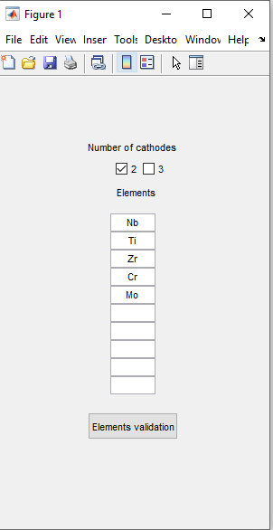
First window: exemple
name_elements=["b, "i,"Zr" C", "o]"
function [name_elements] = get_elements(elements, fig1)
% To acquire the system elements name entered by the user
name_elements=[]
for i=1:size(elements,2)
if isempty(get(elements(i),'String'))==0
name_elements=[name_elements,string(get(elements(i),'String'))];
end
end
uiresume(fig1) % Command that allows to continue the program
end
'callback','get_elements(elements,fig1)');
= When clicking on the button, it activates the function get_elements

Slide 3

nb_elements=size(name_elements,2);
nb_cath_box=get(nb_cathodes,'Value');
if nb_cath_box{1}==[1]
nb_cath=2;
elseif nb_cath_box{2}==[1]
nb_cath=3;
else
fig5 = figure ;
set( fig5 , 'position' , [ 600 , 400 , 500 , 100 ])
uicontrol ( fig5 , 'style' , ' text' ,
'position', [100 30 200 50] ,
'FontSize', 16,
'string' , ' No cathode !' );
return % end program
end
nb_type_mixture=nb_elements;
Variables in the example
name_elements=[ "Nb", "Ti", "Zr", "Cr", "Mo"], list
nb_cath_box = {1,0} , 2x1 cell
nb_cath = 2
Check which box is ticked (1 if ticked, else 0)
If none is ticked
eg: 5 elements in a system
= system contains unaries, binaries, ternaries, quaternaries, quinaries
= 5 types» of mixture

Slide 4





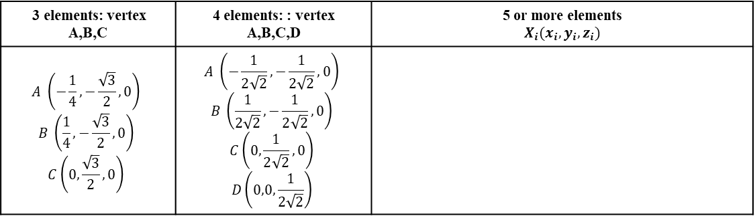






Representation of composition space and of mixture design points
[mixture,name_mixture] = coordinates_name_centroid_points(nb_elements,name_elements);
function [mixture,name_mixture] = coordinates_name_centroid_points(nb_elements,name_elements)
% From the number and the name of the system elements, the function
% calculates the coordinates of the pure elements (standard uniform
% distribution in space) and of the equimolar mixtures of the simplexe
% centroide (all binaries, ternaries...).
% mixture= cell containing coordinates
% name_mixture= cell containing the names of the mixtures.
...
Coordinates of verticies = unaries
3 elements: vertex A,B,C | 4 elements: : vertex A,B,C,D | 5 or more elements $$X_{i}(x_{i},y_{i},z_{i})$$
$$A \left(−\frac{1}{4},−\frac{\sqrt{3}}{2},0\right)$$ $$B \left(\frac{1}{4},−\frac{\sqrt{3}}{2},0\right)$$ $$C\left(0,\frac{\sqrt{3}}{2},0\right)$$ | $$A \left(−\frac{1}{2\sqrt{2}},−\frac{1}{2\sqrt{2}},0\right)$$ $$B \left(\frac{1}{2\sqrt{2}},−\frac{1}{2\sqrt{2}},0\right)$$ $$C\left(0,\frac{1}{2\sqrt{2}},0\right)$$ $$D\left(0,0,\frac{1}{2\sqrt{2}}\right)$$
x = gallery('uniformdata',[nb_elements 1],0);
y = gallery('uniformdata',[nb_elements 1],1);
z = gallery('uniformdata',[nb_elements 1],2);
A =gallery('uniformdata',[m,n,...],j)returns anm-by-n-by-... arrayA. The values ofAare a random sample from the standard uniform distribution. j must be an integer value in the interval[0, 2^32-1]. Callinggallery('uniformdata', ...)with different values ofjwill return different arrays. Repeated calls togallery('uniformdata',...)with the same size vector andjinputs will always return the same array.
$[x_{A},y_{A},z_{A}$]
mixture{1,1}[…]
$$A$$
name_mixture{1,1}[…]
Coordinates of binaries:
$$x_{AB}=\frac{1}{2}{(x}_{A}+x_{B})$$
$[x_{AB},y_{AB},z_{AB}$]
mixture{1,2}[…]
$$AB$$
name_mixture{1,2}[…]
Coordinates of ternaries:
$$x_{ABC}=\frac{1}{3}(x_{A}+x_{B}+x_{C})$$
$[x_{ABC},y_{ABC},z_{ABC}$]
mixture{1,3}[…]
$$ABC$$
name_mixture{1,3}[…]
Coordinates of quaternaries:
$$x_{ABCD}=\frac{1}{4}{(x}_{A}+x_{B}+x_{C}+x_{D})$$
$[x_{ABCD},y_{ABCD},z_{ABCD}$]
mixture{1,4}[…]
...
$$ABCD$$
name_mixture{1,4}[…]

Slide 5
example
name_mixture =
Unaries | Binaries | Ternaries | Quaternaries | Quinaries
"Nb" "Ti" "Zr" "Cr" "Mo" | "NbTi" "NbZr" "NbCr" "NbMo" "TiZr" "TiCr" "TiMo" "ZrCr" "ZrMo" "CrMo" | "NbTiZr" "NbTiCr" "NbTiMo" "NbZrCr" "NbZrMo" "NbCrMo" "TiZrCr" "TiZrMo" "TiCrMo" "ZrCrMo" | "NbTiZrCr" "NbTiZrMo" "NbTiCrMo" "NbZrCrMo" "TiZrCrMo" | "NbTiZrCrMo"
Unaries |  |  | Binaries |  |  | Ternaries |  |  | Quaternaries |  |  | Quinaries
x | y | z | x | y | z | x | y | z | x | y | z | x | y | z
… | … | … | … | … | … | … | … | … | … | … | … | … | … | …
mixture =

Slide 6
