Slide 1
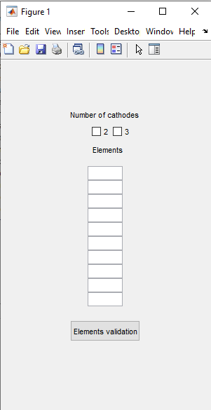
First window
fig1 = figure ;
set( fig1 , 'position' , [ 100 , 300 , 300 , 500 ])
uicontrol ( fig1 , 'style' , ' text' , 'position', [100 400 100 30] , 'string' , 'Number of cathodes ' )
for nc=2:3
nb_cathodes(nc-1) = uicontrol ( fig1,'style', 'checkbox' , 'position',[70+30*nc,390,50,20],
'Max' , 1 ,
'string' ,num2str(nc))
end
uicontrol ( fig1 , 'style' , ' text' , 'position', [125 350 60 30] , 'string' , 'Elements ' )
for i=1:10
elements(i) = uicontrol ( fig1 , 'style' , ' edit' ,
'position', [125,350-i*20,50,20] ,
'Max' , 1 ,
'string' , '' )
end
valid_elements_button=uicontrol ( fig1 , 'style' , 'push' , 'position' , [100 100 100 30 ] ,
'string' , 'Elements validation',
'callback','name_elements=get_elements(elements,fig1)');
uiwait(fig1); % Wait until user click on Elements validation
To be edited by user: enter the name of 3 to 10 elements of a system
Click to continue

Slide 2
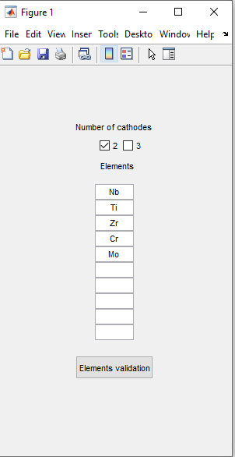
First window: exemple
name_elements=["b, "i,"Zr" C", "o]"
function [name_elements] = get_elements(elements, fig1)
% To acquire the system elements name entered by the user
name_elements=[]
for i=1:size(elements,2)
if isempty(get(elements(i),'String'))==0
name_elements=[name_elements,string(get(elements(i),'String'))];
end
end
uiresume(fig1) % Command that allows to continue the program
end
'callback','get_elements(elements,fig1)');
= When clicking on the button, it activates the function get_elements

Slide 3
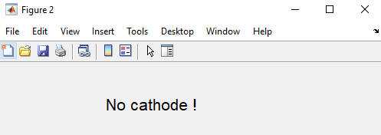
nb_elements=size(name_elements,2);
nb_cath_box=get(nb_cathodes,'Value');
if nb_cath_box{1}==[1]
nb_cath=2;
elseif nb_cath_box{2}==[1]
nb_cath=3;
else
fig5 = figure ;
set( fig5 , 'position' , [ 600 , 400 , 500 , 100 ])
uicontrol ( fig5 , 'style' , ' text' ,
'position', [100 30 200 50] ,
'FontSize', 16,
'string' , ' No cathode !' );
return % end program
end
nb_type_mixture=nb_elements;
Variables in the example
name_elements=[ "Nb", "Ti", "Zr", "Cr", "Mo"], list
nb_cath_box = {1,0} , 2x1 cell
nb_cath = 2
Check which box is ticked (1 if ticked, else 0)
If none is ticked
eg: 5 elements in a system
= system contains unaries, binaries, ternaries, quaternaries, quinaries
= 5 « types» of mixture

Slide 4





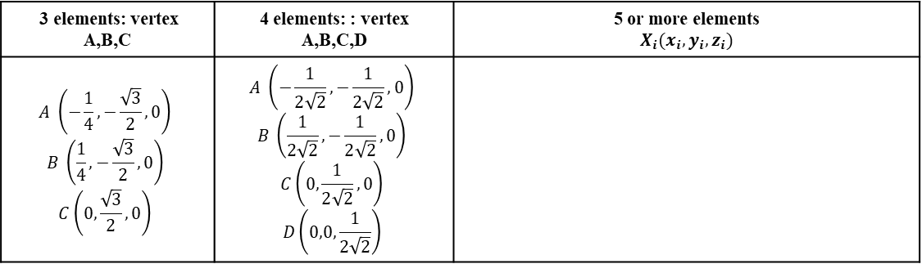






Computation of coordinates of mixture design points
[mixture,name_mixture] = coordinates_name_centroid_points(nb_elements,name_elements);
function [mixture,name_mixture] = coordinates_name_centroid_points(nb_elements,name_elements)
% From the number and the name of the system elements, the function
% calculates the coordinates of the pure elements (standard uniform
% distribution in space) and of the equimolar mixtures of the simplexe
% centroide (all binaries, ternaries...).
% mixture= cell containing coordinates
% name_mixture= cell containing the names of the mixtures.
...
Coordinates of verticies = unaries
3 elements: vertex A,B,C | 4 elements: : vertex A,B,C,D | 5 or more elements $$X_{i}(x_{i},y_{i},z_{i})$$
$$A \left(−\frac{1}{4},−\frac{\sqrt{3}}{2},0\right)$$ $$B \left(\frac{1}{4},−\frac{\sqrt{3}}{2},0\right)$$ $$C\left(0,\frac{\sqrt{3}}{2},0\right)$$ | $$A \left(−\frac{1}{2\sqrt{2}},−\frac{1}{2\sqrt{2}},0\right)$$ $$B \left(\frac{1}{2\sqrt{2}},−\frac{1}{2\sqrt{2}},0\right)$$ $$C\left(0,\frac{1}{2\sqrt{2}},0\right)$$ $$D\left(0,0,\frac{1}{2\sqrt{2}}\right)$$
x = gallery('uniformdata',[nb_elements 1],0);
y = gallery('uniformdata',[nb_elements 1],1);
z = gallery('uniformdata',[nb_elements 1],2);
A =gallery('uniformdata',[m,n,...],j)returns anm-by-n-by-... arrayA. The values ofAare a random sample from the standard uniform distribution. j must be an integer value in the interval[0, 2^32-1]. Callinggallery('uniformdata', ...)with different values ofjwill return different arrays. Repeated calls togallery('uniformdata',...)with the same size vector andjinputs will always return the same array.
$[x_{A},y_{A},z_{A}$]
mixture{1,1}[…]
$$A$$
name_mixture{1,1}[…]
Coordinates of binaries:
$$x_{AB}=\frac{1}{2}{(x}_{A}+x_{B})$$
$[x_{AB},y_{AB},z_{AB}$]
mixture{1,2}[…]
$$AB$$
name_mixture{1,2}[…]
Coordinates of ternaries:
$$x_{ABC}=\frac{1}{3}(x_{A}+x_{B}+x_{C})$$
$[x_{ABC},y_{ABC},z_{ABC}$]
mixture{1,3}[…]
$$ABC$$
name_mixture{1,3}[…]
Coordinates of quaternaries:
$$x_{ABCD}=\frac{1}{4}{(x}_{A}+x_{B}+x_{C}+x_{D})$$
$[x_{ABCD},y_{ABCD},z_{ABCD}$]
mixture{1,4}[…]
...
$$ABCD$$
name_mixture{1,4}[…]

Slide 5
example
name_mixture =
Unaries | Binaries | Ternaries | Quaternaries | Quinaries
"Nb" "Ti" "Zr" "Cr" "Mo" | "NbTi" "NbZr" "NbCr" "NbMo" "TiZr" "TiCr" "TiMo" "ZrCr" "ZrMo" "CrMo" | "NbTiZr" "NbTiCr" "NbTiMo" "NbZrCr" "NbZrMo" "NbCrMo" "TiZrCr" "TiZrMo" "TiCrMo" "ZrCrMo" | "NbTiZrCr" "NbTiZrMo" "NbTiCrMo" "NbZrCrMo" "TiZrCrMo" | "NbTiZrCrMo"
(each column is a cell)
Unaries |  |  | Binaries |  |  | Ternaries |  |  | Quaternaries |  |  | Quinaries
x | y | z | x | y | z | x | y | z | x | y | z | x | y | z
… | … | … | … | … | … | … | … | … | … | … | … | … | … | …
mixture =
(each column is a cell)

Slide 6
Finding alignements between 3 points of the mixture design
[alignements,name_alignement]=compute_alignements(mixture,name_mixture, nb_elements);
function [alignements,name_alignements] = compute_alignements(mixture,name_mixture, nb_type_mixture)
% For each mixture, the function calculates the vector coefficient between
% this mixture and all the other mixtures.
% Then it looks for equals vector coefficients for segments with a common
% point.
First iteration : reference mixture is mixture{i}(j,:)with i=1 and j=1
/!\
1 column = 1 cell
Each column contains a list of the mixture coordinates [x,y,z] that we replace by the name of the mixture to be clearer
Unaries Coordinates of: | Binaries Coordinates of: | Ternaries Coordinates of: | Quaternaries Coordinates of: | Quinaries Coordinates of:
"Nb" "Ti" "Zr" "Cr" "Mo" | "NbTi" "NbZr" "NbCr" "NbMo" "TiZr" "TiCr" "TiMo" "ZrCr" "ZrMo" "CrMo" | "NbTiZr" "NbTiCr" "NbTiMo" "NbZrCr" "NbZrMo" "NbCrMo" "TiZrCr" "TiZrMo" "TiCrMo" "ZrCrMo" | "NbTiZrCr" "NbTiZrMo" "NbTiCrMo" "NbZrCrMo" "TiZrCrMo" | "NbTiZrCrMo"
Reference mixture
mixture =
Calculate normed coefficients of the vector linking reference mixture to all others with
vector_coeff
Normed vector coefficient [X,Y,Z] of segment linking … - …
[0,0,0] "Nb"-"Ti" "Nb"-"Zr" "Nb"-"Cr" "Nb"-"Mo" | "Nb"-"NbTi" "Nb"-"NbZr" "Nb"-"NbCr" "Nb"-"NbMo" "Nb"-"TiZr" "Nb"-"TiCr" "Nb"-"TiMo" "Nb"-"ZrCr" "Nb"-"ZrMo" "Nb"-"CrMo" | "Nb"-"NbTiZr" "Nb"-"NbTiCr" "Nb"-"NbTiMo" "Nb"-"NbZrCr" "Nb"-"NbZrMo" "Nb"-"NbCrMo" "Nb"-"TiZrCr" "Nb"-"TiZrMo" "Nb"-"TiCrMo" "Nb"-"ZrCrMo" | "Nb"-"NbTiZrCr" "Nb"-"NbTiZrMo" "Nb"-"NbTiCrMo" "Nb"-"NbZrCrMo" "Nb"-"TiZrCrMo" | "Nb"-"NbTiZrCrMo"
/!\
1 column = 1 cell
Each column contains a list of a vector coordinates [X,Y,Z] that links the reference mixture and all the following ones
list_coeff_dir=
Compare coefficients and keep the positions of the equal coeffcients in list_coeff_dir with
index_alignements
Example on "Nb"-"Ti" and "Nb"-"NbTi"
The reference mixture Nb is aligned with mixture{1}(2)↔Ti and mixture{2}(1) ↔ NbTi
indice_cell = [[1,2][…][…]…]
indice_list = [[2,1][…][…]…]
coordinates of Nb
coordinates of NbTi
alignements ⬅ [mixture{1}(1,:),mixture{indice_cell(1,2)}(indice_list(1,2),:),
mixture{indice_cell(1,1)}(indice_list(1,1),:)];
name_alignements ⬅ name_mixture{1}(1),name_mixture{indice_cell(1,2)}(indice_list(1,2)),
name_mixture{indice_cell(1,1)}(indice_list(1,1))];
« Nb »
« NbTi »
coordinates of Ti
« Ti »

Slide 7
8th iteration: reference mixture is mixture{i}(j,:)with i=2 and j=3
Unaries Coordinates of: | Binaries Coordinates of: | Ternaries Coordinates of: | Quaternaries Coordinates of: | Quinaries Coordinates of:
"Nb" "Ti" "Zr" "Cr" "Mo" | "NbTi" "NbZr" "NbCr" "NbMo" "TiZr" "TiCr" "TiMo" "ZrCr" "ZrMo" "CrMo" | "NbTiZr" "NbTiCr" "NbTiMo" "NbZrCr" "NbZrMo" "NbCrMo" "TiZrCr" "TiZrMo" "TiCrMo" "ZrCrMo" | "NbTiZrCr" "NbTiZrMo" "NbTiCrMo" "NbZrCrMo" "TiZrCrMo" | "NbTiZrCrMo"
Reference mixture
mixture =
Calculate normed coefficients of the vector linking reference mixture to following ones with
vector_coeff
Normed vector coordinates of segment linking « … » and « … »
[0,0,0] [0,0,0] [0,0,0] "NbCr"-"NbMo" "NbCr"-"TiZr" "NbCr"-"TiCr" "NbCr"-"TiMo" "NbCr"-"ZrCr" "NbCr"-"ZrMo" "NbCr"-"CrMo" | "NbCr"-"NbTiZr" "NbCr"-"NbTiCr" "NbCr"-"NbTiMo" "NbCr"-"NbZrCr" "NbCr"-"NbZrMo" "NbCr"-"NbCrMo" "NbCr"-"TiZrCr" "NbCr"-"TiZrMo" "NbCr"-"TiCrMo" "NbCr"-"ZrCrMo" | "NbCr"-"NbTiZrCr" "NbCr"-"NbTiZrMo" "NbCr"-"NbTiCrMo" "NbCr"-"NbZrCrMo" "NbCr"-"TiZrCrMo" | "NbCr"-"NbTiZrCrMo"
list_coeff_dir=
/!\ The first cell disapears : the indices between list_coeff_dir and mixture cells are no more corresponding: we have to had i-1=2-1=1 to list_coeff_dir cell index to obtain the index of mixture cell
Compare coefficients and keep the positions of the equal coeffcients in list_coeff_dir with
index_alignements
Example on "NbCr"-"TiZr" and "Nb"-"NbTiZrCr"
indice_cell = [[1,3][…][…]…]
indice_list = [[5,1][…][…]…]
The reference mixture NbCr is aligned with mixture{1+1}(5)↔TiZr and mixture{3+1}(1) ↔ NbTiZrCr
coordinates of NbCr
coordinates of TiZr
alignements ⬅ [mixture{2}(3,:),mixture{indice_cell(1,2)+2-1}(indice_list(1,2),:),
mixture{indice_cell(1,1)+i-1}(indice_list(1,1),:)];
name_alignements ⬅ [name_mixture{1}(1),name_mixture{indice_cell(1,2)+2-1}(indice_list(1,2)),
name_mixture{indice_cell(1,1)+2-1}(indice_list(1,1))];
« NbCr »
« TiZr »
coordinates of NbTiZrCr
« NbTiZrCr »

Slide 8
Nb | NbTi | Ti
Nb | NbZr | Zr
Nb | NbCr | Cr
… | … | …
Nb | NbCrMo | CrMo
Nb | NbTiZrCr | TiZrCr
Nb | NbTiZrMo | TiZrMo
… | … | …
Ti | NbTiCr | NbCr
Ti | NbTiMo | NbMo
Ti | TiZrCr | ZrCr
… | … | …
Zr | NbZrMo | NbMo
Zr | TiZrCr | TiCr
… | … | …
NbZr | NbTiZrCrMo | TiCrMo
… | … | …
TiMo | NbTiZrCrMo | NbZrCr
ZrCr | NbTiZrCrMo | NbTiMo
ZrMo | NbTiZrCrMo | NbTiCr
CrMo | NbTiZrCrMo | NbTiZr
Variables in the example
name_elements=[ "Nb", "Ti", "Zr", "Cr", "Mo"], list
nb_cath_box = {1,0} , 2x1 cell
nb_cath = 2
name_alignements= 90x3 cell
alignements= 90x9 cell (3 coordinates x 3 mixtures)
name_alignements=

Slide 9
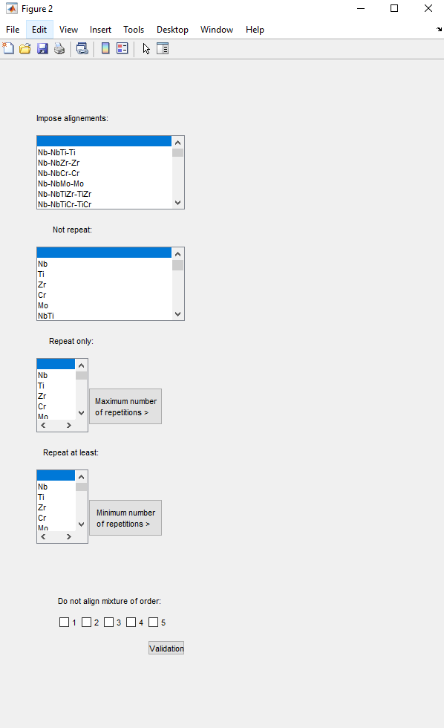
Case 1 : 2 cathodes. Imposing conditions over the selections of the linear gradients
fig2 = figure ;
set( fig2 , 'position' , [ 400 , 100 , 600 , 900 ])
if nb_cath==2
...
list_align_impose= uicontrol ( fig2 , 'style' , 'listbox',
'position', [50 700 200 100],
'Max',size(name_alignement,1),
'string' , [' ',list_alignement]);
not_repeat_list=uicontrol(...)
repeat_only_list=uicontrol (...)
fix_repetition_only_button=uicontrol ( fig2 , 'style' , 'push',
'position' , [120 410 100 50 ],
'string' , '<html>Maximum number <br>of repetitions >', 'callback','nb_repet_only=fix_nb_repetition(repeat_only_list,fig2,[240 500 50 20 ])');
repeat_at_least_list=uicontrol (...)
fix_repetition_at_least_button=uicontrol (...)
for da=1:nb_elements
do_not_align_boxes(da)= uicontrol ( fig2 , 'style' , ' checkbox' ,
'position', [50+da*30,135,50,20] ,
'string' , num2str(da) );
end
valid_condition_button=uicontrol ( fig2 , 'style' , 'push' , 'position' , [200,100,50,20],
'string' , 'Validation',
'callback','uiresume(fig2)');
uiwait(fig2);

Slide 10
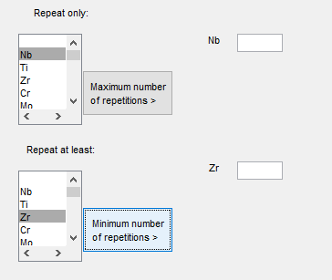
function [nb_repet] = fix_nb_repetition(repeat_list,fig, position)
% This function is a callbacks of push buttons associated to listboxes
% When the buttons are pushed, the function identifies which mixture of the
% repeat_list should be repeated by getting the index of the listbox elements
% that are selected = index_align_to_repeat
% Then it display in the windows the names of the mixtures that should be
% repeated and an edit box nb_repet(i) in which the user can enter the number of repetitions.
index_align_to_repeat=get(repeat_only_list,'Value')
align_to_repeat=get(repeat_only_list,'string')
for i=1:size(index_align_to_repeat,2)
uicontrol ( fig2 , 'style' , ' text' ,
'position', position-[0 i*20 0 0] ,
'string' , align_to_repeat{index_align_to_repeat(i)} )
nb_repet(i) = uicontrol ( fig2 , 'style' , ' edit' ,
'position', position-[-50 i*20 0 0],
'Max' , 1 , 'string' , '' )
end
end

Slide 11
The final selection must contains the gradients selected by the user
The final selection must proposed a set of gradients that are passing once an only once by the selected mixture
The final selection must proposed a set of gradients that are passing by the selected mixture only X time (X being chose by the user)
The final selection must proposed a set of gradients that are passing by the selected mixture at least X time (X being chose by the user)
The final selection must proposed a set of gradients that are not passing by two unaries, or two binaries, or two ternaries… at once. It won’t align mixtures of same order.
Click to continue

Slide 12
Case 1 : 2 cathodes. Selection of gradients
Conditions entered by user obtained through « get » function
Variables in the example
name_elements=[ "Nb", "Ti", "Zr", "Cr", "Mo"], list
nb_cath_box = {1,0} , 2x1 cell
nb_cath = 2
name_alignements= 90x3 list
alignements= 90x9 list (3 coordinates x 3 mixtures)
mixture_list = list that contains all the mixture names of the mixture design
do_no_align=cell containing list of unaries of binaries or…
impose_alignement_name= list of imposed alignement name (Nx3)
impose_alignement_index= list of the indices of imposed alignement in alignements
not_repeat= list of mixture to pass by once only
repeat_only= [[mixture, number of repetitions],[…,…]]
repeat_at_least= [[mixture, number of repetitions],[…,…]]
function [name_alignement_opt,alignement_opt]= gradients_set(name_mixture,
mixture,
alignements,
name_alignement,
not_repeat,
repeat_only,
repeat_at_least,
do_not_align,
impose_alignements_name,
impose_alignements_index);
While name_alignement_opt does not includes all the mixtures of the mixture design
First step: imposed alignements resolution
name_alignement_opt
impose_alignements_name
Second step : mixture that must be repeated at least X time resolution
For all mixture in repeat_at_least, while alignement_opt does not count it at least X times
Random index generation ➔ random selection of an alignement
Check if it the mixture is in the alignement + if the alignement is not already in alignement_opt
If it is: add the alignement to alignement_opt
Else: goes randomly to another alignement
Third step: random selection of other alignements
For all mixtures of mixture_list
If the mixture is already in name_alignement_opt : goes to the next ones
Random index generation ➔ random selection of an alignement
Check if it the mixture is in the alignement
Check that the alignement respects other conditions: repeat_only, do_not_repeat_do_not_align with the check_... functions.
If it respect all condition : add the alignement to alignement_opt
Else: goes randomly to another alignement
The function also includes a timer: restart the selection after 100 sec. If the loop overtimes 10 times, a window is deplayed showing « No solution found ».

Slide 13
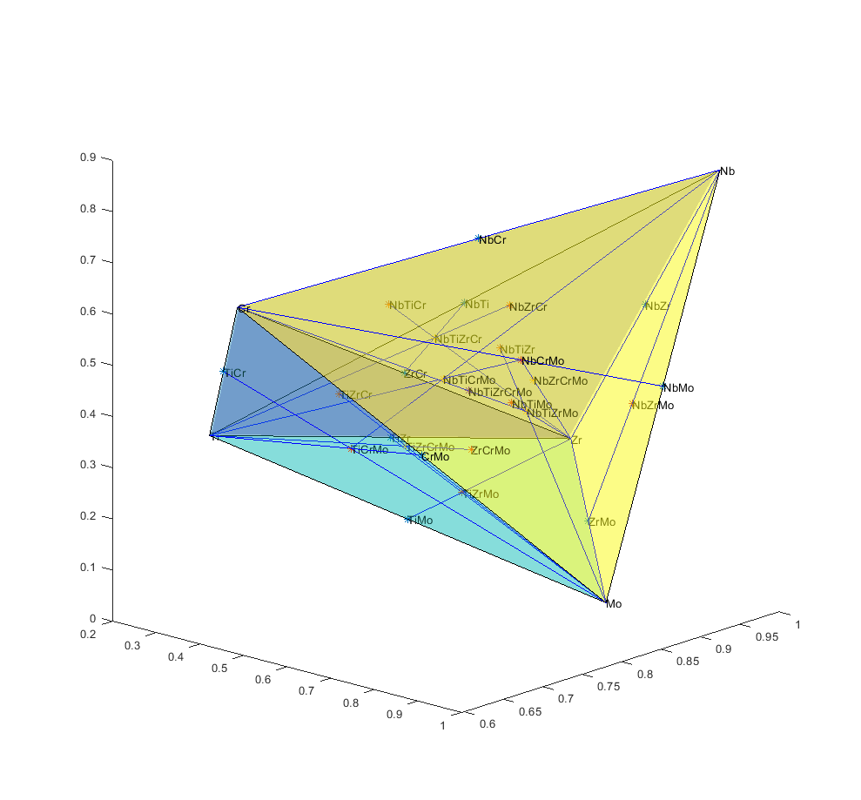
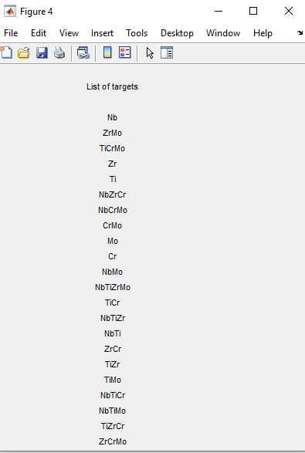
Case 1 : 2 cathodes. Plot results and list targets
function [] = plot_compo_space_gradients(nb_elements,mixture, name_mixture,name_elements, gradients, gradients_color,fignumber , position)
% Plot the composition space with all the simplexe centroid points, using
% the number of elements, the mixture coordinates, the mixture names and
% the elements name.
% To plot gradients you need an array where each lines are the coordinates
% of the gradient [x_begin, y_begin, z_begin, x_end, y_end, z_end]
...

Slide 14
Case 2 : 3 cathodes. Computes planes from linear gradients/alignements
function [plane_points,plane_coord] = compute_planes(name_alignement,alignements,mixture)
% From the gradients, find planes in the composition space made by 3
% gradients with common points, passing by 7 points of the mixture design.
% This means that the plane is centered on one of the point of the mixture
% design
% eg: Nb-NbTi-Ti, Ti-TiZr-Zr and Nb-NbZr-Zr are forming a plane in a
% compositional space center on the ternary NbTiZr wich is a point of the
% mixture design: we validate the plane
…
Nb
For each alignement A_{i}
For all other following alignements A_{j}
Check if the end of A_{i} is the begining of A_{j}
eg: A_{i}=Nb-NbTi-Ti and A_{j}=Ti-TiZr-Zr
But also: A_{i}=Nb-NbTi-Ti and A_{j}=Ti-NbTiZr-NbZr
Then find the gradient A_{k} that closes the triangular plane
eg: find Nb-NbZr-Zr or Ti-NbTiZr-NbZr
Now check that these three alignements define a plane that include 7 points of the mxiture design
eg: Nb-Ti-Zr respect this property ➔ kept in plane_points and plane _coord
Nb-Ti-NbZr does not ➔ rejected
To check this, the function simply check that the medians of the triangles defined by the three vertices are passing by a point of the mixture design.
NbZr
NbTi
NbTiZr
Zr
TiZr
Ti

Slide 15
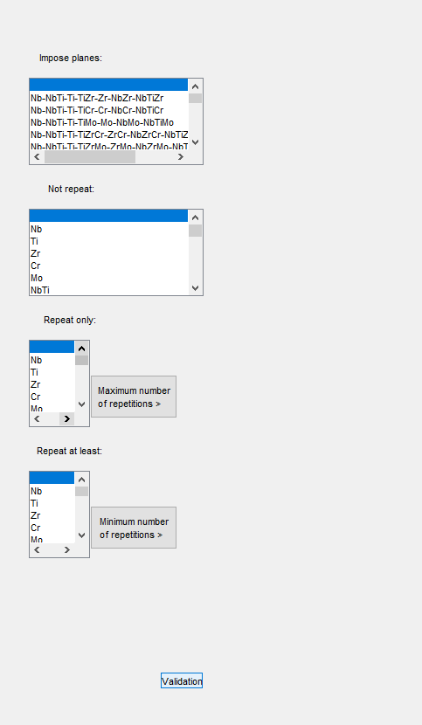
Case 2 : 3 cathodes. Imposing conditions over the selections of the planes
Planes passing by 7 points at once, the user should be particularly careful over the restritions they impose.
This is why the « do not align » condition was supressed for planes

Slide 16
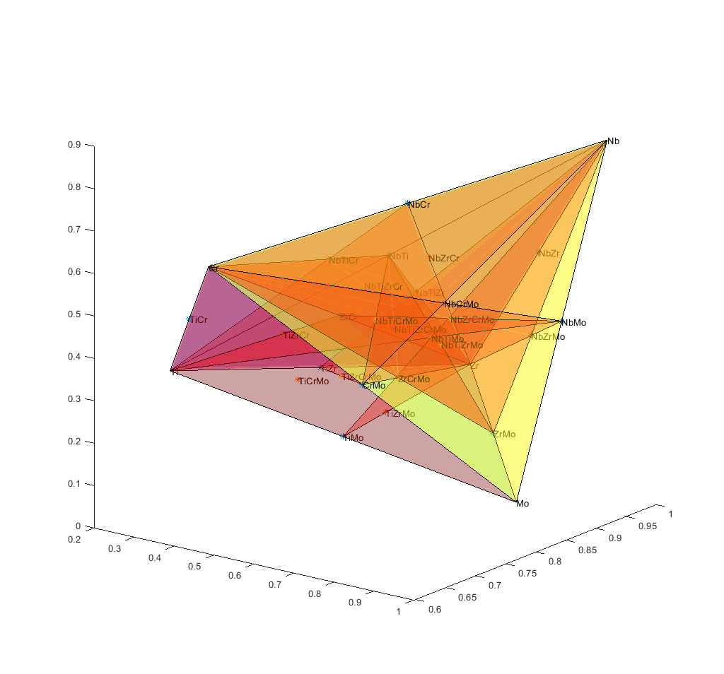
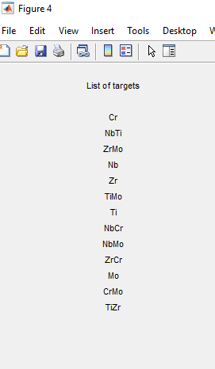
Case 1 : 3 cathodes. Plot results
function [fig2] = plot_compo_space_planes(nb_elements,mixture, name_mixture,name_elements, plane_coord, plane_color, fignumber, position)
% Plot the composition space with all the simplexe centroid points, using
% the number of elements, the mixture coordinates, the mixture names and
% the elements name.
% To plot gradients you need an array where each lines are the coordinates
% of the gradient [x_begin, y_begin, z_begin, x_end, y_end, z_end]
…

