Slide 1
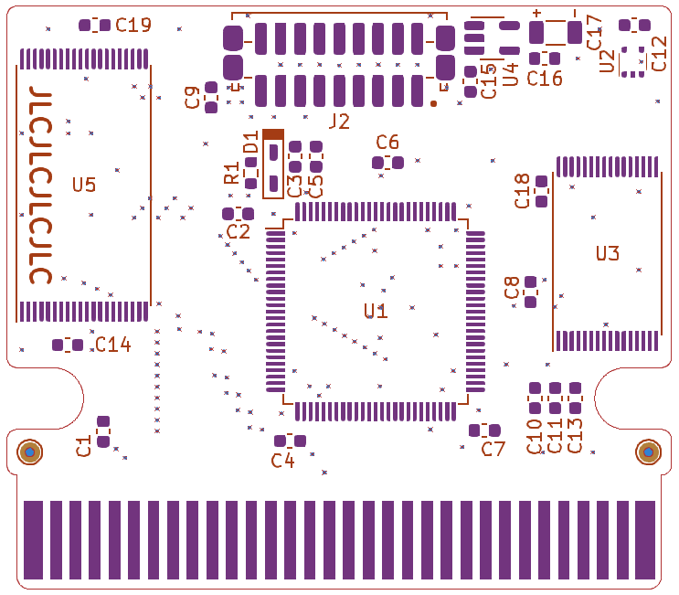
AM29F080B
cathode
FM28V100
anode
39 pF
MAC-GBD
10 nF
dot
100 nF
dot
notch
22 µF
1 kΩ
chips
dot

Slide 2
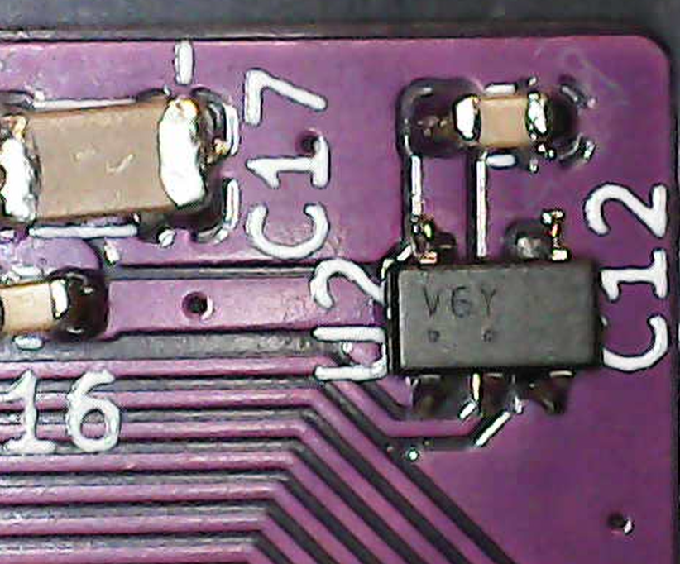
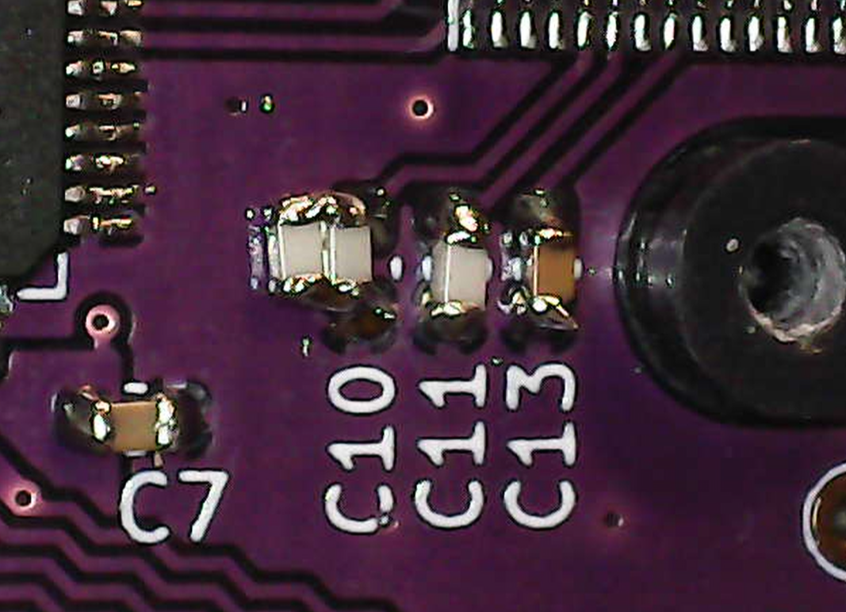

Slide 3
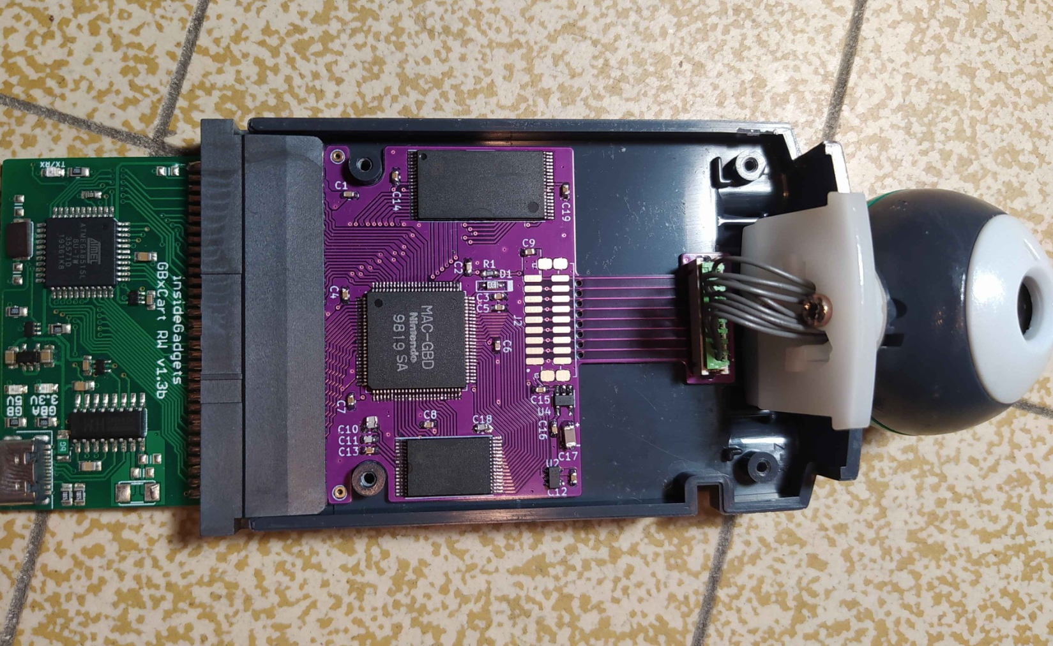

Slide 4
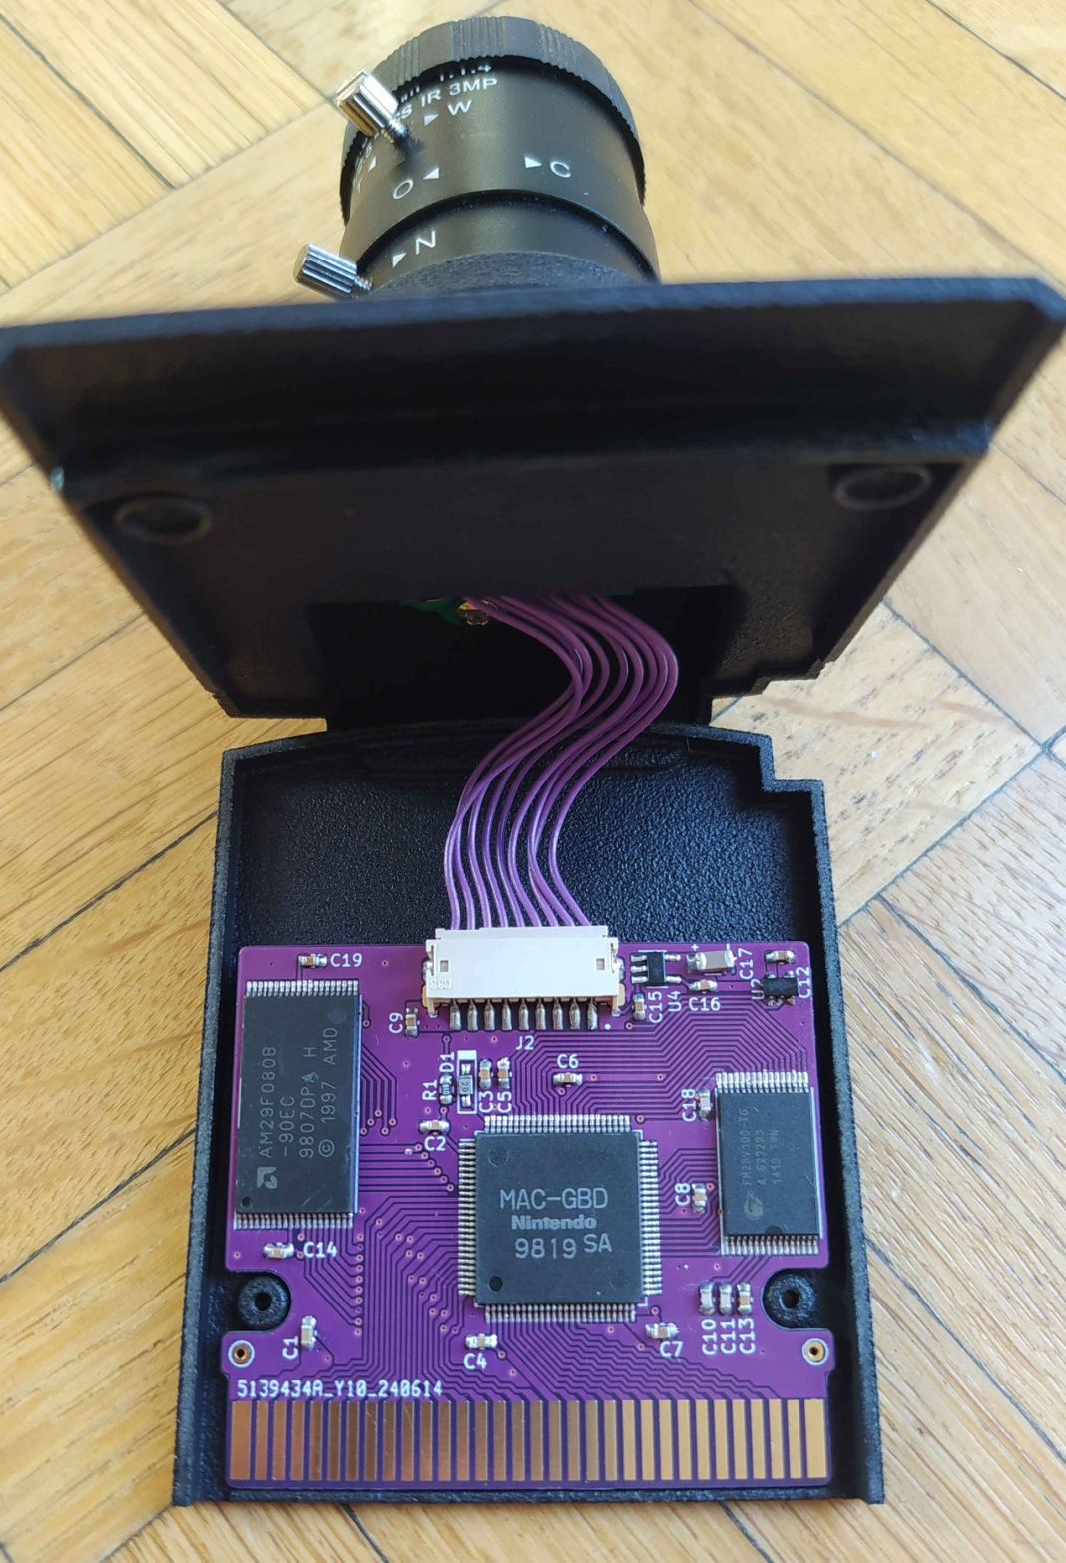
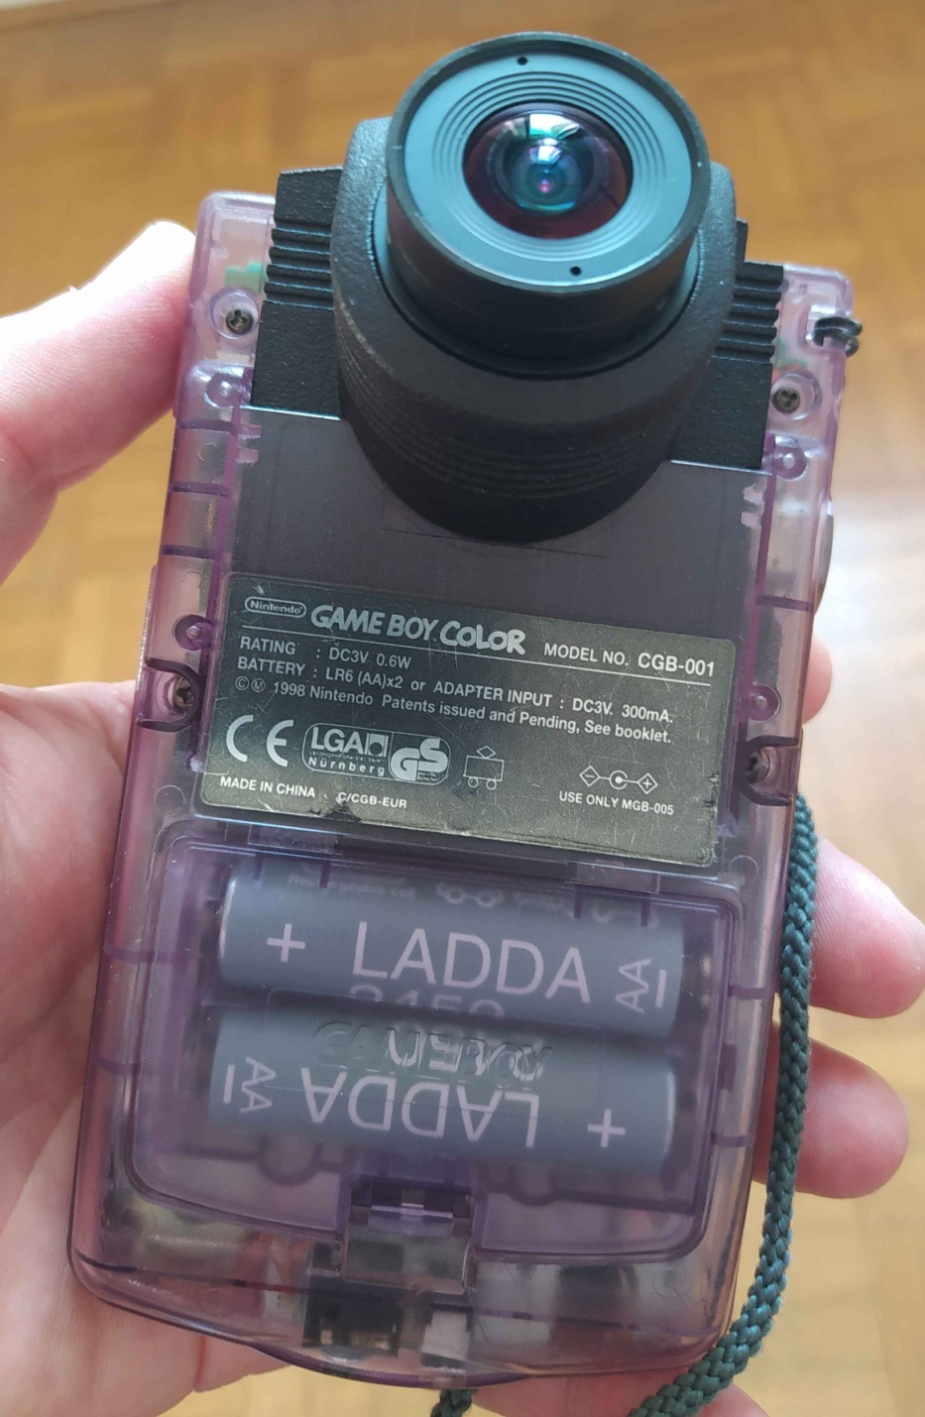

Slide 5




