Slide 1
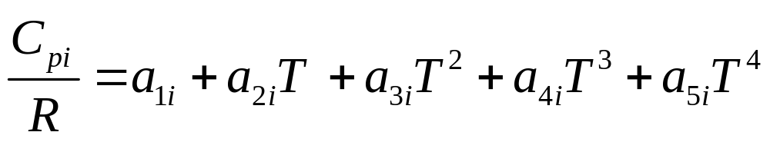
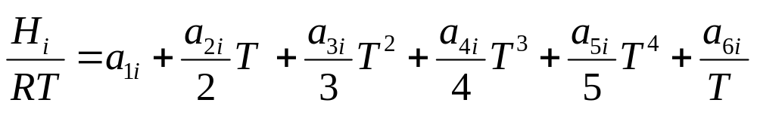
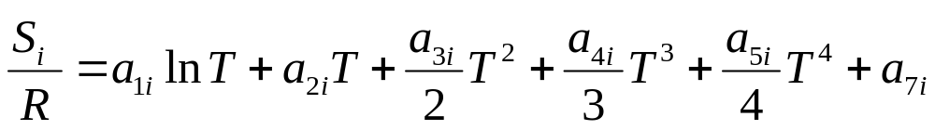
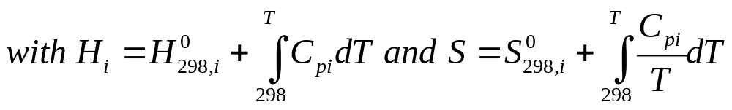

Slide 2

Molecule name
Chemical formula
Phase
Low temp limit
High temp limit
Cutting temp
a1…a7 HT
a1…a7 LT

