Slide 1
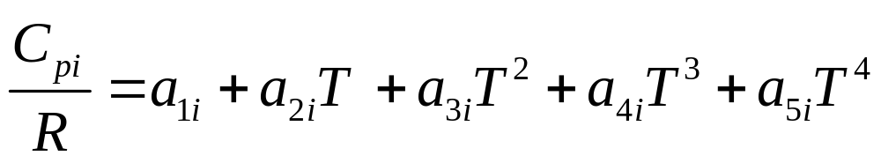
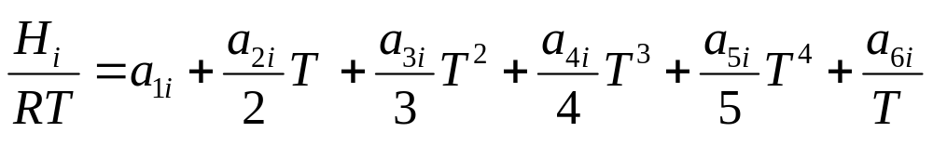
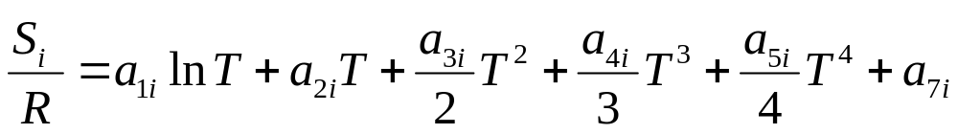
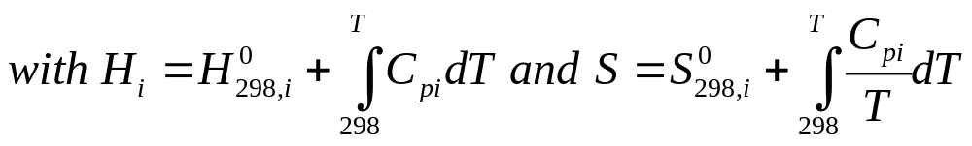

Slide 2
Phase col. 45
Line #
Molecule name, col. 1:24
Chemical formula, col. 25:44
col. 46:55
col. 56:65
col. 66:73
blank
5 characters per field
Low
High
common
4 lines
15 digits per coefficient
80 columns
a1…a7 on High temperature range
a1…a7 on Low temperature range
Temperature range

