Slide 1
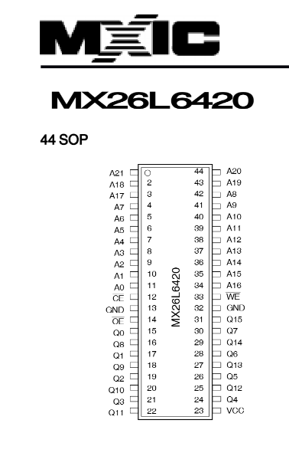
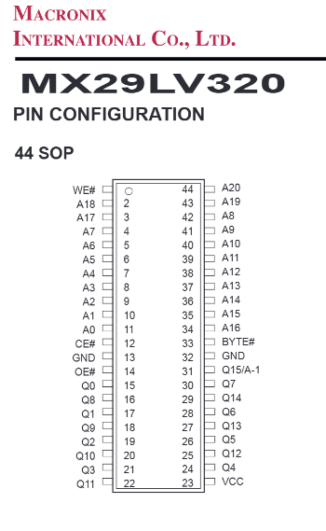
Cut trace and use bodge wire from pin 1 to VCC
On actual bootleg PCB
For drop-in replacement
To LS174 Q0, bankswitching
(not used in Sengoku 2)
High for read mode
GND on PCB
To 3.3V
Low for read mode
High for WORD mode
GND on PCB
GND on PCB
GND on PCB
GND on PCB
To LS139 O_{0a}
To LS139 O_{0a}

Slide 2
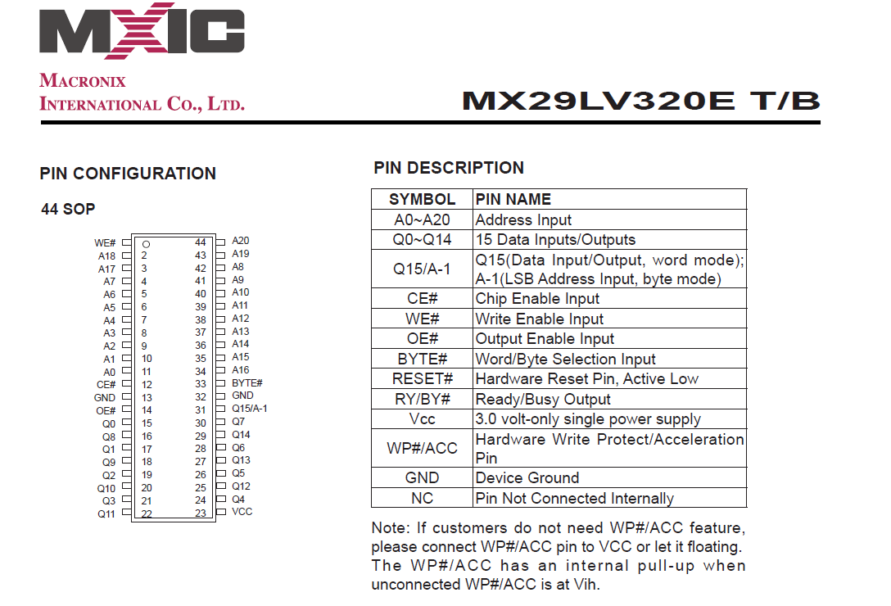

Slide 3
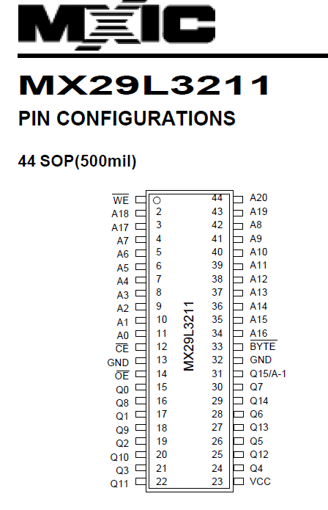
Cut trace and use bodge wire from pin 1 to VCC
On actual bootleg PCB
For drop-in replacement
To LS174 Q0, bankswitching
(not used in Sengoku 2)
High for read mode
GND on PCB
To 3.3V
Low for read mode
High for WORD mode
GND on PCB
GND on PCB
GND on PCB
GND on PCB
To LS139 O_{0a}
To LS139 O_{0a}

Slide 4
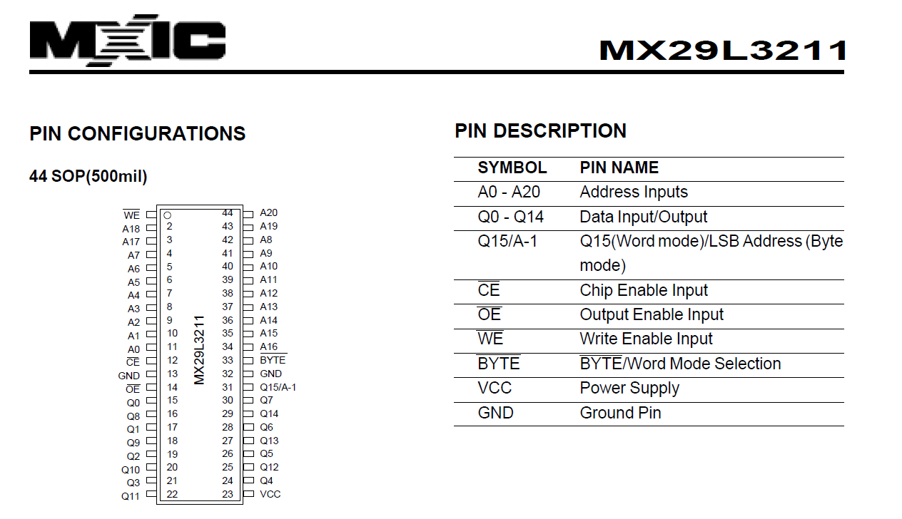

Slide 5
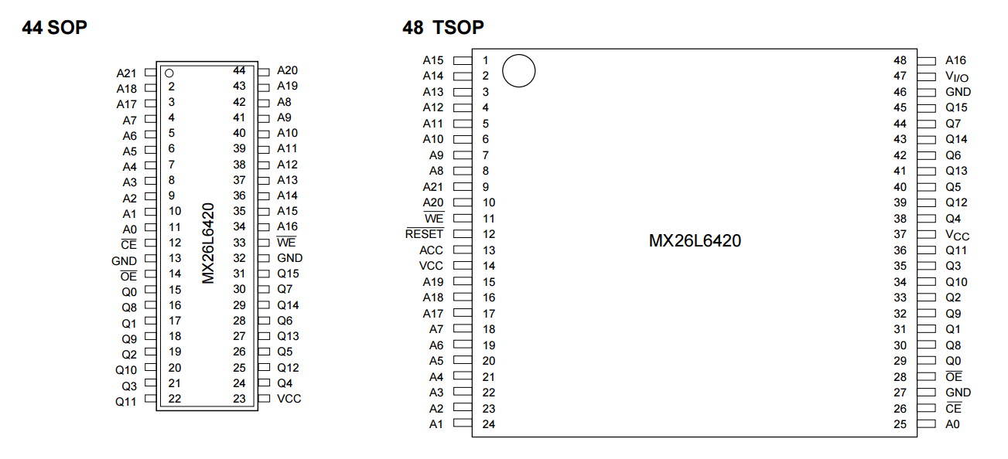
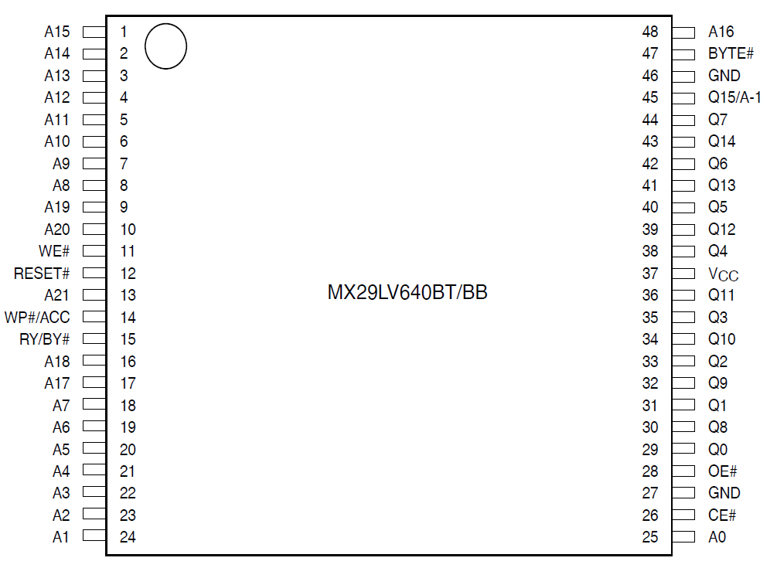
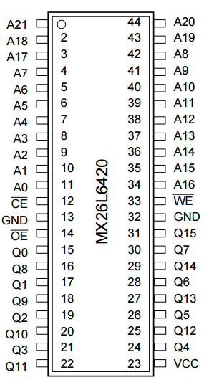
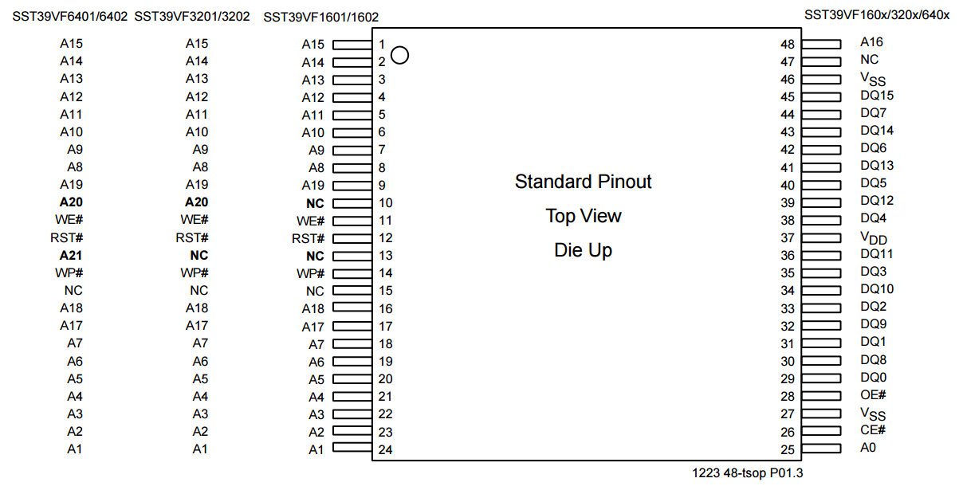

Slide 6
GND on PCB
To 3.3V

Slide 7
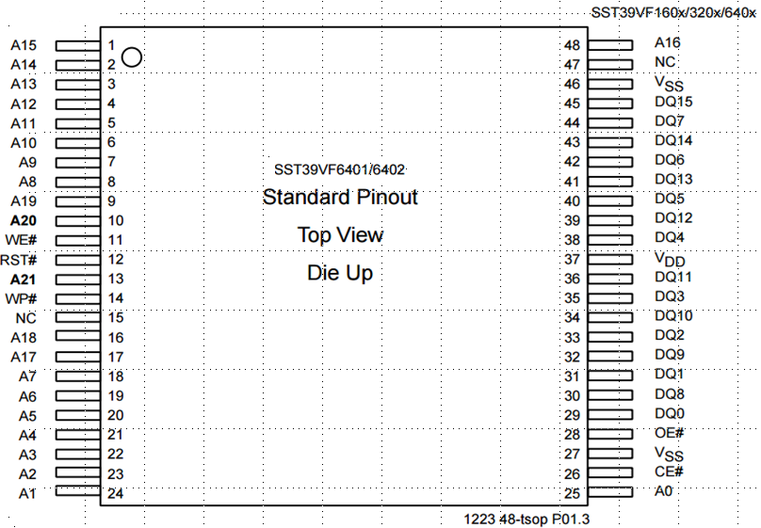
GND on PCB
To 3.3V
GND on PCB
GND on PCB
To LS139 O_{0a}

Slide 8
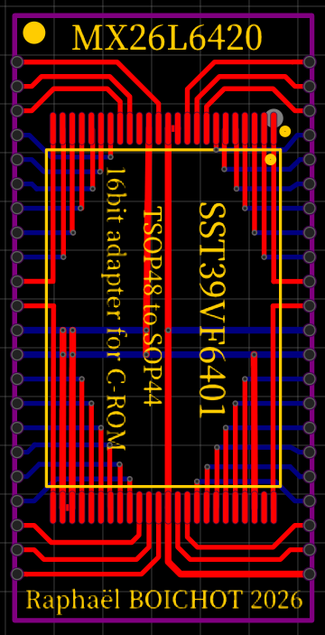
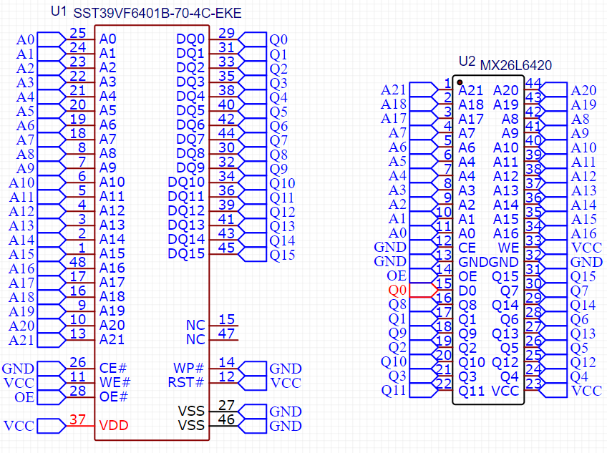

Slide 9
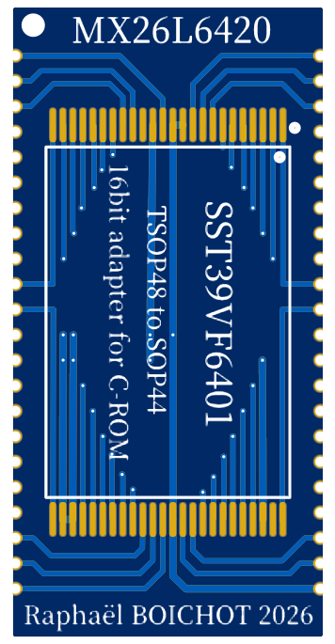


Slide 10
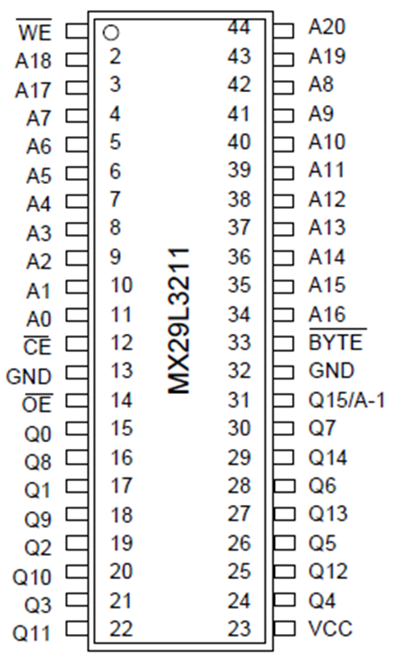
D7
D45
D47
D46
D48
A8
A7
A9
A6
A10
A5
A11
Mega2560 Pins
A4
A12
A3
A13
A2
A14
A1
A15
A0
D49
D9
D6
GND
GND
D16
D29
D37
D30
Mega2560 Pins
D28
D22
D36
D31
D23
D27
D35
D32
D24
D26
D34
D33
D25
VCC

Slide 11
D7
D45
D47
D46
D48
A8
A7
A9
A6
A10
A5
A11
A4
A12
A3
A13
A2
A14
A1
A15
Arduino Mega 2560 Pins
D49
TSOP 44 adapter
A0
D9
D6
GND
GND
D16
D29
D37
D30
D22
D28
D36
D31
D23
D27
D35
D32
D24
D26
D34
D33
D25
VCC

